Slide 1
A Standard CGE model a

Slide 2
Standard CGE model for an oil producer
Follows Hosoe, N., Gasawa, K., & Hashimoto, H. (2010). Textbook of computable general equilibrium modeling: programming and simulations. Springer.
Static model
One representative household
4 industries – Agriculture, Oil, Industry and Services
4 factors of production – Natural Resource, Land, Capital and Labour

Slide 3
Standard CGE model for an oil producer
Taxes included: import tariffs, production tax, direct taxes
Government budget balance achieved by adjusting government expenditure on goods and services e.g. lower tax revenue leads to lower spending
Investment adjusts in response to available saving

Slide 4
Structure
Source: Hosoe et al 2010

Slide 5
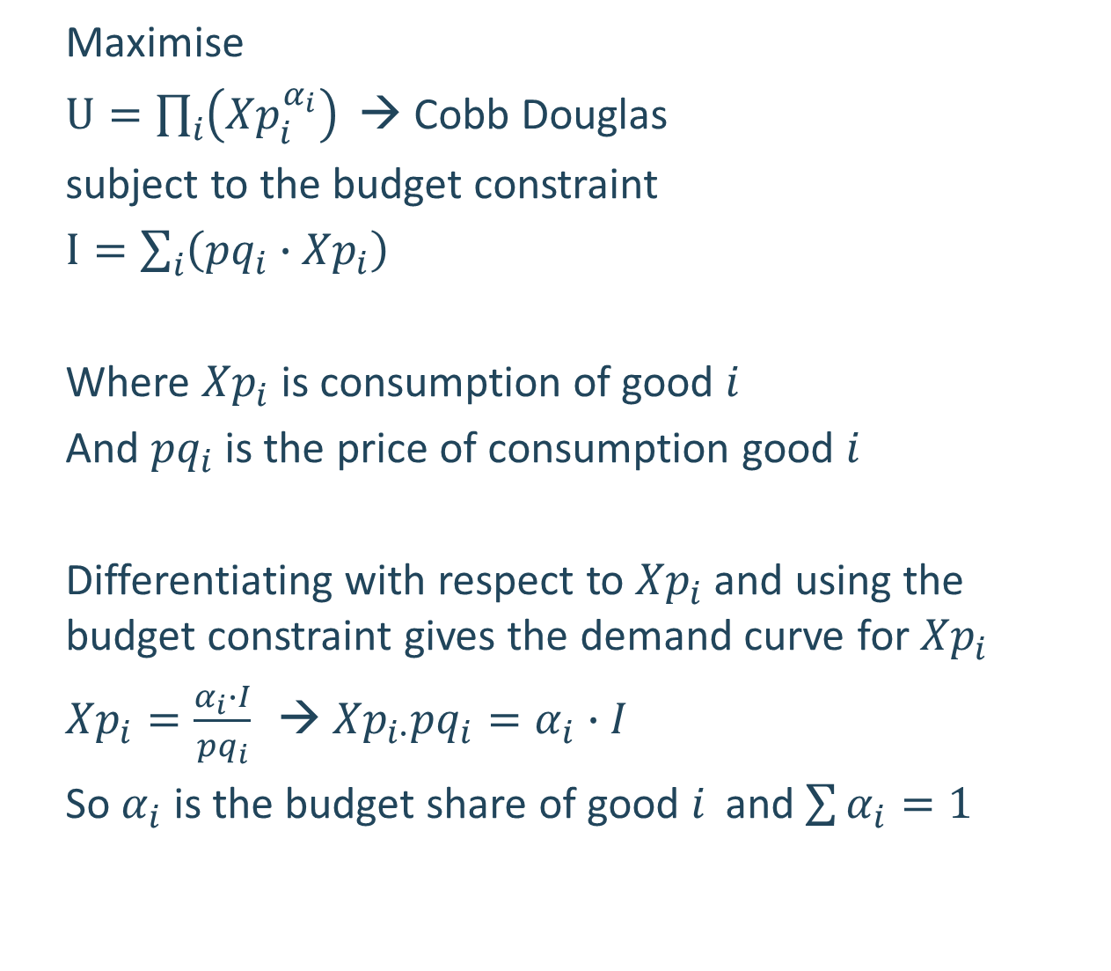
Consumer problem in the CGE model
Maximise
$U=\prod_{i}{\left({Xp}_{i}^{α_{i}}\right)}$ → Cobb Douglas
subject to the budget constraint
$I=\sum_{i}{\left({pq}_{i}∙{Xp}_{i}\right)}$
Where ${Xp}_{i}$ is consumption of good $i_{ }$
And ${pq}_{i}$ is the price of consumption good $i_{ }$
Differentiating with respect to ${Xp}_{i}$ and using the budget constraint gives the demand curve for ${Xp}_{i}$
${Xp}_{i}=\frac{α_{i}∙I}{{pq}_{i}}$ → ${Xp}_{i∙}{pq}_{i}=α_{i}∙I$
So $α_{i}$ is the budget share of good $i_{ }$ and $\sum{α_{i}=1}$

Slide 6
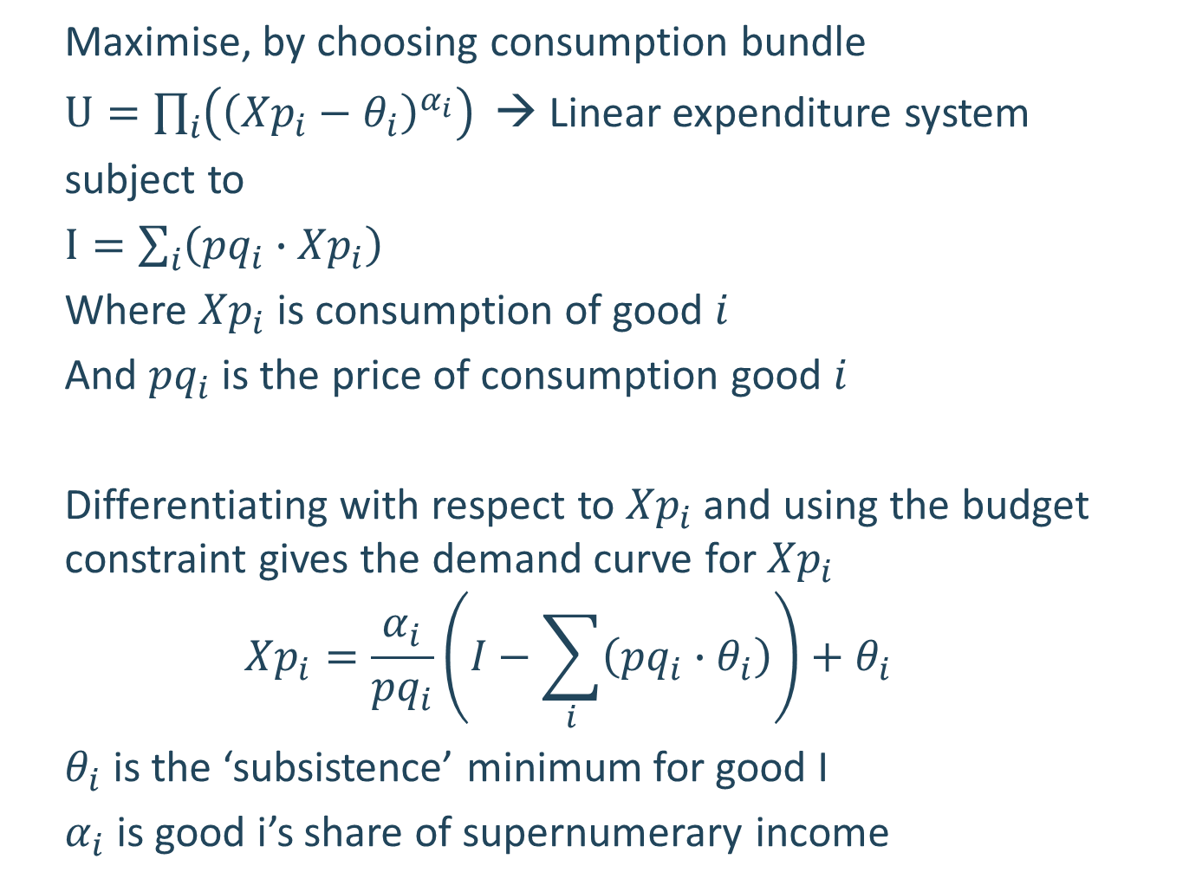
Other common utility functions: LES
Maximise, by choosing consumption bundle
$U=\prod_{i}{\left({\left({Xp}_{i}−θ_{i}\right)}^{α_{i}}\right)}$ → Linear expenditure system
subject to
$I=\sum_{i}{\left({pq}_{i}∙{Xp}_{i}\right)}$
Where ${Xp}_{i}$ is consumption of good $i_{ }$
And ${pq}_{i}$ is the price of consumption good $i_{ }$
Differentiating with respect to ${Xp}_{i}$ and using the budget constraint gives the demand curve for ${Xp}_{i}$
$${Xp}_{i}=\frac{α_{i}}{{pq}_{i}}\left(I−\sum_{i}{\left({pq}_{i}∙θ_{i}\right)}\right)+θ_{i}$$
$θ_{i}$ is the ‘subsistence’ minimum for good I
$α_{i}$ is good i’s share of supernumerary income

Slide 7
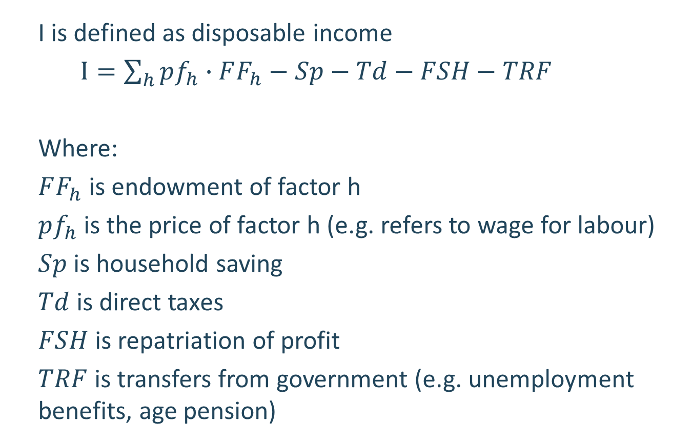
Household Disposable Income
I is defined as disposable income
$I=\sum_{h}{pf_{h}∙FF_{h}}−Sp−Td−FSH−TRF$
Where:
$FF_{h}$ is endowment of factor h
$pf_{h}$ is the price of factor h (e.g. refers to wage for labour)
$Sp$ is household saving
$Td$ is direct taxes
$FSH$ is repatriation of profit
$TRF$ is transfers from government (e.g. unemployment benefits, age pension)

Slide 8
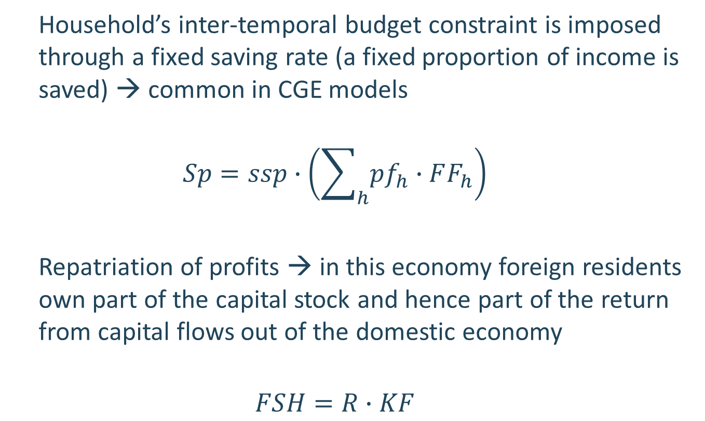
Household Saving
Household’s inter-temporal budget constraint is imposed through a fixed saving rate (a fixed proportion of income is saved) → common in CGE models
$$Sp=ssp∙\left(\sum_{h}{pf_{h}∙FF_{h}}\right)$$
Repatriation of profits → in this economy foreign residents own part of the capital stock and hence part of the return from capital flows out of the domestic economy
$$FSH=R∙KF$$

Slide 9
Households (cont.)
In this model, labour supply is exogenous. However, in more general models labour supply decisions can be built into household’s utility maximization (choosing the amount of leisure to take)

Slide 10
Firms
CGE models use a nested production function to better capture the production decisions made by firms
Nested → make decisions step by step. E.g. first decide how much total labour to use in production, then decide how many foreign workers to use
Here we will simplify the nesting structure to two levels:
Combine factors of production into value added
Combine value added with intermediate inputs to produce output

Slide 11
Structure
Source: Hosoe et al 2010

Slide 12
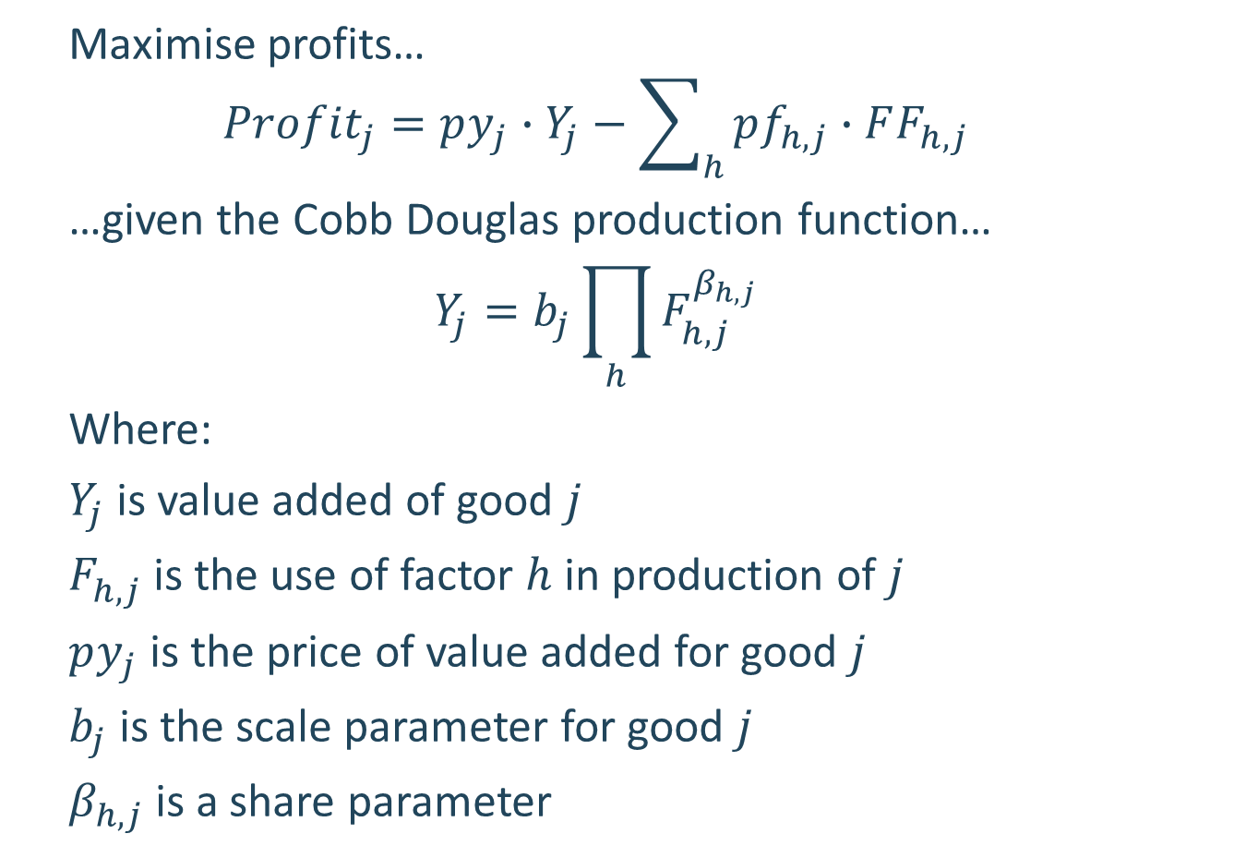
Profit maximization problem
Maximise profits…
$$Profit_{j}=py_{j}∙Y_{j}−\sum_{h}{pf_{h,j}∙FF_{h,j}}$$
…given the Cobb Douglas production function…
$$Y_{j}=b_{j}\prod_{h}{F_{h,j}^{β_{h,j}}}$$
Where:
$Y_{j}$ is value added of good $j_{ }$
$F_{h,j}^{ }$ is the use of factor $h$ in production of $j$
$py_{j}$ is the price of value added for good $j_{ }$
$b_{j}$ is the scale parameter for good $j_{ }$
$β_{h,j}$ is a share parameter

Slide 13
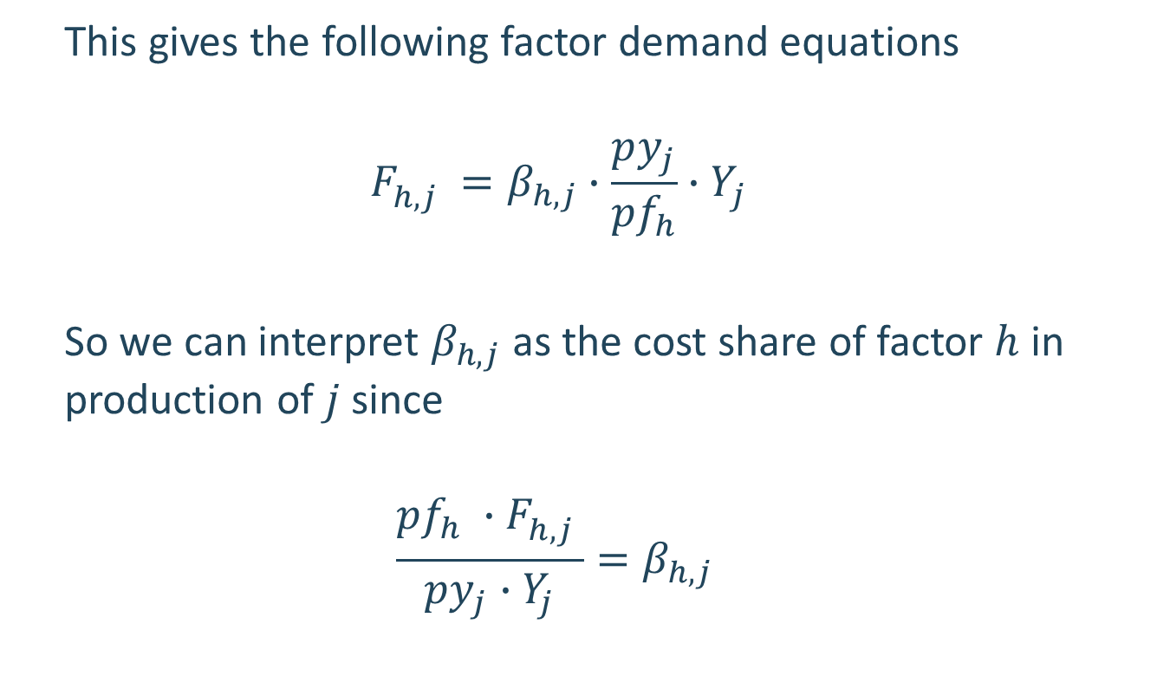
Profit maximization problem
This gives the following factor demand equations
$${F_{h,j}^{ }}_{ }={β_{h,j}∙\frac{py_{j}}{pf_{h}}∙Y}_{j}$$
So we can interpret $β_{h,j}$ as the cost share of factor $h$ in production of $j$ since
$$\frac{pf_{h} ∙{F_{h,j}^{ }}_{ }}{py_{j}∙Y_{j}}={β_{h,j}}_{ }$$

Slide 14
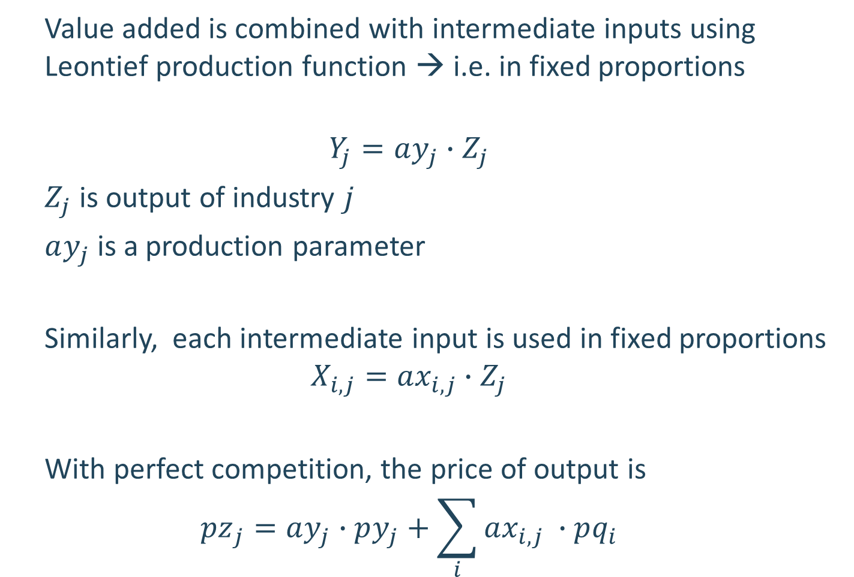
Profit maximisation
Value added is combined with intermediate inputs using Leontief production function → i.e. in fixed proportions
$$Y_{j}=ay_{j}∙Z_{j}$$
$Z_{j}$ is output of industry $j$
$ay_{j}$ is a production parameter
Similarly, each intermediate input is used in fixed proportions
$$X_{i,j}=ax_{i,j}∙Z_{j}$$
With perfect competition, the price of output is
$${pz}_{j}=ay_{j}∙py_{j}+\sum_{i}{ax_{i,j} ∙pq_{i}}$$

Slide 15
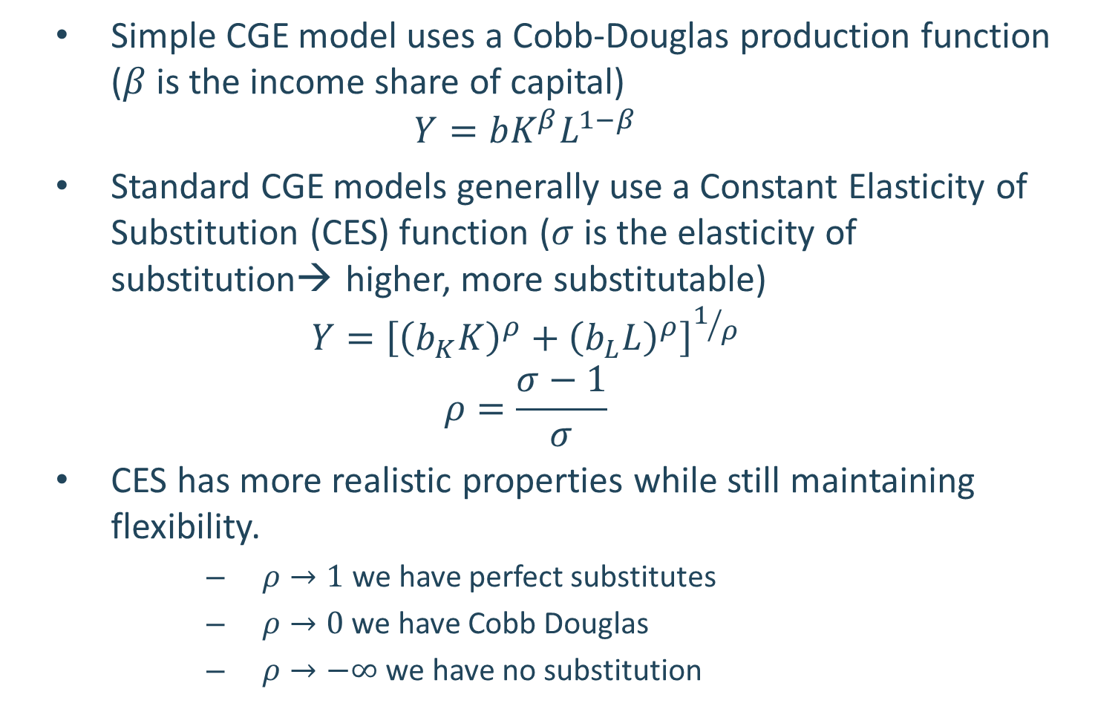
Production function
Simple CGE model uses a Cobb-Douglas production function ($β$ is the income share of capital)
$$Y=bK^{β}L^{1−β}$$
Standard CGE models generally use a Constant Elasticity of Substitution (CES) function ($σ$ is the elasticity of substitution→ higher, more substitutable)
$$Y={\left[{\left(b_{K}K\right)}^{ρ}+{\left(b_{L}L\right)}^{ρ}\right]}^{1/ρ}$$
$$ρ=\frac{σ−1}{σ}$$
CES has more realistic properties while still maintaining flexibility.
$ρ→1$ we have perfect substitutes
$ρ→0$we have Cobb Douglas
$ρ→−∞$ we have no substitution

Slide 16
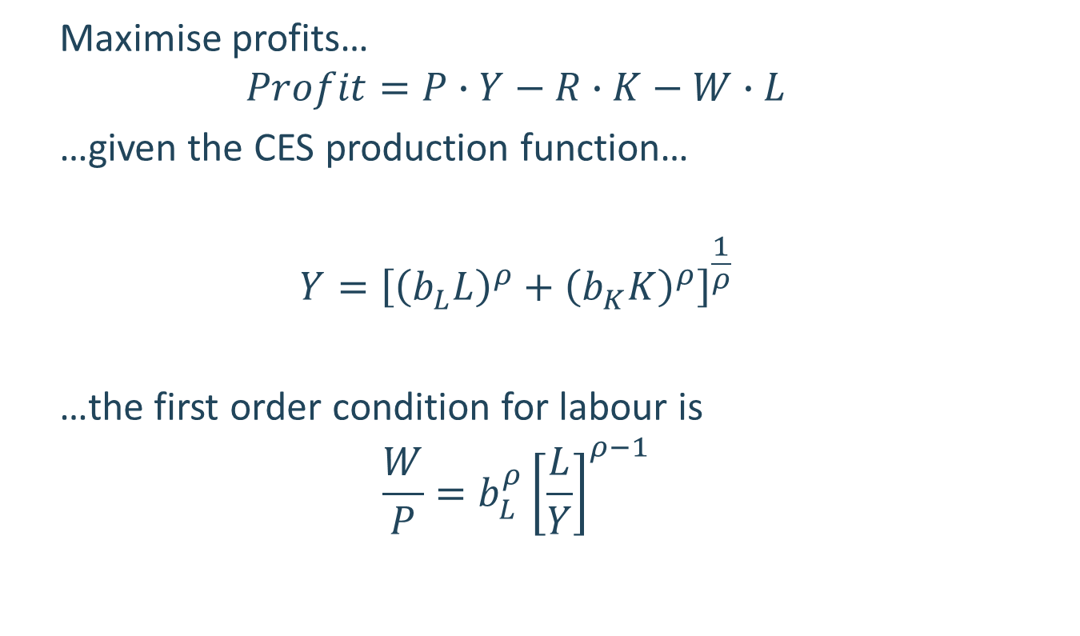
Profit maximization problem in the CGE model
Maximise profits…
$$Profit=P∙Y−R∙K−W∙L$$
…given the CES production function…
$$Y={\left[{\left(b_{L}^{ }L\right)}^{ρ}+{\left(b_{K}^{ }K\right)}^{ρ}\right]}^{\frac{1}{ρ}}$$
…the first order condition for labour is
$$\frac{W}{P}=b_{L}^{ρ}{\left[\frac{L}{Y}\right]}^{ρ−1}$$

Slide 17
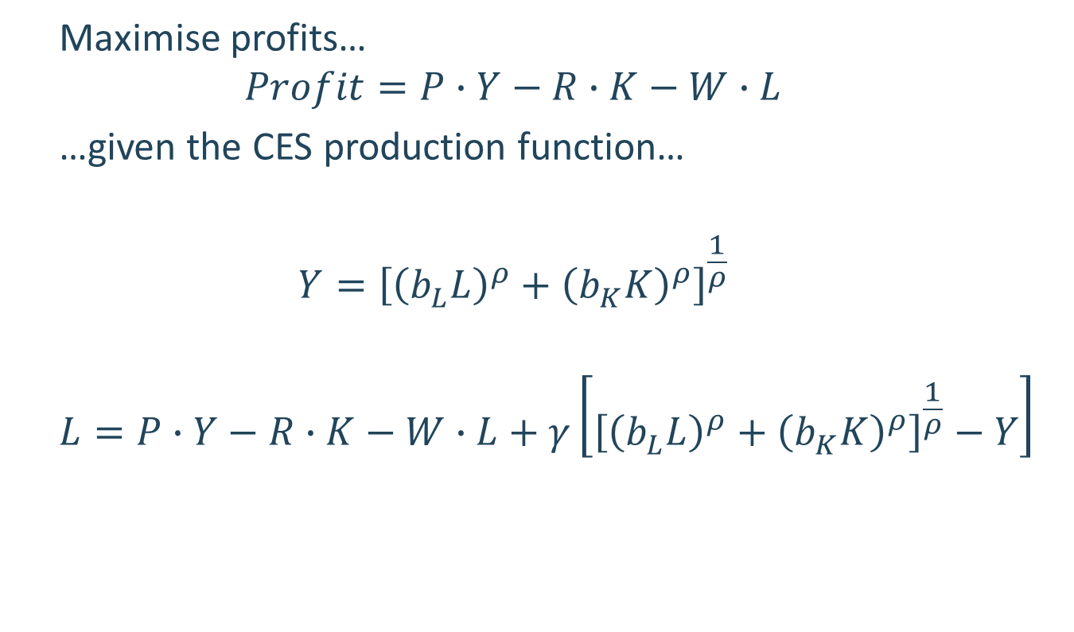
Profit maximization problem in the CGE model
Maximise profits…
$$Profit=P∙Y−R∙K−W∙L$$
…given the CES production function…
$$Y={\left[{\left(b_{L}^{ }L\right)}^{ρ}+{\left(b_{K}^{ }K\right)}^{ρ}\right]}^{\frac{1}{ρ}}$$
$$L=P∙Y−R∙K−W∙L+γ\left[{\left[{\left(b_{L}^{ }L\right)}^{ρ}+{\left(b_{K}^{ }K\right)}^{ρ}\right]}^{\frac{1}{ρ}}−Y\right]$$

Slide 18

Profit maximization problem in the CGE model
$$L=P∙Y−R∙K−W∙L+γ\left[{\left[{\left(b_{L}^{ }L\right)}^{ρ}+{\left(b_{K}^{ }K\right)}^{ρ}\right]}^{\frac{1}{ρ}}−Y\right]$$
$\frac{dL}{dL}=−W+γ\frac{1}{ρ}{\left[{\left(b_{L}^{ }L\right)}^{ρ}+{\left(b_{K}^{ }K\right)}^{ρ}\right]}^{\frac{1}{ρ}−1}ρ{\left(b_{L}^{ }L\right)}^{ρ−1}$ $b_{L}^{ }=0$
$W=γ\frac{1}{ρ}{\left[{\left(b_{L}^{ }L\right)}^{ρ}+{\left(b_{K}^{ }K\right)}^{ρ}\right]}^{\frac{1}{ρ}−1}ρ{\left(b_{L}^{ }L\right)}^{ρ−1}$ $b_{L}^{ }$

Slide 19
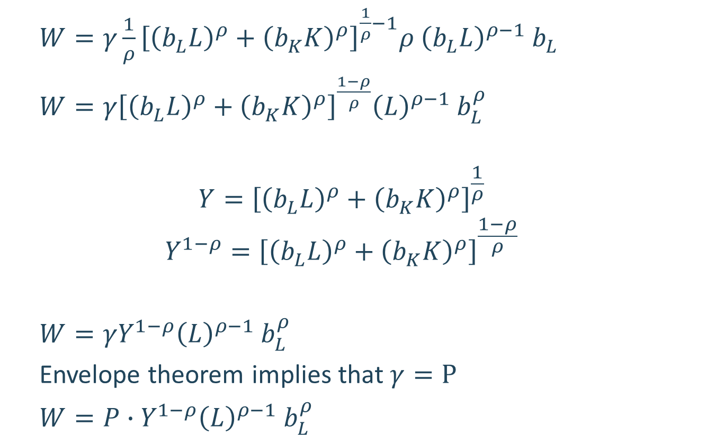
Profit maximization problem in the CGE model
$W=γ\frac{1}{ρ}{\left[{\left(b_{L}^{ }L\right)}^{ρ}+{\left(b_{K}^{ }K\right)}^{ρ}\right]}^{\frac{1}{ρ}−1}ρ$ ${\left(b_{L}^{ }L\right)}^{ρ−1}$ $b_{L}^{ }$
$W=γ{\left[{\left(b_{L}^{ }L\right)}^{ρ}+{\left(b_{K}^{ }K\right)}^{ρ}\right]}^{\frac{1−ρ}{ρ}}{\left(L\right)}^{ρ−1}$ $b_{L}^{ρ}$
$$Y={\left[{\left(b_{L}^{ }L\right)}^{ρ}+{\left(b_{K}^{ }K\right)}^{ρ}\right]}^{\frac{1}{ρ}}$$
$$Y^{1−ρ}={\left[{\left(b_{L}^{ }L\right)}^{ρ}+{\left(b_{K}^{ }K\right)}^{ρ}\right]}^{\frac{1−ρ}{ρ}}$$
$W=γY^{1−ρ}{\left(L\right)}^{ρ−1}$ $b_{L}^{ρ}$
Envelope theorem implies that $γ=P$
$W=P∙Y^{1−ρ}{\left(L\right)}^{ρ−1}$ $b_{L}^{ρ}$

Slide 20
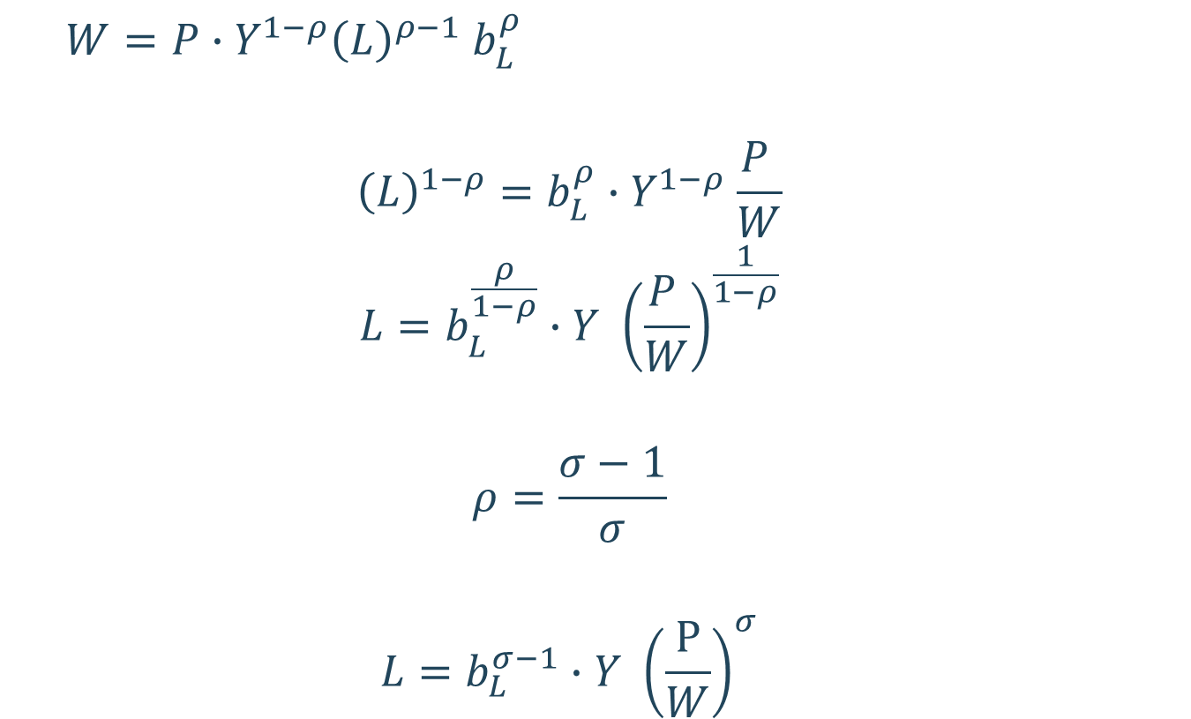
Profit maximization problem in the CGE model
$W=P∙Y^{1−ρ}{\left(L\right)}^{ρ−1}$ $b_{L}^{ρ}$
$${\left(L\right)}^{1−ρ}=b_{L}^{ρ}{∙Y}^{1−ρ}\frac{P }{W}$$
$$L=b_{L}^{\frac{ρ}{1−ρ}}{∙Y}^{ }{\left(\frac{P }{W}\right)}^{\frac{1}{1−ρ}}$$
$$ρ=\frac{σ−1}{σ}$$
$$L=b_{L}^{σ−1}{∙Y}^{ }{\left(\frac{\text{P}}{W}\right)}^{σ}$$

Slide 21
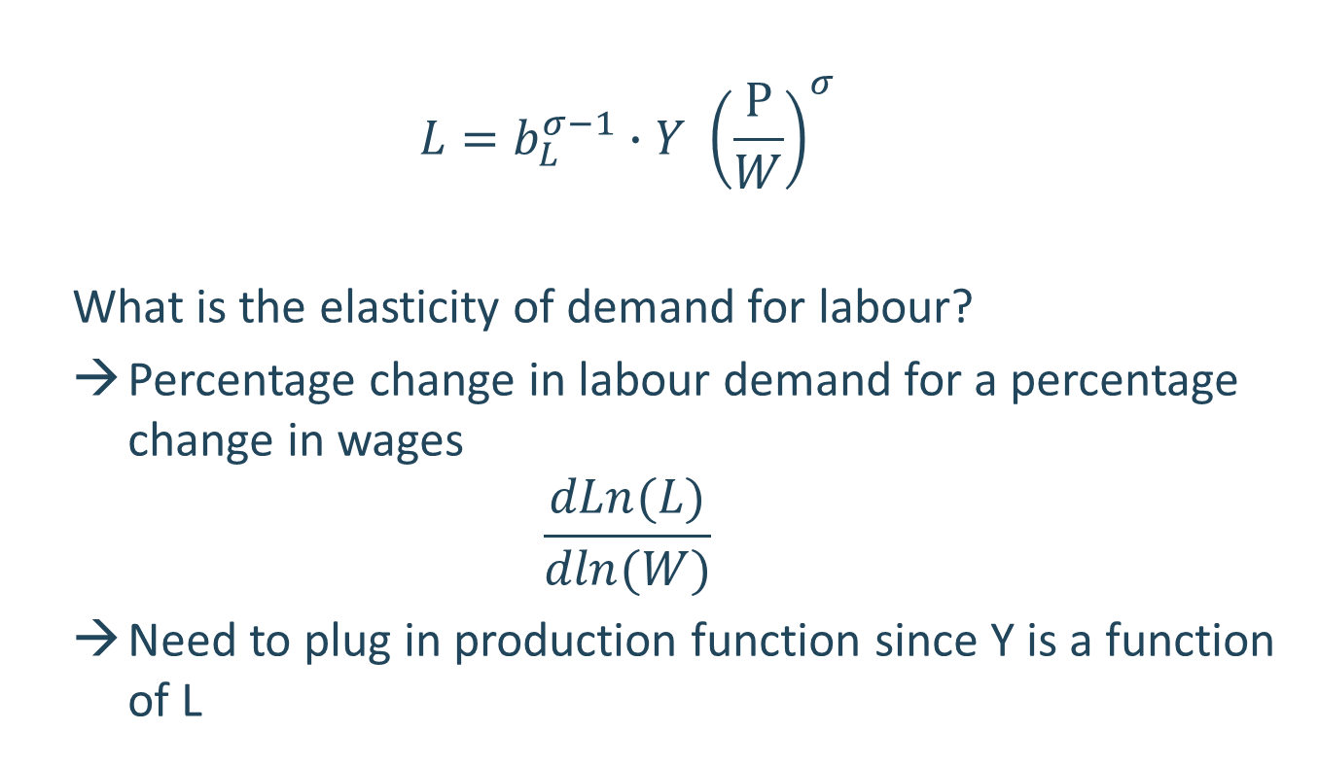
Profit maximization problem in the CGE model
$$L=b_{L}^{σ−1}{∙Y}^{ }{\left(\frac{\text{P}}{W}\right)}^{σ}$$
What is the elasticity of demand for labour?
Percentage change in labour demand for a percentage change in wages
$$\frac{dLn(L)}{dln(W)}$$
Need to plug in production function since Y is a function of L

Slide 22
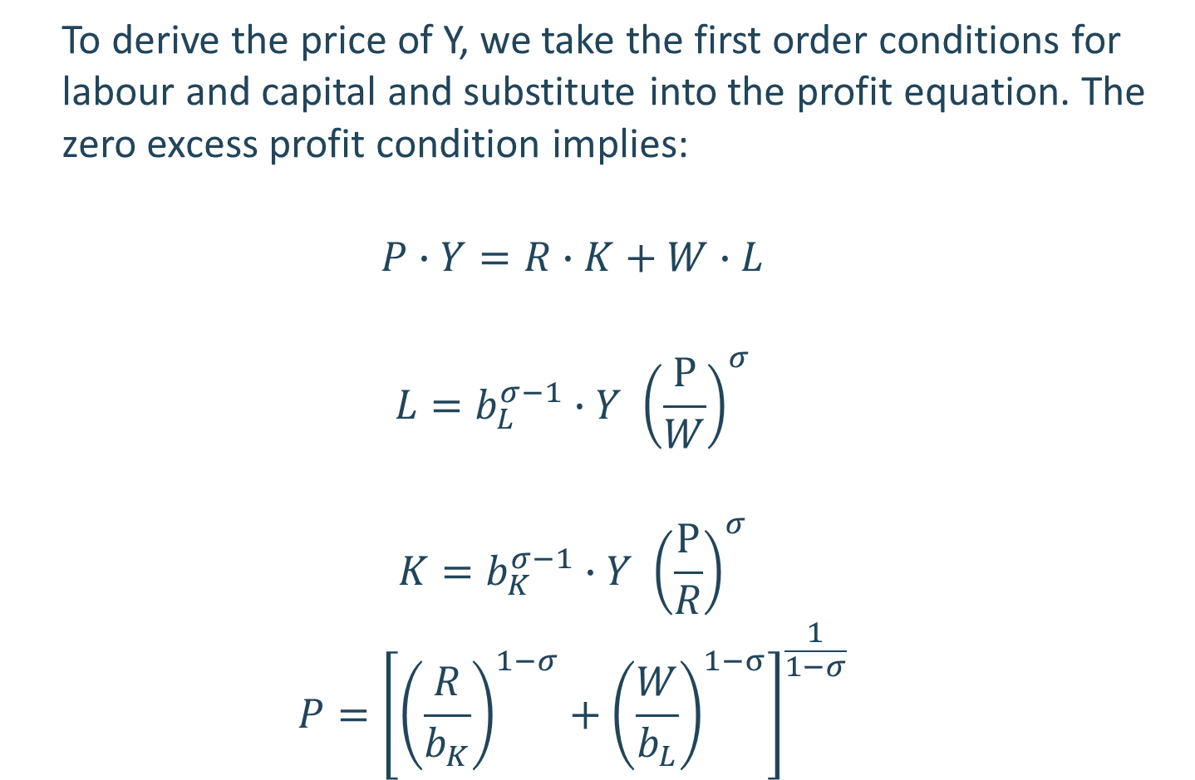
CES Price aggregator
To derive the price of Y, we take the first order conditions for labour and capital and substitute into the profit equation. The zero excess profit condition implies:
$$P∙Y=R∙K+W∙L$$
$$L=b_{L}^{σ−1}{∙Y}^{ }{\left(\frac{\text{P}}{W}\right)}^{σ}$$
$$K=b_{K}^{σ−1}{∙Y}^{ }{\left(\frac{\text{P}}{R}\right)}^{σ}$$
$$P={\left[{\left(\frac{R}{b_{K}}\right)}^{1−σ}+{\left(\frac{W}{b_{L}}\right)}^{1−σ}\right]}^{\frac{1}{1−σ}}$$

Slide 23
A typical production structure
Natural
resources

Slide 24
Firms production function
Labour and capital are combined together to produce value added
The amount of labour and capital used in production depends on their relative prices
If labour becomes relatively expensive, then firms use more capital (e.g. machinery)
Value added is combined with intermediate inputs in fixed proportions to produce output
Proportions do not respond to prices
E.g. A car manufacturer uses 4 tyres as an intermediate input for each car

Slide 25
Firms production decision
Depending on the model, each firm may produce more than one commodity
E.g a motor vehicle manufacturer may produce sedans, trucks, motorcycles etc,
A basic assumption is that the motor vehicle manufacturer produces a fixed amount of each commodity
In this model, each firm produces one commodity

Slide 26
Structure
Source: Hosoe et al 2010

Slide 27
Firms – import decisions
Domestic supply is comprised of domestically produced goods and imported goods
The choice on whether to consume an imported or domestic product depends on:
the relative price of the imported goods versus the domestic good
the substitutability between imports and domestic goods
E.g. Basmati rice from India is not the same as rice grown in China but are similar
Use CES function to represent this choice

Slide 28
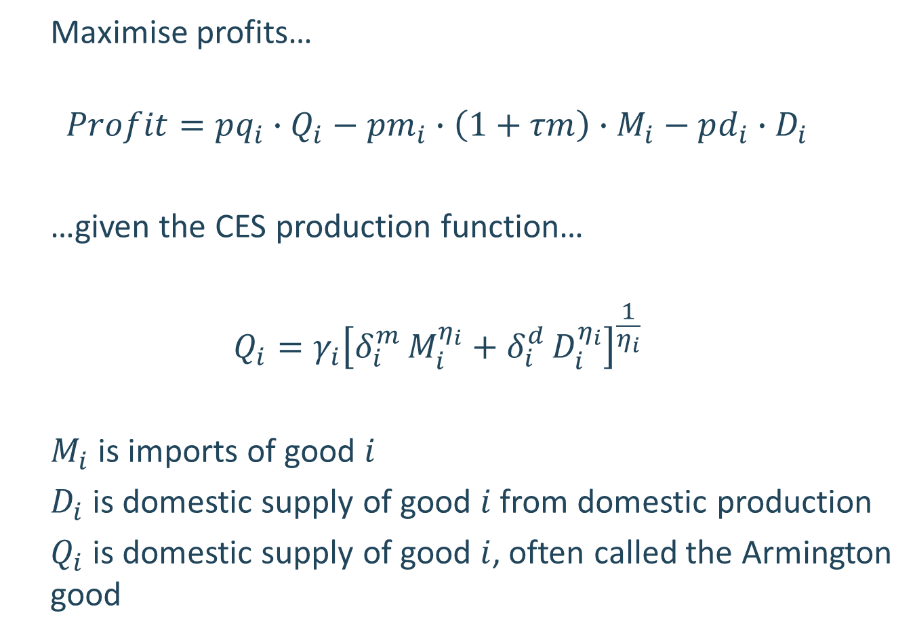
Problem for importing firm
Maximise profits…
$$Profit=pq_{i}∙Q_{i}−pm_{i}∙\left(1+τm\right)∙M_{i}−pd_{i}∙D_{i}$$
…given the CES production function…
$$Q_{i}=γ_{i}{\left[δ_{i}^{m }M_{i}^{η_{i}}+δ_{i}^{d }D_{i}^{η_{i}}\right]}^{\frac{1}{η_{i}}}$$
$M_{i}$ is imports of good $i$
$D_{i}$ is domestic supply of good $i$ from domestic production
$Q_{i}$ is domestic supply of good $i$, often called the Armington good

Slide 29
Firms – export decisions
Producers choose whether to sell domestically or in export markets based on relative prices and how easily the domestically produced product can be transformed for the export market
Assumes that products sold domestically and those exported are not identical. E.g. cars sold in the United Kingdom need to be modified to drive on the left hand side of the road
Use the Constant Elasticity of Transformation (CET) function to represent the exporting firm’s problem
CET has the same functional form as the CES, but different calibration of the parameter

Slide 30
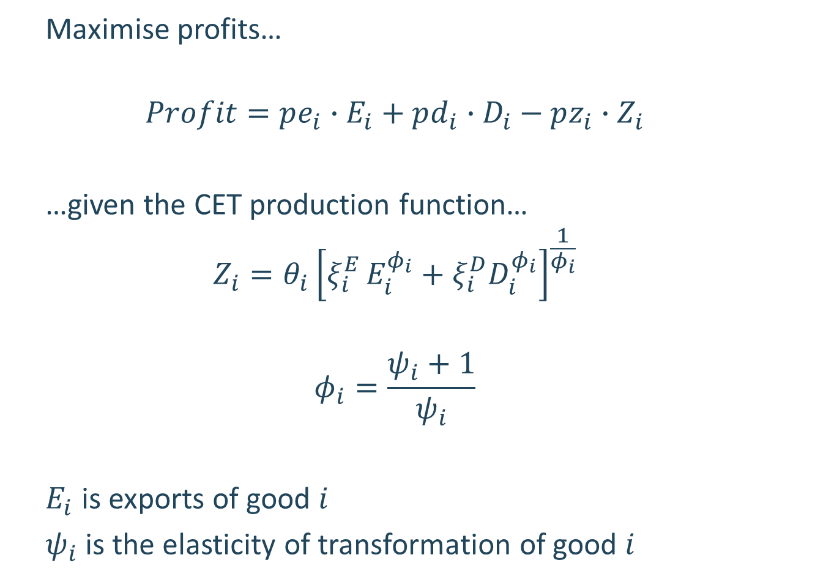
Problem for exporting firm
Maximise profits…
$$Profit=pe_{i}∙E_{i}+pd_{i}∙D_{i}−pz_{i}∙Z_{i}$$
…given the CET production function…
$$Z_{i}=θ_{i}{\left[ξ_{i}^{E }E_{i}^{φ_{i}}+ξ_{i}^{D}D_{i}^{φ_{i}}\right]}^{\frac{1}{φ_{i}}}$$
$$φ_{i}=\frac{ψ_{i}+1}{ψ_{i}}$$
$E_{i}$ is exports of good $i$
$ψ_{i}$ is the elasticity of transformation of good $i$

Slide 31
Government
Receives taxes and uses these to purchase goods and services on behalf of households (e.g. education, health and defence)
Invests in public infrastructure
Provide transfers to households e.g. pensions
Government budget balance can be determined by the model or imposed by model user (e.g. budget targets)
Allows for various options for achieving a target budget balance: tax increase, reduce government spending
Instrument used to achieve the budget balance is called the “swing” fiscal instrument

Slide 32
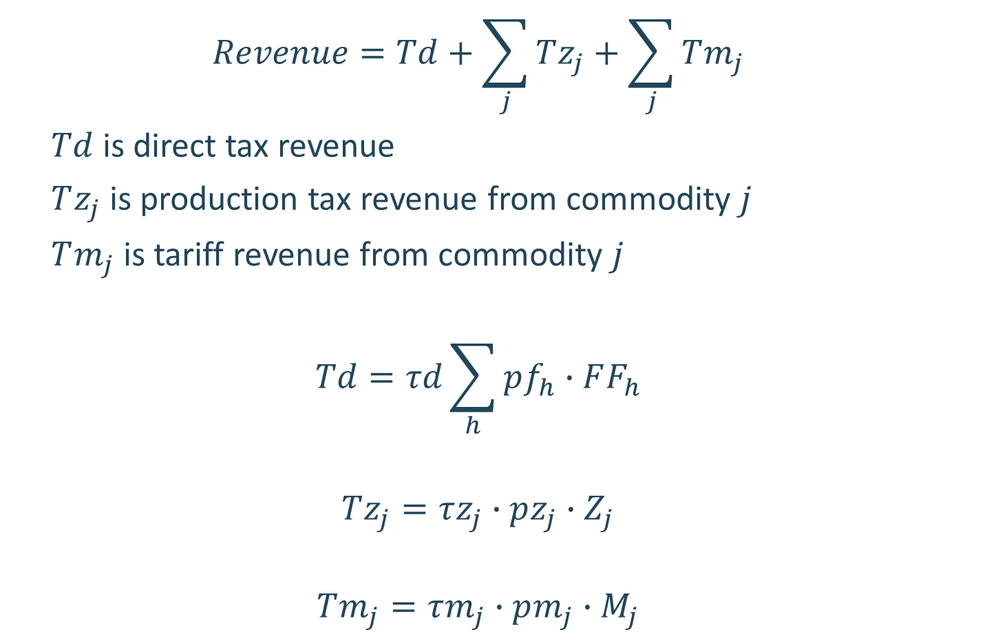
Government Revenue
$$Revenue=Td+\sum_{j}{Tz_{j}}+\sum_{j}{Tm_{j}}$$
$Td$ is direct tax revenue
$Tz_{j}$ is production tax revenue from commodity $j$
$Tm_{j}$ is tariff revenue from commodity $j$
$$Td=τd\sum_{h}{pf_{h}∙FF_{h}}$$
$$Tz_{j}=τz_{j}∙pz_{j}∙Z_{j}$$
$$Tm_{j}=τm_{j}∙pm_{j}∙M_{j}$$

Slide 33
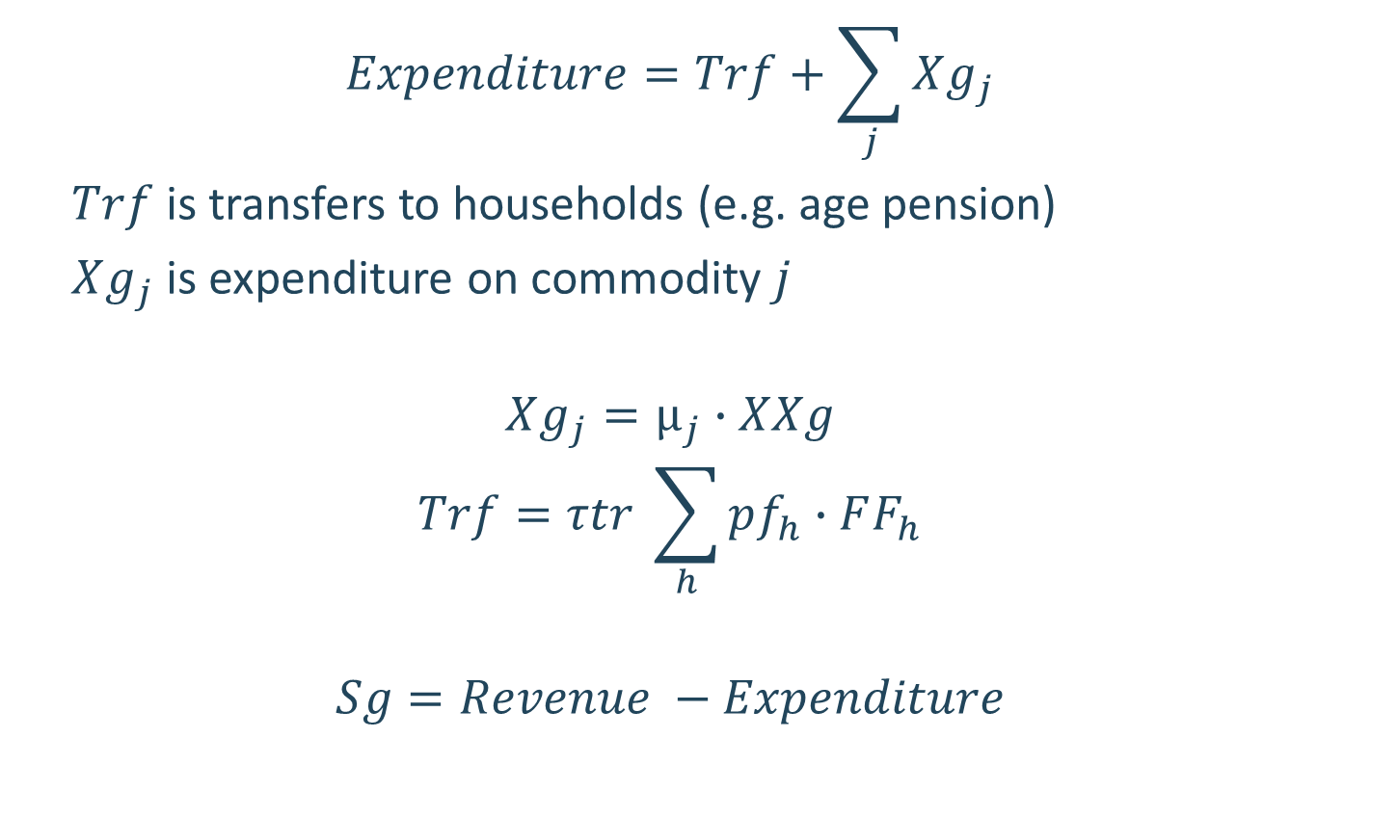
Government Budget Balance
$$Expenditure=Trf+\sum_{j}{Xg_{j}}$$
$Trf$ is transfers to households (e.g. age pension)
$Xg_{j}$ is expenditure on commodity $j$
$$Xg_{j}=μ_{j}∙XXg$$
$$Trf=τtr \sum_{h}{pf_{h}∙FF_{h}}$$
$$Sg=Revenue −Expenditure$$

Slide 34
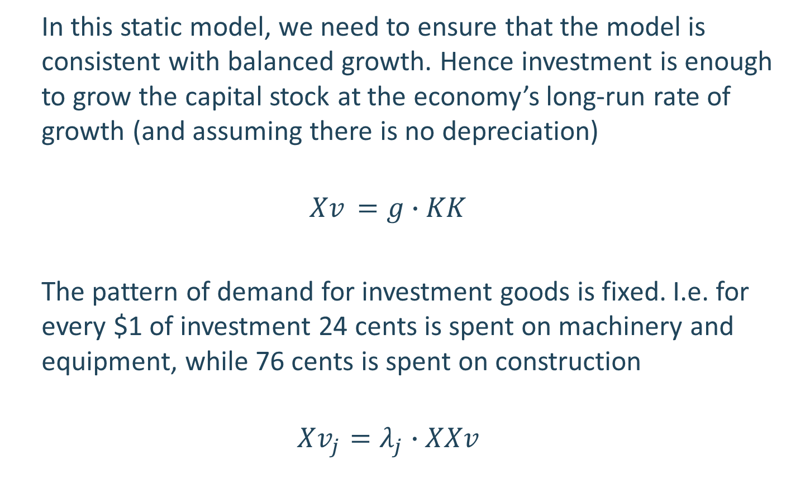
Investment demand
In this static model, we need to ensure that the model is consistent with balanced growth. Hence investment is enough to grow the capital stock at the economy’s long-run rate of growth (and assuming there is no depreciation)
$$Xv_{ }=g∙KK$$
The pattern of demand for investment goods is fixed. I.e. for every $1 of investment 24 cents is spent on machinery and equipment, while 76 cents is spent on construction
$$Xv_{j}=λ_{j}∙XXv$$

Slide 35
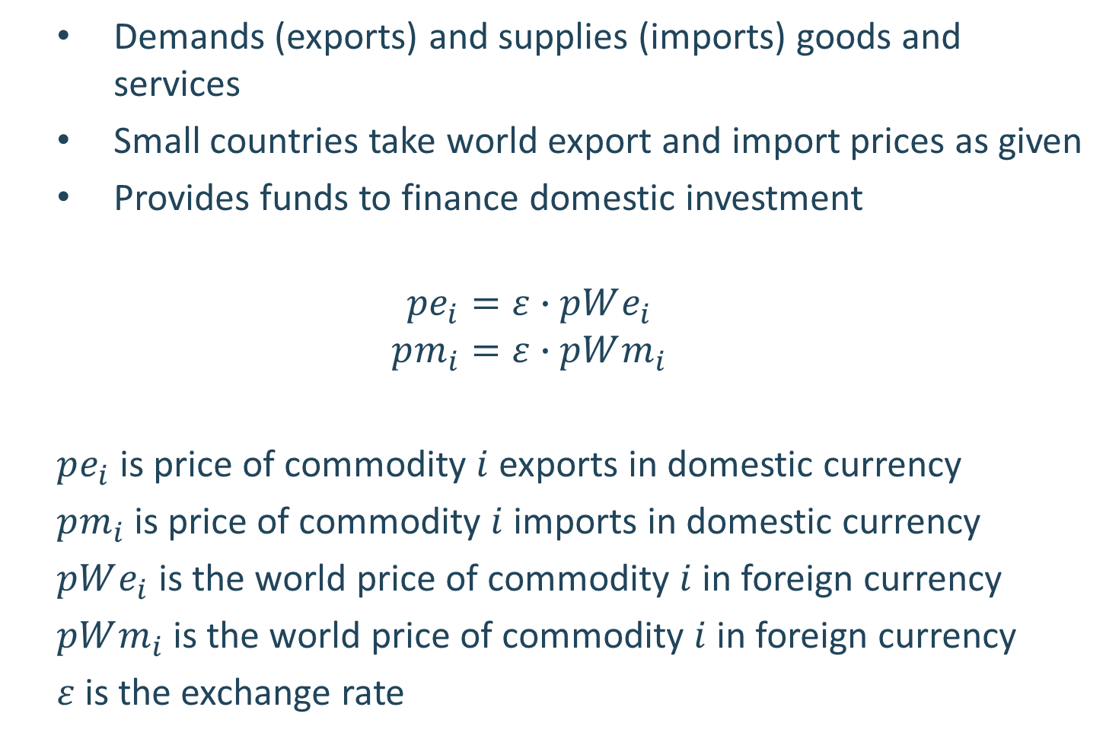
Rest of the world
Demands (exports) and supplies (imports) goods and services
Small countries take world export and import prices as given
Provides funds to finance domestic investment
$$pe_{i}=ε∙pWe_{i}$$
$$pm_{i}=ε∙pWm_{i}$$
$pe_{i}$ is price of commodity $i$ exports in domestic currency
$pm_{i}$ is price of commodity $i$ imports in domestic currency
$pWe_{i}$ is the world price of commodity $i$ in foreign currency
$pWm_{i}$ is the world price of commodity $i$ in foreign currency
$ε$ is the exchange rate

Slide 36
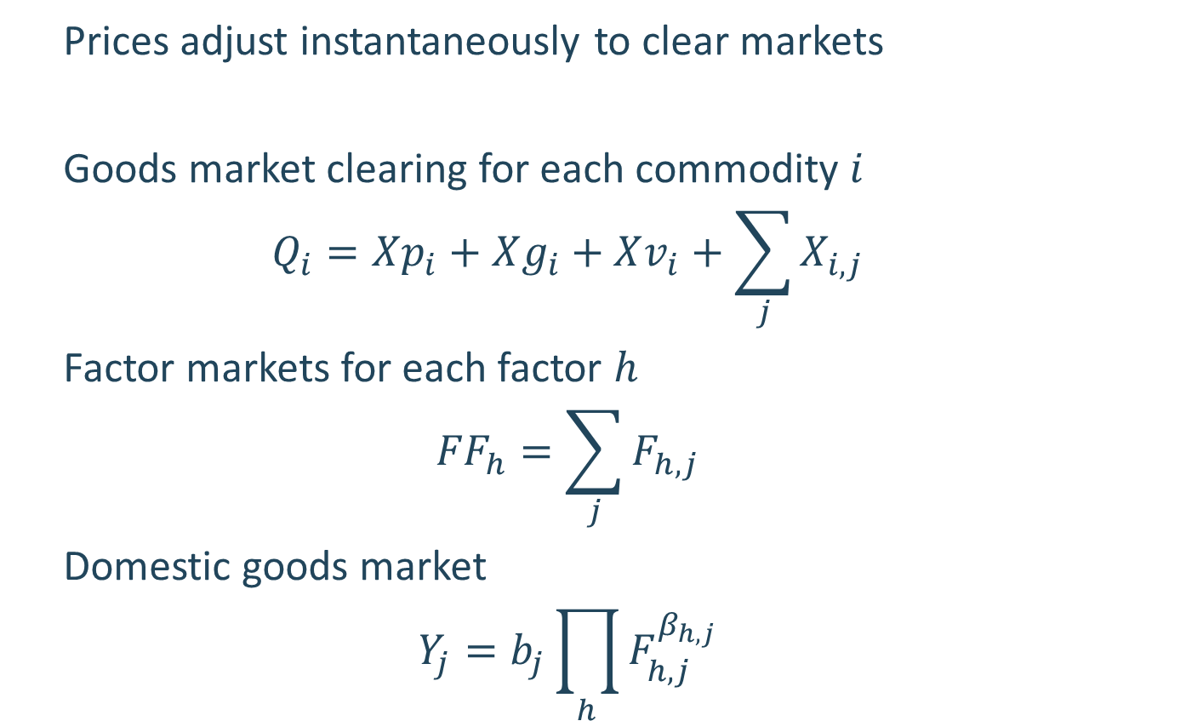
Market clearing
Prices adjust instantaneously to clear markets
Goods market clearing for each commodity $i$
$$Q_{i}=Xp_{i}+Xg_{i}+Xv_{i}+\sum_{j}{X_{i,j}}$$
Factor markets for each factor $h$
$${FF}_{h}=\sum_{j}{F_{h,j}}$$
Domestic goods market
$$Y_{j}=b_{j}\prod_{h}{F_{h,j}^{β_{h,j}}}$$

Slide 37
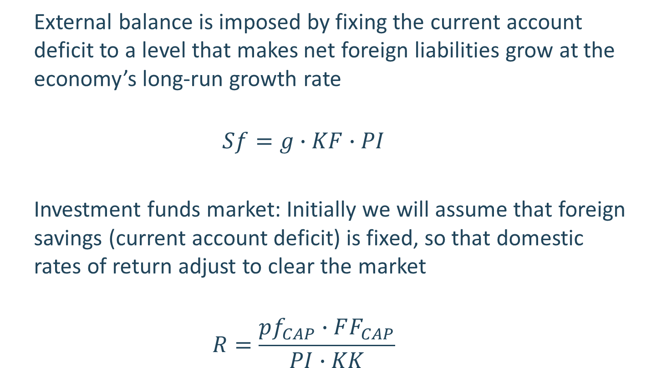
Market clearing
External balance is imposed by fixing the current account deficit to a level that makes net foreign liabilities grow at the economy’s long-run growth rate
$$Sf=g∙KF∙PI$$
Investment funds market: Initially we will assume that foreign savings (current account deficit) is fixed, so that domestic rates of return adjust to clear the market
$$R=\frac{pf_{CAP}∙FF_{CAP}}{PI∙KK}$$

Slide 38
Static vs Dynamic CGE model
Many CGE models are comparative-static. They model the reactions of the economy at only one point in time.
Results from such a model are often interpreted as showing the reaction of the economy in some future period to one or a few external shocks or policy changes.
The process of adjustment to the new equilibrium is not explicitly represented in such a model
Dynamic CGE models explicitly trace each variable through time—often at annual intervals.
The dynamic elements may arise from: partial adjustment processes; stock/flow accumulation relations; or exogenously from population and productivity growth

