Slide 1

..
Dynamic Clustering in Federated Learning
BCSE209L MACHINE LEARNING
DATE: 28/04/2024
Submitted By
22BAI1161 - Kshitij Kumar
Submitted To
Dr. Syed Ibrahim
Project Mentor
Ms. Annie Joshua

Slide 2
Introduction
Introduces dynamic GAN-based clustering in Federated Learning for improved time series forecasting accuracy in wireless network resource management.
Addresses limitations of traditional clustering algorithms in non-Independent and Identically Distributed (non-IID) data, showing a 43% enhancement in cellular handover forecasting.
Extensive simulations on public and private datasets validate efficacy across various scenarios, including power demand, pen digit tracing, and pedestrian count.
Acknowledges drawbacks such as longer execution times in Phase 1 and potential creation of single-client clusters post-division.
Provides a promising solution for enhancing resource management in wireless networks by adapting the number of clusters over time.

Slide 3
Objective of the Experiment
To address the degradation in accuracy of handover predictions caused by non-independent and identically distributed (non-IID) data in wireless network resource management.
To overcome limitations of traditional clustering algorithms in handover prediction, including privacy risks, fixed cluster shapes, and non-adaptive cluster numbers.
To propose a three-phased clustering algorithm: GAN-based clustering, cluster calibration, and cluster division, aimed at preserving privacy, creating dynamic clusters, and adapting cluster numbers over time.
To validate the proposed algorithm's effectiveness through comparison with a baseline clustering algorithm, demonstrating improved performance in use cases such as power demand, pen tracing, and pedestrian count.
To contribute to efficient resource management in wireless networks by enhancing the accuracy of time series forecasting through the proposed dynamic GAN-based clustering approach.

Slide 4
Existing Work/ Literature Review
Previous studies have delved into addressing the challenge of non-IID (non-Independently and Identically Distributed) data. One approach analyzed in the literature involves the use of convolutional neural networks (CNNs) for classification tasks. However, it was found that performance degradation occurred due to the non-IID nature of the data.
Various clustering algorithms have been explored to enhance the performance of ML models in FL settings. Some studies have investigated the application of clustering techniques, such as autoencoders, to compress data and create clusters of clients. Despite improved performance, concerns about privacy breaches arose as the compressed data and autoencoder could potentially reveal sensitive information.
Another line of research has focused on creating clusters based on similarities in gradients. However, applying differential privacy (DP) in this context has proven challenging, as gradients have been shown to potentially reveal original data.
Existing clustering algorithms in FL have predominantly been non-dynamic. However, recent work has introduced dynamic clustering techniques that aim to relocate clients to the best-fitting clusters based on ML model performance. Drawbacks such as varying convergence times and fixed cluster sizes have been identified, highlighting the need for further research in this area.

Slide 5
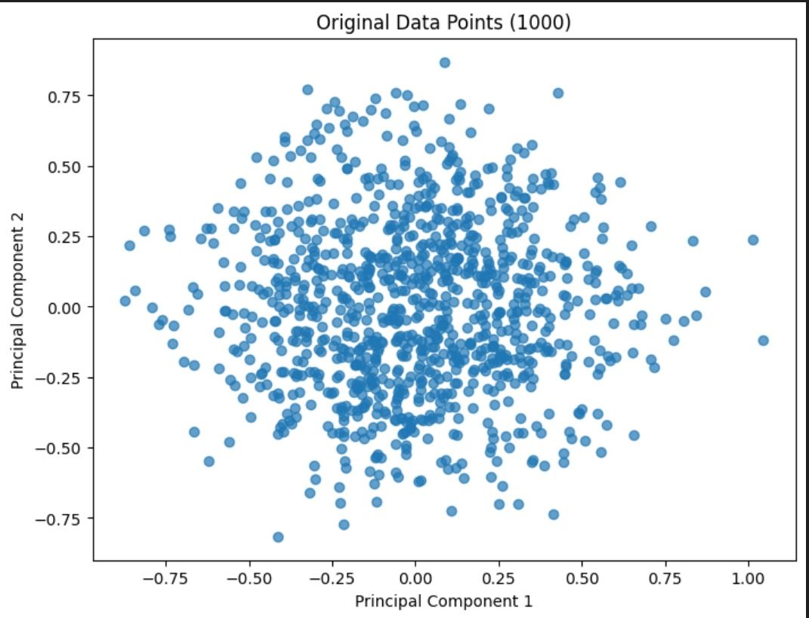

Slide 6
Proposed Algorithm 1
Start by randomly selecting a subset of clients and train initial models for each cluster.
Iterate for a fixed number of times.
At each iteration:
a. Randomly choose a subset of clients.
b. Assign each client to the cluster with the lowest loss based on the current models.
c. Update each cluster's model by running a few steps of optimization using data from clients assigned to that cluster.
After all iterations, determine the final cluster assignment for each client based on the updated models.

Slide 7
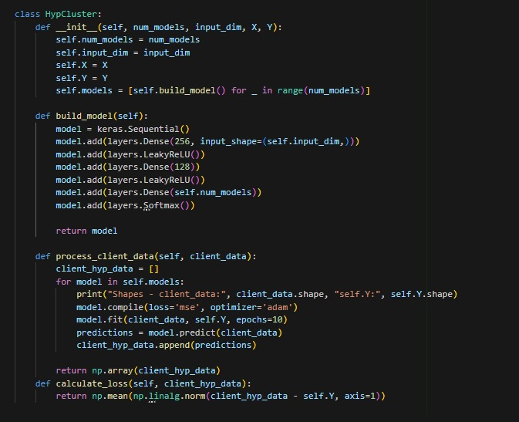

Slide 8
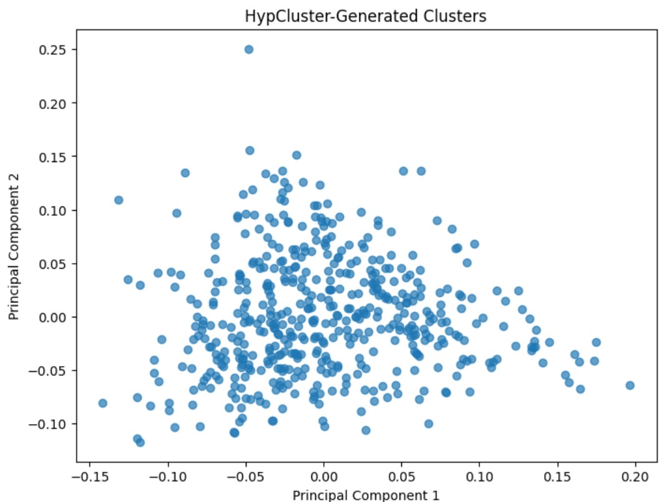

Slide 9
Proposed Algorithm 2
Phase 1: GAN-based Clustering
This phase is aimed at creating clusters using a modified version of ClusterGAN for Federated Learning (FL). The process involves the following steps:
Initialization: Initialize the Generator (G), Discriminator (D), and Encoder (E) with certain parameters.
Iteration: Iterate over multiple rounds (t = 1 to r) for ClusterGAN.
Client Sampling: Sample a subset of clients (St) from all clients (C) with a certain ratio (r).
Client Processing: Each sampled client processes its local data to obtain latent representations (z) and clusters them using GAN-based clustering.

Slide 10
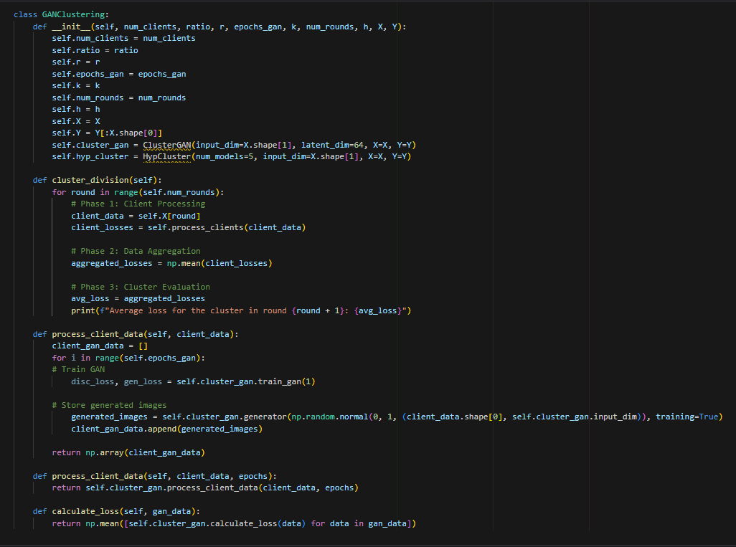

Slide 11
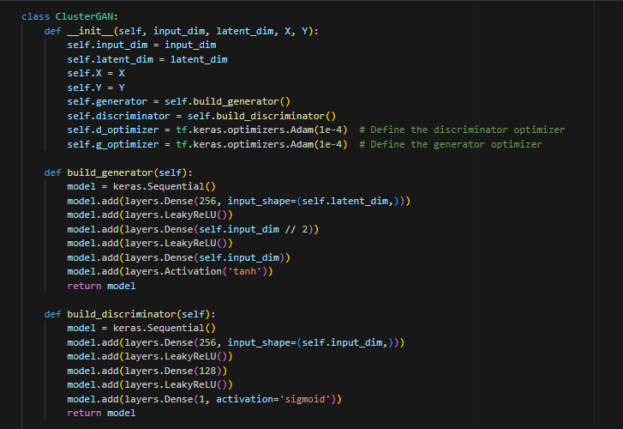

Slide 12
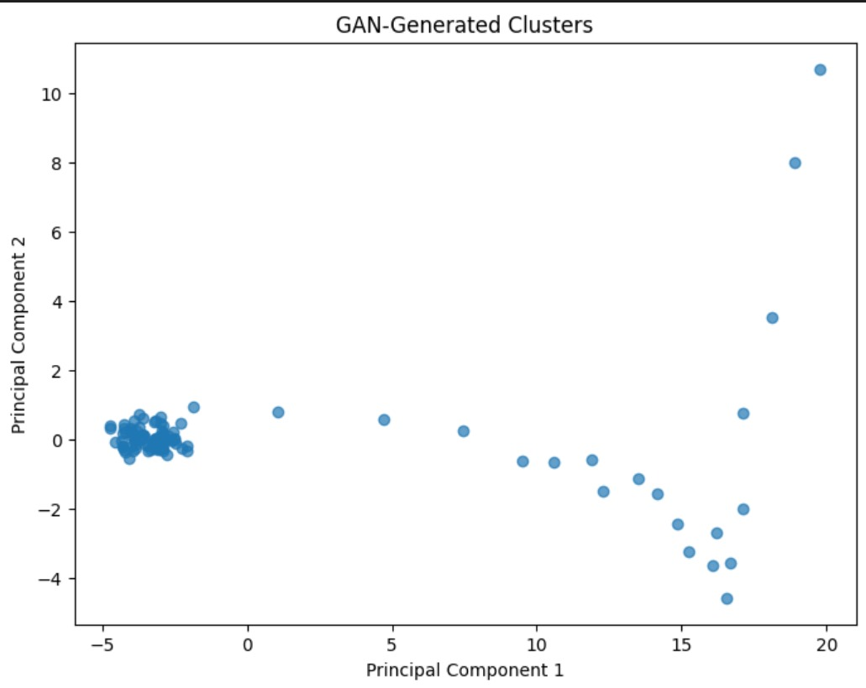

Slide 13
.
Phase 2: Model Training with Cluster Calibration
This phase involves training Machine Learning (ML) models and calibrating clusters using HypCluster. The steps are as follows:
Initialization: Initialize k models for a specific use case.
Iteration: Iterate over multiple rounds (t' = 1 to h) for HypCluster.
Model Training: Train ML models for a certain number of rounds (t" = 1 to l).
Cluster Calibration: Update fixed clusters by modifying them into performance-focused clusters. This involves examining all models on the clients and relocating each client to the best-fitting cluster based on model performance.

Slide 14
.
Phase 3: Cluster Division
This phase modifies divisive clustering using the mean and variance of model performance. The steps are outlined as follows:
Initialization: Set the initial number of clusters (k) and the clients (C).
Iteration: Iterate over multiple rounds (i = 1 to I) for divisive clustering.
Perform Phases 1 and 2: Execute Phase 1 (GAN-based clustering) and Phase 2 (Model Training with Cluster Calibration).
Client Processing: Each client initializes an ML model with certain parameters and runs the model to obtain the loss.
Data Aggregation: Clients send their loss to the server.
Cluster Evaluation: Calculate averages and variances of loss for each cluster.
Cluster Selection: Select a cluster to divide, applying a priority based on average losses and variances. The first priority is given to the cluster with the highest variance above a predefined threshold.
Cluster Splitting: Set the selected cluster's clients as the new cluster and update the number of clusters.
Overall, this approach combines GAN-based clustering, model training with cluster calibration, and cluster division to dynamically adjust clusters based on model performance and variance.

Slide 15
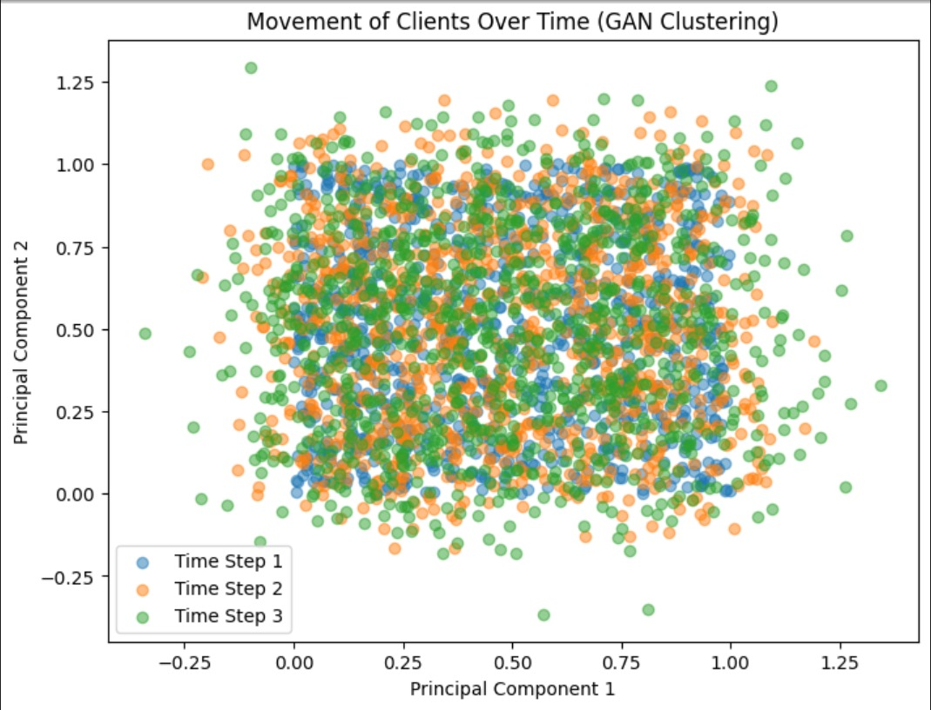

Slide 16
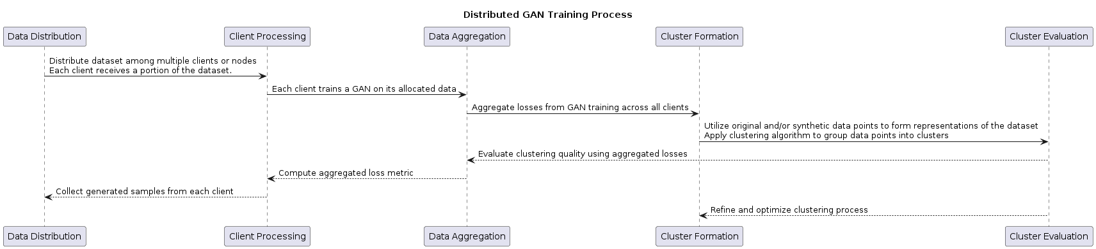
Flow Chart

Slide 17
Implementation
Our implementation of the proposed dynamic GAN-based clustering algorithm involved several key steps.
Our implementation began with dataset preprocessing, and segmentation tailored for Federated Learning (FL) tasks. We seamlessly integrated GAN-based clustering by converting its algorithm into code, training individual models on client data(CICIDS 15 class labels) while integrating dynamic cluster calibration mechanisms in later phases.
Our simulations underwent multiple iterations. These iterations adjusted parameters, such as cluster sizes and learning rates, ensuring a thorough and comprehensive assessment of this approach's efficacy.
This led to a detailed analysis of results, juxtaposing the accuracy of time series forecasting models and the effectiveness of our clustering algorithms against established baselines. We also candidly addressed the limitations encountered, paving the way for future research avenues aimed at refining and enhancing this algorithmic approach.

Slide 18
Proposed Three-Phased Data Clustering Algorithm
Advantages
Limitations
The generative adversarial network-based clustering ensures data privacy.
Cluster calibration adapts to dynamic environments by modifying clusters.
Divisive clustering explores different numbers of clusters for optimization.
Clusters are more well defined.
Clusters loss is less as compared to other clustering algorithms.
Baseline algorithm and our algorithm are suboptimal compared to others.
Modifying clusters may lead to inaccurate results in certain scenarios.
Adapting the number of clusters over time can be complex and resource-intensive.

Slide 19
Experimental Results
Improving Forecasting Performance
Baseline and our algorithm tested on time series forecasting task. The algorithm improves forecasting models, including handover prediction by 43%.
Experimental results demonstrate that the loss incurred by the GAN-based clustering approach is significantly smaller compared to other traditional clustering methods. This reduction in loss signifies the enhanced performance and efficacy of the GAN-based clustering algorithm in capturing the underlying structure of the data and generating well-separated clusters.
Clusters are well defines within their respective boundaries and well separated as compared to other clustering algorithms.
Photo by

Slide 20
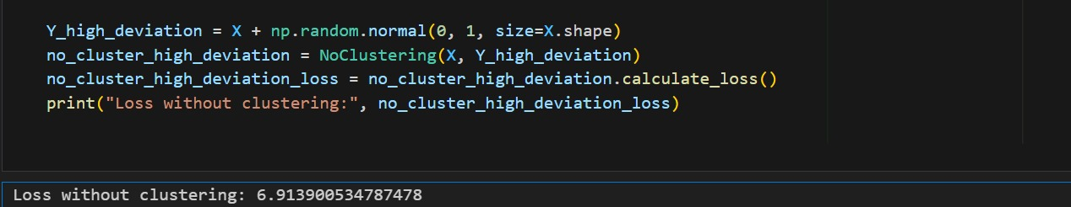
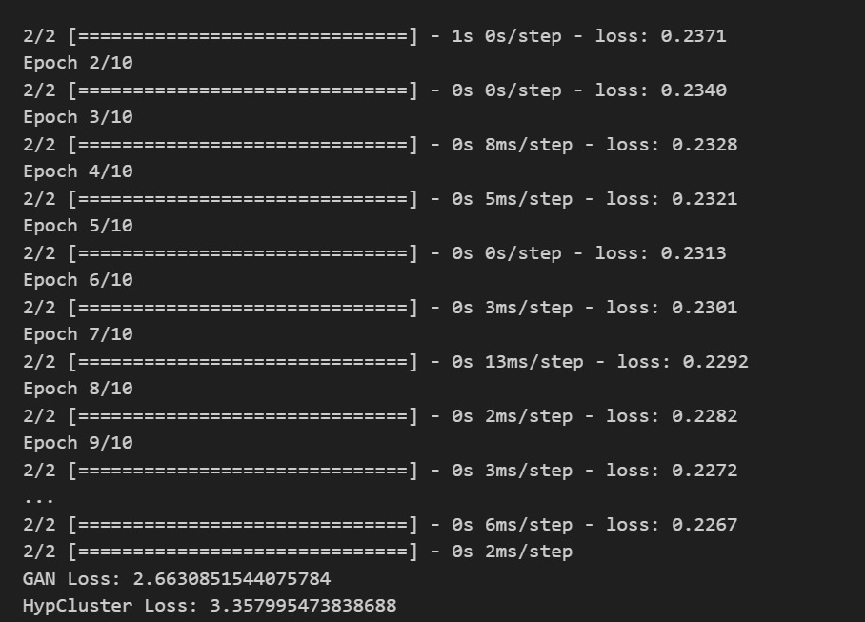
Loss Comparison Between
Baseline And Proposed Model
Baseline
GAN-Based Clustering
Photo by

Slide 21
Inference
Cluster Quality: Researchers often evaluate the quality of the generated clusters. Metrics like silhouette score, Davies-Bouldin index, or purity are commonly used to assess how well-separated and internally cohesive the clusters are. Higher silhouette scores or lower Davies-Bouldin indexes indicate better cluster quality.
Visualization: Visualization techniques like t-SNE or PCA can be employed to visually inspect the clusters and their separability. This helps in understanding the structure of the data and the effectiveness of the clustering algorithm in capturing it.
Convergence Analysis: Researchers may analyze the convergence behavior of the GAN-based clustering algorithm over training iterations. This involves plotting metrics such as loss functions (e.g., generator loss, discriminator loss) over time to ensure that the algorithm converges to a stable solution.

Slide 22
.
Comparison with Baselines: Experimental results often include comparisons with baseline clustering algorithms or variations of the GAN-based clustering algorithm. This helps in assessing whether the GAN-based approach offers improvements over traditional methods.
Scalability: It's important to evaluate the scalability of the GAN-based clustering algorithm, particularly when dealing with large datasets or a large number of clusters. Experimentally demonstrating the scalability of the algorithm can provide insights into its practical utility.
Robustness to Noise and Perturbations: Assessing the robustness of the GAN-based clustering algorithm to noise and perturbations in the data is crucial. This can involve adding noise to the input data or introducing perturbations and evaluating the stability of the generated clusters.
Real-world Application Performance: Finally, experimental results might include evaluations of the GAN-based clustering algorithm in real-world applications. This involves assessing how well the generated clusters perform in downstream tasks such as classification, anomaly detection, or recommendation systems.

Slide 23
Conclusion
K-Means Algorithm:
In conclusion, the K-Means algorithm provides a simple yet effective method for partitioning data into clusters. Its iterative approach to minimizing the within-cluster variance makes it computationally efficient and easy to implement. However, K-Means is sensitive to initial centroid selection and may converge to suboptimal solutions, particularly in high-dimensional or non-linearly separable data. Despite its limitations, K-Means remains a widely used clustering algorithm due to its simplicity and scalability. It serves as a fundamental baseline for more advanced clustering techniques and finds applications in various fields, including data analysis, image segmentation, and customer segmentation.
HypCluster Algorithm:
In conclusion, the HypCluster algorithm introduces an innovative approach to clustering that combines hypothesis-based modeling with dynamic cluster calibration. By iteratively updating cluster assignments and refining cluster-specific models based on client data, HypCluster aims to achieve more accurate and adaptive clustering results compared to traditional static clustering methods. This algorithm offers potential applications in various domains where data distribution and client characteristics change over time, such as federated learning and decentralized systems. Further experimentation and evaluation across different datasets and scenarios are necessary to assess its performance and scalability comprehensively. Overall, HypCluster introduces a promising framework for flexible and efficient clustering in dynamic and heterogeneous environments.

Slide 24
Future Enhancements
Future enhancements for both the K-Means and HypCluster algorithms could include advancements in initialization techniques to improve convergence and robustness, strategies for handling non-spherical or irregularly shaped clusters, scalability improvements through parallelization and distributed computing, dynamic selection of the optimal number of clusters, and enhancing robustness to outliers. For HypCluster specifically, adaptive learning rate schedules, model ensemble techniques, dynamic cluster resizing, incorporation of uncertainty estimates, and enhancements for privacy and security could further enhance its effectiveness and applicability in dynamic and heterogeneous environments. Additionally, exploring novel optimization techniques and parallelization strategies tailored to the unique characteristics of hypothesis-based clustering could lead to significant performance gains and scalability improvements

