Slide 1


Corporate level presentation on
RESPONSIVE UI
By
Shubham Ashish

Slide 2


What is responsive design?
Responsive web design (RWD) is an approach to web design aimed at crafting sites to provide an optimal viewing and interaction experience-easy reading and navigation with a minimum of resizing, panning, and scrolling-across a wide range of devices (from large desktop computer monitors to small mobile phones).

Slide 3
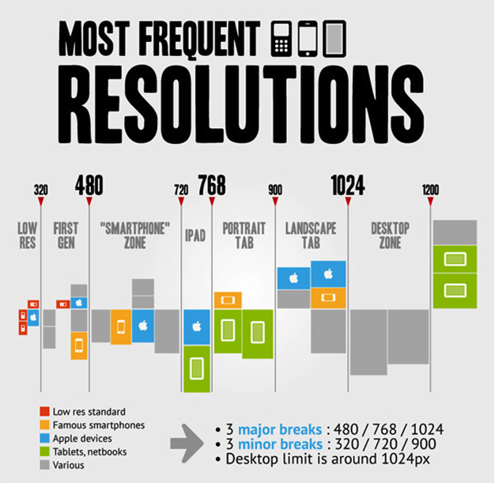
Why responsive design?
As smartphone and tablet adoption rapidly increases, so does the importance of mobile-friendly websites.

Slide 4
Why responsive design?
Brand | Model | Screen Resolution
Apple | Ipad | 768 x 1024
 | Ipad 2 | 768 x 1024
 | Ipad 3 | 1536 x 2048
 | Ipad 4 | 1536 x 2048
 | iPad Air | 1536 x 2048
 | iPad Air 2 | 1536 x 2048
 | iPad Mini | 768 x 1024
 | iPad mini 2 | 1536 x 2048
 | iPad mini 3 | 1536 x 2048
 | iPad Mini 4 | 1536 x 2048
 | iPad Pro | 2048 x 2732
 | iPhone | 320 x 480
 | iPhone 4 | 640 x 960
 | iPhone 4S | 640 x 960
 | iPhone 5 | 640 x 1136
 | iPhone 5c | 640 x 1136
 | iPhone 5S | 640 x 1136
 | iPhone 6 | 750 x 1334
 | iPhone 6 Plus | 1080 x 1920
 | iPhone 6s | 750 x 1334
 | iPhone 6s Plus | 1080 x 1920
 | iPod Touch | 320 x 480
Here you can see how the screen resolution has been vary for different devices of apple.
If you notice only for apple mobile and tablets the minimum & maximum range is 320px to 2048px.
And some uneven width too like 1536px, 750px, 640px.

Slide 5
How to make responsive UI?
Need:
Proper HTML structure.
Good CSS implementation.
A proper HTML structure Implementation is only possible if you understand the UX (mock-up).
And Good CSS implementation is possible when have set your mind for a better (even best) HTML structure.
So, it may help you to avoid code like !important, inline-CSS etc.

Slide 6
How to make responsive UI?
Don't:
Don't set fix size of any HTML elements.
Avoid px and pt.
Example: img.profile-pic { width: 100px; }
It will never be responsive. If you wrote code like this then you may need to add media-queries; but for how many screen resolution you will add media-queries, its range is very huge like you see earlier.
It will increase the code complexity nothing else.

Slide 7
How to make responsive UI?
Do's:
Use flexible unit to set the size of HTML elements.
Use percentage(%), vw, vh, vmin, vmax.
Use media-queries smartly.
Example: img.profile-pic { width: 10vw; }
Above code will set your image width to 10% of view-width; now you don’t need to write media-queries for these small stuffs, until and unless your UX is very complex.
You can use other unit as per your need which set the element size dynamically.

Slide 8
How to make responsive UI?
Exceptions:
Use of em.
Use of libraries.
Set CSS rules by using JS.
These points are set in exceptions because of there abnormal behaviour, which can be normal if we are having at least 85% knowledge of it.

Slide 9
Thank You ☺

