Slide 1

GettyImages-1012013836-16-9.jpg
Connect F(ARMERS)OR GOOD-CFG
Vaishnavi S
Ravi Shekar Singh
Kiruthika Nallamal Vardarajan
Rimple Panjwani
Sivakami Velusamy
DELL TECHNOLOGIES

Slide 2




CFG – Ideation and relation with sustainability
Goal/Aim:
Increasing value proposition for farmers produce is the idea of our hackathon project
Ideation:
ConnectF(armers)orGood(CFG) .
The following capability of the app provides a conducive environment for a farmer to sell his produce and ensure sustainable living and eradicate poverty.
List of neighboring communities, colonies that can provide demand list
for a week or 2 days minimum
Identify and register farmers to the CFG app, SMS or MMS facilities are
also sufficient.
Let farmers decide the cost of their produce – provide potential help in
developing a profit model initially.
Value chain proposition meetings to ensure not all farmers grow same
produces all time.
Provide ways for farmers to leverage best farming practices –
sustainable farming practices
Alternate income recommendations – live stocks – dungs can be used as manure, etc.,
Consumers in colonies., communities group together to ensure logistics on the way with the benefit of sharing cost.
Ou
r focus
Credit : UN : Sustainability
Notes:
>Agriculture is one of the major means to eradicate poverty in the world. It must feed close to 10 billion people by 2050. 65% of people in the world survive with the income from agriculture.
It is very crucial for economic growth, eradication of poverty, and global GDP improvements among the countries in the world.
Current system of food is lot more threating in nature - lot of water usage (70% of water in the earth is used for agriculture), lot of unsustainable pollution and waste. One-Third of food produced is wasted globally. Fresh produce, nutrition values of produce is always retained only when produce reaches consumer households or any form of consumer earlier than now. It takes closer to 24-48 hours for a produce to reach a market and then takes about 4-5 hours to reach a household or the place where it’s used for making dishes.
On the other hand, farmers struggle to make ends meet. If a farmer must survive, farming policies needs to change across world and needs a massive shift – policy should deliver fair prices and allow them to make a living that never put them at risk any time during their lifetime. When farmer do better, we all do better, and vice-versa. Farming is termed inelastic – with farmers and consumers not knowing the demand and supply for a given year. Parity pricing set by farmer is important to address pricing woes and that will benefit farmer and help consumer consume without additional middleman cost.

Slide 3
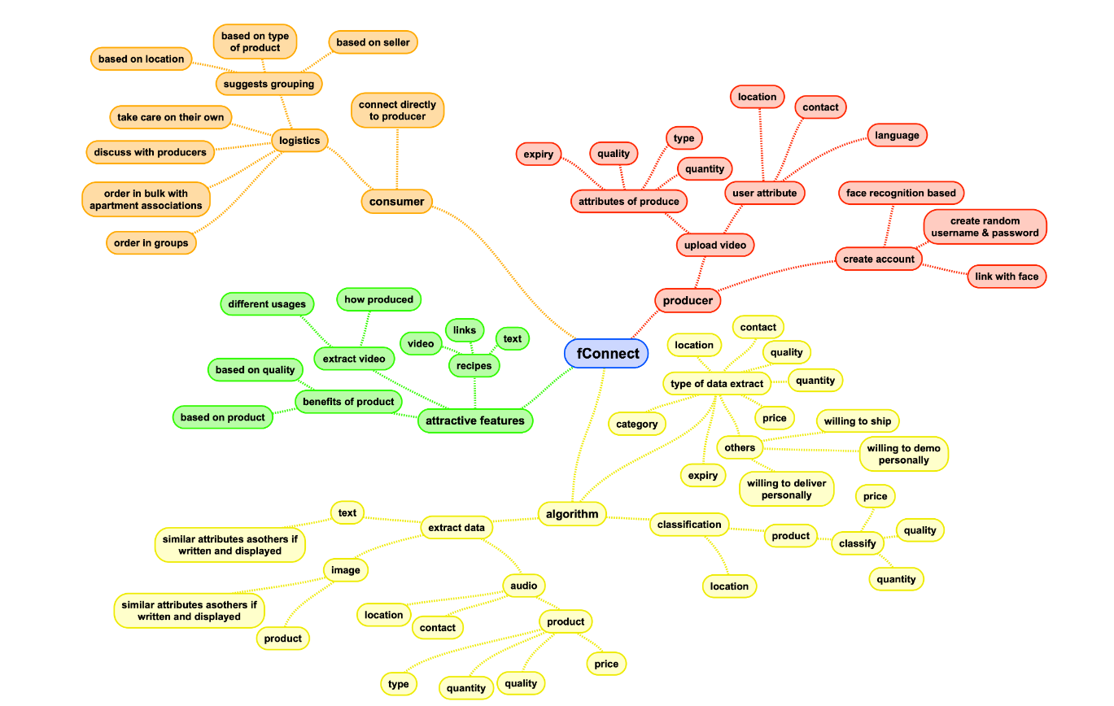
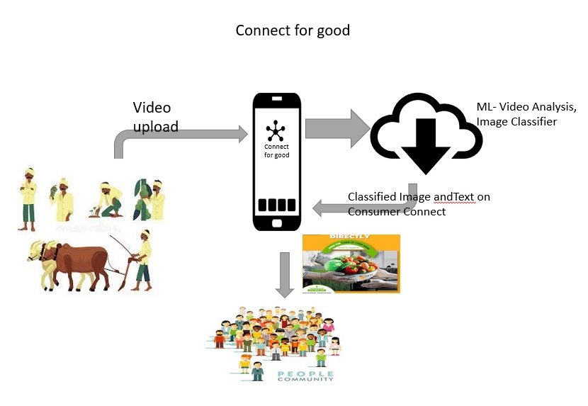
Solution - Proposed
Farmers upload video of produce in Native / known language describing cost in retail /whole-sale, Quantity availability, location, and available items using the CFG android app
The details extracted as below:
>> Name of the farmer / Farm , Mobile Number, Location/Address, Name of produce-Type/Sub-Type, QTY of produce, Price for min and max QTY
The extracted details are put in json format and stored in IBM COS(Cloud Object Storage) as well and displayed for consumers once the video upload complete with extraction done on the android app
User can then place the order on the app , the details are again consolidated in Cloud storage , fair pricing on logistics arrived at for community and order is confirmed.
Once order is confirmed, community logistics will work towards collaborating with neighboring community using Newman detection algorithm
is uploaded to the IBM Cloud Object Storage (COS) for retrieving the text, image of produce and other relevant details using the trained ML model (PixelLib).
Programming languages – Python,
Machine Learning –Model – Pixel Lib & Audio bot
IBM catalog – IBM Cloud Object Storage , IBM COS SDK for Python using IBM_boto3
OS – Android Studio 4.2.1, Android SDK( 9.0,),SDK platform tools/SDK-tools -31.0.2/26.1.1
Steps 1-5 is complete with 6 on fair pricing and 7 is to be implemented in future

Slide 4
Demo
Video link
Github link

Slide 5
Extensible futuristic solution Plans to integrate Groceries as part of the app Leverage Environment friendly farming practices and live sessions Share canceled orders or produce to the nearest needy. Lend loans to needy farmers with the community sharing corpus. Corpus to be used for sponsoring education of farmers kids till they stabilize as they start with CFG app. Advantages/Disadvantages Limited / no middleman looting farmers anymore. Farmers will be able to determine the cost Best farming practices for sustainable living and greater food chain ability for future generation Right cost for right produce
Future and Advantages of solution

