Slide 1


Data Management II – ETL and Smart Data Project
(Product Sales Data)
Presented by: Shekhar Singh (11011694)
13.11.2019
Master | Big Data & Business Analytics
1

Slide 2
Content
Introduction
Problem Statement
Data Profiling
ETL Pipeline
Star Schema
Demo
13.11.2019
Master | Big Data & Business Analytics
2

Slide 3
Introduction
Dataset : Product Sales Data
Fictitious company called Adventure Works Cycle (AWC) , a multinational manufacturer and seller of bicycles and its related accessories
Records : 1048543 ; Attributes : 13
Fails on Completeness, Consistency, Accuracy, Conformity and Validity dimensions of Data Quality
13.11.2019
Master | Big Data & Business Analytics
3

Slide 4
Problem Statement
Considering total purchase amount, classify customers into 3 categories (High, Mid or Low)
Classify employees into 3 bonus categories (3% Bonus, 2% Bonus, 1% Bonus) based on the total count & amount of sale provided
Explore co-relations between employee, customers and products
13.11.2019
Master | Big Data & Business Analytics
4

Slide 5
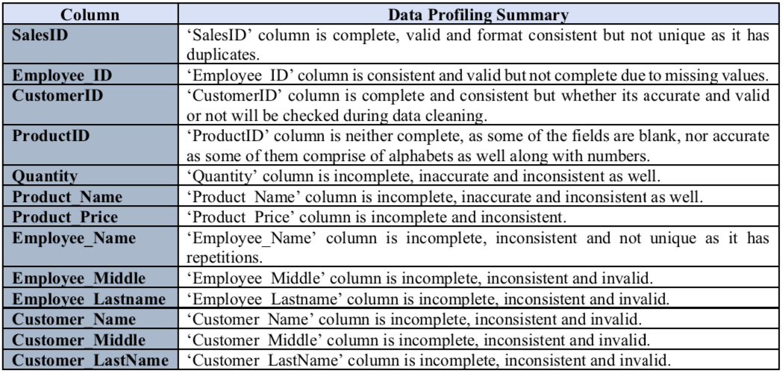
Data Profiling
13.11.2019
Master | Big Data & Business Analytics
5

Slide 6
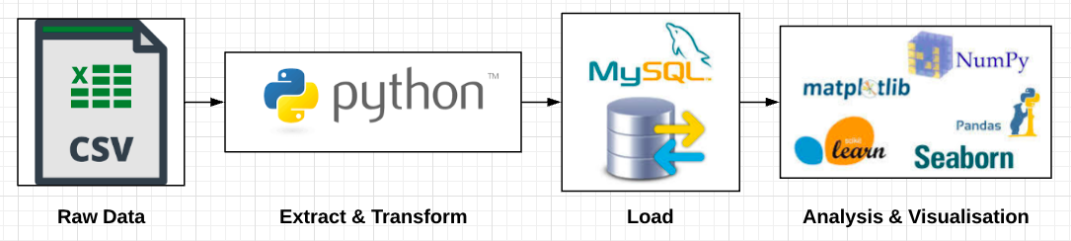
ETL Pipeline
13.11.2019
Master | Big Data & Business Analytics
6

Slide 7
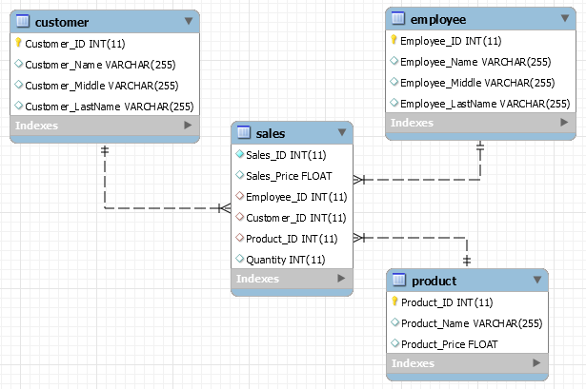
Star Schema
13.11.2019
Master | Big Data & Business Analytics
7

Slide 8
Demo
13.11.2019
Master | Big Data & Business Analytics
8

Slide 9
Thank You!
13.11.2019
Master | Big Data & Business Analytics
9

