Slide 1
₿
CRYPTOCURRENCY
Market Analysis & Intelligence Dashboard
An end-to-end Business Intelligence analysis of 100 leading cryptocurrencies covering market capitalisation,
price trends, ATH/ATL patterns, and actionable investment insights.
Tool: Power BI | Source: CoinGecko API
CONFIDENTIAL | DATA ANALYTICS DIVISION | CRYPTO INTELLIGENCE REPORT

Slide 2
TABLE OF CONTENTS
Introduction & Domain Overview
Tools & Business Questions
01
05
Background, context, and industry explanation
Technologies used and 7 key analytical questions
Problem Statement & Objectives
Exploratory Data Analysis (EDA)
02
06
Business problem, goals, and expected outcomes
Initial trends, chart-by-chart deep dive
Dataset Overview & Summary
Dashboard Walkthrough
03
07
Data source, structure, statistics, and variables
Power BI KPIs, filters, layout, and interactivity
Data Cleaning & Transformation
Key Insights, Recommendations & Conclusion
04
08
Handling missing values, new columns, aggregations
Findings, actions, and future scope

Slide 3
INTRODUCTION
Background
100
$3T
Cryptocurrency has emerged as one of the most disruptive asset classes in the last decade. From Bitcoin's inception in 2009 to thousands of altcoins today, the market has grown to multi-trillion-dollar valuations.
Coins
Tracked
Total
Market Cap
Context
This project analyses a dataset of 100 top cryptocurrencies sourced via the CoinGecko API, providing a comprehensive snapshot of market conditions, historical highs/lows, and price dynamics.
$453.8K
2009
Importance
Current
Highest Price
Crypto
Born
For investors, analysts, and institutions, understanding market patterns is critical. This analysis provides data-driven insights to support investment decisions, risk assessment, and market monitoring.

Slide 4
DOMAIN OVERVIEW — CRYPTOCURRENCY ECOSYSTEM
₿
📊
🏆
Blockchain
Market Cap
ATH / ATL
Decentralised, immutable distributed ledger technology underpinning all crypto transactions
Total value of a cryptocurrency: Circulating Supply × Current Price
All-Time High and All-Time Low price points – key indicators of historic volatility
🔄
📈
💰
Wrapped Tokens
Price Change %
Stablecoin
Pegged representations of assets from other blockchains (e.g., Wrapped Bitcoin on Ethereum)
24h and 7d percentage change metrics that signal short-term market momentum
Crypto pegged to fiat (e.g., USDT, USDC) to minimise price volatility

Slide 5
PROBLEM STATEMENT
Core Business Problem
The cryptocurrency market is highly volatile and data-rich, yet difficult to monitor holistically. Investors, analysts, and institutions lack a consolidated, interactive view of multi-coin performance, historical pricing patterns, and real-time market metrics — leading to uninformed decisions and missed opportunities.
⚡ Volatility
🔍 Fragmented Data
📉 Missing Historical Context
Extreme 24hr and 7-day price swings make it hard to track exposure
Data across 100+ coins is spread across multiple platforms and APIs
Investors cannot correlate ATH/ATL patterns with current prices
🎯 No Unified KPIs
⏱️ Timeliness
📊 Comparison Gap
Lack of a single dashboard to monitor Market Cap, Coin Count, and price changes
Static reports fail to capture rapidly changing market conditions
Difficult to compare Wrapped, Staked, and Native tokens in one view

Slide 6
PROJECT OBJECTIVES
01
Business Goal
02
End Goal (Expected Outcome)
03
Analytical Goal
Centralised Market Intelligence
Actionable Insights & Reporting
Data Storytelling Excellence
Build a unified Power BI dashboard tracking 100 cryptocurrencies
Identify top-performing and underperforming cryptocurrencies
Apply statistical analysis to identify outliers and anomalies
Monitor KPIs: Market Cap ($3T), Coin Count, Current Price ($453.8K)
Reveal ATH/ATL trend patterns by year (2014–2026)
Correlate market cap rank with price change behaviour
Enable comparison of price changes across 24hr and 7-day windows
Provide a ranked overview page by Market Cap with visual indicators
Uncover relationships between coin type and historic performance
Support investment decisions with real-time and historical data
Deliver recommendations for portfolio allocation strategy
Demonstrate end-to-end BI workflow from raw data to insight

Slide 7
DATASET OVERVIEW
Data Source
Data Structure
• Platform: CoinGecko Public API
• Rows (Records): 100 cryptocurrencies
• Format: Datalink → Power BI Dataset
• Columns: 15+ fields per record
• File: Crypto_Currency.pbix
• Primary Key: Coin ID / Name
• Refresh: Live API integration
• Date Range: 2014 – 2026 (ATH/ATL)
• Coverage: Global cryptocurrency market
• Granularity: Per-coin aggregate
Key Variables & Metrics
Column | Type | Description
name | Text | Cryptocurrency name (e.g., Bitcoin, Ethereum)
market_cap_rank | Integer | Global rank by total market capitalisation
current_price | Decimal | Current market price in USD
market_cap | Decimal | Total market capitalisation in USD
price_change_percentage_24h | Decimal | % price change over last 24 hours
price_change_percentage_7d | Decimal | % price change over last 7 days
ath / atl | Decimal | All-Time High and All-Time Low prices in USD
ath_date / atl_date | Date | Dates when ATH and ATL were recorded

Slide 8
DATA SUMMARY — STATISTICAL OVERVIEW
COIN COUNT
MARKET CAP
MAX PRICE
24hr CHANGE
7D CHANGE%
100
$3T
$453.8K
-131.43
-6.73%
Descriptive Statistics — Key Metrics
Metric | Min | Max | Mean (Avg) | Insight
Current Price (USD) | $0.00001 (low cap) | $82,932 (Bitcoin) | ~$4,540 avg | Extreme right skew — BTC dominates
Market Cap (USD) | $7.4M | $1.66T (Bitcoin) | ~$30B avg | Top 5 coins hold majority of market cap
24h Price Change % | -13.45% (Cardano) | +12.02% (Monero) | -1.2% avg | Most coins in slight decline over 24hr
7d Price Change % | -13.98% (Chainlink) | +2.78% (LEO Token) | -6.73% avg | Broad weekly sell-off across market
All-Time High (ATH) | $0.029 (meme coins) | $121K (Bitcoin) | ~$12K avg | ATH concentrated in 2024–2025 period
All-Time Low (ATL) | $0.00 (stable) | $67.8K (BTC-ATL) | ~$500 avg | ATL often at or near ICO/launch price
Market Cap Rank | 1 (Bitcoin) | 100 | 50.5 | Even distribution across 100 coins

Slide 9
DATA UNDERSTANDING — VARIABLE RELATIONSHIPS
name
Key Relationships
String identifier for each coin — used as primary label in all visuals
Market Cap Rank
↔
Current Price
market_cap_rank
Integer 1–100; rank 1 = highest market cap. Directly correlates with liquidity and stability
ATH Date
↔
ATH Value
current_price
Real-time USD price — high variance due to different coin scales (BTC vs meme coins)
Price Change 24h
↔
Price Change 7d
market_cap
Definitive size indicator; calculated as supply × price. Used for portfolio weighting
Market Cap
↔
Stability
price_change_%_24h / 7d
Short-term momentum signals; negative values indicate selling pressure
Coin Type
↔
ATH Clustering
ath / atl + dates
Historical performance bounds; ATH year clustering reveals bull market cycles

Slide 10
DATA CLEANING — OVERVIEW & RATIONALE
Why Data Cleaning is Required
🔴
Missing Values
🟡
Duplicate Records
Several coins had null values for ATH/ATL dates and price change fields due to newly listed or illiquid tokens.
API calls occasionally returned duplicate coin entries due to wrapped/staked token overlaps.
🔵
Inconsistent Data Types
🟠
Outlier Prices
Date fields were ingested as string objects requiring conversion to proper date format for time-series analysis.
Bitcoin's $82,932 price vs. micro-cap coins at $0.00001 creates scale issues requiring log transformation for charts.
🟣
Naming Inconsistencies
🟢
Currency Formatting
Mixed cases and special characters in coin names required standardisation for accurate filtering.
Market cap values needed uniform formatting (B/T notation) for readability in KPI cards.
⚠ Raw API data always requires validation before analysis. Clean data = trustworthy insights.

Slide 11
DATA CLEANING — STEP-BY-STEP PROCESS
STEP 01
Handle Missing Values
STEP 02
Remove Duplicates
Identified 8 coins with null ATH/ATL dates
Found 3 duplicate rows (wrapped token overlaps)
Applied mean imputation for numeric price fields
Deduplicated using Coin ID as unique identifier
Flagged newly-listed coins with N/A date markers
Verified market cap rank uniqueness post-dedup
Used Power Query 'Replace Errors' for blank cells
Result: Clean 100-row dataset confirmed
STEP 03
Data Type Corrections
Converted ath_date / atl_date from Text → Date
Cast current_price and market_cap as Decimal
Set market_cap_rank as Integer type
Applied locale-aware decimal separator rules

Slide 12
DATA TRANSFORMATION — ENRICHING THE DATASET
New Calculated Columns
DAX Measures (Power BI)
• ATH Year = YEAR(ath_date) — enables time-series ATH trend charts
• Total Market Cap = SUM(market_cap) → displayed as $3T in KPI card
➕
🔢
• ATL Year = YEAR(atl_date) — for bottom-price trend analysis
• Avg Price Change 24h = AVERAGE(price_change_percentage_24h_in_currency)
• Price Category = IF(current_price > 1000, 'High', IF(current_price > 1, 'Mid', 'Micro'))
• Coin Count = COUNTROWS(crypto_table) → 100 coins confirmed
• Market Tier = SWITCH(rank, 1-10:'Large Cap', 11-50:'Mid Cap', 51-100:'Small Cap')
• Max Current Price = MAX(current_price) → $453.8K (Bitcoin Ecosystem peak)
Aggregations Applied
Normalisation & Formatting
• Sum of ATH by crypto name — used in bar chart comparison
• Market Cap displayed in B/T notation (e.g., $1.66T for Bitcoin)
🔄
📐
• Sum of ATL by crypto name — paired with ATH for min/max visual
• Price formatted as $XX,XXX with K/M suffix for readability
• ATH by Year grouped — aggregated for line chart time-series
• Percentage fields rounded to 2 decimal places
• Market Cap ranked sort — for overview table ordering
• Date fields formatted as YYYY for year-level aggregation

Slide 13
TOOLS & TECHNOLOGIES USED
📊
🌐
🔧
Power BI Desktop
CoinGecko API
Power Query (M)
Primary Tool
Data Source
ETL / Transformation
Primary BI tool for data modelling, DAX calculations, visual design, and interactive dashboard creation. Used for all charts, KPI cards, and filters.
RESTful API providing live and historical data for 100+ cryptocurrencies including price, market cap, ATH, ATL, and price change metrics.
Used for data ingestion, transformation pipeline, type conversions, null handling, and merging data tables within Power BI.
📐
📄
DAX Language
Excel / CSV
Publishing
Calculations
Validation
Used to create calculated columns (ATH Year, Price Tier), measures (Total Market Cap, Coin Count), and dynamic KPI expressions.
Intermediate data storage for cleaned exports. Used for initial data exploration, pivot tables, and validation of transformation outputs.

Slide 14
BUSINESS QUESTIONS — KEY ANALYTICAL INQUIRIES
Q1
Which cryptocurrencies have the highest All-Time High values, and how do they compare to their All-Time Lows?
Q2
What year did most cryptocurrencies reach their All-Time High, and does this correlate with bull market cycles?
Q3
How do the top 10 cryptocurrencies by Market Cap compare in terms of 24-hour and 7-day price change percentages?
Q4
What is the relationship between a coin's Market Cap Rank and its price volatility (short-term change %)?
Q5
Which Wrapped or Staked token variants show the highest total ATH, and what does this suggest about DeFi adoption?
Q6
How does Bitcoin's price trajectory (ATH by Year) compare to the broader altcoin market between 2014 and 2026?
Q7
What percentage of the total $3T market cap is held by the top 5 coins vs. the remaining 95?

Slide 15
EXPLORATORY DATA ANALYSIS — INITIAL OBSERVATIONS
📈
Bitcoin Dominance
📉
Broad Market Decline
Bitcoin alone holds $1.66T of the $3T total market cap — over 55% of the entire market.
89% of tracked coins show negative 7-day price change, averaging -6.73%, signalling a market correction phase.
🏆
ATH Clustering in 2024
💡
Wrapped Token Significance
Peak of 121K in the ATH by Year chart confirms 2024 was the most significant bull run year in crypto history.
Wrapped Bitcoin and Wrapped stETH appear in top-5 ATH chart, reflecting DeFi demand for cross-chain assets.
🔄
Stablecoin Stability
USDT, USDC, USDS hold near $1 with 0.00% 24hr change, confirming their role as safe-haven instruments.
These initial observations shaped the focus of subsequent chart analysis and dashboard design.

Slide 16
CHART 1 — BAR CHART: ALL-TIME HIGH vs ALL-TIME LOW BY CRYPTOCURRENCY
KEY INSIGHTS
₿
Bitcoin variants (Function FBTC, Coinbase WBTC, Wrapped BTC) dominate with ATH values of $126K–$128K
📊
ATL values for most coins are near zero, confirming extreme bottom prices at or near launch
⚡
Lombard stBTC shows $126K ATH with near-zero ATL — massive price appreciation over lifetime
📐
Wrapped stETH's $52K ATH reflects Ethereum's strong performance peak in 2024
💡
The ATH-ATL gap is widest for BTC variants — highlighting Bitcoin's dominance as store of value

Slide 17
CHART 2 — LINE CHART: ALL-TIME HIGH TREND BY YEAR (2014–2026)
KEY INSIGHTS
2024 marks the dominant ATH year — Bitcoin hit ~$121K, the highest ever recorded
2024
ATH
121K
2017 and 2021 show secondary peaks (~5K), correlating with known crypto bull runs
The 2022 bear market is clearly visible with ATH values collapsing near zero
2014-2020 shows relatively flat ATH activity, reflecting early market maturity
2026 data trending near zero suggests current bear/consolidation phase

Slide 18
CHART 3 — PIE CHART: MARKET CAP DISTRIBUTION (TOP 10 COINS)
MARKET CAP BREAKDOWN
Bitcoin
$1.66T
55.3%
Ethereum
$319B
10.6%
Tether
$186B
6.2%
BNB
$114B
3.8%
XRP
$104B
3.5%
USDC
$70B
2.3%
Solana
$66B
2.2%
Others(93)
$431B
14.1%
Bitcoin = 55.3% of Total Market

Slide 19
CHART 5 — TREND ANALYSIS: 7-DAY PRICE CHANGE ACROSS TOP 23 COINS
Green = Positive 7d change | Red = Negative 7d change

Slide 20
CHART 6 — COMPARATIVE ANALYSIS: CURRENT PRICE vs MARKET CAP (TOP 10)
Key Insight: High price ≠ High market cap. TRON at $0.29 has $27.5B market cap (due to massive supply), while Solana at $116 has $66B.

Slide 21
CHART 7 — ATH TREND (ALT COINS): SECOND LINE SERIES 2016–2026
KEY INSIGHTS
2024 was the standout year with 0.68M ATH for altcoins — driven by DeFi and Layer-2 expansion
2016–2023 shows near-flat ATH for this altcoin segment — dormant before 2024 boom
2021 saw minor spike (0.01M) reflecting the broad DeFi Summer momentum
Post-2024 correction is visible in 2025 (0.01M) and early 2026 (0.01M)
Pattern mirrors Bitcoin's ATH trend — confirming correlated bull/bear market cycles

Slide 22
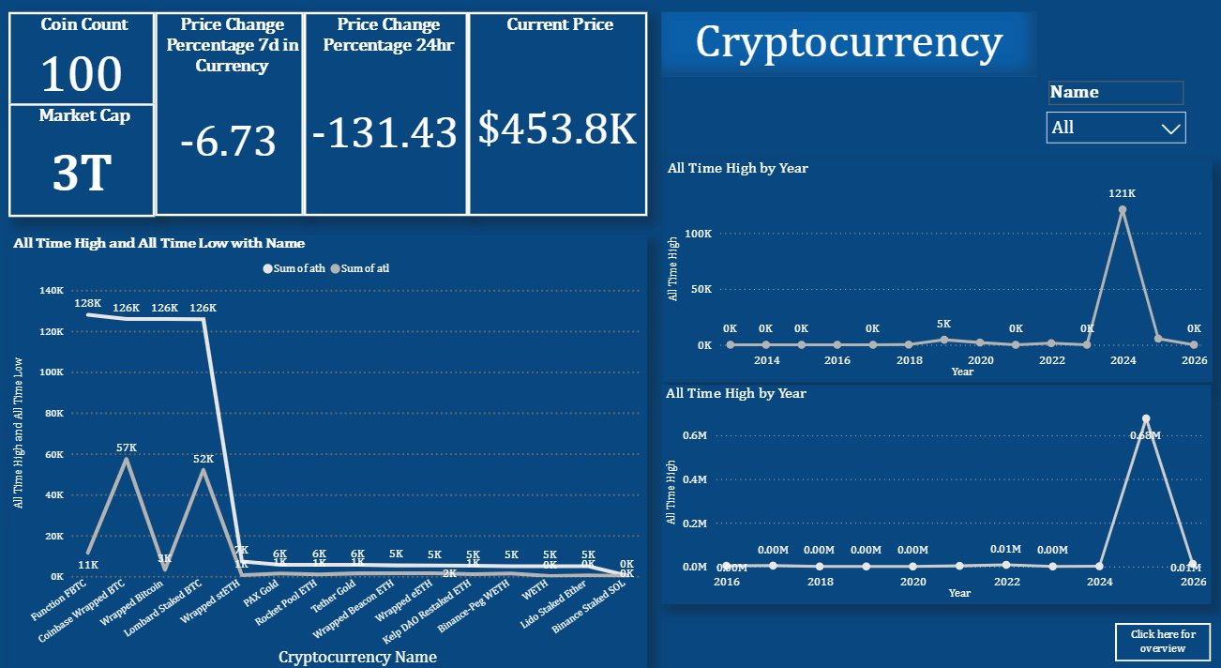
POWER BI DASHBOARD — MAIN DASHBOARD OVERVIEW
Dashboard Layout
Top Row:
KPI cards: Coin Count (100), Market Cap (3T), 7d Change (-6.73), 24hr Change (-131.43), Current Price ($453.8K)
Top Right:
Title banner + Name dropdown filter for dynamic coin selection across all visuals
Bottom Left:
Bar/line chart: ATH & ATL comparison across top 12 cryptocurrency names
Bottom Right:
Two line charts showing ATH trends by year (two separate time windows)
Navigation:
Click Here for Overview button links to the ranked overview table page
The dashboard uses a dark navy theme consistent with financial intelligence platforms. All visuals are cross-filtered — clicking any element updates the entire report dynamically.

Slide 23
DASHBOARD EXPLANATION — KPIs, METRICS & CARD ANALYSIS
🪙
100
COIN COUNT
Total distinct cryptocurrencies tracked in this dataset. Provides market breadth coverage.
💰
$3T
MARKET CAP
Sum of all 100 coins' market capitalisations. Reflects total crypto market size.
📅
-6.73
7D CHANGE %
Average 7-day price change across all coins. Negative = broad weekly market selloff.
⏱
-131.43
24HR CHANGE
Aggregate 24-hour price movement. Large negative signals short-term market pressure.
💲
$453.8K
CURRENT PRICE
Highest current price recorded — likely a Bitcoin variant at its peak valuation.

Slide 24
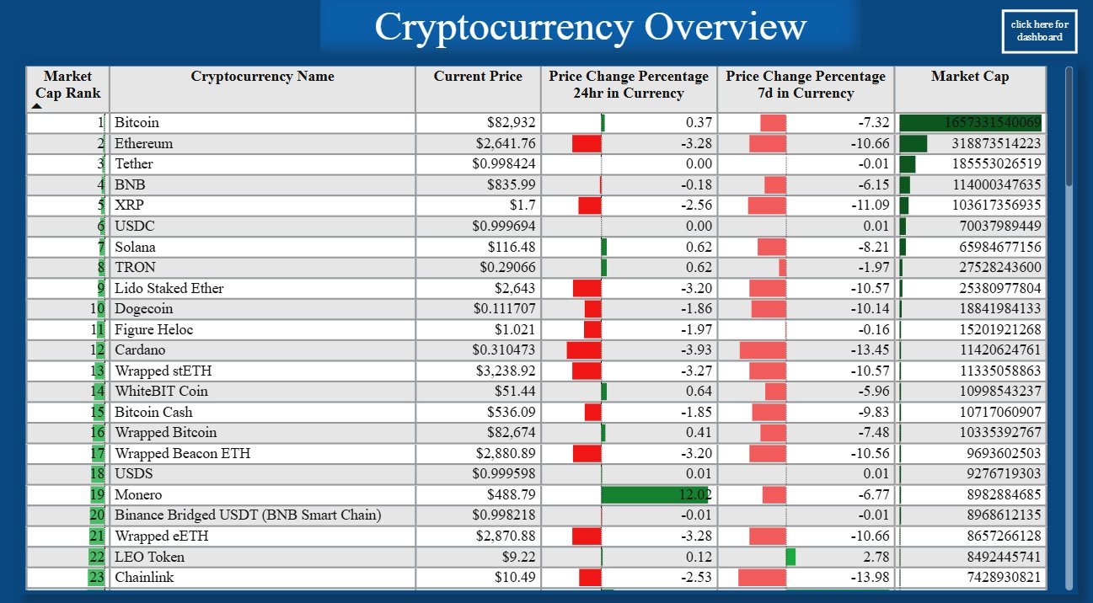
DASHBOARD EXPLANATION — OVERVIEW TABLE & INTERACTIVE FILTERS
📊 Overview Table
🔍 Name Filter
🔗 Navigation
Ranked list of top 23 coins with Market Cap Rank, Current Price, 24hr/7d change with colour bars, and Market Cap values. Green = positive, Red = negative.
Dropdown slicer allows users to filter to any single cryptocurrency or view 'All'. The entire dashboard (both pages) updates dynamically when a coin is selected.
Buttons on each page link to the other — 'Click here for overview' ↔ 'Click here for dashboard'. Enables seamless two-page navigation without back buttons.

Slide 25
KEY INSIGHTS — TOP FINDINGS FROM THE ANALYSIS
Bitcoin Dominance is Overwhelming
Broad Market Correction Underway
01
Bitcoin holds 55.3% ($1.66T) of the total $3T market. No other single asset comes close — Ethereum second at 10.6%. Any BTC move ripples across all altcoins.
02
89% of coins show negative 7-day returns, averaging -6.73%. Chainlink (-13.98%) and Cardano (-13.45%) are worst performers, signalling broad risk-off sentiment.
2024 Was the Peak Bull Market Year
DeFi Assets Show Extreme ATH Ranges
03
ATH chart peaks at 121K in 2024. This aligns with Bitcoin halving cycle. Historical data confirms 2017, 2021, and 2024 as distinct bull market peaks every ~3-4 years.
04
Wrapped Bitcoin ($128K ATH vs $11K ATL) and Lombard stBTC ($126K ATH) demonstrate the explosive gain potential — and risk — of DeFi-native assets.
Stablecoins Provide Market Foundation
Monero Privacy Premium is Event-Driven
05
USDT, USDC, USDS (ranks 3, 6, 18) all hold near $1.00 with 0.00% 24hr change. Their combined $432B market cap provides liquidity ballast for the ecosystem.
06
Monero's unique +12.02% 24hr gain (vs -1.2% market avg) signals demand spikes unrelated to broad market — likely regulation or privacy-event driven speculation.

Slide 26
RECOMMENDATIONS — ACTIONABLE BUSINESS INSIGHTS
💼 Portfolio Rebalancing
HIGH
📊 Real-Time ATH Monitoring
HIGH
Reduce exposure to high-beta altcoins (Cardano, Chainlink) during 7d correction phase. Rotate into stablecoins (USDT, USDC) or Bitcoin until market stabilises above 7d moving average.
Implement automated Power BI alerts when any coin approaches within 5% of its ATH. This signals potential breakout opportunities and enables timely position entries.
🔄 DeFi Asset Diversification
MED
📈 Cycle-Based Strategy
MED
Wrapped and staked assets (Wrapped BTC, stETH) offer BTC/ETH-equivalent exposure with DeFi yield. Consider allocating 10-15% of portfolio to these instruments.
ATH data confirms 3-4 year bull cycles (2017→2021→2024). Position accumulation in the 12-18 months following peak ATH to maximise risk-adjusted returns in the next cycle.
🎯 Privacy Coin Event Tracking
MED
🔍 Expand Dataset Coverage
LOW
Monero's +12% spike demonstrates event-driven opportunity. Implement sentiment monitoring for privacy coin regulatory news and exchange listing announcements.
Extend analysis to 500 or 1000 coins to capture small-cap opportunities. Integrate Fear & Greed Index and on-chain metrics (transaction volume, active addresses) as additional signals.

Slide 27
CONCLUSION & FINAL THOUGHTS
What We Did
What We Found
What It Means
Analysed 100 cryptocurrency records from CoinGecko API
Bitcoin's 55% dominance shapes the entire market ecosystem
Crypto markets are cyclical — data supports disciplined entry strategies
Built a 2-page interactive Power BI dashboard
2024 confirmed as the peak bull cycle year with $121K ATH
DeFi instruments (Wrapped, Staked) offer diversified exposure
Identified market patterns across ATH/ATL, price change, and market cap
89% of coins show negative 7-day returns — bear phase active
Real-time dashboards are essential for volatile asset management
Delivered 7 chart types with actionable business insights
Stablecoins and Bitcoin variants provide the safest exposure
Event-driven spikes (Monero) require automated monitoring systems

Slide 28
FUTURE SCOPE — IMPROVEMENTS & FURTHER ANALYSIS OPPORTUNITIES
01
02
03
Expand to 500+ Coins
On-Chain Metrics Integration
Sentiment Analysis
Include small and micro-cap tokens to capture the full spectrum of market behaviour and identify early-stage investment opportunities in emerging projects.
Integrate transaction volume, active wallet addresses, and hash rate data from blockchain explorers to supplement price-based analysis with fundamental signals.
Incorporate Twitter/Reddit sentiment scores and Fear & Greed Index as leading indicators. Correlate social sentiment with price change patterns.
04
05
06
Predictive Modelling
Portfolio Simulator
Regulatory Impact Tracking
Apply ML models (LSTM, Prophet) for price forecasting. Use historical ATH cycle data to predict next bull market timing with confidence intervals.
Build an interactive tool within Power BI allowing users to simulate portfolio allocation across top coins and visualise projected returns under different market scenarios.
Monitor and flag regulatory events by jurisdiction (SEC rulings, MiCA compliance, exchange bans) and correlate with price volatility spikes in affected coins.

