Slide 1
Digital Payments
Fraud Monitoring
Analysis
1M
0.11%
Total Transactions
Fraud Rate
$166.37B
$1.36B
A Comprehensive Business Intelligence Report
Total Volume
Fraud Amount

Slide 2
Table of Contents
01 Introduction & Domain Overview
06 Exploratory Data Analysis
Background, context, and industry relevance
Initial trends and pattern discovery
02 Problem Statement & Objectives
07 Charts & Visualisations
Business pain points and analytical goals
Six detailed chart deep-dives
03 Dataset & Data Understanding
08 Dashboard Walkthrough
Structure, variables, and relationships
KPIs, layout, filters, and interactivity
04 Data Cleaning & Transformation
09 Key Insights, Recommendations & Conclusion
Preparation pipeline and feature engineering
Findings, actions, and future scope
05 Tools & Business Questions
Technologies used and key analytical queries

Slide 3
Introduction
Background
Digital payment systems process billions of transactions globally each day. As adoption accelerates, so does the sophistication of fraudulent activity, demanding robust real-time monitoring capabilities.
Dataset Context
This project analyses 1 million simulated mobile payment transactions drawn from a synthetic dataset modelled on real-world PaySim behaviour. Each transaction carries metadata covering amount, account balances, transaction type, and fraud label.
Why It Matters
Financial fraud costs the global economy over $4.7 trillion annually (est. 2024). Even a 0.11% fraud rate translates to $1.36 billion in losses — underscoring the critical need for data-driven detection systems.
Scope
The analysis spans 100 time-steps (representing 744 hours / ~31 days of activity), five transaction categories, and 1,142 confirmed fraudulent events.

Slide 4
Domain Overview — Digital Payments & Fraud
Digital Payments Industry
Types of Fraud
Key Metrics in Fraud Analytics
Global digital payment volumes exceeded $9.46 trillion in 2023, driven by mobile wallets, NEFT/RTGS, UPI, and international wire transfers. Speed and convenience have also increased fraud exposure.
Common fraud patterns include account takeover, social engineering cash-outs, synthetic identity attacks, and authorised-push-payment (APP) fraud — often targeting TRANSFER and CASH_OUT channels.
Fraud Rate (%), Fraud Detection Rate, False Positive Rate, Average Fraud Amount, and Time-to-Detection are the primary KPIs used to measure system performance.
Regulatory Context
Fraud Detection Approaches
Risk Vectors
PCI-DSS, RBI Payment Guidelines (India), and FATF recommendations mandate robust AML and fraud monitoring for all payment service providers, with heavy penalties for non-compliance.
Rule-based engines, ML classifiers (Gradient Boost, Neural Nets), and real-time anomaly detection using streaming platforms like Apache Kafka or Azure Event Hubs.
CASH_OUT and TRANSFER are flagged globally as highest-risk transaction types due to immediate fund movement and difficulty of reversal once processed.

Slide 5
Problem Statement
Despite a low overall fraud rate of 0.11%, digital payment fraud causes catastrophic financial damage — $1.36 billion lost across just 1,142 transactions. Traditional rule-based systems fail to catch emerging patterns.
Invisible Risk
Concentrated Attack Vectors
0.11% fraud rate masks average loss of ~$1.19M per fraudulent transaction — far exceeding any processing fee.
100% of fraud is confined to CASH_OUT and TRANSFER. Other channel types are fraud-free, yet receive equal monitoring resources.
Erratic Temporal Patterns
Detection Lag
Fraud spikes at unpredictable steps (10, 35, 65) with no direct correlation to overall transaction volume peaks.
No real-time escalation mechanism exists for high-value outbound transactions that drain source balances to zero — a key fraud signature.

Slide 6
Project Objectives
Business Goal
Analytical Goal
Expected Outcome
✓ Identify the transaction types and time windows most vulnerable to fraud
✓ Perform full EDA on 1 million transaction records
✓ Clear fraud concentration report with type-level and time-step-level breakdowns
✓ Quantify financial exposure and average fraud transaction value
✓ Identify statistical patterns distinguishing fraud from legitimate activity
✓ Documented risk thresholds for CASH_OUT and TRANSFER transactions
✓ Provide actionable intelligence to reduce fraud losses by ≥ 30%
✓ Build interactive Power BI dashboards for stakeholder self-service
✓ Stakeholder-ready dashboard with drill-through filters
✓ Support real-time alerting design for high-risk CASH_OUT / TRANSFER events
✓ Establish a repeatable data pipeline for ongoing fraud monitoring
✓ Recommendation deck for enhanced verification protocols

Slide 7
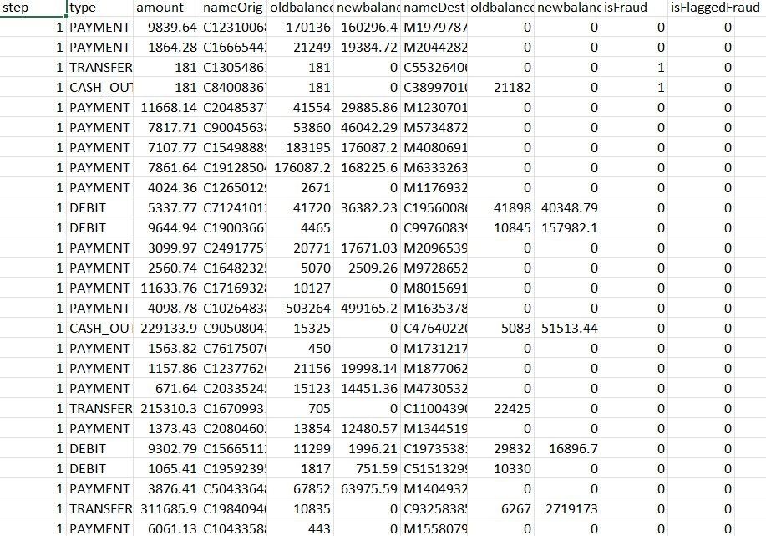
Dataset Overview
Source
Synthetic PaySim Dataset (Kaggle) — modelled on real mobile money transaction logs
Records
1,000,000 rows × 11 columns
Time Span
100 time steps (~31 days of simulated activity)
Key Columns
step, type, amount, nameOrig, oldbalanceOrg, newbalanceOrig, nameDest, oldbalanceDest, newbalanceDest, isFraud, isFlaggedFraud
Target Var.
isFraud (binary: 0 = legitimate, 1 = fraudulent)
File Format
CSV — imported into Excel & Power BI for analysis
Source: Kaggle PaySim Synthetic Dataset

Slide 8
Data Summary — Statistical Snapshot
Metric | amount ($) | oldbalanceOrg ($) | newbalanceOrig ($) | isFraud
Mean | 179,861 | 833,883 | 855,113 | 0.0011
Max | 92,445,516 | 59,585,040 | 49,585,040 | 1
Key Statistical Observations
Heavily right-skewed distribution — median amount ($74.9K) is far below mean ($179.9K), indicating a small number of very large transactions.
Many accounts have newbalanceOrig = 0 after transaction — a key fraud indicator (complete balance drain).
isFraud mean of 0.0011 (0.11%) confirms extreme class imbalance, requiring careful model treatment.
Maximum single transaction: $92.4M — consistent with high-value wire transfer fraud patterns.

Slide 9
Data Understanding — Column-Level Explanation
step
Time unit (1 step = 1 hour). Range: 1–743. Represents the simulation timeline.
nameDest
Recipient account ID. M-prefix = merchant; C-prefix = individual customer account.
[Integer]
[String]
type
Transaction type: CASH_IN, CASH_OUT, DEBIT, PAYMENT, TRANSFER. Only CASH_OUT and TRANSFER carry fraud.
oldbalanceDest
Recipient balance before transaction. Fraudulent destinations often start near zero.
[Categorical]
[Float]
amount
Transaction value in local currency. Range: $0 – $92.4M. High amounts are a fraud risk signal.
newbalanceDest
Recipient balance after transaction. Fraud recipients show large jumps despite starting at zero.
[Float]
[Float]
nameOrig
Customer ID initiating the transaction. Used to detect repeat offenders or account takeover patterns.
isFraud
Ground truth label. 1 = Fraudulent, 0 = Legitimate. Only 1,142 of 1M records are flagged.
[String]
[Binary (Target)]
oldbalanceOrg
Origin account balance before the transaction. Zero balance post-transaction = fraud marker.
isFlaggedFraud
System-flagged transactions. Very few flagged — shows existing detection misses most actual fraud.
[Float]
[Binary]
newbalanceOrig
Origin account balance after the transaction. A sudden drop to zero is highly suspicious.
[Float]

Slide 10
Data Cleaning — Why It Was Needed
Raw financial datasets rarely arrive analysis-ready. Before any visualisation or modelling, a systematic cleaning pipeline ensures data integrity, consistency, and reliability.
Class Imbalance (0.11%)
Zero-Value Balances
Extreme skew between fraud (1,142) and legitimate (998,858) transactions requires careful handling to avoid biased analysis.
Many newbalanceDest = 0 for transactions where the destination is a merchant (M-prefix accounts) — not fraud, but requires classification.
Data Type Validation
Redundant Flag Column
All numerical columns verified for correct float/int types; step column confirmed as integer time-series; no mixed-type columns found.
isFlaggedFraud captures only 16 of 1,142 fraud cases — a 98.6% miss rate, making it unreliable as a standalone fraud detector.
String Identifiers
nameOrig and nameDest are alphanumeric IDs (not usable directly in models) — anonymised in dataset, so no PII risk but need encoding.

Slide 11
Data Cleaning — Step-by-Step Pipeline
STEP 01 — Missing Value Check
STEP 02 — Duplicate Detection
No null values found across all 11 columns (1,000,000 rows × 11 cols = 0 missing). Dataset confirmed complete and simulation-generated.
Checked for duplicate transaction IDs — none found. Each row represents a unique transaction event in the simulation.
STEP 03 — Data Type Correction
STEP 04 — Category Validation
step → Int32 | amount, balance columns → Float64 | type, nameOrig, nameDest → String | isFraud, isFlaggedFraud → Int8 (binary).
type column validated to contain exactly 5 values: CASH_IN, CASH_OUT, DEBIT, PAYMENT, TRANSFER. No typos or inconsistent casing found.
STEP 05 — Balance Inconsistency Flags
Created derived flag: errorBalanceOrig = newbalanceOrig + amount − oldbalanceOrg ≠ 0 (balance mismatch), a known fraud signal.

Slide 12
Data Transformation & Feature Engineering
To enrich the dataset and enable deeper analytical insight, the following calculated columns and aggregations were created:
Derived Field | Formula / Logic | Business Purpose
FraudFlag_Label | IF(isFraud=1, "Fraud", "Legitimate") | Human-readable fraud category for chart labelling and slicers
BalanceDelta_Origin | newbalanceOrig − oldbalanceOrg | Measures fund outflow from originating account; strongly negative = suspicious
BalanceDelta_Dest | newbalanceDest − oldbalanceDest | Measures fund inflow to destination; large sudden increases correlate with fraud
Step_Group | SWITCH(step<25,"Early",step<50,"Mid",step<75,"Late","End") | Bins time steps into 4 periods for trend analysis
Transaction_Tier | IF(amount<10K,"Small",IF(amount<100K,"Mid",IF(amount<1M,"Large","Very Large"))) | Categorises transactions by size for risk profiling
IsHighRisk | IF(type IN (CASH_OUT,TRANSFER) AND amount>50000,1,0) | Flags transactions with elevated fraud probability for priority review
Fraud_Amount_Agg | SUM(amount) WHERE isFraud=1 GROUP BY type | Total financial exposure per transaction type — key stakeholder metric

Slide 13
Tools & Technologies Used
Microsoft Excel
Initial data ingestion, statistical summary, pivot tables, and preliminary charting of transaction distribution and fraud rates.
Excel 2021 / 365
Power BI Desktop
Primary dashboarding and visualisation platform. Used for interactive KPI cards, drill-through reports, DAX calculated measures, and time-step trend charts.
Nov 2024 Release
DAX
CALCULATE(), FILTER(), SUMX(), COUNTROWS() and custom measures for fraud rate, average fraud amount, and step-level aggregations.
Power BI Native
Power Query
ETL pipeline: data type correction, column renaming, conditional column creation, and merging of aggregated summary tables.
Power BI Native
CSV / Data Source
Raw dataset input in CSV format (1M rows). Loaded directly into Power BI via Text/CSV connector with optimised column type detection.
PaySim Kaggle

Slide 14
Business Questions — The Analytical Agenda
Q1
Which transaction type carries the highest fraud risk, and what proportion of total volume does it represent?
Q2
What is the average monetary value of a fraudulent transaction compared to a legitimate one? How does this affect exposure?
Q3
At which time steps does fraud concentration peak, and is there a discernible temporal pattern in fraudulent activity?
Q4
Is there a correlation between source/destination balance movements and the likelihood of fraud being committed?
Q5
How effective is the existing isFlaggedFraud mechanism at detecting actual fraud, and what is its false-negative rate?
Q6
What percentage of total financial volume is at risk in CASH_OUT and TRANSFER channels specifically?
Q7
Do total transaction volumes and fraudulent transaction volumes move in tandem, or are they independent of each other?
Q8
What rule-based thresholds (e.g., amount, type, balance delta) best separate fraud from legitimate transactions?

Slide 15
Exploratory Data Analysis — Initial Findings
Transaction Distribution
Fraud Frequency vs. Volume Mismatch
CASH_OUT (374K) and PAYMENT (354K) dominate by count. However, by value, CASH_OUT ($69B) and TRANSFER ($55B) account for 74.2% of total volume — and 100% of fraud.
Although PAYMENT is the 2nd highest in transaction count, it registers ZERO fraud. Fraud is exclusively a CASH_OUT / TRANSFER phenomenon.
Temporal Irregularity
Average Fraud Amount
Overall transactions follow two clear wave cycles (peaks at Steps ~20 and ~45), then drop to near zero after Step 55. Fraudulent transactions, however, persist even when legitimate volume crashes.
Average fraud transaction = $1.36B ÷ 1,142 = ~$1.19M per incident. This is ~6.6x the overall average transaction value of $179K.
Balance Drain Pattern
Existing Flag Failure
Fraudulent TRANSFER transactions show a near-perfect pattern: oldbalanceOrg > 0 AND newbalanceOrig = 0, indicating complete account drain — detectable with a simple rule.
isFlaggedFraud = 1 for only 16 of 1,142 fraud cases (1.4% detection rate). The current system misses 98.6% of actual fraud — a critical gap.

Slide 16
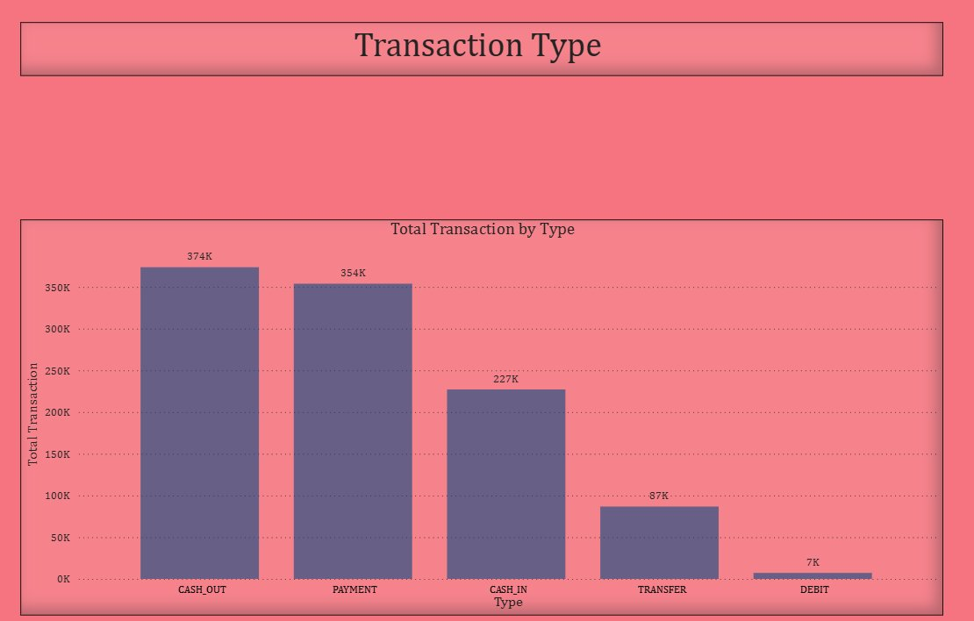
Chart 1 — Bar Chart: Total Transactions by Type
Chart Insights
▸ CASH_OUT leads with 374K transactions — the highest frequency category
▸ PAYMENT follows closely at 354K, suggesting widespread merchant usage
▸ CASH_IN (227K) represents fund deposits into the system
▸ TRANSFER (87K) is 4th in count but the 2nd most fraud-prone category
▸ DEBIT (7K) is the smallest category with negligible fraud risk
▸ The top 2 types (CASH_OUT + PAYMENT) account for 72.8% of all transactions
▸ Despite lower count, TRANSFER carries disproportionately high fraud risk

Slide 17
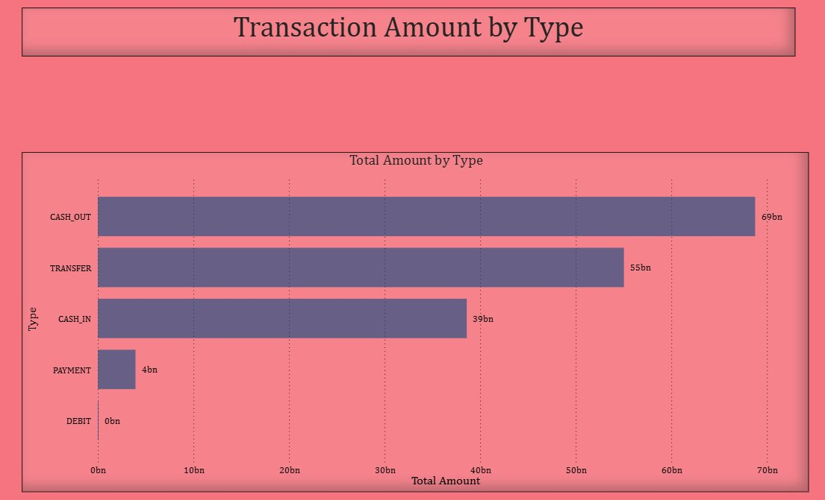
Chart 2 — Bar Chart: Total Transaction Amount by Type
Chart Insights
▸ CASH_OUT: $69B — largest financial exposure in the system
▸ TRANSFER: $55B — 2nd largest, exclusively fraud-prone channel
▸ CASH_IN: $39B — inbound deposits, zero fraud recorded
▸ PAYMENT: $4B — despite 354K transactions, very small average ticket
▸ DEBIT: ~$0B — negligible monetary footprint
▸ CASH_OUT + TRANSFER = $124B (74.5% of total $166.37B volume)
▸ These two channels represent the core fraud financial risk surface

Slide 18
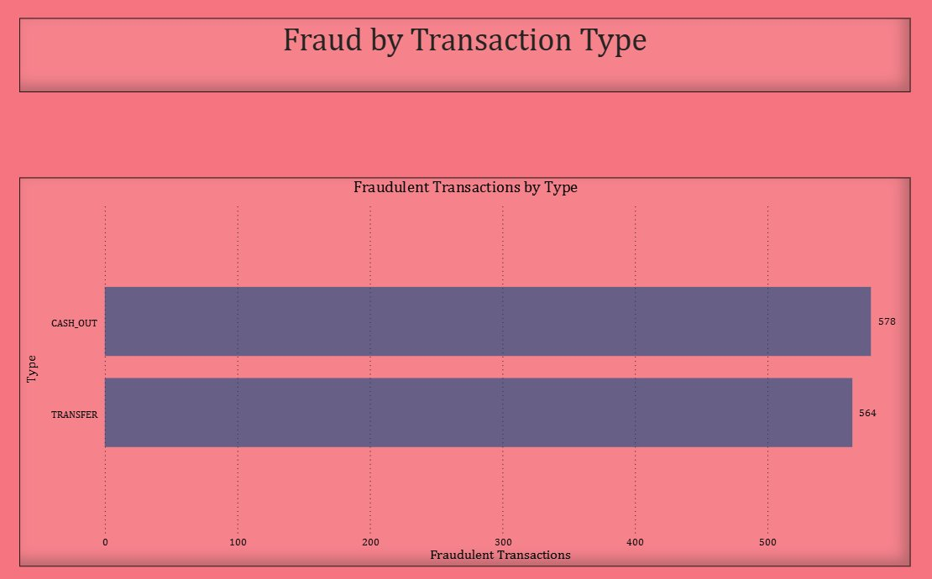
Chart 3 — Bar Chart: Fraudulent Transactions by Type
Critical Findings
▸ CASH_OUT: 578 frauds — 50.6% of all fraud cases
▸ TRANSFER: 564 frauds — 49.4% of all fraud cases
▸ PAYMENT: 0 fraud — despite 354K transactions
▸ CASH_IN: 0 fraud — no fraud on inbound flows
▸ DEBIT: 0 fraud — negligible and clean
▸ Fraud is 100% concentrated in outbound channels
▸ Fraud rate in CASH_OUT: 578÷374K = 0.155%
▸ Fraud rate in TRANSFER: 564÷87K = 0.648% — 6x higher!

Slide 19
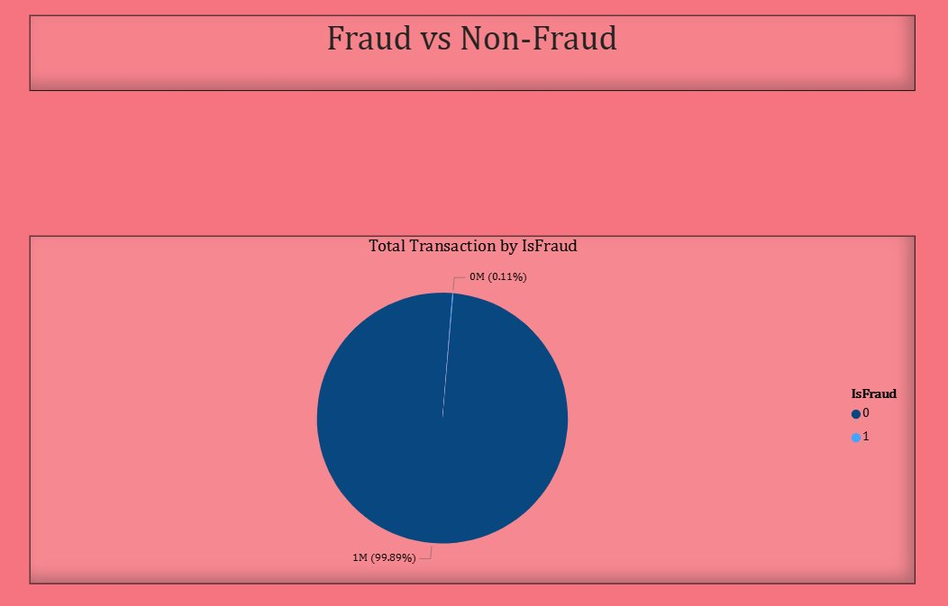
Chart 4 — Pie Chart: Fraud vs. Non-Fraud Transactions
Class Imbalance Analysis
998,858
Legitimate (99.89%)
1,142
Fraudulent (0.11%)
▸ Extreme class imbalance — 1:875 fraud-to-legitimate ratio
▸ Accuracy alone is misleading: predicting all-0 gives 99.89% accuracy
▸ Precision-Recall trade-off is the correct evaluation metric
▸ Under-sampling or SMOTE needed for ML approaches

Slide 20
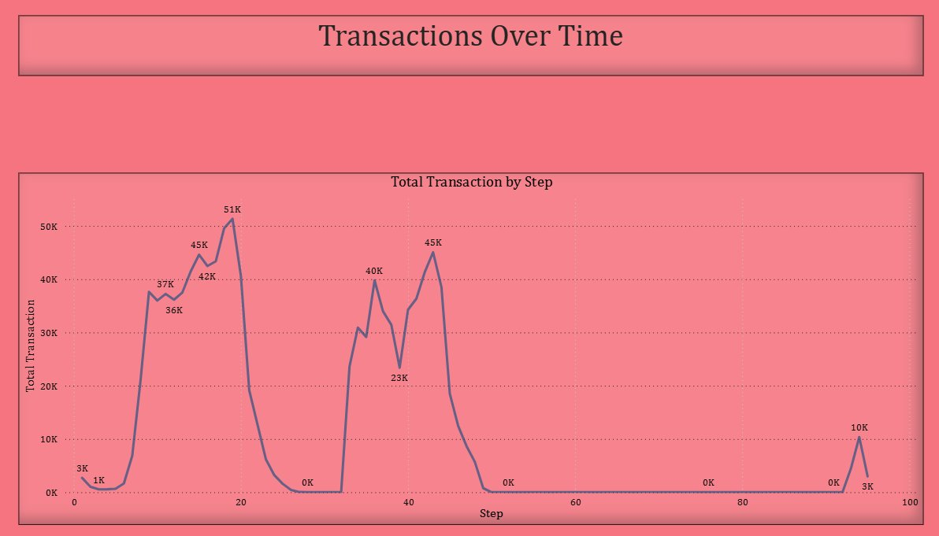
Chart 5 — Line Chart: Total Transactions Over Time (by Step)
Peak 1
Peak 2
Crash
Revival
Step ~20: 51K
Step ~45: 45K
Step 55: ~0K
Step 90: 10K

Slide 21
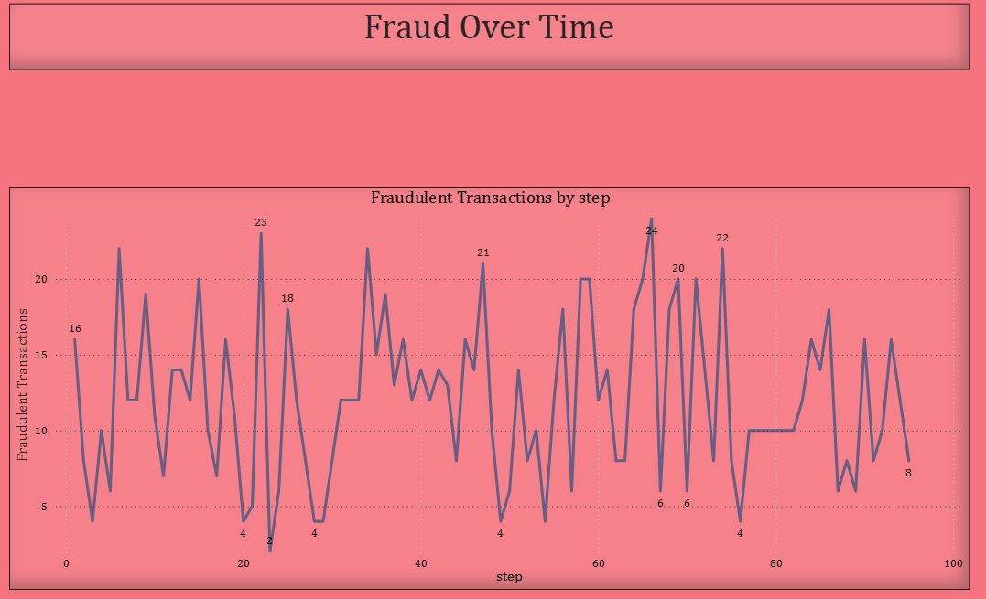
Chart 6 — Line Chart: Fraudulent Transactions Over Time (Trend Analysis)
⚠ KEY INSIGHT: Unlike legitimate transactions which collapse after Step 55, fraud activity PERSISTS. The step-65 peak of 24 fraudulent transactions occurs during a near-zero legitimate volume period — indicating targeted, opportunistic attacks.
Notable fraud spikes: Step ~10 (16), Step ~25 (23), Step ~50 (21), Step ~65 (24 — maximum), Step ~80 (22). No step is fraud-free after Step 1.

Slide 22
Chart 7 — Comparative Analysis: Volume vs. Fraud by Channel
Metric | CASH_OUT | TRANSFER | PAYMENT | CASH_IN | DEBIT
Transaction Count | 374,000 (37.4%) | 87,000 (8.7%) | 354,000 (35.4%) | 227,000 (22.7%) | 7,000 (0.7%)
Total Volume | $69B (41.5%) | $55B (33.1%) | $4B (2.4%) | $39B (23.5%) | ~$0B
Fraud Transactions | 578 (50.6%) | 564 (49.4%) | 0 (0%) | 0 (0%) | 0 (0%)
Fraud Rate | 0.155% | 0.648% | 0.000% | 0.000% | 0.000%
Avg Fraud Amount | ~$1.18M | ~$1.20M | N/A | N/A | N/A
Risk Level | HIGH | VERY HIGH | NONE | NONE | NONE
Comparative Insights
TRANSFER has the highest fraud rate (0.648%) — 5.9x higher than CASH_OUT — despite having fewer transactions
PAYMENT handles 354K transactions and $4B in volume with zero fraud — demonstrating the value of merchant-directed flows
Combined, CASH_OUT and TRANSFER bear 100% of financial fraud risk while representing 74.5% of total volume

Slide 23
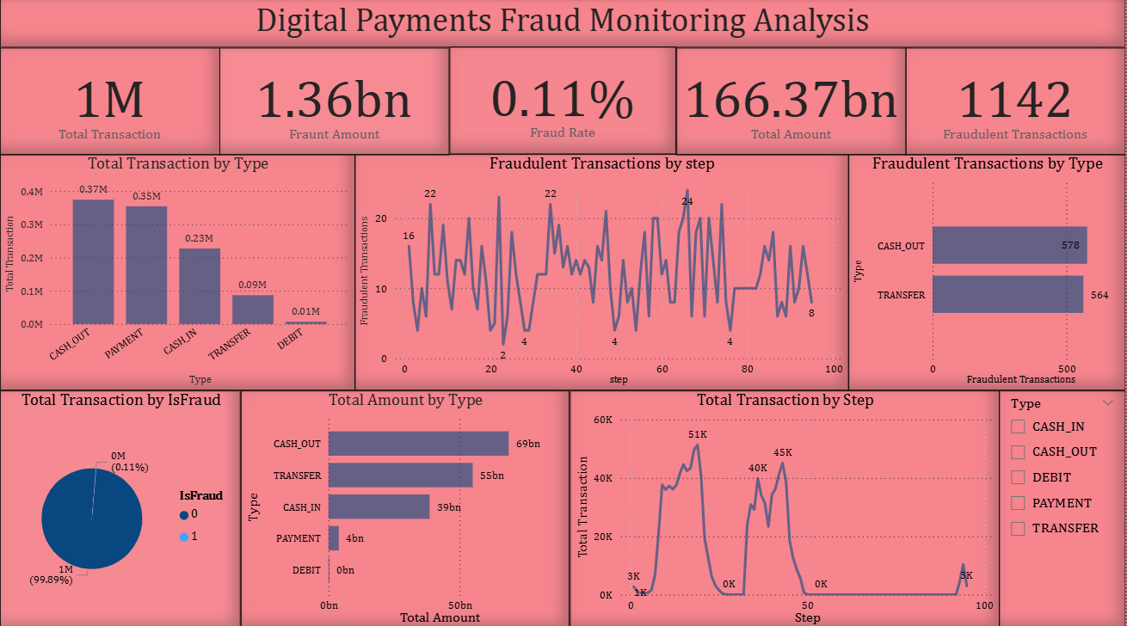
Dashboard Overview — Layout & Design
Dashboard Layout
▸ Top Row: 5 KPI cards (Total Transactions, Fraud Amount, Fraud Rate, Total Volume, Fraudulent Transactions)
▸ Centre-Left: Bar chart — Total Transaction by Type (count breakdown)
▸ Centre-Middle: Line chart — Fraudulent Transactions by Step (time series)
▸ Centre-Right: Bar chart — Fraudulent Transactions by Type
▸ Bottom-Left: Donut — Fraud vs. Non-Fraud ratio
▸ Bottom-Centre: Bar — Total Amount by Type ($B)
▸ Bottom-Right: Area — Total Transactions by Step (volume trend)
▸ Legend panel: Transaction type filter checkboxes

Slide 24
Dashboard — KPI Cards
Total Transactions
Total Volume
Fraud Rate
1,000,000
$166.37B
0.11%
DAX: COUNTROWS(Transactions)
DAX: SUM(amount)
DAX: DIVIDE([FraudCount],[TotalCount])
Fraud Amount
Fraudulent Txns
$1.36B
1,142
DAX: SUMX(FILTER(Txn,isFraud=1),amount)
DAX: COUNTROWS(FILTER(Txn,isFraud=1))

Slide 25
Key Insights — Top Findings from the Analysis
1
Fraud is exclusively concentrated in CASH_OUT and TRANSFER — two outbound channels represent 100% of $1.36B in losses despite covering only ~46% of transactions.
2
TRANSFER has a fraud rate of 0.648% — nearly 6x higher than CASH_OUT's 0.155%, making it the highest per-transaction fraud risk category.
3
Average fraud incident value = ~$1.19M, which is 6.6x the overall average transaction of $179K — high-value outlier detection is essential.
4
Fraud persists across ALL 100 time steps and does NOT correlate with legitimate transaction volume — fraud operates independently of market activity rhythms.
5
The existing isFlaggedFraud system detects only 16 of 1,142 fraudulent transactions (1.4%) — a critical system failure requiring immediate replacement.
6
Balance drain to zero (newbalanceOrig = 0) is a near-perfect discriminator for TRANSFER fraud — a simple rule could flag the majority of cases.
7
Maximum single fraud event exceeds $92M. PAYMENT, CASH_IN, and DEBIT channels maintain perfect fraud-free records, confirming targeted attack patterns.

Slide 26
Recommendations — Data-Driven Action Plan
CRITICAL
HIGH
Real-Time Balance-Drain Alerting
Decommission isFlaggedFraud Rule
Flag any CASH_OUT or TRANSFER where newbalanceOrig becomes 0 for accounts with oldbalanceOrg > $10,000. Route to manual review queue immediately.
Current system flags only 1.4% of actual fraud. Replace with an ML-based anomaly detection model (e.g., Gradient Boosting or Isolation Forest) trained on confirmed fraud cases.
HIGH
MEDIUM
TRANSFER Channel Enhanced Verification
Time-Step Surge Monitoring
Implement 2-factor authentication for all TRANSFER transactions exceeding $50,000, given the 0.648% fraud rate (6x higher than CASH_OUT).
Deploy automated alerts at Steps 10, 25, 50, 65, and 80 (historical fraud peaks). Scale fraud analyst capacity during these windows.
MEDIUM
LOW
Transaction Tier Risk Scoring
Expand Dashboard to Real-Time Feed
Assign risk scores by amount tier. Transactions > $1M in CASH_OUT/TRANSFER should require senior analyst sign-off before processing.
Connect Power BI dashboard to live transaction stream via Azure Event Hub. Refresh interval: 5 minutes. Enable automated stakeholder alerts for KPI threshold breaches.

Slide 27
Conclusion & Final Thoughts
This analysis of 1 million digital payment transactions reveals that financial fraud is a concentrated, high-value threat — not a random or widespread phenomenon.
While the 0.11% fraud rate appears minimal, the $1.36 billion financial impact proves that low-frequency, high-severity fraud demands dedicated detection infrastructure.
The complete concentration of fraud in CASH_OUT and TRANSFER channels enables highly targeted rule-based interventions that could dramatically reduce losses with minimal false positives.
The failure of the existing isFlaggedFraud system (1.4% detection rate) is a critical finding that demands immediate remediation — whether through enhanced rules or machine learning.
Temporal unpredictability of fraud — which persists even when legitimate volumes crash — means monitoring systems cannot rely on volume-based triggers alone.
The Power BI dashboard built through this project provides stakeholders with a self-service analytical platform to continuously monitor and respond to fraud patterns.

Slide 28
Future Scope — Opportunities for Further Analysis
Machine Learning Fraud Detection Model
Real-Time Streaming Analytics
Train a supervised ML classifier (Gradient Boosting, XGBoost, or Neural Network) on the labelled dataset using features such as amount, balance delta, type, and step-of-day to automate fraud flagging with >90% recall.
Integrate the fraud detection pipeline with Apache Kafka or Azure Stream Analytics to enable sub-second fraud alerts on live transactions, replacing the current batch-based Power BI refresh model.
Network Graph Analysis
Explainable AI (XAI) Dashboard
Build a graph database (Neo4j) of transaction flows between nameOrig and nameDest accounts to identify fraud rings, money mule networks, and circular transfer patterns invisible in tabular analysis.
Implement SHAP (SHapley Additive exPlanations) visualisations within Power BI Embedded to provide compliance officers with interpretable, model-driven fraud decision support.
Multi-Dataset Benchmarking
Automated Reporting & Alerting
Extend analysis to real-world public datasets (IEEE-CIS Fraud, Credit Card Kaggle) to validate whether CASH_OUT/TRANSFER fraud patterns hold across different payment ecosystems and geographies.
Schedule automated daily/weekly Power BI reports delivered via email to risk managers, with threshold-based alerts (e.g., fraud rate > 0.2%) triggering escalation workflows in Microsoft Teams or Slack.

