Slide 1
Viraj Shekhda 91900133026
AUTHENTICATION
AUTHORISATION
CONFIDENTIALITY
DATA-INTEGRITY
NON-REPUDATION
Prof. Kapil Shukla
OS (Security & Protection)

Slide 2
Authentication is the process of verifying the identity of user or information. User authentication is the process of verifying the identity of user when that user logs into a computer system Authentication is the process of verifying the identity of user or information. User authentication is the process of verifying the identity of user when that user logs into a computer system
Authorization is a security mechanism to determine access levels or user/client privileges related to system resources including files, services, computer programs, data and application features. ... Key factors contain user type, number and credentials, requiring verification and related actions and roles

Slide 3
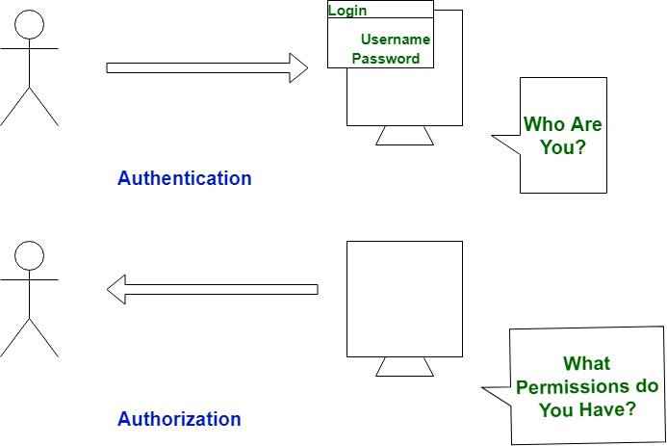

Slide 4
Confidentiality means that data, objects and resources are protected from unauthorized viewing and other access
Data-Integrity means that data is protected from unauthorized changes to ensure that it is reliable and correct
Non-repudiation is the assurance that someone cannot deny the validity of something. Non-repudiation is a legal concept that is widely used in information security and refers to a service

Slide 5
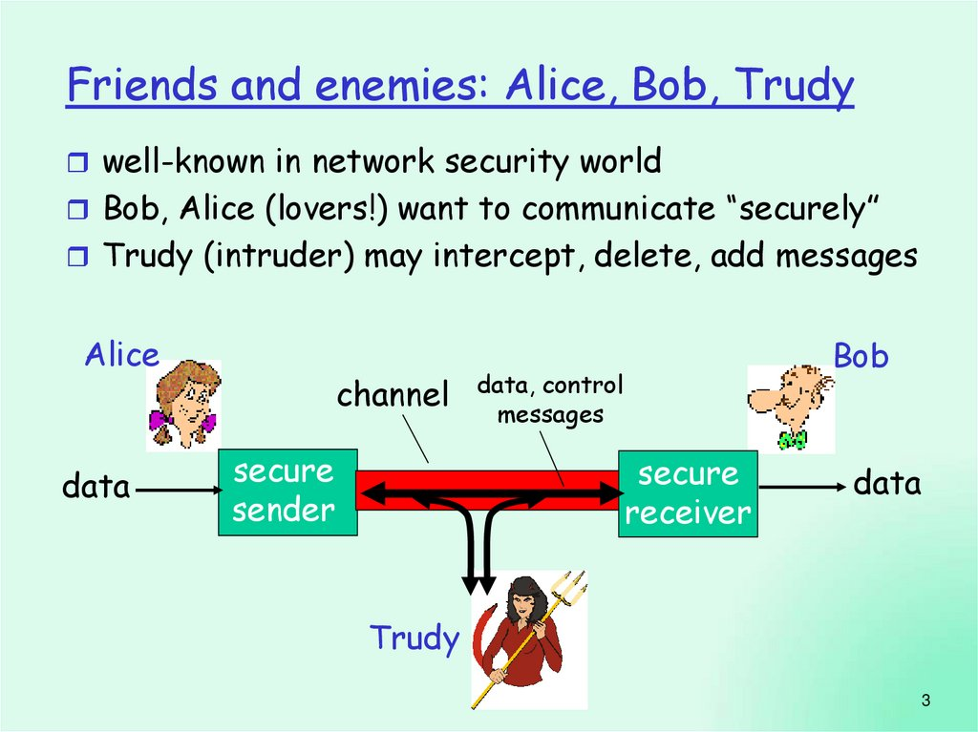

Slide 6
THANK YOU !
BE SECURE STAY PROTECTED

