Slide 1

Impact of SVD Rank on Model Accuracy
Exploring Image Compression and CNN Performance
Agness Lungu

Slide 2
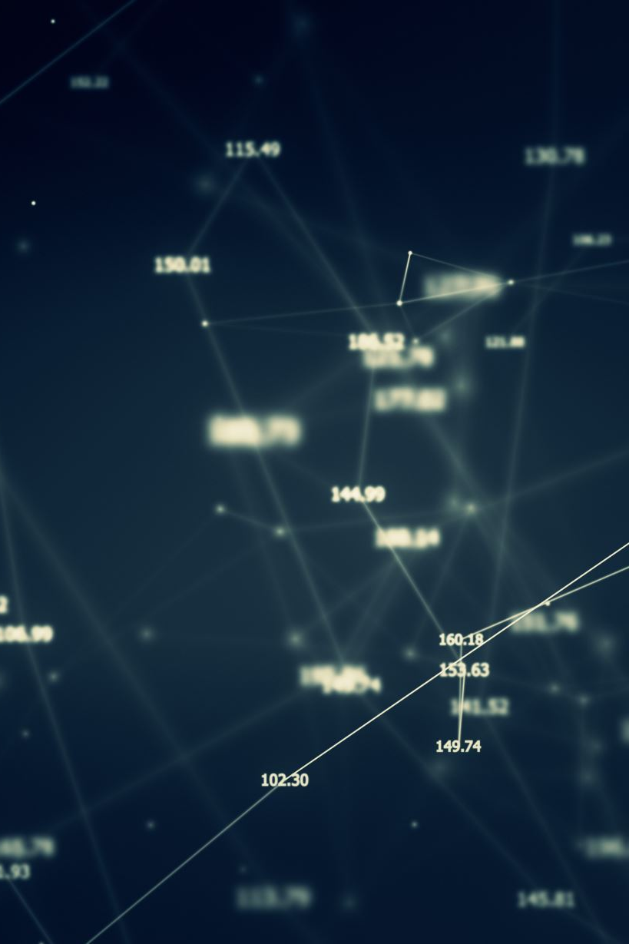
Project Overview
The goal of this project was to explore the impact of the rank parameter (k) in Singular Value Decomposition (SVD) on the accuracy of a Convolutional Neural Network (CNN). By compressing CIFAR-10 images using SVD, we aimed to determine if accurate predictions could be achieved with reduced computations.

Slide 3
Motivation
Modern AI models often work with large datasets like images, which are computationally expensive to store and process.
SVD offers a method to compress data efficiently while preserving critical features, making it suitable for resource-constrained environments.
Simplifying models and optimizing their input data can lead to faster, more resource-efficient systems.

Slide 4

Methodology
Custom CNN:
Designed a model tailored to CIFAR-10 for baseline accuracy on original images.
Dataset and SVD Compression:
CIFAR-10 dataset with 10 classes of 32x32 images.
Applied SVD at varying ranks to generate datasets with different levels of compression.
Training Process:
Train the original custom CNN on uncompressed CIFAR-10 images to establish a baseline.
Train the simplified CNN on SVD-compressed images at multiple ranks.
Measure and compare model performance (accuracy, loss) across ranks.

Slide 5
Key Analysis:
Error vs. Rank Plots: How does the CNN’s performance change with increasing or decreasing SVD rank?
Model Comparison:
Performance differences between the original and simplified CNNs.
Assess how compression impacts models of varying complexity.

Slide 6
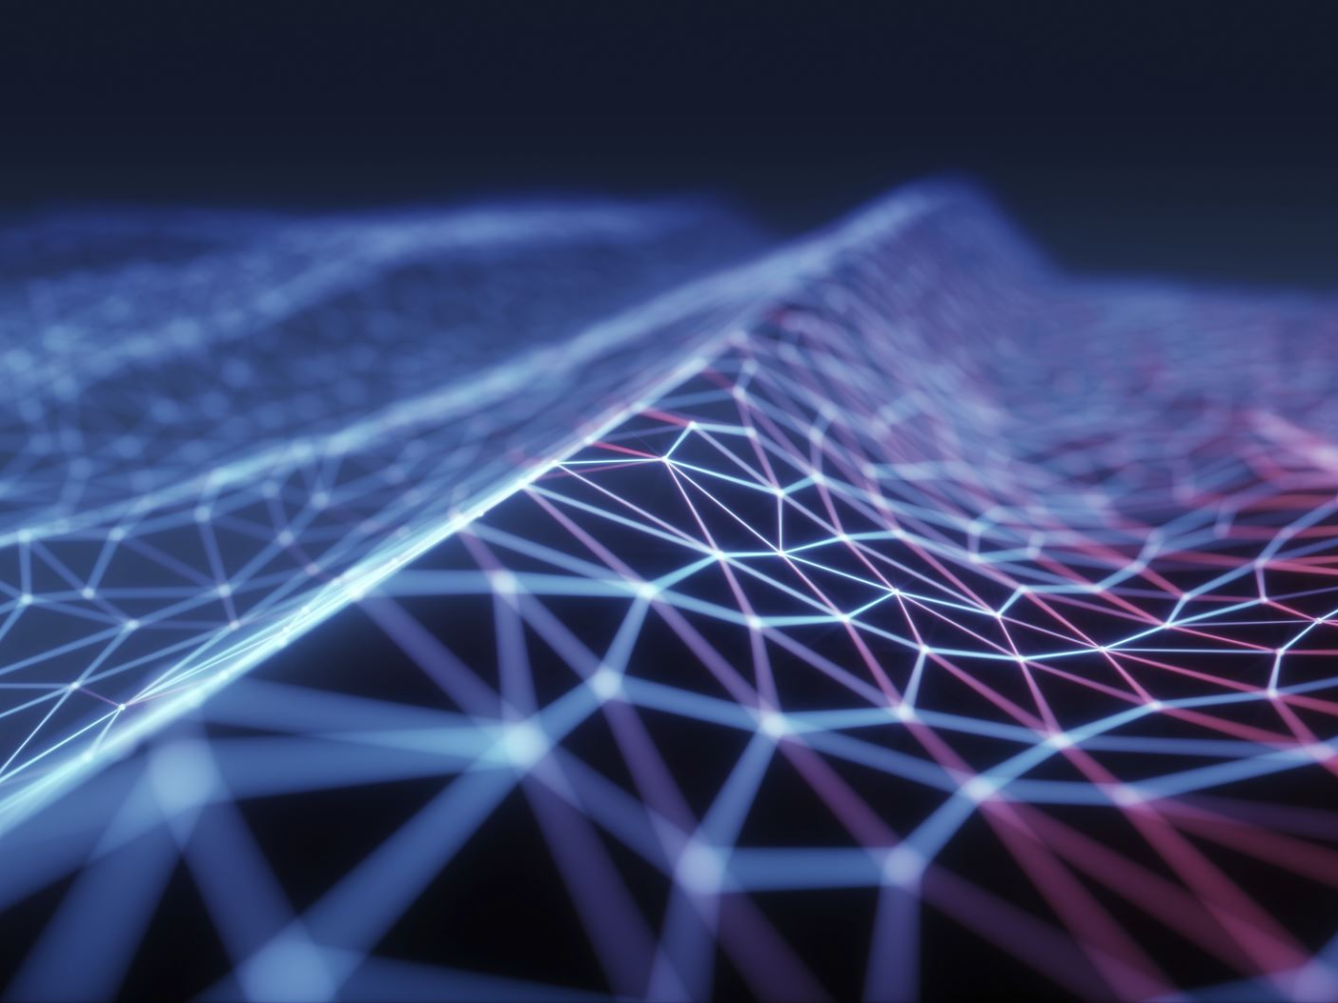
Dataset Details
Dataset: CIFAR-10
- 60,000 32x32 color images
- 10 classes (e.g., airplane, car, bird, etc.)
- 50,000 training images, 10,000 test images
Images were normalized and then compressed using SVD.

Slide 7
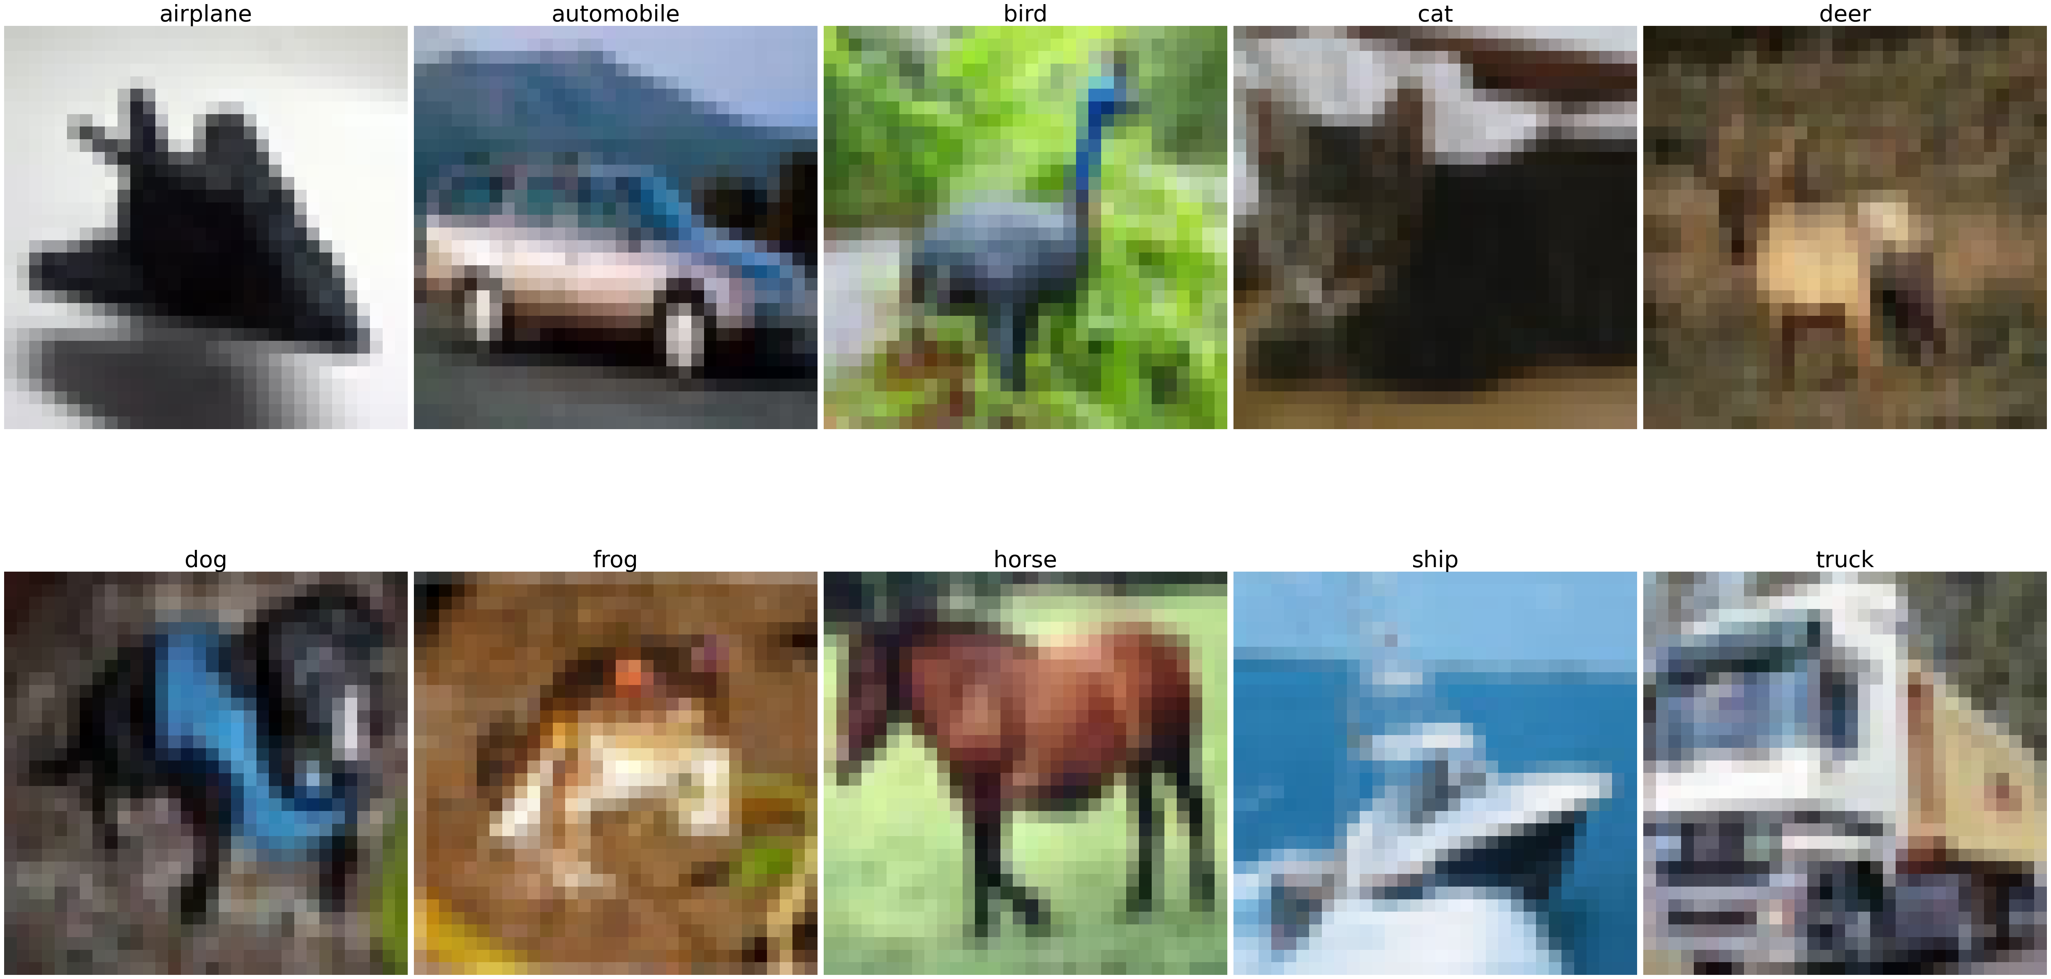
Original CIFAR-10 images
Notes:
"There are two types of blurriness we encounter in this project. First, the inherent blurriness of CIFAR-10 images is due to their small size of 32×3232 \times 3232×32 pixels. When these images are printed or displayed, the resolution is insufficient to capture fine details, leading to a blurry appearance. However, this blurriness does not involve any loss of information—it is simply a limitation of the dataset's resolution."
"In contrast, the blurriness caused by SVD compression is intentional. SVD reduces the rank of the image matrix, keeping only the top kkk singular values. This approximation compresses the image but also discards some information, particularly high-frequency details like sharp edges. The degree of blurriness depends on the value of kkk: higher kkk values retain more detail, while lower kkk values prioritize compression at the cost of image quality."
"Understanding this difference is key because the inherent blurriness of CIFAR-10 does not affect the model's performance, whereas the blurriness caused by SVD compression creates a trade-off between computational efficiency and prediction accuracy."

Slide 8
Why SVD for images?
SVD reduces computation by compressing the input data before training:
1. Reducing Input Data Size:
- Original data processes all pixel values (e.g., 32x32 for CIFAR-10).
- SVD-Compressed data with rank k (e.g., k=18) significantly reduces size.
2. Impact on Model Computation:
- Model architecture remains the same.
- Simplified input reduces effort in convolutional layers.
3. Efficient Memory and Data Transfer:
- Compressed images use less memory.
- Faster data transfer and less overhead in batch handling.
4. Training on Focused Features:
- SVD removes noise, retaining only critical features.
- Leads to faster convergence and reduced computational cost.
5. SVD optimizes preprocessing while allowing the model to achieve similar accuracy.
-Compressing images while preserving critical features.

Slide 9
What is Singular Value Decomposition (SVD)?
SVD is a mathematical technique used in linear algebra to decompose a matrix into three components:
A = UΣVᵀ
- U: Orthogonal matrix (left singular vectors)
- Σ: Diagonal matrix (singular values)
- Vᵀ: Orthogonal matrix (right singular vectors)
It is widely used in data compression, noise reduction, and dimensionality reduction.

Slide 10
How SVD Works
Steps in SVD decomposition:
1. Decompose the input matrix A into U, Σ, and Vᵀ.
2. Select the top-k singular values from Σ to approximate A.
3. Reconstruct the compressed matrix A_k = U_k Σ_k Vᵀ_k.
Key Benefits:
- Reduces data complexity by focusing on significant singular values.
- Retains essential information while discarding noise.

Slide 11
SVD Compression
Singular Value Decomposition (SVD) was applied to compress the images:
- Performed channel-wise on each RGB channel
- Kept top-k singular values to reconstruct images
Compression Levels Tested:
- Rank k = 1-32

Slide 12
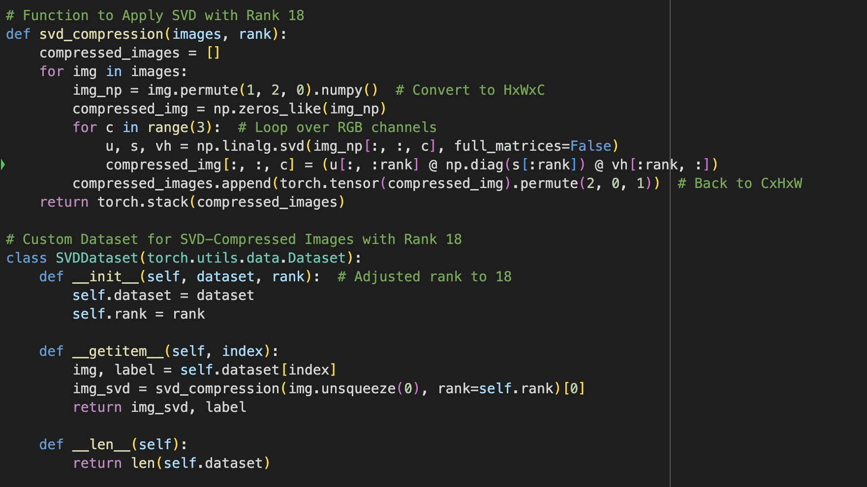
Code Snippets: SVD Compression

Slide 13
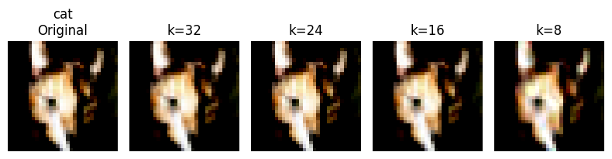
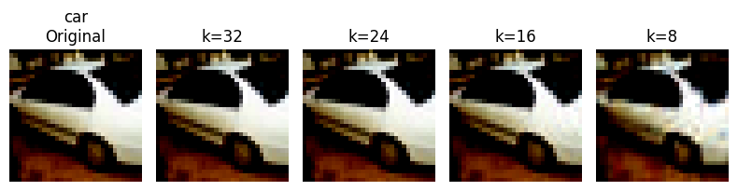
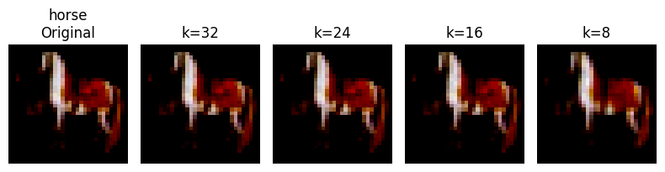

Slide 14
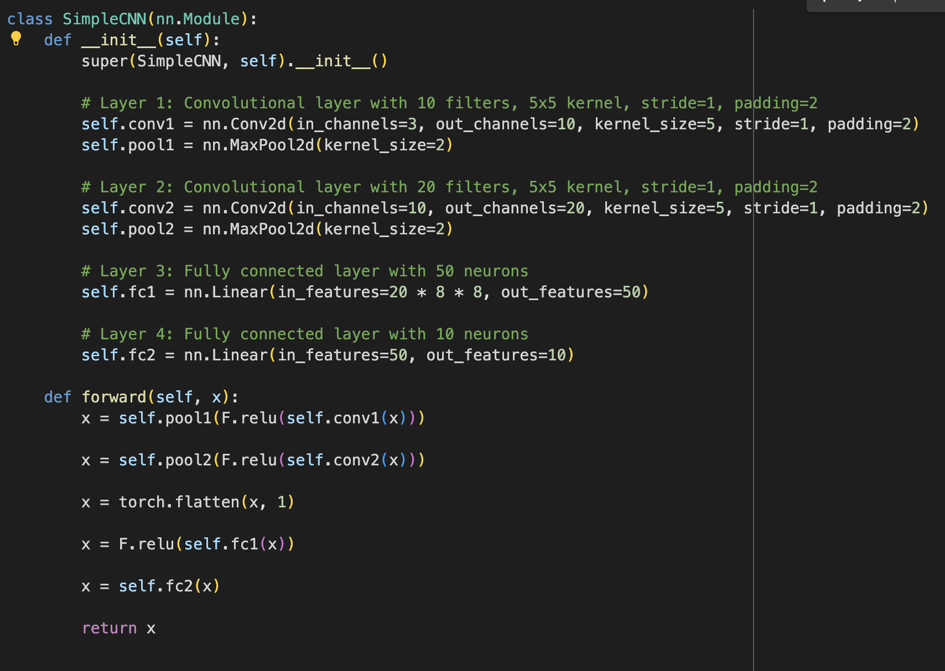
CNN Model Architecture

Slide 15
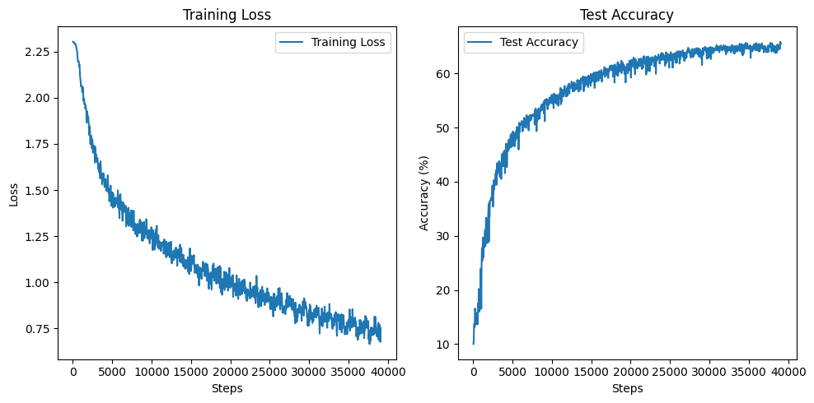
Base accuracy

Slide 16
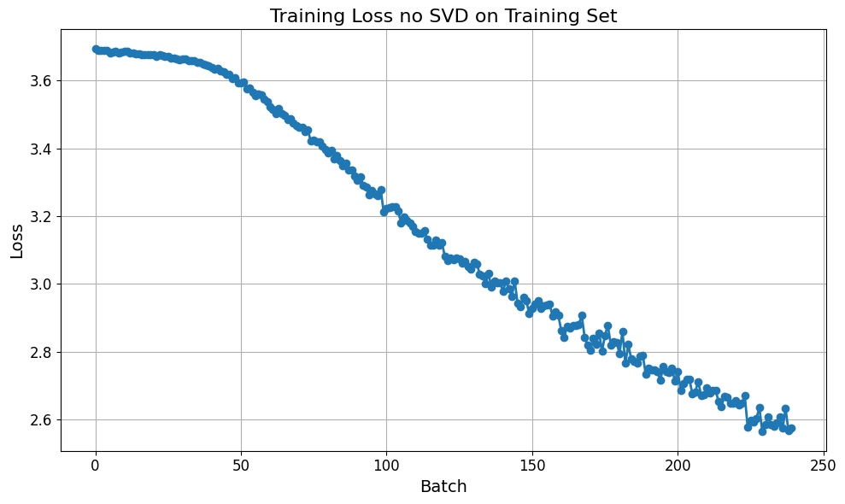

Slide 17
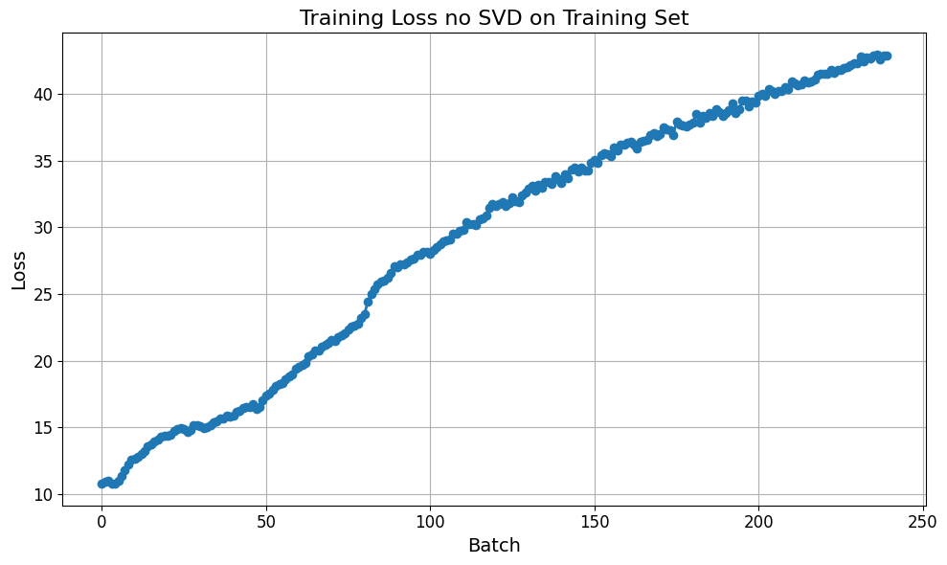

Slide 18
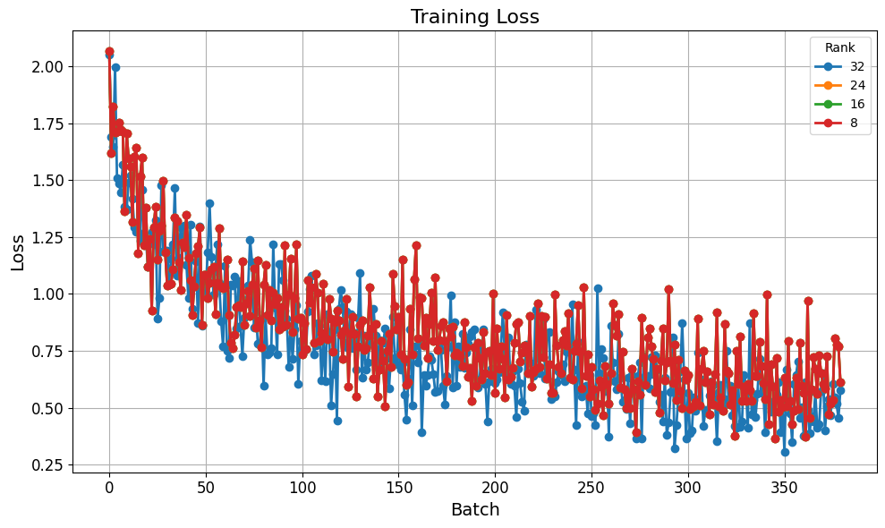
Training Loss for SVD on Train

Slide 19
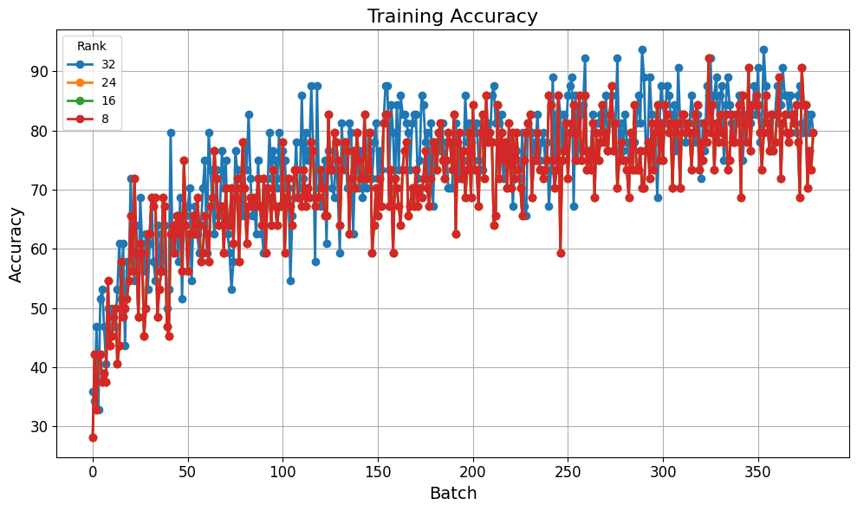
Training Accuracy for SVD on Train

Slide 20
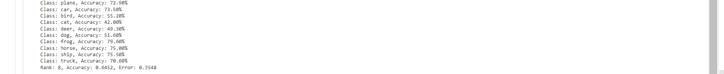
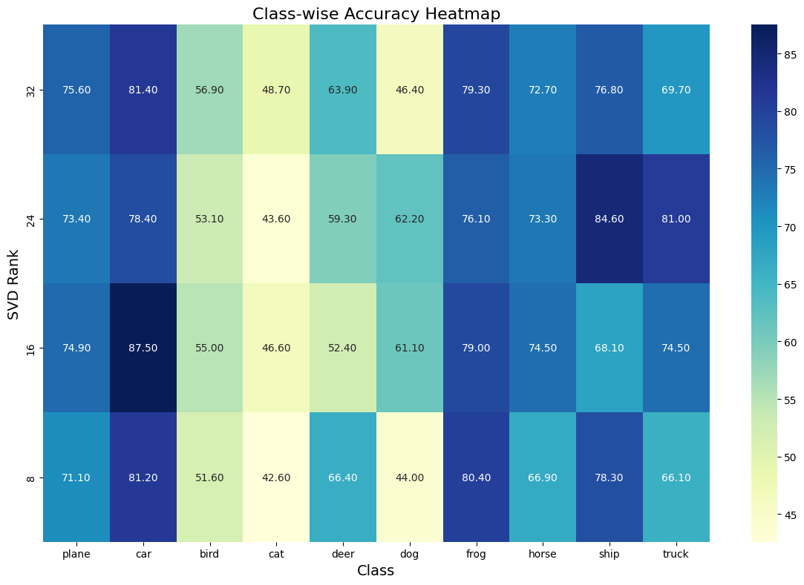
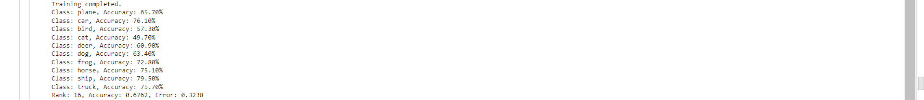
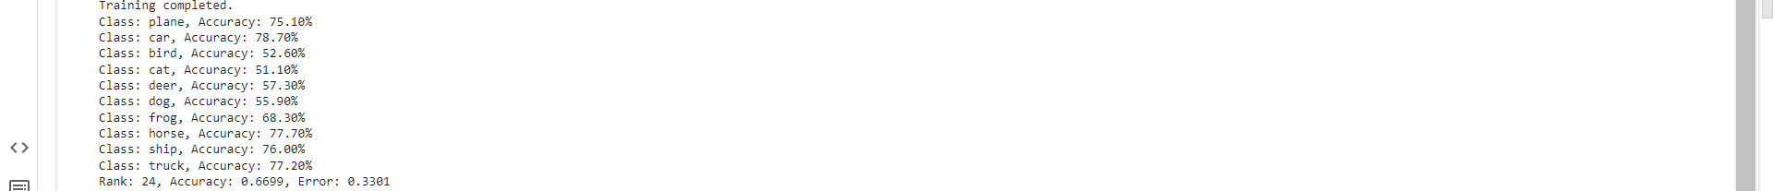
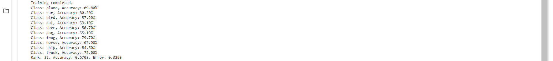
Per Class
Rank 8
Rank 16
Rank 24
Rank 32

Slide 21
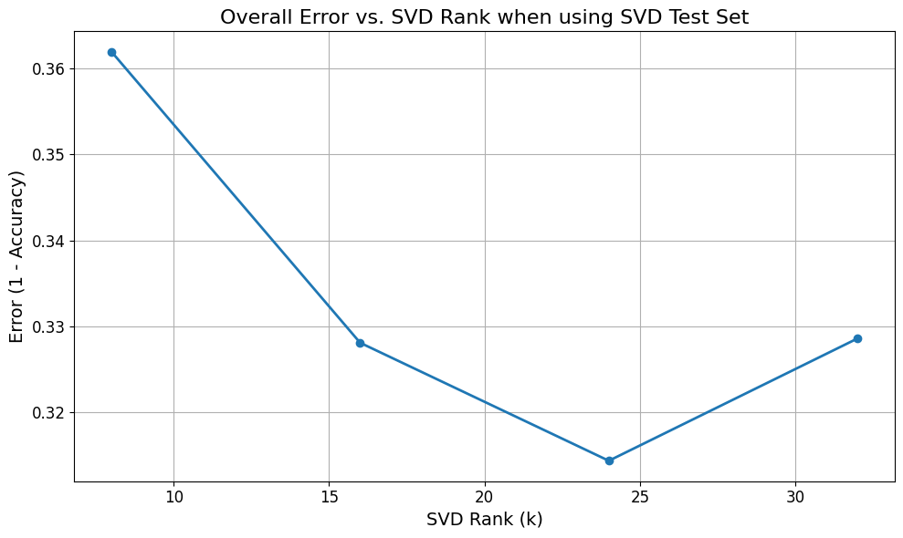
Error vs K

Slide 22
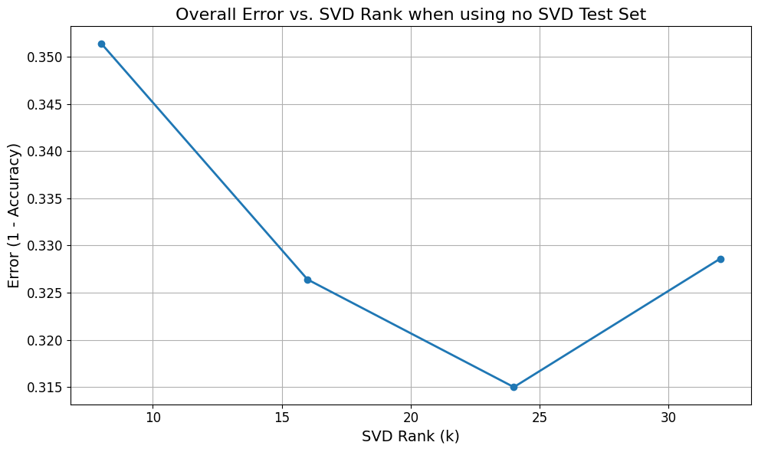
Error vs K

Slide 23
Results and Observations
Observations:
- Higher ranks retained more image details, improving accuracy.
- Lower ranks reduced computations but impacted accuracy slightly.
- Trade-off between compression and model performance.

Slide 24
Future Work
Time per Rank
Testing over different model designs
Accuracy changes per class
Better results with higher resolution dataset

Slide 25
Conclusion
This experiment demonstrated that SVD compression can significantly reduce the computational requirements of training CNNs on image datasets while retaining reasonable accuracy
Key Takeaways:
- Higher rank (k) results in better accuracy but more computations.
- Lower rank reduces computational overhead but affects accuracy.
Future Work:
- Explore dynamic rank selection.
- Test on larger and more complex datasets.

