Slide 1
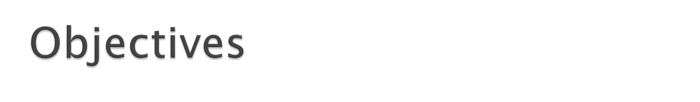
After completing this chapter you will be able to
  Define An Exception.
  Identify what happens when an exception occurs
  Understand the benefits of Exception Handling Framework
  Describe the Exception Hierarchy
  Elaborate on different ways of handling exception
  Throw an Exception
  Create a User Defined Exception

Slide 2


What is an Exception?
  Exception refers to any abnormality or an error
  that occurs during run time
  An exception in Java is a signal that indicates the occurrence of some important or unexpected condition during execution of a program at runtime.
  Exception causes normal program flow to be disrupted.
Examples :
  int num=5/0 – Divide by Zero Error –Arithmetic Exception
  Out of Memory Error.
  Trying to open a file that has been deleted.

Slide 3
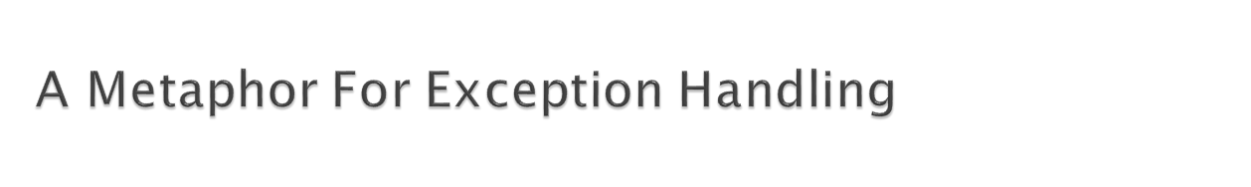
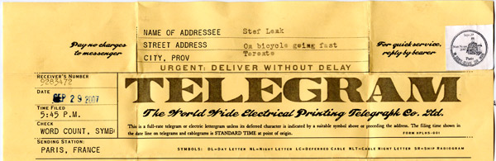
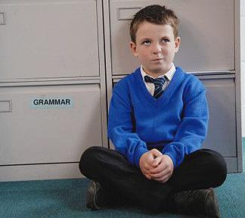


It is Story Time
Exception Object containing info about error, its type and state is created and thrown by the run time system
Telegram which has the necessary details is sent to the guardian by the school management
Boy studying in boarding school falls sick
Exception Occurs while a program is being executed
Run time system checks if the 1st method can handle the exception. If not throw the exception.
Guardian checks if he has the necessary expertise to handle this situation, if not he forwards the telegram to the parents
In Java Handlers are used for handling exceptions.
The exception is thrown to the other methods in the invocation chain till one method handles it.
Parents finally handle the problem

Slide 4
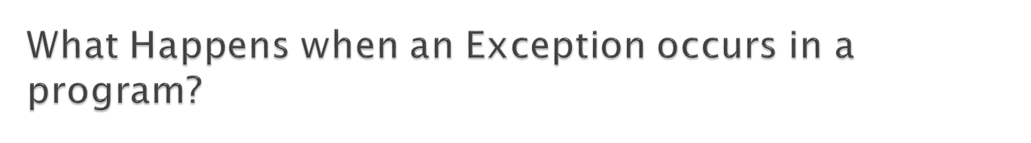
What happens when an Exception occurs?
Step 1:
  When an exception occurs within a method, the method creates an exception object and hands it off to the run-time system (called throwing an exception)
  Exception object contains information about the error, including its type and the state of the program when the error occurred.
Step 2:
  The run time system searches the call stack for a method that contains the method handler
Method where error occurred
Throws Exception
Method Call
Exception not handled
and thrown back
Method without Exception Handler
Method Call
Method with an Exception Handler
Exception handled
Method Call
Control goes back
to main method
Main Method

Slide 5
Step 3:
  When an appropriate handler is found, the run-time system passes the exception to the handler,
    The exception handler catches the exception and handles the exception.
If the run-time system cannot find an appropriate method to handle the exception, then the run-time system terminates and uses the default exception handler.
We will learn about how the handler handles the exception in the subsequent slides.

Slide 6
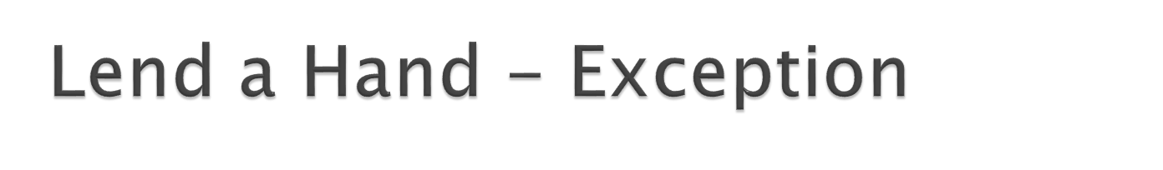
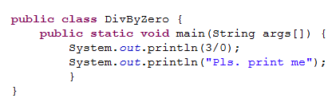
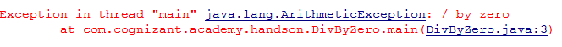
Try to run this program in your SDE
You can notice the following exception thrown by the run time system,

Slide 7

Benefits of Java Exception Handling Framework:
  It separates Error-Handling code from “regular” business logic code.
  It can propagate errors up the call stack till a handler handles the exception.
  It can group and categorize the exception types.

Slide 8
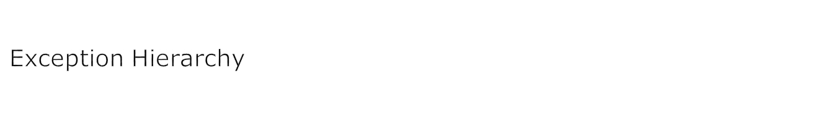
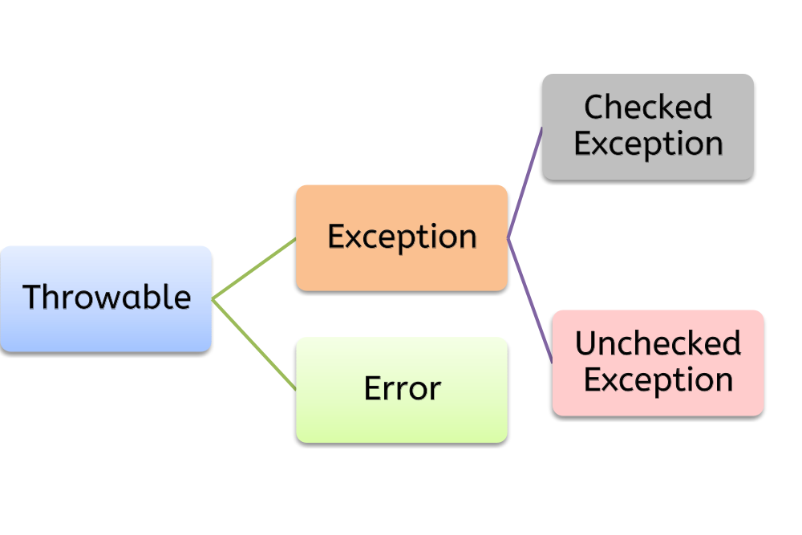
Can be handled
by the programmer
Parent class of Exception and Error
Forces the programmer to handle the exception in the program they develop.
Example: SqlException, IOException
These are run time exception.
Compiler does not force the programmer to handle it in the program.
Example: NullPointerException, ArithmeticException.
Out of programmer’s control.
Example: Out of memory, network down.
Notes:
For the Trainers:

Slide 9

Checked Exception | Unchecked Exception
At compile time, the java compiler automatically checks that a program contains handlers for checked exceptions. | The compiler doesn’t force them to be declared in the throws clause.
Checked exceptions must be explicitly caught or propagated using try-catch-finally blocks | Unchecked exceptions do not have this requirement. They don't have to be caught or declared thrown.
Checked exceptions in Java extend the java.lang.Exception class | Unchecked exceptions extend the java.lang.RuntimeException.
Exception handling is mandated by JVM for these exceptions | It is not advisable to catch these exceptions since it might make the code unstable.
Example: IOException | Example: NullPointerException

Slide 10
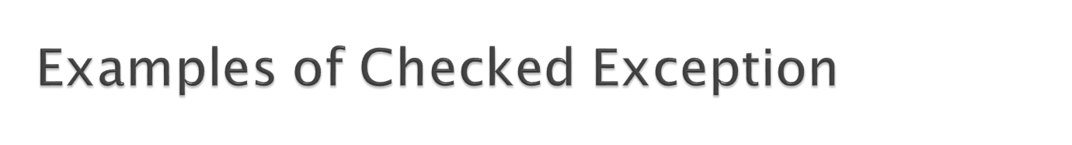
Checked Exception | Description
ClassNotFoundException | This Exception occurs when Java run-time system fail to find the specified class mentioned in the program.
InstantiationException | This Exception occurs when you create an object of an abstract class and interface.
IllegalAccessException | This Exception thrown when one attempts to access a method or member that visibility qualifiers do not allow
NoSuchMethodException | This Exception occurs when the method you call does not exist in class.

Slide 11
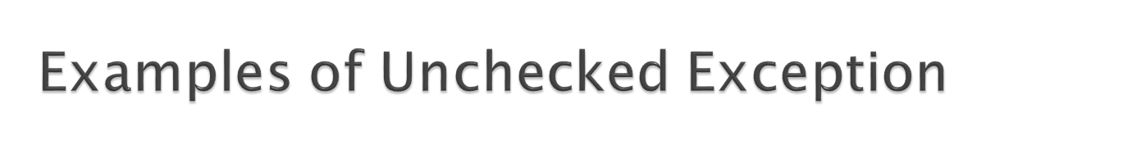

Unchecked Exception | Description
ArithmeticException | These Exception occurs, when you divide a number by zero causes an Arithmetic Exception
ClassCastException | These Exception occurs, when you try to assign a reference variable of a class to an incompatible reference variable of another class.
NullPointerException | These Exception occurs, when you try to invoke a method on a object without instantiating it.
ArrayIndexOutOf Bounds Exception | These Exception occurs, when you assign an array which is not compatible with the data type of that array.
For more information on exception refer to
http://docs.oracle.com/javase/6/docs/api/

Slide 12

How can Exception be handled?
  Exception can be handled using a exception handler.
What is a Exception Handler?
  A set of code which can handle an error conditions in a program systematically by taking necessary action
Exception Handling Techniques:
  Option I: try-catch-finally
  Option II: throws.

Slide 13
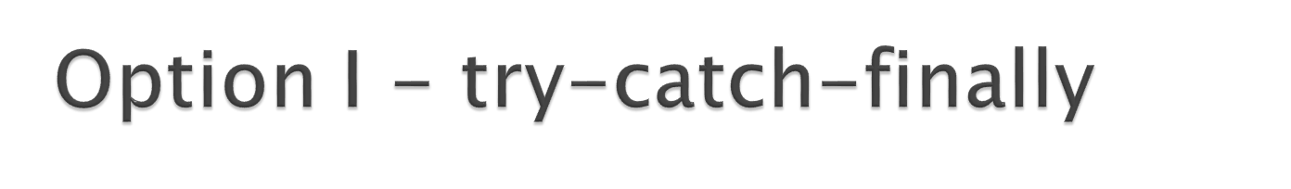
Try-Catch:
  When a program performs an operation that causes an exception, an exception will be thrown. Exception can be handled by using the try and catch blocks.
  How is it done?
The suspected code is embraced in the try block, followed by the catch block in which the code to handle the exception is written.
In the catch block, the programmer can also write the code to recover from the exception and can also print the exception.
A catch block is executed only if it catches the exception coming from within the corresponding try block.

Slide 14
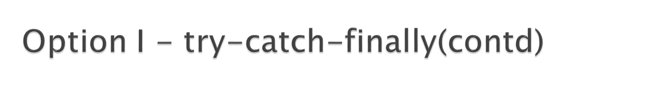
Syntax:
try{
  // The code that is prone to throw exception
}
catch(Exception exception){
  // What to do if this exception is thrown
}
finally{
  //to be done whether exception is thrown or not
  (Will be explained in next slide)
}
public void divide(int a,int b){
  int quotient=0;
  try{
    quotient=a/b;
  }
  catch(ArithmeticException exception){
    System.out.println(“Exception Occurred” +exception.getMessage());
  }
  finally{
    System.out.println(“The quotient is ”+quotient);
  }
}
Here, there is a possibility that an Arithmetic Exception can be thrown when b = 0
This statement (block) is called when Arithmetic exception occurs
This statement will execute irrespective of the exception being thrown or not

Slide 15

Features of Finally block:
  The finally block will execute whether or not an exception is thrown.
  Finally block can be useful for closing file handles and freeing up any other resources that might have been allocated at the beginning of a method.
  The finally block is optional.
  If a finally block is associated with a try, the finally block will be executed upon conclusion of the try
  A try can contain multiple catch block and only one finally block.

Slide 16

public divide(int dividend, int divisor){
try{
result = dividend/ divisor;
// other statements..
}
Catch(ExceptionObject)
{
// Exception handled
}
// other statements..
}
If exception raised.
Exception Caught
Exception handled
Other statements till the end of the method will be triggered.

Slide 17
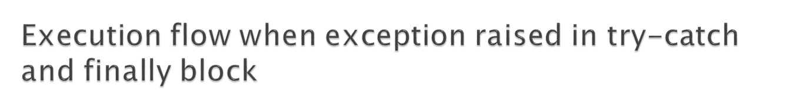
public divide(int dividend, int divisor){
try{
result = dividend/ divisor;
// other statements..
}
Catch(ExceptionObject)
{
// Exception handled
}
finally
{
//some logic
}
// other statements..
}
If exception raised.
Exception Caught
Exception handled
Finally block statements invoked
Other statements till the end of the method will be trigerred.

Slide 18
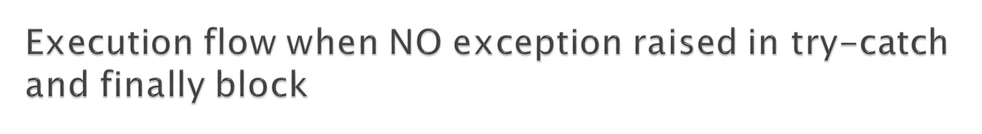
public divide(int dividend, int divisor){
try{
result = dividend/ divisor;
// other statements..
}
Catch(ExceptionObject)
{
// Exception handled
}
finally
{
//some logic
}
// other statements..
}
If NO exception raised in the method
Finally block statements invoked
Other statements till the end of the method will be trigerred.

Slide 19
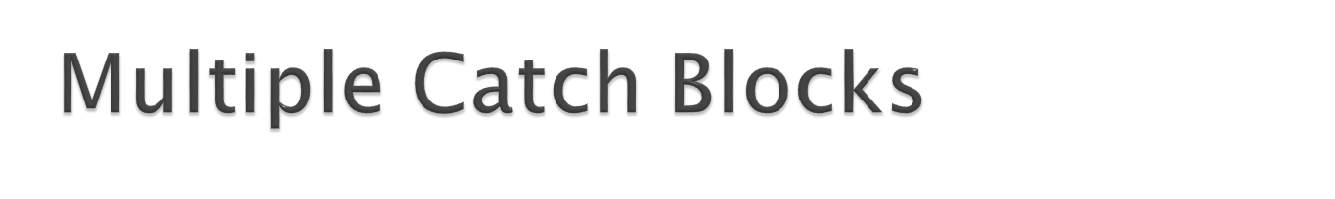
Multiple catch Blocks:
  One block of code can generate different types of exception.
Example:
    try {
      int den = Integer.parseInt(args[0]);
      System.out.println(3/den);
    }
  This can be handled by having multiple catch blocks
This can lead to ArrayIndexOutOfBounds Exception
This can lead to Arithmetic Exception
  Example of Multiple Catch blocks:
    try{
      int den = Integer.parseInt(args[0]);
      System.out.println(3/den);
    }catch(ArrayIndexOutOfBoundsException ab){
      // Exception a handled here
    }catch(Arithmetic Exception ar){
      // Exception b handled here
    }
Based on the exception thrown in the try block, the appropriate catch block will be executed

Slide 20
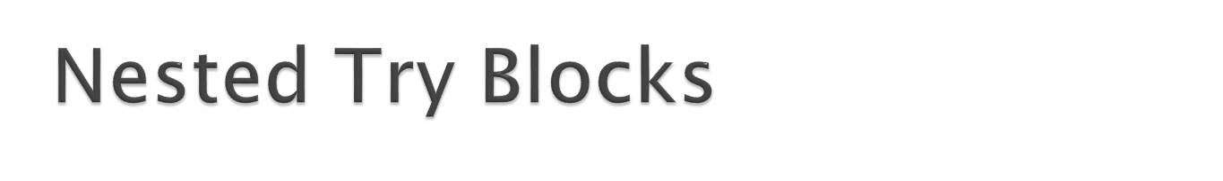
Nested Try Blocks:
  Nested trys can be used when we want to catch exceptions for specific lines of code
  Example of Nested Try block:
    try{
      int den = Integer.parseInt(args[0]);
      try{
        System.out.println(3/den);
      } catch(ArithmeticException ar){
        // Exception a handled here
      }
    }catch(ArrayIndexOutOfBoundsException ab){
      // Exception b handled here
    }
This is the nested TRY. Arithmetic Exception thrown here will be caught inside this block itself
NOTE: If the inner try does not have a matching catch statement for a particular exception, the control is transferred to the outer try statement’s catch handlers where it searches for a matching catch statement

Slide 21
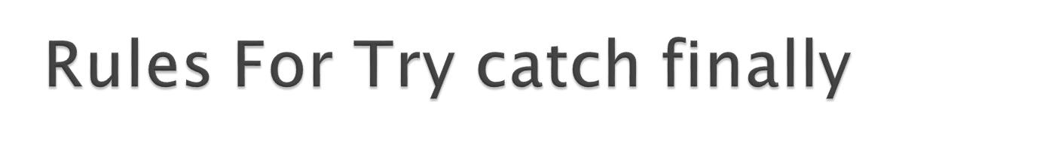

Rules for writing the try-catch-finally:
  The try block must be followed by either a catch block or a finally block, or both.
  The try block by itself is not complete.
  Any catch block must immediately follow a try block.
  The finally block must immediately follow the last catch block, or the try block if there is no catch block.

Slide 22
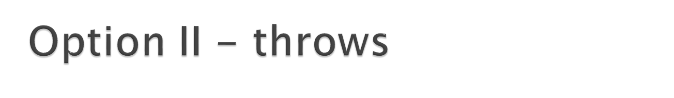

Alternate way of handling exceptions:
Hope you remember how the guardian delegated
the responsibility back to the parents.
In exception handling, this delegation is done by throwing the exception.
Throws keyword is used to throw exception object from a method to the calling method.
The exception thrown by the method needs to be handled by the calling method.

Slide 23
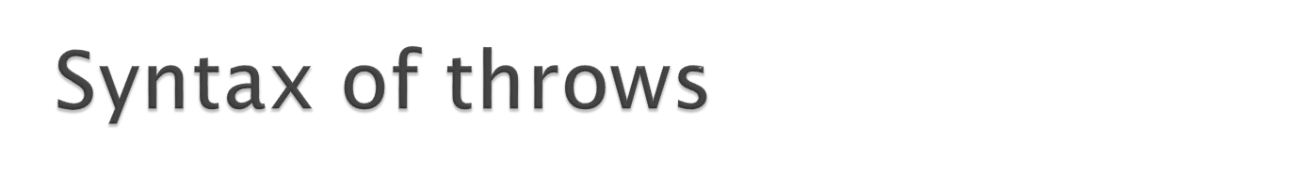
Syntax:
<access specifier><return type><method name>() throws Exception-list {
//some code here which can throw
//any type of exception specified in Exception-list
}
Exception-list is a comma-separated list of the exceptions that a method can throw.
The method invoking this method should handle the exceptions in the exception list using try catch block.

Slide 24

Lets develop the program to demonstrate throws, try/catch.
Step 1: Create a class, Demo with a method, division with two int parameters
Dividend
Divisor
This method should divide the dividend by divisor and return the result.
This method should also throw an ArithmeticException to the calling method.
Step 2: Create a class, ThrowsDemo with a main method
The main method should invoke the division method in Demo class.
The main method should also catch the ArithmeticException thrown by the division method and print the Exception “Arithmetic Exception is Thrown”
The try/catch block should also have a finally block which prints a message “The result is” <Result>

Slide 25
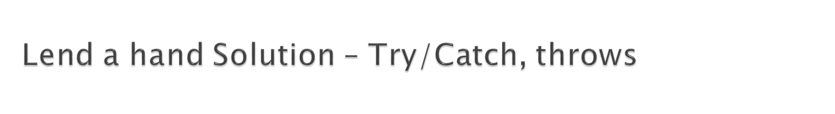
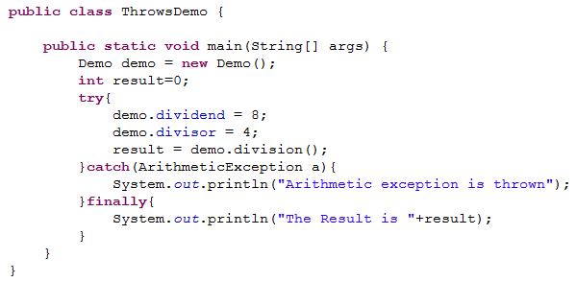
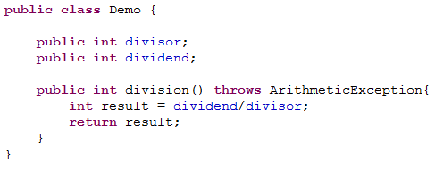
Execute the divide method for two inputs
Dividend | Divisor | What did you notice?
8 | 4 | Finally block executed and result printed as 2.
8 | 0 | Arithmetic exception thrown, exception printed , finally block executed and result printed as ‘0’
Replace the value of divisor as 0 and execute the 2nd test case

Slide 26

Java allows you to throw Exceptions and generate Exceptions. An Exception you throw is an Object
  Syntax:
    throw <Exception Object>
    Throw should be used in conjunction with throws clause. So if a method uses throw keyword it should either,
    Surround the throw statement with try/catch block and catch the exception thrown (or)
    Declare the throws clause in the methods signature for the exception thrown.
How to create a Exception Object?
  throw new ArithmeticException(“Id not found”);

Slide 27

When is throw used?
  Used for throwing Throwable objects under undesired circumstances in a program and is used for throwing exception explicitly.
  Example:
  User manually checks if the file is present, if the file is not present, user can throw a FileNotFoundException.
  Used to re-throw the caught exception object in catch block.
  Example:
    User catches a FileNotFoundException and
    Performs some logic and re-throws it as IOException (or)
    Performs some logic and throw it as FileNotFoundException itself with some additional information.

Slide 28

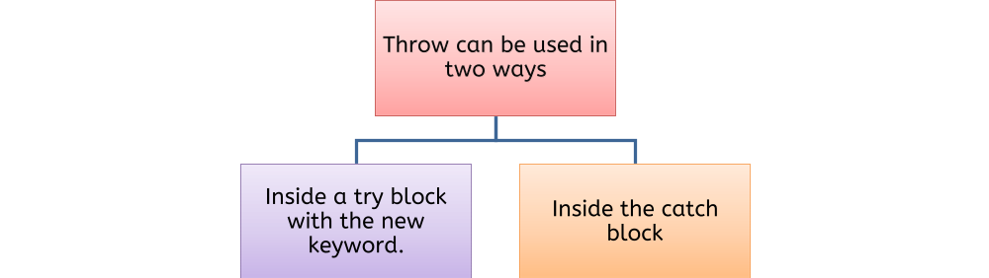
try{
  If(id ==0){
    throw new <Throwable-Object>;
  }
  catch(<Throwable-Object>)
  {
  // The thrown exception is caught here
  }
try{
  //some code here which throws an exception
}
catch(<Throwable-Object ){
  throw < Throwable-Object >;
}

Slide 29

Lets handle exception using throw in the division demo created earlier
Step 1: In the Demo class division method perform the following logic.
If Divisor is zero throw a ArithmeticException with message “Divisor cannot be zero”
This method should throw this ArithmeticException.
Step 2: The exception thrown needs to be handled in ThrowsDemo
The main method should catch the ArithmeticException thrown by the division method and print the Exception and print the message in the exception Object.
The try/catch block should also have a finally block which prints a message “The result is” <Result>

Slide 30
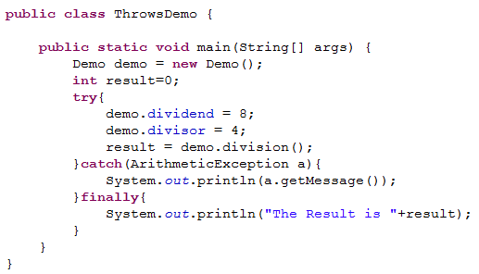
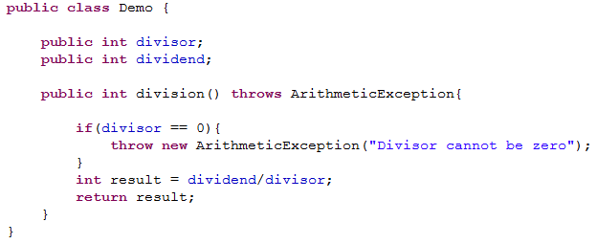
Execute the divide method for two inputs
Dividend | Divisor | What did you notice?
8 | 2 | Finally block executed and result printed as 4.
8 | 0 | Arithmetic exception thrown, exception message “Divisor cannot be zero” printed n console, finally block executed and result printed as ‘0’
Replace the value of divisor as 0 and execute the 2nd test case

Slide 31

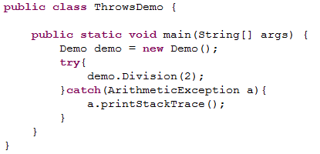


Print Stack Trace is a method used for printing the exception stack, which maintains the invocation sequence of methods.
This method prints the error message of exception object and also the line number where the exception occurred, thus helps in identifying root cause of a problem.
It is not a best practice to use printStackTrace during development, since it consumes a lot of space memory.
This depicts the invocation sequence that the division method is invoked from line # 9 in ThrowsDemo.java and finally exception thrown in line # 6 in Demo.java
Stack Trace:

Slide 32

Server found:
java.rmi.ServerException: RemoteException occurred in server thread; nested exception is:
java.rmi.RemoteException: Exception in f7; nested exception is:
at StatusTest.f1(StatusTest.java:51)
at StatusTest.main(StatusTest.java:30)
java.lang.NullPointerException
at StatusTest.f1(StatusTest.java:61)
at StatusTest.main(StatusTest.java:30)
This is an Exception that has occurred.
Now let us learn how to analyze exceptions

Slide 33
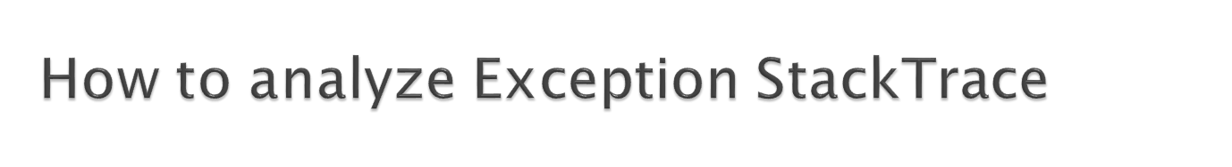
The root cause of the exception will be always at the bottom of the nested exception stack trace.
Server found
java.rmi.ServerException: RemoteException occurred in server thread; nested exception is:
java.rmi.RemoteException: Exception in f7; nested exception is:
java.lang.NullPointerException:
at StatusTest.f1(StatusTest.java:51)
at StatusTest.main(StatusTest.java:30)
java.lang.NullPointerException
at StatusTest.f1(StatusTest.java:61)
at StatusTest.main(StatusTest.java:30)

Slide 34

Here is Tim with another problem !!!
  Tim has three classes where each class calls the method in the next class.
  The third class needs to check if the employee name and employee designation is empty.
  If the fields are empty then appropriate exception needs to be thrown back to the first class.
  Tim is confused on which Exception object to throw back since there is no exception object that depicts empty values!!!
  How does Tim solve this problem?
Using custom Exceptions

Slide 35
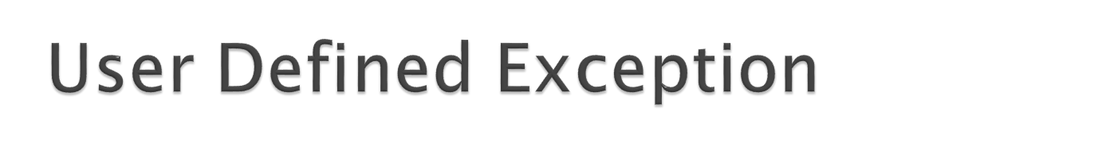
User Defined Exceptions are custom exceptions which are created by programmers to handle the various application specific errors.
Example: In a banking application the developers can create the following exceptions in the specified scenario,
InvalidAccountNumberException - Thrown when the account number entered by the user is wrong.
AccountInactiveException – Exception thrown when User trying to operate an account which has become inactive.
InsufficientFundException - Exception thrown when user trying to transfer amount with insufficient funds.

Slide 36
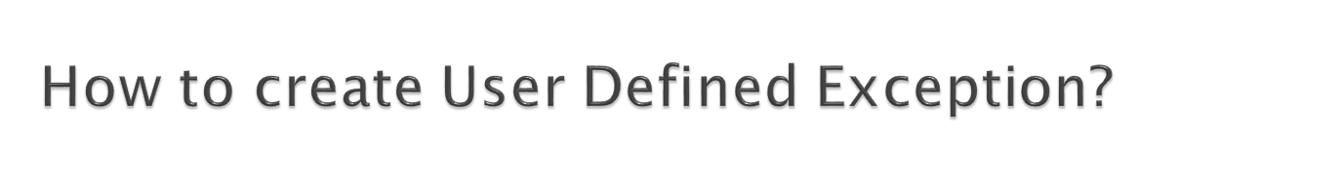
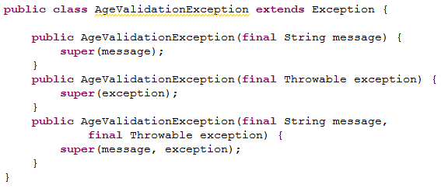
Step 1: Create a Java class which extends the Exception class.
Step 2: Override the necessary constructors.
Scenario: Assume an application has a business logic of validating the age entered by the user, the programmer may create a user defined exception named “InvalidAgeException” and throw it when the validation fails.
Step 1: Create a java class extending Exception
Step 2: Override the necessary constructors.

Slide 37
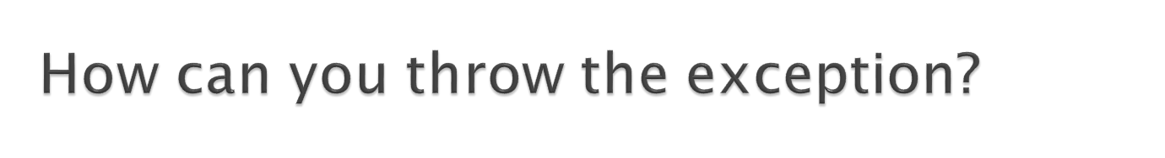
Assume in the application if the user age is < 18 he should not be allowed to register in the site.
public void registerProfile() throws AgeValidationException
{
try{
  if(age< 18){
    throw new AgeValidationException(“User Age is not eligible”);
  }
}
}
NOTE: The method throwing the exception should also declare the exception in throws clause.

Slide 38

After this demo you will be able to create custom Exceptions and understand how to throw them.
Scenario: A shopping portal provides users to register their profile. During registration the system needs to validate the user age above 18 and should be placed in India. If not the system should throw an appropriate error.
Create a user defined exception classes named “InvalidCountryException” & “InvalidAgeException”
Overload the respective constructors.
Create a main class “UserRegistration” , add the following method,
registerProfile - The parameter are String userName , int age, String country. Add the following logic
  if country is not equal to “India” throw a invalidCountryException with error message “User Outside India cannot be registered”
  If age < 18 throw a InvalidAgeException with error message “User is a Minor”
Invoke the method registerProfile from the main method with the data specified and see how the program behaves,

Slide 39
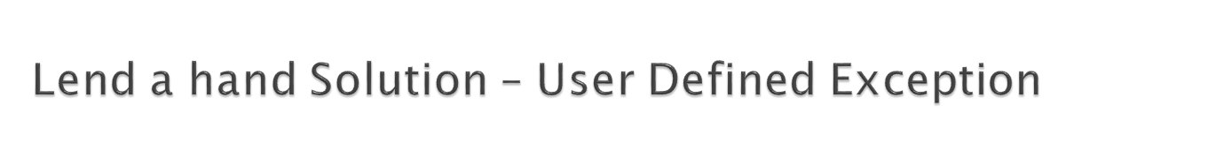
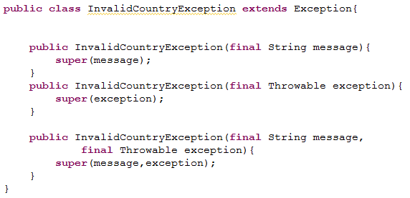
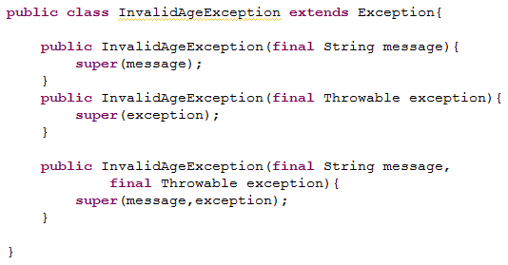
Create the exception class as mentioned below.
Execute the program for the following scenarios.
Name | Age | Country | Output
John | 13 | India | InvalidAgeException should be thrown. The error message should be “User is a Minor”
Jack | 23 | US | InvalidCountryException should be thrown. The error message should be “User Outside India cannot be registered”

Slide 40
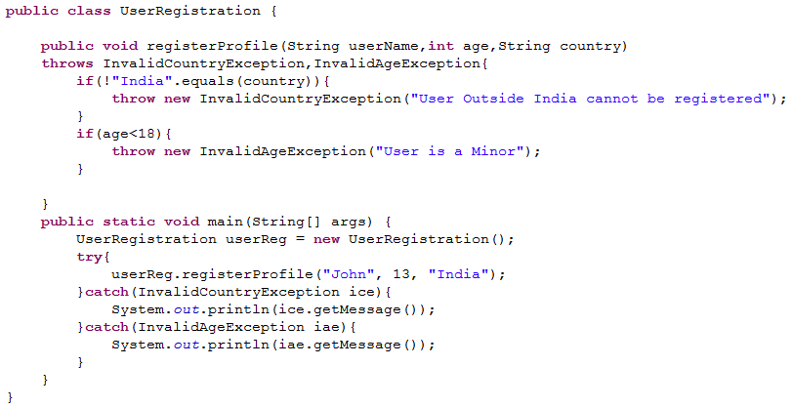
Create the user registration program as mentioned below.

