Slide 1

After completing this chapter you will be able to:
  Define Abstract Classes and Abstract methods.
  Extend an abstract class.
  Understand when we use an abstract class.
  Declare and implement an abstract method.

Slide 2

Dictionary Meaning of Abstract:
    Conceptual
    Theoretical
    Existing in thought or as an idea but not having a physical or concrete existence.

Slide 3

Abstract Method in Java:
  Methods that do not have any implementation(body) are called abstract methods
  Example:
  Method:
  public void add(){
    int x = a + b;
  }
  Abstract Method:
  public void add();
To create an abstract method, just write the method declaration without the body and use the keyword “abstract”
      DO NOT USE CURLY BRACES.

Slide 4

Abstract Class in Java
  An abstract class is a class that contains one or more abstract methods.
  Example:
  abstract class Calculator{
    public void calculateSineValue();
  }
Abstract class should use the keyword “Abstract”
An abstract class can contain non abstract methods also.
If a class has at least one abstract method, then that class should be declared abstract.

Slide 5
More about abstract classes and methods:
  Abstract classes cannot be instantiated.
  Abstract classes can be sub classed.
  When an abstract class is sub classed, the subclass should provide the implantation for all the abstract methods in its parent class.
  If the subclass does not implement the abstract method in its parent class, then the subclass must also be declared abstract.
  Example: When we try to instantiate the abstract class ‘Calculator’, we will get a compile time error.
  Calculator calculator = new Calculator();
Compile Time Error

Slide 6

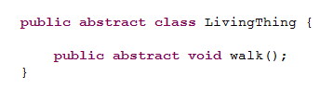
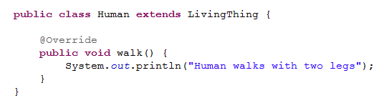
Assume a parent class as LivingThing
Abstract method - walk() in parent class
Human subclass of LivingThing
Implementation of abstract method - walk() in subclass

Slide 7



Scenario: Lets take a passport issuance process, assume that the passport head office is located in Delhi and corresponding local offices are in Chennai/Bangalore. The passport issuance is a two step process, verification of photo identity and final approval. In Chennai and Bangalore the verification document for photo identity are different. Say in Bangalore they verify using ration card and in Chennai they use drivers license. So the head office at Delhi decides to define a protocol and delegate the photo identity verification process but the final approval will be done by the head office.
Delhi Office,
Defines a protocol, that all local passport office should verify the photo identity.
HO verifies and approves the final document.
Bangalore,
Adheres to the protocol and performs photo identification using ration card.
Sends the document to HO for approval.
Chennai,
Adheres to the protocol and performs photo identification using driver license.
Sends the document to HO for approval.
Passport Head Office,
Delhi
Passport Office,
Bangalore
Passport Office,
Chennai

Slide 8

Passport Head Office
Abstract Class
Local passport Offices
Sub Class
Photo Identity Verification
Protocol: Abstract Methods
Final Approval
Common concrete method in abstract class reused by sub classes.
NOTE: No people can directly reach Delhi head office for passport application rather they should always go via the local offices in appropriate cities.
Similarly abstract Class cannot be instantiated only the subclasses can be instantiated and methods in abstract class invoked.

Slide 9

When do we use abstract classes and Methods?
  Abstract class (Passport Head Office) is one way of dictating a strict protocol for the subclasses (Local passport offices) to follow, that is implement the abstract methods (verify photo identity) declared in parent class.
    NOTE: Defining methods to be implemented (protocol) cannot be done in case of normal class being extended.
  Abstract methods are usually declared where two or more subclasses are expected to fulfill a similar role (abstract methods) in different ways
      These subclasses extend the same abstract class and provide different implementations for the abstract methods.
  You can use abstract classes to implement common methods (passport final approval) and use the subclasses to implement the abstract methods specific to the sub class.

Slide 10
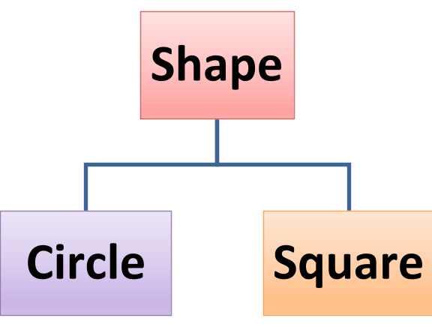
When do we use abstract classes and Methods? – Software Example
Assume Shape is the parent class, Circle and Square are subclasses that extends Shape. All the Shapes should have red color and they should expose a method to calculate area based on their appropriate shape.
Abstract class Shape
  Implements the common method setColor.
  Declares a abstract method (protocol) calculateArea for sub class to implement.
Classes Square & Circle extend Shape and
  Inherit setColor method.
  Implement abstract method calculateArea (adhere the protocol).

Slide 11

Let us understand more about abstract classes with the below program
  Create a parent class Shape.java with a instance variable color and methods below,
    Abstract method calculateArea() which returns double value;
    Concrete method setColor which accepts a String color as the parameter and sets the instance variable ‘color’. It should also print the color in the console.
  Create a sub class Circle.java which extends Shape.java and
    Implements the calculateArea() method. It should calculate the area as 3.14*r*r and print the area in the console. Consider radius = 5.0.
  Create another sub class Square.java which extends Shape and
    Implements the calculateArea() method. It should calculate the area as length*breadth and print the area in the console. Consider Length/Breadth = 4.0.
  Create AbstractDemo.java class with Main method which invokes the setColor method and the calculateArea() method on Circle and Square Object

