Slide 1

After completing this chapter you will be able to
  Understand what is an Array?
  List out the types of Array.
  Declare and create an array.
  Iterate through an array.

Slide 2


Apples
A box of Apples. Box is the container for apples.
Similar to box Arrays are container for data of similar data type (like the apples).

Slide 3

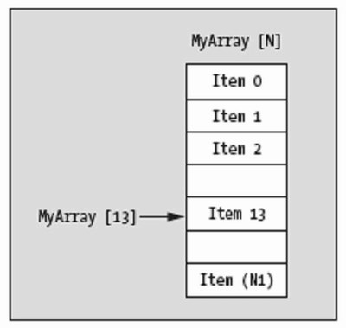
What is an Array?
  An array is variable that can hold a group of values of same type and referred by a common name.
  Arrays can hold primitives or objects of same types.
Individual values being stored inside an array named MyArray.
Each item can be accessed using the variable name MyArray.

Slide 4

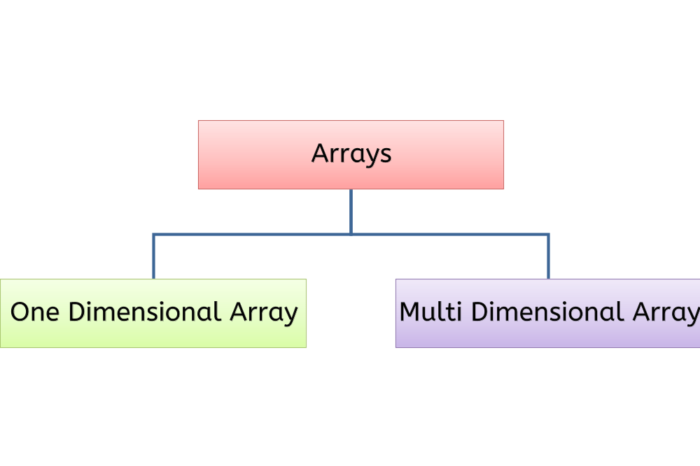
Example: int[] empId ;
//Integer array named empId to store employee id.
Example: int square[ ][ ];
// Two dimensional array.

Slide 5

Declaring an Array:
    An array variable declared should has a data type and a valid identifier.
      Syntax : <type> [ ] <array-name>;
      Example : int [ ] empId;
        Employee[ ] emp;
Initializing an Array
      As arrays are also a type of object, they are created with the new keyword.
      Syntax: <array-name>= new <type>(<size>);
      Example: empId=new int[3];
        emp=new Employee[3];
Declares an array of type int
Declares an array of Employee Object
Creates an array that can hold 3 int values
Creates an array that can hold 3 Employee objects.

Slide 6

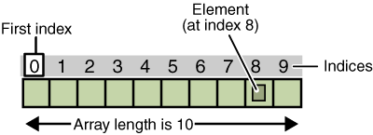
Some Facts about arrays:
The length of an array is established when the array is created.
The length of an array is fixed at the time of its creation.
Each item in an array is called an element, and each element is accessed by its numerical index.
The above diagram depicts an array of ten elements

Slide 7
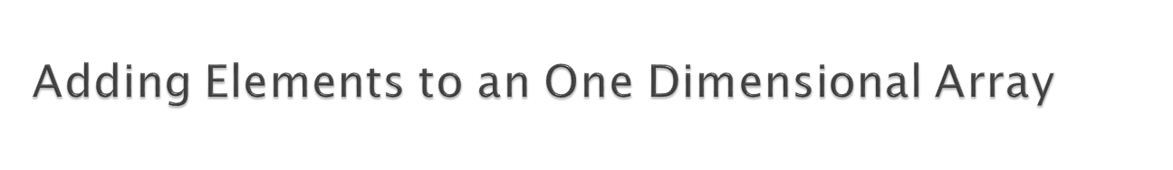
How to add values to a one dimensional array?
Based on the data type of the array the respective values can be stored inside the array.
Syntax:
    <array-name>[<index-number>] = <value>;
Example:
This sets the empName & empId objects in Employee Class
empId[0]=76;
empId[1]=13;
empId[2]=56;
emp[0]=new Employee(“Arun”,12000);
emp[1]=new Employee(“Ram”,11100);
emp[2]=new Employee(“Raj”,8000);
emp[3]=new Employee(“Sam”,10000);
This adds the employee id’s in the ‘empId’ array`
This adds employee object

Slide 8
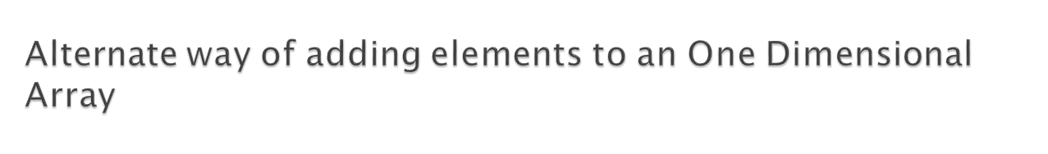
Let us look at an alternate way to create, initialize and assign values in one step,
  int[] empId = { 76, 13, 56, 87};
  Employee[] emp={new Employee(“Ram”,22),new Employee(“Arun”,44)};
  Here, the length of the array is determined by the number of values stored in the array.
  This declares an array of type int with values 76, 13, 56 and 87
  This declares an Employee object array, stores two employee objects

Slide 9

How to retrieve values from an array?
  Array elements are accessed using the element’s index.
  The index position of the first element in the array is 0, last element is position is array length -1.
Syntax:
    <type> <array name> = <array-name>[index-number];
Example:
      int id=empId[0]; Employee emp1=emp[3];
Retrieves the first item in empId array
Retrieves the fourth item in emp array
How to find the length of an array?
Use empId.length; to get the total number of items in the array.

Slide 10

Program to print even numbers between 0 & 100.
Create a program “ArrayDemo” add two methods,
  storeNumbers – Creates and stores a array with values from 0~100
  printEvenNumber – traverse through the array stored and print all the even numbers.
  From the main method invoke both the mentioned above and print the even numbers.

Slide 11

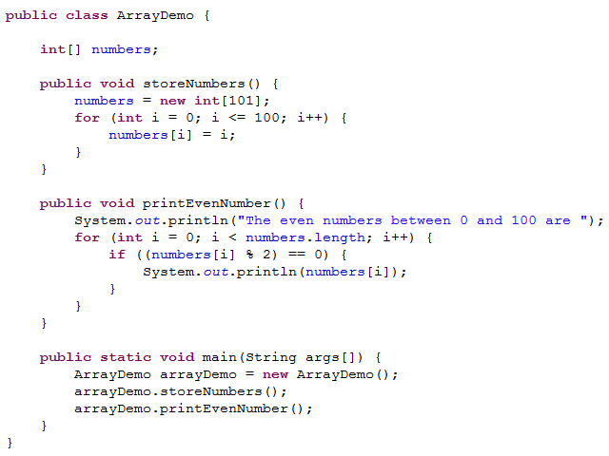
This method stores 100 numbers in an array.
This method prints the even numbers between 0 and 100.
Invokes the methods.

Slide 12

What are multi dimensional arrays?
  Multi Dimensional Arrays are array of arrays.
The two dimensional array can be termed as a physical table with rows and columns, each row labeled with an index of 0 to its maximum bound.
  Syntax:
    type array-name = new type[rows][cols];
  Example:
    int marks[ ][ ] = new int[2][3 ]; // 3 rows and 4 columns
 | 0 | 1 | 2 | 3
0 | 41 | 38 | 28 | 31
1 | 32 | 34 | 36 | 43
2 | 23 | 31 | 12 | 18
A two dimensional array is similar to a matrix representation as depicted here

Slide 13

Advantages of Java Array:
  Arrays can store large number of elements by just specifying the index number and the array name.
  Arrays permit efficient random access
  Iteration in arrays is faster than iterating through its counterparts (such as a linked list of the same size)
Disadvantages of Java Array:
  An array has fixed size.
  An array holds only one type of data.
  Insertion and deletion of elements is not efficient

