Slide 1

After completing this chapter you will be able to,
  Identify Java Keywords
  Use Primitive Data Types
  Define, declare & initialize variables in Java.
  Identify Java Literals.
  Convert & Cast Primitives.
  Use Operators in Java

Slide 2

What are Java Keywords?
  Keywords are reserved identifiers that are predefined in java language.
  Keywords cannot be used as names for variables, methods and classes.
Few Points on Java Keywords
  Keywords use letters only, they do not use special characters (such as $, _, etc.) or digits.
  All keywords are in lowercase letters and incorrect usage results in compilation errors.

Slide 3

abstract | default | implements | protected | throw
assert | do | import | public | throws
boolean | double | instanceof | return | transient
break | else | int | short | try
byte | extends | interface | static | void
case | final | long | strictfp | volatile
catch | finally | native | super | while
char | float | new | switch | null
class | for | package | synchronized | true
continue | if | private | this | false

Slide 4

Java, like other programming languages such as C and C++, supports basic built-in data types, which are also called primitive data types.
There are eight primitive data types in Java they are,
Data Type | Size In Bits | Range | Default Value
boolean | 1 | true or false | false
byte | 8 | –2⁷ to 2⁷ – 1 | 0
short | 16 | –2¹⁵ to 2¹⁵ – 1 | 0
int | 32 | –2³¹ to 2³¹ – 1 | 0
long | 64 | –2⁶³ to 2⁶³ – 1 | 0L
float | 32 | –2³¹ to 2³¹ – 1 | 0.0f
double | 64 | –2⁶³ to 2⁶³ – 1 | 0.0d
char | 16 | 0 to 2¹⁵ – 1 | ‘\u0000’

Slide 5


Dictionary Definition of Variables:
A quantity that can assume any of a set of values.
Something that is likely to vary; something that is subject to variation.
Variable analogy:
  The box is used as a container to hold white papers.
What is a Java variable?
  Similar to the box, Java variables are the basic unit of storage in a Java program. It is used to store the state of objects.

Slide 6

  Variables declaration:
  <data type> <name> [=initial value];
  Where,
    Data Type – Indicates the type of value that variable can hold.
    Name – Name by which the variable is identified.
  Values enclosed in <> are mandatory attributes
  Values enclosed in [ ] are optional attributes
  Example:
  int salary; // Declared a variable salary with data type int.
  (or)
  int salary =10000; // Salary declared as int with initial value 10000

Slide 7

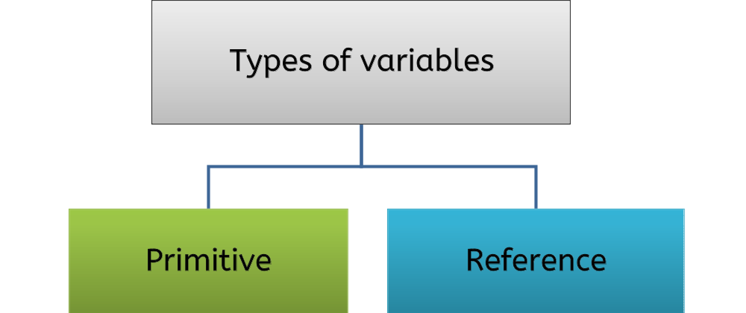
Variables declared with object, this points to a location in memory where actual data is present
Variables declared with primitive data type such as int or long
Example: int tax;
Example: Employee emp;
NOTE: A primitive variable holds the value of the data item, while a reference variable holds the memory address where the object values are stored.

Slide 8

Initializing Variables:
  The process of assigning an initial value to a variable is called initialization.
  Syntax:
<data Type> <variableName> = <initialValue> ;
Example:
int tax = 5;
The above statement declares a variable named tax of data type int and assigns an initial value of 5 that can later be changed.

Slide 9

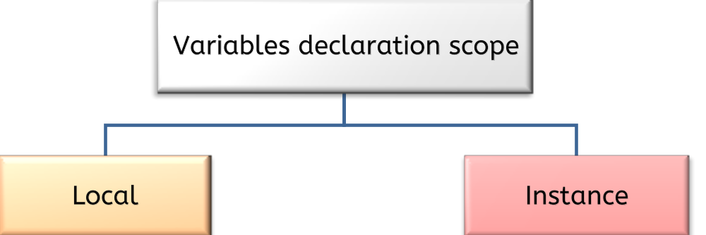
Variables declared inside a method.
Can be accessed only inside the method in which they are declared.
They lose their values stored when the method execution completes.
Variables declared inside a class and not inside any method.
This variable can be accessed by all the methods of that class.
This variable can also be accessed by other classes based on access modifiers.
You will learn more about variable scope and accessibility in the Access modifier session.

Slide 10

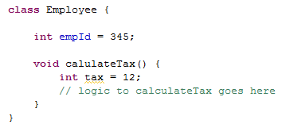
Example:
Instance Variable – Declared inside the body of the class.
Local Variable – Declared inside the body of the method.

Slide 11

Variable Naming Rules:
  The first character of a variable must be a letter, a dollar sign ($), or an underscore (_).
    The convention is to however begin your variables with a letter.
  A character other than the first character in an identifier may be a letter, a dollar sign, an underscore, or a digit.
    Example: age, $count, _count.
  None of the Java language keywords (or reserved words) can be used as identifiers.

Slide 12

Variable Naming Rules:
  If the variable name has only one word, then spell that word in all lowercase letters. If it consists of more than one word, then capitalize the first letter of each subsequent word.
  Example: employeeName, employeeAge
  Avoid abbreviations, the variable name should be meaningful.
  Don’t: empSal, empAdd.
  Do: empSalary, empAddress.

Slide 13

What is a literal?
A literal is a value assigned to a variable in a class.
Literals appears on the right hand side of the variable declaration.
Literals value can be assigned for any of the primitive data type.
  Example:
    int tax = 5 ;
    (or)
float salary =1000.0;
A literal is a value and not a variable
Where “5” and “1000.0” are int and float literals respectively.

Slide 14

Literal Type | Description | Formats and Example
Integer Literals | Integral literals may be represented by decimal, octal, or hexadecimal numbers. The octal number is prefixed with 0, and hexadecimal with 0x or 0X. | Decimal :12 Hexadecimal:0xC Octal:014
Floating Literals | A floating-point literal is represented by a floating-point number, and is used for both float and double data types. | Float:1234.5f Double:12.65,3.56E2 ,23d
Boolean Literals | A variable of boolean type can have only one of two possible values, true or false. Therefore, these two values are the only available boolean literals | true, false

Slide 15

Literal Type | Description | Formats and Example
Char Literals | A char literal may be represented by a single character enclosed in single quotes. | ‘a’, '\u4567'
String Literals | String literals represent multiple characters and are enclosed by double quotes. | “Hello World”
Escape Sequences | Java supports the escape sequences for denoting special characters. | \n :a new line \r :a return \t :a tab \b :a backspace \f :a form feed \‘ :a single quote \“ :a double quote \\ :a backslash

Slide 16

Create a java class “Employee” with the following variables created,
Create a method named calulatePF() which will have a local float variable named “pfRate” with value as 10.5 and the following message should be printed.
“The PF Rate Of The Employee is <pfRate>”
3. Create a java class “MainProgram” add a main method which will
  Create a object instance of the Employee.
  Access the instance variables and display the default values of variable as follows .
  “The Id of the Employee is <empId> ”
  “The Salary of The Employee is <empSal> ”
  “The Percentage of Tax The Employee needs to Pay is <empTax>”
  “The Total Number of Working Days is <daysOfWork>”
  Invoke the calculatePF() method .
Variable Name | Data Type | Default value
empId | long | 345
empSalary | Double | 10,000
empTax | Float | 9.5
empDaysOfWork | Int | 24

Slide 17

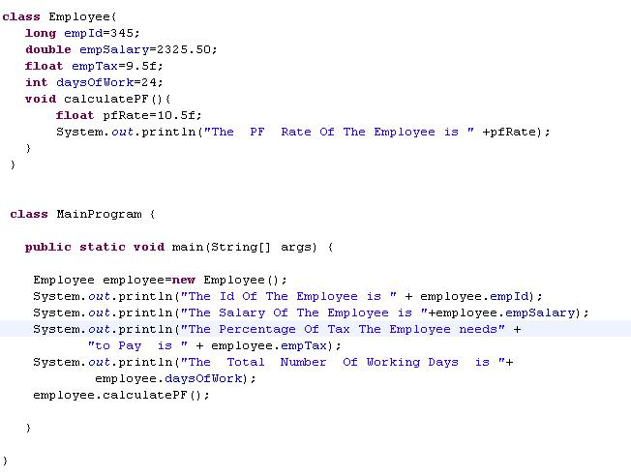

Slide 18


What is casting?
Casting is the process by which a liquid is poured into a mold and is allowed to solidify. In this process, it attains the shape of the mold
Similarly in Java, a value of one primitive type is assigned to a variable of another primitive type. This is called primitive type casting.
Example: A variable int is casted into float. Here float is the mold and int variable is casted as a float.
  Casting is done with any of the primitive data types
  Boolean type variable cannot be casted

Slide 19

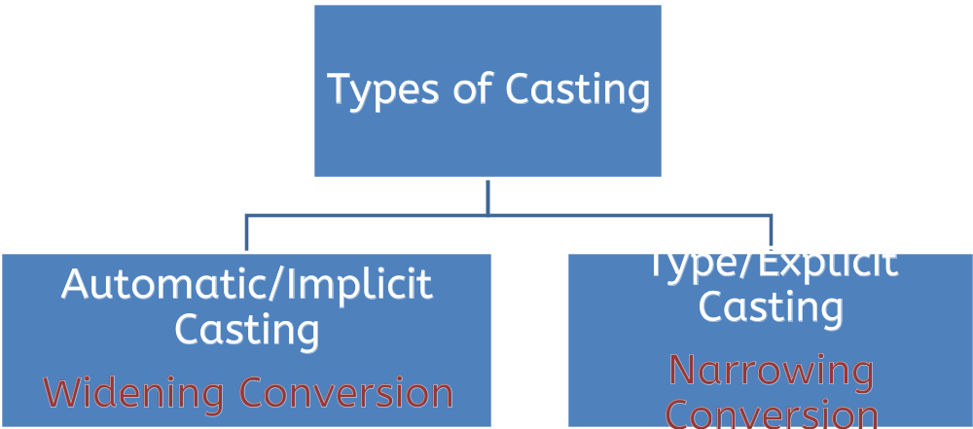

Slide 20

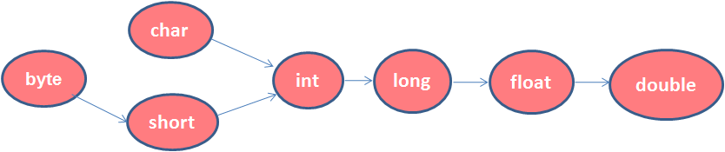
Java will performs automatic conversion when:
  The two data types are compatible.
  The destination data type is larger than the source data type.
Example: An int value (source) to a long variable (destination).
    int mySal=500;
    long sal=mySal;
Destination(64 bits)
Source(32 bits)
Figure depicts the allowed conversions for primitive data types (arrows indicate paths of allowed conversion).
Example: int can be type casted to long. Long can be type casted to float. etc

Slide 21

Explicit Casting will be done by the programmers when the following condition is met.
  The destination type is smaller than the source type.
Example:
double pf=12.67;
float myPf=pf; // compile-time error.
float myPf=(float) pf; // Explicit Casting.
A different type of conversion named “truncation” will occur when a floating-point value is assigned to an integer type.
Example: if the value 1.23 is assigned to an integer, the resulting value will be 1.The 0.23 will have been truncated.

Slide 22

What is an operator?
Operators are special symbols that perform specific operation on one, two or more operands and return a result.
Example:
  Here,
    a and b are variables
    the data in a and b are operands
    ‘+’ is the operator
    c contains the result
  Navigate to the next slide for more explanation
a + b = c

Slide 23
Operators operate on the data represented by a variable.
The data that is being operated on is called an operand.
Operators operate on their operands in a variety of ways
    Operators change the values of their operands.
    Operators can produce a new value without changing the values of the operands.
    Operators can compare the values of two operands.

Slide 24

Types of data operators based on the number of operands,
  Unary operators: Require only one operand.
  Example:
  ++ increments the value of its operand by 1.
  - - decrement the value of its operand by 1.
  Binary operators: Require two operands.
  Example:
  + adds the values of its two operands.
  Ternary operators: Operate on three operands(?).
  The ? operator consists of three operands and is used to evaluate boolean expressions. The goal of the operator is to decide which value should be assigned to the variable.
  Syntax:
  variable x = (expression) ? value if true : value if false

Slide 25

class Test{
public static void main(String args[]){
int num1=10;
int num2;
num2 = (num1>5) ? 20: 30;
System.out.println( "Value of num2 is : " + num); }
}
In the above example since the num1 is greater than 5 the value 20 will be assigned to num2.
If num1 is < 5 the value 30 will be assigned to num2.

Slide 26

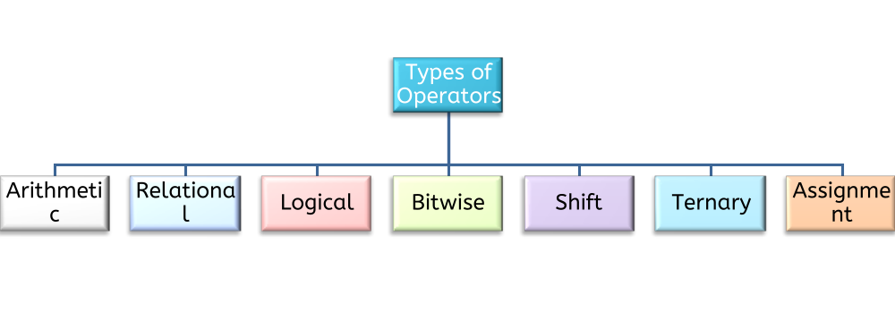
Types of Operators – Based on the Operation
You will learn more about operators in the next coming slides.

Slide 27

Arithmetic Operator:
  Arithmetic operators are used for mathematical calculations. The following table lists the arithmetic operators,
Operator | Value of a | Value of b | Usage | Value of c
+ | 6 | 5 | c=a+b | 11
- | 6 | 5 | c=a-b | 1
* | 6 | 5 | c=a* b | 30
/ | 6 | 5 | c=a/b | 1
% | 6 | 5 | c=a%b | 1

Slide 28

Unary Arithmetic Operator:
The unary operators require only one operand. They perform various operations such as incrementing/decrementing a value by one, negating an expression, or inverting the value of a boolean.
Operator | Use | Description
- | int a =-b; | Negates the operand b and stores the value in a
++ | int b=a ++ | Increments the value of a by 1
-- | Int b=a -- | Decrements the value of a by 1

Slide 29

Example of Increment & Decrement Operators:
Initial Value of x | Code Statement | Final Value of y | Final value of x
7 | y=++x; | 8 | 8
7 | y=x++; | 7 | 8
7 | y=--x; | 6 | 6
7 | y=x--; | 7 | 6

Slide 30

Relational Operator:
A Relational operator, also called a comparison operator, compares the values of two operands and returns a boolean value, true or false.
Operator | Use | Description
> | op1>op2 | True if op1 is greater than op2, otherwise false
>= | op1>=op2 | True if op1 is greater than or equal to op2, else false
< | op1 < op2 | True if op1 is less than op2, otherwise false
<= | op1 <=op2 | True if op1 is less than or equal to op2, otherwise false
== | op1 == op2 | True if op1 and op2 are equal, otherwise false
!= | op != op2 | True if op1 and op2 are not equal, otherwise false

Slide 31

Create a java class “Calculator” with two instance variable int num1 and num2.
Create three methods “addition“,“subtraction” and ”printSmaller” which will add ,subtract and print the smallest of two numbers respectively. The methods should display the results as follows,
  Addition:“The Sum of the Two numbers <num1> and <num2> is <result>”
  Subtraction:“The Subtracted Result of the two numbers <num1> and <num2> is <result>”
  Print Smaller:“The Smallest of the Two numbers <num1> and <num2> is <result>”
Create a java class “MainProgram” add a main method which will
  Create a object instance of the Calculator .
  Set the value of num1 and num 2 as 12 and 8.
  Invoke the methods “addition”,“subtraction” and “printSmaller “.
The message needs to be displayed in the console.

Slide 32

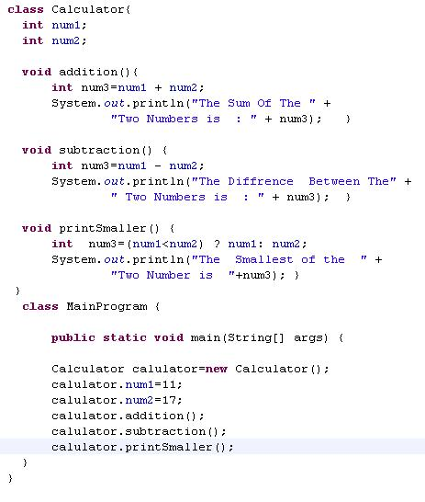

Slide 33

Logical Operator:
Logical operators are used to evaluate one or more conditions and return a true or false value based on conditions result.
Operator | Operator Type | Use | Description
&& | Binary | op1 &&op2 | True if both the operands are true, otherwise false.
|| | Binary | op1 ||op2 | True if any one of the operand is true , otherwise false.
! | Unary | ! op1 | True if operand is false and vice versa

Slide 34

Bitwise Operator:
Bitwise operators that are used to manipulate bits of an integer (byte, short, char, int, long) value.
Operator | Type | Use | Description
& | Binary | op1 &op2 | The AND operator & returns a value 1 bit if both operands are 1,a zero is produced in all other cases. It is equivalent to multiplying both the bits.
| | Binary | op1|op2 | The OR operator |, returns a value 1 if one of the bits in the operands is a 1. Returns zero if both the operands has a value zero. It is equivalent to adding both the bits.
~ | Unary | ~ op1 | The unary NOT operator, ~, inverts all of the bits of its operand., converts the 1 to zero and vice versa.
^ | Binary | op1 ^ op2 | The XOR operator, ^, It represents the inequality function, i.e., the output is HIGH (1) if the inputs are not alike otherwise the output is LOW (0).

Slide 35

Example of Bitwise Operators:
Initial Value of x | Initial Value of y | Code Statement | Final Value of z
15(0000 1111) | 5(0000 0101) | Z=x & y; | 5 (0000 0101)
15(0000 1111) | 5(0000 0101) | y=x | y; | 15(0000 1111)
7(0000 1111) | - | z=~x; | 240(1111 0000)
15(0000 1111) | 5(0000 0101) | z=x ^ y; | 10(0000 1010)

Slide 36
Create a java class “Calculator” add two integer instance variables “num1” and ”num2”.
Create four methods which will perform bitwise and ,or , XOR and NOT for the two numbers and print in following the format
  “The Bitwise AND of the Two numbers <num1> and <num2> is <result>”
  “The Bitwise OR Result of the two numbers <num1> and <num2> is <result>”
  “The Bitwise XOR of the Two numbers <num1> and <num2> is <result>”
  “The Bitwise NOT Result of the number <num1> is <result>”
Create a java class “MainProgram” add a main method which will
  Create a object instance of the Calculator .
  Set the value of num1 and num2 as 15 and 5 .
  Invoke the four methods.
The message needs to be displayed in the console.

Slide 37
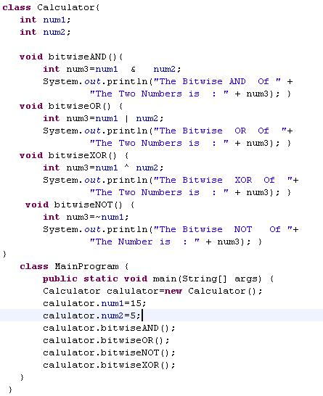

Slide 38

Shift Operator:
Shift operators operates on one or more bit patterns or binary numerals at the level of their individual bits.
Operator | Use | Description
<< | op1 <<op2 | The left shift operator, <<, shifts all of the bits in a value to the left a specified number of times.
>> | op1>>op2 | The right shift operator, >>, shifts all of the bits in a value to the right a specified number of times.
>>> | op1 >>> op2 | Shift right zero fill operator. The left operands value is moved right by the number of bits specified by the right operand and shifted values are filled up with zeros.

Slide 39

Assignment Operators:
  An assignment operator is used to set (or reset) the value of a variable
Operator | Use | Description
+= | op1 +=op2 | Equivalent to op1=op1+op2
-= | op1-=op2 | Equivalent to op1=op1-op2
*= | op1*=op2 | Equivalent to op1=op1 * op2
/= | op1 /=op2 | Equivalent to op1=op1/op2
%= | op1%=op2 | Equivalent to op1=op1%op2

Slide 40

Operator | Use | Description
&= | op1 &=op2 | Equivalent to op1=op1& op2
| = | Op1|=op2 | Equivalent to op1=op1| op2
^= | op1 ^=op2 | Equivalent to op1=op1 ^ op2
/= | op1 /=op2 | Equivalent to op1=op1/op2
%= | op1%=op2 | Equivalent to op1=op1%op2

Slide 41
Operator | Use | Description
<<= | op1 <<=op2 | Equivalent to op1=op1<< op2
>>= | op1>>=op2 | Equivalent to op1=op1>> op2
>>>= | op1 >>>=op2 | Equivalent to op1=op1 >>> op2

Slide 42

If in a expression there are more than one operators the order in which they are evaluated would be based on the operator precedence.
Precedence | Operator
1 | ( ),[ ]
2 | ++,--
3 | *,/,%,+,-
4 | <.<=,>,>=
5 | ==,!=
6 | &&,||

Slide 43

Let us analyze some examples to understand the precedence of operators
Example 1:
result = (num1*num2) + num3 / num4;
Here is the order on how the above expression is processed
  num1 * num2
  num3 / num4
  Final Result = result of step 1 + result of Step 2

Slide 44
Example 2:
result = num1 > num2 && num3 <= num4 || num5 != num6;
Here is order on how the above expression is processed
  num1 > num2
  num3 <= num4
  num5 != num6
  Result of Step 1 && Result of Step 2
  Final Result = result of Step 4 || result of Step 3

