Slide 1
Assignment #1
Due 25 Sept 2017

Slide 2
Specification
Create asgn1.html to create a view similar to those illustrated in the next few slides.
You can copy the HTML content from without-css.html and modify the HTML accordingly (e.g., insert CSS, introduce class/id attributes, add/remove elements, rearrange elements, etc.)
Some of the requirements are stated as text in the next two slide.

Slide 3
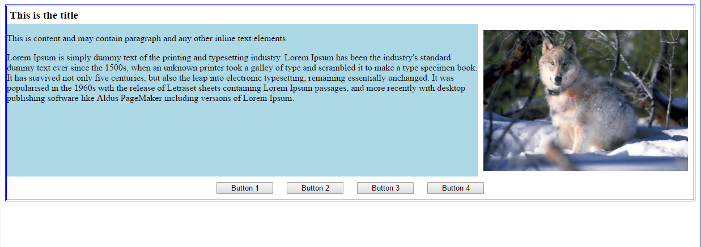
Wide Screen View #1
Max height of the light blue area is 270px
Set image height to 250px (there is a 10px space between the image and its container)
Set the image width accordingly to keep the image aspect ratio intact.
Feel free to add margin/padding accordingly

Slide 4
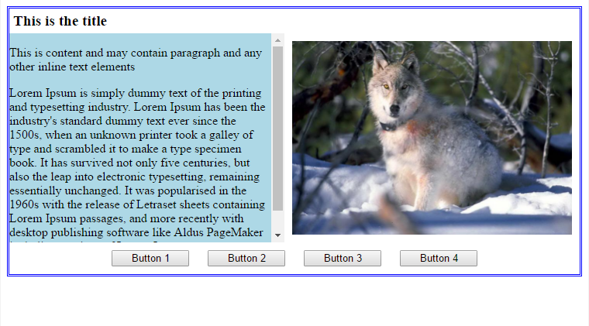
Wide Screen View #2
Show vertical scroll bar automatically when the text content overflows.

Slide 5
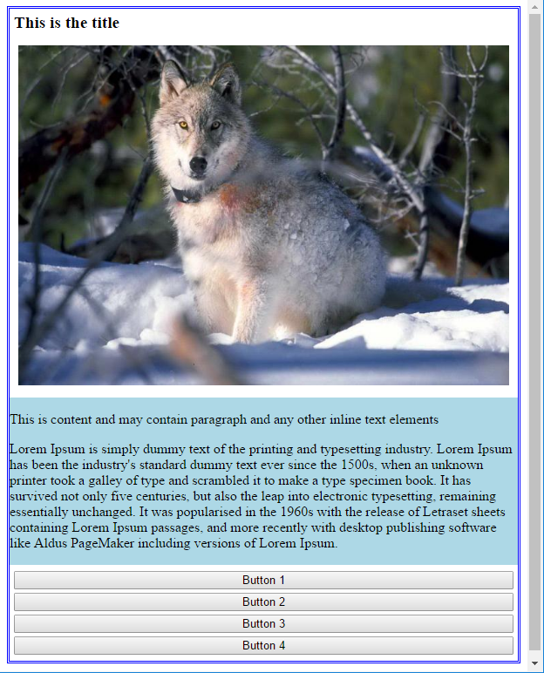
Narrow Screen View (screen width < 640 px)

Slide 6
Some Suggestions
Use media query and two sets of CSS for two different ranges of screen width
The top level div element contains three div children.
Introduce class/id attribute to help you select different div elements.
Address the layout of each div child separately.
Flex layout could be useful to arrange the content and image.
Use max-width and max-height to make sure element won’t grow beyond certain size.

