Slide 1
Assignment #2
Due 9 Oct 2017

Slide 2
Specification
Objective: To implement an interactive To-Do List using JavaScript.
For the HTML and CSS of the UI, we are going to use those made available at the TodoMVC (http://todomvc.com).

Slide 3
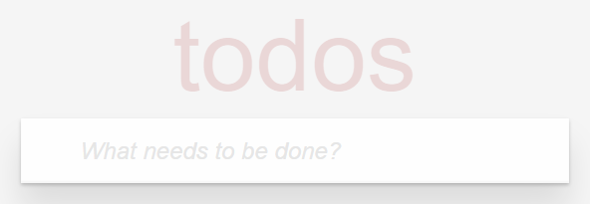
Initial State
The list is empty initially and only a text field is shown.

Slide 4
Initial State
...
<section class="todoapp">
<header class="header">
<h1>todos</h1>
<input class="new-todo" placeholder="What needs to be done?"
autofocus>
</header>
<section class="main">
...
</section>
<footer class="footer">
...
</footer>
</section>
...
Whenever a user hits "Enter" key in the textfield and the textfield is not empty, your code should append the text in the textfield as a new to-do item to the end of the to-do list, and then clear the textfield.
Shuld NOT be visible when the list is empty

Slide 5
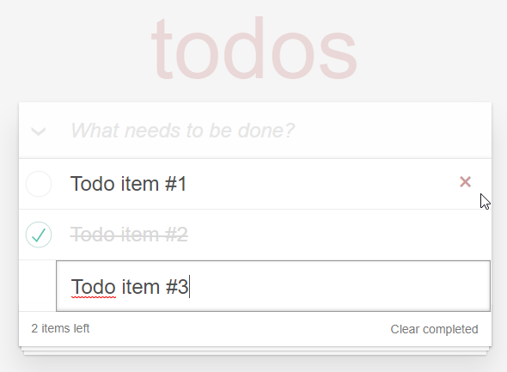
List with item(s)

Slide 6
...
<section class="todoapp">
<header class="header">
...
</header>
<section class="main">
<input id="toggle-all" class="toggle-all" type="checkbox">
<label for="toggle-all">Mark all as complete</label>
<!-- The list of todo items -->
<ul class="todo-list">
<li>
<div class="view">
<input class="toggle" type="checkbox">
<label>Todo item #1</label>
<button class="destroy"></button>
</div>
<input class="edit" value="Todo item #1">
</li>
...
A checkbox that appears as "\/" of the left of the input text field. Whenever it is checked/unchecked (using a mouse), your code should mark all to-do items as checked/unchecked.
Each "li" element corresponds to a to-do item.
You should reuse the HTML code and only set the text marked in red color accordingly.
Whenever the "button" element of an item is clicked, the item should be removed from the list.

Slide 7
Whenever the checkbox of an item is checked/unchecked (using a mouse), your code should add/remove class "completed" to/from the "li" element. In addition, the "toggle-all" checkbox should be updated accordingly.
...
<li class="completed">
<div class="view">
<input class="toggle" type="checkbox">
<label>Todo item #2</label>
<button class="destroy"></button>
</div>
<input class="edit" value="Todo item #2">
</li>
<li class="editing">
<div class="view">
<input class="toggle" type="checkbox">
<label>Todo item #2</label>
<button class="destroy"></button>
</div>
<input class="edit" value="Todo item #2">
</li>
</ul>
</section>
...
Whenever the "label" element of an item receives a double-clicked event, you should add class "editing" to the corresponding "li" element. (The CSS will hide the "div" element and reveal the "input" element)
Whenever the "input" element loses focus or when a user hits "Enter" key in it, your code should update the text of the to-do item and remove class "editing" from the "li" element.

Slide 8
This number should always be updated to reflect the current number of to-do items that are not marked as completed.
Singular/Plural form of "item"
0 items
1 item
2 items
...
...
<footer class="footer">
<span class="todo-count"><strong>0</strong> item left</span>
<button class="clear-completed">Clear completed</button>
</footer>
</section>
Whenever this button is clicked, all the checked items (i.e., all the completed items) should be removed from the list.

Slide 9
Suggestion
Create a model to represent To-do List
An array of objects, with each object having two properties: "completed" (true/false) and "description" (string);
# of to-do items (that are not marked as completed)
Update View – Write code to generate the corresponding HTML content from the model.
Assign event handlers to the elements
Most event handlers should just update the model and then call a function to update the view.
Introduce "id" attributes to each item if necessary.
Make sure the "Update View" is working properly first before assigning event handlers.

Slide 10
Notes
You can check the behavior of your To-do List against those found at the ToDoMVC website.
You do not need to implement the "filter" features.
Do not copy or use of the JavaScript code made available at TodoMVC!
Archive your solution into a ZIP file and submit the ZIP file to Blackboard eLearning system.

