Slide 1
Prince William Sound Profiler
Mid-semester Design Review
ECE 4873 Senior Design Project
Aquanauts

Slide 2
Introduction
1989 Exxon Valdez oil spill caused environmental damage
Since 2013 an autonomous moored profiler (AMP) has collected data on PWS recovery
Profiler needs modifications/updates
Goals:
Updated data storage and transmission capabilities for existing profiler
Module can send data from profiler sensors to scientists
Centralized data storage in module
Relay system to supply power to sensors on-demand
Notes:
Shayna

Slide 3
Project Description and Goals
Customer Requirements
Higher data transfer volume and speed
Updated central memory and processing
Automated system to turn sensors on/off on a schedule
How we will address each
Revamp communications utilizing the nearby 3G/4G cell tower and updated data transfer rates vs. current 2G utilization
Direct FTP of data will provide full data transfer vs. the current direct UDP packetized transfer only representing 1/10th of collected data
Updated memory and processing unit to replace outdated/no longer manufactured Persistor
Raspberry Pi 3B
Samsung 870 EVO Solid State Drive
Custom-built MOSFET switching board to supply power to on-board sensors on a schedule
Conserves battery life
Notes:
jim

Slide 4
Technical Specification
Table 3. Technical Specifications
Specification | Min | Max
Functional Temperature | -5 C | 30 C
Functional Depth | Sea level | 60m
Total Power Consumption | 9 Vdc, 1.01 A | 14 Vdc, 1.67 A
Communication Range (Approx) | 8000m (Nearest cell tower, approx. 5 miles) | N/A
Communication Protocol | 3G & 4G SFTP (Direct to local server, or to cloud)
Notes:
Jim

Slide 5
Design Approach and Details
Update Processor
Raspberry Pi 3B
Choice considerations:
Lowest power consumption of RPi models that support Linux
Linux required for ftp & ssh protocols
Arduino does not support Linux
USB bootable from SSD
Cons
Power consumption still not optimal (~210mA at idle)
Notes:
Jim

Slide 6
Design Approach and Details Cont’d
Data Transmission
Raspberry Pi communicating with 3G/4G cell tower via SixFab Cellular Communications Module and antennas
SFTP to Cloud storage, or transmit direct to local server in Alaska
Cloud storage may require paid subscription, but not dependent on state of local server in Alaska, also will act as data backup
Local server in Alaska requires user setup/maintenance, data transmission success relies on state of local server
Cons:
Hard to test whether or not the signal in Alaska is strong enough
Notes:
Shelby

Slide 7
Design Approach and Details - SSD
SSD is preferred over SD card for the following reasons:
Longevity -- SDs with DRAM cache last significantly longer than SD cards
They also have longer warranties
Size -- The system will have more storage to collect more data
Size also increases longevity
Performance -- SSDs have faster read and write speeds
This will help to run programs more efficiently
Samsung 870 EVO (256 GB)
Has DRAM cache, good size, noted performance in user reviews, and 5 year warranty
Notes:
Ruben

Slide 8
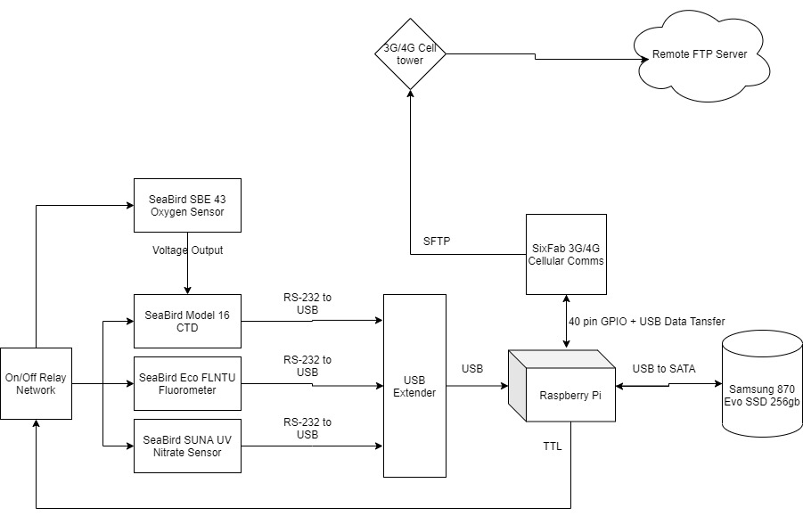
Communications Diagram
Notes:
Shelby

Slide 9
Design Approach and Details - MOSFET Board
Buck converter to step down the voltage from the battery from 30V to 12V
Isolation capable buck converter with adjustable voltage
All sensors on the profiler can operate on 12V
Individual MOSFETS will be used to turn individual sensors on and off
MOSFETs instead of relays
Since the battery voltage will be stepped down using an isolated buck converter, additional electric isolation is not required
The power MOSFETs can be simulated, but it was difficult to find spice models for SSRs
MOSFET board will allow for new sensors to be added to the profiler in the future
Notes:
Tim

Slide 10
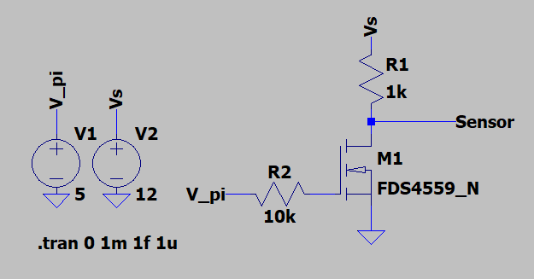
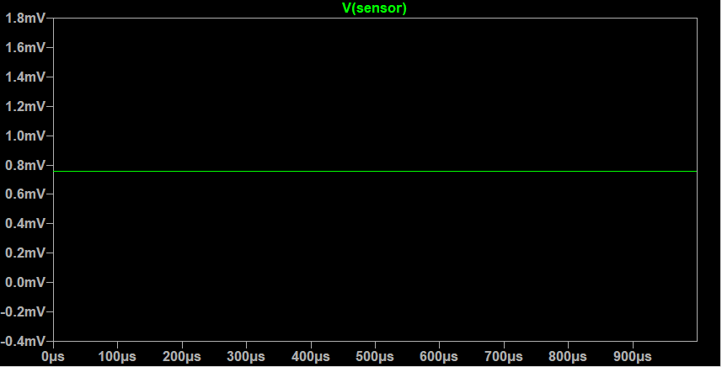
MOSFET Switching Simulation
Notes:
Jason

Slide 11
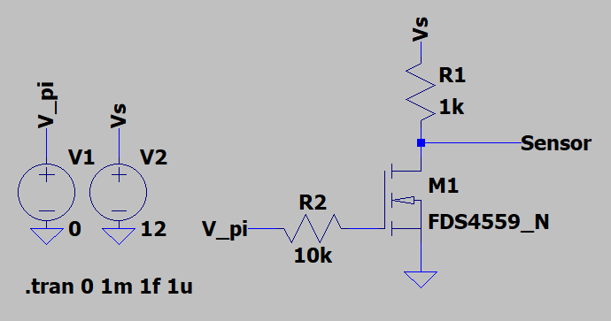
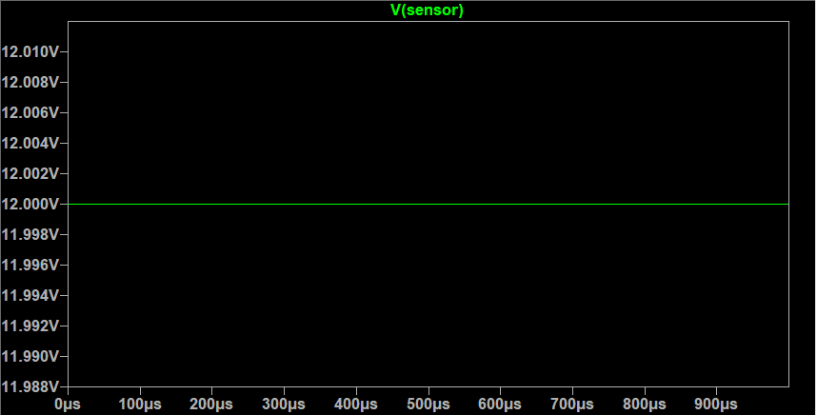
MOSFET Switching Simulation (Continued)
Notes:
JAson

Slide 12
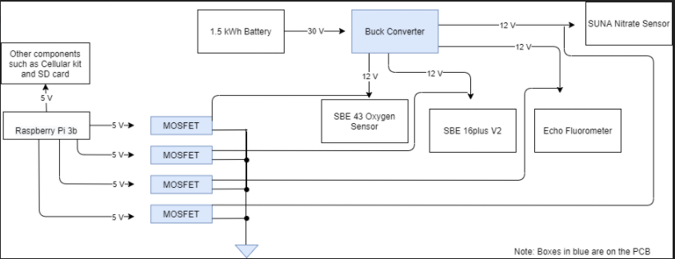
Power Diagram
Notes:
Shayna

Slide 13
Codes and Standards
802.15.4-2020 - IEEE Standard for Low-Rate Wireless Networks: The standard provides for ultra low complexity, ultra low cost, ultra low power consumption, and low data rate wireless connectivity among inexpensive devices.
IMT-2000: Offers the capability of providing value-added services and applications for frequencies between 400 MHz and 3 GHz.
Makes 3G systems affordable
Adds compatibility feature with existing systems such as 2G
Notes:
Jason

Slide 14
Project Demonstration
Verification and Validation
Software simulation and physical testing with the final prototype (Inspect, Demonstrate, Test)
Expo
Poster, Video, Prototype Demo
Present simulation results in a descriptive manner
Video demo for features not easily demonstrated during the Expo
Physical prototype
Notes:
Shayna

Slide 15
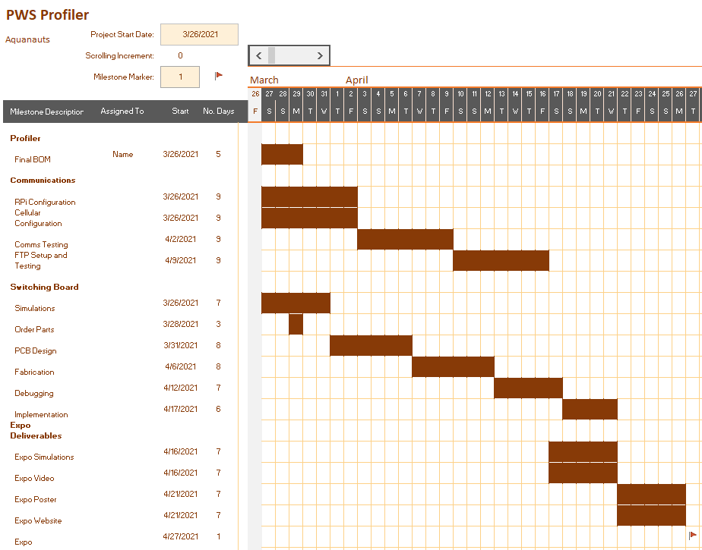
Schedule, Tasks, and Milestones
Chance of Success: 95%
Notes:
Tim

Slide 16
BOM
Part | Manufacturer | Retailer | Price per Item | Quantity | Part Total
Raspberry Pi 3B | Raspberry Pi | Digi-Key | 35 | 1 | 35
Raspberry Pi 4G/LTE Cellular Modem Kit | Sixfab | Sixfab | 109 | 1 | 109
Sixfab Connect Sim | Sixfab | Sixfab | 2 | 1 | 2
SAMSUNG PRO Plus SDHC Full Size SD Card 32GB | Samsung | Amazon | 9.99 | 1 | 9.99
MKR SD PROTO SHIELD | Arduino | Arduino | 13.8 | 1 | 13.8
USB 3.0 SATA III Hard Drive Adapter Cable, SATA to USB Adapter Cable | SKL Tech | Amazon | 7.99 | 1 | 7.99
SAMSUNG 870 EVO 250GB 2.5 Inch SATA III Internal SSD | Samsung | Amazon | 39.99 | 1 | 39.99
DC-DC Converter | Mean Well USA | Digi-Key | 26.71 | 1 | 26.71
Power MOSFET FQP30N06L | ON Semiconductor | Digi-Key | 1.22 | 4 | 4.88
USB to Serial RS232 Adapter | SIIG | Amazon | 49.85 | 1 | 49.85
Total
299.21
Notes:
Jason

Slide 17
Current Status
Full analysis of power requirements - COMPLETE
PCB design - IN PROGRESS
Communication Design - COMPLETE
Testing phase - IN PROGRESS
Software & processing - IN PROGRESS
Creating a full BOM - NEARLY COMPLETE
Order parts - NEARLY COMPLETE (Need RS-232 hub & buck converters)
Notes:
Ruben

Slide 18
Leadership Roles
Group Leader: Jim O’Donnell
Expo Coordinator: Shayna Seidel
Financial Advisor: Seungju Jason Lee
Webmaster: Ruben Quiros
Documentation Coordinator: Timothy Pierce
Tech lead: Shelby Crisp
Notes:
Ruben

