Slide 1
Prince William Sound Profiler Communication Module
ECE 4873 Senior Design Project
Aquanuats

Slide 2
Introduction
1989 Exxon Valdez oil spill caused environmental damage
Since 2013 an autonomous moored profiler (AMP) has collected data on PWS recovery
Profiler needs modifications/updates
Goal: design new communication module for existing profiler
Module can send data from profiler sensors to scientists
Centralized data storage in module
Requesting $400, preliminary cost estimate is $183.78
PCB printing cost, other components, and shipping will increase cost
Notes:
Shayna

Slide 3
Project Description and Goals
2 main customer requirements, 2 auxiliary requirements:
Higher data transfer volume and speed (M)
Longer battery life (M)
Updated central memory and processing (A)
Improved profiling ability (A)
How we will address each:
Revamp comms utilizing the nearby 3G cell tower and updated data transfer rates. Current - 9600 baud, proposed 56,000 to 114,000 baud (Arduino GSM shield specs)
One main sensor module operating on separate winch. This will accomplish two things:
Better battery life - reduce use of larger anchoring winch by only surfacing the sensor module for comms
Ability to profile on the way down by preventing water wash through profiler
Updated memory and processing unit to replace outdated/no longer manufactured Persistor
Notes:
jim

Slide 4
Technical Specification
Table 3. Technical Specifications
Specification | Min | Max
Functional Temperature | -5 C (** Datasheet says 0) | 30 C
Functional Depth | N/A | 100m
Total Power Consumption | 9 Vdc, 1.01 A (** Missing min amp info for RBR Brevio) | 14 Vdc, 1.67 A (**Missing max amp info for RBR Brevio)
Communication Range (Approx) | 100m (Operating depth + realistic estimate of surface buoy distance) | 8000m (Nearest cell tower, approximately 5 mi.)
Communication Frequency | GSM 850 MHz for remote 3G compatibility (869.2 – 893.8 MHz) Other available frequencies: E-GSM 1900 MHz, DCS 1800 MHz, PCS 1900 MHz
Notes:
Questions:
Need power req’s for RBR Brevio
Which optode sensor is being used, or both? Link had 4531 and 4835

Slide 5
Design Approach and Details
Smaller Module
Design
Connected to power supply via a long cable
Aquanauts focus is on technology inside module and not the enclosure
Pros
Will save battery life
Safer than using a buoy
Cons
May not surface properly to send signals
Centralized sensors
Design
Currently using outdated persistor
New microcontroller- Arduino Mega
Pros
Update older sensor
Allow for replacement
Cons
Added Cost
Notes:
Shayna + shelby

Slide 6
Design Approach and Details Cont’d
Data Transmission
Design
Considered Satellite and Radio
Nearby 3G cell tower
Arduino GSM 1400 Cellular Kit
Pros
Currently in use
Easier to test
Cons
Doesn’t work if module doesn’t surface
Notes:
Shayna + shelby

Slide 7
Codes and Standards
IP69K: Ingress Protection rating that states that the device will be dust-tight and will be protected against complete, continuous submersion.
The Research Vessel Safety Standards (RVSS) states that the tension in the rope must be monitored at the operator’s station with a resolution of a certain frequency depending on the factor of safety.
802.15.4-2020 - IEEE Standard for Low-Rate Wireless Networks: The standard provides for ultra low complexity, ultra low cost, ultra low power consumption, and low data rate wireless connectivity among inexpensive devices.
Notes:
Jason

Slide 8
Project Demonstration
Verification and Validation
Software simulation and physical testing with the final prototype (Inspect, Demonstrate, Test)
Expo
Poster, Video, Prototype Demo
Present simulation results in a descriptive manner
Video demo for features not easily demonstrated during the Expo
Physical prototype
Notes:
Tim

Slide 9
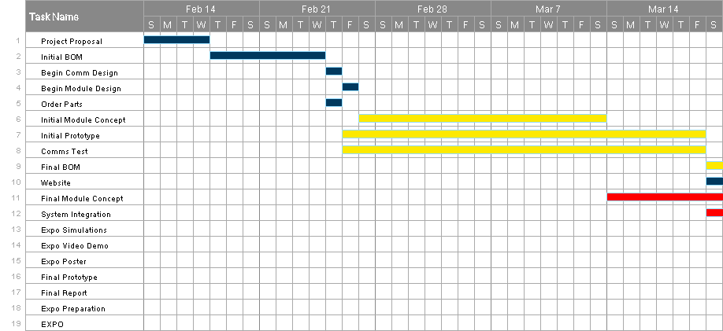
Schedule, Tasks, and Milestones Pt. 1
Notes:
Tim

Slide 10
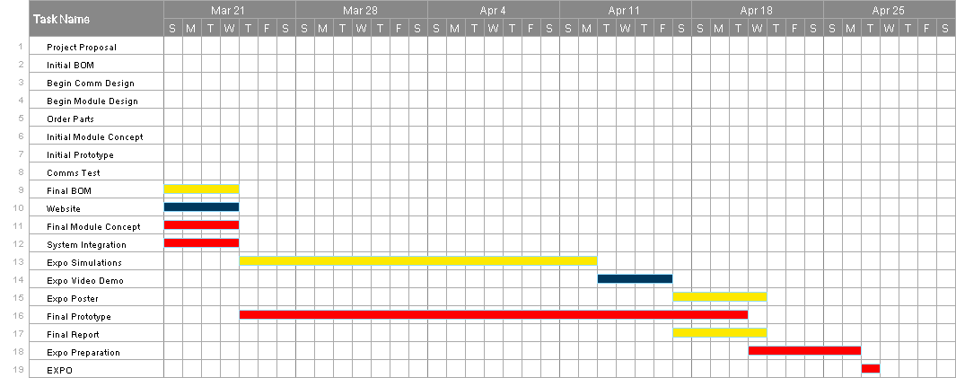
Schedule, Tasks, and Milestones Pt. 2
Chance of Success: 95%
Notes:
Tim

Slide 11
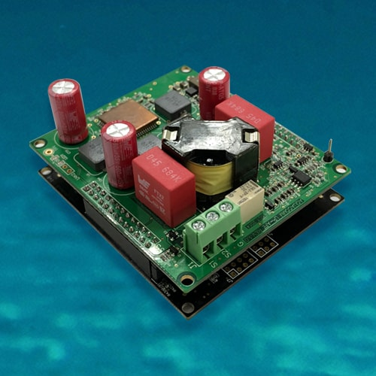
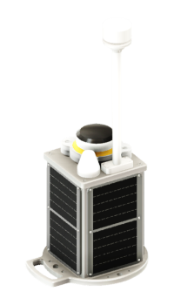
Marketing and Cost Analysis
Some similar products on market
DSPComm underwater acoustic modem
Used underwater
Transmit signal 3 km away
MarineLabs CoastScout
Long range communication buoy
5 MB wirelessly
Use of buoy isn’t optimal due to boat traffic and weather conditions
Notes:
Shelby pt 1 Tim pt 2

Slide 12
Preliminary BOM
Part | Quantity | Manufacturer | Retailer | Price per Item | Total
Arduino Mega 2560 | 1 | Arduino | Arduino | $40.30 | $40.30
Arduino SIm MKR GSM 1400 Cellular Kit | 1 | Arduino | Newegg | $119.69 | $119.69
PRO Plus SD Card 32GB | 1 | Samsung | Amazon | $9.99 | $9.99
MKR SD Proto Shield | 1 | Arduino | Arduino | $13.80 | $13.80
Notes:
Jason

Slide 13
Current Status
Designing a new centralized storage component for data - IN PROGRESS
Designing a system that will send data to the research facility over a cellular connection - IN PROGRESS
Designing software programs for components listed above - INCOMPLETE
Creating a full BOM - IN PROGRESS
Order parts - INCOMPLETE
Notes:
Ruben

Slide 14
Leadership Roles
Group Leader: Jim O’Donnell
Expo Coordinator: Shayna Seidel
Financial Advisor: Seungju Jason Lee
Webmaster: Ruben Quiros
Documentation Coordinator: Timothy Pierce
Tech lead: Shelby Crisp
Notes:
Ruben

