Slide 1
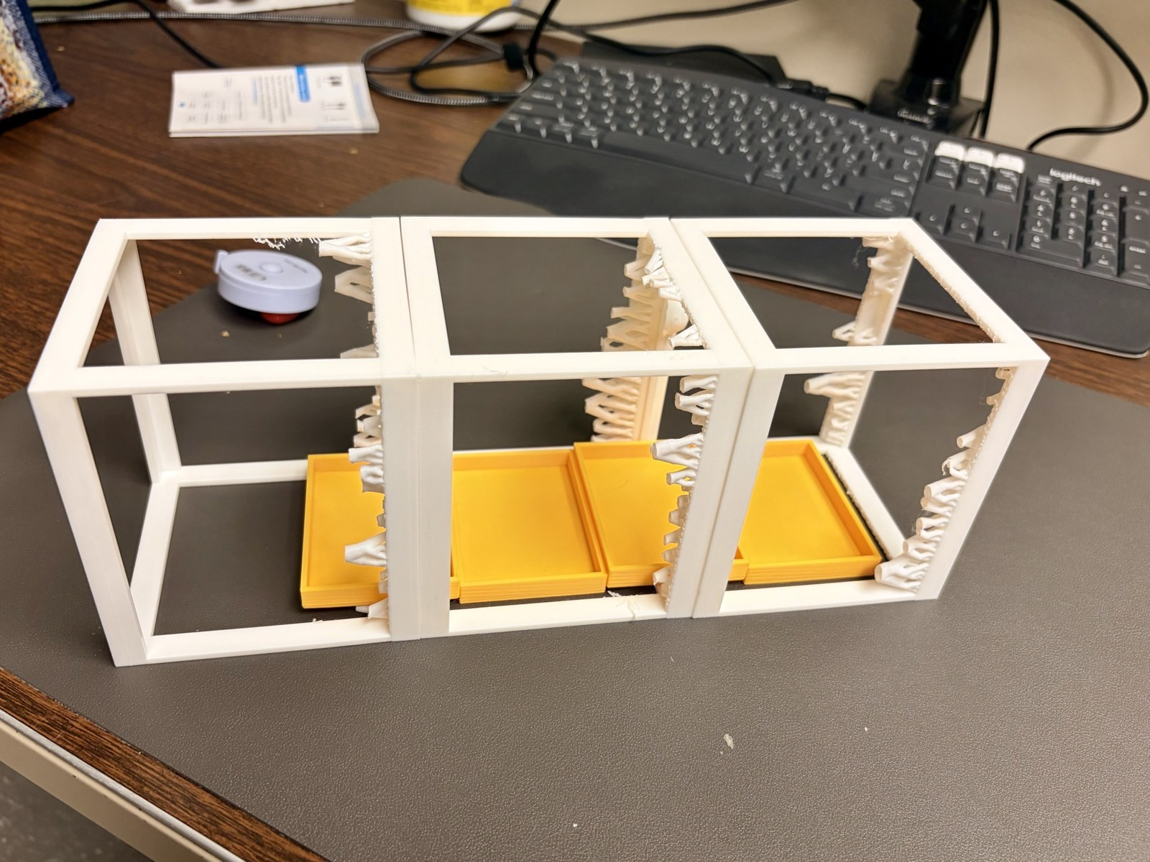
PUALEI
1 / 5
Plant water stress
in a small chamber
Plant health sensing for a compact
International Space Station experiment
University of Hawaiʻi at Mānoa
Supported through NASA EPSCoR ISS
Printed enclosure and tray mockup.
Ground development in progress. October 2026.
Notes:
Public project introduction. Photo: project enclosure mockup supplied in October 2026. The physical model supports spatial fit checks. It does not establish flight qualification.

Slide 2
PUALEI
2 / 5
The research question
Can combined plant images and environmental
measurements help identify water stress?
Ground reference
Microgravity question
Establish repeatable growth and record the
conditions around each plant observation.
Evaluate how methods developed on Earth
perform under a different growing environment.
Stress detection performance and microgravity validation remain research objectives.
Notes:
Project research direction: autonomous plant health inference using combined images and environmental measurements. This slide states research questions. It reports no accuracy results or microgravity validation.

Slide 3
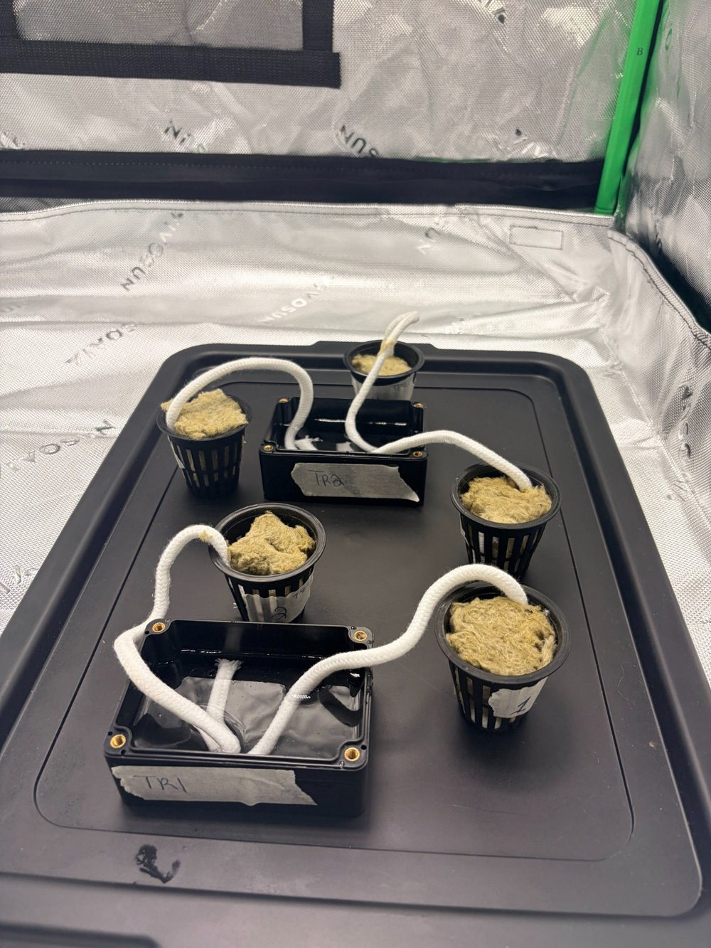
PUALEI
3 / 5
Current ground work
Growing station assembled
Grow tent and LED lighting arrangement
for terrestrial experiments.
Logging through the light cycle
Pi 5 logged light, CO₂, temperature and humidity.
October 27–28 checkout.
Light counts show relative changes, not PAR.
Earlier rockwool watering setup
Notes:
The Pi recorded 1,489 consecutive samples, one per minute. The sensor run lasted 24 hours and 48 minutes. Raw light counts showed changes in brightness. The team still needs to compare them with the timer schedule. Source: PUALEI Wick Experiment Closeout Report, October 27 and 28, 2026.

Slide 4
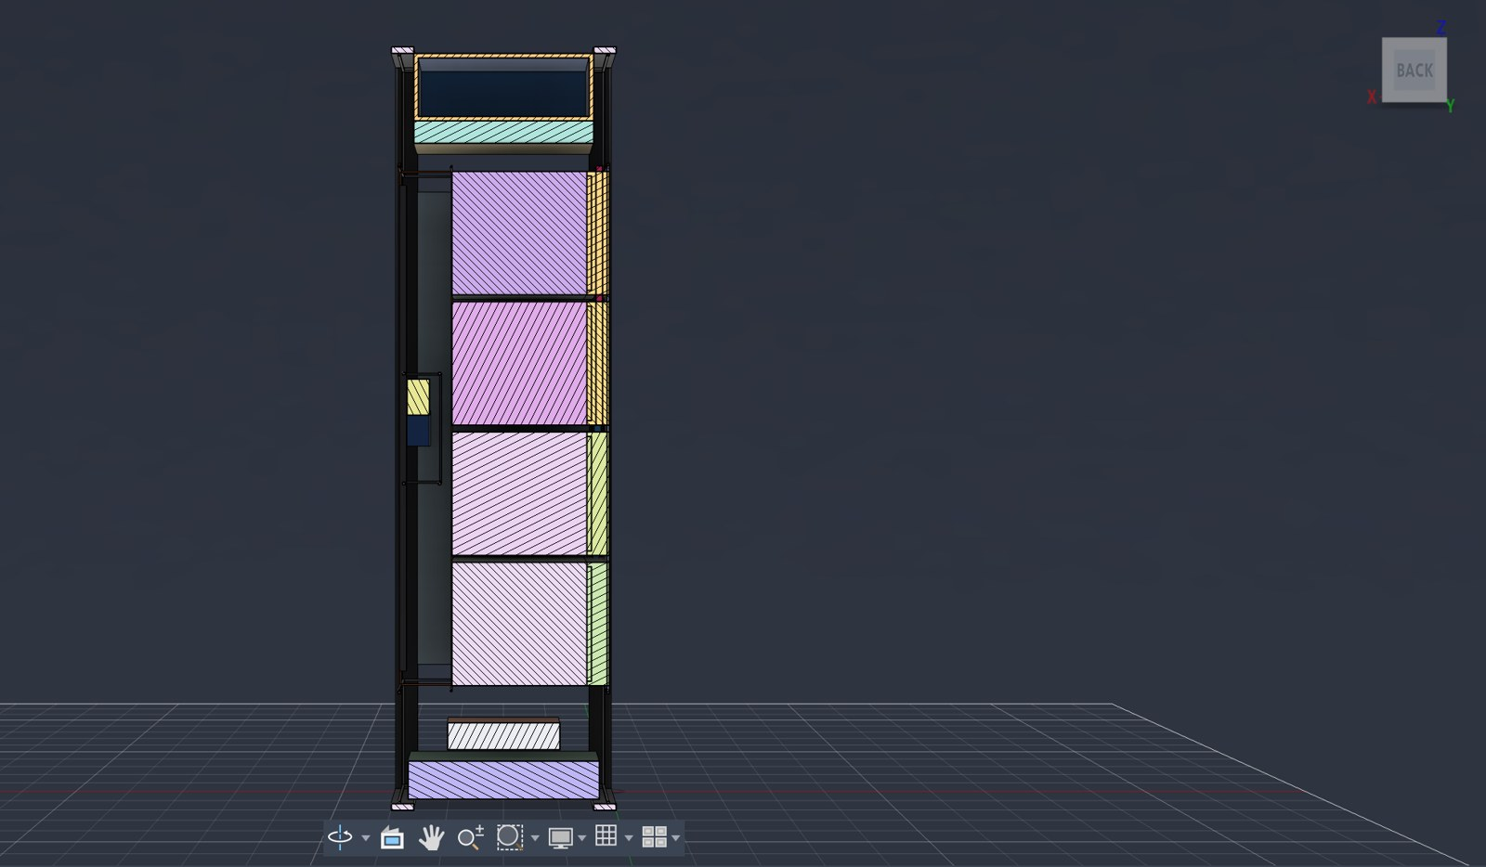
PUALEI
4 / 5
Preliminary payload concept
A compact spatial model
Working envelope: about 100 × 100 × 340 mm.
Individual wick paths supply hemp-mat trays.
The layout reserves space for imaging.
Reservoir capacity and camera selection remain
open. Optical access needs validation.
Preliminary concept. Internal volumes and camera
bodies are placeholders. Flight design remains open.
Notes:
Source: PUALEI 3U Initial Concept v4 notes, October 2026. The CAD is for spatial planning. RGB, multispectral and radiometric thermal imaging are represented as proposed modalities. No camera hardware selection or optical validation is claimed. CAD section supplied with the project materials.

Slide 5
PUALEI
5 / 5
The first wick test
We weighed 22 trays after nearly 23 hours.
What we observed
The next test
Tray 6 and its mat gained 12.82 g.
One corner of that mat stayed dry.
Most trays barely changed in mass.
Start with wet mats and wicks.
Use the same water height for each tray.
Check where the wick touches each mat.
We used distilled water and left the trays unplanted.
Notes:
The corrected endpoint sheet lists 22 tray and mat pairs. Tray 6 gained 12.82 g and retained one dry corner. Seventeen pairs changed by at most 0.10 g in absolute mass. The physical trial lasted between 22 h 37 min and 22 h 53 min. Source: PUALEI Wick Experiment Closeout Report, October 27 and 28, 2026.

