Slide 1

A Model for Multi-Drug Resistant Tuberculosis with Fast and Slow Latent States
Presented By: Shelby Scott
Partners: Aditya Biswas and Patrick McCusker
Faculty Advisor: Erin Bodine
International Symposium on Biomathematics and Ecology Education Research
St. Louis, MO
11 November 2012

Slide 2
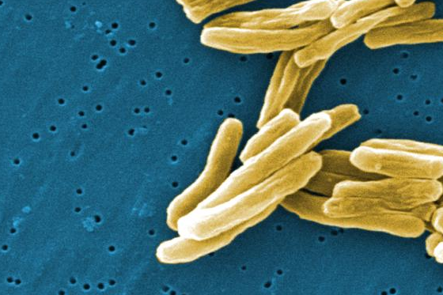
Introduction
myobacterium tuberculosis (TB)
Spread of TB through infected saliva
Worldwide issue of TB
South Africa and TB
http://www.news-medical.net/health/What-is-Tuberculosis.aspx

Slide 3
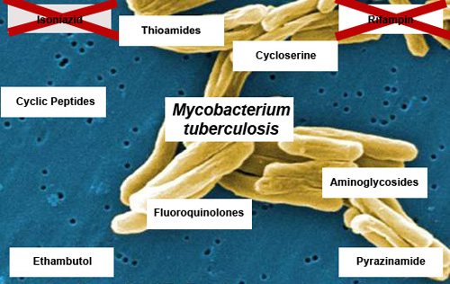
The Two-Strain Model
Drug sensitive (DS) or wild-type TB responds appropriately to drug treatment
Multi-Drug Resistant TB (MDR) resists 1-3 drugs
http://www.health24.com/tools/gallery/xdrtbgallery/

Slide 4
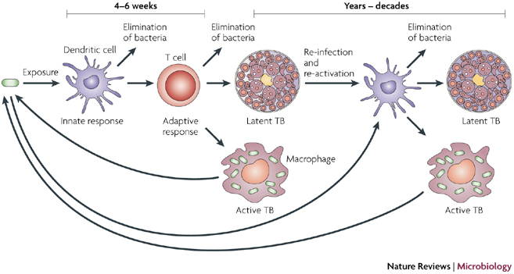
TB Latency
Fast Latency
Slow Latency
Movement of Individuals from Fast Latency into Slow Latency
http://www.nature.com/nrmicro/journal/v6/n7/box/nrmicro1919_BX2.html

Slide 5
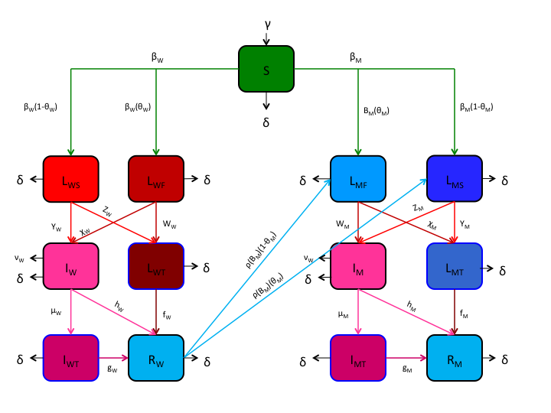
Mathematical Model

Slide 6
Parameters
Parameter | Description | Units
γ | Natural births per year in population | ppl/time
δ | Natural death rate in population | 1/time
β_{W}, β_{M} | Strain-respective transmission rates | 1/time
θ_{W}, θ_{M} | Strain-respective probabilities that a newly infected individual becomes a latent slow progressor | -
χ_{W}, χ_{M} | Strain-respective rates at which latent fast individuals become infected | 1/time
y_{W}, y_{M} | Strain-respective rates at which a latent slow progressor becomes infected | 1/time
w_{W}, w_{M} | Strain-respective rates at which a latent slow progressor receives treatment | 1/time
z_{W}, z_{M} | Strain-respective rates at which a latent slow progressor receives treatment | 1/time
μ_{W}, μ_{M} | Strain-respective rates at which an infected individual receives treatment | 1/time
f_{W}, f_{M} | Strain-respective rates at which treated latent individuals recover | 1/time
g_{W}, g_{M} | Strain-respective rates at which treated infected individuals recover | 1/time
h_{W}, h_{M} | Strain-respective rates at which an untreated individual recovers | 1/time
ν_{W}, ν_{M} | Strain-respective rates at which an untreated infected individual dies from the infection | 1/time
ρ | Degree of susceptibility to MDR strain after acquired partial immunity from DS strain | -

Slide 7
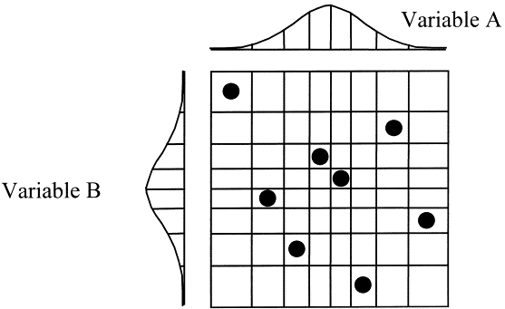
Uncertainty Analysis
Purpose of Uncertainty Analysis
Uncertainty Analysis: Latin Hypercube Sampling (LHS)
http://www.sciencedirect.com/science/article/pii/S1350630700000091

Slide 8
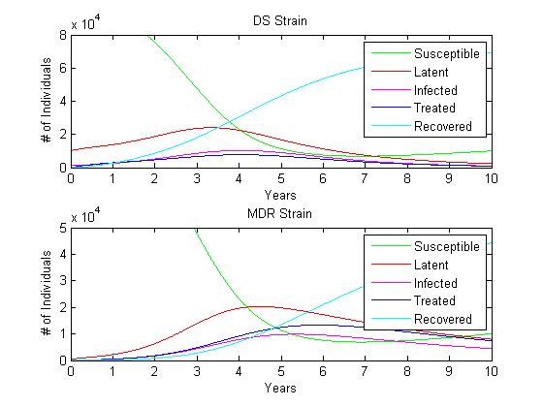
Results: LHS
Comparison of MDR and DS strains
10,000 Simulations over a span of 10 years
Initial susceptible population of 100,000

Slide 9
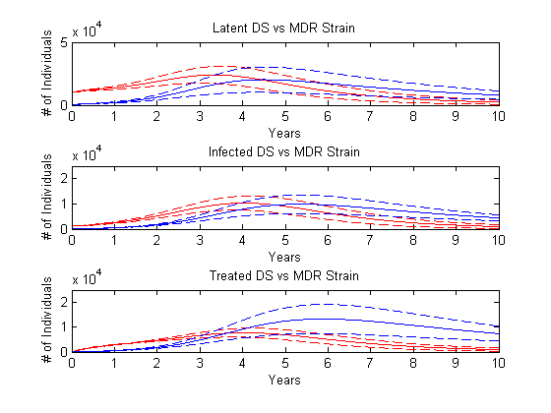
Results: Quartile Analysis
Purpose of Quartile Analysis
DS strain quartile (represented by red lines)
MDR strain quartile (represented by blue lines)

Slide 10
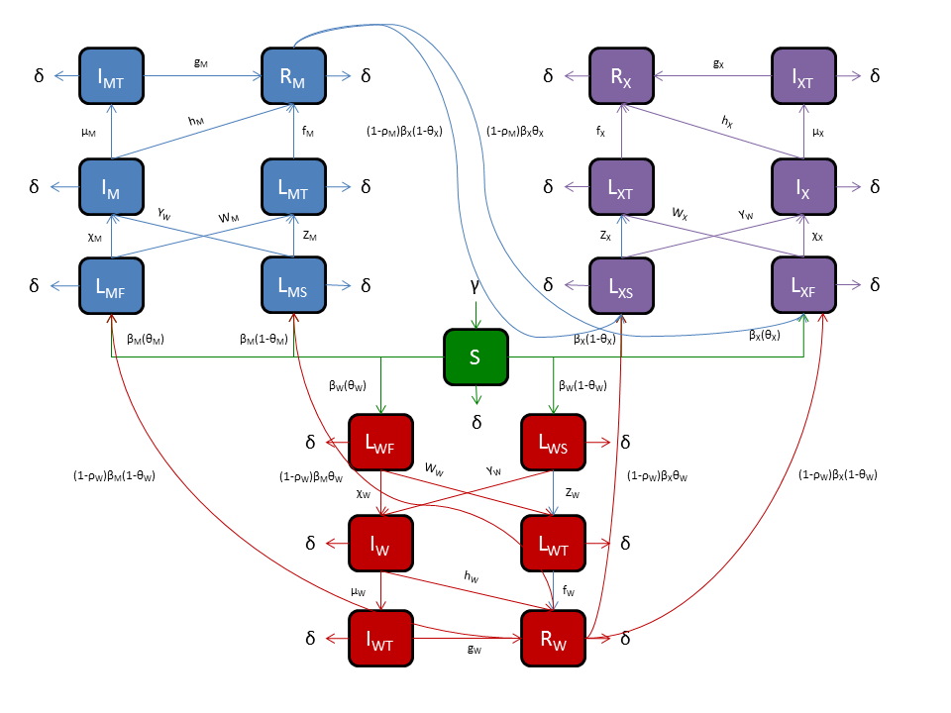
Modifications
Extensively Drug Resistant (XDR) TB
Resistance to >3 medications
PRCC Analysis
Future Comparison to MDR

Slide 11
Math 315- Mathematical Modeling
Coding
MatLab
LaTex
Peer Reviews
Writing
Scientific Writing vs. Humanities Writing
Implications of Results

Slide 12
References
http://www.cdc.gov/tb/
http://www.gummy-stuff.org/latin-hypercube.htm
http://mathworld.wolfram.com/Quartile.html
http://www.ncbi.nlm.nih.gov/pmc/articles/PMC2570191/

