Slide 1
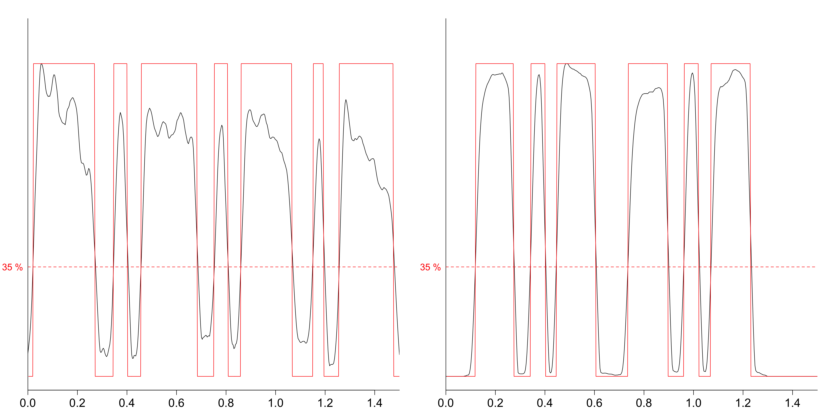
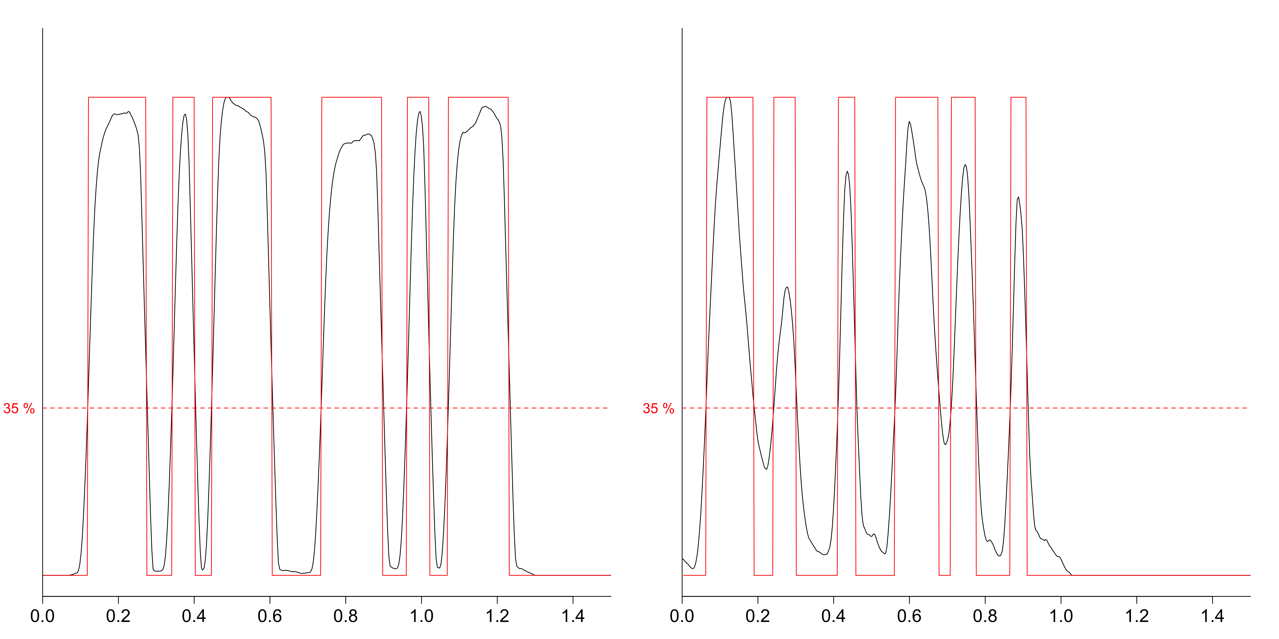
a)
Trochaic Rhythm
Cretic Rhythm
A
B
A
B
A
B
A
A
B
A
B
A
B
b)
Cretic Rhythm
Dactyl Rhythm
Amplitude (percentage of peak)
B
C
B
C
B
C
B
C
A
A
A
A
Time (s)

