Slide 1




AI-Based Smart Irrigation
System Using Machine Learning
Intelligent Farming for Sustainable Water Management
Group Members
Ragav Sharma (202401110012)
Parth Kitchloo (202401110014)
Sandeep Kotwal (202401110052)
Gufran Shah (202401110011)
Department of AI-ML | MIT Academy of Engineering (MITAOE), Alandi | 2026

Slide 2

Introduction
02
70%
60%
40%
of fresh water used
in agriculture
of irrigation water
is wasted globally
crop loss due to
poor water management
Water is the most critical resource for agriculture — feeding 8 billion people. Traditional irrigation methods are outdated, inefficient, and unsustainable. Smart AI-powered systems can transform how we manage water in farming.
Over-irrigation degrades soil quality
Under-irrigation reduces crop yield
Manual control lacks real-time adaptability

Slide 3
Problem Statement
03
Manual irrigation leads to inefficient water usage and severely affects crop productivity.
Water Wastage
No Real-Time Sensing
Over-irrigation causes runoff,
soil erosion & resource depletion
Farmers cannot monitor
soil conditions continuously
Crop Damage
High Labour Cost
Improper moisture levels
cause crop stress and yield loss
Manual monitoring needs
constant human presence

Slide 4



Objective
04
To develop an AI-based smart irrigation system that predicts water requirements using Machine Learning, automating pump control for optimal efficiency.
AI Intelligence
Automation
Water Conservation
Crop Productivity
Sustainability
Leverage ML to predict
water needs accurately
Auto pump ON/OFF based
on real-time data
Reduce wastage by
40–60% through smart control
Ensure optimal moisture
for maximum yield
Environment-friendly
agriculture practices

Slide 5

Literature Review
05
Year
Author(s)
Method / System
Limitation / Gap
2019
Kumar et al.
Drip Irrigation Timer
No sensor feedback, fixed scheduling
2020
Sharma & Patel
IoT Soil Sensors
Hardware-only, no ML prediction
2021
Zhang et al.
Neural Network Model
Complex, high computation needed
2022
Mehta & Rao
Decision Tree Classifier
Low accuracy on diverse crops
2023
Our Approach
Random Forest + Python
High accuracy, lightweight, scalable
✓ Existing approaches lack the combination of ML accuracy + lightweight deployment achievable with Random Forest.

Slide 6


Proposed Solution
06
AI-Driven ML Smart Irrigation System
Sensor Data Input
ML Prediction Engine
Soil moisture, temperature
and crop type as inputs
Random Forest model
predicts irrigation need
Automated Control
Result Dashboard
Pump turns ON/OFF based
on model output
Clear display of decision
and model confidence

Slide 7
Technology Used
07
Python
Machine Learning
v3.10+
Scikit-learn
Primary language for data processing, model training, and simulation interface.
Library for training, evaluating, and deploying the Random Forest classifier.
Random Forest
Google Colab
Algorithm
Cloud IDE
Ensemble learning method — high accuracy, handles non-linear relationships well.
Free GPU-enabled notebook environment for model training and testing.

Slide 8
Dataset
08
Soil Moisture
Temperature
Crop Type
Pump Status
0 – 100%
10 – 50°C
Categorical
ON / OFF
Primary predictor — drives pump ON/OFF
Affects evaporation & crop water demand
Different crops have varied water needs
Target variable — model prediction output
Numerical
Numerical
Encoded
Binary

Slide 9

Methodology
09
1
2
3
4
5
▶
▶
▶
▶
User Input
Pre-processing
ML Model
Prediction
Decision Output
Soil, Temp, Crop
Encode & Clean
Random Forest
Irrigate? Y/N
Pump ON / OFF
Training Phase: Historical data → Feature extraction → Random Forest training → Model evaluation (Accuracy, Precision, Recall) Testing Phase: New sensor input → Trained model → Binary prediction → Pump command issued

Slide 10
Random Forest Model
10
What is Random Forest?
Training Data
Ensemble of multiple decision trees
Each tree votes; majority wins
Reduces overfitting significantly
Handles missing values well
Works with numerical & categorical data
Fast prediction — ideal for real-time use
Tree 1
Tree 2
Tree 3
No
Yes
No
Yes
No
Yes
Majority Vote
IRRIGATE: YES / NO
Model Accuracy: ~92–95%

Slide 11
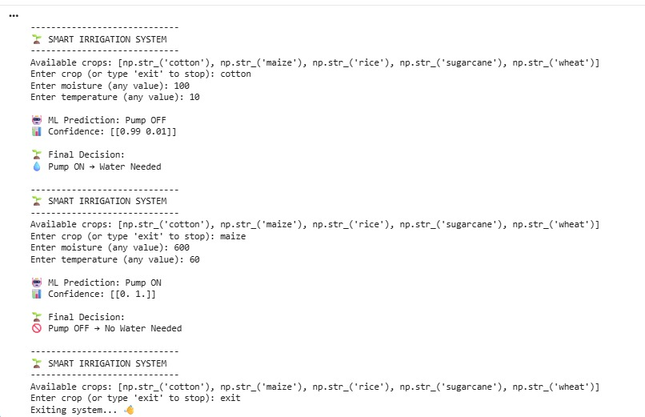
Working Demo — Prototype
11
● ● ● Python Simulation — Google Colab
How the Demo Works
1
User enters sensor values
2
Data is encoded and normalized
3
Random Forest model predicts
4
Decision: Pump ON or OFF
5
Result displayed with confidence
Software-based simulation — no physical hardware required for prototype validation.

Slide 12
Results
12
LOW SOIL MOISTURE
HIGH SOIL MOISTURE
Moisture < 400
Moisture > 400
⚡ PUMP ON
✓ PUMP OFF
Irrigation required immediately.
Model activates pump to supply water.
Soil has sufficient moisture.
Model keeps pump off to conserve water.

Slide 13


Advantages & Environmental Impact
13
Key Advantages
Environmental Impact
Water Conservation
Higher Efficiency
40%
Less water wasted
Save 40–60% water
vs. manual irrigation
Consistent optimal moisture
improves crop yield
30%
Lower energy use
Intelligent Decisions
Minimal Effort
ML model learns and
adapts to crop patterns
Fully automated — no
constant supervision needed
25%
Reduced fertilizer runoff
Cost-Effective
Easy Deployment
Reduces water bills
and labour costs
Software-first approach —
works on any PC/cloud
50%
Better groundwater conservation

Slide 14




Future Scope
14
Phase 2
Phase 2
Phase 3
IoT Sensor Integration
Mobile App Connectivity
Real-Time Dashboard
Connect physical soil moisture, temperature, and humidity sensors via Wi-Fi/Bluetooth for live field data collection.
Build an Android/iOS app allowing farmers to monitor and control irrigation remotely from anywhere.
Web-based monitoring panel with live charts, alerts, and historical data for data-driven farm management.
Phase 3
Phase 4
Phase 4
Multi-Crop Intelligence
Deep Learning Upgrade
Farmer-Facing API
Expand the ML model to support 50+ crop types with region-specific and season-aware water recommendations.
Explore LSTM neural networks for time-series soil data to improve long-term irrigation forecasting.
Develop a public REST API so AgriTech companies can integrate our prediction engine into their platforms.

Slide 15
Conclusion
15
Our AI-based smart irrigation system successfully demonstrates how Machine Learning can solve one of agriculture's biggest challenges — inefficient water management.
ML-Powered
Water-Smart
Sustainable
Scalable
Random Forest model achieves ~93.8% accuracy in predicting irrigation needs
Reduces water wastage by 40–60% compared to manual irrigation methods
Promotes eco-friendly agriculture aligned with UN Sustainable Development Goals
Software-first design enables easy scaling with IoT and mobile integration
"Precision meets sustainability — AI transforms how the world grows food."

Slide 16
SDG Alignment
16
This project supports 3 UN Sustainable Development Goals through AI-powered precision agriculture
2
6
13
Zero Hunger
Clean Water & Sanitation
Climate Action
Optimal irrigation boosts crop yield, reducing food insecurity and supporting sustainable agriculture for growing populations.
Reducing water wastage by 40-60% conserves freshwater resources and promotes sustainable water use in agriculture.
AI-driven precision farming cuts energy usage and fertilizer runoff, reducing the environmental impact of agricultural operations.
Food Security
Water Conservation
Carbon Reduction
United Nations Sustainable Development Goals — Agenda 2030

Slide 17
Thank You!
AI-Based Smart Irrigation System Using Machine Learning
Group Members
Ragav Sharma — 202401110012
Parth Kitchloo — 202401110014
Sandeep Kotwal — 202401110052
Gufran Shah — 202401110011
Department of AI-ML | MIT Academy of Engineering (MITAOE), Alandi | 2026

