Slide 1
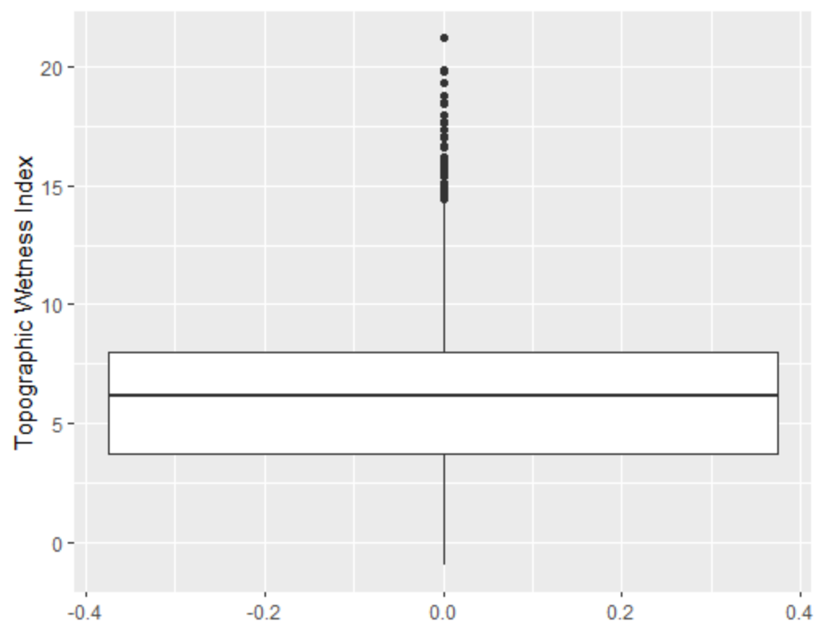
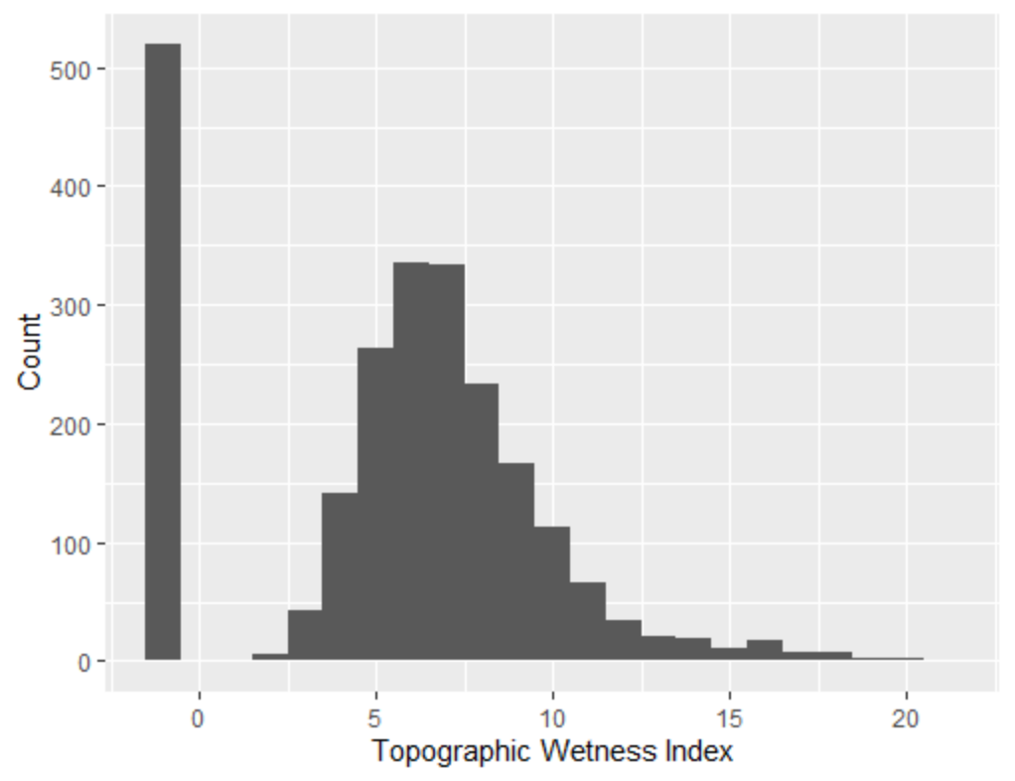
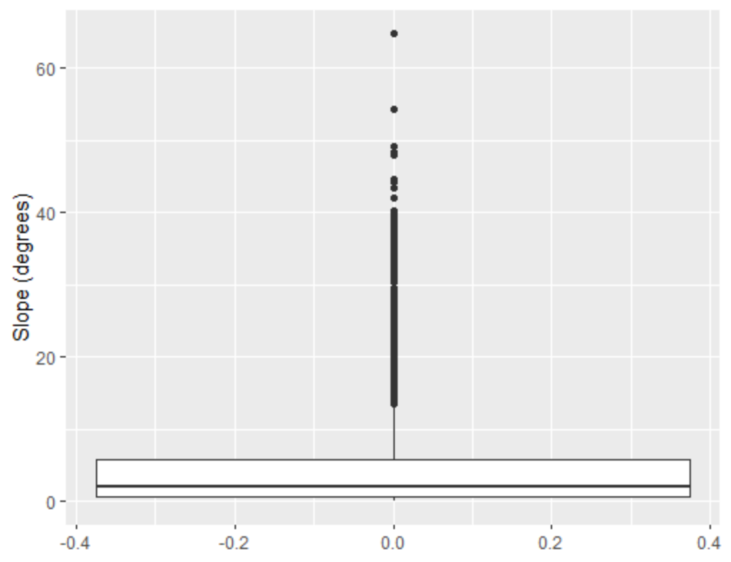
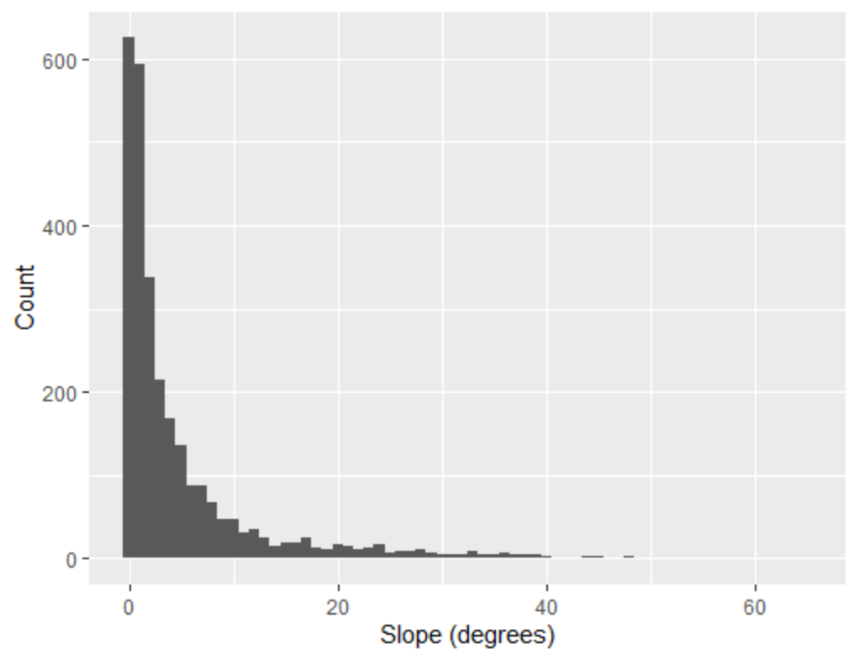
All Observations

Slide 2
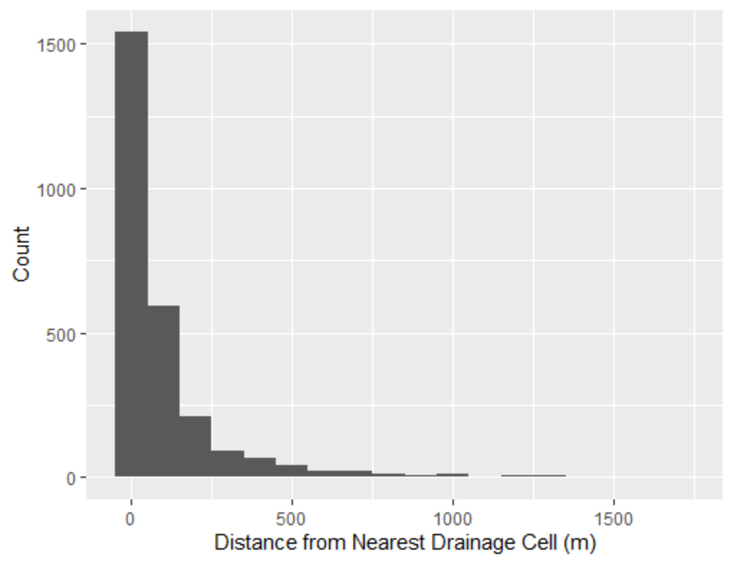
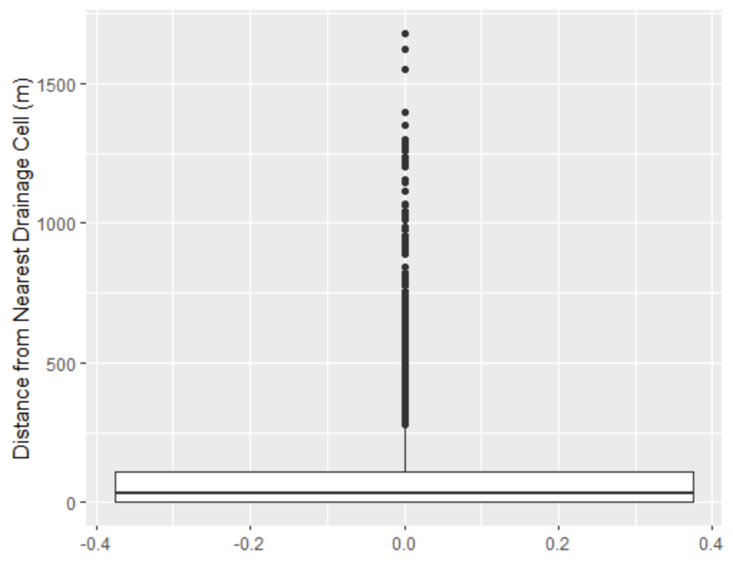
All Observations

Slide 3
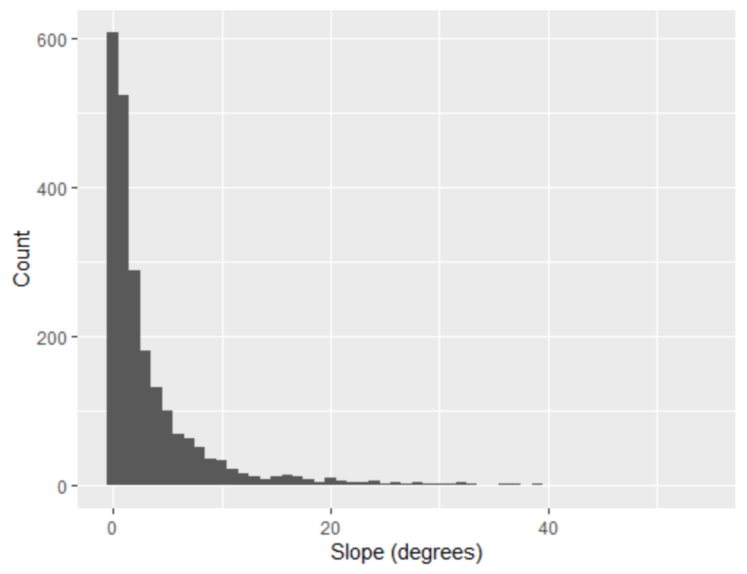
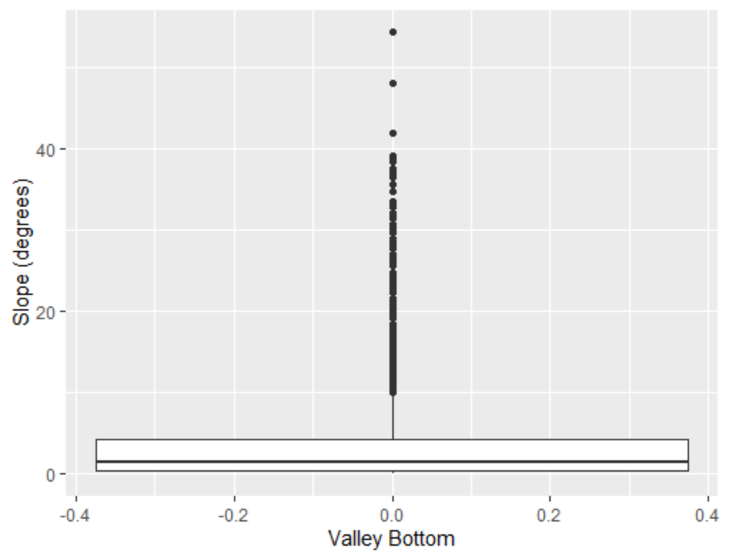
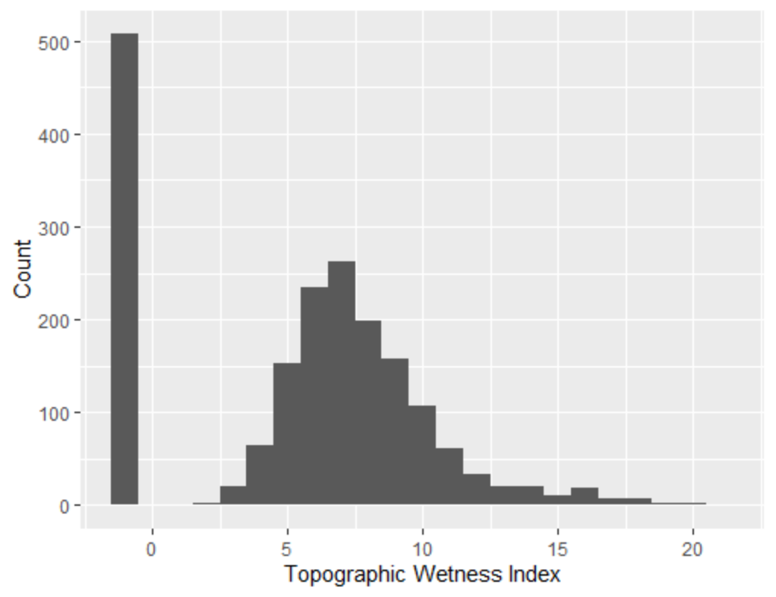
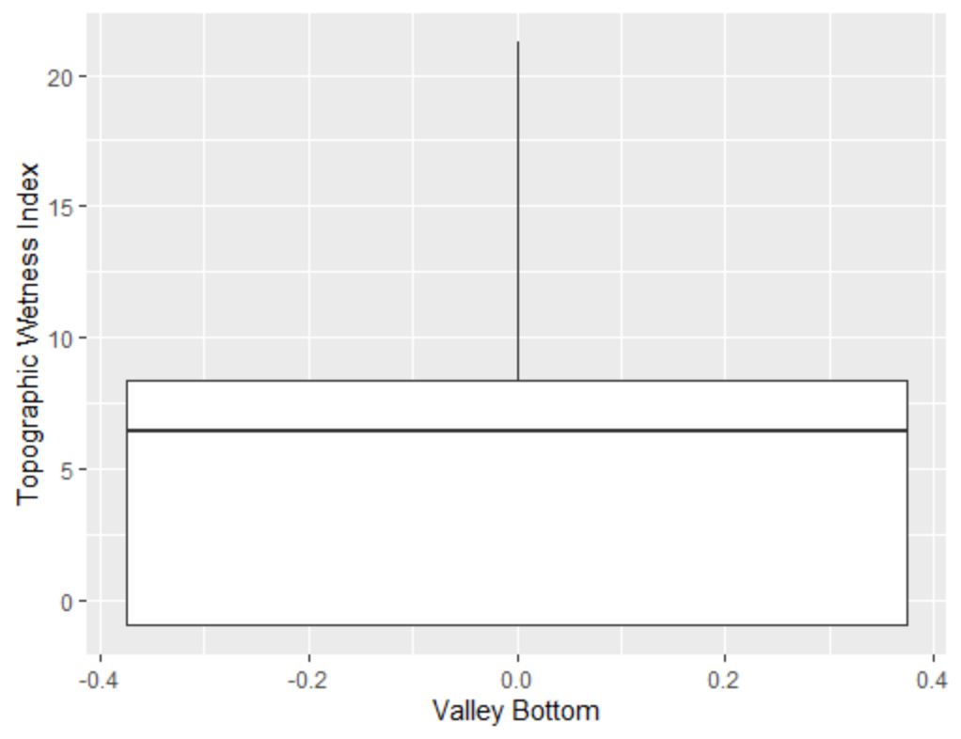
Valley Bottom

Slide 4
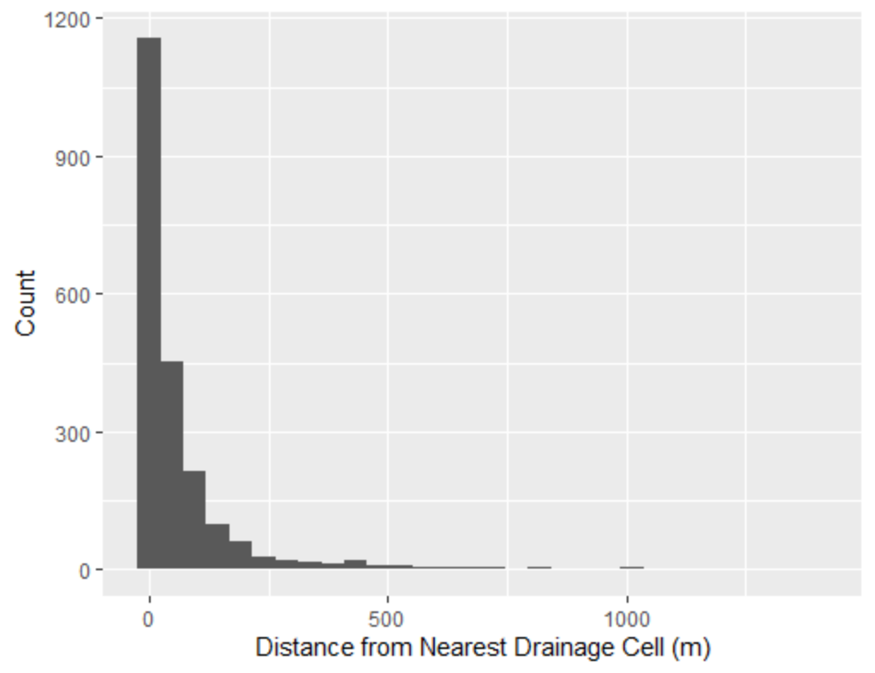
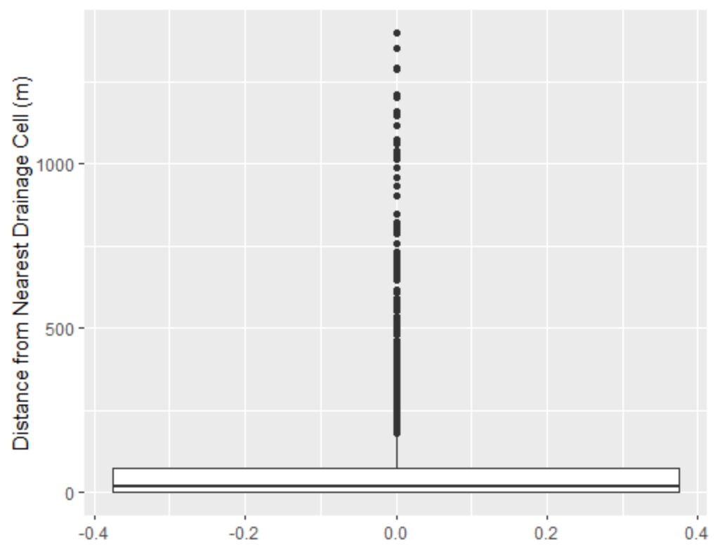
Valley Bottom

Slide 5
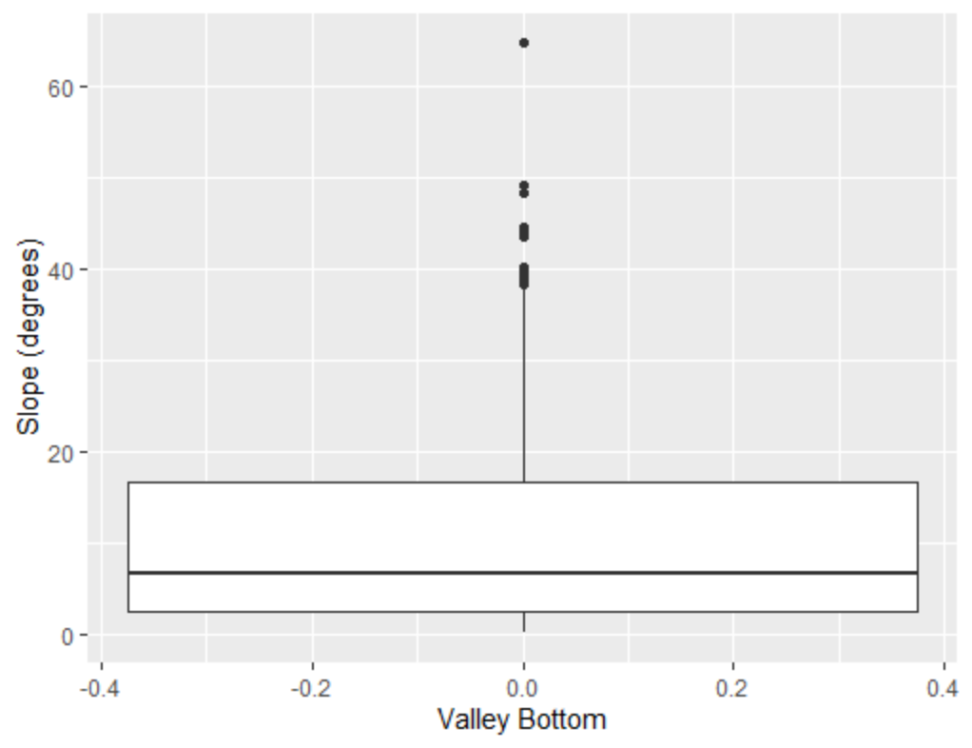
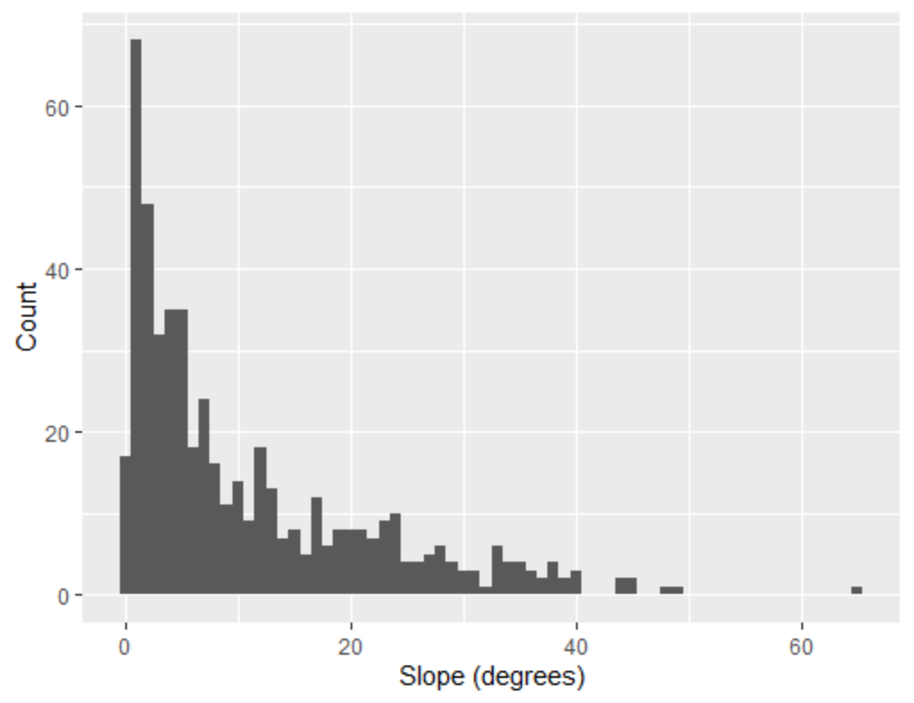
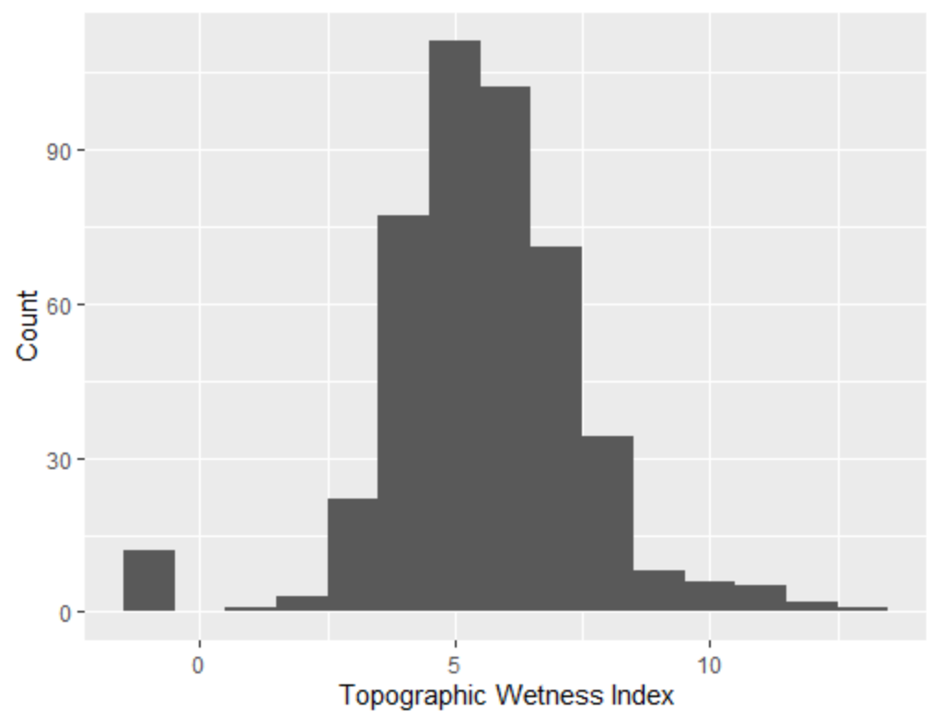
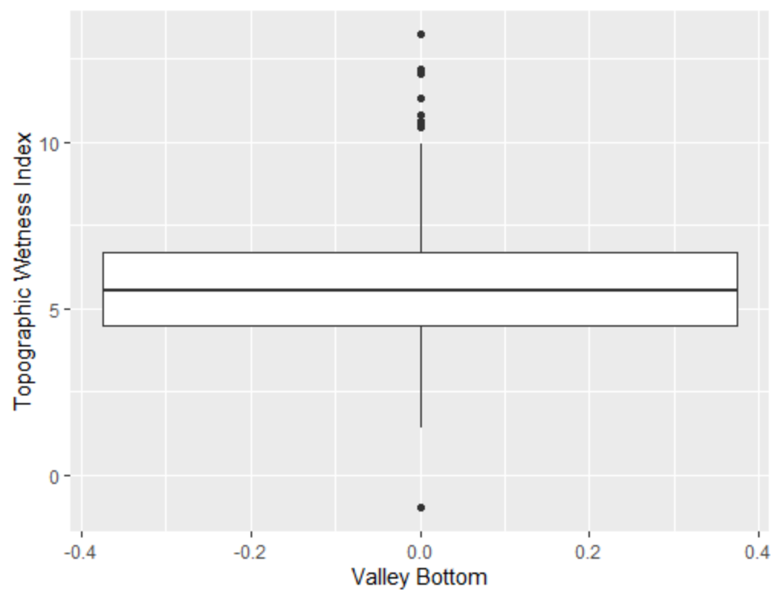
Non-Valley Bottom

Slide 6
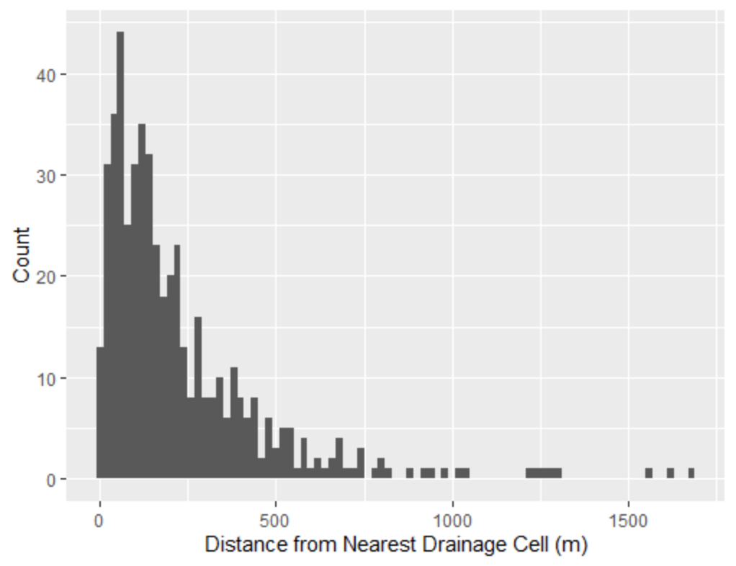
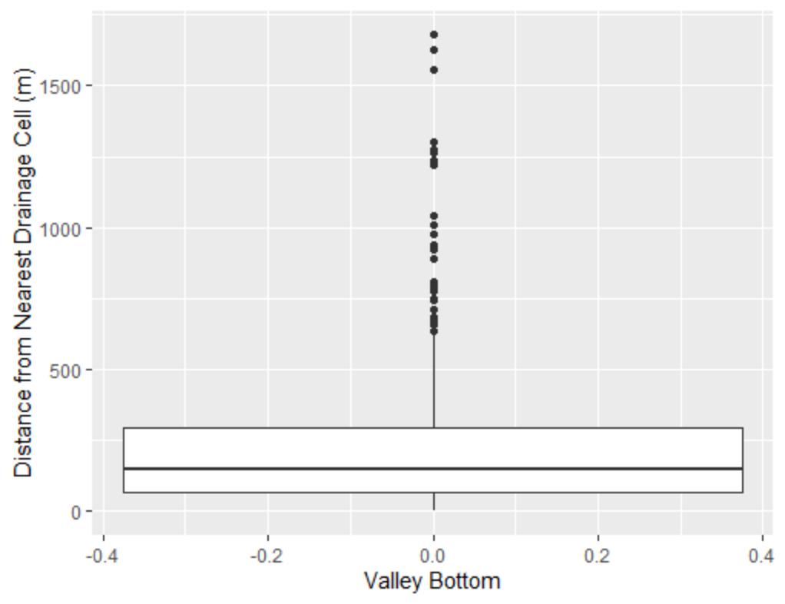
Non-Valley Bottom

Slide 7
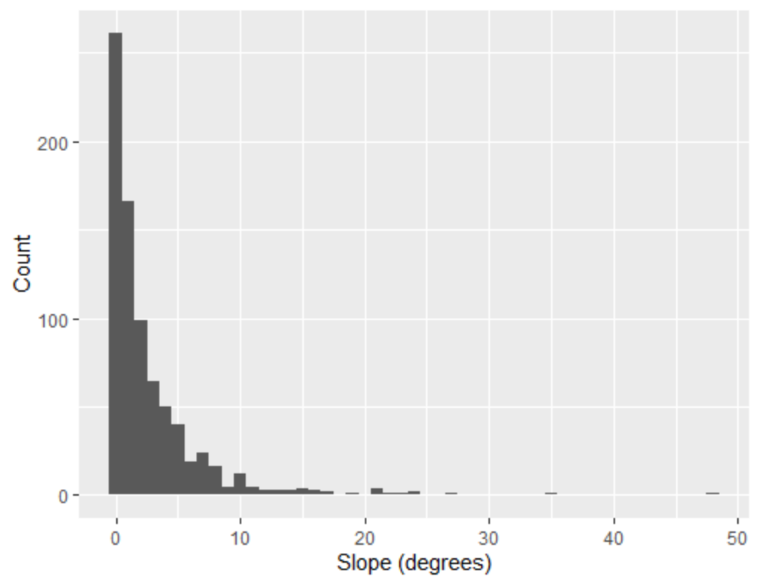
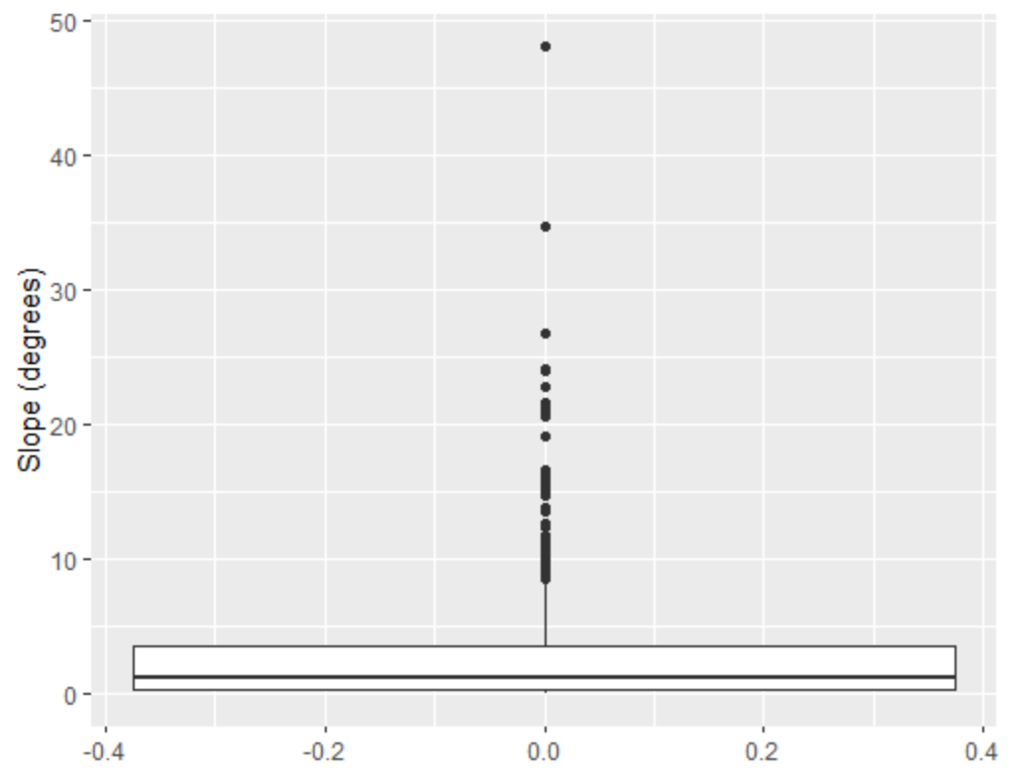
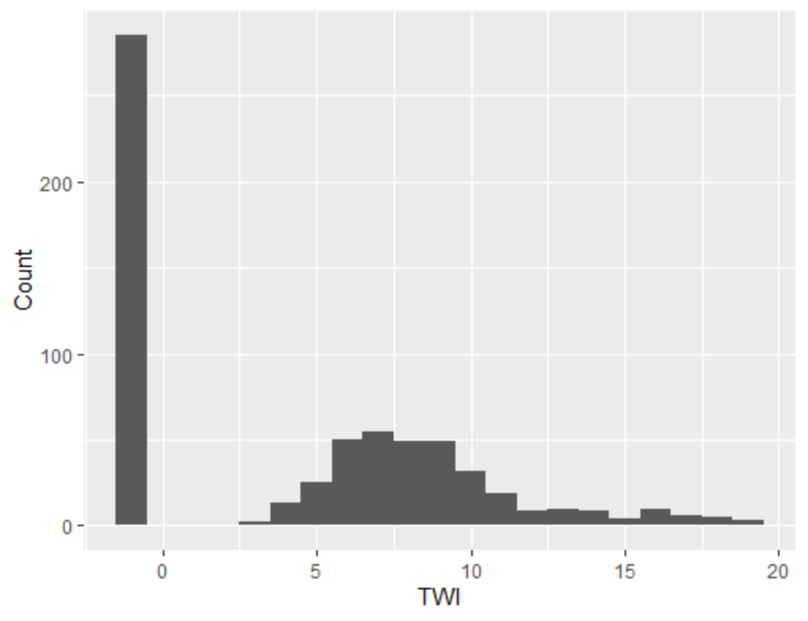
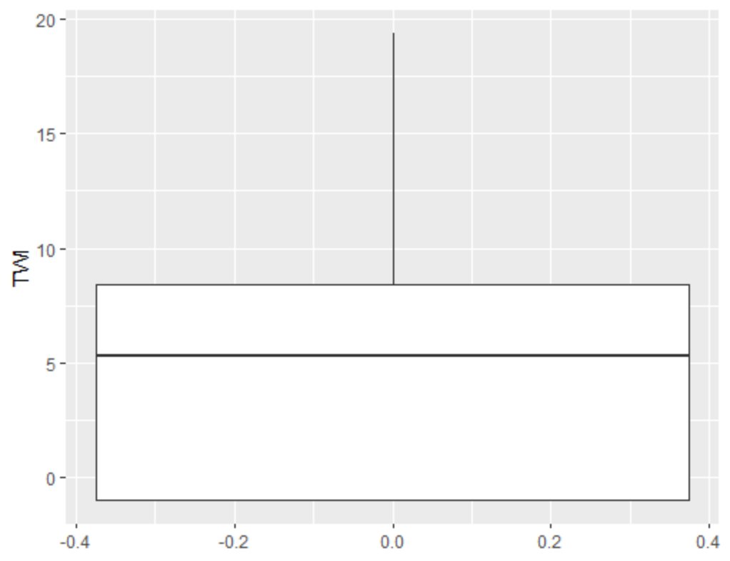
In-Channel

Slide 8
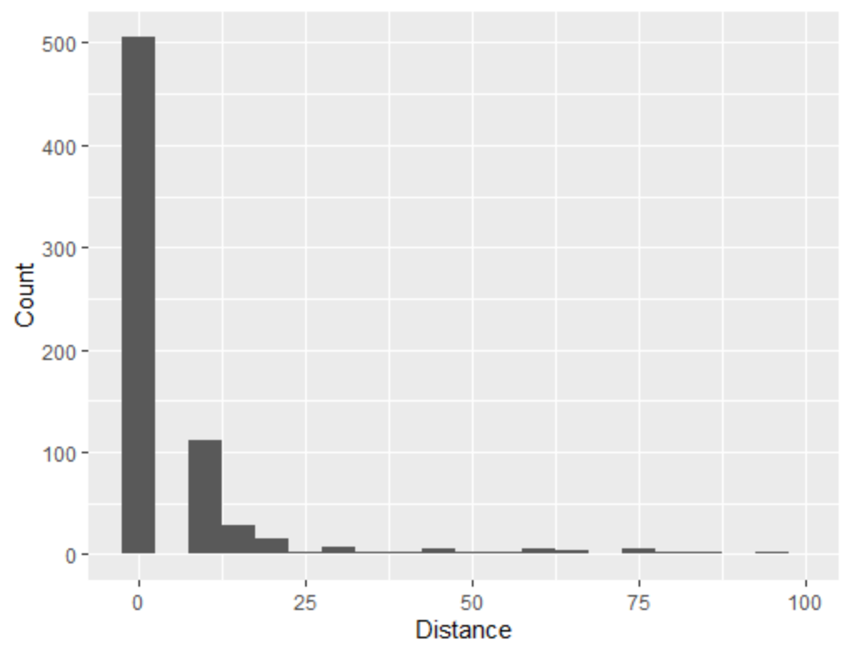
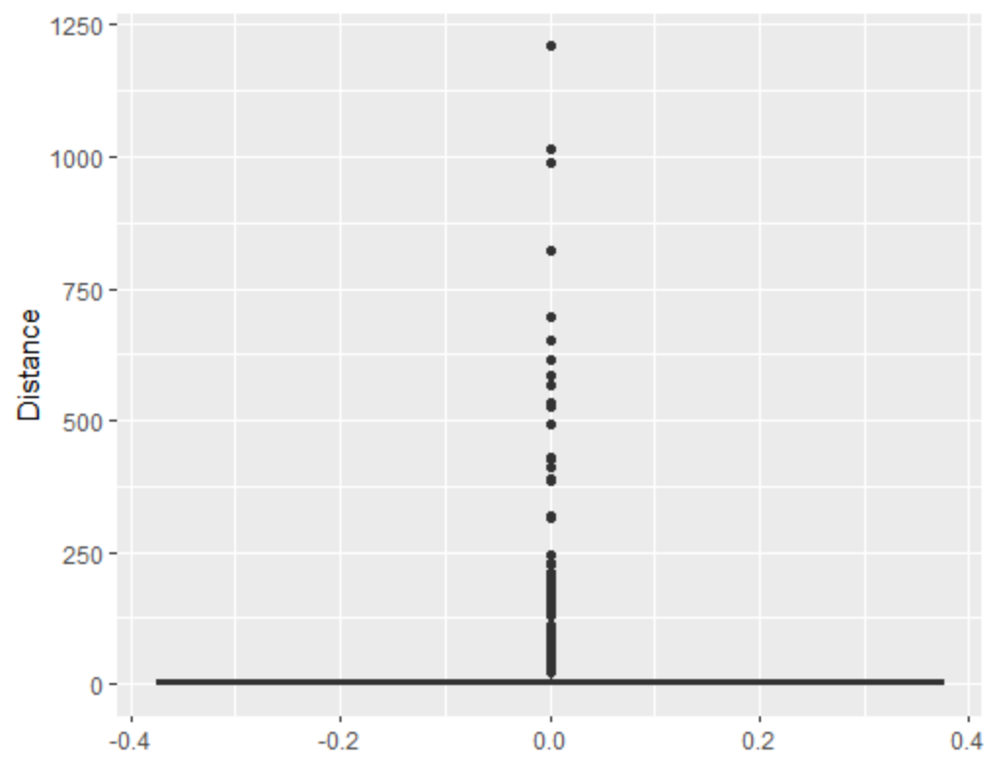
In-Channel

Slide 9
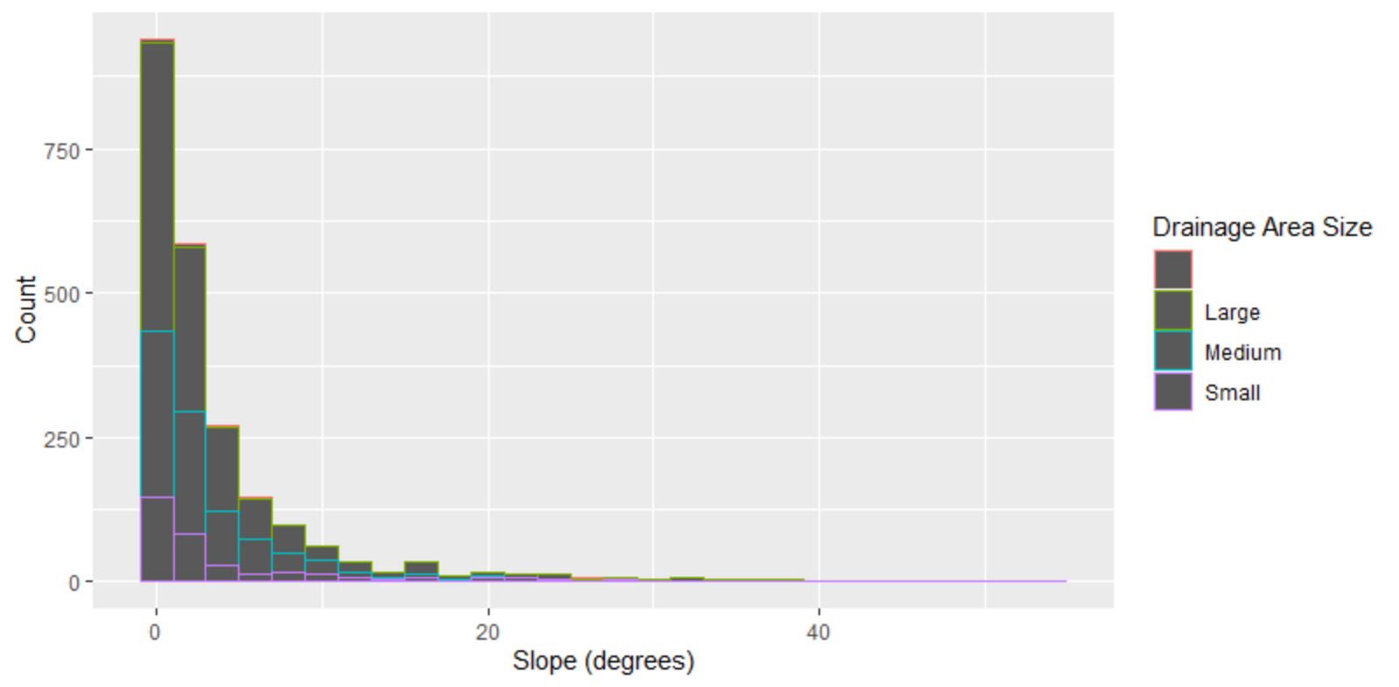
Valley Bottom by Sm, Md, Lg

Slide 10
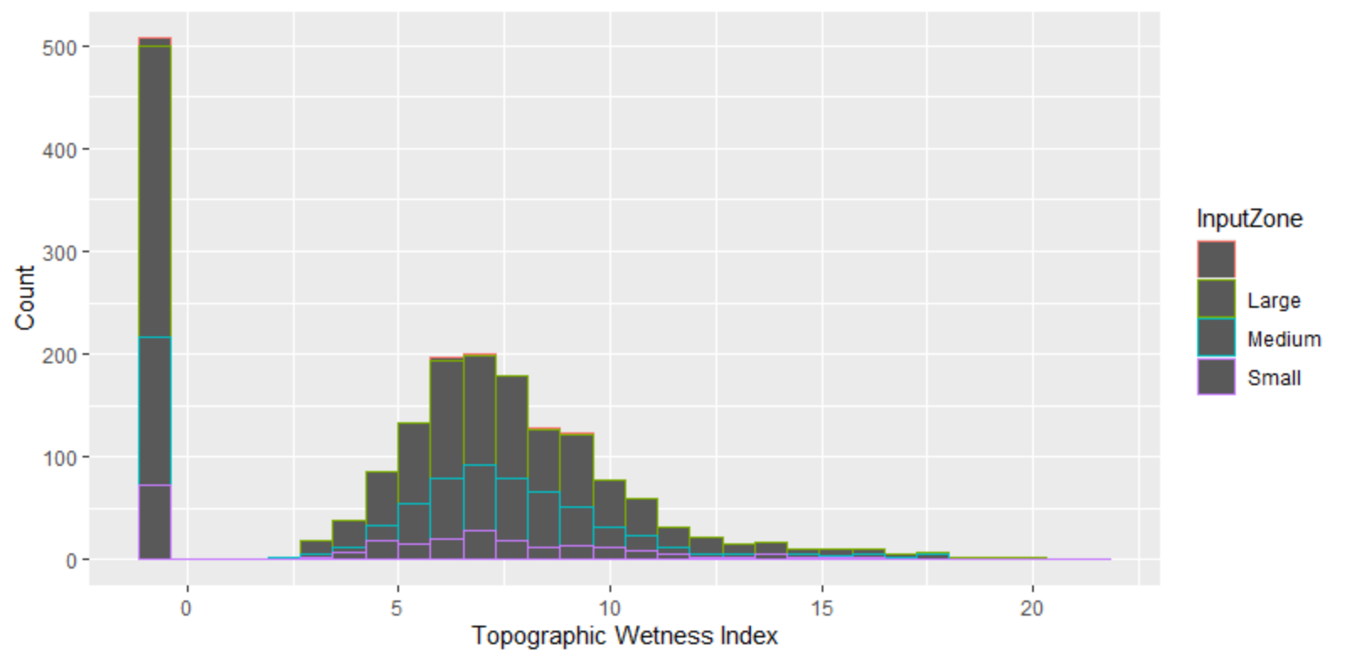
Valley Bottom by Sm, Md, Lg

Slide 11
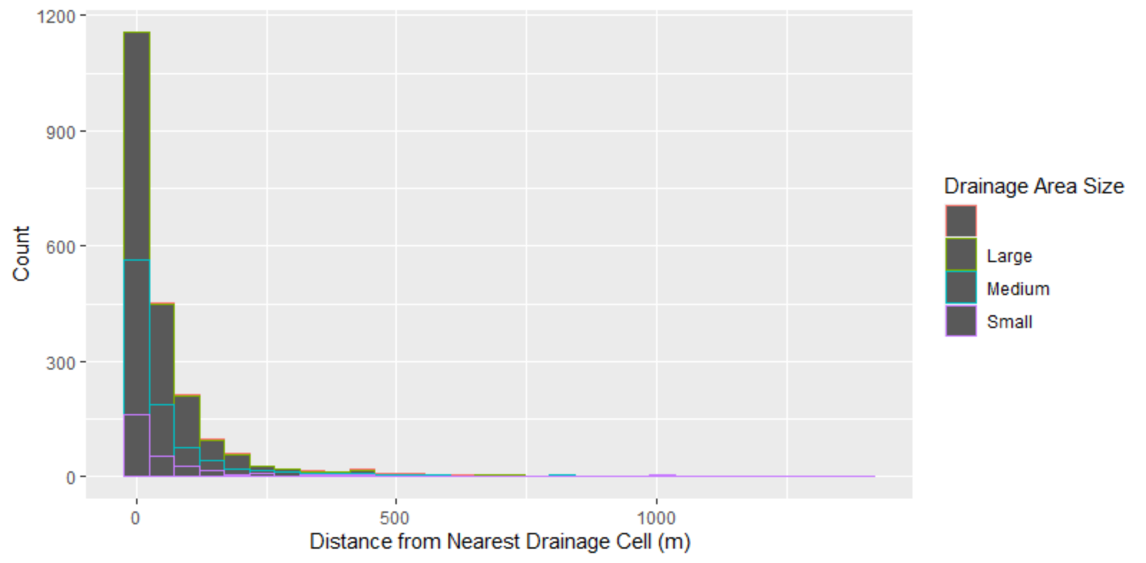
Valley Bottom by Sm, Md, Lg

Slide 12
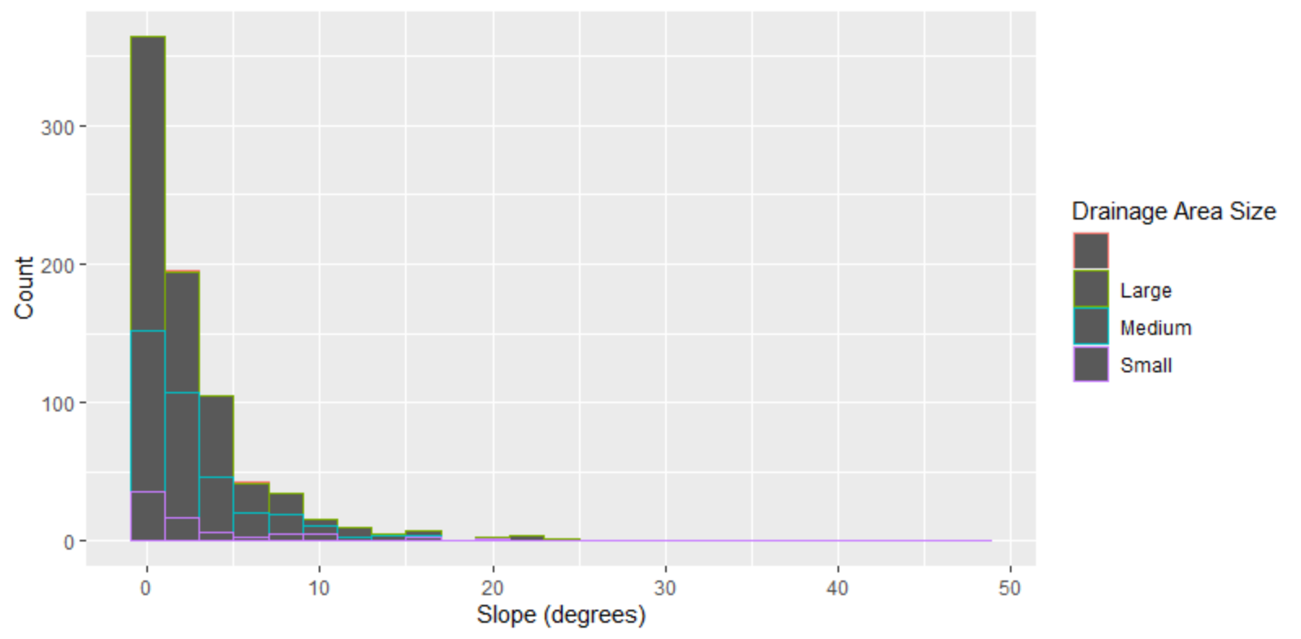
In-Channel by Sm, Md, Lg

Slide 13
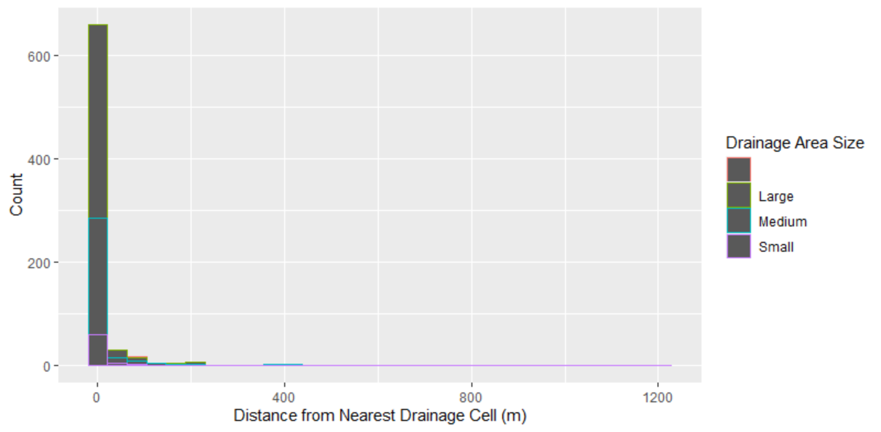
In-Channel by Sm, Md, Lg – with outlier

Slide 14
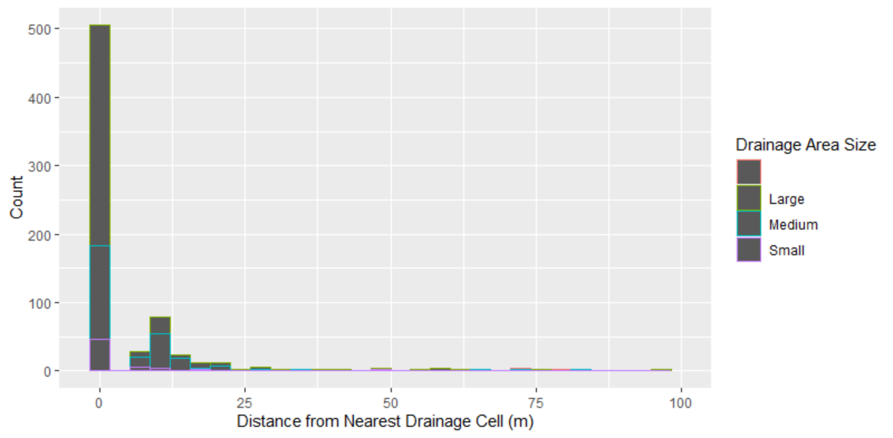
In-Channel by Sm, Md, Lg

Slide 15
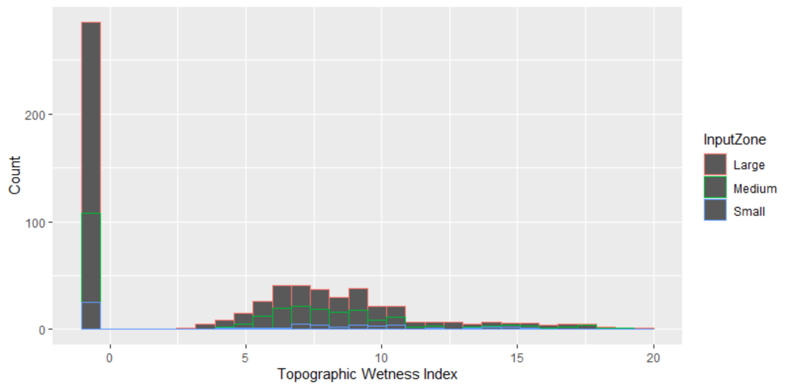
In-Channel by Sm, Md, Lg

Slide 16
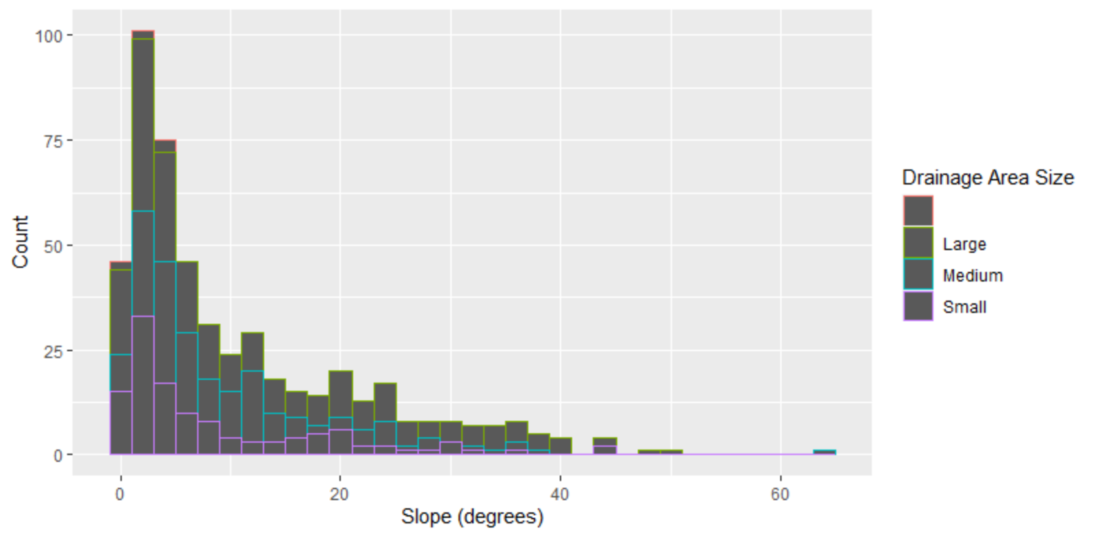
Non-Valley Bottom by Sm, Md, Lg

Slide 17
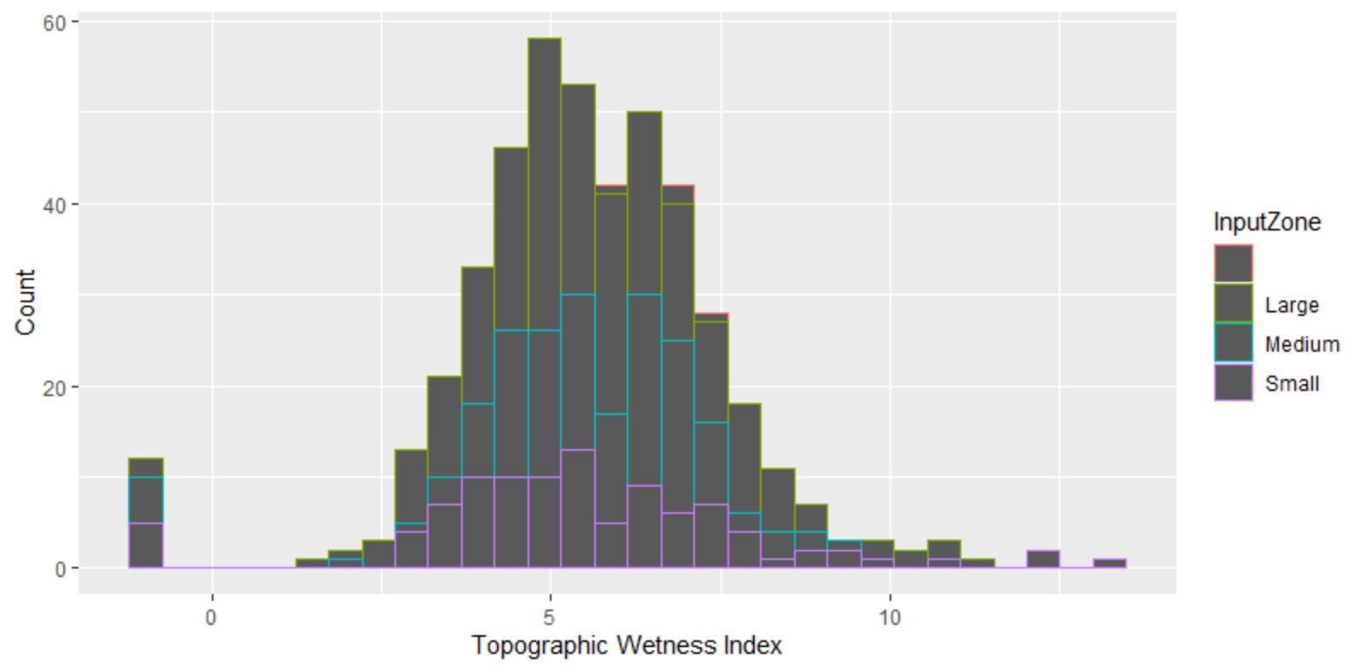
Non-Valley Bottom by Sm, Md, Lg

Slide 18
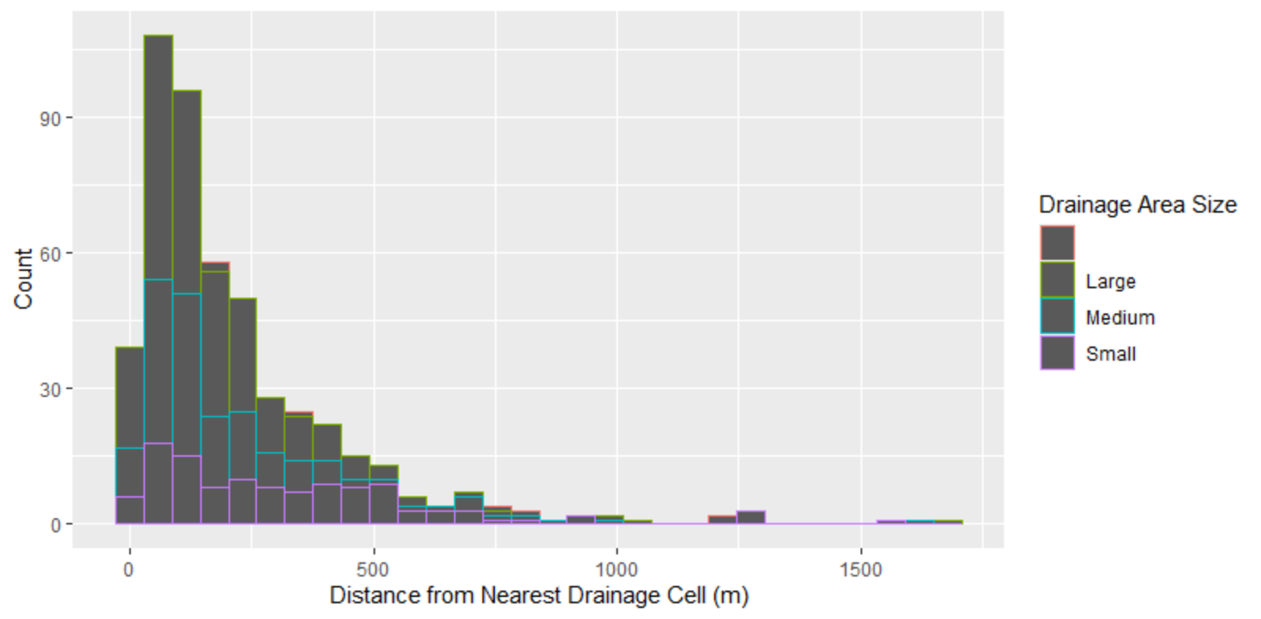
Non-Valley Bottom by Sm, Md, Lg

Slide 19
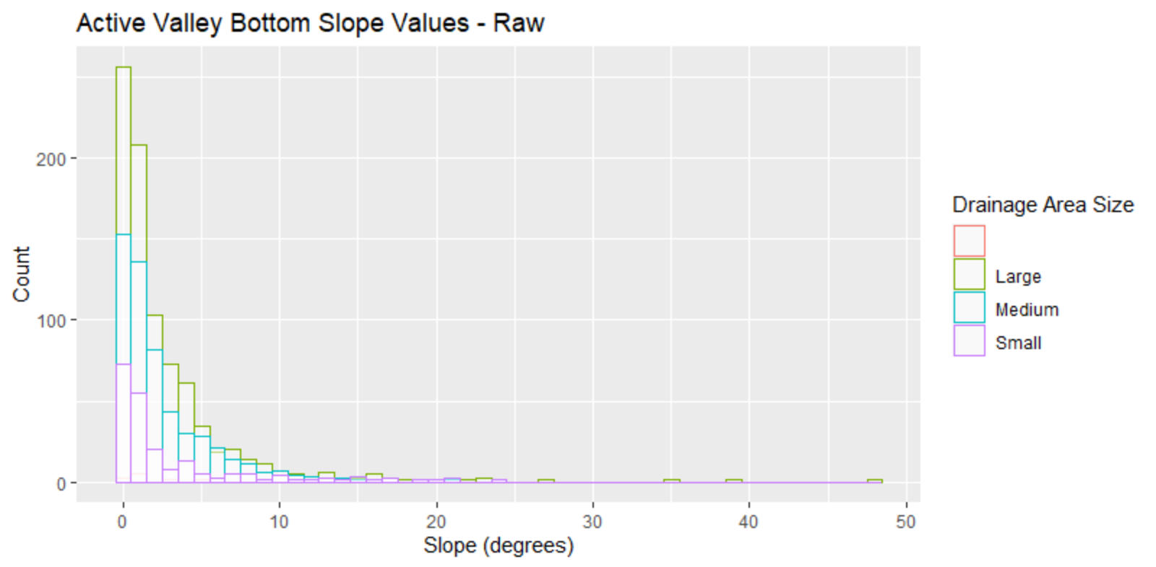
Active Valley Bottom by Drainage Area Size

Slide 20
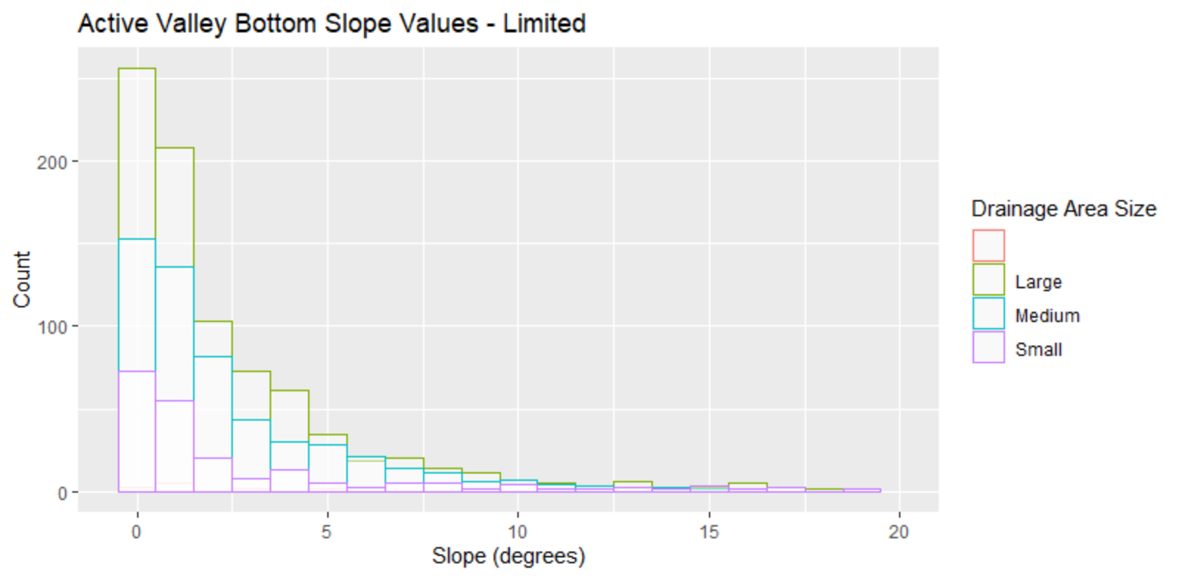
Active Valley Bottom by Drainage Area Size

Slide 21
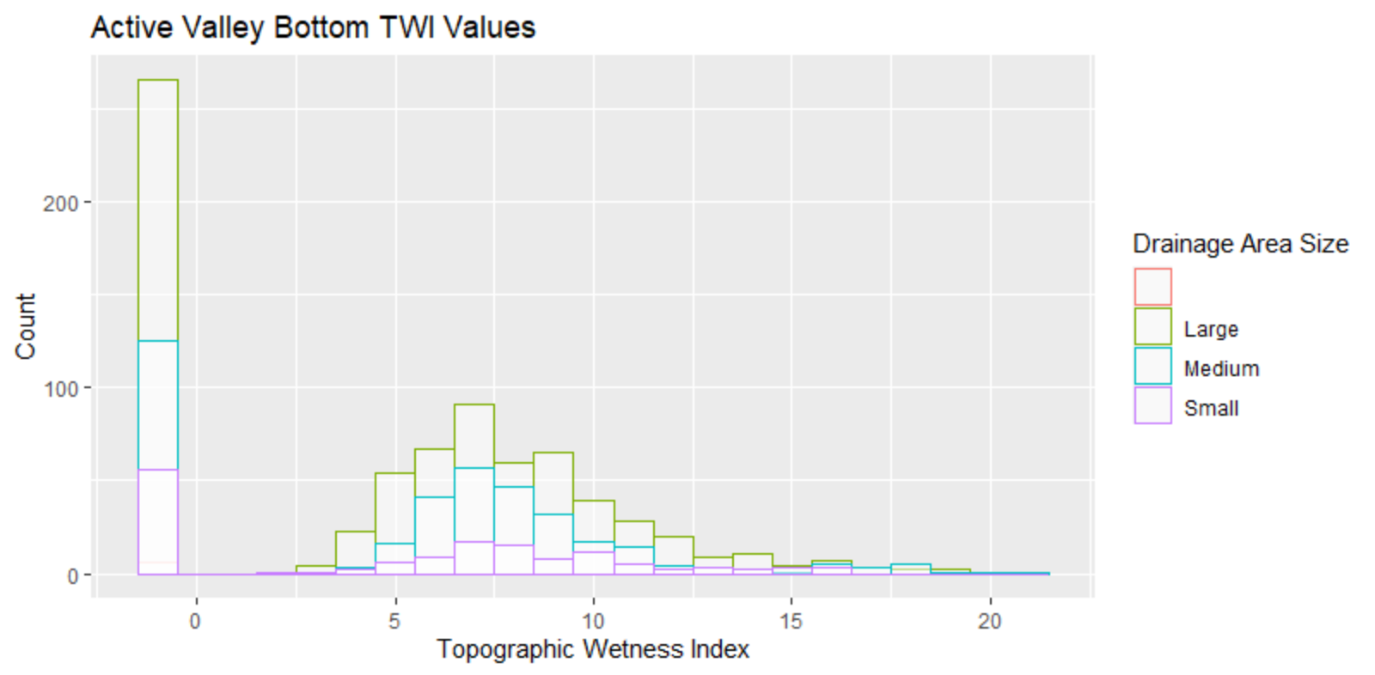
Active Valley Bottom by Drainage Area Size

Slide 22
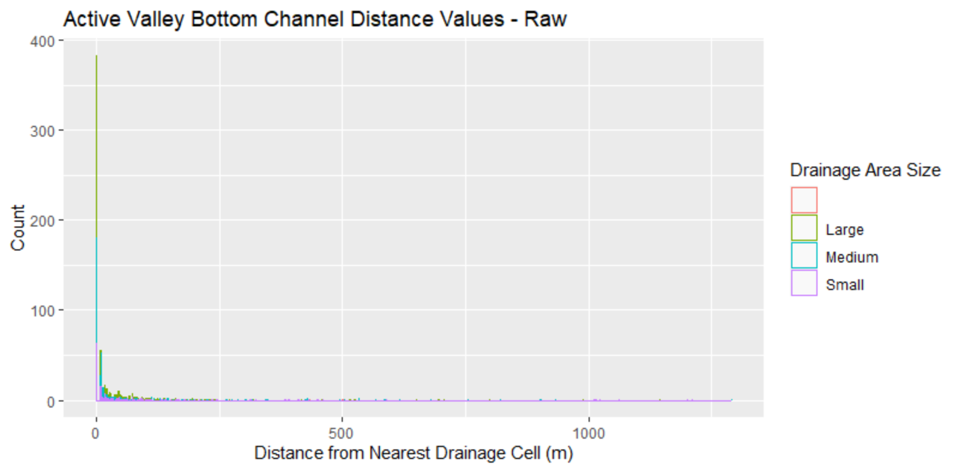
Active Valley Bottom by Drainage Area Size

Slide 23
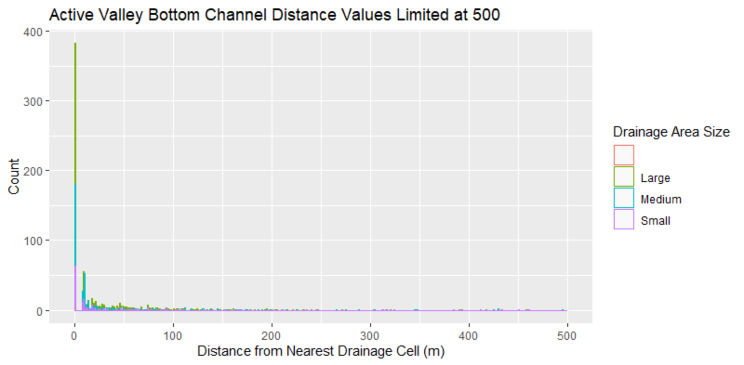
Active Valley Bottom by Drainage Area Size

Slide 24
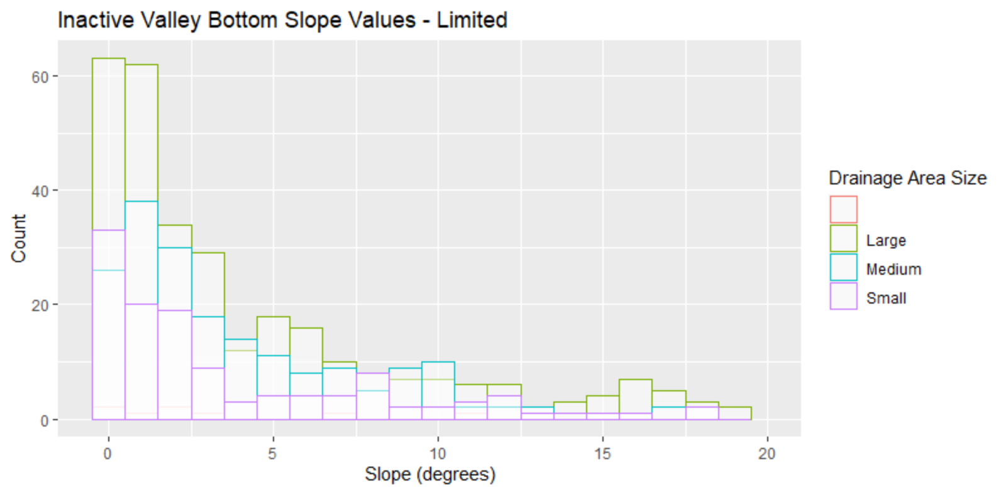
Inactive Valley Bottom by Drainage Area Size

Slide 25
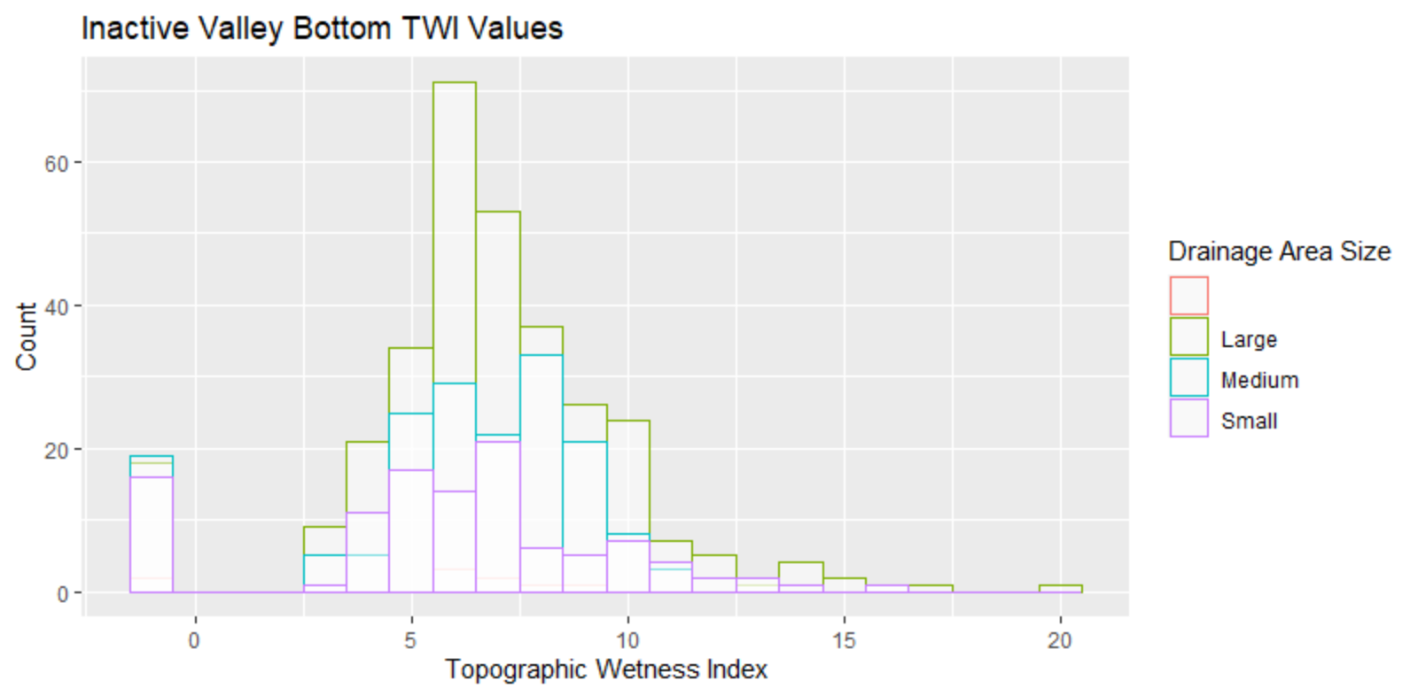
Inactive Valley Bottom by Drainage Area Size

Slide 26
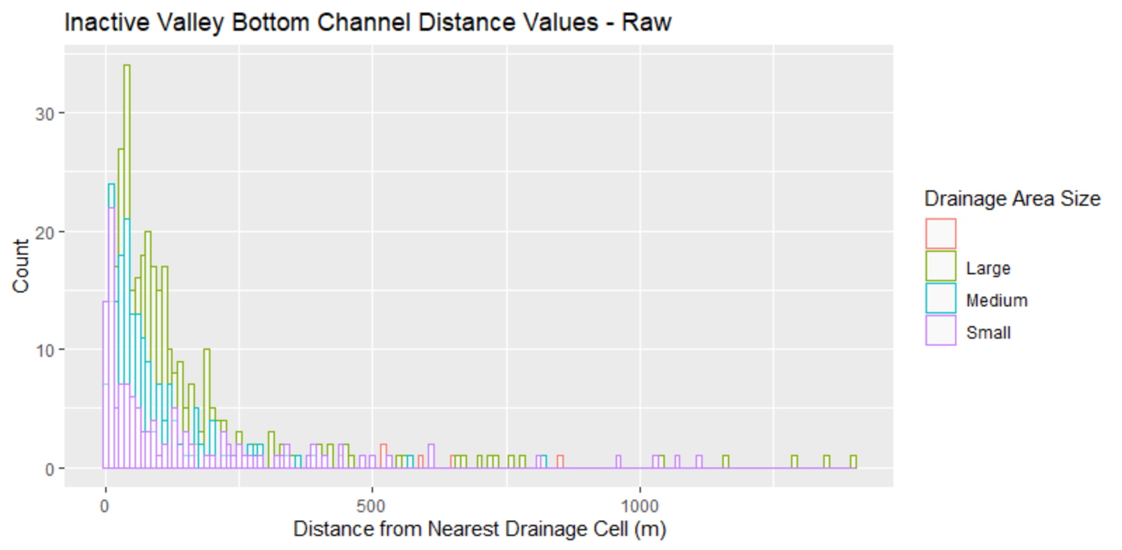
Inactive Valley Bottom by Drainage Area Size

Slide 27
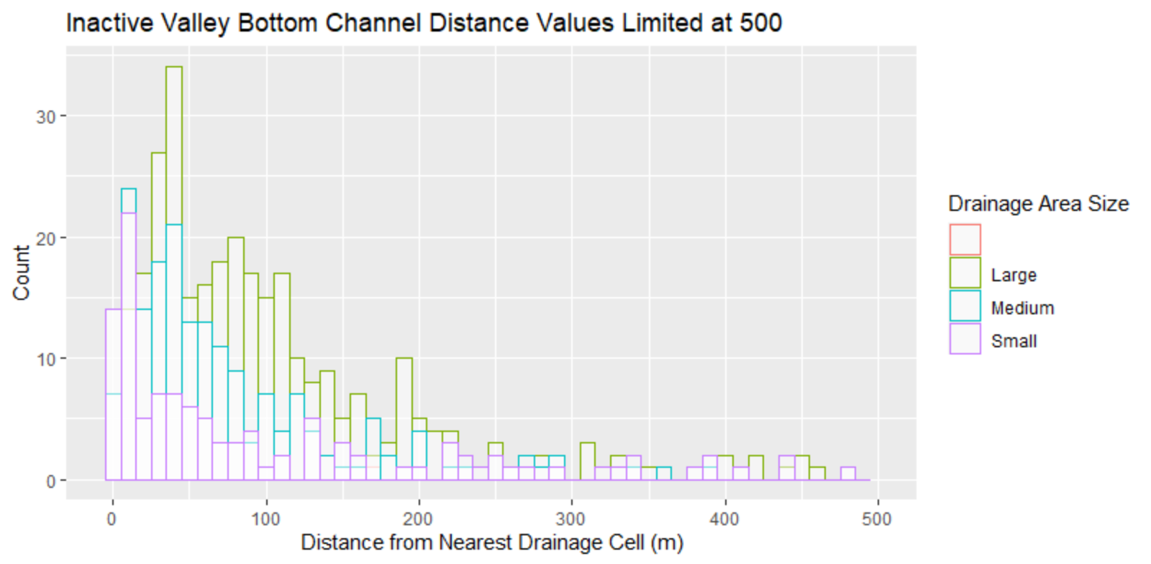
Inactive Valley Bottom by Drainage Area Size

Slide 28
max(evidence$Slope)
[1] 64.76403
> min(evidence$Slope)
[1] 0
> mean(evidence$Slope)
[1] 4.976803
> mode(evidence$Slope)
[1] "numeric"
> median(evidence$Slope)
[1] 1.979812

