Slide 1
Visualizing Neural Networks
Exploring architecture, noise, complexity, and performance with TensorFlow Playground
Shelby Steward – Indiana Wesleyan University – AIML 501: Model Development – Dr. Lawrence Iweriebor

Slide 2
How a Neural Network Works
Information moves forward through connected layers, while training adjusts the connections.
INPUT
HIDDEN LAYER 1
HIDDEN LAYER 2
OUTPUT
X₁
X₂
Prediction
1 Inputs
2 Processing
3 Prediction
Features such as X₁ and X₂ enter the network.
Hidden neurons transform and combine information.
The output layer produces the final classification.
2

Slide 3
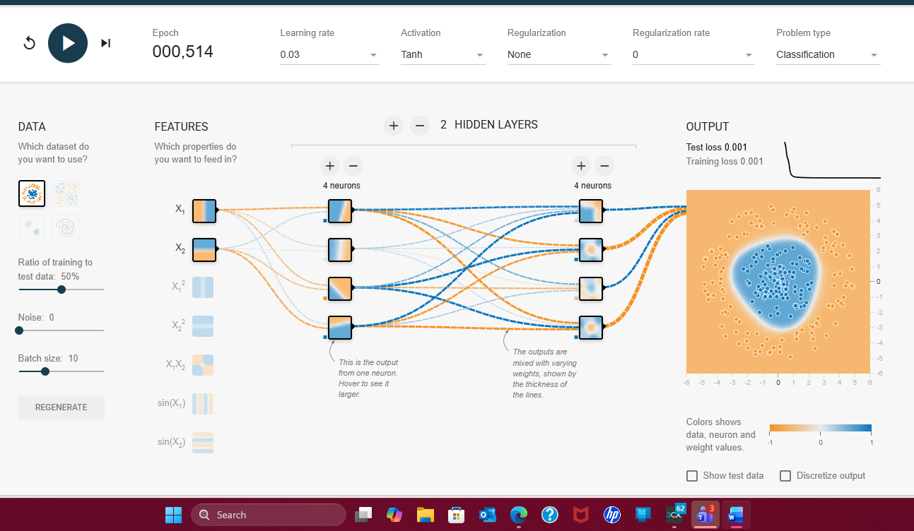
Layers and Neurons
The architecture determines how much representational capacity the model has.
Neurons
Individual processing units within a layer. Each neuron combines incoming values, applies learned weights and a bias, then passes the result through an activation function.
Layers
Stages of processing in a neural network. The input layer receives features, hidden layers learn intermediate patterns, and the output layer produces a prediction.
In the baseline model, the two hidden layers each contain four neurons. The boxes are neurons; their vertical groups are layers.
3

Slide 4
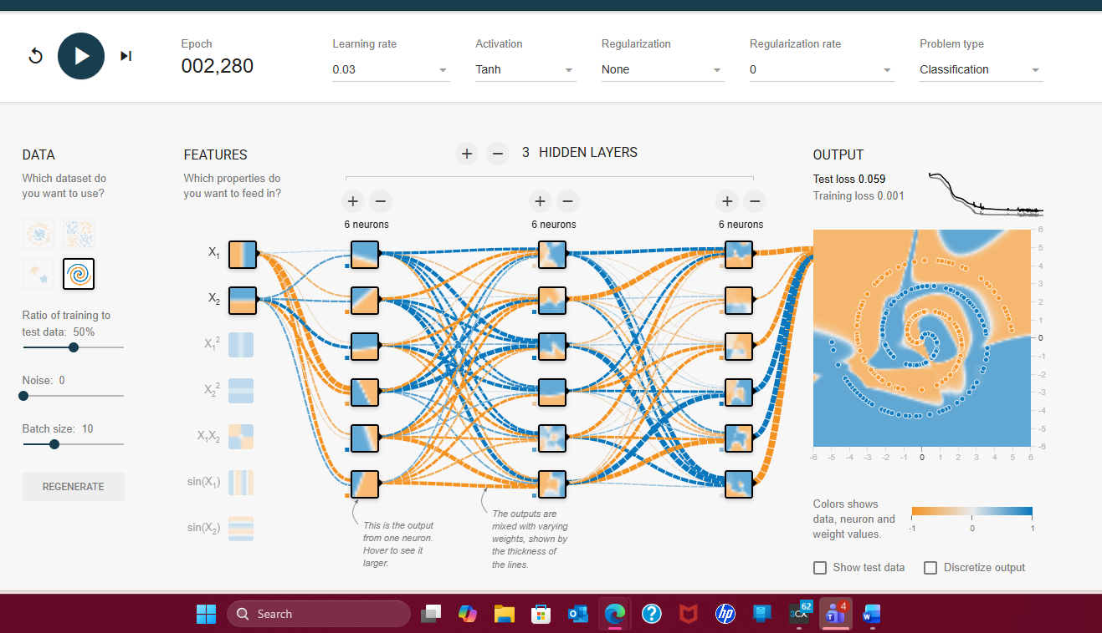
Weights and Activation Functions
These components determine how strongly information is used and how complex patterns can be represented.
Weights
Numerical values attached to connections between neurons. During training, weights are adjusted so useful signals have more influence on the final prediction.
Activation Functions
Functions that transform a neuron's combined input. Nonlinear activations allow a network to learn patterns that cannot be represented by a simple straight-line boundary.
Playground uses line color and thickness to visualize learned weights. These experiments used the Tanh activation function.
4

Slide 5
Loss Functions and Optimization Algorithms
Training is an iterative process: measure error, adjust the model, and repeat.
Predict
Measure Loss
Optimize
Repeat
The network produces an output.
→
A loss function quantifies prediction error.
→
An optimization algorithm updates weights to reduce loss.
→
Additional epochs continue refining the model.
Loss Function
Optimization Algorithm
A mathematical measure of how far predictions are from the correct answers. Lower loss generally indicates better fit. Playground reports both training loss and test loss.
A procedure that uses the loss signal to update weights in a direction that improves performance. Repeated updates across epochs are what allow the network to learn.
Why both losses matter: training loss shows fit to examples the model learned from, while test loss helps indicate how well the model generalizes to unseen examples.
5

Slide 6
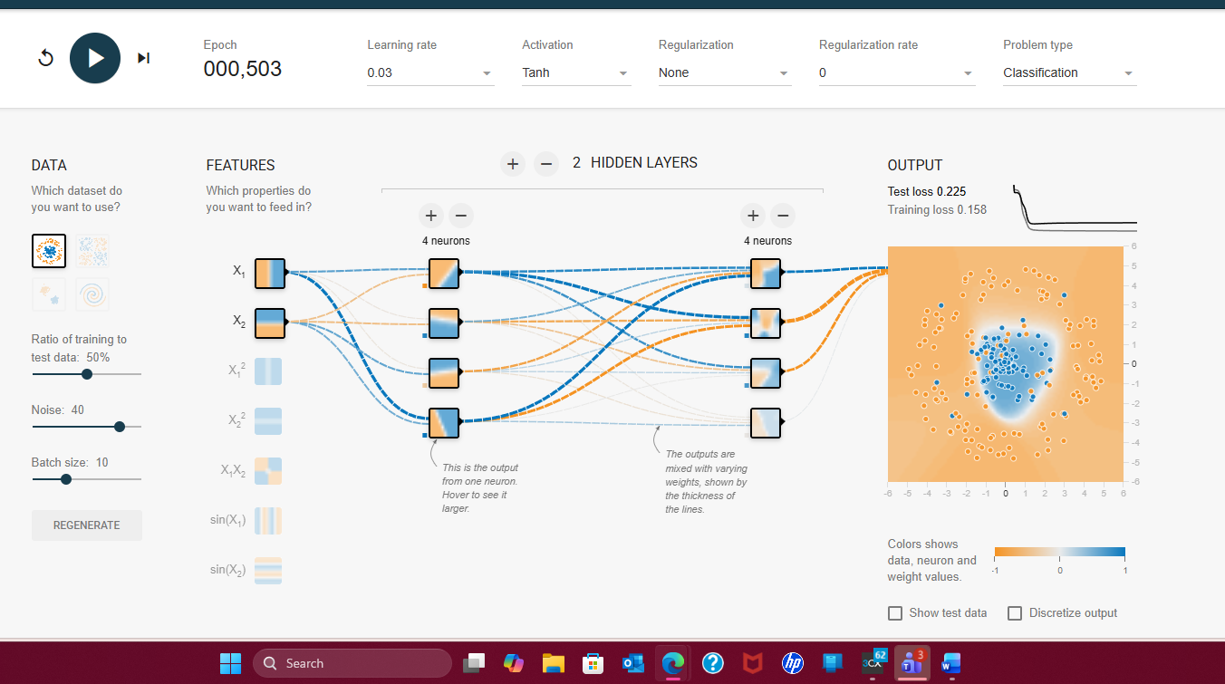
Experiment: The Effect of Noise
Same architecture. Same settings. One variable changed: noise increased from 0 to 40.
CLEAN DATA — Noise 0
NOISY DATA — Noise 40
TEST LOSS
TRAINING LOSS
TEST LOSS
TRAINING LOSS
0.001
0.001
0.225
0.158
Finding: overlapping, noisy observations made the classification boundary less certain and sharply increased loss.
6

Slide 7
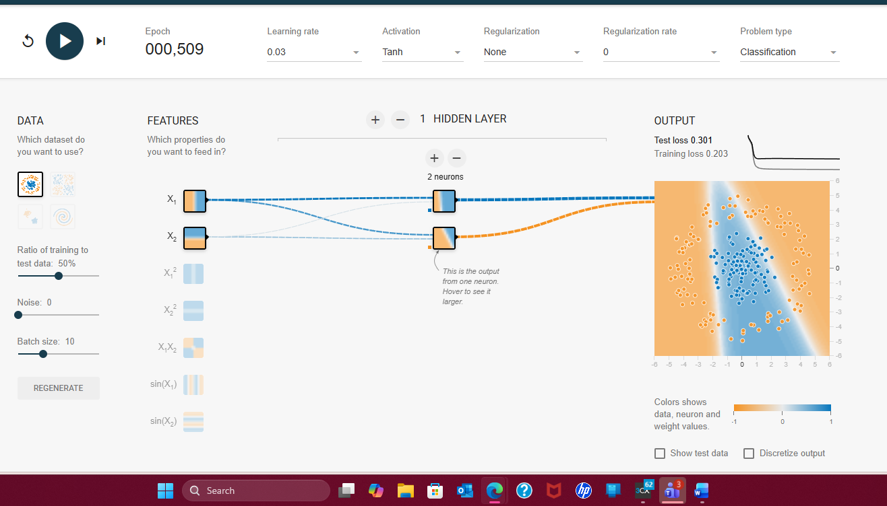
Experiment: Reducing Network Capacity
A smaller network struggled with the same clean circular dataset.
Architecture
1 hidden layer × 2 neurons
TEST LOSS
TRAINING LOSS
0.301
0.203
What changed?
The model could no longer form the circular nonlinear boundary effectively. Fewer neurons and layers reduced its ability to represent the pattern.
Baseline comparison: the larger 4 + 4 network reached 0.001 test loss on the same clean circle dataset.
7

Slide 8
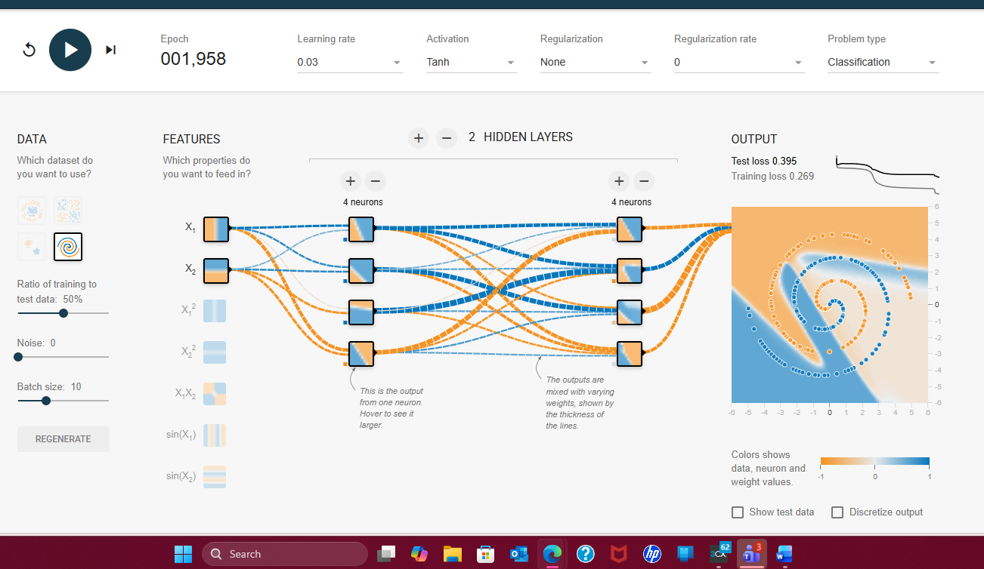
Experiment: Learning a More Complex Pattern
Increasing depth and width dramatically improved performance on the spiral dataset.
2 layers × 4 neurons
3 layers × 6 neurons
TEST LOSS
TRAINING LOSS
TEST LOSS
TRAINING LOSS
0.395
0.269
0.059
0.001
Finding: additional layers and neurons gave the model enough capacity to follow the intertwined nonlinear spiral much more closely.
8

Slide 9
Summary and Key Insights
Visualizing the network made abstract concepts easier to connect to actual model behavior.
Data Quality Matters
Architecture Matters
Complexity Can Help
Increasing noise from 0 to 40 raised test loss from 0.001 to 0.225, showing how overlapping data makes classification harder.
Reducing the network to one layer with two neurons raised test loss to 0.301, even on the clean circle dataset.
For the spiral dataset, increasing the network to 6 + 6 + 6 neurons reduced test loss from 0.395 to 0.059.
Why visualization is valuable
The Playground made it possible to see how layers, neurons, weights, activation functions, loss, and optimization work together during training. Instead of viewing neural networks only as equations, I could observe how changing the data or architecture changed the decision boundary and model performance in real time.
Key takeaway: a successful neural network depends on both the quality and complexity of the data and on choosing an architecture with enough capacity to learn the underlying pattern.
9

