Slide 1
BuyBuddy Multipurpose shopping Application
TEAM ID : ITG15
MEMBERS:
SHELCIA VIMALA VERONICA M
(211221205145)
SAI VARSHA
(211521205)
SAHAYA PRINCY F
(211521205127)
SOWMYA BALA B
(211521205153)
GUIDED BY:
Dr.S.SUMA CHRISTAL MARY M.E.,Ph.D.,
ASSOCIATE PROFESSOR
HEAD OF THE DEPARTMENT
DEPARTMENT OF INFORMATION & TECHNOLOGY
PANIMALAR INSTITUTE OF TECHNOLOGY

Slide 2
Abstract
The project aims to develop a multipurpose eCommerce website that caters to diverse shopping needs by providing a user-friendly platform for both buyers and sellers.
The website integrates multiple product categories, secure payment gateways, and efficient product management.
It is built with scalability, responsiveness, and seamless navigation to enhance the overall user experience, thus improving the efficiency of online shopping.

Slide 3
Introduction
ECommerce has revolutionized the way people shop, offering the convenience of purchasing products from the comfort of their homes.
This project focuses on developing an eCommerce website with a modern design, allowing users to browse through various categories, view detailed product descriptions, add items to their cart, and make secure payments.
The website will also support sellers to manage their listings easily. The aim is to create a versatile platform that serves different user needs across multiple product segments.

Slide 4
Existing System
Current e-commerce platforms, like Amazon and Flipkart, dominate the market but come with
Challenges:Centralized Control: Limited transparency and user control over data.
Seller Difficulties: High fees, complex onboarding, and stiff competition for visibility.
Limited Personalization: Broad algorithms lead to a generic shopping experience.
High Operational Costs: Resulting in increased fees and product prices.
These limitations create barriers for small businesses and reduce flexibility for diverse product categories, driving the need for a more adaptable solution like our Multipurpose E-commerce Website.

Slide 5
Proposed system
The proposed system is a fully functional multipurpose eCommerce website that supports:
Product Listings: Sellers can upload and manage products across different categories such as electronics, fashion, home decor, and more.
User Account Management: Customers can create accounts, track orders, and save products to a wishlist for future purchases.Shopping
Cart and Checkout: Users can add products to their cart, adjust quantities, and securely check out using integrated payment gateways.
Admin Dashboard: The platform includes an admin panel where admins can monitor product listings, orders, and overall website analytics.
Responsive Design: The website is mobile-friendly, ensuring smooth navigation across different devices.Screenshots of the Model

Slide 6
FUTURE IMPLEMENTATION
AI-Powered Virtual Shopping Assistant
Description: A virtual assistant that helps guide customers through the purchasing process by understanding their needs, preferences, and shopping history.
Subscription-Based and Buy-Now-Pay-Later Models
Description: Introduce flexible purchasing options such as subscription models and buy-now-pay-later (BNPL) payment systems.

Slide 7
AI-Powered Virtual Shopping Assistant
Description: A virtual assistant that helps guide customers through the purchasing process by understanding their needs, preferences, and shopping history.
Sustainable & Ethical Shopping Choices
Description: Highlight eco-friendly or ethically produced products using machine learning to sort and display items that match these criteria.

Slide 8
ARCHITECTURE DAIGRAM

Slide 9
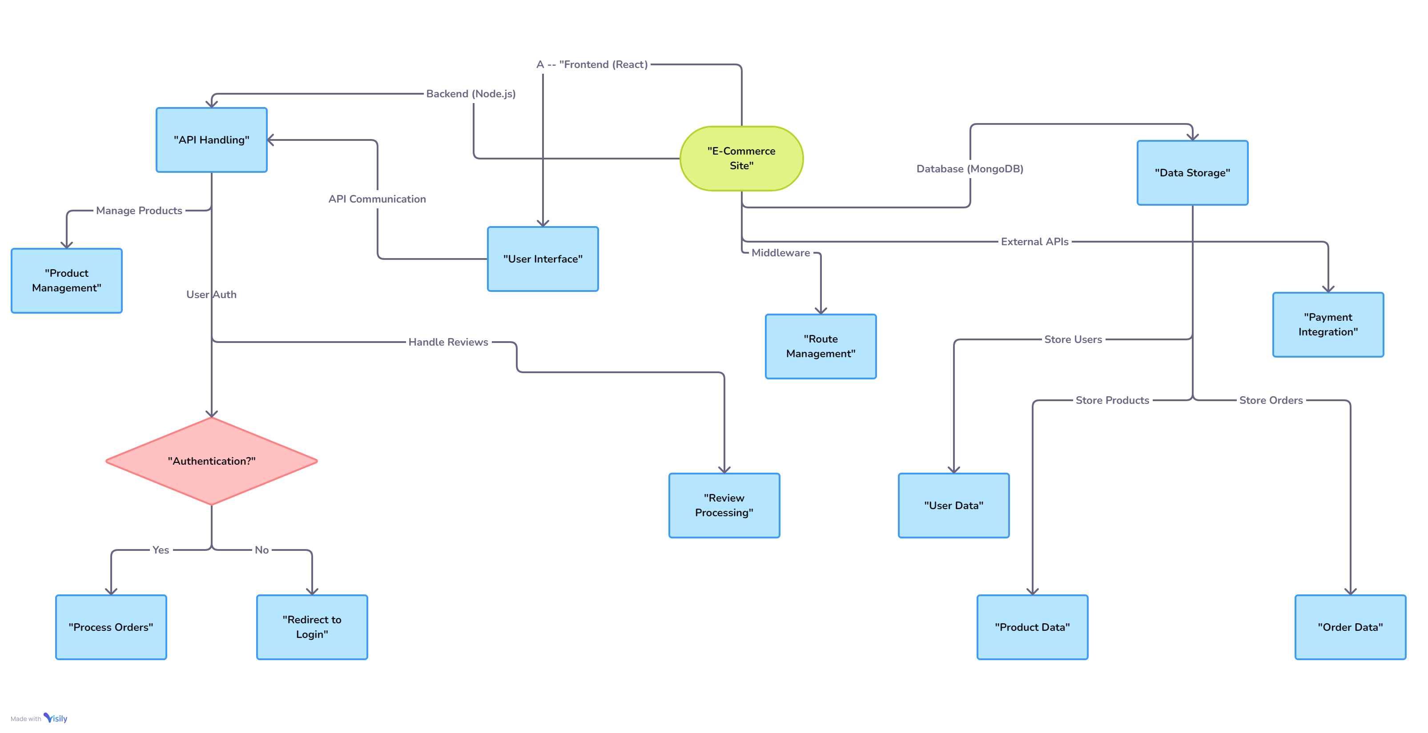

Slide 10
Frontend Technology Stack: React.js
Responsibilities:
- Manages user interface and interactions
- Displays product catalog, search, and filtering
- Provides shopping cart and checkout functionalities
Communicates with backend via APIs
Key Features:
Responsive design for all devices
- Real-time updates from backend
- User-friendly experience

Slide 11
Backend Technology Stack: Node.js, Express.js
Responsibilities:
- Handles all business logic and data processing
- Manages database (MongoDB) for product and user data
- Implements security measures like authentication and authorization
- Provides APIs for frontend communication
Key Features:
- Scalable architecture
- Manages inventory, orders, and payments
- Secure user data and transactions

Slide 12
Integration
Frontend-Backend Communication: REST APIs -
Third-Party Integrations:
- Payment gateway for secure transactions
- External APIs for shipping and inventory updates
Responsibilities:
- Ensures seamless data exchange between frontend and backend
- Synchronizes product, order, and customer data
- Handles real-time cart management and checkout
Key Features:
- Smooth integration with external services
- Secure data flow
- Automated processes for efficiency

Slide 13
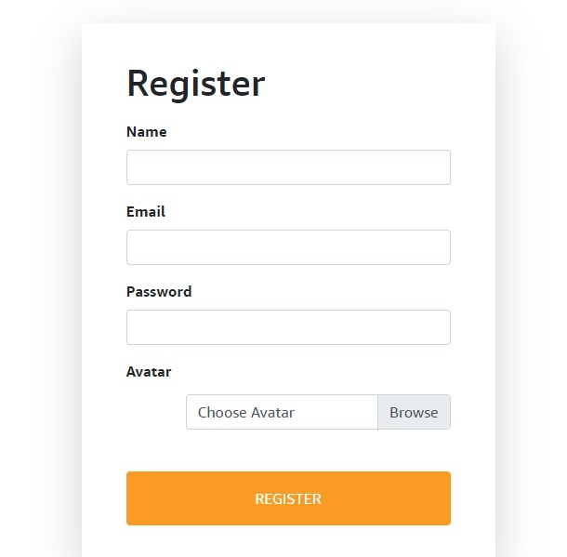

Slide 14
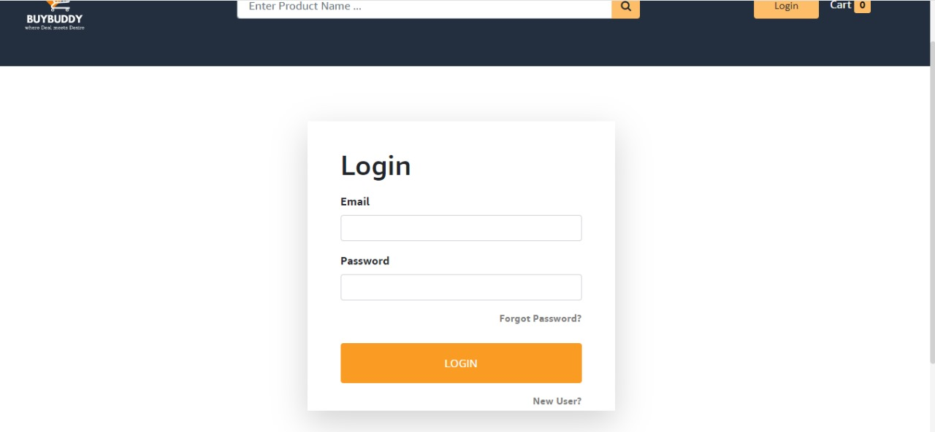
MODELS

Slide 15
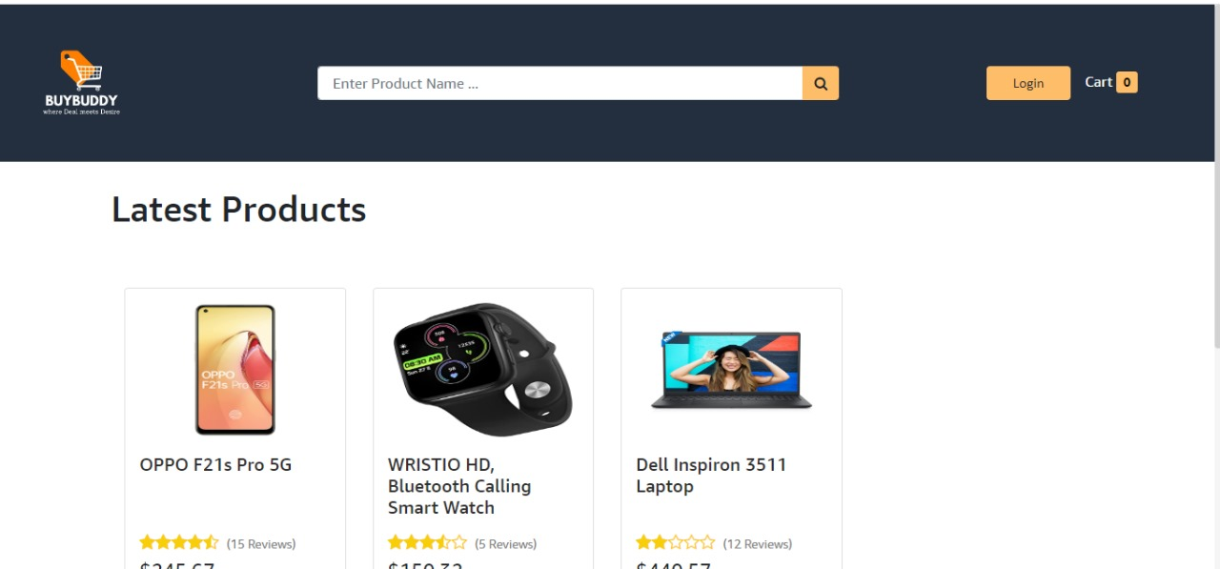

Slide 16
Conclusion:
This multipurpose eCommerce website project demonstrates the creation of a comprehensive online shopping platform that meets the needs of both buyers and sellers.
The project leverages modern web technologies to provide a seamless user experience, enhance operational efficiency, and support scalability for future expansion.
Through continuous optimization and feedback, the platform can be further enhanced to cater to a broader audience and a wider range of products.

Slide 17
THANK YOU!!

