Slide 1
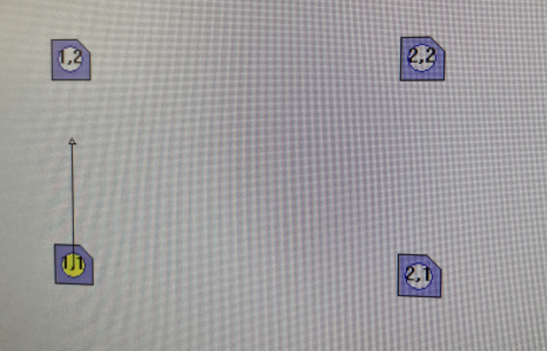
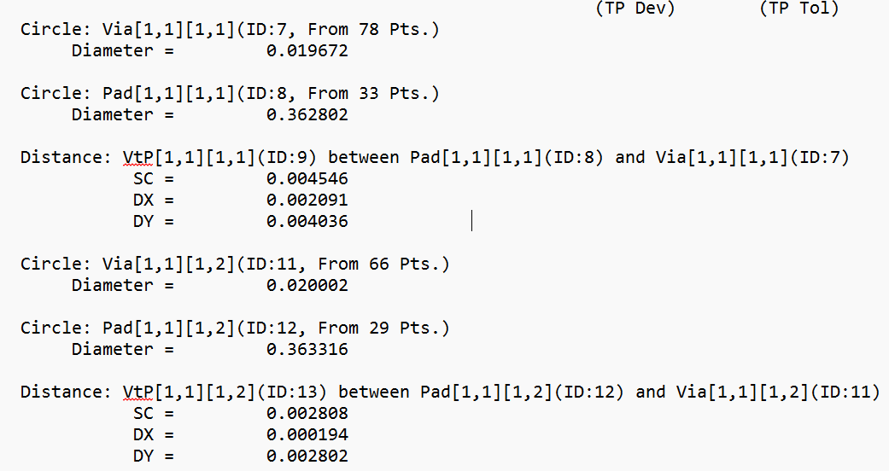
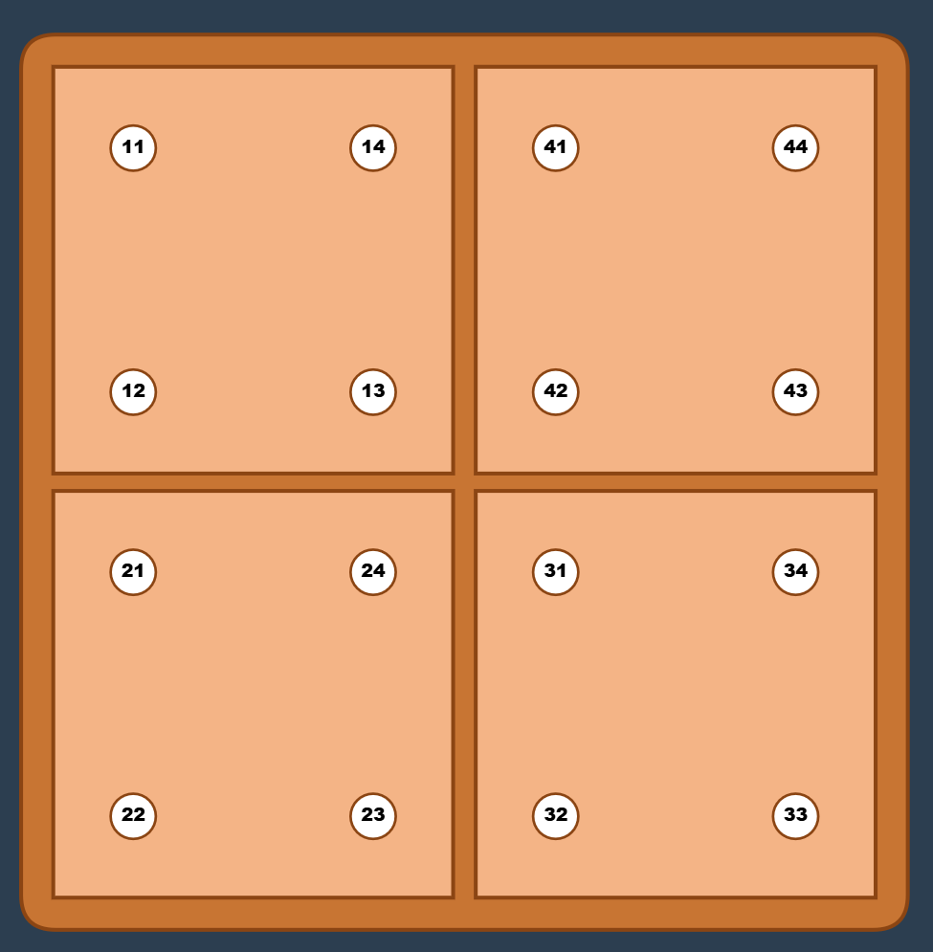
Mapping of indeces
Indeces automatic
Sequence
Sequence of measurement (manual and automatic) | Ideces QVM automatic output file | QP/Fiducial number
1 | [1,1][1,1] | 22
2 | [1,1][1,2] | 21
3 | [1,1][2,1] | 23
4 | [1,1][2,2] | 24
5 | [1,2][1,1] | 12
6 | [1,2][1,2] | 11
7 | [1,2][2,1] | 13
8 | [1,2][2,2] | 14
9 | [2,1][1,1] | 32
10 | [2,1][1,2] | 31
11 | [2,1][2,1] | 33
12 | [2,1][2,2] | 34
13 | [2,2][1,1] | 42
14 | [2,2][1,2] | 41
15 | [2,2][2,1] | 43
16 | [2,2][2,2] | 44
End
QP/Fiducial number
Start

