Slide 1

Exploratory Data Analysis
G2M Insights for Cab Investment Case Study
July 28, 2024

Slide 2
Agenda
Executive Summary
Problem Statement
Approach
EDA
EDA Summary
Recommendations

Slide 3
Executive Summary
XYZ, a private US firm, is exploring investment opportunities in the cab industry. To support their Go-to-Market strategy, an in-depth market analysis has been conducted using data from two prominent cab companies. The objective is to identify which company presents the most promising investment opportunity based on various customer and transaction metrics.

Slide 4
Problem Statement
XYZ needs a comprehensive analysis of the market and performance of two potential cab companies. The goal is to provide actionable insights to help XYZ identify the most promising investment opportunity.
Key Areas of Focus:
Customer Volume and Trends
Financial Performance
Customer Demographics and Segmentation
Geographical Analysis

Slide 5
Approach
Data Understanding and Preparation:
Review and understand field names, data types, and relationships across datasets.
Merge datasets to create a comprehensive master dataset.
Rename columns and format data types where necessary.
Perform feature engineering.
Exploratory Data Analysis (EDA):
Conduct initial EDA to uncover patterns, trends, and outliers.
Formulate and test hypotheses to investigate various aspects of the data.

Slide 6
Approach
3. Analysis and Visualization:
Use statistical analysis and data visualization techniques to derive insights.
Compare and contrast the performance of the two cab companies.
4. Findings and Recommendations:
Summarize findings and provide data-driven recommendations to XYZ’s executive team.
Identify which company is the better investment opportunity based on the analysis.

Slide 7
Case Study Flowchart
Data Understanding and Preparation
Exploratory Data Analysis
Analysis and Visualization
Findings and Recommendations

Slide 8
EDA with Data Visualization
Relationship between trip profit and price charged
Number of transactions per company
Gross revenue per company
Gross profit per company
Number of transactions per gender
Company profitability per city
Gender profitability per city
Profitability per year
Profitability trend
Total number of customers per year per company

Slide 9
EDA with Data Visualization
Customer number trend
Number of customers per age group
Number of customer per income group
Gender profitability per age group
Gender profitability per income group

Slide 10
Insights Drawn from EDA

Slide 11
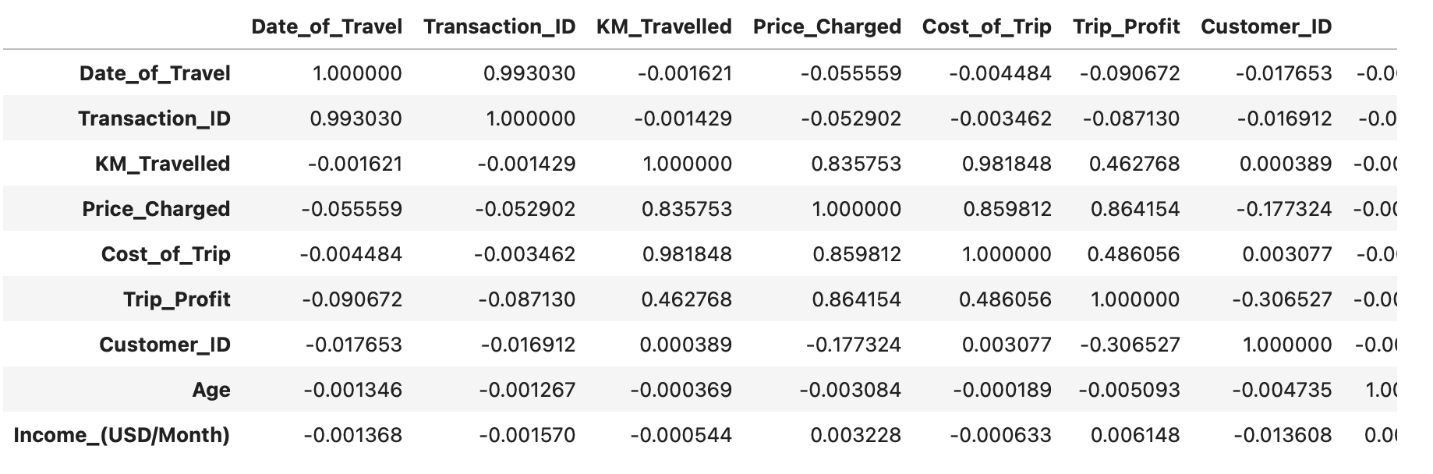
Correlation of Numeric Features
Noteworthy correlations:
Distance travelled is strongly correlated with price charged and trip cost but weakly correlated with trip profit.

Slide 12
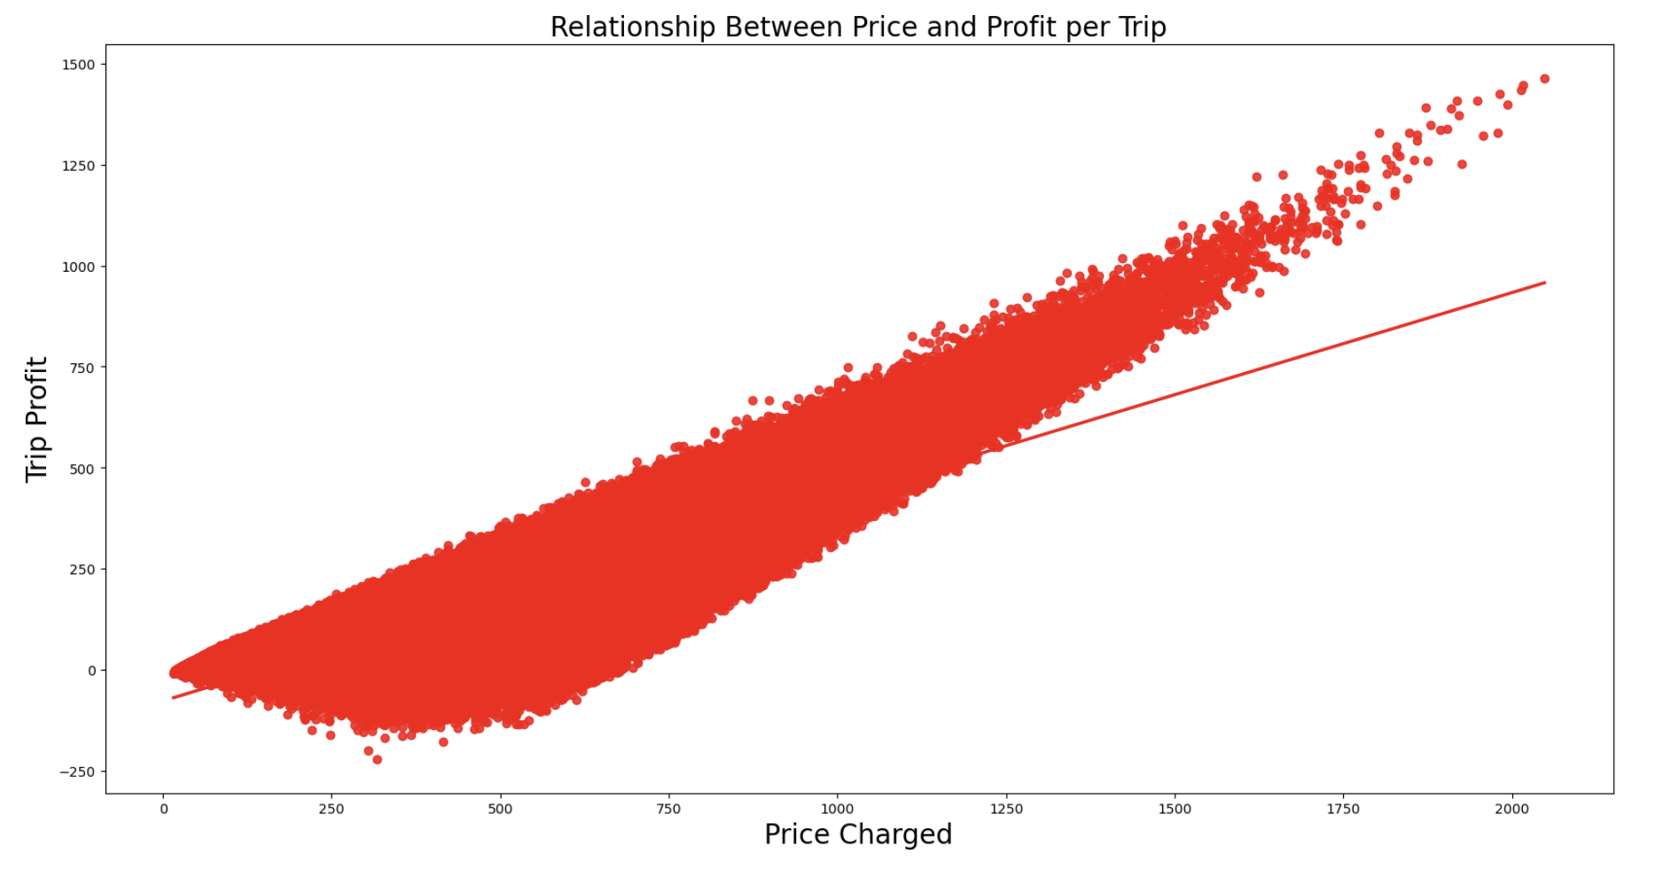
Trip Profit vs. Price Charged
Weak correlation which might be due to price discounts or deeper issue with pricing model.

Slide 13
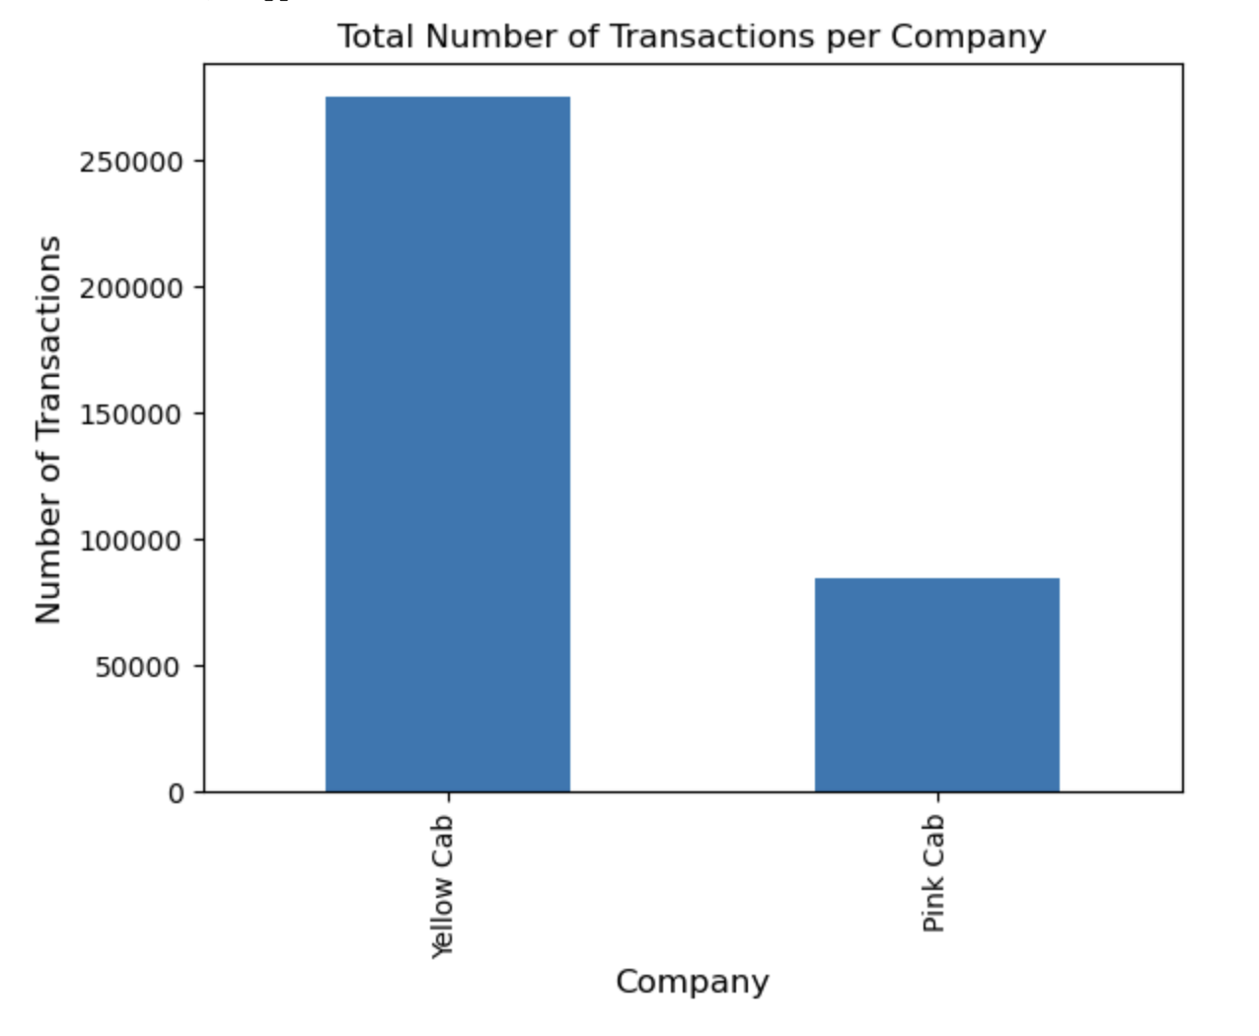
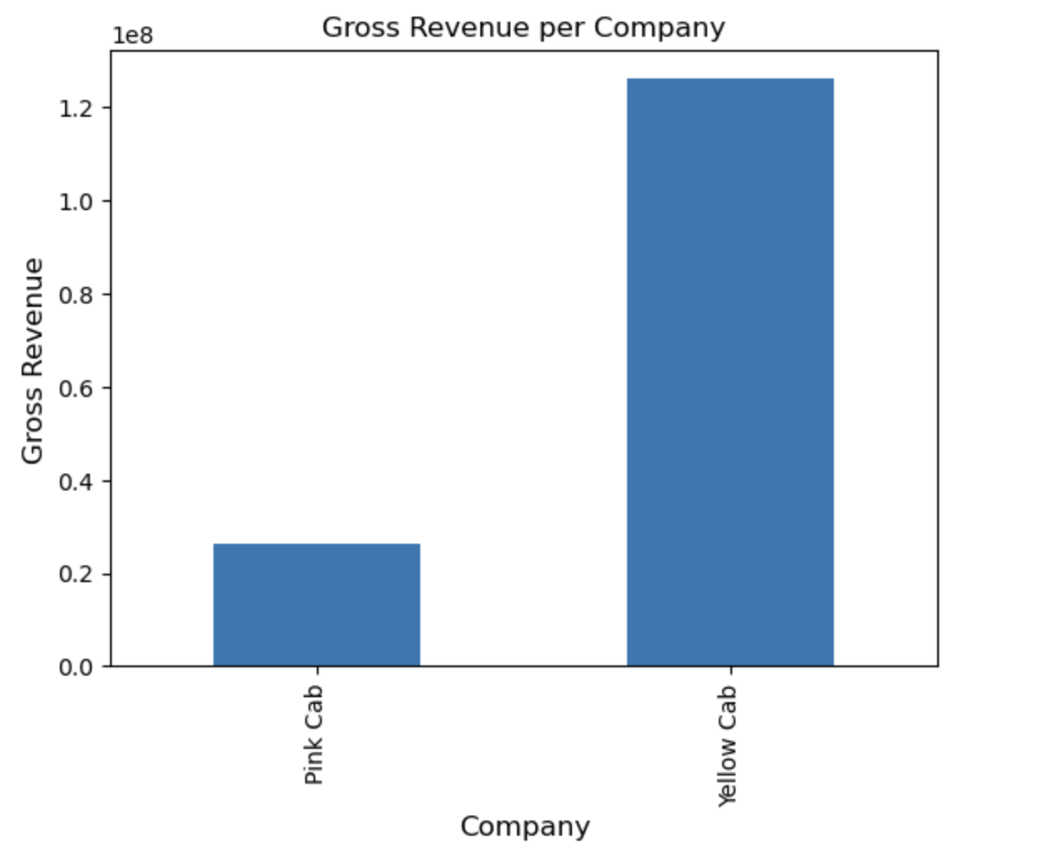
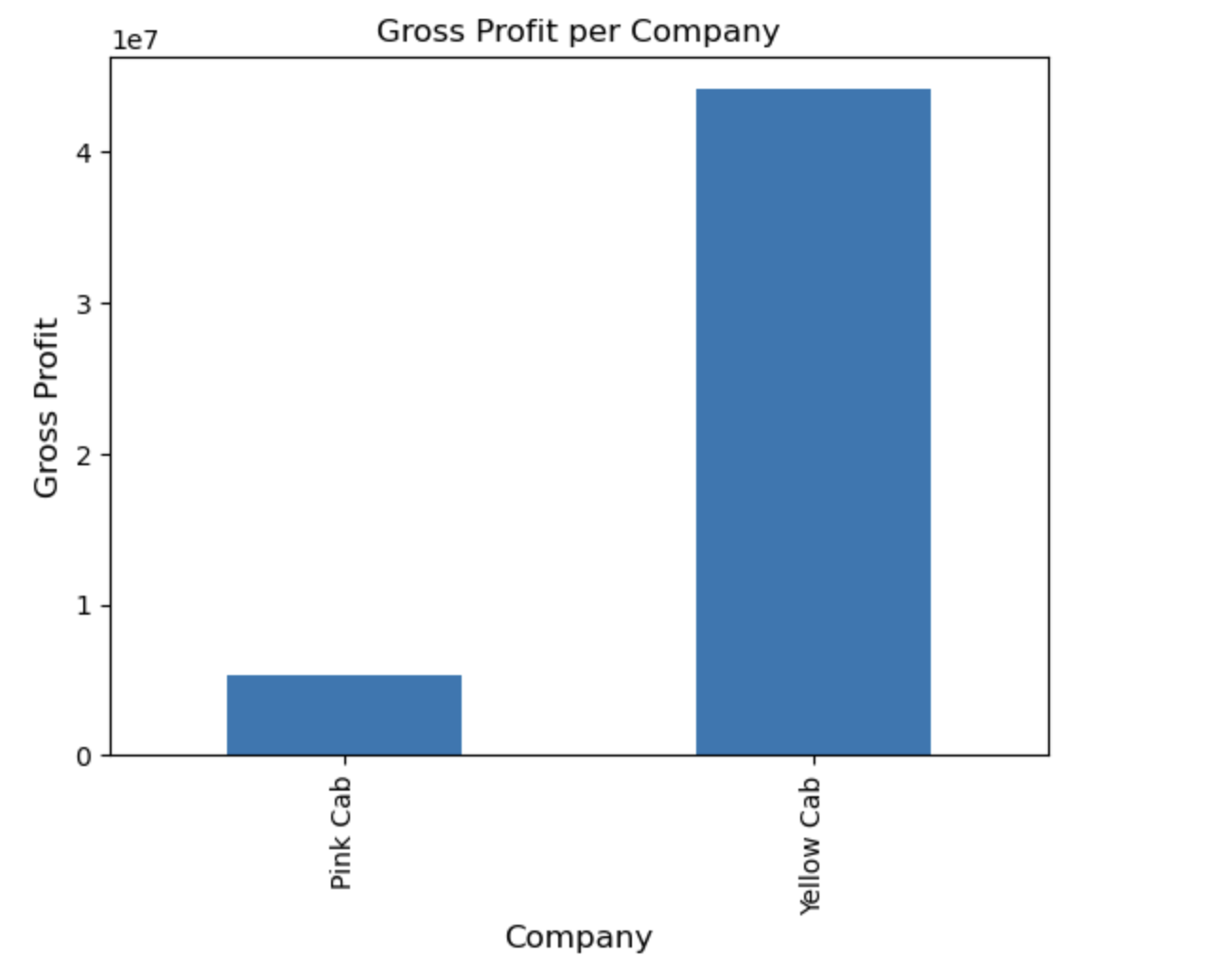
Transactions, Gross Revenue and Gross Profit per Company
Yellow Cab outperforms Pink Cab in the areas of number of transactions, revenue and profit. Additionally, Yellow Cab does just about 3 times as many transactions but is about 7.5 times as profitable.

Slide 14
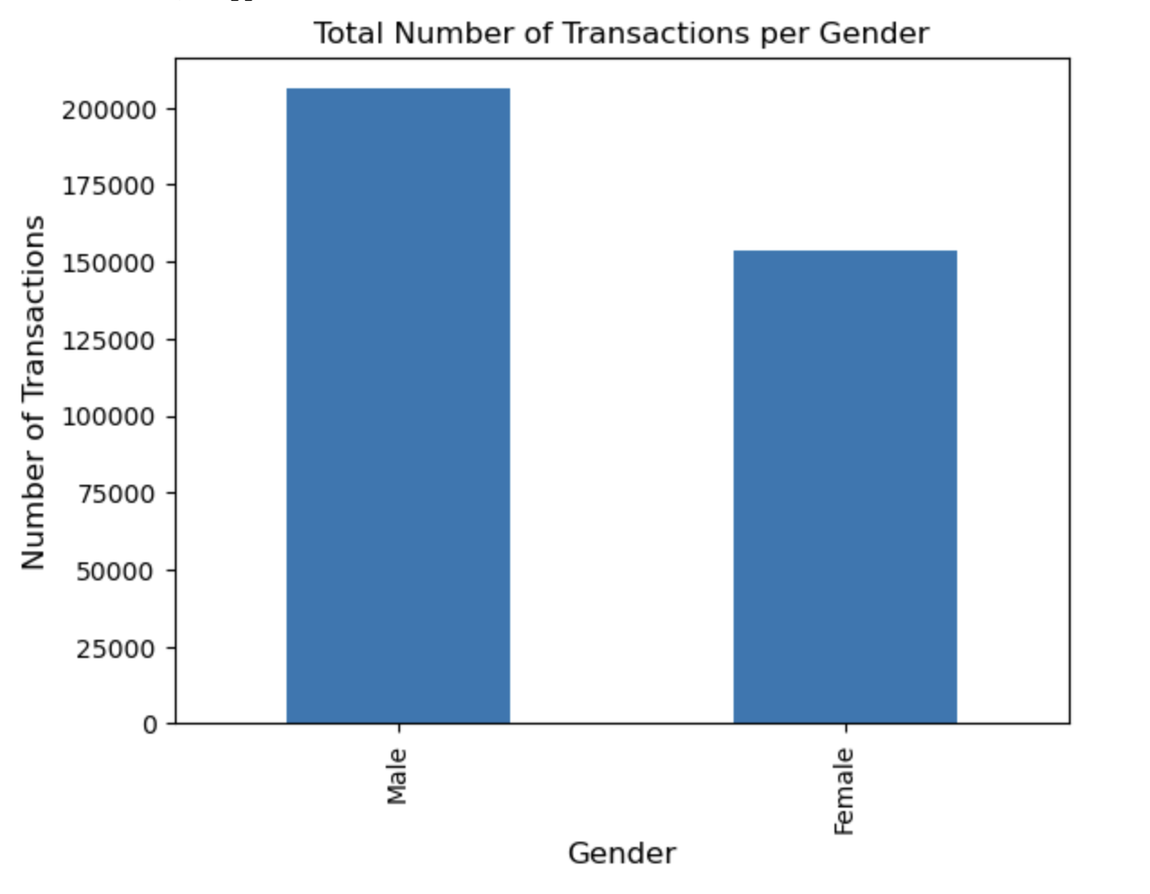
Number of Transactions by Gender
There are more male users across both platforms relative to females.

Slide 15
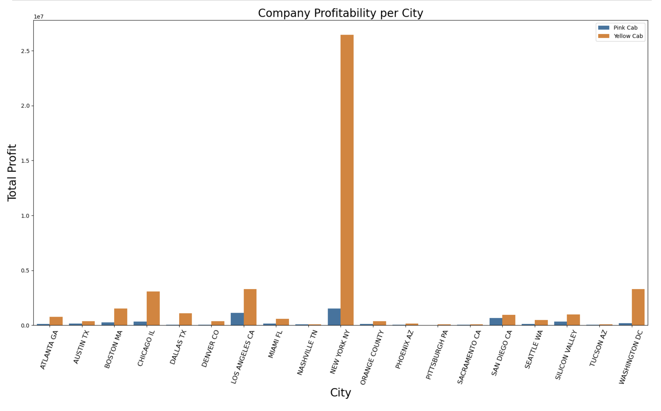
Company Profitability per City
Yellow Cab outperforms its competition in all 20 studied cities.
Also, New York was about 8 times as profitable as the next most profitable city, which is Los Angeles.

Slide 16
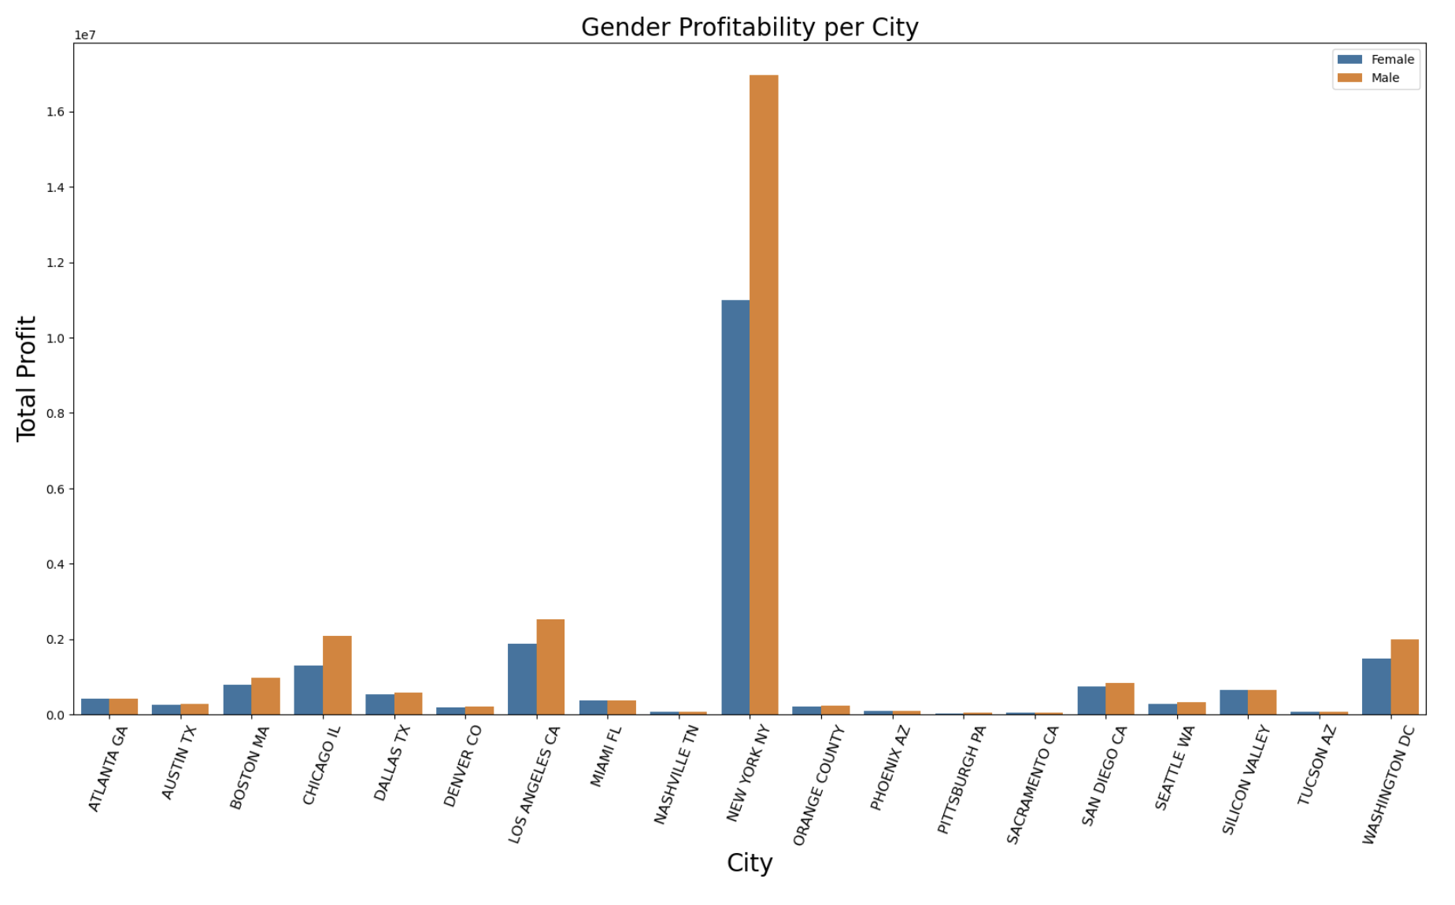
Gender Profitability per City
There are more male users in more profitable cities in the study, with the widest gender gap in New York.

Slide 17
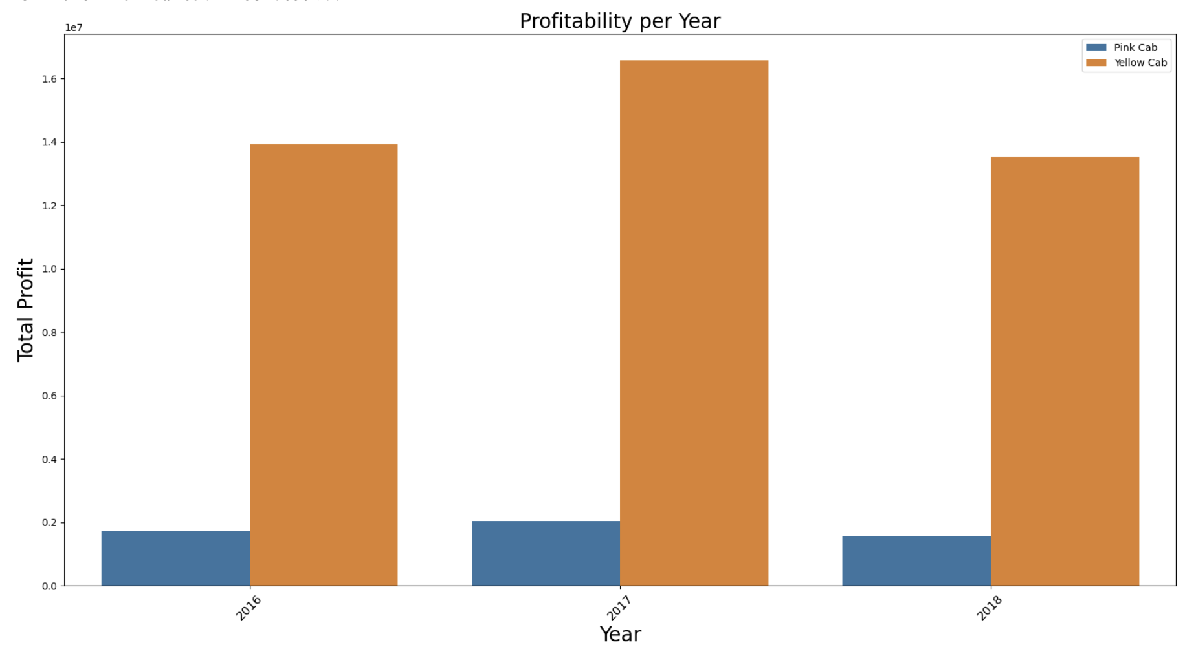
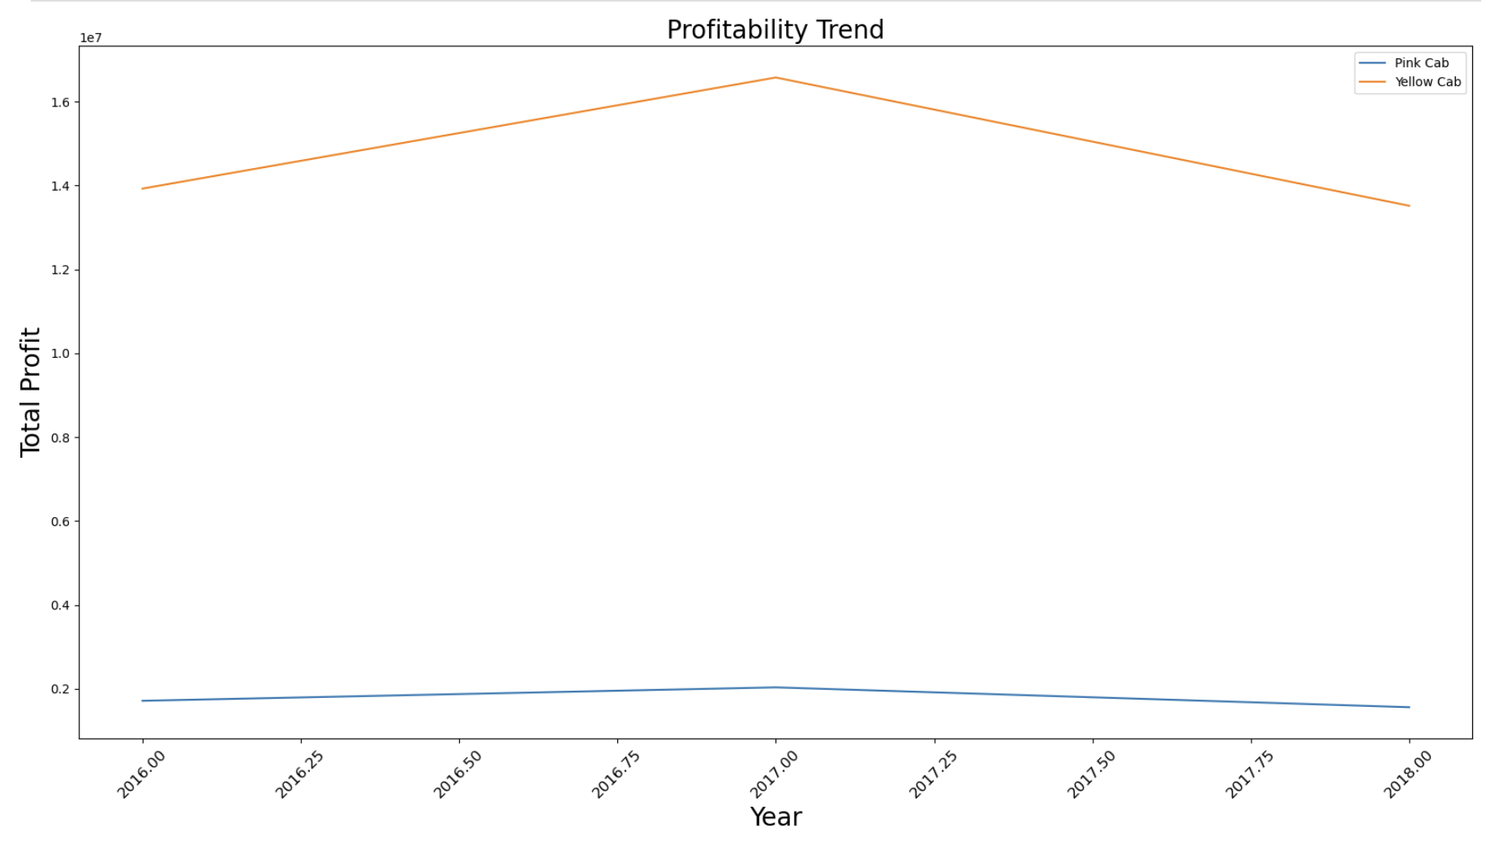
Profitability per Year | Profitability Trend
Yellow Cab is about 7 times as profitable as Pink Cab.

Slide 18
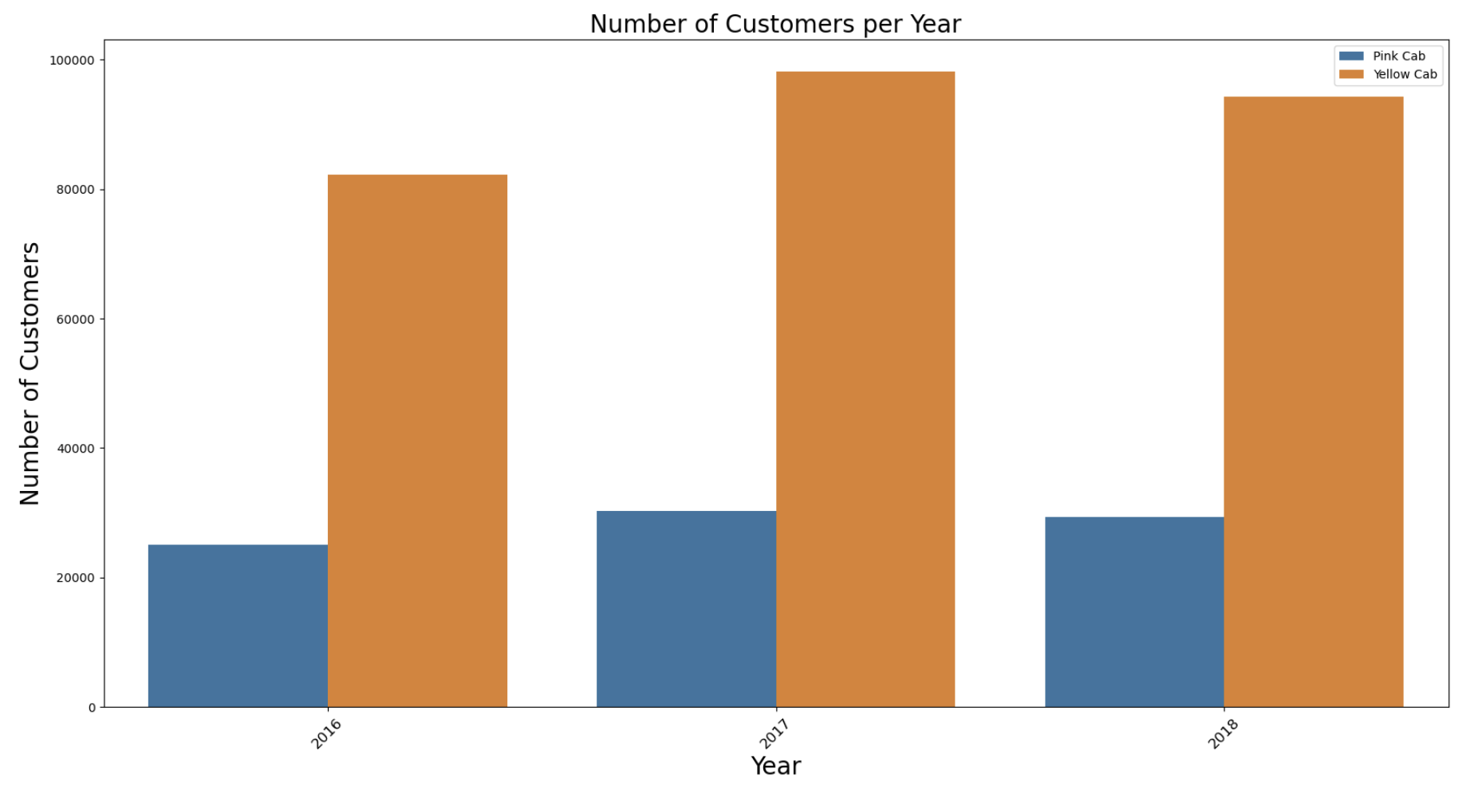
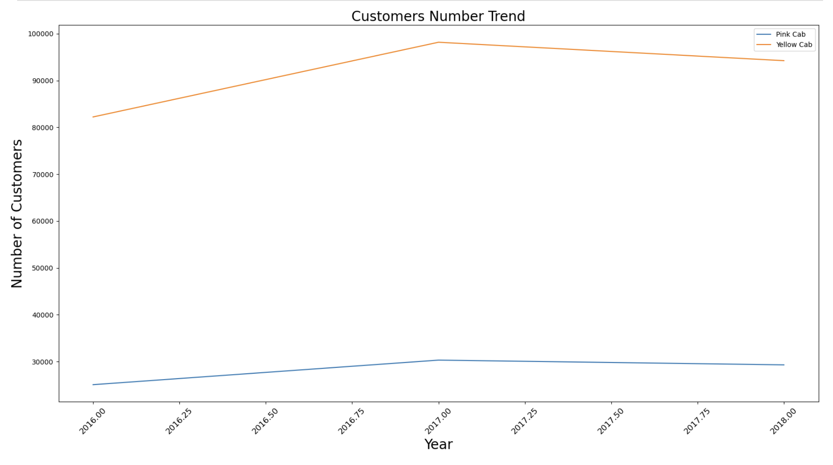
Number of Customers per Year | Customer Numbers Trend
Both companies have stable customer bases, but Yellow Cab has about 3 times more customers.

Slide 19
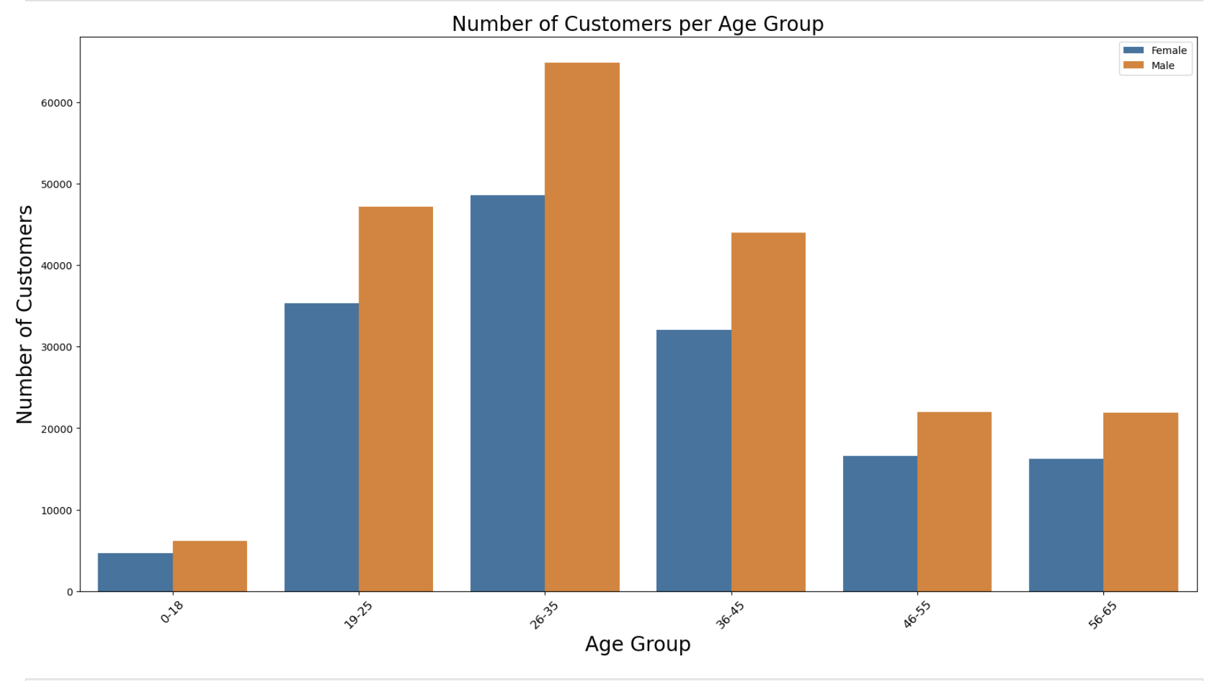
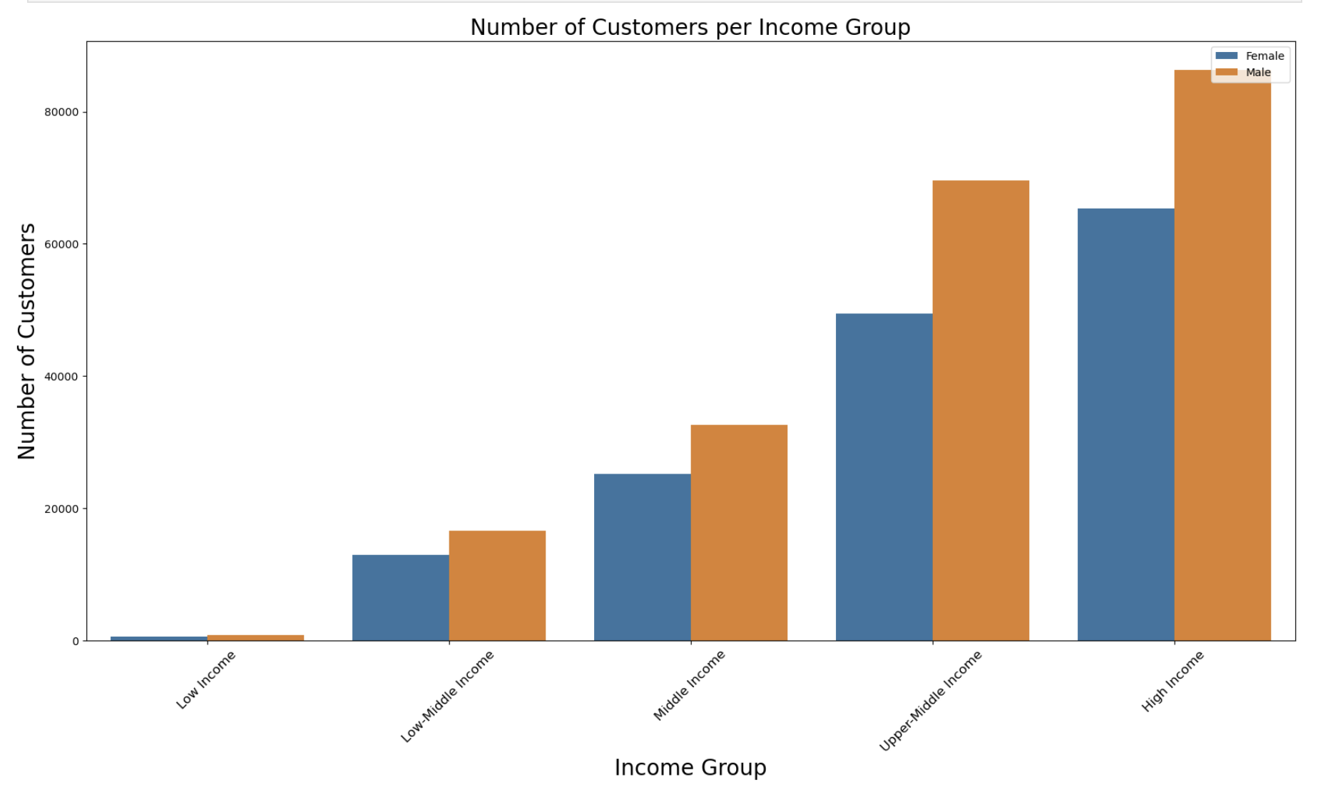
Customer Distribution by Age and Income
The 26–35 age group is the most frequent user group, followed by 19–25 and 36–45 age groups. Higher income groups use the services more frequently. Both observations are true for both genders.

Slide 20
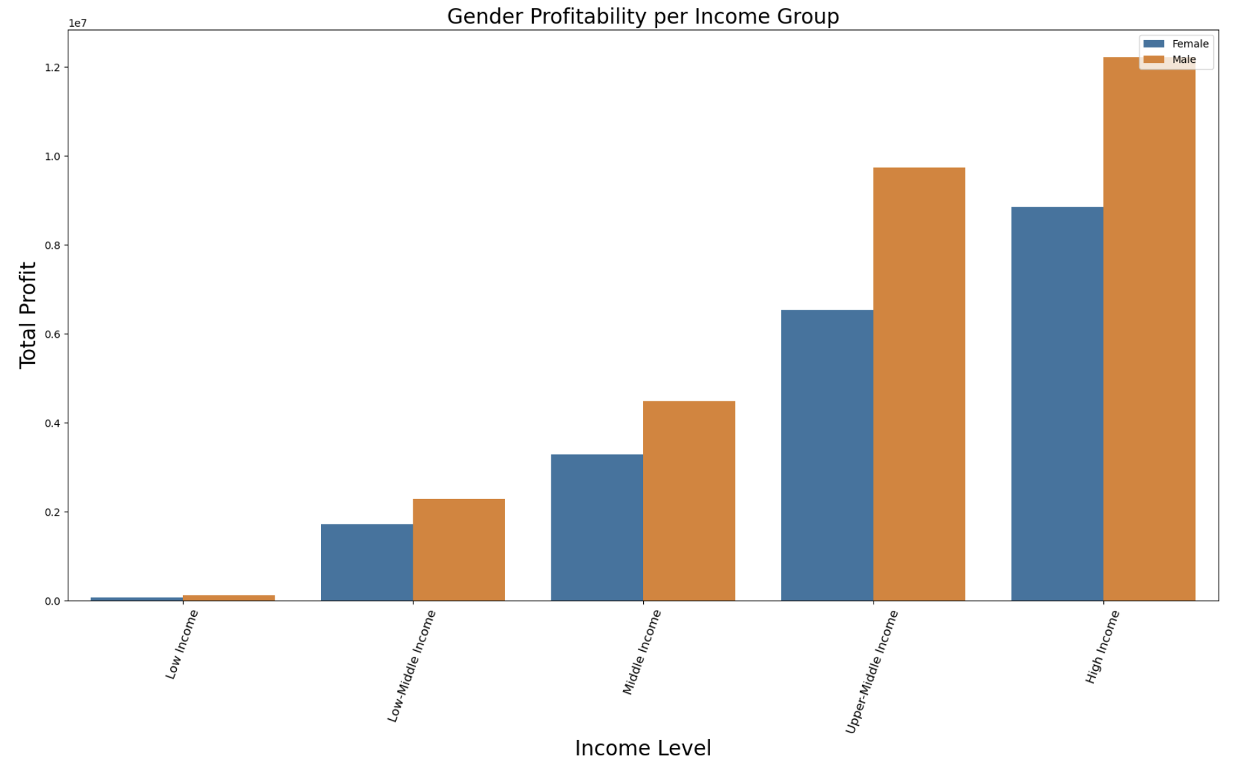
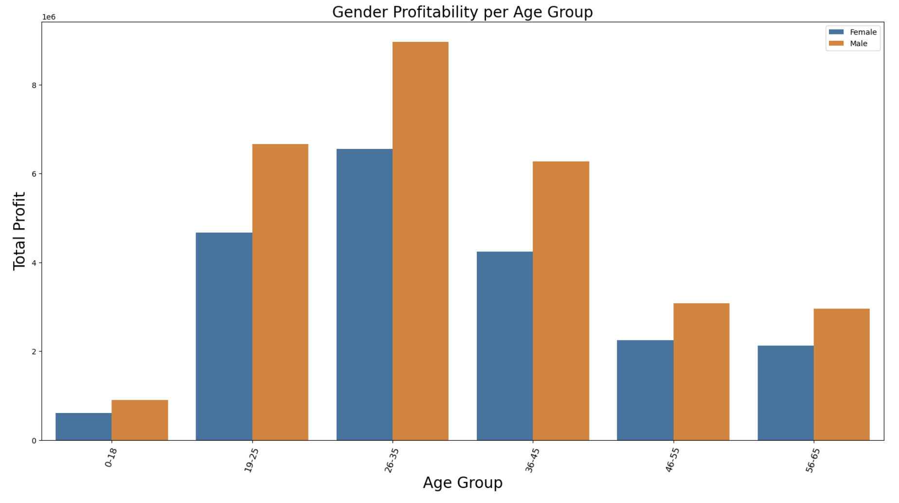
Profitability per Age and Income Groups
Profitability per age and income groups mirrors the customer distribution: the 26–35 age group is the most profitable, and higher income groups more profitable.

Slide 21
EDA Summary
Distance traveled is strongly correlated with trip cost but weakly correlated with trip profit, possibly due to price discounts or issues with the pricing model.
Yellow Cab outperforms Pink Cab in all 20 cities studied, as well as in transactions, revenue, and profit. Yellow Cab has about 3 times more transactions and is 7.5 times more profitable.
New York is 8 times more profitable than Los Angeles, the second most profitable city.
Both companies have stable customer bases, but Yellow Cab has about 3 times more customers.
There are more male users than female users on both platforms, especially in more profitable cities, with the widest gender gap in New York.
The 26–35 age group is the most frequent user group, followed by 19–25 and 36–45 age groups. Higher income groups use the services more frequently, true for both genders.
Profitability per age and income groups mirrors the customer distribution: the 26–35 age group is the most profitable, and higher income groups are more profitable.

Slide 22
Recommendations
Based on Analysis
Yellow Cab is the superior investment option, outperforming Pink Cab in all metrics and cities studied.
Focus Areas:
Establish major urban hubs: New York, Los Angeles, Washington DC, Chicago, and Boston, as these are the most profitable.
Launch a special campaign for New York, the most profitable city by a significant margin.
Target Demographics:
Focus on male users, particularly those aged 19-45, and higher income earners.
Pricing Review:
Review the pricing model to ensure it is optimized and free of issues.

Slide 23
Thank You

