Slide 1


Apple PowerPort
Team 5
Irina Abramova
John Gannon
Daniel Wong

Slide 2

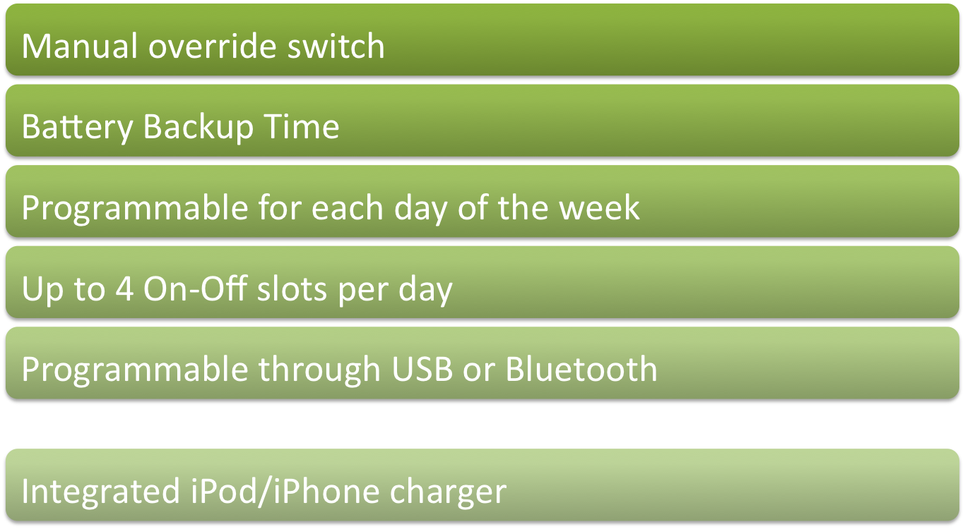
Product Features

Slide 3
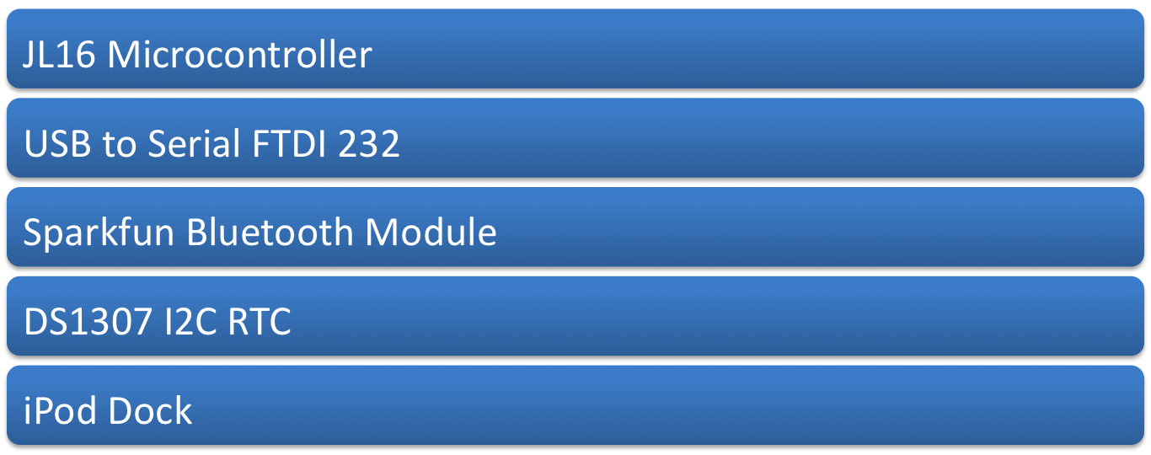
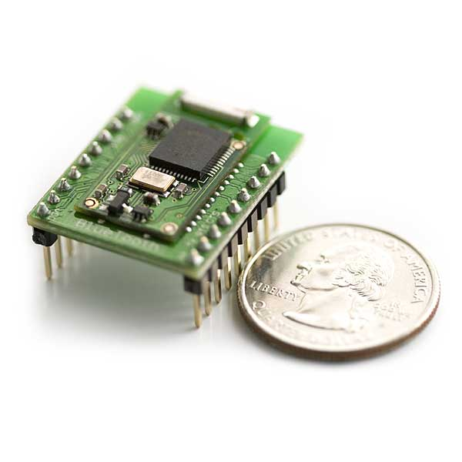
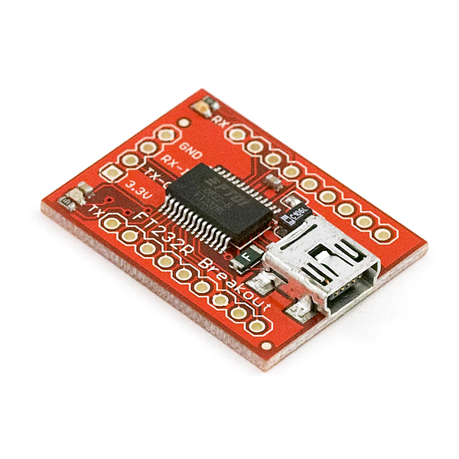
Key Components

Slide 4
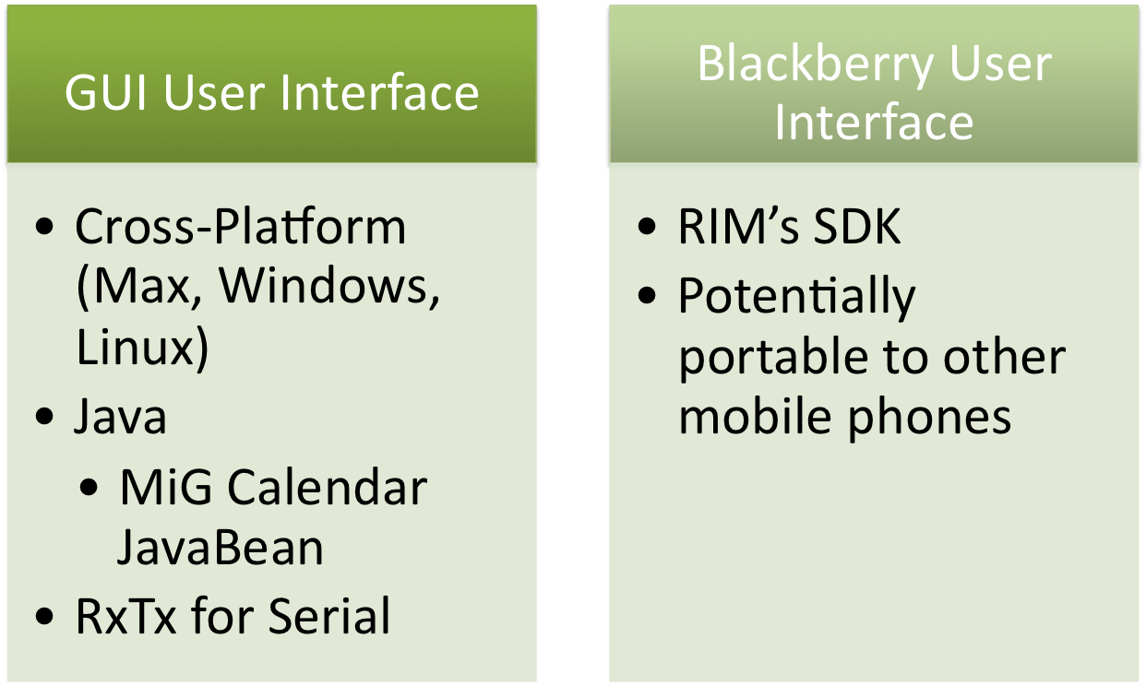
Software

Slide 5
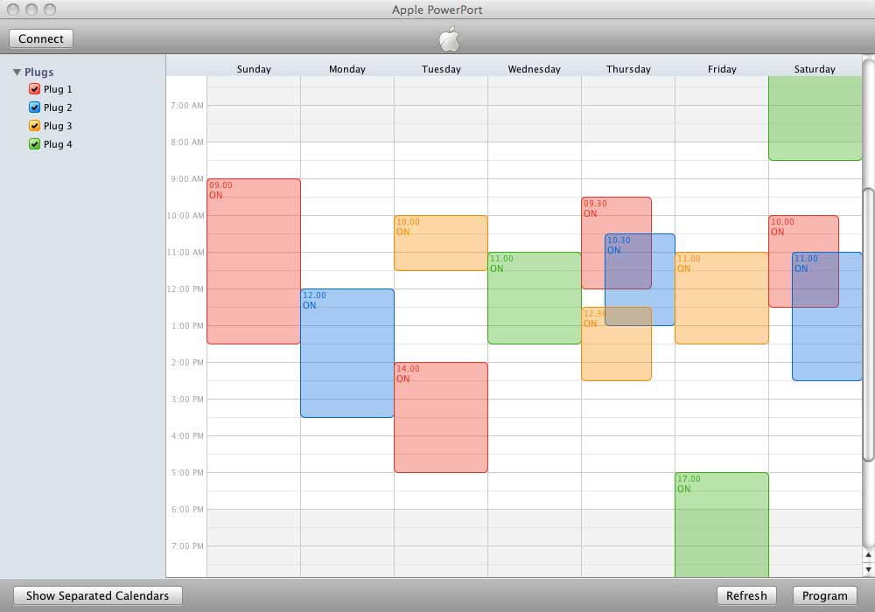
Computer Interface

Slide 6
Communication Protocol
Array Arrangement:
|On byte 1|On byte 2|
|Off byte 1|Off byte 2|
(This is one Time Slot, support for upto 4 slot/day)
Time Slot Format:
Byte 1 Byte 2
|_|_|_|_|_|_|_|_| |_|_|_|_|_|_|_|_|
|_____|_________| |___|___________|
| Day | Hour | |0 0| Minute |
| 1-7 | 0 - 23 | |0 0| 0 - 59 |
Sun-Sat
Byte 1 & 2 can never be:
0x3C - Get Plug 1 Settings (returns byte[128])
0x3D - Get Plug 2 Settings (returns byte[128])
0x3E - Get Plug 3 Settings (returns byte[128])
0x3F - Get Plug 4 Settings (returns byte[128])
0x7C - Set Time - Send 3 bytes {Hour,Minute,Day} (in decimal)
0x7D - Get Time - Returns 3 bytes {Hour,Minute,Day}
0x7E
0x7F – Termination Character
0xBC - Program Plug 1
0xBD - Program Plug 2
0xBE - Program Plug 3
0xBF - Program Plug 4
0xFC - ACK
0xFD
0xFE - Erase Data in FLASH
0xFF - NULL (-1)

Slide 7
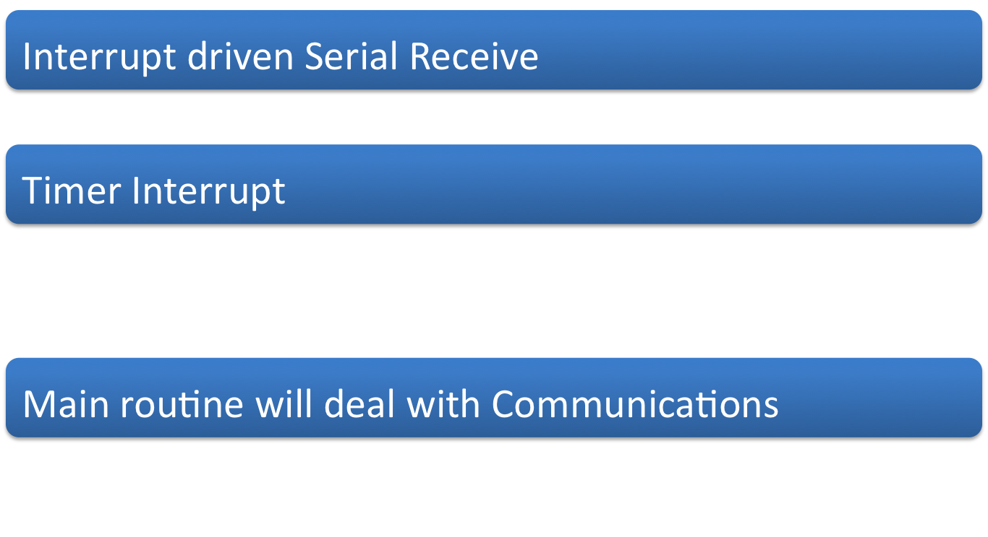
Firmware Design

Slide 8
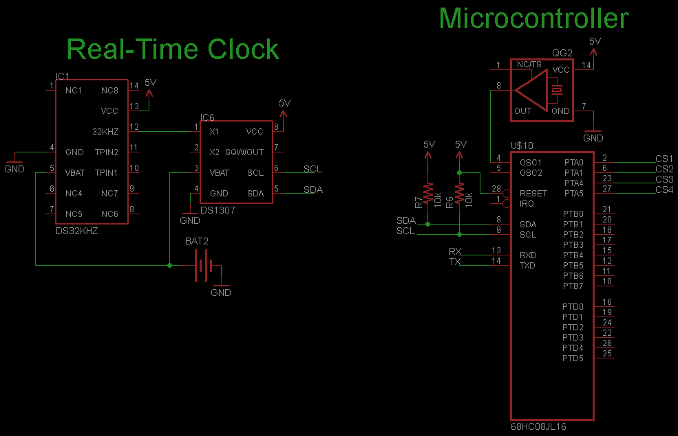
Microcontroller/RTC

Slide 9
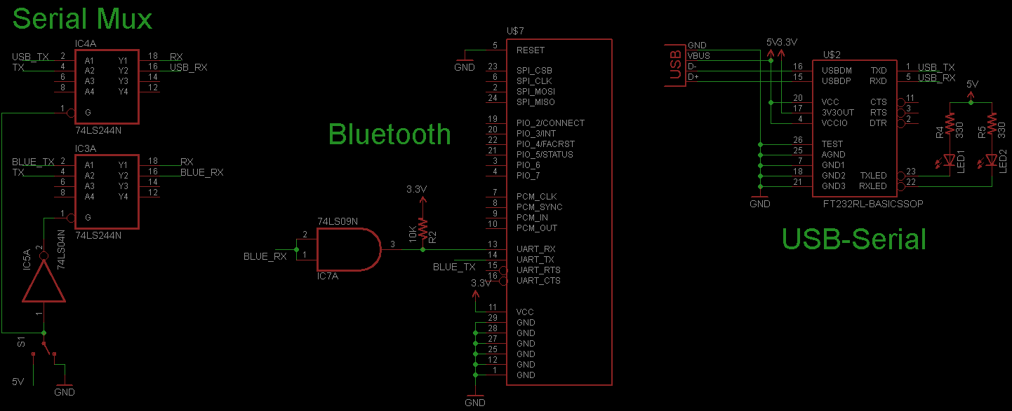
Communication Interface

Slide 10
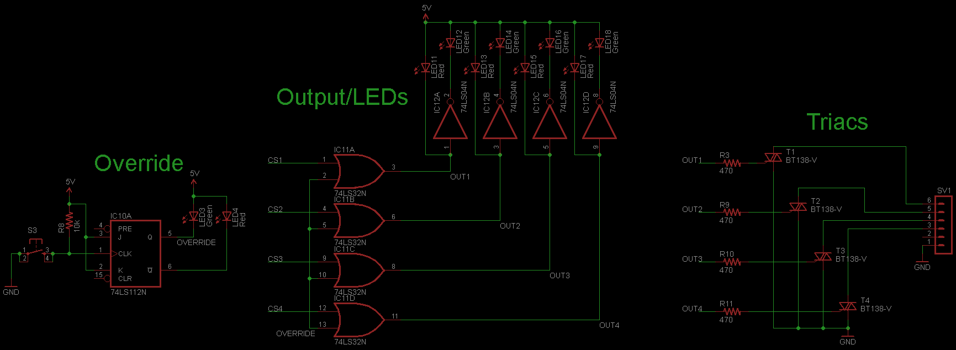
Override/Output

Slide 11
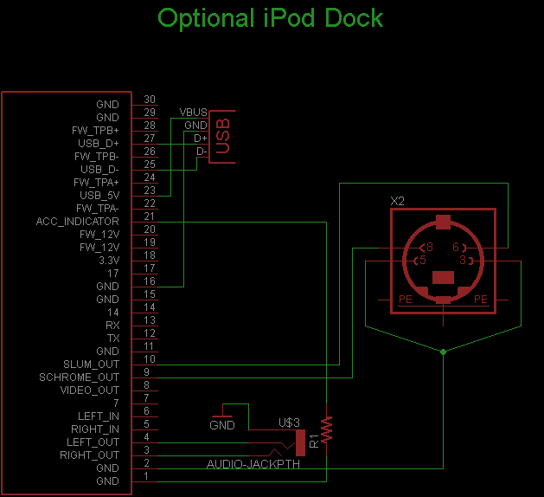
iPod Dock

Slide 12

Questions?

