Slide 1
MapNotes Project
A Geo-Based Note Sharing App
A Geo-Based Note Sharing App
group member : Li Zhixiao23219669 Wang Yuanzhe23219679 Zhang Zekai23219680

Slide 2
App Idea – MapNotes
MapNotes is an Android application that allows users to create and share geo-tagged notes on a map.
Each note includes photos, text, and location data, turning the map into a shared visual diary.
Users can browse nearby posts and discover interesting places through shared stories.
Core innovation: Combines Amap SDK and Clustering to solve performance and clutter issues of dense markers.

Slide 3
Similar / Related Apps
App Name | Description | Similar Features | Limitations
Google Maps – Local Guides | Allows users to add reviews and photos. | Map + media + location data | Focuses on business reviews only.
Travel Mapper | Travel journal app with map pins and photos. | Geo-tagged notes | Lacks social or interactive features.
Mapstr | Lets users pin favorite spots and categorize them. | Map-based bookmarking | No media upload or sharing.
Instagram Maps | Shows posts on map view. | Photo + location | Not fully map-centric.

Slide 4
Reusable Open Source Code
Library / Source | Purpose | License
高德地图 SDK for Android (Amap) | Interactive map rendering, GPS positioning，Official marker clustering API | Commercial (Free Tier for Dev)
Firebase Auth & Firestore | Login, storage, and database | Free tier
Glide / Coil | Image loading | BSD
GeoFire / GeoFirestore | Implement efficient Geohash queries on Firestore to quickly retrieve notes within specific regions. | Apache 2.0
Android Location API | GPS coordinates | Open Source

Slide 5
Unique Features & Enhancements
Feature | Description | Implementation Idea
Photo Markers | Each note shows image thumbnail. | Custom marker icons with Glide.
Location Feed | View posts near GPS location. | Firestore query with geohash.
Anonymous Posting | Post with nickname only. | Local ID + Firebase Auth.
Note Preview | Bottom pop-up card. | BottomSheetDialogFragment.
Offline Mode | Cached map tiles + notes. | Room DB + offline cache.

Slide 6
Functional Requirements
ID | Feature | Description
M1 | Map View | Displays map centered on location.
M2 | Marker Display | Shows notes as image markers.
M3 | Note Details | Tap marker → preview → details.
M4 | Clustering | Automatically cluster markers in high-density areas
P1 | Create Note | Upload image + text, auto-locate.
U1 | Basic Login | Anonymous or nickname login.
U2 | Like | Users can like note, and the likes will update automatically

Slide 7
Technical Stack
Layer | Technology
Frontend | Kotlin + Android Studio
Map SDK | 高德地图 SDK (Amap SDK)
Query EngineGeoFire / GeoFirestore | Query EngineGeoFire / GeoFirestore
Database | Firebase Firestore
Storage | Firebase Storage
Auth | Firebase Auth

Slide 8
Development Timeline (Weeks 6–15)
Week | Goal / Deliverable | Milestone
6 | Project Outline Submission | Outline
7–8 | Map setup, GPS, markers | Alpha v1
9–10 | Note creation, Firestore link | Alpha v2
11–12 | UI polishing, note details | Beta v1
13–14 | User login, bug fixes | Beta v2
15 | Final optimization & report | Final Submission

Slide 9
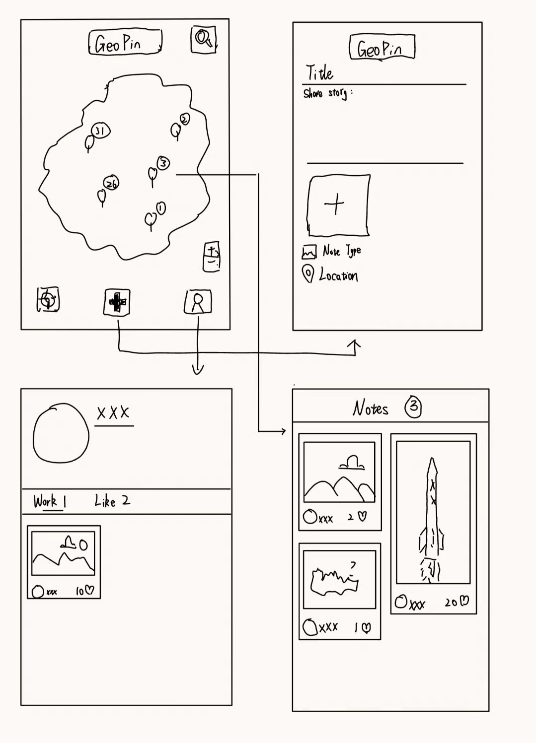
APP UI design(provisional)

Slide 10
Future Improvements & Uniqueness
• Add search and tag-based filtering.
• Enable comments and notifications for interaction.
• Explore AR-based map browsing experience.
These improvements will enhance social interaction and immersion in MapNotes.

Slide 11
Implemented functions
Module | Main Files | Function Description
Map & Cluster Display | com.amap.apis.cluster.*, com.noworld.notemap.utils.MapUtil | Implements map display, cluster display, and coordinate point annotation using AMap SDK (AutoNavi Maps).
Route & Overlay Drawing | RouteOverlay.java, WalkRouteOverlay.java | Provides walking route drawing and path navigation overlay functions.
Main Interface | MainActivity.java, activity_main.xml | App launch page that loads the map and displays note locations.
Add Note Interface | AddNoteActivity.java, activity_add_note.xml | Allows creating location-bound notes (supports images and text descriptions).
Note Detail View | NoteDetailActivity.java, activity_note_detail.xml | Displays saved note content and location information.
Cluster Detail Page | ClusterDetailActivity.java, activity_cluster_detail.xml | Shows all notes information in the area when clicking a map cluster point.
Image Management | PictureActivity.java, activity_picture.xml | Browses and manages uploaded images, which may be bound to locations or notes.
User Profile Page | ProfileActivity.java, activity_profile.xml | Displays user avatar, nickname.
Note Card List | NoteCardAdapter.java, item_note_card.xml | Displays note items in a card-style layout using RecyclerView.
App Entry | App.java | Global Application class that initializes SDKs, databases, and other services.

Slide 12
Technical Features
1. Map-related
- The package name com.amap.apis indicates the use of AMap SDK (AutoNavi Maps).
- Files such as ClusterOverlay.java, ClusterItem.java, and RegionItem.java have implemented the map cluster algorithm. WalkRouteOverlay.java implements walking route drawing. MapUtil.java and AMapServicesUtil.java are helper classes responsible for coordinate calculation, path computation, and AMap service calls.

Slide 13
2. UI Design (res/layout)
6 main Activity layouts + 1 RecyclerView card:
activity_main.xml
activity_add_note.xml
activity_note_detail.xml
activity_cluster_detail.xml
activity_picture.xml
activity_profile.xml
item_note_card.xml
The app UI fully covers the entire process from the main interface, note management to the personal center.

Slide 14
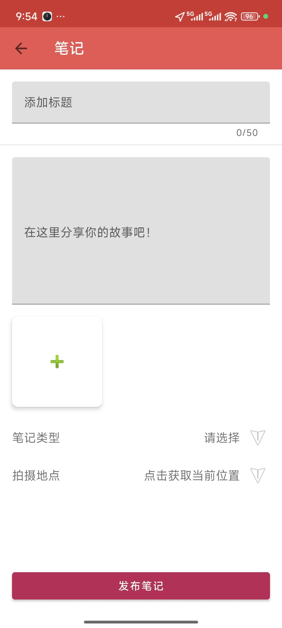
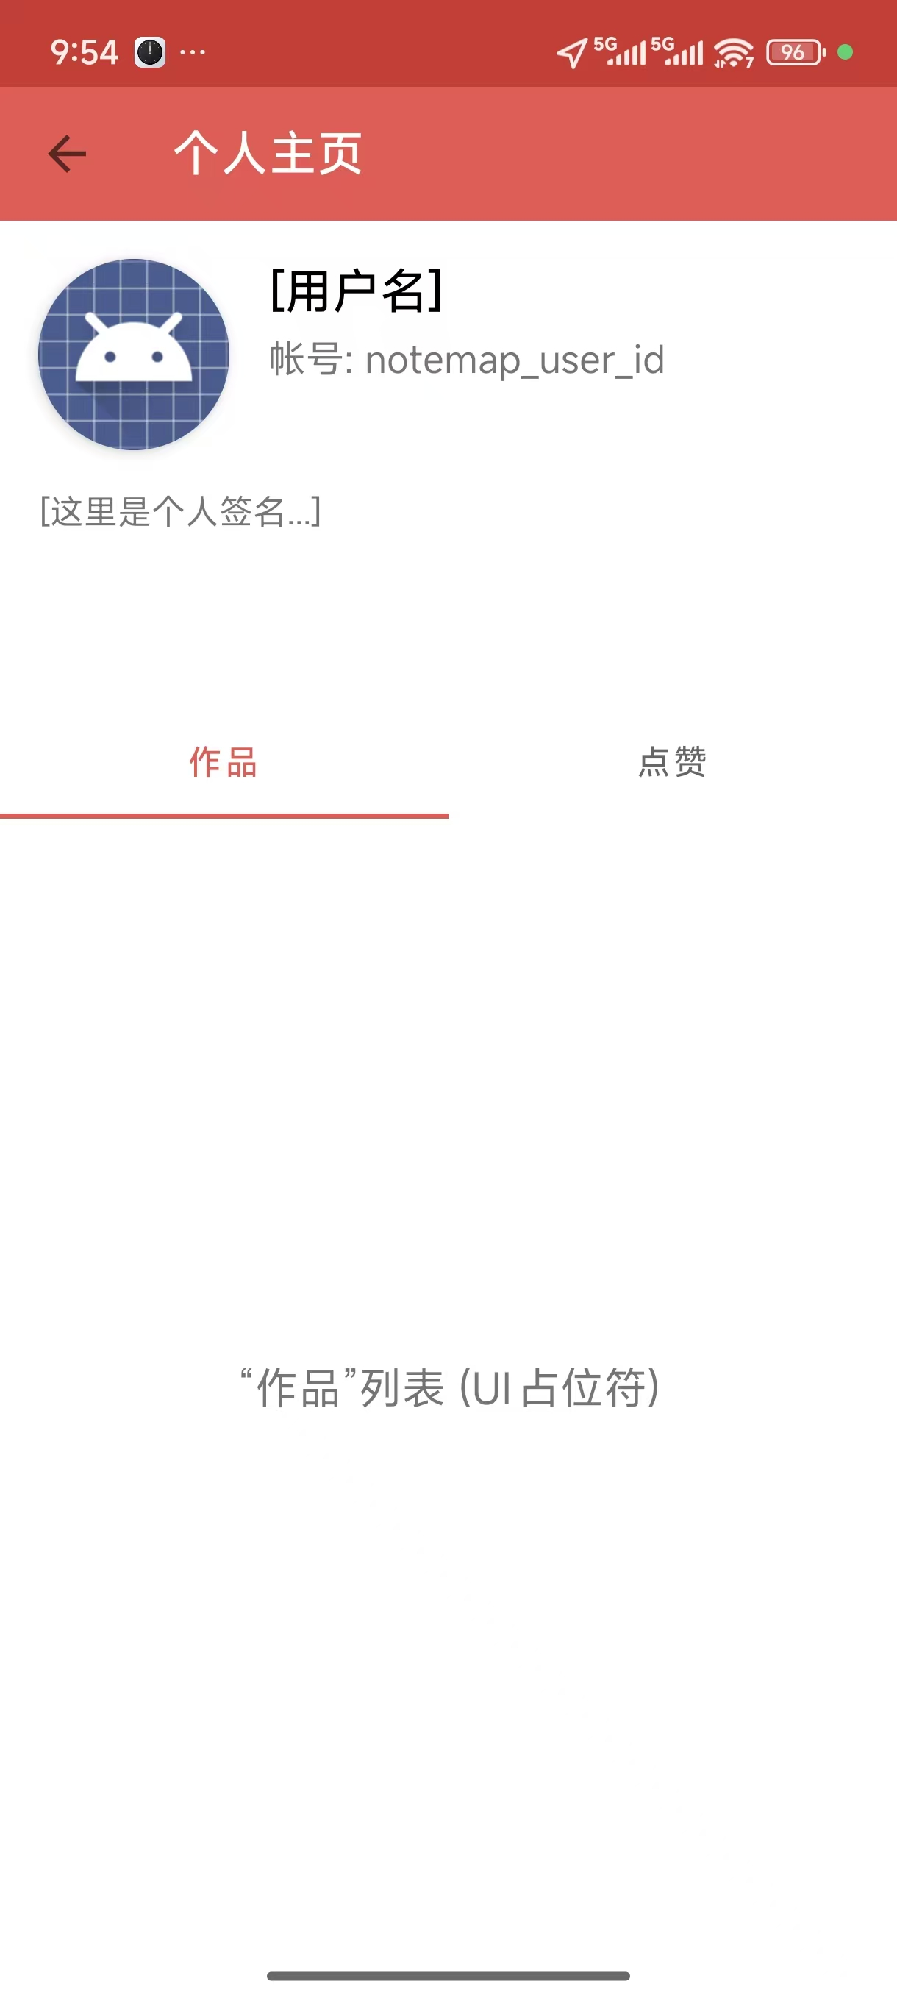
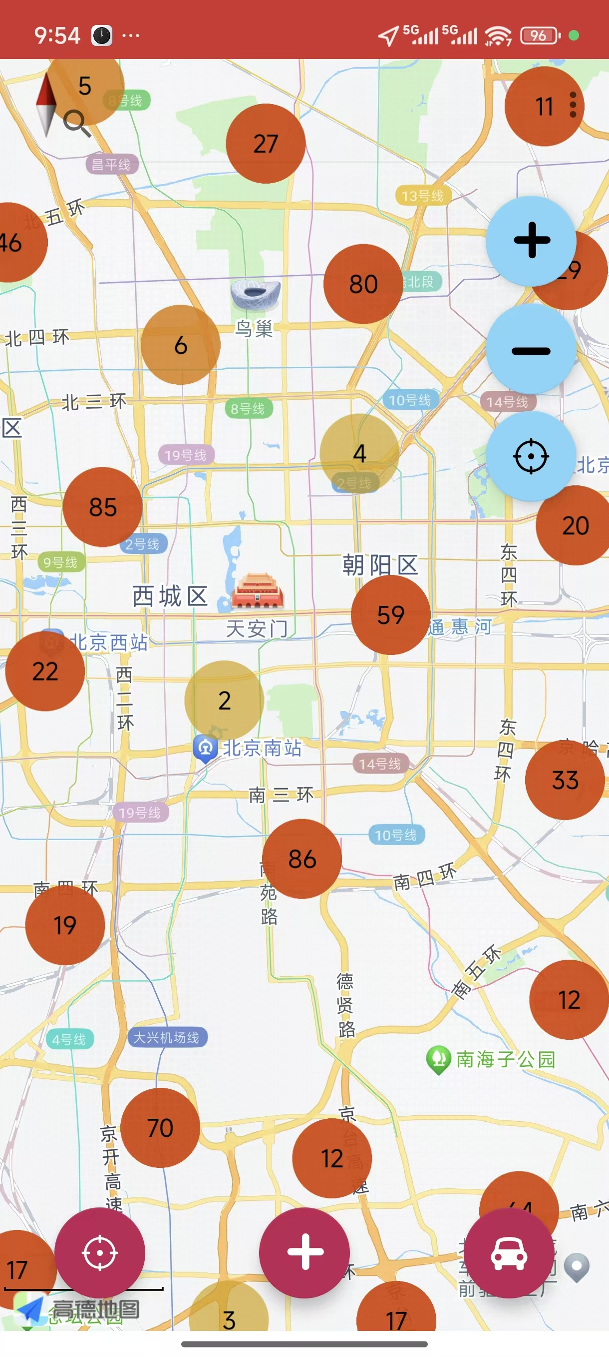
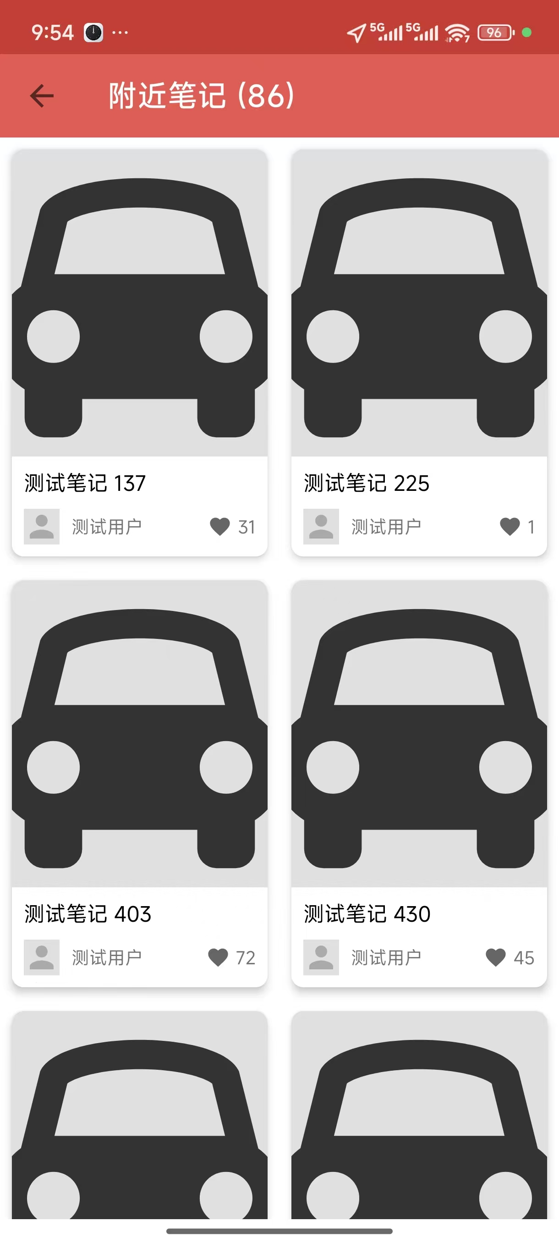
UI Design

Slide 15
3. Resource Files
- The drawable/ folder contains a large number of map icons (such as start point, end point, GPS point, navigation arrow, etc.).
- values/strings.xml, themes.xml, colors.xml have defined themes and interface styles.
- xml/file_paths.xml is used for file read/write permission configuration on Android 7+, indicating support for image upload or local storage.

