Slide 1
遗忘因子

Slide 2
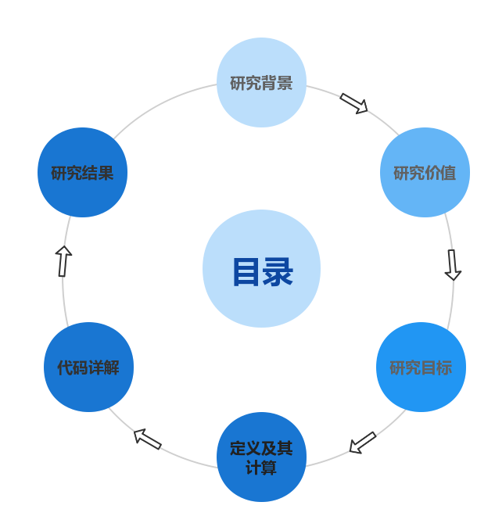

Slide 3
研究背景
前置知识(1/4)
学习：从function sets里找出一个function，使其能够很好地拟合当前输入输出关系的过程。
遗忘：学习过程中，对旧的信息进行扬弃，对新的信息进行学习。

Slide 4
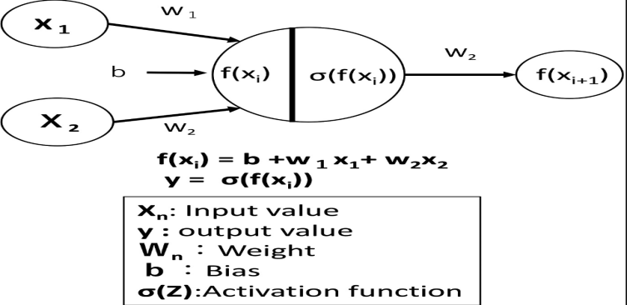
研究背景
前置知识(2/4)
Y = f(x)

Slide 5
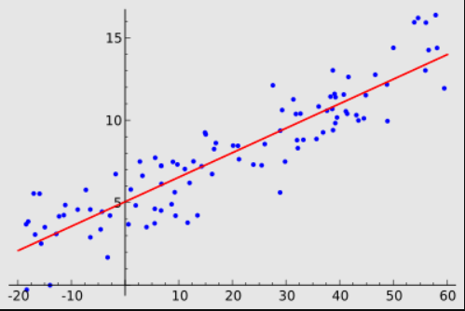
研究背景
前置知识(3/4)
Loss(Y, Y*)

Slide 6

研究背景
前置知识(4/4)
Gradient Decent
back propagation
update parameters

Slide 7
研究背景
灾难性遗忘现象
神经网络在训练阶段动态地在节点之间创建带权路径，这些路径是根据当前输入计算机的数据所构建的https://www.sciencedirect.com/science/article/abs/pii/S0079742108605368?via%3Dihub
New Information
New Path
New Path + Confined Model Complexity
the phenoemenon of catastropic forgetting
may cause higher error
forget

Slide 8
研究价值
1. 通过分析DNN在train model的过程中数据间的相互作用，深入了解优化过程。数据集的可压缩性，从而在不影响泛化能力和精度的情况下提高效率。
2. 可用于识别对model来说起着“重要”作用的数据，检测其中有异常值或带有noise标签的数据。

Slide 9
研究目标
model选择性遗忘样本的原因
1. 哪些样本容易被遗忘，为什么？
2. 哪些样本总是不会被遗忘，哪些总是会被遗忘，为什么？

Slide 10
定义及其计算(1/3)
前提假设
Based on a standard classifaction problem
Datasets: D = (Xi, Yi)
Target: Minimize
Randomly select data from datasets, using SGD to update DNN.
Predicted label for example Xi after t steps of SGD:
A binary variable indicating whether the example is correctly classified at time step t:

Slide 11
定义及其计算(2/3)
Learning Event:
Forgetting Event ：
Unforgettable Examples
It is learnt t* verifies t∗ < ∞ and for all k ≥ t∗,
Forgettable Examples
Have been forgotten at least once
The First Learning Event
The first time t when example i was learnt
The First Forgetting Event
The first time t when example i was forgotten

Slide 12
定义及其计算(3/3)
ForgettingScore: calculate all cases’ forgetting score over all adjacent epoches(epoch12, 23, ...)
Learning Event： acc(i, t) < acc(i, t + 1) score[i] += 2
Forgetting Event： acc(i, t) > acc(i, t + 1) score[i] -= 2
when:
acc(i, t) == acc(i, t + 1) && acc(i, t) == 1 score[i] += 1
acc(i, t) == acc(i, t + 1) && acc(i, t) == 0 score[i] -= 1

Slide 13
代码详解
train & test main
def main():
torch.cuda.empty_cache()
train_dataloader, test_dataloader = load_data(test_batch_size = test_batch_size, train_batch_size = train_batch_size, download = True, shuffle = True)
result_no_filter_train_data = train_predict(train_dataloader = train_dataloader, test_dataloader = test_dataloader, lr = lr, epoches = epoches, save_checking_points = True, checking_points_path = checking_points_cpts1)
process_train_data_via_forgetting(train_dataloader = train_dataloader)
process_train_data_via_tracIn(lr = lr, test_batch_size = test_batch_size, checking_points_path = checking_points_cpts1, train_dataloader = train_dataloader, test_dataloader = test_dataloader)
train_dataloader = select_train_dataloader_via_forgetting_tracin(train_dataloader = train_dataloader)
result_filtered_train_data = train_predict(train_dataloader = train_dataloader, test_dataloader = test_dataloader, lr = lr, epoches = epoches, save_checking_points = True, checking_points_path = checking_points_cpts2)
compare_result_if_filtered_or_not(result_no_filter_train_data = result_no_filter_train_data, result_filtered_train_data = result_filtered_train_data)
find_correlation_between_Forgetting_and_TracIn()

Slide 14
代码详解
train & test train_predict
def train_predict(train_dataloader, test_dataloader, lr, epoches, save_checking_points = True, checking_points_path = "./cpts/"):
...
for epoch in range(epoches):
model.train()
for _, (x, label) in enumerate(train_dataloader):
x, label = x.to(device), label.to(device)
logits = model(x)
loss = criteon(logits, label)
optimizer.zero_grad()
loss.backward()
optimizer.step()
model.eval()
with torch.no_grad():
for x, label in test_dataloader:
x, label = x.to(device), label.to(device)
logits = model(x) # [batchsize, 10]
pred = logits.argmax(dim = 1)
if accuracy_detail_dict.get(tot_epoch) == None:
accuracy_detail_dict[tot_epoch] = torch.eq(pred, label).int().tolist()
else:
accuracy_detail_dict[tot_epoch].append(torch.eq(pred, label).int().tolist())
...

Slide 15
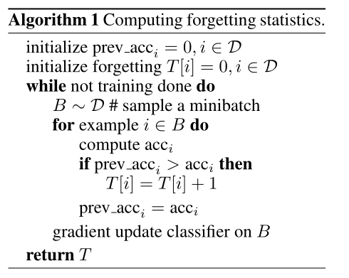
代码详解
process_train_data_via_forgetting

Slide 16
代码详解
process_train_data_via_forgetting
def Algorithm_1_Computing_forgetting_statistics(to_shuffle = False, len_per_epoch = 0):
forgetting_event_happend_state = [False for _ in range(len_per_epoch)]
learning_event_happend_state = [False for _ in range(len_per_epoch)]
first_learning_event_happened_state = [-1 for _ in range(len_per_epoch)]
first_forgetting_event_happend_state = [-1 for _ in range(len_per_epoch)]
tot_forgetting_score = [0 for _ in range(len_per_epoch)]
unforgettable_examples = []
unforgettable_examples_start_unforget_idx = [-1 for _ in range(len_per_epoch)]
forgettable_examples = []
global all_epoch_detail_dict
all_epoch_detail_dict = {k: v for k, v in sorted(all_epoch_detail_dict.items(), key=lambda item: item[0].split("_")[-1])}
for current_epoch_idx in range(len(all_epoch_detail_dict)): # while not training done, across all epoches
next_epoch_idx = min(current_epoch_idx + 1, len(all_epoch_detail_dict) - 1)
for i in range(len_per_epoch):
current_acc = all_epoch_detail_dict["epoch_" + str(current_epoch_idx)][i]
next_acc = all_epoch_detail_dict["epoch_" + str(next_epoch_idx)][i]
if first_learning_event_happened_state[i] == -1 and current_acc < next_acc:
first_learning_event_happened_state[i] = current_epoch_idx
if first_forgetting_event_happend_state[i] == -1 and learning_event_happend_state[i] and current_acc < next_acc:
first_forgetting_event_happend_state[i] = current_epoch_idx
if current_acc > next_acc:
tot_forgetting_score[i] -= 2
elif current_acc == next_acc and current_acc == 0:
tot_forgetting_score[i] -= 1
elif current_acc == next_acc and current_acc == 1:
tot_forgetting_score[i] += 1
elif current_acc < next_acc:
tot_forgetting_score[i] += 2
forgetting_event_happend_state[i] = True if current_acc > next_acc else forgetting_event_happend_state[i]
learning_event_happend_state[i] = True if current_acc < next_acc else learning_event_happend_state[i]
for i in range(len_per_epoch):
if learning_event_happend_state[i] == True:
unforgettable_examples.append(i)
unforgettable_examples_start_unforget_idx[i] = get_start_unforget_idx(first_learning_event_happened_state[i], i)
if forgetting_event_happend_state[i]:
forgettable_examples.append(i)
return tot_forgetting_score, unforgettable_examples, forgettable_examples, first_learning_event_happened_state, first_forgetting_event_happend_state, unforgettable_examples_start_unforget_idx
def check_rest_epoch_forgetting_happend(current_first_learning_event_happend_time, example_i):
global all_epoch_detail_dict
for current_epoch_idx in range(current_first_learning_event_happend_time, len(all_epoch_detail_dict) - 1):
current_acc = all_epoch_detail_dict["epoch_" + str(current_epoch_idx)][example_i]
if current_acc == 0:
return True
return False
def get_start_unforget_idx(start_learn_happend_time, example_i):
res = -1
global all_epoch_detail_dict
for current_epoch_idx in range(start_learn_happend_time, len(all_epoch_detail_dict) - 1):
current_acc = all_epoch_detail_dict["epoch_" + str(current_epoch_idx)][example_i]
if current_acc == 0: continue
if check_rest_epoch_forgetting_happend(current_epoch_idx, example_i) == False:
res = current_epoch_idx
break
return res

Slide 17
代码详解
outputs
tot_forgetting_score: [15, -4, 23, 3, 12, 21, 4, 12, ...]
cnt_unforggetable_examples: 6486 (total: 10000)
unforgettable_examples:[0, 1, 2, 3, 4, 5, 6, 7, ...]
unforgettable_examples_start_unforget_idx:[40, -1, 40, 38, 40, 31, 40, -1, ...]
forgettable_examples:[0, 1, 2, 3, 4, 5, 6, 7, ...]
first_learning_event_happened_state:[0, 2, 0, 2, 2, 0, 2, 1, ...]
first_forgetting_event_happend_state:[3, 4, 7, 6, 6, 6, 5, 4, ...]

Slide 18
研究结果(在论文中被提及，暂未证实)
存在大量永不被遗忘的数据（Once learnt. Never forgotten），这些数据在不同随机种子下都是稳定的，并且在不同的神经结构之间具有很强的相关性。(已验证)
带有噪声标签的数据，具有“不常见”特征、视觉上难以分类的图像数据 是最容易被遗忘的数据。
在一个数据集上训练一个神经网络，在这个数据集上，删除大部分被不容易被遗忘的数据后，仍然会在测试集上表现得很好。

Slide 19
谢谢

