Slide 1
Codex

Slide 2
About CodeX
CodeX is a German beverage company which is recently launched in India. They launched their energy drink in 10 cities in India.

Slide 3
Task
CodeX conducted a survey in those 10 cities and received results from 10k respondents. The survey was based on consumer behaviour questions like their purchasing habits, their feedback about energy drinks available in the market, pricing, packaging etc.
The Marketing Team wants their Data Analyst to convert these survey results to meaningful insights which the team can use to drive actions.
The Marketing Team have asked to share certain insights. They have also asked to share meaningful recommendations from the data or external factors etc.

Slide 4
Demographic Insights

Slide 5
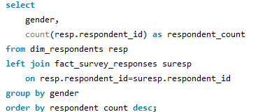

1. Who prefers energy drink more? (male/female/non-binary?)
As per the survey analysis, males consume energy drinks more

Slide 6
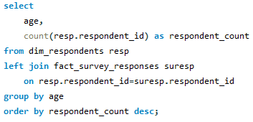
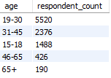
2. Which age group prefers energy drinks more?
As per the survey analysis, the age group of 19-30 prefer energy drinks the most which is 50%+ amongst the total respondents

Slide 7
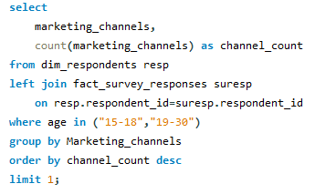

3. Which type of marketing reaches the most Youth (15-30)?
As per the survey analysis, Online Ads is the most successful marketing channel among the age group of 15-30

Slide 8
Consumer Preferences

Slide 9
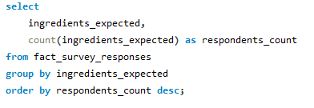

1. What are the preferred ingredients of energy drinks among respondents?
As per the survey analysis, Caffeine is the most preferred ingredient in energy drinks

Slide 10
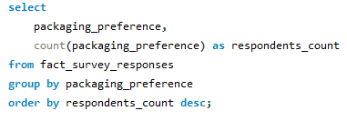
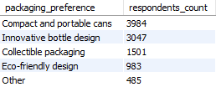
2. What packaging preferences do respondents have for energy drinks?
As per the survey analysis, Compact and portable cans & innovative bottle designs are the packaging preferences among the respondents

Slide 11
Competition Analysis

Slide 12
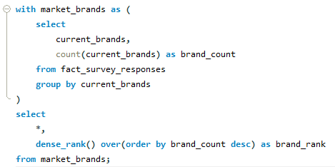
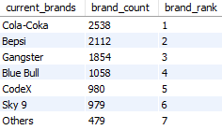
1. Who are the current market leaders?
As per the survey analysis, Cola-Coka is the current market leader followed by Bepsi and Gangster. Codex is ranked 5th in the market

Slide 13
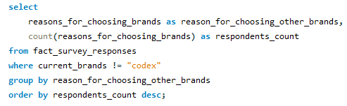
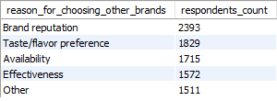
2. What are the primary reasons consumers prefer those brands over ours?
As per the survey analysis, Brand reputation is one of the primary reasons why the respondents prefer other brands over CodeX

Slide 14
Marketing Channels & Brand Awareness

Slide 15
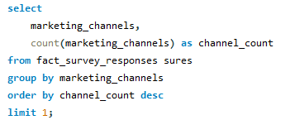

1. Which marketing channel can be used to reach more customers?
As per the survey analysis, Online Ads can be used to reach more customers as it has highest success rate among the respondents

Slide 16
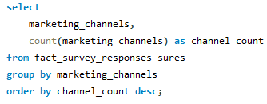
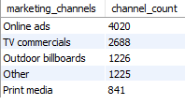
2. How effective are different marketing strategies and channels in reaching our customers?
As per the survey analysis, Online Ads is the most effective marketing channel followed by TV commercials, Outdoor billboards, Other and Print media

Slide 17
Brand Perception

Slide 18


1. What do people think about our brand? (overall rating)
As per the survey analysis, CodeX has an average rating of 3.3

Slide 19
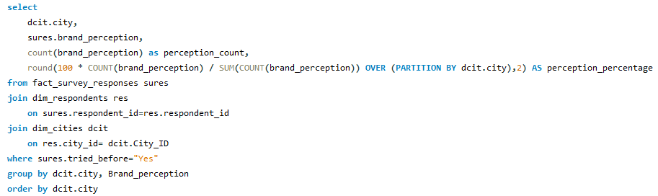
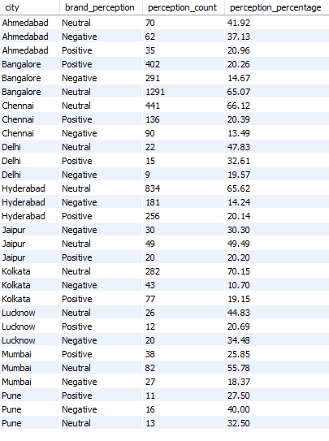
2. Which cities do we need to focus more on?
As per the survey analysis, we need to focus on improving the brand perception positive response % rate

Slide 20
Purchase Behaviour

Slide 21
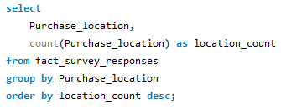
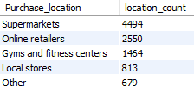
1. Where do respondents prefer to purchase energy drinks?
As per the survey analysis, Supermarkets are the most preferred location for buying energy drinks

Slide 22
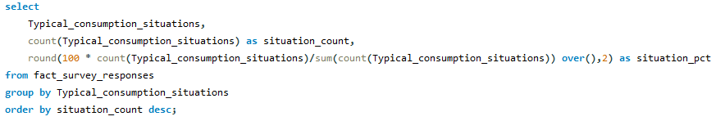
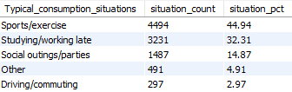
2. What are the typical consumption situations for energy drinks among respondents?
As per the survey analysis, Sports/exercise and studying/working are the most typical situations for enegy drink consumption

Slide 23
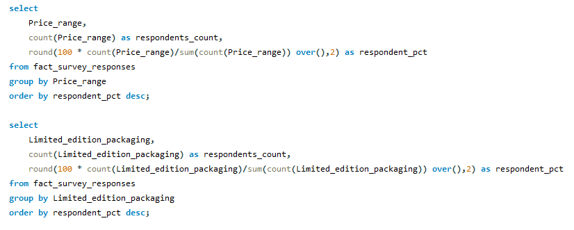


3. What factors influence respondents' purchase decisions, such as price range and limited edition packaging?
As per the survey analysis, energy drinks within price range of 50-99 seems to be preferred the most. Also, limited edition packaging seems to have a neutral impact.

Slide 24
Product Development

Slide 25
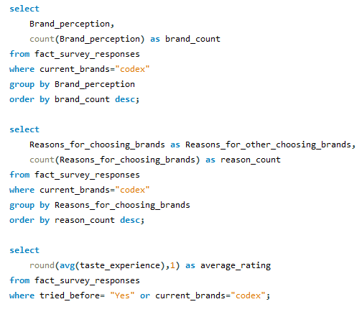

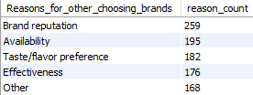

Which area of business should we focus more on our product development?
As per the survey analysis, CodeX needs to improve on brand reputation, availability and taste.

Slide 26
Additional Recommendations

Slide 27
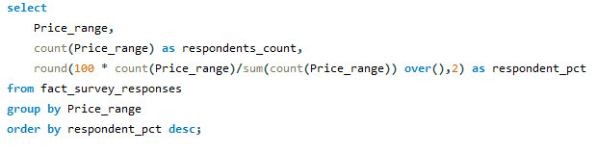

1. What should be the ideal price of our product?
As per the survey analysis, CodeX needs to be priced between 50-150 which is around 70% of our survey respondents’ preference

Slide 28
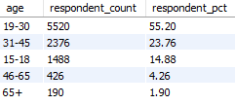
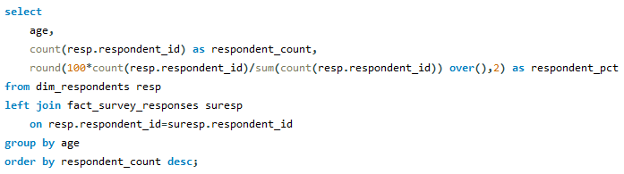
2. Who should be our target audience, and why?
As per the survey analysis, athletes, college students, working professionals should be our target audience since they fall within the age group of 19-45 and also as per the ideal situation for energy drink consumption

Slide 29
3. Who can be a brand ambassador, and why?
Virat Kohli
Virat Kohli is an Indian cricketer and the former captain of the Indian national team.
Kohli is known for his dedication to fitness and has undergone a noticeable transformation in his appearance.
He has a massive fan following on social media especially among the youth and working professionals alike.

