Slide 1

1D COMSOL EM Analysis Program EM_1D_Via_Branch
Zeyu Sun
Sheldon Tan
Department of Electrical and Computer Engineering
University of California at Riverside

Slide 2
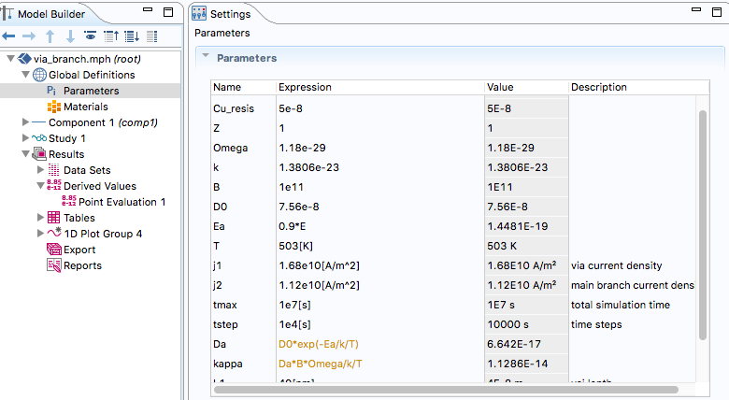
Steps to run COMSOL file
1. use COMSOL to open the .mph file
2. set the parameters
parameters
meaning of parameters

Slide 3
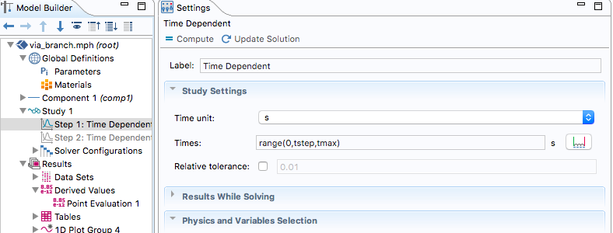
Steps to run COMSOL file
3. Run the COMSOL simulation
run the simulation use compile

Slide 4
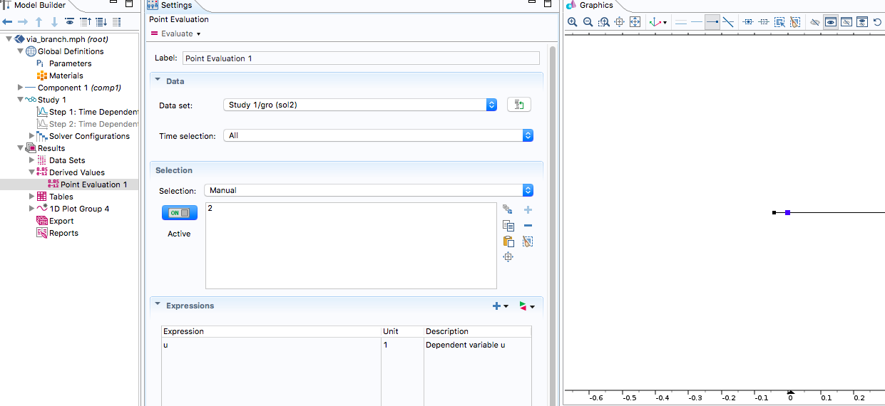
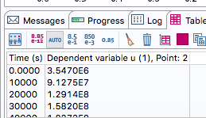
Steps to run COMSOL file
Collect stress on main branch
Do point analysis
End of main branch
Stress on the point change with time

Slide 5
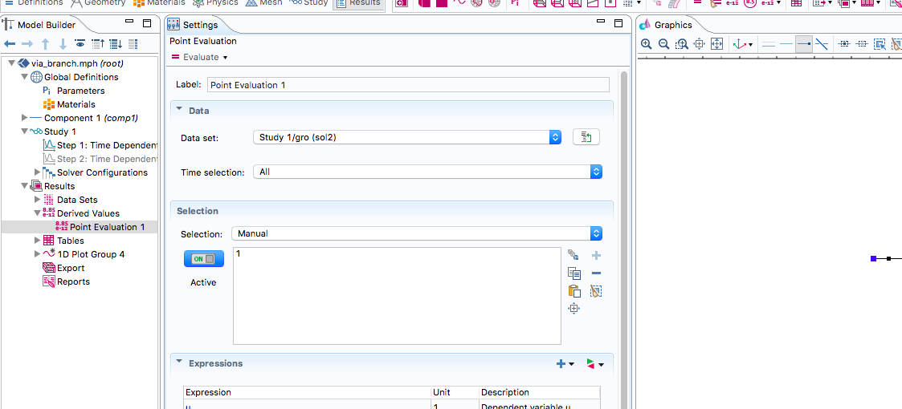
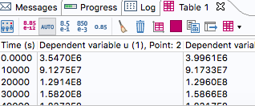
Steps to run COMSOL file
Collect stress on via
Do point analysis
End of main via
Stress on the point change with time

