Slide 1
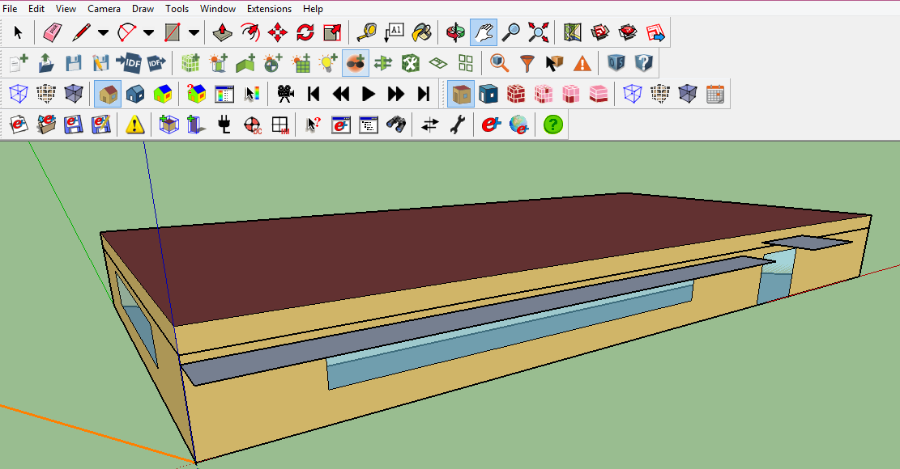
Model
This building has 5 rooms:
Then use Energyplus to get the temperature distribution of each room:

Slide 2
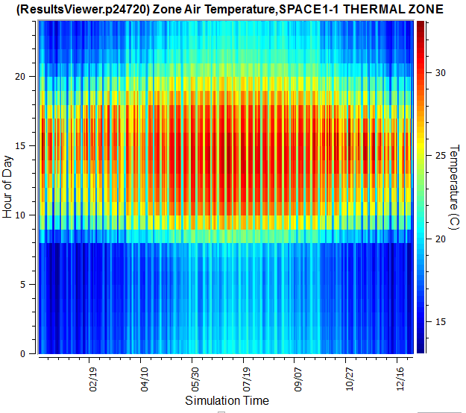
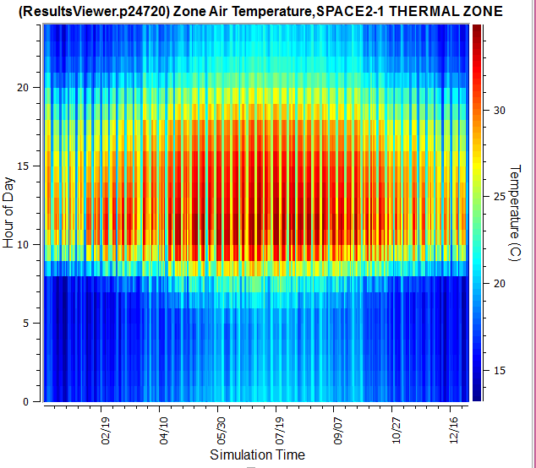
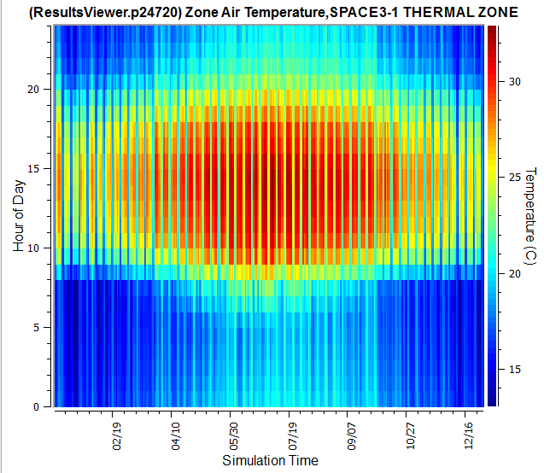
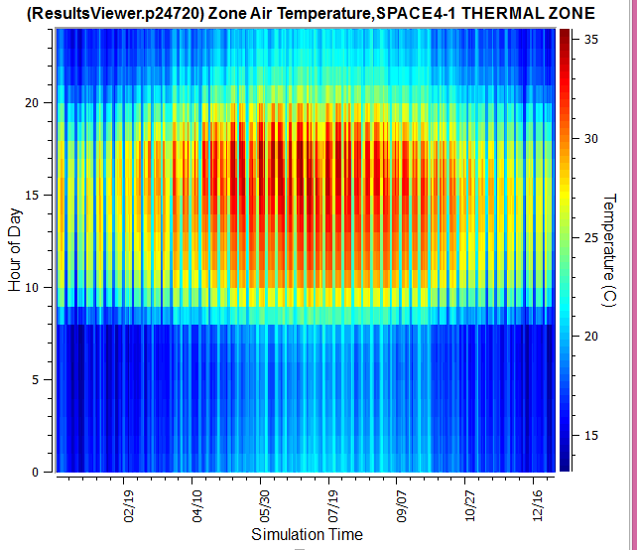

Slide 3
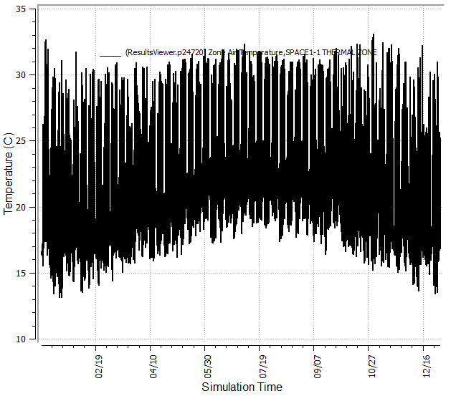

Slide 4
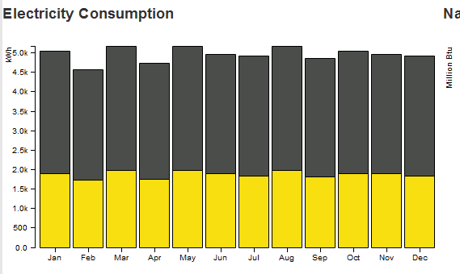
Annual Energy Consumption:

Slide 5
Changing any variable (such as the wall conductivity) will get the similar results shown in the previous slides

