Slide 1
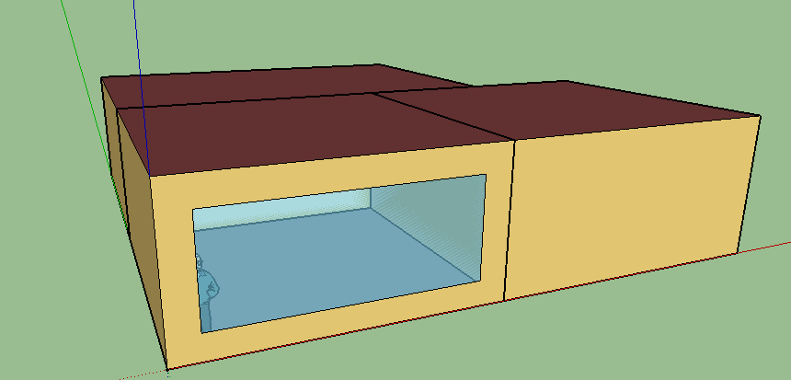
North Zone
East Zone
West Zone

Slide 5
Outside-dry bulb Temperature

