Slide 1
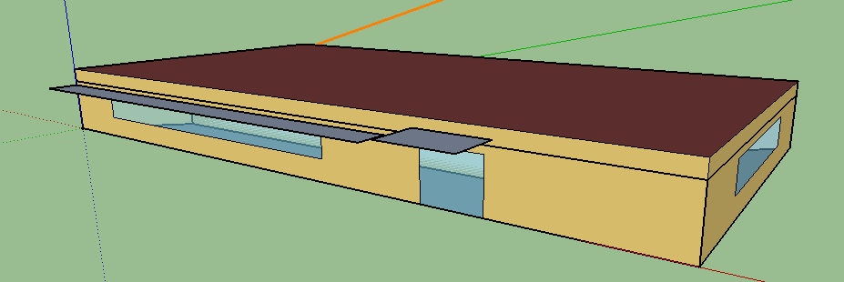
HVAC 5 Zone Fan Coil
This model has 5 zones

Slide 2
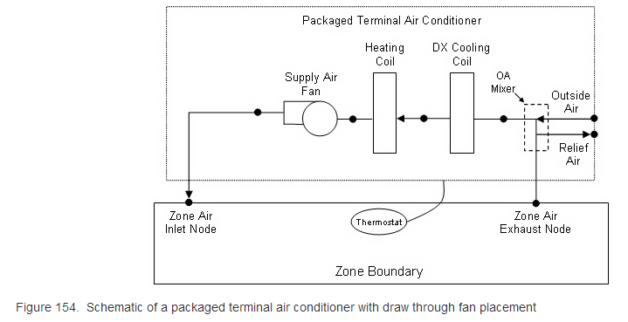
https://energyplus.net/sites/default/files/docs/site_v8.3.0/InputOutputReference/02-HVACTemplates/

Slide 7
Select power for the input
For HVAC system, there are different loops, such as air loop, water loop and gas loop. So we need to decide which power need to be considered for our model.
For the air system:
Zone Air System Sensible Cooling Rate (W): Overall sensible cooling energy to the zone from the HVAC system
Zone/Sys Sensible Heating Rate [W]: Overall sensible heating energy to the zone from the HVAC system
http://www.designbuilder.co.uk/helpv3/Content/Calculation_of_DesignBuilder_Output_from_EnergyPlus_Report_Variables.htm

Slide 8
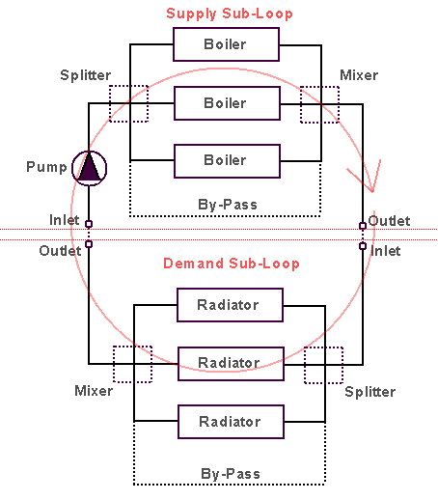
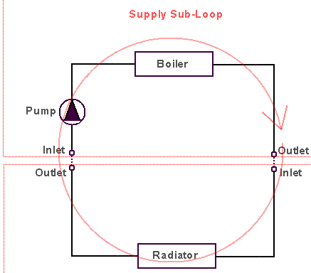
Loops in HVAC
Demand and supply loop
Plant and Condenser loop

Slide 9
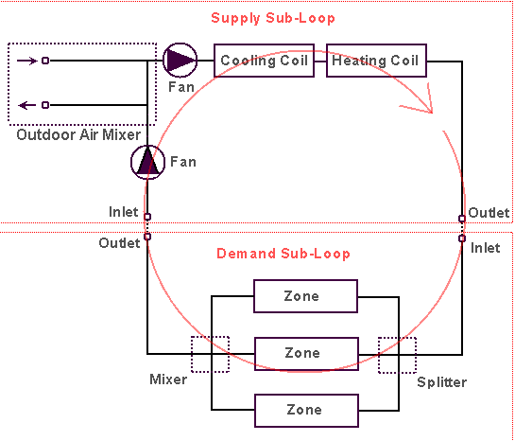
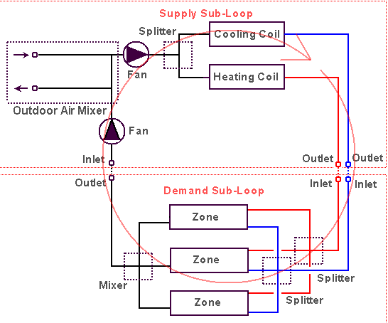
Loops in HVAC
Single duct air loop
Dual duct air loop
http://www.designbuilder.co.uk/helpv3/Content/Detailed%20HVAC/Understanding%20HVAC%20Loops.htm

