Slide 1
Energy Plus / Smart Building Project Update
Daniel Quach
6/6/2015

Slide 2
Summary
Initial Results
Results 2 : Included work day / work style characteristics
Results 3 : Modified part 2 and increased order

Slide 3
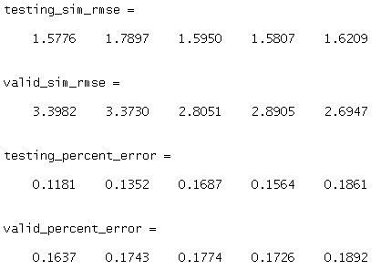
Initial Results
Input : Outside Temperature ( and Power Input for cases with HVAC on )
Output : Indoor Room Temperature ( Results show for 5 rooms )
Order for system identification : 50
Extra Modifications : None
Legend:
  Blue lines are results from energyplus
  Red Lines are results estimated from our system
Note: See results between 400 and 500. There is some extra effect that causes the real result to be abnormal. Our system does not handle it well for both testing and validation phases.

Slide 4
Initial Results (Testing Phase)

Slide 5
Initial Results (Validation Phase)

Slide 6
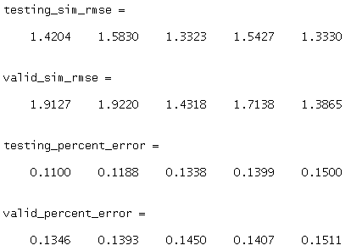
Results 2 - added work style characteristics
Input : Outside Temperature ( and Power Input for cases with HVAC on )
Output : Indoor Room Temperature ( Results show for 5 rooms )
Order for system identification : 50
Extra Modifications :
  Added work day (vector of 8x 1’s and 16x 0’s to denote 8 hour work day) [Assumed from previous results]
  Added work week (vector of 5x 1’s and 2x 0’s to denote 5 working days per week) [Assumed from previous results]
Legend:
  Blue lines are results from
  energyplus
  Red Lines are results estimated
  from our system
Note: See results between 400 and 500.
Similar error from previous result exist.

Slide 7
Results 2 : Testing Phase

Slide 8
Results 2 : Validation Phase

Slide 9
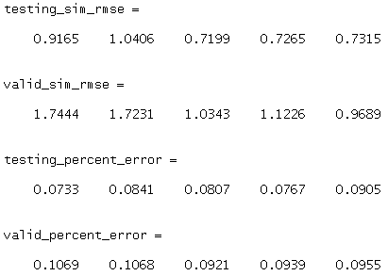
Results 3 : Modified part 2 and increased order
Input : Outside Temperature ( and Power Input for cases with HVAC on )
Output : Indoor Room Temperature ( Results show for 5 rooms )
Order for system identification : 75 (Increased from 50)
Extra Modifications :
  Modified work day characteristic (vector of 1 2 3 … 24 for added flexibility)
  Modified work week (vector of 1 2 3 4 5 0 0 …)
Legend:
  Blue lines are results from
  energyplus
  Red Lines are results estimated
  from our system
Note: See results between 400 and 500.
Slightly better, but similar error from
previous result exist.

Slide 10
Results 3 : Testing Phase

Slide 11
Results 3 : Validation Phase

Slide 12
Conclusion
Estimation seems good, but could be improved with more data and other factors
Need more input data:
  Include date to determine workweek for a more accurate model (from observation, we can see 5 high peaks in a row with two lower peaks, then repeating)
  Count of persons in the room at every sample time
  Humidity
  Wind Speed
Any other factors generating heat? (computers?)

