Slide 1
Energy Plus / Smart Building Project Update 2
Daniel Quach
6/15/2015

Slide 2
Summary
Initial Results
Results 4 : Updated Results
(Please see 20150606.pptx for Results 1-3)

Slide 3
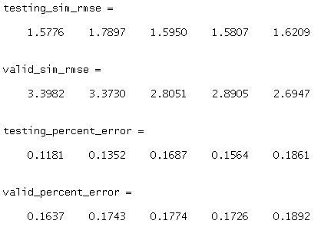
Initial Results (Taken from previous ppt)
Input : Outside Temperature ( and Power Input for cases with HVAC on )
Output : Indoor Room Temperature ( Results show for 5 rooms )
Order for system identification : 50
Extra Modifications : None
Legend:
  Blue lines are results from energyplus
  Red Lines are results estimated from our system
Note: See results between 400 and 500. There is some extra effect that causes the real result to be abnormal. Our system does not handle it well for both testing and validation phases.

Slide 4
Initial Results (Testing Phase)

Slide 5
Initial Results (Validation Phase)

Slide 6
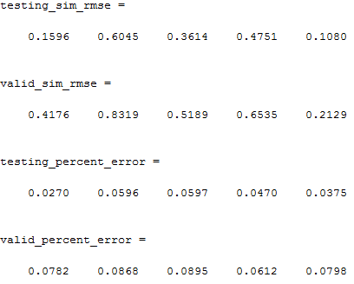
Results 4 : Updated Results
Input : Outside Temperature ( and Power Input for cases with HVAC on )
Output : Indoor Room Temperature ( Results show for 5 rooms )
Order for system identification : 90
Legend:
  Red lines are results from
  energyplus
  Blue lines are results estimated
  from our system
Note: See Legend notes. Red and Blue colors are
reversed compared to Initial Results

Slide 7
Results 4 : Testing Phase

Slide 8
Results 4 : Validation Phase

Slide 9
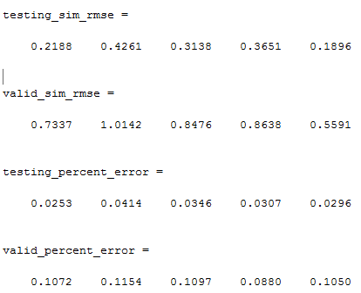
More Results 4: With HVAC on

Slide 10
Results 4: HVAC on – Testing Phase

Slide 11
Results 4: HVAC on – Validation Phase

