Slide 1
Energy Plus / Smart Building Project Update 3
Daniel Quach
6/23/2015

Slide 2
Summary
Results 4 : Updated Results
(Copied from 20150615.pptx for reference)
(Please see 20150606.pptx for Results 1-3)
Results 5 : Results with Light Factor

Slide 3
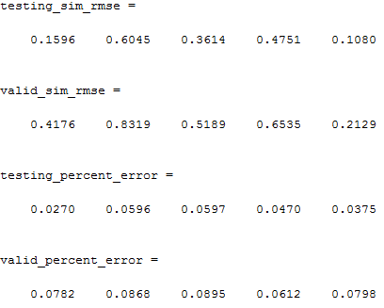
Results 4 : Updated Results
Input : Outside Temperature ( and Power Input for cases with HVAC on )
Output : Indoor Room Temperature ( Results show for 5 rooms )
Order for system identification : 90
Legend:
  Red lines are results from
  Energy Plus
  Blue lines are results estimated
  from our system

Slide 4
Results 4 : Testing Phase

Slide 5
Results 4 : Validation Phase

Slide 6
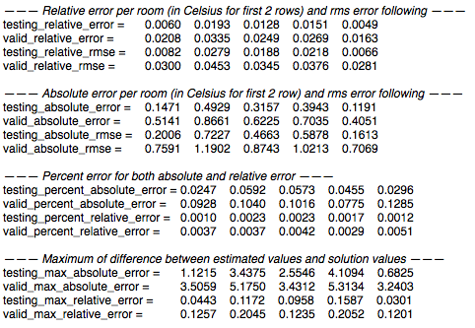
Results 5 : Results with Light Factor
Input : Outside Temperature, Custom Scheduler, Light Heating Rate
Output : Indoor Room Temperature ( Results show for 5 rooms )
Order for system identification : 90
Legend:
  Blue lines are results from
  Energy Plus
  Red lines are results estimated
  from our system
Note: See Legend notes. Red and Blue colors are
reversed compared to Results 4

Slide 7
Results 5: w/ Light Factor – Testing Phase

Slide 8
Results 5: w/ Light Factor– Validation Phase

Slide 9
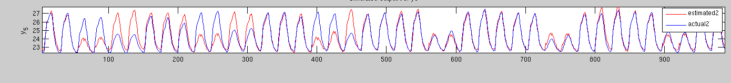
Analysis
Example below:
Actual schedule(blue) : 4-2-5-2-5-1-4-2-5-2-5-2-…
Estimated schedule(red) : 2-2-5-2-5-2-5-2-5-2-5-2-…
(Underlined numbers are weekend days)
Testing phase seems to build the model accurately, even with light heat as a factor.
Validation phase seems to have the trouble.
  When schedule is irregular, results will be very inaccurate.
  Points around 600-800 show good results (5 workday , 2 week end)
  Points between 50-250 show a shifted workweek (red is our estimated) compared to the actual results (in blue)
  Strange factors such as 450-550 show actual data workweek as 4 days which show inaccurate results for our estimation

Slide 10
Summary
Agree from basic observation and conclusion that the impacts of such may be nonlinear and cannot get accurate results for room temperature from just outdoor temperature as only input
New results from experiment 5 (earlier in this ppt) show other factors
Suggesting an RNN-based model to have a better model.

