Slide 1
Building Thermal Modeling for Energy-Efficient Smart Building Control
Daniel Quach
Professor: Dr. Sheldon Tan
7/17/2015

Slide 2
Summary
EnergyPlus Review
Initial Results with no extra factors
Results with extra factors
Optimization and Final Results

Slide 3
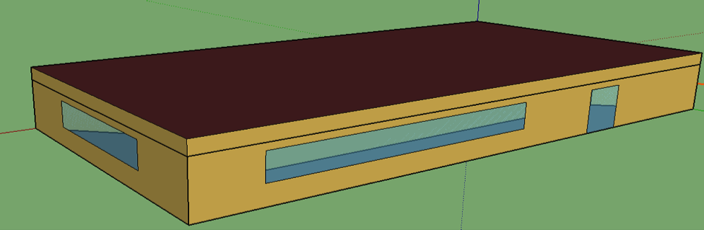
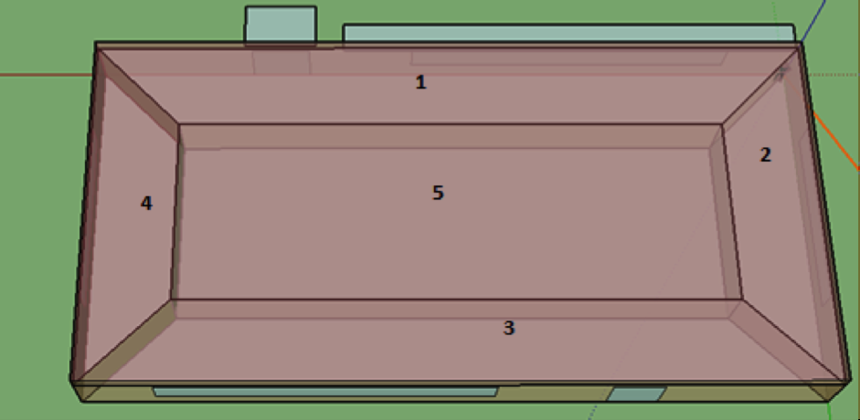
EnergyPlus
Software package by U.S.
Dept. of Energy used for
modeling thermal behavior,
energy, and water use.
Capable of modifying
specific settings for each zone
  Thermal zones, Space type, Schedule, Outdoor Air, People, Lights, Electric Equipment, Surfaces, etc.

Slide 4
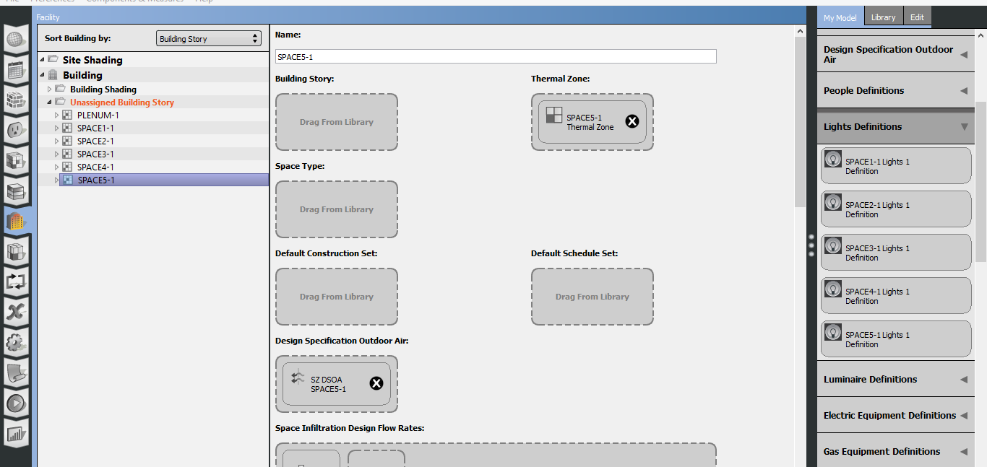
Setting For Each Thermal Zone

Slide 5
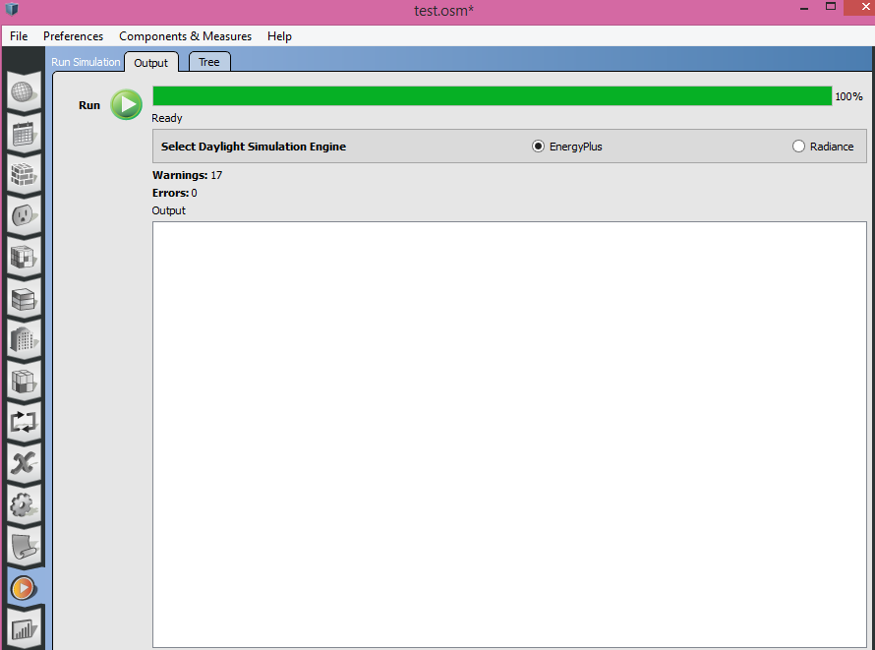
Run The Model

Slide 6
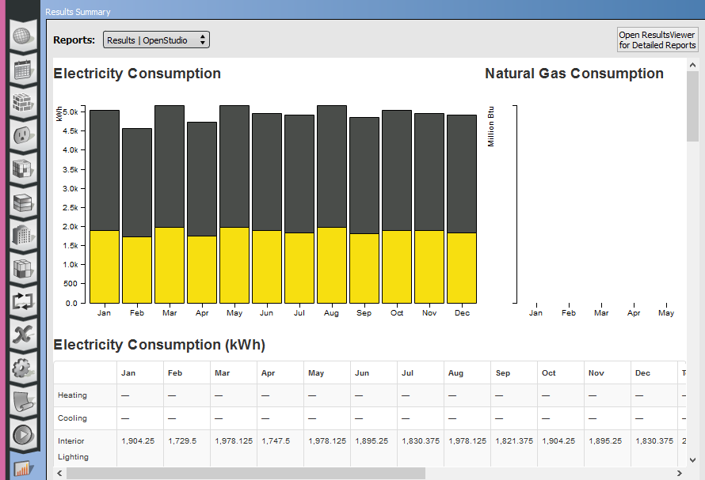
EnergyPlus Results
Use this to get more results

Slide 7
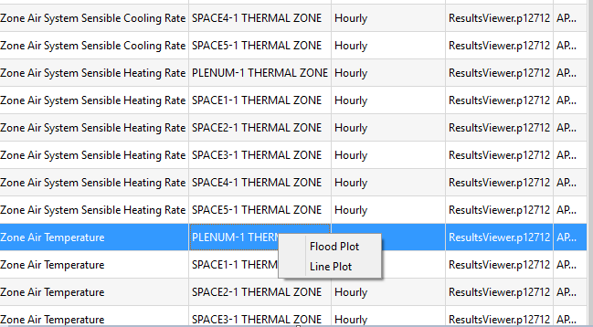
EnergyPlus Results

Slide 8
Proposed Method
Implemented using MATLAB with System Identification Toolbox
Used EnergyPlus to simulate model and generate inputs and ‘golden’ outputs
Inputs:
  Ambient temperature, HVAC data, light, electrical equipment, people
Output:
  Zone room temperature

Slide 9
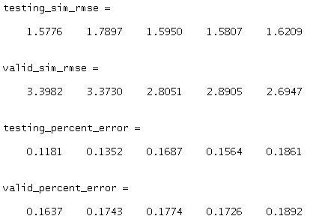
Initial Results (no extra factors)
Order for system identification: 50
Legend:
  Blue lines are EnergyPlus results
  Red lines are our estimated results
Note: see results between 400 and 500. There is some extra effect that causes the golden result to be strange. Our system does not handle it well for both training (testing) and validation phases.

Slide 10
Initial Results (Training Phase)

Slide 11
Initial Results (Validation Phase)

Slide 12
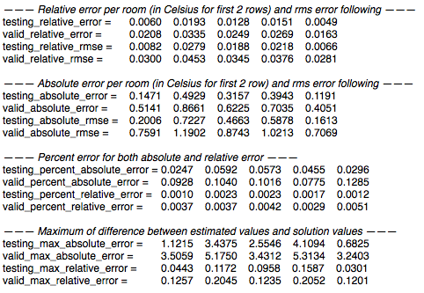
Results with extra factors
Specifications
  Input:
    Ambient temperature, Custom scheduler, Light Heating Rate
  Output:
    Zone room temperatures
  Order for system
  identification: 90
Legend:
  Blue lines are EnergyPlus
  results
  Red lines are our estimated
  results

Slide 13
Results (Training Phase)

Slide 14
Results (Validation Phase)

Slide 15
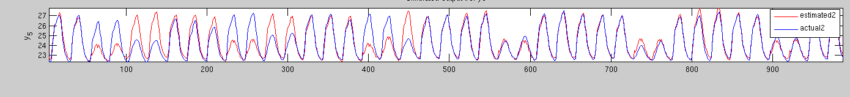
Analysis
Testing phase seems to build the model accurately, even with light heat as a factor.
Example below:
Actual schedule(blue) : 4-2-5-2-5-1-4-2-5-2-5-2-…
Estimated schedule(red) : 2-2-5-2-5-2-5-2-5-2-5-2-…
(Underlined numbers are weekend days)

Slide 16
Optimization and Final Results
Done various optimization which includes selecting a proper order.
For this order study, the best order seen below is 37. After many trials, we found an acceptable order.

Slide 17
Final Results (Training Phase)
For 5-zone building, only one zone and the first 500 hours shown below

Slide 18
Final Results (Validation Phase)

Slide 19
Absolute and Relative Errors
Five zone with HVAC only considering ambient temperature
 |  | SPACE 1 | SPACE 2 | SPACE 3 | SPACE 4 | SPACE 5
Testing | Relative RMS Error | 0.0150 | 0.0165 | 0.0138 | 0.0136 | 0.0120
 | Max Relative Error | 0.0879 | 0.0825 | 0.0958 | 0.0927 | 0.0900
 | Absolute RMS Error | 0.3078 | 0.3372 | 0.2752 | 0.2739 | 0.2482
 | Max Absolute Error | 1.8780 | 1.7701 | 2.0544 | 1.9978 | 1.9546
Validation | Relative RMS Error | 0.0267 | 0.0290 | 0.0187 | 0.0199 | 0.0166
 | Max Relative Error | 0.1510 | 0.1868 | 0.1438 | 0.1463 | 0.1375
 | Absolute RMS Error | 0.5707 | 0.6267 | 0.3874 | 0.4157 | 0.3538
 | Max Absolute Error | 2.7525 | 4.1471 | 3.2361 | 3.3607 | 3.1209
Five zone with HVAC and considering extra factors
 |  | SPACE 1 | SPACE 2 | SPACE 3 | SPACE 4 | SPACE 5
Testing | Relative RMS Error | 0.0153 | 0.0167 | 0.0132 | 0.0139 | 0.0088
 | Max Relative Error | 0.0792 | 0.0948 | 0.0759 | 0.0788 | 0.0598
 | Absolute RMS Error | 0.3297 | 0.3620 | 0.2742 | 0.2919 | 0.1900
 | Max Absolute Error | 1.7938 | 2.0272 | 1.6310 | 1.6794 | 1.3117
Validation | Relative RMS Error | 0.0320 | 0.0333 | 0.0187 | 0.0203 | 0.0145
 | Max Relative Error | 0.1594 | 0.1690 | 0.0786 | 0.0930 | 0.0650
 | Absolute RMS Error | 0.7247 | 0.7520 | 0.3947 | 0.4352 | 0.3187
 | Max Absolute Error | 4.3228 | 4.6669 | 1.6876 | 2.0009 | 1.4297

Slide 20
2-Zone Results
Two zone with HVAC and extra factors
 |  | SPACE 1 | SPACE 2
Testing | Relative RMS Error | 0.0021 | 0.0022
 | Max Relative Error | 0.0128 | 0.0144
 | Absolute RMS Error | 0.0476 | 0.0488
 | Max Absolute Error | 0.2959 | 0.3235
Validation | Relative RMS Error | 0.0041 | 0.0060
 | Max Relative Error | 0.0214 | 0.0229
 | Absolute RMS Error | 0.0939 | 0.1338
 | Max Absolute Error | 0.4912 | 0.5164

Slide 21
Thank you!

