Slide 1
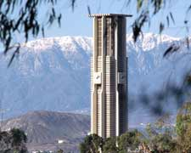
Building Thermal Modeling for Energy-Efficient Smart Building Control
Daniel Quach, Shujuan Wang, Jian Ma, Hengyang Zhao, Hai Wang, Sheldon X.-D. Tan
Department of Electrical and Computer Engineering
University of California, Riverside, CA

Slide 2
Outline
Motivation
EnergyPlus Review
Subspace Identification based method
Initial Results with no extra factors
Results with extra factors
Optimization and Final Results
Summary

Slide 3
Motivation
Estimated building section makes up about 40% energy consumption in U.S.
Responsible for 70% of electricity use on average households
About 50% of energy consumed in buildings are related to space heating, cooling, and ventilation
Notes:
Need to control the heating, ventilation and air conditioning in a more energy-efficient way.

Slide 4
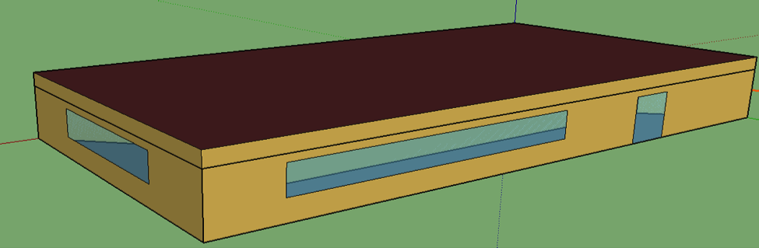
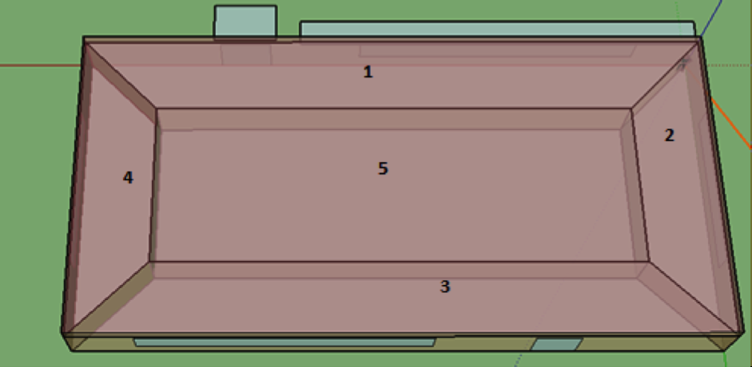
EnergyPlus
Software package by U.S.
Dept. of Energy used for
modeling thermal behavior,
energy, and water use.
Capable of modifying
specific settings for each
zone
  Thermal zones, Space type, Schedule, Outdoor Air, People, Lights, Electric Equipment, Surfaces, etc.

Slide 5
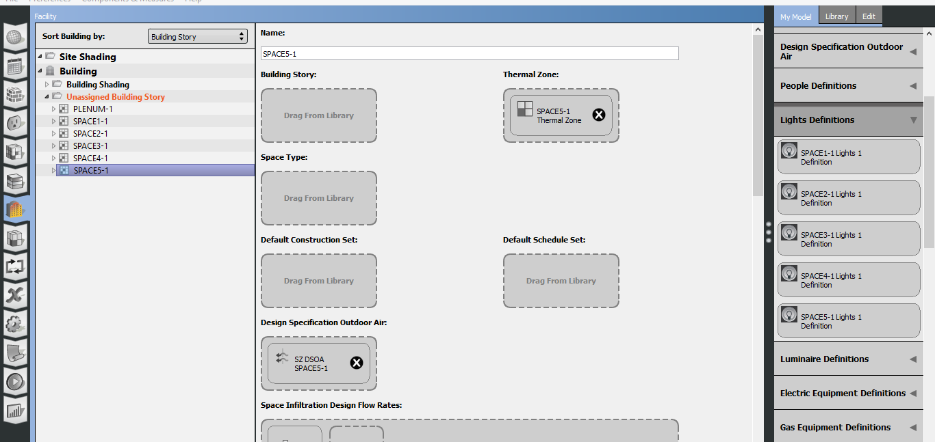
Setting For Each Thermal Zone

Slide 6
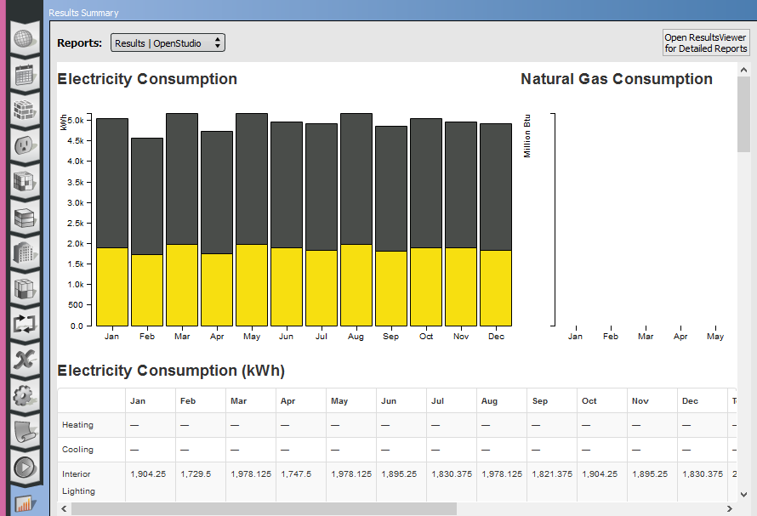
EnergyPlus Results
Use this to get more results

Slide 7
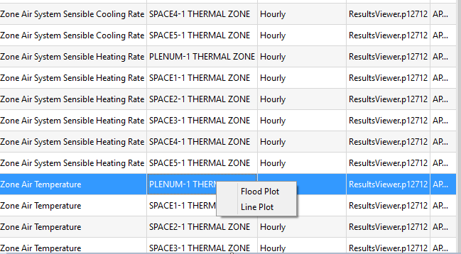
EnergyPlus Results

Slide 8
Proposed thermal modeling method
Applied subspace system identification (SID) method to build the dynamic linear thermal model
  Used EnergyPlus to simulate model and generate inputs and ‘golden’ outputs
  Inputs:
    Ambient temperature, HVAC data, light, electrical equipment, people
  Output:
    Zone room temperature

Slide 9
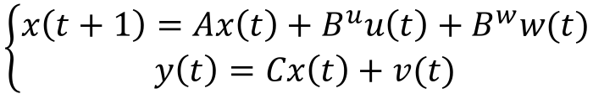
Behavioral thermal modeling problem
Described as a discrete linear time invariant (LTI) system
p0
p1
p2
p3
p4
t0
t1
t2
t3
t4
$$\left\{\begin{aligned}x\left(t+1\right)=Ax\left(t\right)+B^{u}u\left(t\right)+B^{w}w(t) \\ y\left(t\right)=Cx\left(t\right)+v(t)\end{aligned}\right.$$
A: stable matrix u: input matrix
y: output matrix x: state matrix

Slide 10
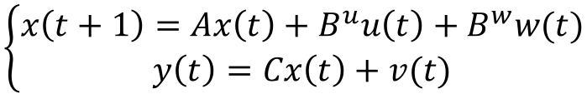
Subspace System Identification^{[1]}
State space models (LTI)
  Here input u is Power, and output y is Temperature
Goal
  Given input and output observations u and y, find an appropriate order n and the system matrices {A, B^{u}, C}
$$\left\{\begin{aligned}x\left(t+1\right)=Ax\left(t\right)+B^{u}u\left(t\right)+B^{w}w(t) \\ y\left(t\right)=Cx\left(t\right)+v(t)\end{aligned}\right.$$
Considering
Noise!
A : stable matrix w,v : stationary zero-mean white-noise seq.
u/y : input/output
[1] N.Y. Chen, J.S. Gibson, “Subspace System Identification Using a Multichannel Lattice Filter”, Proc. American Control Conference, 2004, Volume 1, Issue 30, pp. 855 - 860
Notes:
A is a stable matrix. The sequences w, and v are stationary zero-mean white noise sequences. Only the
sequences y and U are measured. Our goal is to use the measured y and U to identify unbiased system matrices
(A, B", C).
recursive least-squares (RLS) estimation.

Slide 11
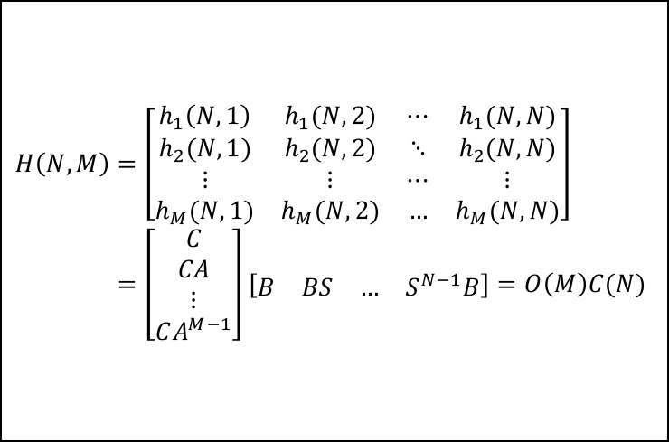
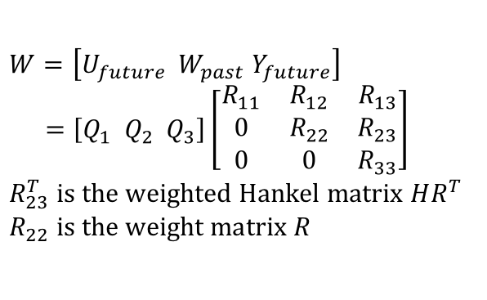
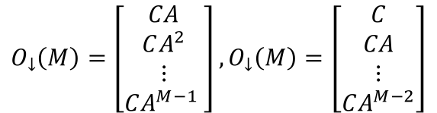
SID algorithm flow see [1] for more details
Input/Ouput Data
u(t), y(t)
Weighted
Hankel Matrix
HR^{T}
QR
SVD
HR^{T}=UΣV^{T}
$$W=\left[U_{future} W_{past} Y_{future}\right] \\ =\left[Q_{1} Q_{2} Q_{3}\right]\left[\begin{matrix}R_{11} & R_{12} & R_{13} \\ 0 & R_{22} & R_{23} \\ 0 & 0 & R_{33}\end{matrix}\right] \\ R_{23}^{T} is the weighted Hankel matrix HR^{T} \\ R_{22} is the weight matrix R$$
Reduced SVD
HR^{T}=U_{r}Σ_{r}V_{r}^{T}
Extended Observability
/Controllability Matrix
O(M)=U_{r}Σ_{r}^{1/2}
C(N)= Σ_{r}^{1/2}V_{r}^{T}(R^{T})⁻¹
$$H\left(N,M\right)=\left[\begin{matrix}h_{1}\left(N,1\right) & h_{1}(N,2) & ⋯ & h_{1}(N,N) \\ h_{2}(N,1) & h_{2}(N,2) & ⋱ & h_{2}(N,N) \\ ⋮ & ⋮ & ⋯ & ⋮ \\ h_{M}(N,1) & h_{M}(N,2) & … & h_{M}(N,N)\end{matrix}\right] \\ =\left[\begin{matrix}C \\ CA \\ ⋮ \\ CA^{M−1}\end{matrix}\right]\left[\begin{matrix}B & BS & … & S^{N−1}B\end{matrix}\right]=O\left(M\right)C(N)$$
C = first top block row of O(M)
[F(t) B^{u}]=first left block column of C(N)
$$O_{↓}\left(M\right)=\left[\begin{matrix}CA \\ CA^{2} \\ ⋮ \\ CA^{M−1} \end{matrix}\right], O_{↓}\left(M\right)=\left[\begin{matrix}C \\ CA \\ ⋮ \\ CA^{M−2}\end{matrix}\right]$$
Notes:
This figure illustrates the basic steps in subspace identification of a state space model of a linear time invariant
(LTI) system.

Slide 12
Two-Stage Modeling
We separate two kinds of factors and study their impacts on room temperatures independently
  (1) All power sources are deactivated. Only use ambient temperature T_{amb}(t) to predict the room temperatures T_{np}(t): T_{np}(t) = M₁(T_{amb}(t))
  (2) Activate HVAC and other input effects and build model using input power P(t) to predict the temperature difference of each room with/without those extra inputs: T_{all}(t) - T_{np}(t) = M₂(P(t))

Slide 13
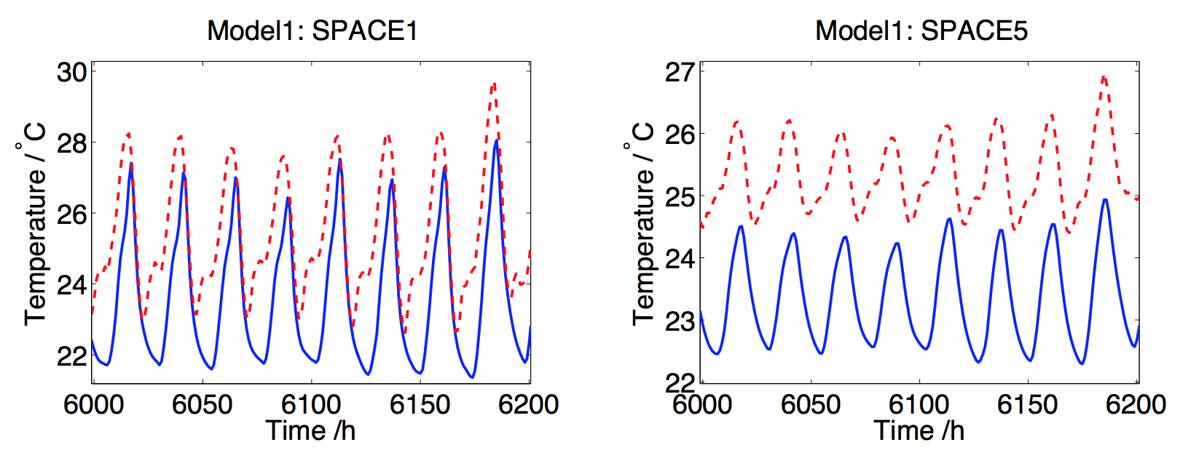
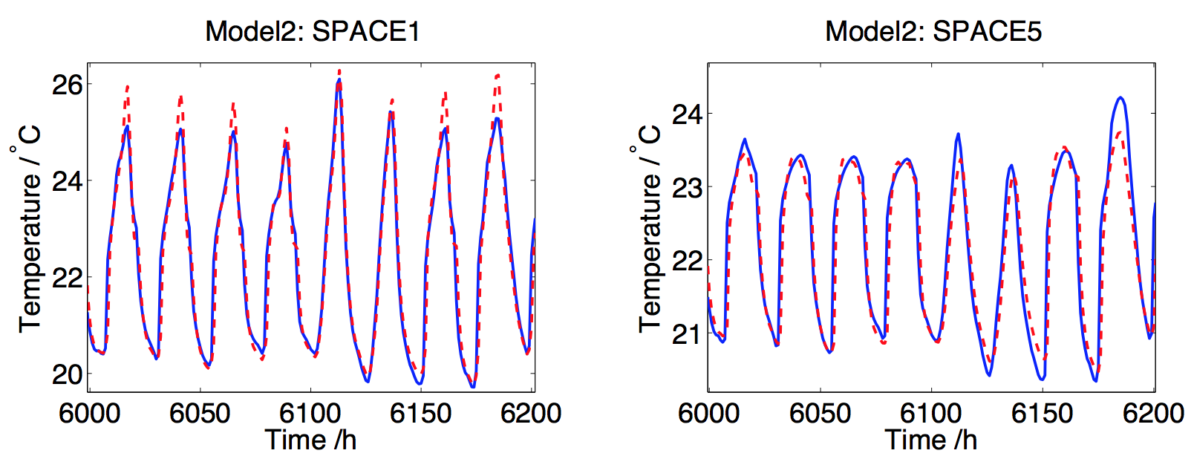
Two-Stage Modeling Results
M₁ model has low accuracy, implying ambient T has nonlinear impact on room temperatures
M₂ model has higher accuracy. HVAC and other power inputs have more linear effects on T_{all}(t) - T_{np}(t)

Slide 14
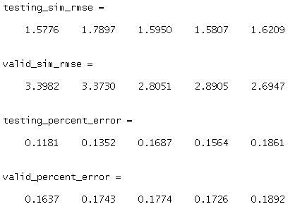
Initial Results (no extra factors)
Order for system identification: 50
Legend:
  Blue lines are EnergyPlus results
  Red lines are our estimated results
Note: see results between 400 and 500. There is some extra effect that causes the golden result to be strange. Our system does not handle it well for both training (testing) and validation phases.

Slide 15
Initial Results (Training Phase)

Slide 16
Initial Results (Validation Phase)

Slide 17
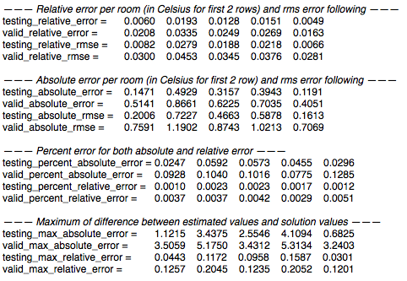
Results with extra factors
Specifications
  Input:
    Ambient temperature, Custom scheduler, Light Heating Rate
  Output:
    Zone room temperatures
  Order for system
  identification: 90
Legend:
  Blue lines are EnergyPlus
  results
  Red lines are our estimated
  results

Slide 18
Results (Training Phase)

Slide 19
Results (Validation Phase)

Slide 20
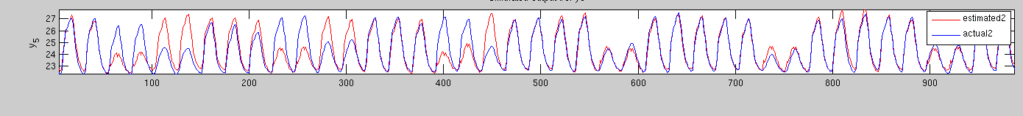
Analysis
Testing phase seems to build the model accurately, even with light heat as a factor.
Example below:
Actual schedule(blue) : 4-2-5-2-5-1-4-2-5-2-5-2-…
Estimated schedule(red) : 2-2-5-2-5-2-5-2-5-2-5-2-…
(Underlined numbers are weekend days)

Slide 21
Model order selection to avoid overfitting
Done various optimization which includes selecting a proper order.
For this order study, the best order seen below is 37. After many trials, we found an acceptable order.

Slide 22
Final Results (Training Phase)
For 5-zone building, only one zone and the first 500 hours shown below

Slide 23
Final Results (Validation Phase)

Slide 24
Absolute and Relative Errors
Five zone with HVAC only considering ambient temperature
 |  | SPACE 1 | SPACE 2 | SPACE 3 | SPACE 4 | SPACE 5
Testing | Relative RMS Error | 0.0150 | 0.0165 | 0.0138 | 0.0136 | 0.0120
 | Max Relative Error | 0.0879 | 0.0825 | 0.0958 | 0.0927 | 0.0900
 | Absolute RMS Error | 0.3078 | 0.3372 | 0.2752 | 0.2739 | 0.2482
 | Max Absolute Error | 1.8780 | 1.7701 | 2.0544 | 1.9978 | 1.9546
Validation | Relative RMS Error | 0.0267 | 0.0290 | 0.0187 | 0.0199 | 0.0166
 | Max Relative Error | 0.1510 | 0.1868 | 0.1438 | 0.1463 | 0.1375
 | Absolute RMS Error | 0.5707 | 0.6267 | 0.3874 | 0.4157 | 0.3538
 | Max Absolute Error | 2.7525 | 4.1471 | 3.2361 | 3.3607 | 3.1209
Five zone with HVAC and considering extra factors
 |  | SPACE 1 | SPACE 2 | SPACE 3 | SPACE 4 | SPACE 5
Testing | Relative RMS Error | 0.0153 | 0.0167 | 0.0132 | 0.0139 | 0.0088
 | Max Relative Error | 0.0792 | 0.0948 | 0.0759 | 0.0788 | 0.0598
 | Absolute RMS Error | 0.3297 | 0.3620 | 0.2742 | 0.2919 | 0.1900
 | Max Absolute Error | 1.7938 | 2.0272 | 1.6310 | 1.6794 | 1.3117
Validation | Relative RMS Error | 0.0320 | 0.0333 | 0.0187 | 0.0203 | 0.0145
 | Max Relative Error | 0.1594 | 0.1690 | 0.0786 | 0.0930 | 0.0650
 | Absolute RMS Error | 0.7247 | 0.7520 | 0.3947 | 0.4352 | 0.3187
 | Max Absolute Error | 4.3228 | 4.6669 | 1.6876 | 2.0009 | 1.4297

Slide 25
2-Zone Results
Two zone with HVAC and extra factors
 |  | SPACE 1 | SPACE 2
Testing | Relative RMS Error | 0.0021 | 0.0022
 | Max Relative Error | 0.0128 | 0.0144
 | Absolute RMS Error | 0.0476 | 0.0488
 | Max Absolute Error | 0.2959 | 0.3235
Validation | Relative RMS Error | 0.0041 | 0.0060
 | Max Relative Error | 0.0214 | 0.0229
 | Absolute RMS Error | 0.0939 | 0.1338
 | Max Absolute Error | 0.4912 | 0.5164
For 2-zone, only one zone
and first 500 hours are
shown below

Slide 26
Summary
Based on recently proposed subspace identification method
5-zone (all factors)
  1.4 - 3.3% average relative error
  6.5 – 16.9% max relative error
5-zone (HVAC only)
  1.7 – 2.9% average relative error
  13.8 – 18.7% max relative error
2-zone (all factors)
  0.4 – 0.6% average relative error
  2.1 – 2.3% max relative error

Slide 27
Questions???

