Slide 1
Origins of Heavy Elements – The r-Process
By: Sheldon Wasik

Slide 2
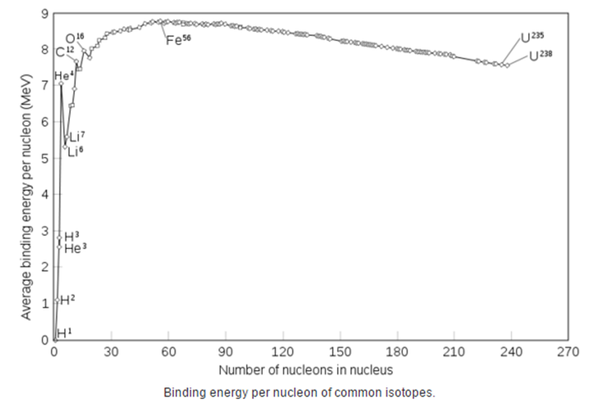
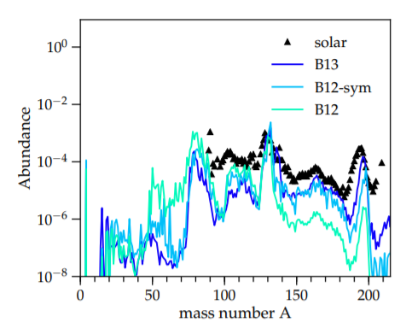
History of element creation
94 *naturally* occurring elements
Most abundant: H, He
Early 1950’s – “all elements come from nuclear fusion”
Exception of H, He (Big Bang)
Late 1950’s – observed solar abundance, nuclear physics advances, debunk “all elements from fusion”
Stellar cores stop at Iron (Fe)
Theory of neutron capture process arrived (late 1950’s)

Slide 3
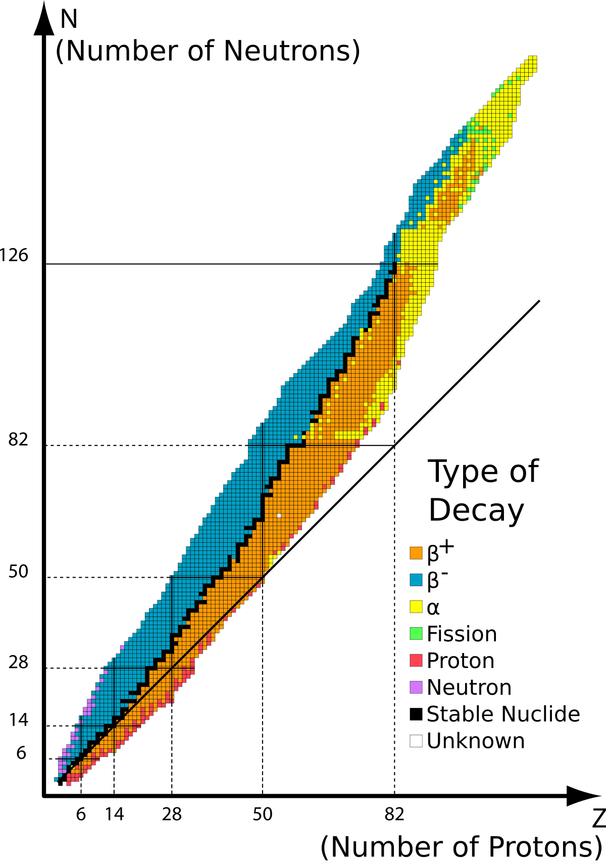
Rapid neutron capture process (r-process)
Consecutive neutron captures (1) before beta decay (2) can spontaneously occur
^{A}X + ¹n → ^{A+1}X’ (1)
_{Z}X → _{Z+1}X’ + e⁻ + v_{e} (2)
Conditions
High temperature (> 10⁹ K)
Densities of at least 10²² cm⁻³
About 100 neutron captures per second
Creates half of the heavy (Z>26) elements
Slow neutron capture process (s-process) creates other half
Occurs over thousands of years
Well known to exit in AGB stars (cool luminous stars)

Slide 4
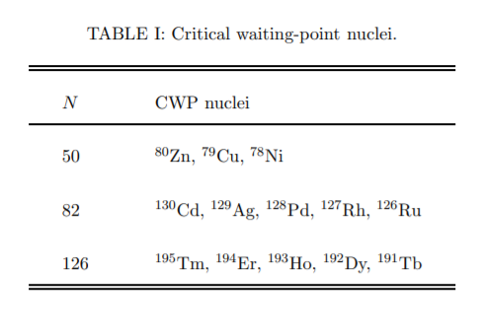
R-process (cont.)
While extreme conditions met
Neutron capture → increase mass number
Results in unstable nuclei
Beta decay occurs – resulting in new element creation
₇₈Pt → ₇₉Au + e⁻ + v_{e}
Decay occurs until neutron drip line
Any additional neutron will not be bound → stable nuclei
Results in *variety* of new elements
Laws of nuclear physics yield 3 r-process abundance “peaks”
A = 82, 130, 192 (respectively N = 50, 82, 126)
Core-collapse supernovae remnants theorized as site

Slide 5
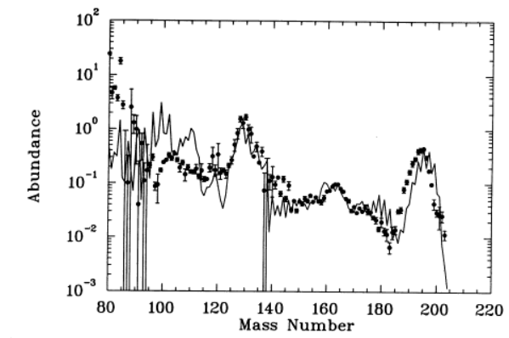
Early theoretical models (1994)
Core-collapse supernova (20 M☉)
2 out of 3 abundance peaks
Remnants from last 10⁻⁴ M☉
Flaws
nuclei of ⁸⁸Sr, ⁸⁹Y, and ⁹⁰Zr (80 < A < 120)
multidimensional evolution
Steppingstone for future models

Slide 6
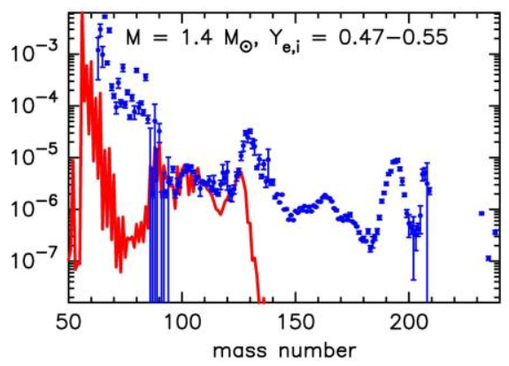
Future core-collapse models
Guided by spectroscopic observations
Extremely metal-poor stars in Galactic Halo compared to solar abundances (2005)
Results
Take place in neutrino winds of CCSN, most like a 10 – 20 M☉ progenitor
Remnant neutron star mass of 1.4 M☉
Only produce “weak” r-process elements
Suggests different astrophysical sites need to be studied (specifically black holes, NS-NS mergers)

Slide 7
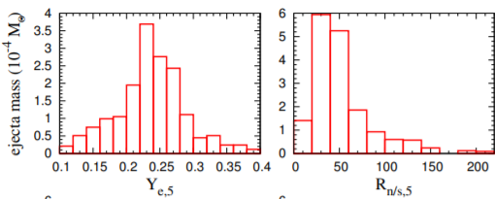
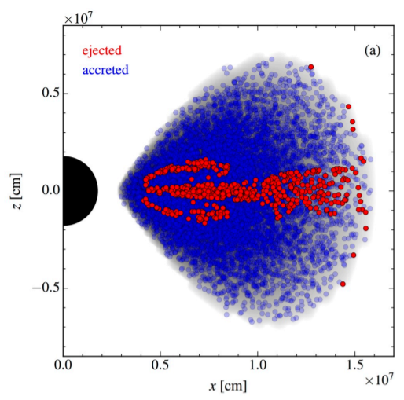
Black hole models
Simulate accreting black hole (30 M☉ progenitor)
Various estimated initial conditions
Displays an uncertainty
Electron Fraction (Y_{e}) → test between 0.1 and 0.3
Intensive Y_{e} distribution study → backbone of future sims
Lower nuclei/seed ratio is more common
Mass ejecta (2-3% < m_{initial} < 20%)
High and low bounds result in r-process elements, seen on future slide

Slide 8
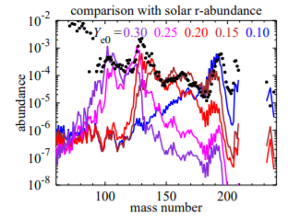
Black hole models (cont.)
Models have strong dependence on Y_{e}
0.3+ → first r-process peak (A=82)
0.2 to 0.3 → second r-process peak (A=130)
0.1 to 0.2 → third r-process (A=196)
Production of all elements depending on the free variable Y_{e}
Results point towards all high energy mergers (low Y_{e} values)

Slide 9
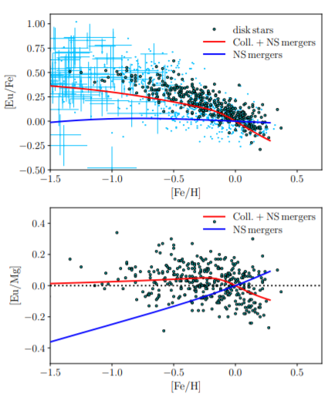
Neutron star-neutron star mergers
Never modeled, only hypothesized
LIGO and VIRGO detected GW170817
Spectroscopy of NS-NS merger yielded r-process elements! (first r-process obs)
Metallicity of galaxies can give us fits to r-process sites
Core-collapse + NS mergers fit galactic metallicities better then NS mergers alone
More work to be done
Combination of sites better fits the observed quantities, than one alone

Slide 10
conclusion
60-year-old problem to find origin of half the heavy elements
Complicated problem that requires numerous areas of expertise
Observations of solar abundances sparked the derivation of the r-process (1950’s)
Theoretical computations are extremely important
Initial conditions are a hurdle
Expense of core-collapse models (specifically 3-D) limit results
Future works on FRIB and JWST look promising for the r-process
What are the origins of the r-process?
Core-collapse supernovae, black holes, NS-NS mergers
Numerous sites give “better fit” to observed elements

