Slide 1

Project Title - Seasonal Agriculture Performance Analysis
Student Name: Shelke Chaitanya Raju
College Name: Sanjivani College Of Engineering Koparagon
AICTE STU ID : STU698b6b3da80ae1770744637

Slide 2

PROBLEM STATEMENT
(Agricultural activities are influenced by seasonal variations in environmental conditions, farming practices, resource availability and market conditions. As a result, agricultural performance may differ from one season to another. However, raw agricultural data does not clearly explain how agricultural performance changes across seasons or what patterns can be observed in different seasonal conditions. The problem is to analyze the given agricultural dataset and investigate seasonal differences in agricultural performance by identifying meaningful patterns, trends, relationships and variations within the available data.

Slide 3
Project Description This project analyzes a dataset of 4,000 farm records across three cropping seasons (Kharif, Rabi, Zaid), 8 Indian states, and 8 crops, to uncover how environmental conditions, resource usage, and economic outcomes vary seasonally. After cleaning and preparing the data, statistical tests (ANOVA, correlation) and visualizations (box plots, heatmaps, bar charts) were used to compare seasons on yield, profitability, water efficiency, and disease/pest risk. The analysis reveals that profitability - not raw yield - is the sharpest seasonal differentiator, with the Zaid season showing the highest share of loss-making farms due to low rainfall and high irrigation dependency. Findings are translated into actionable, evidence-based recommendations for seasonal agricultural planning.

Slide 4

WHO ARE THE END USERS?
Farmers & farming cooperatives - to choose crops, irrigation methods, and inputs suited to each season
Agricultural policy makers & government departments - to design season-specific support schemes and subsidies
Agribusinesses & input suppliers (seed, fertilizer, irrigation equipment) - to plan seasonal demand and offerings
Agricultural banks & insurance providers - to assess seasonal risk when offering credit or crop insurance
Agricultural researchers & extension officers - to guide farmers with evidence-based seasonal practices

Slide 5

Technology Used
Python 3 - core programming language for the analysis
Pandas & NumPy - data cleaning, transformation, and aggregation
Matplotlib & Seaborn - statistical visualizations (box plots, heatmaps, bar/violin charts)
SciPy (stats module) - hypothesis testing (one-way ANOVA, Pearson correlation)
Jupyter Notebook - end-to-end documentation of the analysis workflow
Microsoft PowerPoint - presentation of findings and recommendations

Slide 6
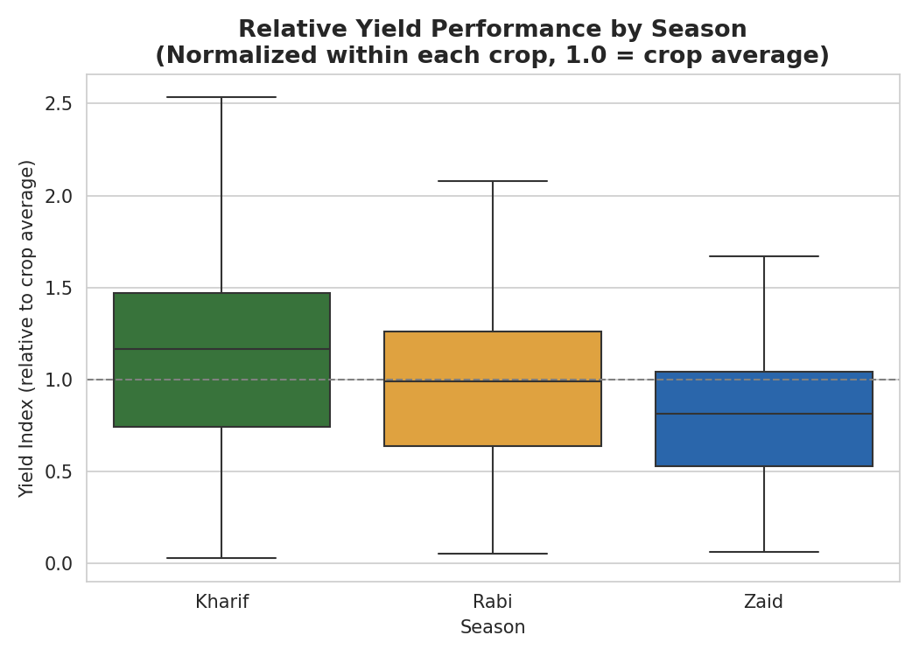
1. Yield Performance by Season
Kharif shows the strongest relative yield; ANOVA shows no significant difference in raw yield across seasons (p=0.23).

Slide 7
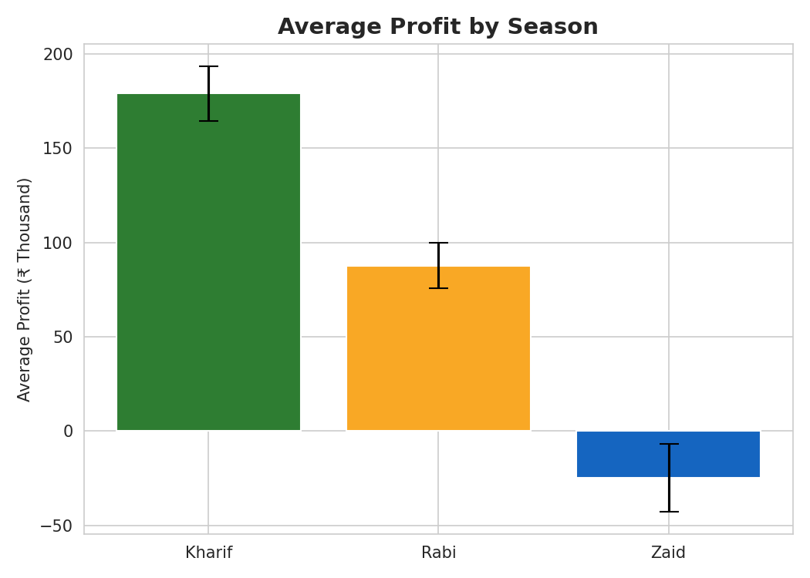
2. Profitability by Season
Profit differs sharply by season (ANOVA p<0.001) - average profit falls steadily from Kharif to Zaid.

Slide 8
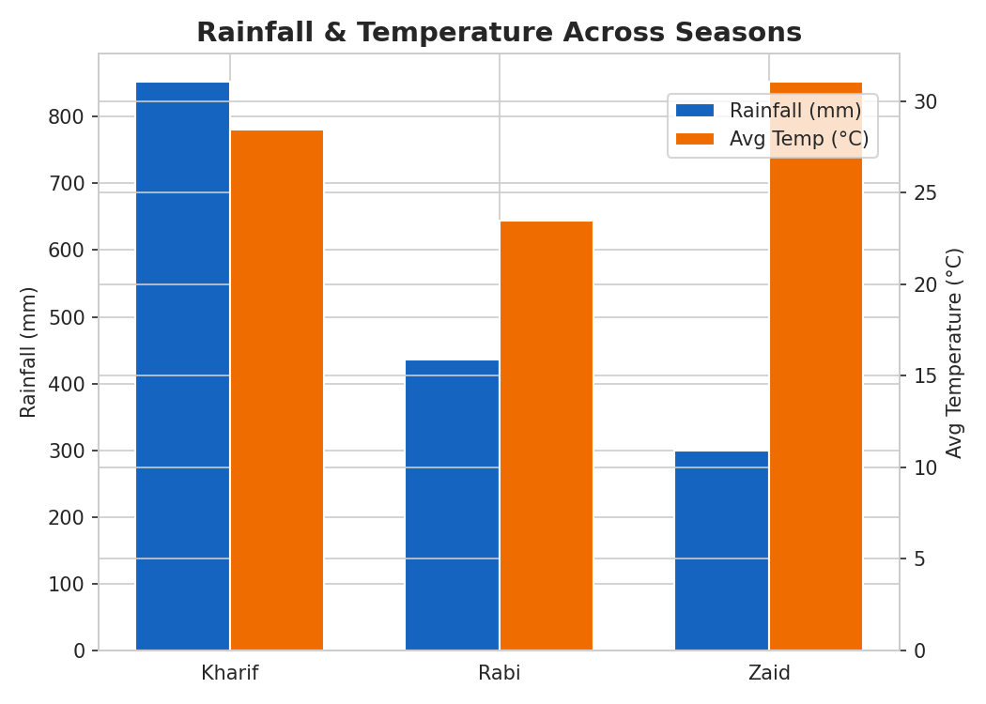
3. Rainfall & Temperature by Season
Zaid receives roughly half the rainfall of Kharif while running hotter, forcing heavier irrigation dependence.

Slide 9
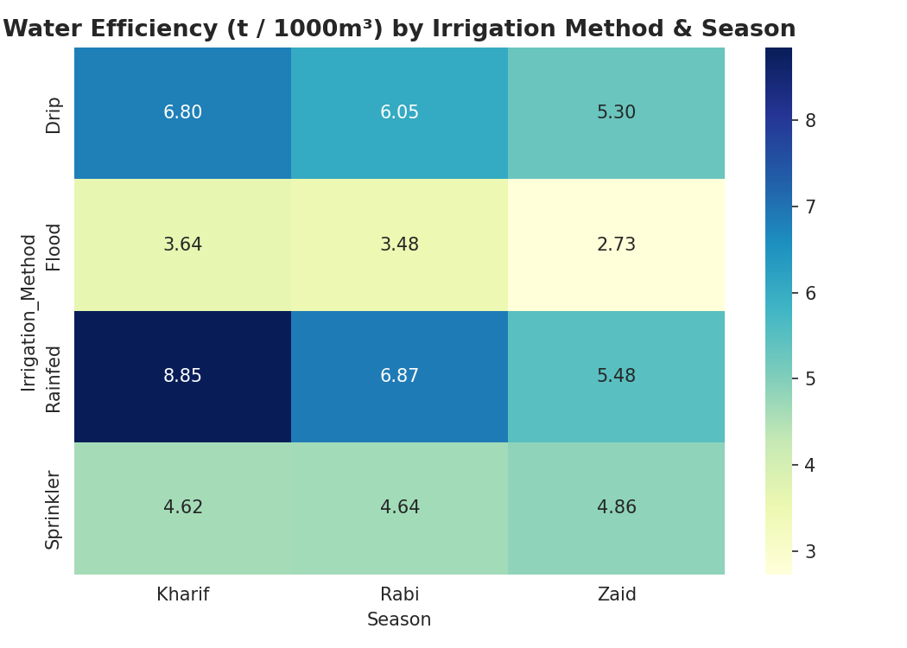
4. Water Efficiency by Irrigation Method
Rainfed and Drip irrigation are the most water-efficient methods across every season; Flood is the least efficient.

Slide 10
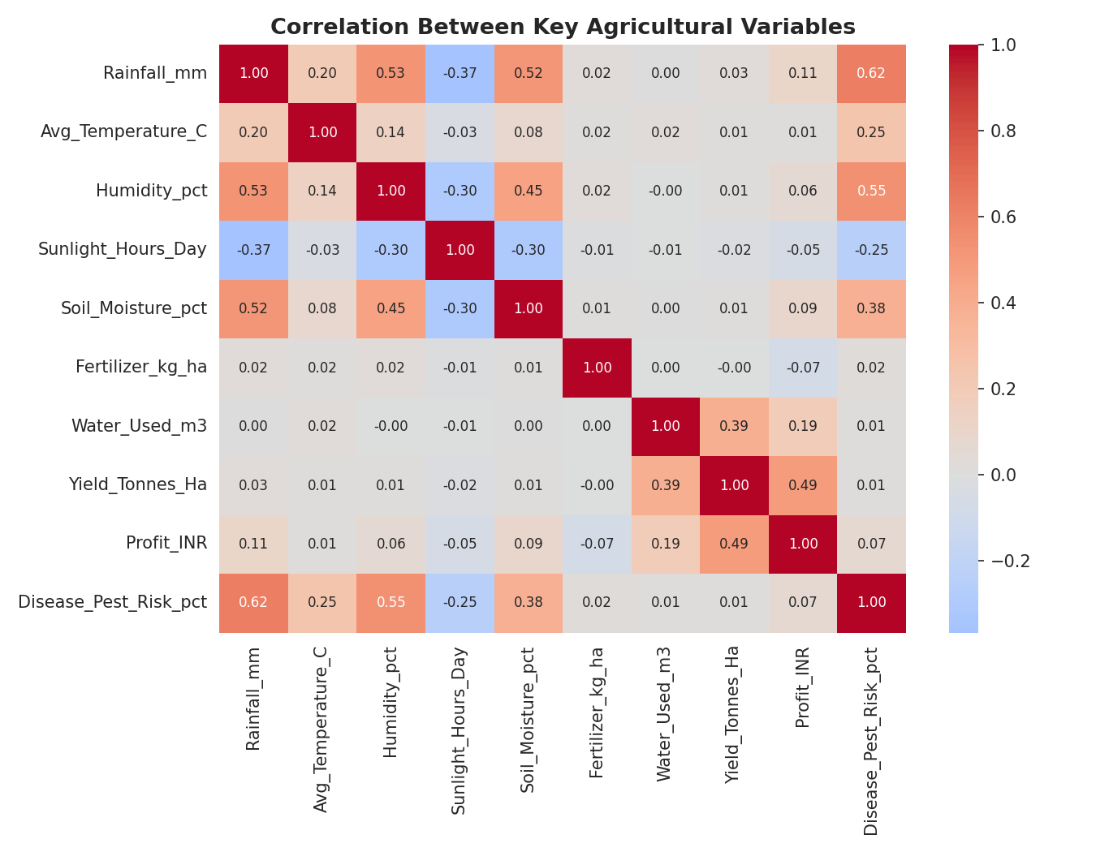
5. Correlation Between Key Variables
Water used correlates with yield (r=0.39); rainfall alone shows little direct correlation, since irrigation compensates.

Slide 11
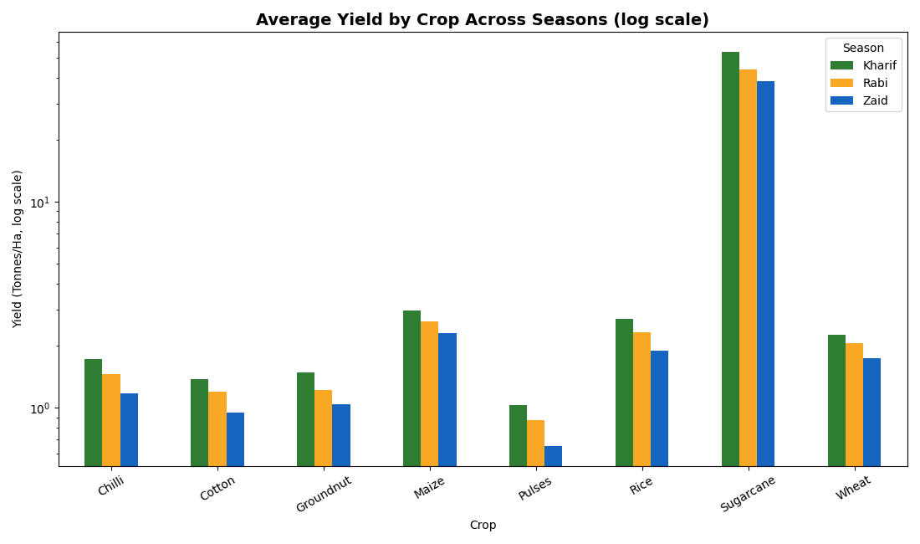
6. Average Yield by Crop Across Seasons
Sugarcane yields far exceed other crops; all crops show a mild yield decline from Kharif to Zaid.

Slide 12
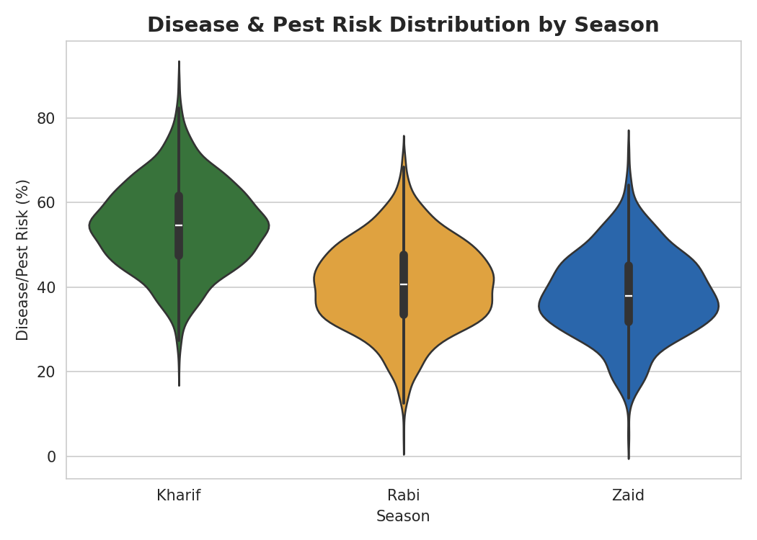
7. Disease & Pest Risk by Season
Kharif carries the highest disease/pest risk (54%) due to humid monsoon conditions; Zaid the lowest (38%).

Slide 13
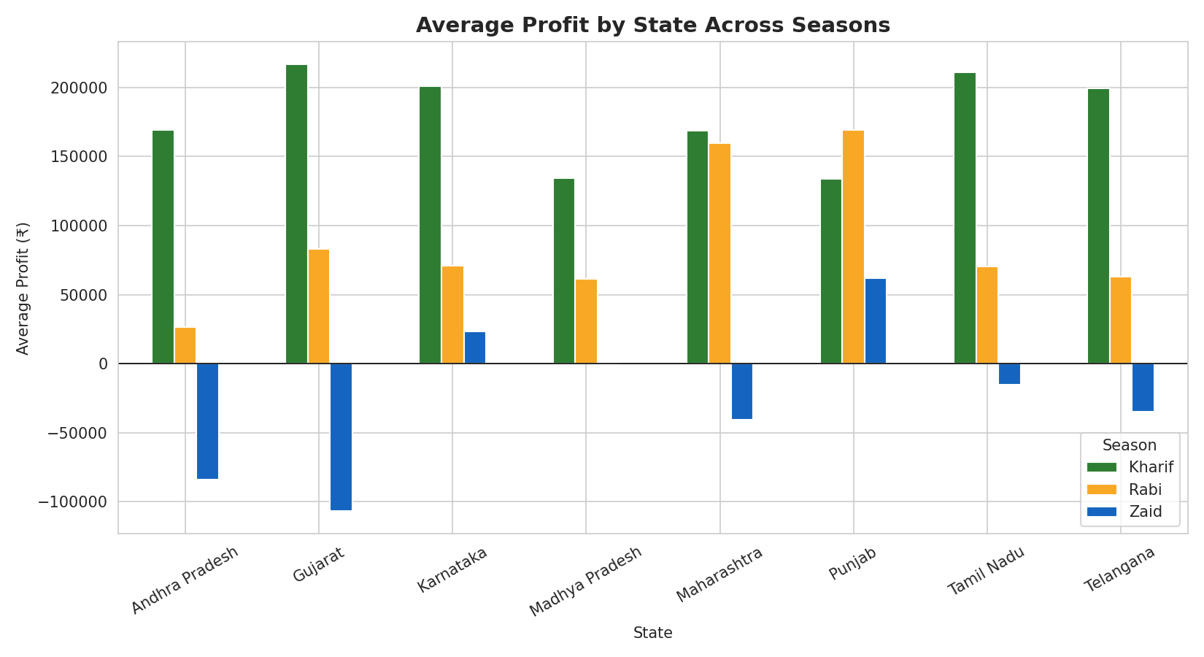
8. State-wise Profit by Season
Zaid-season losses are consistent across nearly every state, indicating a systemic seasonal effect.

Slide 14
Future scope
• Incorporate real-time weather & satellite data for dynamic, season-aware forecasting
• Build a predictive ML model to forecast profit/yield risk before a season begins
• Extend analysis to district & farm-level granularity for hyper-local recommendations
• Develop a farmer-facing dashboard/app to deliver these insights in the field

Slide 15
GitHub Link
https://github.com/shelkechaitanya2678-spec/-Data-Analytics-Internship.git

Slide 16

VOIS Course completion certificate - Course name- Data Visualization

Slide 17
Thank you
.

