Slide 1
QUEST TC Workshop
2025 IEEE India Geoscience and Remote Sensing Symposium, IIIT Bhubaneswar, India
December 10th, 2025 Artur Miroszewski, Amer Delilbasic

Slide 2
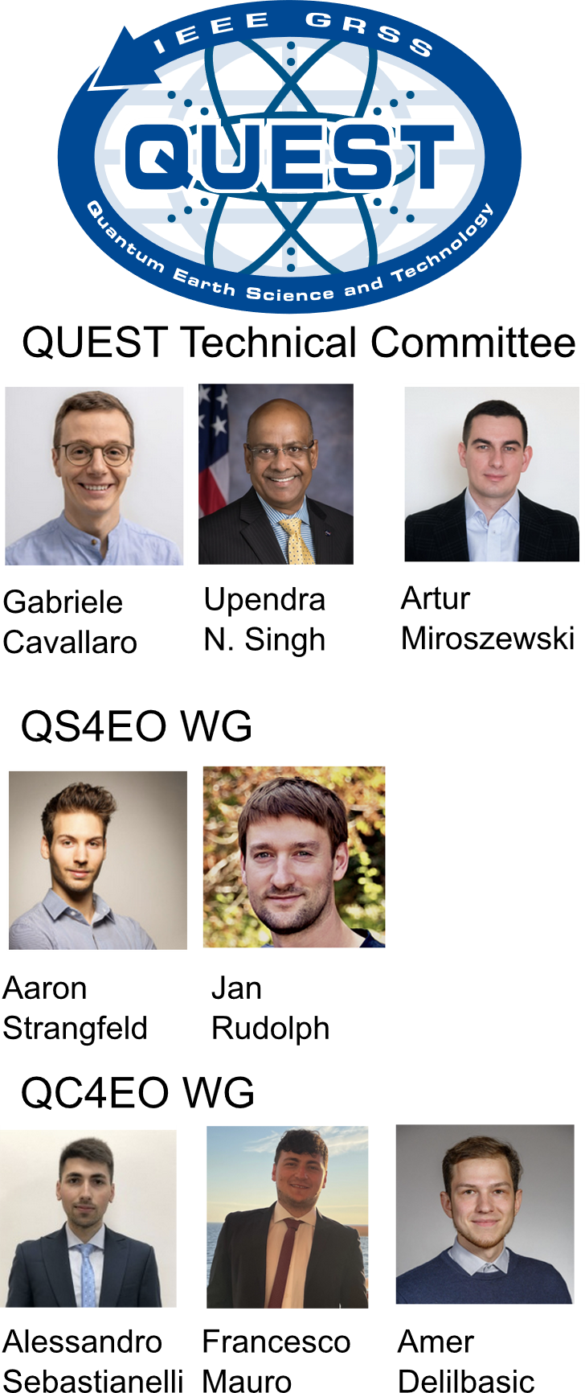
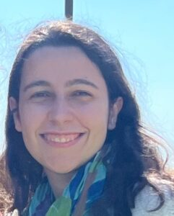
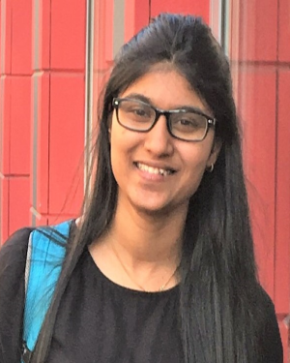
QUEST TC
Francesca
de Falco
Prajakta
Sathe
QUEST structure
2

Slide 3
Workshop schedule
~1 hour lecture
What you’ll learn
Introduction to Quantum Computing and the Landscape of Quantum Technologies
Fundamentals of Quantum Machine Learning (QML)
Getting Started with Quantum Computing Libraries
Quantum Kernel SVM and Parameterized Quantum Circuits (PQC): basic circuit design, interpretation and insights
Hybrid Architectures: Combining Classical Neural Networks with Quantm Layers
~1.5 hours hands-on tutorial

Slide 4

Workshop repository
https://github.com/delilbasic/ingarss2025

Slide 5
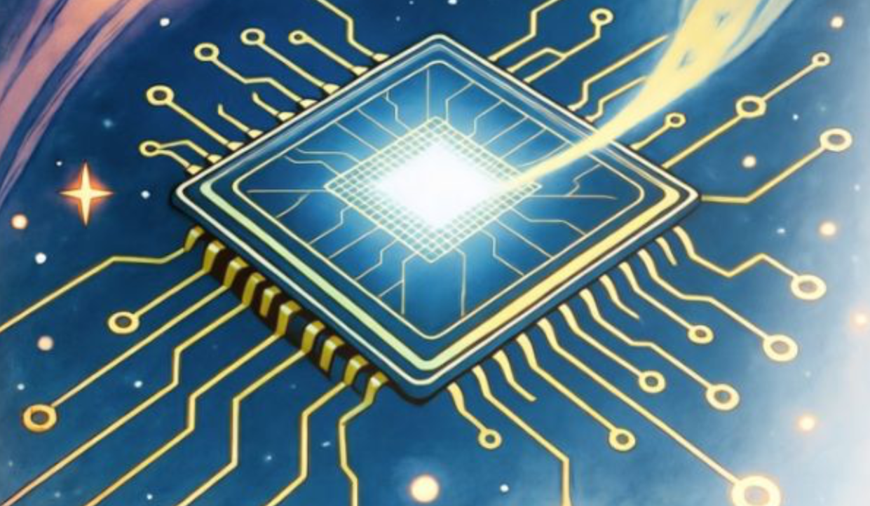
Workshop schedule
Introduction to quantum computing
~1 hour lecture
What you’ll learn
Introduction to Quantum Computing and the Landscape of Quantum Technologies
Fundamentals of Quantum Machine Learning (QML)
Getting Started with Quantum Computing Libraries
Quantum Kernel SVM and Parameterized Quantum Circuits (PQC): basic circuit design, interpretation and insights
Hybrid Architectures: Combining Classical Neural Networks with Quantm Layers
~1.5 hours hands-on tutorial

Slide 6

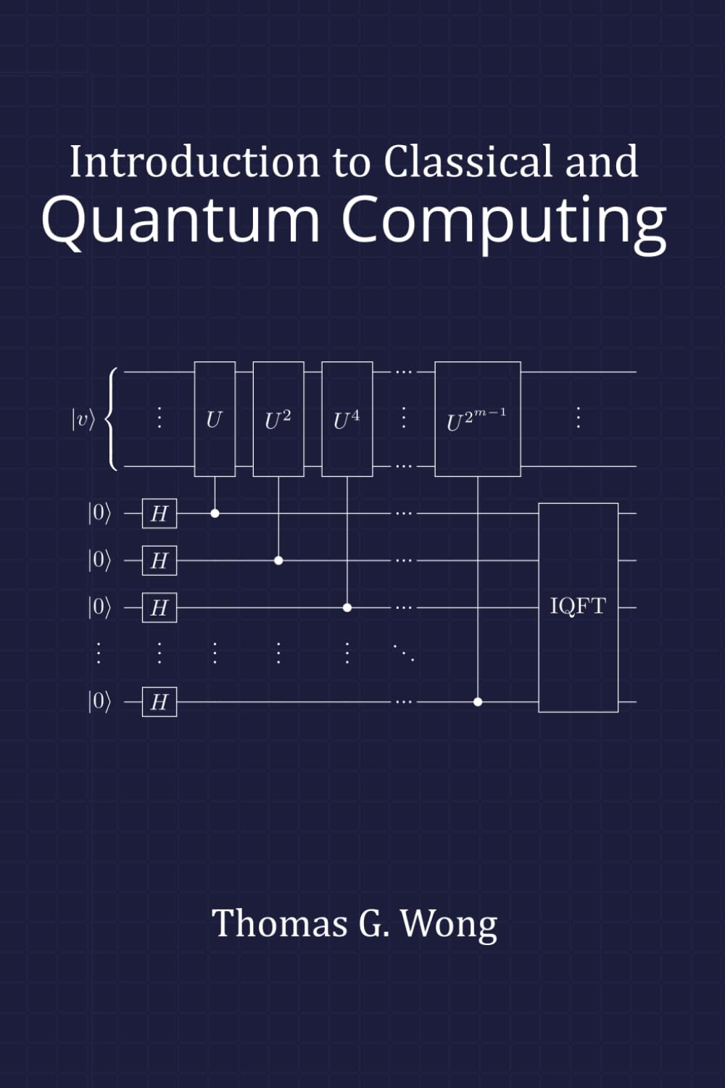
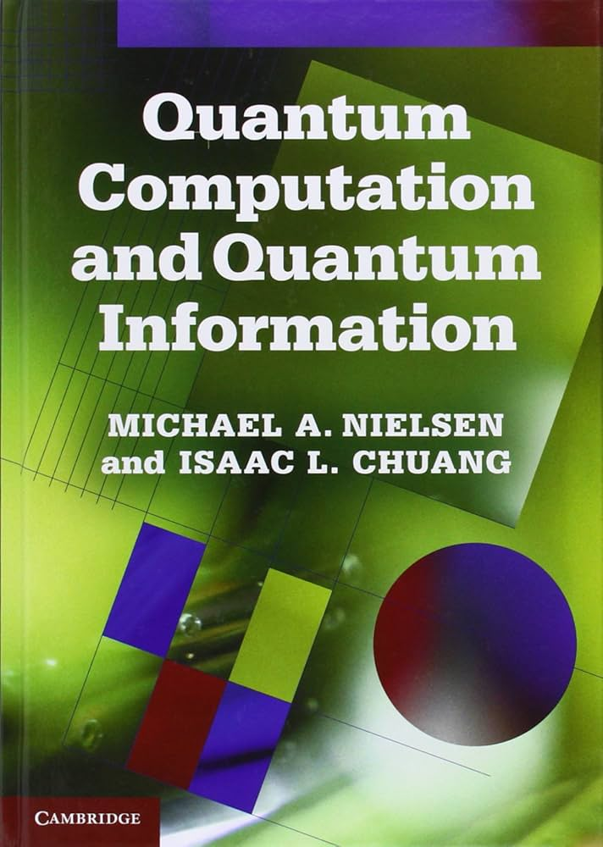

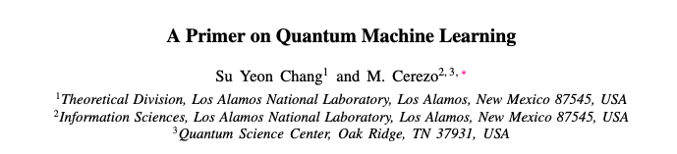
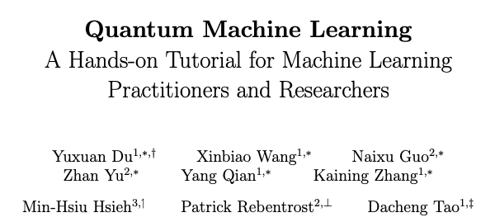
Textbooks, manuals, materials
Arxiv: 2511.15969
Arxiv: 2502.01146

Slide 7

What is quantum computing?
Quantum computing is a model of computation that processes information using the laws of quantum mechanics, rather than classical physics.
Classical Computing
Quantum Computing
Collective behaviour of vast numbers of electrons (e.g. electrical current)
Information unit: bit
Gates: transistor switching gates
Deterministic manipulation of definite logical states
Properties of individual quantum systems (e.g. single electrons)
Information unit: qubit
Gates: unitary operations
Evolution exploring multiple logical states simultaneously. Probabilistic measurement
Classical computing interprets macroscopic electrical signals, while quantum computing manipulates the microscopic quantum states of individual particles.
This shift in the physical substrate enables new computational capabilities.

Slide 8
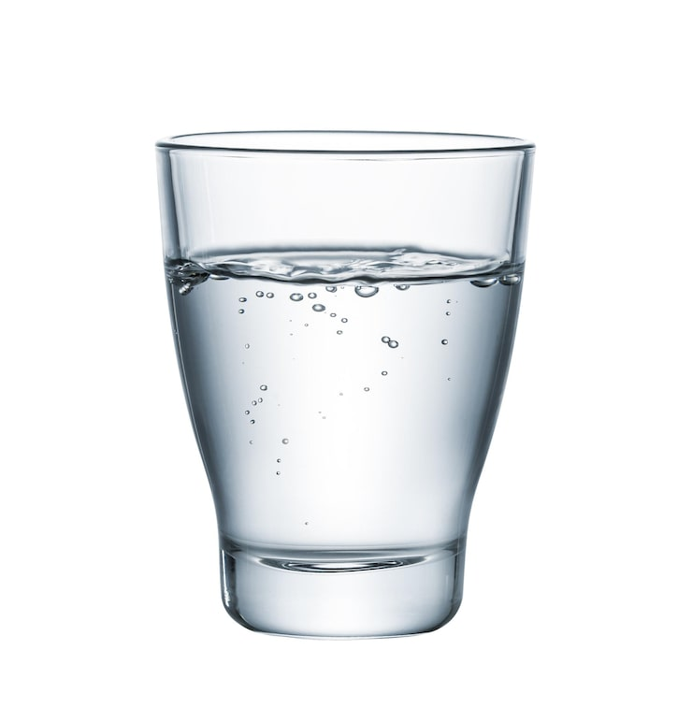
Computation as a physical process
Glass of water
Quantum systems
Macrosystem
Microsystem

Slide 9
Quantum computation split: computing & measurement
Quantum Information Processing
Classical World

Slide 10
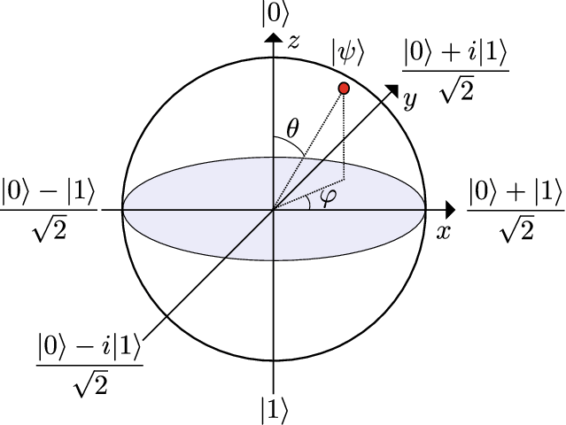
Quantum computation: basic objects
“Bit Qubit”
Span a vector space!
(pure)
Arbitrary, one-qubit state:
State is always normalized!

Slide 11
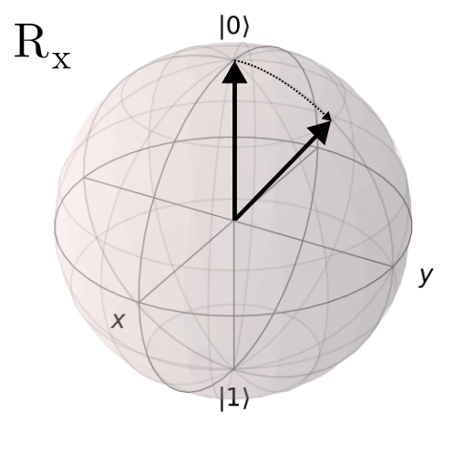
Quantum computation: basic operations
X
Z
H
R_{x}( )

Slide 12
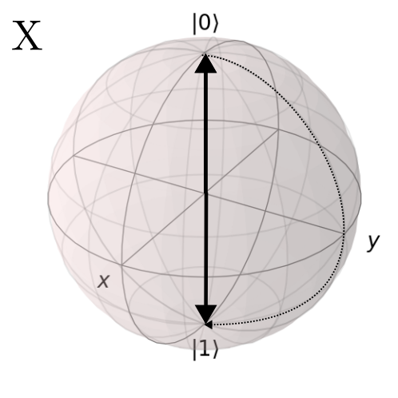
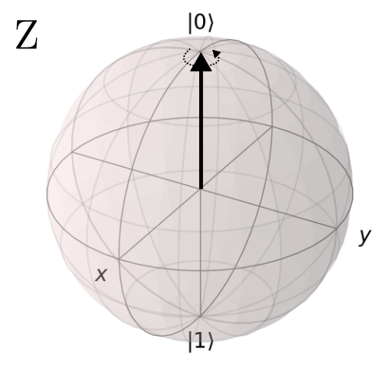
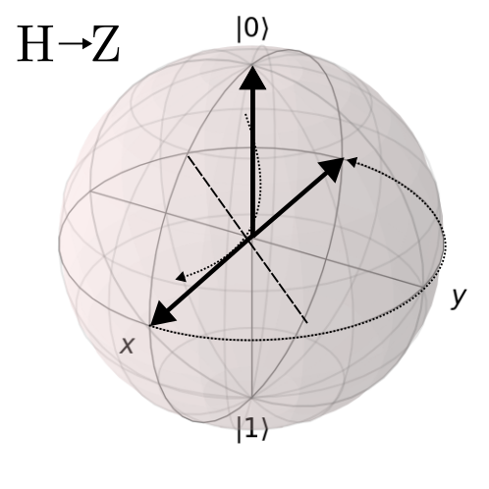
Quantum computation: basic operations

Slide 13

Quantum computation: basic objects
Two qubits:
?
+
=

Slide 14

Quantum computation: basic objects
Two qubits:
?
+
=
≅

Slide 15
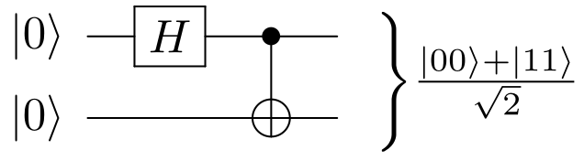
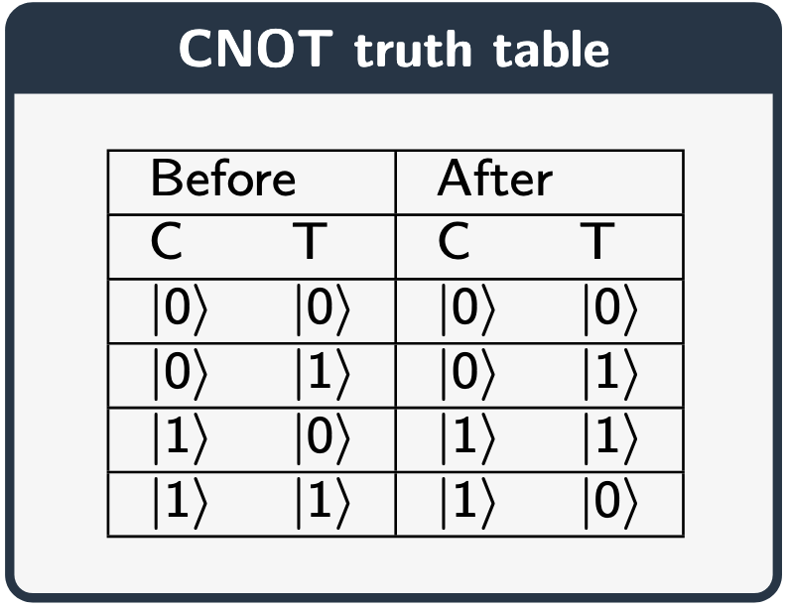
Creating entangled states – two-qubit gates
H
CNOT

Slide 16
Density matrices
Quantum states can be described in different “languages”.
We can either use vectors (as before) or matrices.
The ”languages” differ slightly but describe the same objects.
Vector:
Density Matrix
Example:
Example:

Slide 17
Trace operation
With density matrices we can perform a trace:
and partial trace operations:
With partial trace we first divide the system into subsystems (e.g. first qubit, second qubit) and then “average out” one of the subsystems.

Slide 18
Measurement
We cannot see “Bloch spheres”
collapse
collapse
“Born rule”
with probability
Measurement is a truly random process
where

Slide 19
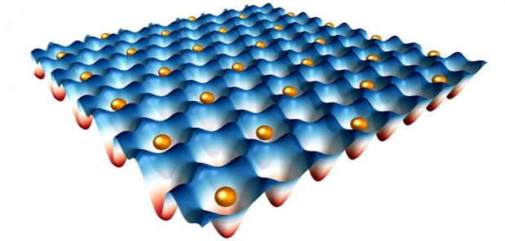
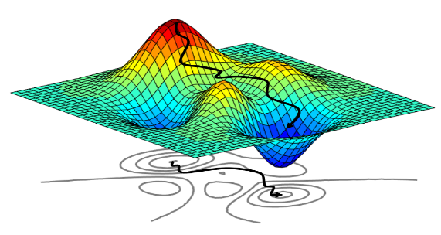
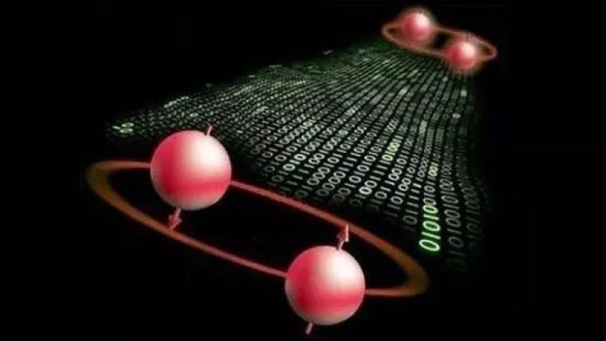
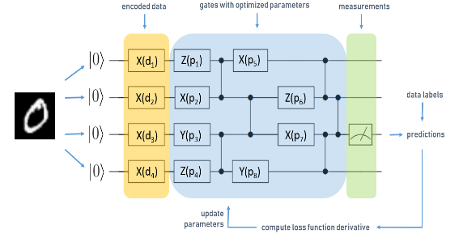
Applications of quantum computing
Quantum simulation
Quantum optimization
https://quantum.cornell.edu/files/2021/11/quantum_simulation-1024x576.jpg
https://towardsdatascience.com/an-introduction-to-surrogate-optimization-intuition-illustration-case-study-and-the-code-5d9364aed51b
Quantum cryptography
Quantum machine learning
https://miro.medium.com/v2/resize:fit:760/0*ccRjnUb2QLCYTK5a.jpg
https://blog.tensorflow.org/2020/08/layerwise-learning-for-quantum-neural-networks.html

Slide 20
Workshop schedule
Fundamentals of quantum
Machine Learning (QML)
~1 hour lecture
What you’ll learn
Introduction to Quantum Computing and the Landscape of Quantum Technologies
Fundamentals of Quantum Machine Learning (QML)
Getting Started with Quantum Computing Libraries
Quantum Kernel SVM and Parameterized Quantum Circuits (PQC): basic circuit design, interpretation and insights
Hybrid Architectures: Combining Classical Neural Networks with Quantm Layers
~1.5 hours hands-on tutorial

Slide 21
Driving questions
What is quantum machine learning?
How to encode data into a quantum circuit?
What are the most important quantum machine learning models?
What are the advantages and drawbacks of quantum machine learning?

Slide 22








What is machine learning?
Machine Learning
finding patterns in data
Quantum Machine Learning
quantumly finding patterns in data
Data $D=\{x_{i},y_{i}\}$
Data $D=\{x_{i},y_{i}\}$
Model $F$
training
Loss$L$
Quantum model $F$
training
Loss$L$
Trained model $F:F\left(x_{u}\right)=y_{u}$
Trained model $F:F\left(x_{u}\right)=y_{u}$
QML Theory
Data Encoding
QML Models
Why QML?

Slide 23
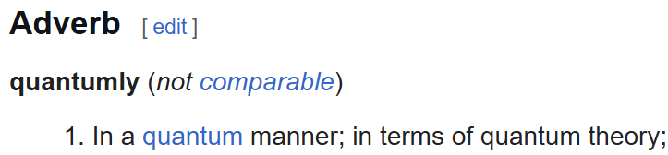



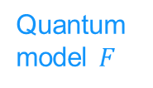




What about a quantum model?
Machine Learning
finding patterns in data
Quantum Machine Learning
quantumly finding patterns in data
Data $D=\{x_{i},y_{i}\}$
Data $D=\{x_{i},y_{i}\}$
Model $F$
training
Loss$L$
Quantum model $F$
training
Loss$L$
Trained model $F:F\left(x_{u}\right)=y_{u}$
Trained model $F:F\left(x_{u}\right)=y_{u}$
QML Theory
Data Encoding
QML Models
Why QML?

Slide 24
















What about quantum data?
Machine Learning
finding patterns in data
Quantum Machine Learning
quantumly finding patterns in data
Data $D=\{x_{i},y_{i}\}$
Data $D=\{x_{i},y_{i}\}$
Quantum model $F$
training
Loss$L$
Model $F$
training
Loss$L$
Trained model $F:F\left(x_{u}\right)=y_{u}$
Trained model $F:F\left(x_{u}\right)=y_{u}$
Quantum Machine Learning
finding patterns in quantum data
Quantum Machine Learning
quantumly finding patterns in quantum data
Quantum data $D=\{x_{i},y_{i}\}$
Quantum data $D=\{x_{i},y_{i}\}$
Model $F$
training
Loss$L$
Quantum model $F$
training
Loss$L$
Trained model $F:F\left(x_{u}\right)=y_{u}$
Trained model $F:F\left(x_{u}\right)=y_{u}$
QML Theory
Data Encoding
QML Models
Why QML?

Slide 25







What about both?
Machine Learning
finding patterns in data
Quantum Machine Learning
quantumly finding patterns in data
Data $D=\{x_{i},y_{i}\}$
Data $D=\{x_{i},y_{i}\}$
Quantum model $F$
focus of today
Model $F$
training
Loss$L$
training
Loss$L$
Trained model $F:F\left(x_{u}\right)=y_{u}$
Trained model $F:F\left(x_{u}\right)=y_{u}$
Quantum Machine Learning
finding patterns in quantum data
Quantum Machine Learning
quantumly finding patterns in quantum data
Quantum data $D=\{x_{i},y_{i}\}$
Quantum data $D=\{x_{i},y_{i}\}$
Model $F$
training
Loss$L$
Quantum model $F$
training
Loss$L$
Trained model $F:F\left(x_{u}\right)=y_{u}$
Trained model $F:F\left(x_{u}\right)=y_{u}$
QML Theory
Data Encoding
QML Models
Why QML?

Slide 26
What about both?
CC
CQ
focus of today
QC
QQ
QML Theory
Data Encoding
QML Models
Why QML?

Slide 27
What is quantum machine learning (with classical data)?
Finding patterns in classical data with quantum computing:
data encoding & processing
model training
model inference
QML Theory
Data Encoding
QML Models
Why QML?

Slide 28

Encoding classical data into a quantum circuit
For doing QML, we need to move classical data to the quantum domain!
label $y∈\{void, grass, car, sand\}$
2 channels
4 pixels
Animation and image credits: Hao Geng (adapted)
QML Theory
Data Encoding
QML Models
Why QML?

Slide 29

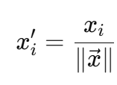
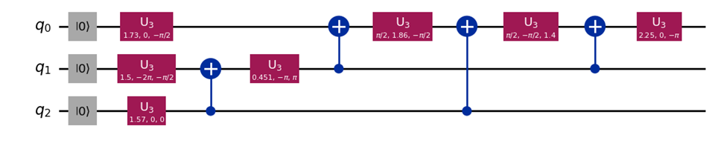

Amplitude encoding
x₀
x₁
x₂
x₃
x₄
x₅
x₆
x₇
flattening
normalization
encoding
Animation and image credits: Hao Geng (adapted)
QML Theory
Data Encoding
QML Models
Why QML?

Slide 30



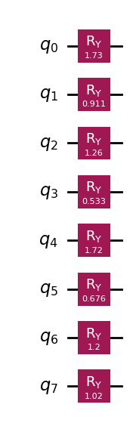

Angle encoding
x₀
x₁
x₂
x₃
x₄
x₅
x₆
x₇
flattening
scaling
encoding
Animation and image credits: Hao Geng (adapted)
QML Theory
Data Encoding
QML Models
Why QML?

Slide 31
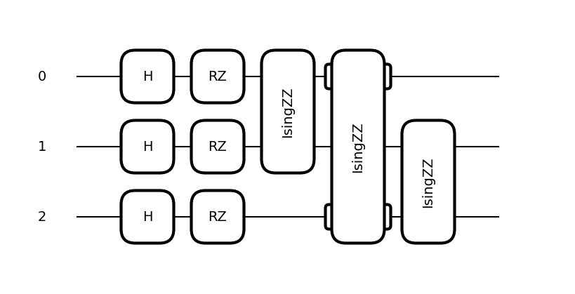
ZZ-feature map
Encoding Pairwise Correlations in Quantum Kernels
Circuit Idea
Start in
Create an equal superposition with Hadamard gates
Apply single-qubit rotations to encode the raw features (like in angle encoding)
Add entangling terms between pairs of qubits
This creates a feature space containing nonlinear pairwise products.
QML Theory
Data Encoding
QML Models
Why QML?

Slide 32
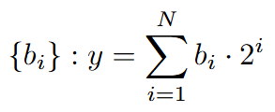


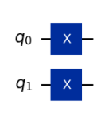



Basis encoding
$$y∈\{$$
$$\}$$
indexing
0
1
2
3
3
binarization
encoding
QML Theory
Data Encoding
QML Models
Why QML?

Slide 33
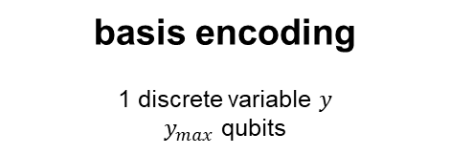


How to encode data into a quantum circuit?
angle encoding
$n$ continuous variables
$n$ qubits
amplitude encoding
$n$ continuous variables
$log⁡(n)$ qubits
basis encoding
1 discrete variable $y$
$y_{max}$ qubits
There’s more…
QML Theory
Data Encoding
QML Models
Why QML?

Slide 34
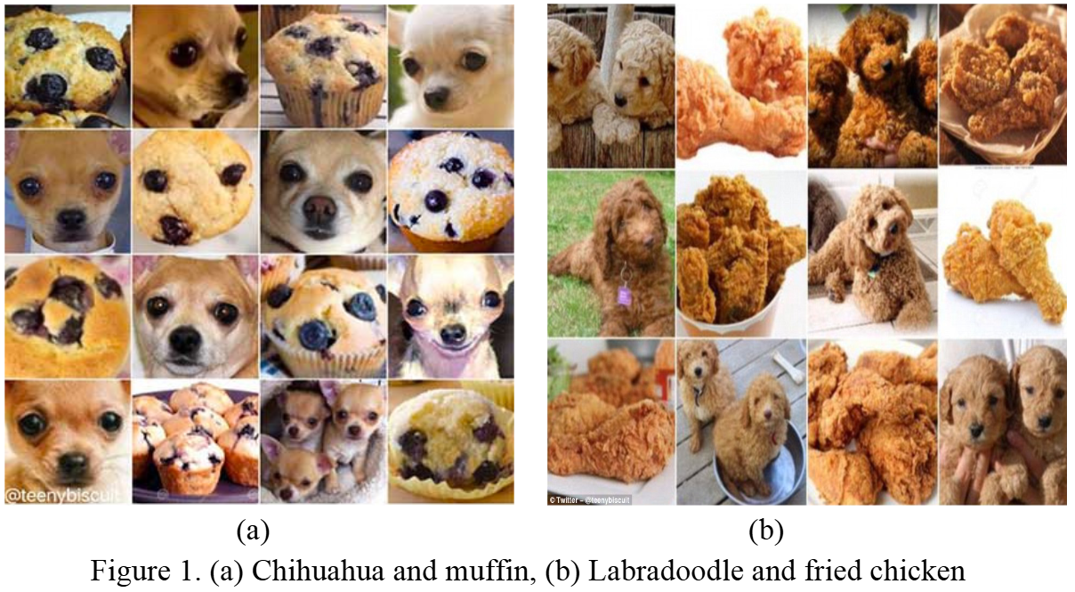
Quick recap: binary classification
Togootogtokh, Enkhtogtokh and Amarzaya Amartuvshin. “Deep Learning Approach for Very Similar Objects Recognition Application on Chihuahua and Muffin Problem.” ArXiv abs/1801.09573 (2018)
QML Theory
Data Encoding
QML Models
Why QML?

Slide 35
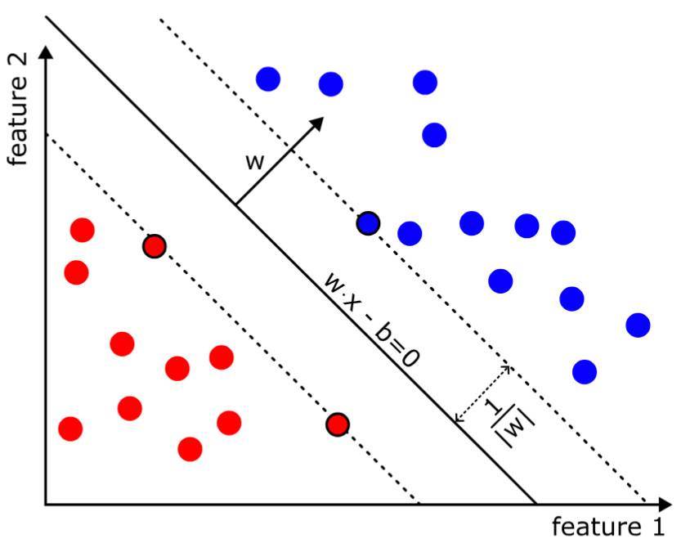

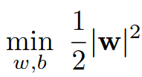

Linear classifiers
In a perfect world, classes are linearly separable…
Linear classifier:
Model training: “finding optimal weights w that minimize errors on unseen examples”
Example: support vector machine (SVM)
Image credits: Artur Miroszewski
QML Theory
Data Encoding
QML Models
Why QML?

Slide 36
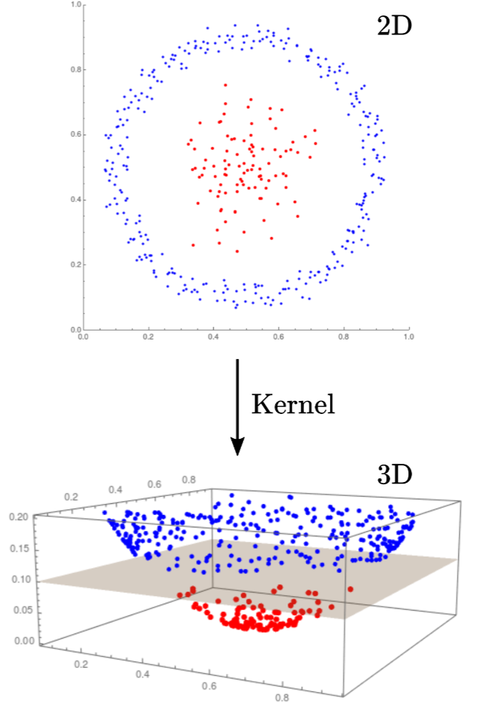

Feature maps for higher dimensional spaces
…but we can always strive for perfection!
Linear classifier:
Model training: “finding optimal weights w that minimize errors on unseen examples”
Example: support vector machine (SVM)
Image credits: Artur Miroszewski
QML Theory
Data Encoding
QML Models
Why QML?

Slide 37

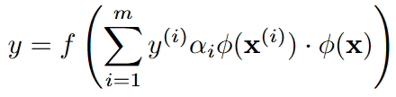
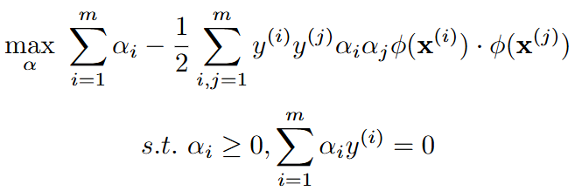

The kernel trick
e.g. RBF kernel
The dual formulation simplifies training
Linear classifier:
The feature map only appears in dot products
Model training: “finding optimal weights α that minimize errors on unseen examples”
We don’t need the transformed feature space!
Example: support vector machine (SVM)
Kernel function
QML Theory
Data Encoding
QML Models
Why QML?

Slide 38
Quantum kernels
Quantum kernels are quantum circuits designed for computing
QML Theory
Data Encoding
QML Models
Why QML?

Slide 39
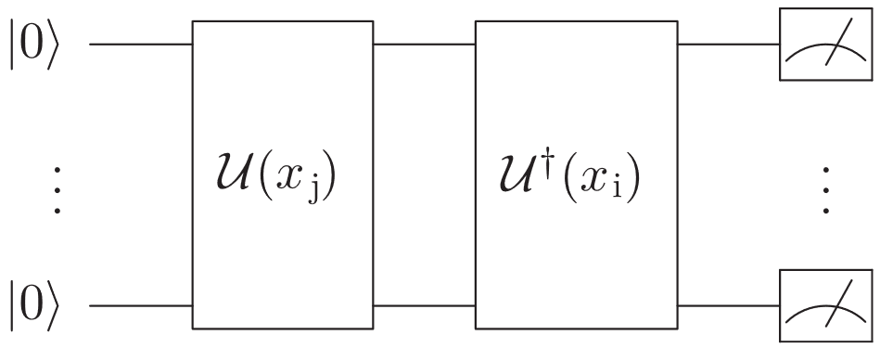
Quantum kernels
Quantum kernels are quantum circuits designed for computing
QML Theory
Data Encoding
QML Models
Why QML?

Slide 40
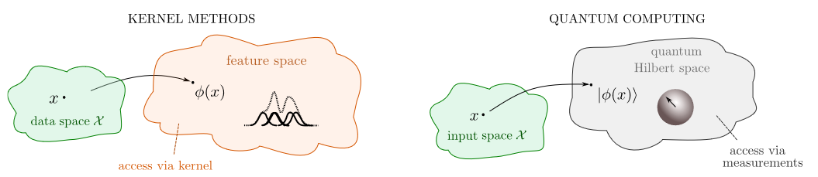
QML is basically a fancy kernel machine
Quantum kernels are quantum circuits designed for computing
Schuld, Maria. “Supervised Quantum Machine Learning Models Are Kernel Methods,” January 26, 2021. https://arxiv.org/abs/2101.11020v2.
QML Theory
Data Encoding
QML Models
Why QML?

Slide 41
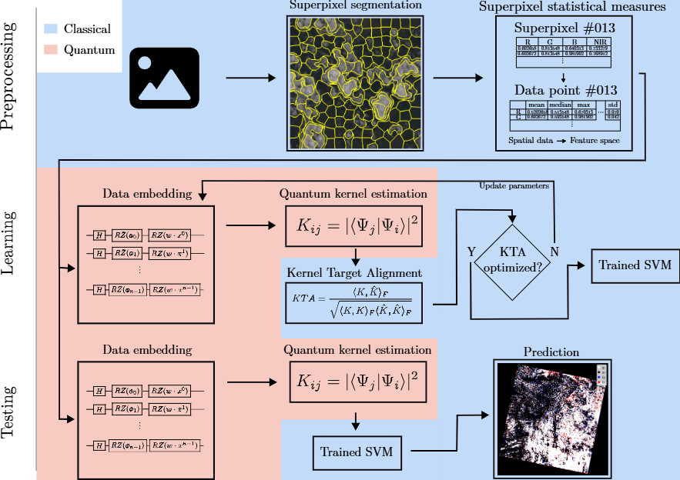
Example: quantum kernels for cloud detection
Image credits: Artur Miroszewski
QML Theory
Data Encoding
QML Models
Why QML?

Slide 42
Variational quantum algorithms
Variational quantum algorithms (VQAs) are parametric circuits in which parameters are updated based on the measured value and gradient of a cost function
QML Theory
Data Encoding
QML Models
Why QML?

Slide 43
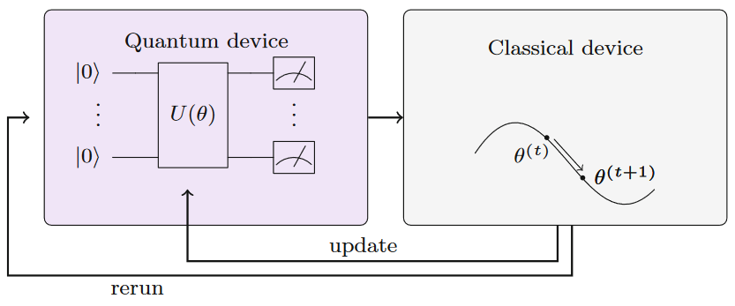
Variational quantum algorithms
Variational quantum algorithms (VQAs) are parametric circuits in which parameters are updated based on the measured value and gradient of a cost function
This looks familiar…
Schuld, Maria, and Francesco Petruccione. Supervised Learning with Quantum Computers. Quantum Science and Technology. Cham: Springer International Publishing, 2018.
QML Theory
Data Encoding
QML Models
Why QML?

Slide 44
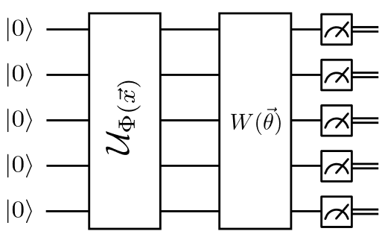
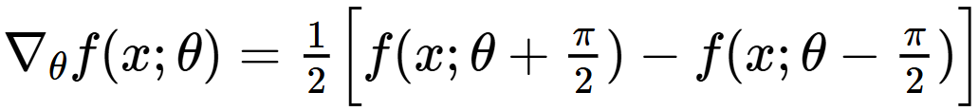
Variational quantum classifier
The variational quantum classifier (VQC) is a VQA for binary classification, taking both examples (x) and parameters (θ) as input, using measurements to make predictions, and using classification error as cost function for updating the parameters
Parameter shift rule: exact calculation of gradient is possible!
This DEFINITELY looks familiar…
Havlicek, Vojtech, Antonio D. Córcoles, Kristan Temme, Aram W. Harrow, Abhinav Kandala, Jerry M. Chow, and Jay M. Gambetta. “Supervised Learning with Quantum Enhanced Feature Spaces.” Nature 567, no. 7747 (March 14, 2019): 209–12.
QML Theory
Data Encoding
QML Models
Why QML?

Slide 45
VQC is the quantum cousin of MLP
…
QML Theory
Data Encoding
QML Models
Why QML?

Slide 46
Quantum neural networks
Quantum neural networks (QNNs) can combine multiple encoding and parametric layers, or even mix with classical layers in hybrid architectures
QML Theory
Data Encoding
QML Models
Why QML?

Slide 47
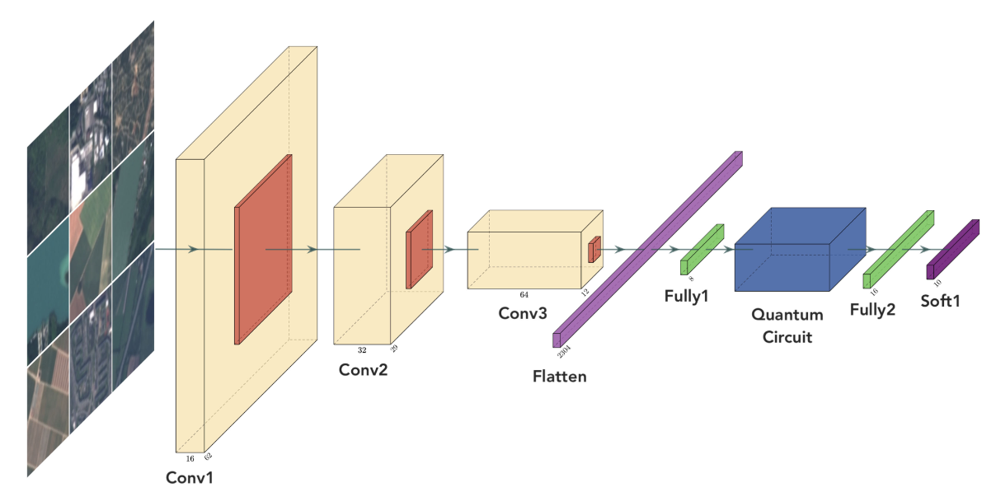
Example: quantum neural networks for image classification
Quantum neural networks (QNNs) can combine multiple encoding and parametric layers, or even mix with classical layers in hybrid architectures
In this case, the quantum circuit takes a (classically) convoluted image as input
Sebastianelli, Alessandro, Daniela Alessandra Zaidenberg, Dario Spiller, Bertrand Le Saux, and Silvia Ullo. “On Circuit-Based Hybrid Quantum Neural Networks for Remote Sensing Imagery Classification.” IEEE Journal of Selected Topics in Applied Earth Observations and Remote Sensing 15 (2022): 565–80. https://doi.org/10.1109/JSTARS.2021.3134785.
QML Theory
Data Encoding
QML Models
Why QML?

Slide 48
Some QML approaches in Earth observation
Data preprocessing
Advanced QNN architectures
QC for training ML models
Feature extraction / selection with quantum circuits / annealing
“Quanvolutional” layers: convolution can be done by a quantum circuit!
Quantum annealing for efficient binary and multiclass SVM training
Specific quantum embeddings for satellite images
Quantum diffusion models for synthetic image generation
QML Theory
Data Encoding
QML Models
Why QML?

Slide 49
Some QML approaches in Earth observation
De Falco, Francesca, Andrea Ceschini, Alessandro Sebastianelli, Bertrand Le Saux, and Massimo Panella. “Quantum Latent Diffusion Models.” Quantum Machine Intelligence 6, no. 2 (November 27, 2024): 85. https://doi.org/10.1007/s42484-024-00224-6.
Delilbasic, Amer, Bertrand Le Saux, Morris Riedel, Kristel Michielsen, and Gabriele Cavallaro. “A Single-Step Multiclass SVM Based on Quantum Annealing for Remote Sensing Data Classification.” IEEE Journal of Selected Topics in Applied Earth Observations and Remote Sensing 17 (2024): 1434–45. https://doi.org/10.1109/JSTARS.2023.3336926.
Fan, Fan, Yilei Shi, and Xiao Xiang Zhu. “Earth Observation Data Classification with Quantum-Classical Convolutional Neural Network.” In IGARSS 2022 - 2022 IEEE International Geoscience and Remote Sensing Symposium, 191–94. Kuala Lumpur, Malaysia: IEEE, 2022. https://doi.org/10.1109/IGARSS46834.2022.9883949.
Miroszewski, Artur, Jakub Mielczarek, Grzegorz Czelusta, Filip Szczepanek, Bartosz Grabowski, Bertrand Le Saux, and Jakub Nalepa. “Detecting Clouds in Multispectral Satellite Images Using Quantum-Kernel Support Vector Machines.” IEEE Journal of Selected Topics in Applied Earth Observations and Remote Sensing 16 (2023): 7601–13. https://doi.org/10.1109/JSTARS.2023.3304122.
Miroszewski, Artur, Jakub Mielczarek, Filip Szczepanek, Grzegorz Czelusta, Bartosz Grabowski, Bertrand Le Saux, and Jakub Nalepa. “Cloud Detection in Multispectral Satellite Images Using Support Vector Machines with Quantum Kernels.” In IGARSS 2023 - 2023 IEEE International Geoscience and Remote Sensing Symposium, 796–99. Pasadena, CA, USA: IEEE, 2023. https://doi.org/10.1109/IGARSS52108.2023.10282416.
Otgonbaatar, Soronzonbold, and Mihai Datcu. “A Quantum Annealer for Subset Feature Selection and the Classification of Hyperspectral Images.” IEEE Journal of Selected Topics in Applied Earth Observations and Remote Sensing 14 (2021): 7057–65. https://doi.org/10.1109/JSTARS.2021.3095377.
Sebastianelli, Alessandro, Francesco Mauro, Giulia Ciabatti, Dario Spiller, Bertrand Le Saux, Paolo Gamba, and Silvia Ullo. “Quanv4EO: Empowering Earth Observation by Means of Quanvolutional Neural Networks.” arXiv, July 24, 2024. http://arxiv.org/abs/2407.17108.
Zollner, Johann Maximilian, Paul Walther, and Martin Werner. “Satellite Image Representations for Quantum Classifiers.” Datenbank-Spektrum 24, no. 1 (March 2024): 33–41. https://doi.org/10.1007/s13222-024-00464-7.
QML Theory
Data Encoding
QML Models
Why QML?

Slide 50
Why bothering with QML?
Operating in exponentially large feature spaces can provide great expressivity
High-dimensional quantum kernels can be impossible to simulate on classical computers
Generally lower number of parameters compared to classical ML models
Some theoretical guarantees of computational advantage, e.g., PAC distribution learning
Can better fit specific types of data (e.g., complex-valued, certain distributions, quantum)
It’s different and underexplored!
QML Theory
Data Encoding
QML Models
Why QML?

Slide 51
Some limitations of QML
Implementation on real hardware
Large-dimensional input data requires high number of qubits
Deep circuits require very low gate error rates
Kernel value concentration
For large-dimensional input data, quantum kernel values tend to concentrate to a single value, making them undistinguishable between different pairs of examples
Barren plateaus
For deep quantum neural networks, gradients tend to zero, making training impossible
QML Theory
Data Encoding
QML Models
Why QML?

Slide 52
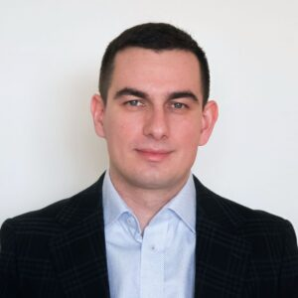
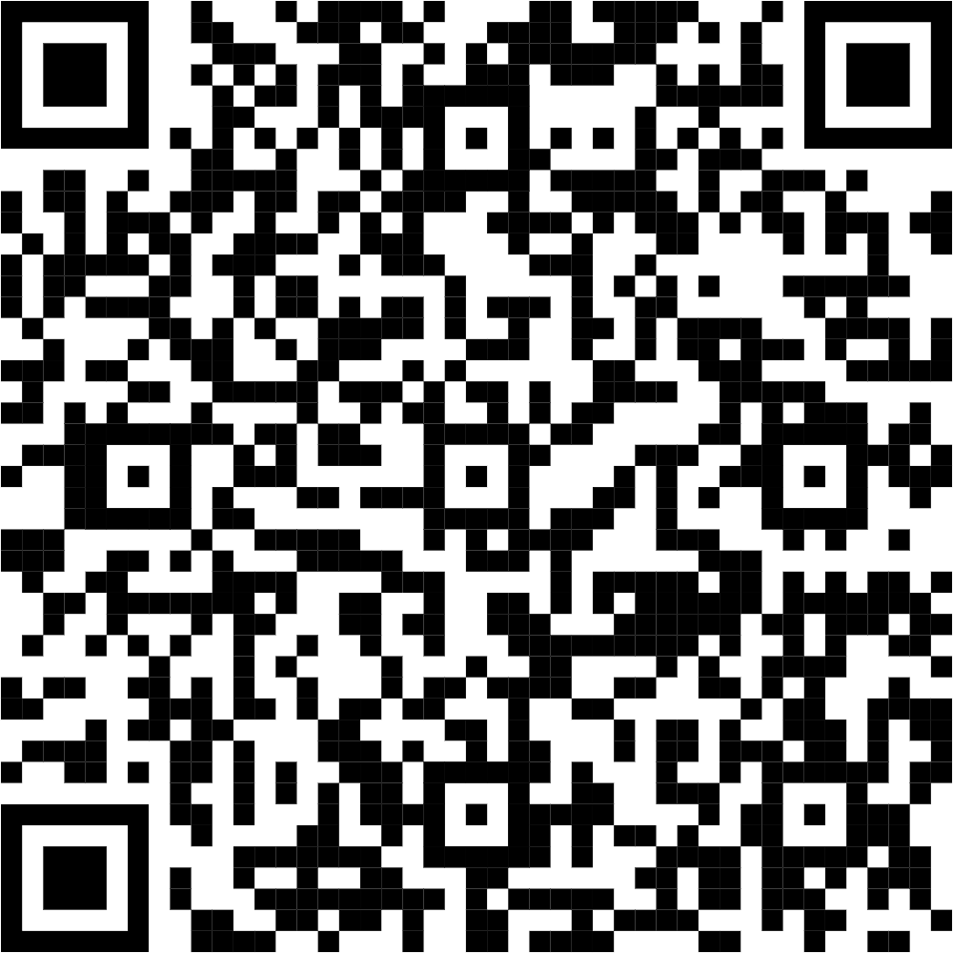
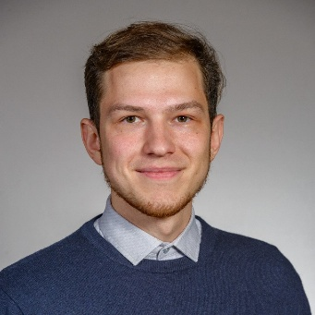
Questions?
Get updates on QUEST activities!
Artur Miroszewski
Postdoctoral Researcher
Jagiellonian University, Kraków, Poland
artur.miroszewski@uj.edu.pl
Amer Delilbasic Doctoral Researcher
Jülich Supercomputing Centre, FZJ, Germany
University of Iceland, Reykjavík, Iceland
a.delilbasic@fz-juelich.de

