Slide 1
Design and Analysis of Algorithms
1. Introduction
Mingyu XIAO（肖鸣宇）
School of Computer Science and Engineering
University of Electronic Science and Technology of China

Slide 2

Turing Award
The first Turing Award was given in 1966.
Up to 2019, there are 72 winners in total.

Slide 3
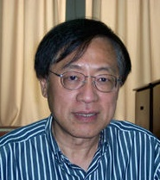


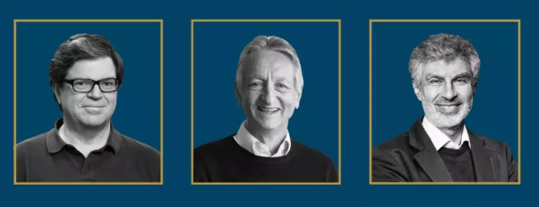

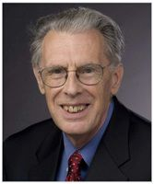

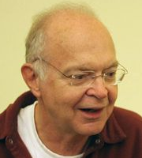
姚期智
(2000)
Stephen A. Cook
(1982)
Edsger W. Dijkstra
(1972)
Yann LeCun
Geoffrey Hinton
Yoshua Bengio
（2018）
John Hopcroft
(1986)
Robert Tarjan
(1986)
Richard M. Karp
(1985)
Donald Knuth
(1974)

Slide 4
1.1 Course Information

Slide 5
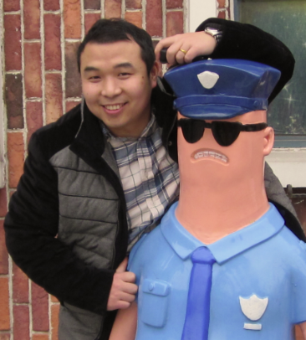
Course Information
Lecture time and venue:
Time: Tuesday (7-8), Thursday (9-11). The first EIGHT weeks
Venue: B203, Pingxue building (Qingshuihe campus)
Language:
Chinese + English
Instructor:
Dr. XIAO Mingyu (肖鸣宇)
Email: myxiao@gmail.com
Tel: 153-97626165
Other information:

Slide 6

Course Information
Syllabus:
Introduction (2 hours)
Basics of algorithm design & analysis (8 hours)
Flows (4 hours)
NP-Completeness and Appro. alg. (16 hours)
Advance topics (6 hours)
Others (4 hours)
Textbook:
J. Kleinberg， E. Tardos, Algorithm design，Addison Wesley， 2005
Reference:
Cormen，Leiserson，Rivest，Stein，算法导论（影印版），高等教育出版社，2007
Grading Scheme:
Final exam 70% Assignments and others 30%
算法设计与分析基础
网络流
NP完备性和近似算法
算法高级讲座
习题课
Notes:
成绩构成：平时10分，小测试10分，实验10分，期末考试70分，要求期末考试40%以上通过才算通过。
可能有一个小测试，10分。

Slide 7
Course Information
Data from 2019 fall:
考试 160
考试160人 | 90分 | 80分 | 70分 | 60分 | 不及格 | 未参考
 | 8 | 50 | 54 | 27 | 9 | 12
 | 5% | 31% | 34% | 17% | 6% | 8%
Data from 2018 spring:
考试 202 考查 46
考试202人 | 90分 | 80分 | 70分 | 60分 | 不及格 |  | 考查 46人
 | 28 | 78 | 38 | 17 | 4+24 |  | 35人通过
 | 13.9% | 38.6% | 18.8% | 8.4% | 14.7% |  | 76.1%

Slide 8
Course Information
Data from 2017:
限选170人
考试 134 考查 38
考试134人 | 90分 | 80分 | 70分 | 60分 | 不及格 |  | 考查 38人
 | 18 | 59 | 38 | 7 | 7+2 |  | 25人通过
Data from 2016:
限选300人
考试 223 考查 77
考试197人 | 90分 | 80分 | 70分 | 60分 | 不及格 |  | 考查 77人
 | 25 | 72 | 69 | 28 | 29 |  | 56人通过

Slide 9
Course Information
Data from 2015:
Attended final exam: 149 (Registration: 187)
考试 129 考查 20
考试129人 | 90分 | 80分 | 70分 | 60分 | 不及格 |  | 考查 20人
 | 5 | 24 | 65 | 31 | 3 |  | 16人通过
Data from 2014:
Attended final exam: 164 (Registration: 175)
考试 137 考查 27
考试137人 | 90分 | 80分 | 70分 | 60分 | 不及格 |  | 考查 27人
 | 3 | 40 | 65 | 20 | 9 |  | 18人通过

Slide 10
Course Information
2019年秋冠军榜（卷面分数）
第一名：92分，李杰，计算机科学与技术
陈果，计算机技术
第三名：91分，王嘉唯，计算机技术
胡兴航 ，计算机科学与技术
2018年春冠军榜（综合分数）
第一名：94.2分，周连明，计算机科学与技术
第二名：93.4分，施钦凯，通信与信息系统
第三名：92.9分，陈静， 计算机技术
2017年冠军榜(卷面分数)
第一名：98分，闵文超， 计算机科学与技术
第二名：97分，林维博， 计算机科学与技术
高毅， 通信与信息系统
第四名：96分，艾小翔， 信息与通信工程

Slide 11
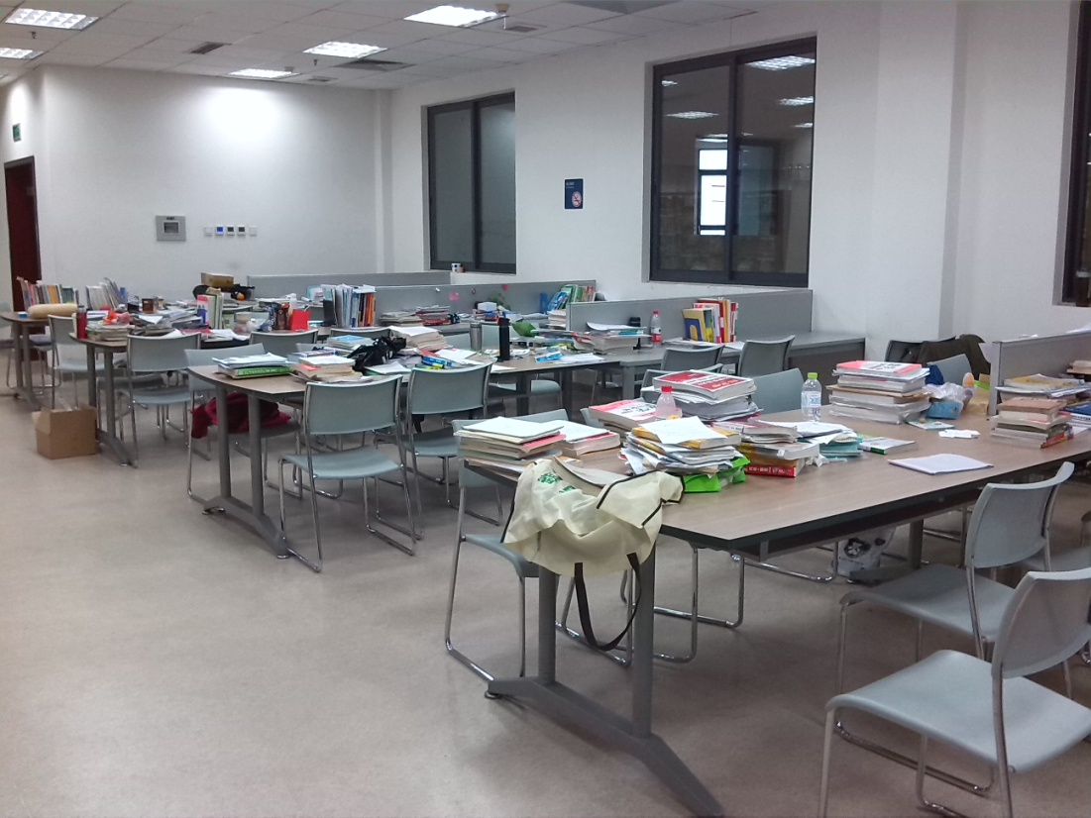
Course Information
记住自己曾经战斗过的地方！

Slide 12

Course Information
送给大家一句话：
靠自己！

Slide 13
Course Information
Advices to who wants to register this course:
1. This course is worthy of your time. You will be proud of yourself when you fall in this course.
2. This course may be a heavy load for you, if you donot want to spend time on it. So DON’T select this course if you just want to get the credit.
3. Read the lecture notes carefully, which will be more helpful for you than the text books.
4. Make sure that you can solve the problems that I put highlines in the course.
5. In some interviews of job hunting, you may find the techniques in the course useful.

Slide 14
1.2 Introduction

Slide 15
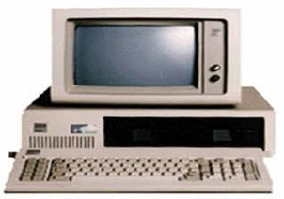
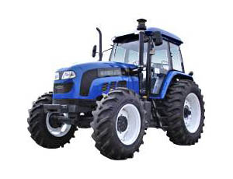
Computers v.s. Tractors
What is the difference between the two machines?
v.s.
Computers more powerful?

Slide 16
Computer Problems
Problem：A task to be performed by computers
  Problems ⇔ Mathematical function from inputs to matching outputs.
  A particular input must always result in the same output every time the function is computed
  Problem definition should include constraints on the resources that may be consumed by any acceptable solution

Slide 17
Three Kinds of Problems
Decision Problem (with yes-no answers)
  e.g. Is there a solution better than some given bound?
  Optimal Value/Optimal Solution
  e.g. What is the value of a best possible solution?
  e.g. Find a solution that achieves the optimal value
  Numerical Calculation
  e.g. Solving an equation group

Slide 18
Algorithms
What is an algorithm?
Problem
1. a method or a process followed to solve a problem using a computer
2. takes the input of a problem and transforms it to the output
3. A problem can have many algorithms
Algorithm
Program
Inputs
Computer
Outputs

Slide 19
Programs and algorithms
  A computer program is an instance, or concrete representation, for an algorithm in some programming language.
  A program is to be read by computer
  An algorithm is to be read by human being
  Algorithms can be expressed by pseduocodes or just some short steps that are easy to read and understand

Slide 20
Goals of Algorithm Design
  We want to use computes to solve problems
  --To solve problems under the recourse constrains
Two ‘conflicting’ goals :
To design an algorithm that is easy to understand, code and debug.
To design an algorithm that makes efficient use of the computer’s resources.

Slide 21
Good Algorithms Always Exist?
  Some problems have good algorithms and can be solved quickly. Some may not have (we have not found good algorithms yet).
  What should we do for hard problems?
  -believe that there are some good algorithms for them?
  -believe that these problems are fundamentally different from easy problems?

Slide 22

Different Classes of Problems
  人类认识世界的一个共同规则：物以类聚
  Computational complexity.
  Classify the problems into different classes by measuring the minimum resource (running time, space, or others) required to solve the problem.
  Some important classes: P, NP, NPC, PTAS,…

Slide 23
Different Classes of Problems
  P: a solution can be solved in polynomial time.
  NP: a solution can be checked in polynomial time.
  NPC: problems that may not have polynomial-time algorithms.
NPC
P
P = NP?
植物是否等同动物？
NP
  Many important problems in practice are NPC.

Slide 24
NPC Problems
  Many methods to deal with NPC problems:
  Heuristic algorithms: solving the problems by your feeling. Donot know if it is right or not, but the algorithm runs fast.
  Approximation algorithms: the algorithm finds a solution not far away from the optimal solution and runs in polynomial time.
  Fast exact algorithms: effective exponential-time algorithms (must faster than simple search algorithms).
  Parameterized algorithms: the algorithm is effective when the parameter is small.

Slide 25
1.3 Some Representative Problems

Slide 26
Interval Scheduling
Input. Set of jobs with start times and finish times.
Goal. Find maximum cardinality subset of mutually compatible jobs (donot overlap).
a
b
b
c
d
e
e
f
g
h
h
Time
0
1
2
3
4
5
6
7
8
9
10
11
Notes:
Activity selection = interval scheduling
OPT = B, E, H
Note: smallest job (C) is not in any optimal solution, job that starts first (A) is not in any optimal solution.

Slide 27
Weighted Interval Scheduling
Input. Set of jobs with start times, finish times, and weights.
Goal. Find maximum weight subset of mutually compatible jobs.
23
12
20
26
13
20
11
16
Time
0
1
2
3
4
5
6
7
8
9
10
11

Slide 28
Bipartite Matching
Input. Bipartite graph.
Goal. Find maximum cardinality matching.
A
1
B
2
C
3
D
4
E
5

Slide 29
Independent Set
Input. Graph.
Goal. Find maximum cardinality independent set.
subset of nodes such that no two
joined by an edge
1
2
1
4
5
4
5
3
6
7
6

Slide 30
Competitive Facility Location
Input. Graph with weight on each node.
Game. Two competing players alternate in selecting nodes. Not allowed to select a node if any of its neighbors have been selected.
Goal. Select a maximum weight subset of nodes.
10
1
5
15
5
1
5
1
15
10
Second player can guarantee 20, but not 25.
Notes:
subset of selected nodes must form an independent set

Slide 31
Representative Problems
Interval scheduling: n log n, greedy algorithm.
Weighted interval scheduling: n log n, dynamic programming algorithm.
Independent set: NP-complete.
Competitive facility location: PSPACE-complete.

