Slide 1
Design and Analysis of Algorithms
2. Basics of algorithm design & analysis
Mingyu XIAO
School of Computer Science and Engineering
University of Electronic Science and Technology of China

Slide 2
2.1 Analysis
Consider the following problems:
What is the difference between polynomial time and exponential time?
How to evaluate the running time and space?
How to denote the running time or space?

Slide 3
How To Measure the Running Time
  Use a clock to calculate the running time?
--May not be good.
We Hope: there is a uniform standard for all instances.
For most algorithms, the running time and space are related to the size of the input.
Different types of running times:
Worst case running time. Obtain bound on largest possible running time of algorithm on input of a given size N.
Average case running time. Obtain bound on running time of algorithm on random input as a function of input size N.
Notes:
focusing on worst-case poly-time is a subtle modeling decision - we try to justify it here

Slide 4
How To Measure the Running Time
  There are also some other kinds of running times, such as smooth analysis and son.
  We only consider worst case running time in this course.
  Questions:
  Why do we consider worst case running time for most problems?
  If the worst case running time is W, then there is at least one instance that the running time of it is W?
Notes:
focusing on worst-case poly-time is a subtle modeling decision - we try to justify it here

Slide 5
How To Measure the Running Time
  Consider this problem: Max independent set problem
  To find a vertex set of max cardinality in a given graph such that no pair of vertices in the set are adjacent.
A Brute force method for this problem: For many non-trivial problems, there is a natural brute force search algorithm that checks every possible solution.
What is the worst case running time of this algorithm?
  It takes 2^{N} time for inputs of size N (N vertices).
  (any problem for this algorithm?)
Notes:
focusing on worst-case poly-time is a subtle modeling decision - we try to justify it here

Slide 6
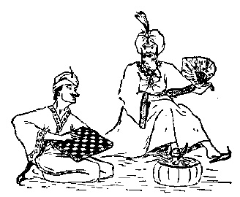
A Famous Story
在席·盖莫夫著的《从一到无穷大》中记载着一个关于古印度舍罕王（Shirham）的故事：
舍罕王打算重赏“国际象棋”（真正的国际象棋是后来进化演变来的）的发明人和进贡者，宰相西萨·班·达伊尔（Sissa Ben Dahir）。这位聪明的大臣的胃口看来并不大，他跪在国王面前说：“陛下，请您在这张棋盘的第一个小格内，赏给我一粒麦子；在第二个小格内两粒，第三个给四粒，照这样下去，每个小格内都比以前一个小格加一倍。陛下啊，把这样摆满棋盘上所有64格的麦粒，都赏给您的仆人罢！”
舍罕王听后很生气，说：”你也太小看我们印度国了，我拿一袋子麦子全给你好了。“
西萨·班·达伊尔坚持说还是按要求放满好。最后大家拿了许多袋麦子过来都只完成了一小部分的填充工作，大家这才感觉到问题的严重。

Slide 7
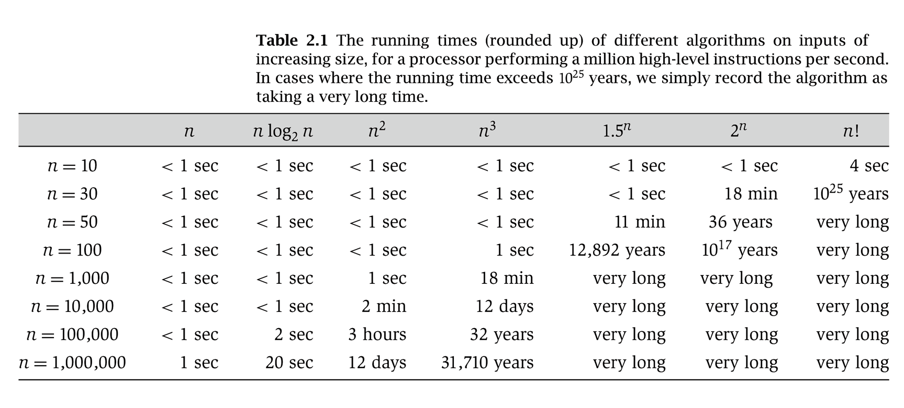
Why It Matters
Notes:
table taken from More Programming Pearls, p. 82, 400MhZ Pentium II scaled up
one step takes one nanosecond
msec = millisecond

Slide 8
What It Matters
Shirham’s story.
  The amount of wheat
0 | 1 | 2 | 3 | …… | 23 | …… | 63
2⁰ | 2¹ | 2² | 2³ | …… | 2²³ | …… | 2⁶³
1 | 2 | 4 | 8 | …… | 8388608 | …… | 9223372036854775808
Sum | 3 | 7 | 15 | …… | 16777215 | …… | 18446744073709551615
It takes more than 2,000,000 years for a modern computer to count the wheat!
Brute force solution to the max impendent set problem.
  If the graph has 100 vertices,
  Number of solution: 2¹⁰⁰= 1267650600228229401496703205376

Slide 9
Polynomial and exponential
（多项式和指数）
上表中我们可以观察到 n³ 和 3^{n} 有巨大差别。
这个差别就是指数与多项式的差别。
在n³ 和 3^{n} 中，如果n变成2n的话（也就是输入增大一倍），两个数分别是以前的多少倍？
对于 n³ 来说，是8倍，一个常数倍；
对于 3^{n} 来说，是3^{n}倍，这个倍数与n有关。
指数增长是恐怖的，在算法运行时间中应当尽量避免。很多问题很容易就可以给出一个指数运行时间的穷举搜索算法，但是否都存在多项式算法？（计算机科学的核心问题）
是否每个多项式时间的算法都有效？

Slide 10
数量级的差别
对于一个输入为n的问题，现给出两个算法A和B.
算法A运行100n步，算法B运行nlogn步。
哪个算法好？
若算法A运行n²+100n步，算法B运行2n²步。
哪个算法好？
很多时候我们认为n和n²之间的差异是较大的，而n和5n之间的差异是微小的甚至可以忽悠不计的，怎样表达这种差异？
用渐进表达式可以解决这个问题。
就算都是多项式，也需表现差异

Slide 11
渐进表达式
常数间的差异较小
  很多情况下，没有意义去说一个运行2n² 步的算法比一个运行n² 步的算法要好.
  在渐进表式方式中我们忽略常数，这样我们将下面式子看成相等的:
  100n², 1.5n², n²+4, 10n²-3n+6.
  用如下符合表式 Θ(n²).
渐进表式的核心内容就是忽略常数！
渐进表式是一个被大家认同的计算机里表式运行时间和空间的方法。
渐进表式系统产生另一个数学系统，与精确数学、模糊数学、近似数学都不相同。

Slide 12
2.2 Asymptotic Order of Growth
(渐进分析)

Slide 13
渐近分析的符号
在下面的讨论中，对所有n，f(n) ≥ 0，g(n) ≥ 0。
（1）渐近上界记号O
O(g(n)) = { f(n) | 存在正常数c和n₀使得对所有n≥ n₀有：0 ≤ f(n) ≤ cg(n) }
（2）渐近下界记号Ω
Ω(g(n)) = { f(n) | 存在正常数c和n₀使得对所有n≥ n₀有：0≤ cg(n) ≤ f(n) }
（3）紧渐近界记号Θ
Θ (g(n)) = { f(n) | 存在正常数c₁,c₂和n₀使得对所有n≥ n₀有：c₁g(n) ≤ f(n) ≤ c₂g(n) }
如果 f(n) 集合 O(g(n))中的一个成员，我们说f(n) 属于 O(g(n))。
例如： f(n) = 32n² + 17n + 32.
  f(n) 属于 O(n²), O(n³), Ω(n²), Ω(n), and Θ(n²) .
  f(n) 不属于 O(n), Ω(n³), Θ(n), or Θ(n³).

Slide 14
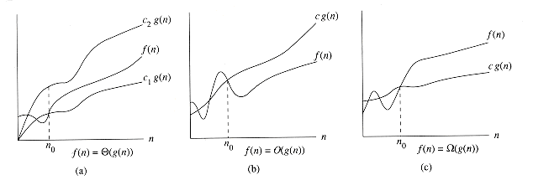
渐近分析的符号
f(n)=Θ(g(n))
f(n)=O(g(n))
f(n)= Ω(g(n))
≅
≅
≅
f(n)=g(n)
f(n) ≤ g(n)
f(n) ≥ g(n)

Slide 15
更多渐近分析的符号
在下面的讨论中，对所有n，f(n) ≥ 0，g(n) ≥ 0。
（4）非紧上界记号o
o(g(n)) = { f(n) | 对于任何正常数c>0，存在正数和n₀ >0使得对所有n≥ n₀有：0 ≤ f(n)<cg(n) }
等价于 f(n) / g(n) →0 ，as n→∞。
（5）非紧下界记号ω
ω (g(n)) = { f(n) | 对于任何正常数c>0，存在正数和n₀ >0使得对所有n≥ n₀有：0 ≤ cg(n) < f(n) }
等价于 f(n) / g(n) →∞ ，as n→∞。
f(n) ∈ ω (g(n)) ⇔ g(n) ∈ o (f(n))

Slide 16

在渐进分析中等于符号的滥用
我们用f(n)= O(g(n))来表示 f(n) 是 O(g(n))的一个成员函数而不用传统的T(n)∈O(f(n))来表示。原因？没有原因，习惯问题而已。
  例子
    f(n) = 5n³; g(n) = 3n²
    f(n) = O(n³) = g(n)
    but f(n) ≠ g(n).
  更好的表式方式: T(n) ∈ O(f(n)).
    5n³ ∈ O(n³)
    3n² ∈ O(n²) O(n³)

Slide 17
在渐进分析中等于符号的滥用
因此f(n)= Θ(g(n))的确切意义是：f(n) ∈ Θ(g(n))。
一般情况下，等式和不等式中的渐近记号Θ(g(n))表示Θ(g(n))中的某个函数。
例如：2n² + 3n + 1 = 2n² + Θ(n) 表示
2n² +3n +1=2n² + f(n)，其中f(n) 是Θ(n)中某个函数。
等式和不等式中渐近记号O,o, Ω和ω的意义是类似的。

Slide 18
渐近分析中函数比较
f(n)= O(g(n)) ≈ a ≤ b;
f(n)= Ω(g(n)) ≈ a ≥ b;
f(n)= Θ(g(n)) ≈ a = b;
f(n)= o(g(n)) ≈ a < b;
f(n)= ω(g(n)) ≈ a > b.

Slide 19
渐近分析记号的若干性质
（1）传递性：
f(n)= Θ(g(n))， g(n)= Θ(h(n)) ⇒ f(n)= Θ(h(n))；
f(n)= O(g(n))， g(n)= O (h(n)) ⇒ f(n)= O (h(n))；
f(n)= Ω(g(n))， g(n)= Ω (h(n)) ⇒ f(n)= Ω(h(n))；
f(n)= o(g(n))， g(n)= o(h(n)) ⇒ f(n)= o(h(n))；
f(n)= ω(g(n))， g(n)= ω (h(n)) ⇒ f(n)= ω (h(n))；

Slide 20
（2）反身性：
f(n)= Θ(f(n))；
f(n)= O(f(n))；
f(n)= Ω(f(n)).
（3）对称性：
f(n)= Θ(g(n)) ⇔ g(n)= Θ (f(n)) .
（4）互对称性：
f(n)= O(g(n)) ⇔ g(n)= Ω (f(n)) ；
f(n)= o(g(n)) ⇔ g(n)= ω (f(n)) ；

Slide 21
（5）算术运算：
O(f(n))+O(g(n)) = O(max{f(n),g(n)}) ；
O(f(n))+O(g(n)) = O(f(n)+g(n)) ；
O(f(n))*O(g(n)) = O(f(n)*g(n)) ；
O(cf(n)) = O(f(n)) ；
g(n)= O(f(n)) ⇒ O(f(n))+O(g(n)) = O(f(n)) 。

Slide 22
规则O(f(n))+O(g(n)) = O(max{f(n),g(n)}) 的证明：
对于任意f₁(n) ∈ O(f(n)) ，存在正常数c₁和自然数n₁，使得对所有n≥ n₁，有f₁(n) ≤ c₁f(n) 。
类似地，对于任意g₁(n) ∈ O(g(n)) ，存在正常数c₂和自然数n₂，使得对所有n≥ n₂，有g₁(n) ≤ c₂g(n) 。
令c₃=max{c₁, c₂}， n₃ =max{n₁, n₂}，h(n)= max{f(n),g(n)} 。
则对所有的 n ≥ n₃，有
f₁(n) +g₁(n) ≤ c₁f(n) + c₂g(n)
≤ c₃f(n) + c₃g(n)= c₃(f(n) + g(n))
≤ c₃2 max{f(n),g(n)}
= 2c₃h(n) = O(max{f(n),g(n)}) .

Slide 23
作业1：
证明：O(f(n)+g(n)) = O(max{f(n),g(n)})，其中f(n)和g(n)是关于n的两个函数。

Slide 24
最常用的关系式
多项式. a₀ + a₁n + … + a_{d}n^{d} = Θ(n^{d}) 其中 a_{d} > 0.
对数. O(log _{a} n) = O(log _{b} n) 其中 a, b > 0为常数.
对数. 对任意 x > 0, log n = O(n^{x}).
指数. 对任意 r > 1 和 d > 0, n^{d} = O(r^{n}).
重点记住内容！

Slide 25
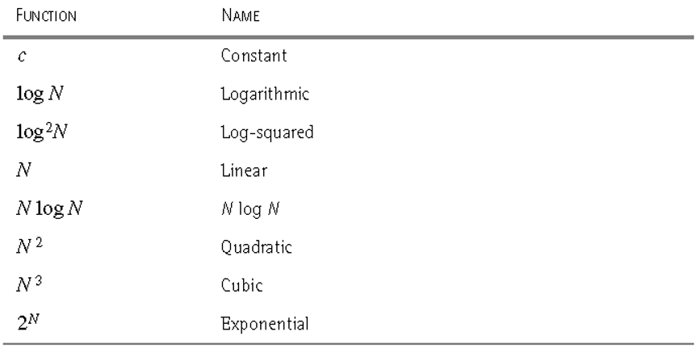
算法分析中常见的复杂性函数

Slide 26

小规模数据

Slide 27

中等规模数据

Slide 28
2.3 Three Techniques for Designing Algorithms
Greedy Algorithms
Divide and Conquer
Dynamical Programming

Slide 29
Greedy Algorithm
Basic Idea: In each iteration, we choose the “best” solution at that moment. This “best” solution may not yield the BEST final solution.
Local optimal v.s. Global optimal: Greedy algorithm is to make the locally optimal choice at each moment. In SOME problems, such strategy can lead to a global optimal solution.
Advantage: Simple, efficient
Disadvantage: May be incorrect / may not be optimal

Slide 30
Interval Scheduling
Interval scheduling.
  Job j starts at s_{j} and finishes at f_{j}.
  Two jobs compatible if they don't overlap.
  Goal: find maximum subset of mutually compatible jobs.
a
b
c
d
e
f
g
h
Time
0
1
2
3
4
5
6
7
8
9
10
11
Notes:
Activity selection = interval scheduling
OPT = B, E, H
Note: smallest job (C) is not in any optimal solution, job that starts first (A) is not in any optimal solution.

Slide 31
Interval Scheduling: Greedy Algorithms
Greedy template. Consider jobs in some order. Take each job provided it's compatible with the ones already taken.
  [Earliest start time] Consider jobs in ascending order of start time s_{j}.
  [Earliest finish time] Consider jobs in ascending order of finish time f_{j}.
  [Shortest interval] Consider jobs in ascending order of interval length f_{j} - s_{j}.
  [Fewest conflicts] For each job, count the number of conflicting jobs c_{j}. Schedule in ascending order of conflicts c_{j}.

Slide 32
Interval Scheduling: Greedy Algorithms
Greedy template. Consider jobs in some order. Take each job provided it's compatible with the ones already taken.
breaks earliest start time
breaks shortest interval
breaks fewest conflicts

Slide 33
Interval Scheduling: Greedy Algorithm
Greedy algorithm. Consider jobs in increasing order of finish time. Take each job provided it's compatible with the ones already taken.
Implementation. O(n log n).
  Remember job j* that was added last to A.
  Job j is compatible with A if s_{j} ≥ f_{j*}.
Sort jobs by finish times so that f₁ ≤ f₂ ≤ ... ≤ f_{n}.
A ← φ
for j = 1 to n {
if (job j compatible with A)
A ← A ∪ {j}
}
return A
jobs selected

Slide 34
Interval Scheduling: Analysis
Theorem. Greedy algorithm is optimal.
Pf. (by contradiction)
  Assume greedy is not optimal, and let's see what happens.
  Let i₁, i₂, ... i_{k} denote set of jobs selected by greedy.
  Let j₁, j₂, ... j_{m} denote set of jobs in the optimal solution with
  i₁ = j₁, i₂ = j₂, ..., i_{r} = j_{r} for the largest possible value of r.
job i_{r+1} finishes before j_{r+1}
Greedy:
i₁
i₁
i_{r}
i_{r+1}
OPT:
j₁
j₂
j_{r}
j_{r+1}
. . .
why not replace job j_{r+1}
with job i_{r+1}?

Slide 35
Interval Scheduling: Analysis
Theorem. Greedy algorithm is optimal.
Pf. (by contradiction)
  Assume greedy is not optimal, and let's see what happens.
  Let i₁, i₂, ... i_{k} denote set of jobs selected by greedy.
  Let j₁, j₂, ... j_{m} denote set of jobs in the optimal solution with
  i₁ = j₁, i₂ = j₂, ..., i_{r} = j_{r} for the largest possible value of r.
job i_{r+1} finishes before j_{r+1}
Greedy:
i₁
i₁
i_{r}
i_{r+1}
OPT:
j₁
j₂
j_{r}
i_{r+1}
. . .
solution still feasible and optimal, but contradicts maximality of r.

Slide 36
Greedy Analysis Strategies
Greedy algorithm stays ahead. Show that after each step of the greedy algorithm, its solution is at least as good as any other algorithm's.
Structural. Discover a simple "structural" bound asserting that every possible solution must have a certain value. Then show that your algorithm always achieves this bound.
Exchange argument. Gradually transform any solution to the one found by the greedy algorithm without hurting its quality.
Other greedy algorithms. Kruskal, Prim, Dijkstra, Huffman, …
Notes:
Hard, if not impossible, to precisely define "greedy algorithm." Though there are some formalizations, e.g., matroids.
myopic
greed: "at every iteration, the algorithm chooses the best morsel it can swallow, without worrying about the future"
Objective function. Does not explicitly appear in greedy algorithm!

Slide 37




Coin Changing
Goal. Given currency denominations: 1, 5, 10, 25, 100, devise a method to pay amount to customer using fewest number of coins.
Ex: 34¢.
Dose this algorithm work? At each iteration, add coin of the largest value that does not take us past the amount to be paid.
Notes:
most of us solve this kind of problem every day without thinking twice, unconsciously using an obvious greedy algorithm
http://www.frbatlanta.org/publica/brochure/fundfac/html/coinfaces.html

Slide 38
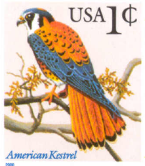
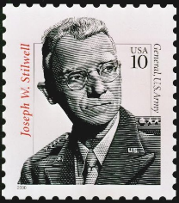
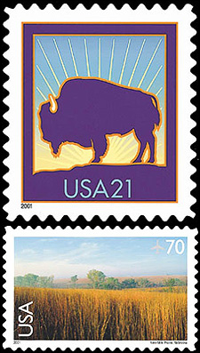
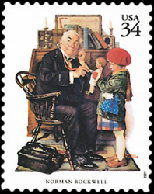


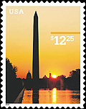

Coin-Changing
Observation. Greedy algorithm is not optimal for US postal denominations: 1, 10, 21, 34, 70, 100, 350, 1225, 1500.
Counterexample. 140¢.
  Greedy: 100, 34, 1, 1, 1, 1, 1, 1.
  Optimal: 70, 70.
Notes:
note: may not even lead to *feasible* solution if c_1 > 1!
Ex. C = {7, 8, 9}, x = 15

Slide 39
Divide-and-Conquer
Divide-and-conquer.
  Break up problem into several parts.
  Solve each part recursively.
  Combine solutions to sub-problems into overall solution.
Most common usage.
  Break up problem of size n into two equal parts of size ½n.
  Solve two parts recursively.
  Combine two solutions into overall solution in linear time.

Slide 40
Integer Arithmetic
Add. Given two n-digit integers a and b, compute a + b.
  O(n) bit operations.
Multiply. Given two n-digit integers a and b, compute a × b.
  Brute force solution: Θ(n²) bit operations.
1
1
0
1
0
1
0
1
*
0
1
1
1
1
1
0
1
1
1
0
1
0
1
0
1
0
Multiply
0
0
0
0
0
0
0
0
0
1
1
0
1
0
1
0
1
0
1
1
0
1
0
1
0
1
0
1
1
1
1
1
1
0
1
1
1
0
1
0
1
0
1
0
1
1
0
1
0
1
0
1
1
1
0
1
0
1
0
1
0
+
0
1
1
1
1
1
0
1
1
1
0
1
0
1
0
1
0
1
0
1
0
1
0
0
1
0
0
0
0
0
0
0
0
0
0
Add
0
1
1
0
1
0
0
0
0
0
0
0
0
0
0
1
0

Slide 41
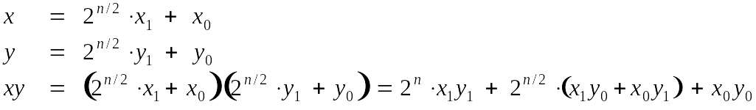
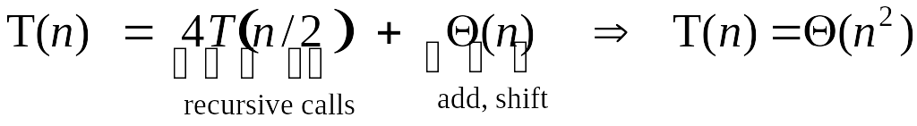
Divide-and-Conquer Multiplication: Warmup
To multiply two n-digit integers:
  Multiply four ½n-digit integers.
  Add two ½n-digit integers, and shift to obtain result.
assumes n is a power of 2

Slide 42
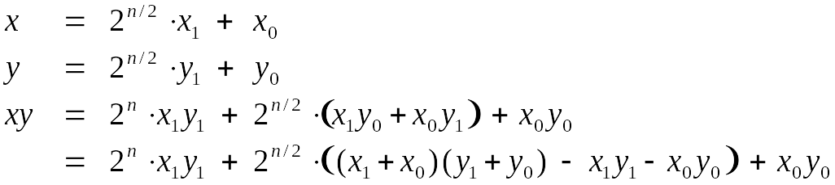
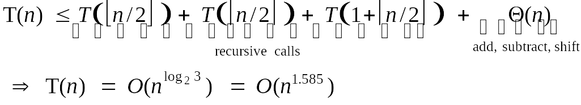
Karatsuba Multiplication
To multiply two n-digit integers:
  Add two ½n digit integers.
  Multiply three ½n-digit integers.
  Add, subtract, and shift ½n-digit integers to obtain result.
Theorem. [Karatsuba-Ofman, 1962] Can multiply two n-digit integers in O(n^{1.585}) bit operations.
A
B
A
C
C
Notes:
Karatsuba: also works for multiplying two degree N univariate polynomials

Slide 43
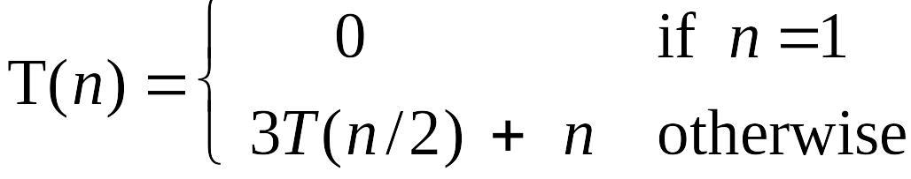
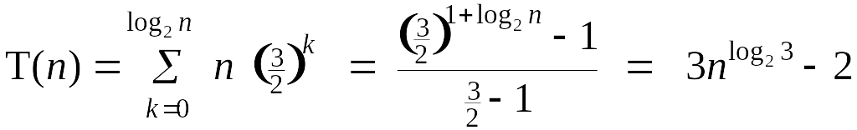
Karatsuba: Recursion Tree
T(n)
n
T(n/2)
T(n/2)
T(n/2)
3(n/2)
T(n/4)
T(n/4)
T(n/4)
T(n/4)
T(n/4)
T(n/4)
T(n/4)
T(n/4)
T(n/4)
9(n/4)
. . .
. . .
T(n / 2^{k})
3^{k} (n / 2^{k})
. . .
. . .
T(2)
T(2)
T(2)
T(2)
T(2)
T(2)
T(2)
T(2)
3 ^{lg n} (2)

Slide 44
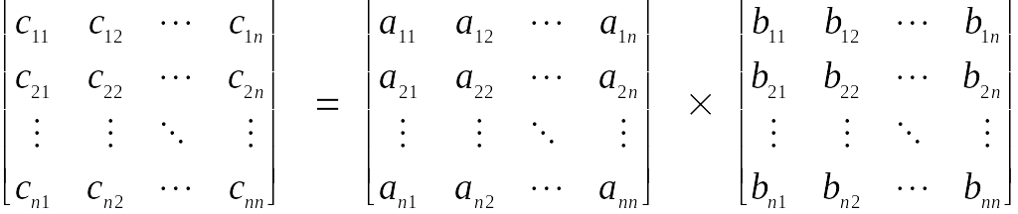
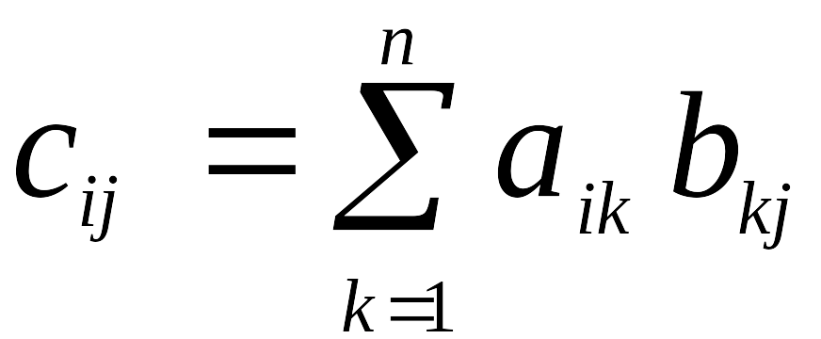
Exercise: Matrix Multiplication
Matrix multiplication. Given two n-by-n matrices A and B, compute C = AB.
Brute force. Θ(n³) arithmetic operations.
Fundamental question. Can we improve upon brute force?
Notes:
among most basic problems in linear algebra and scientific computing

Slide 45
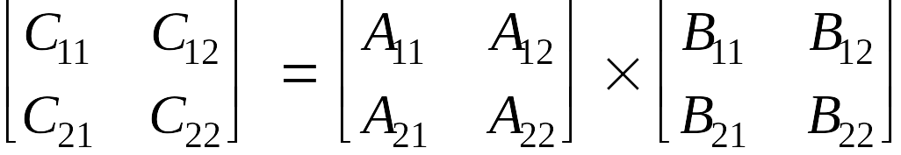
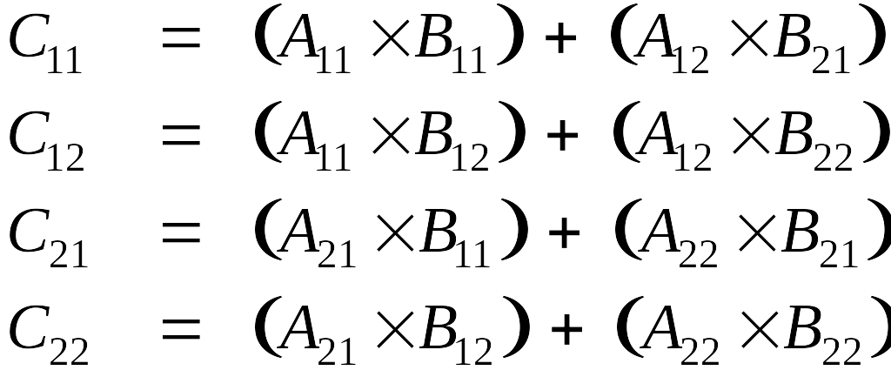
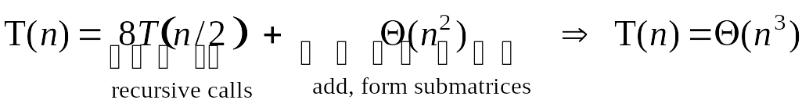
Matrix Multiplication: Warmup
Divide-and-conquer.
  Divide: partition A and B into ½n-by-½n blocks.
  Conquer: multiply 8 ½n-by-½n recursively.
  Combine: add appropriate products using 4 matrix additions.
Notes:
for scalars, probably not worth elimination one multiplication at expense of 14 extra additions (cost of add and multiply similar), but for matrices can make huge difference since standard multiplies are more expensive than additions

Slide 46
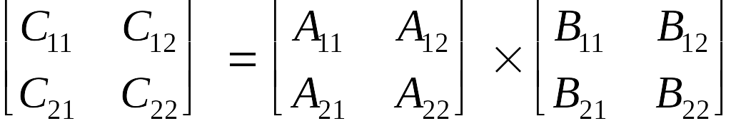
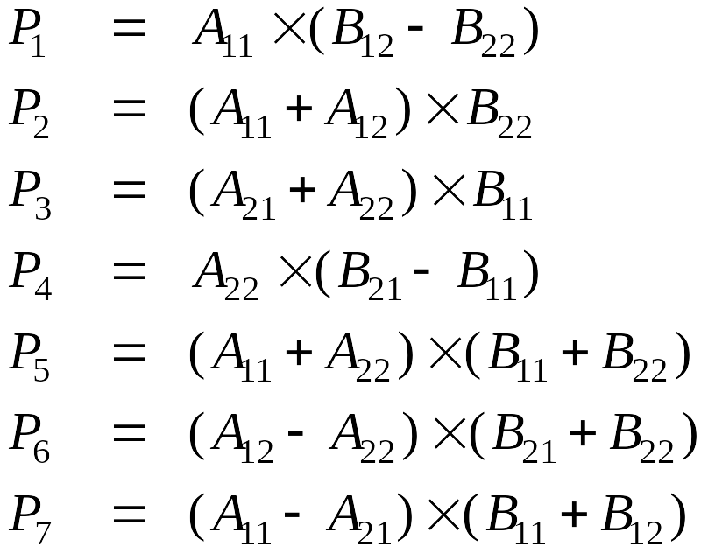
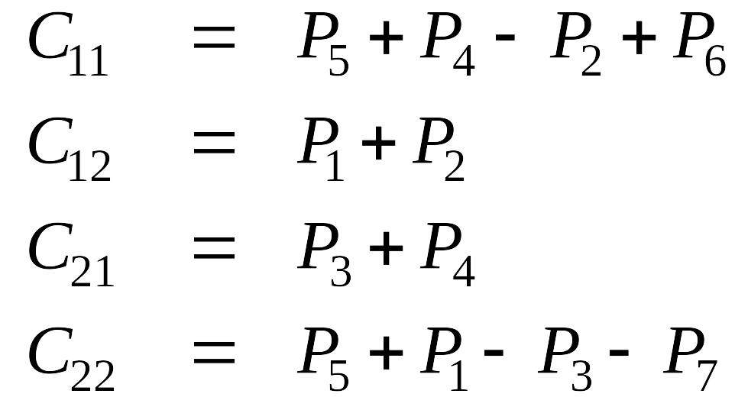
Matrix Multiplication: Key Idea
Key idea. multiply 2-by-2 block matrices with only 7 multiplications.
  7 multiplications.
  18 = 10 + 8 additions (or subtractions).
Notes:
somewhat counterintuitive to be subtracting, especially if all original matrix entries are positive
Winograd's variant. 7 multiplications, 15 additions, but less numerically stable than Strassen

Slide 47
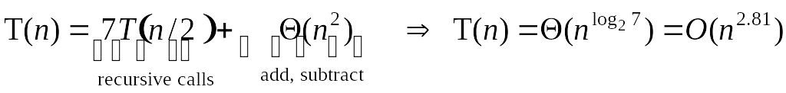
Fast Matrix Multiplication
Fast matrix multiplication. (Strassen, 1969)
  Divide: partition A and B into ½n-by-½n blocks.
  Compute: 14 ½n-by-½n matrices via 10 matrix additions.
  Conquer: multiply 7 ½n-by-½n matrices recursively.
  Combine: 7 products into 4 terms using 8 matrix additions.
Analysis.
  Assume n is a power of 2.
  T(n) = # arithmetic operations.

Slide 48
Read by Yourself
How to solve recurrences?
Some methods:
Substitution method
Recursion-tree method
Master method
Refer to ‘Introduction to Algorithms’ or other books of special topical on Recursion Theory.

Slide 49
Algorithmic Paradigms
Greed. Build up a solution incrementally, myopically optimizing some local criterion.
Divide-and-conquer. Break up a problem into some sub-problems, solve each sub-problem independently, and combine solution to sub-problems to form solution to original problem.
Dynamic programming. Break up a problem into a series of overlapping sub-problems, and build up solutions to larger and larger sub-problems.
Notes:
overlapping sub-problem = sub-problem whose results can be reused several times

Slide 50
Overlapping Subproblems
When a recursive algorithm re-visits the same problem over and over again, we say that the problem has overlapping subproblems.
An idea to save the running time is to avoid computing the same subproblem twice.
This idea is the essential of dynamic programming.

Slide 51
Weighted Interval Scheduling
Weighted interval scheduling problem.
  Job j starts at s_{j}, finishes at f_{j}, and has weight or value v_{j} .
  Two jobs compatible if they don't overlap.
  Goal: find maximum weight subset of mutually compatible jobs.
a
b
c
d
e
f
g
h
Time
0
1
2
3
4
5
6
7
8
9
10
11

Slide 52
Unweighted Interval Scheduling Review
Recall. Greedy algorithm works if all weights are 1.
  Consider jobs in ascending order of finish time.
  Add job to subset if it is compatible with previously chosen jobs.
Observation. Greedy algorithm can fail spectacularly if arbitrary weights are allowed.
weight = 999
b
weight = 1
a
Time
0
1
2
3
4
5
6
7
8
9
10
11

Slide 53
Weighted Interval Scheduling
Notation. Label jobs by finishing time: f₁ ≤ f₂ ≤ . . . ≤ f_{n} .
Def. p(j) = largest index i < j such that job i is compatible with j.
Ex: p(8) = 5, p(7) = 3, p(2) = 0.
1
2
3
4
5
6
7
8
Time
0
1
2
3
4
5
6
7
8
9
10
11

Slide 54
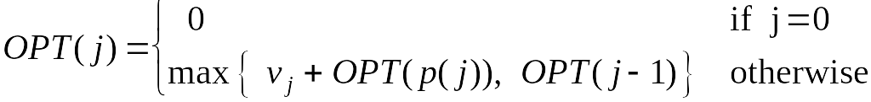
Dynamic Programming: Binary Choice
Notation. OPT(j) = value of optimal solution to the problem consisting of job requests 1, 2, ..., j.
  Case 1: OPT selects job j.
    can't use incompatible jobs { p(j) + 1, p(j) + 2, ..., j - 1 }
    must include optimal solution to problem consisting of remaining compatible jobs 1, 2, ..., p(j)
  Case 2: OPT does not select job j.
    must include optimal solution to problem consisting of remaining compatible jobs 1, 2, ..., j-1
optimal substructure

Slide 55
Weighted Interval Scheduling: Brute Force
Brute force algorithm.
Input: n, s₁,…,s_{n ,} f₁,…,f_{n ,} v₁,…,v_{n}
Sort jobs by finish times so that f₁ ≤ f₂ ≤ ... ≤ f_{n}.
Compute p(1), p(2), …, p(n)
Compute-Opt(j) {
if (j = 0)
return 0
else
return max(v_{j} + Compute-Opt(p(j)), Compute-Opt(j-1))
}

Slide 56
Weighted Interval Scheduling: Brute Force
Observation. Recursive algorithm fails spectacularly because of redundant sub-problems ⇒ exponential algorithms.
Ex. Number of recursive calls for family of "layered" instances grows like Fibonacci sequence.
5
1
4
3
2
3
3
2
2
1
4
2
1
1
0
1
0
5
p(1) = 0, p(j) = j-2
1
0

Slide 57
Weighted Interval Scheduling: Memoization
Memoization. Store results of each sub-problem in a cache; lookup as needed.
Input: n, s₁,…,s_{n ,} f₁,…,f_{n ,} v₁,…,v_{n}
Sort jobs by finish times so that f₁ ≤ f₂ ≤ ... ≤ f_{n}.
Compute p(1), p(2), …, p(n)
for j = 1 to n
M[j] = empty
M[0] = 0
M-Compute-Opt(n) {
if (M[n] is empty)
M[n] = max(v_{n} + M-Compute-Opt(p(n)), M-Compute-Opt(n-1))
return M[n]
}
global array

Slide 58
Weighted Interval Scheduling: Running Time
Claim. Memoized version of algorithm takes O(n log n) time.
  Sort by finish time: O(n log n).
  Computing p(⋅) : O(n) after sorting by start time.
  M-Compute-Opt(j): each invocation takes O(1) time and either
    (i) returns an existing value M[j]
    (ii) fills in one new entry M[j] and makes two recursive calls
  Progress measure Φ = # nonempty entries of M[].
    initially Φ = 0, throughout Φ ≤ n.
    (ii) increases Φ by 1 ⇒ at most n recursive calls.
  Overall running time of M-Compute-Opt(n) is O(n). ▪
Remark. O(n) if jobs are pre-sorted by start and finish times.

Slide 59
Weighted Interval Scheduling: Bottom-Up
Bottom-up dynamic programming. Unwind recursion.
Input: n, s₁,…,s_{n ,} f₁,…,f_{n ,} v₁,…,v_{n}
Sort jobs by finish times so that f₁ ≤ f₂ ≤ ... ≤ f_{n}.
Compute p(1), p(2), …, p(n)
Iterative-Compute-Opt {
M[0] = 0
for j = 1 to n
M[j] = max(v_{j} + M[p(j)], M[j-1])
}

Slide 60
Dynamic Programming
Recall that the main idea of dynamic programming is to save the running time by avoiding computing same subproblems.
What should be most important step of designing dynamic programming algorithms?
To find a good way to separate the problem into may overlapping subproblems.

Slide 61
Knapsack Problem
Knapsack problem.
  Given n objects and a "knapsack."
  Item i weighs w_{i} > 0 kilograms and has value v_{i} > 0.
  Knapsack has capacity of W kilograms.
  Goal: fill knapsack so as to maximize total value.
Ex: { 3, 4 } has value 40.
Greedy: repeatedly add item with maximum ratio v_{i} / w_{i}.
Ex: { 5, 2, 1 } achieves only value = 35 ⇒ greedy not optimal.
Item
Value
Weight
1
1
1
2
6
2
W = 11
3
18
5
4
22
6
5
28
7

Slide 62
Dynamic Programming: False Start
Def. OPT(i) = max profit subset of items 1, …, i.
  Case 1: OPT does not select item i.
    OPT selects best of { 1, 2, …, i-1 }
  Case 2: OPT selects item i.
    accepting item i does not immediately imply that we will have to reject other items
    without knowing what other items were selected before i, we don't even know if we have enough room for i
Conclusion. Need more sub-problems!

Slide 63
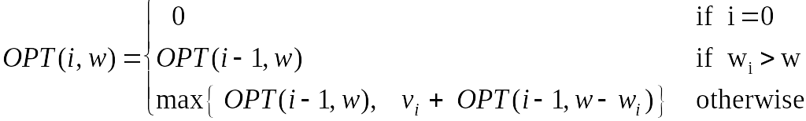
Dynamic Programming: Adding a New Variable
Def. OPT(i, w) = max profit subset of items 1, …, i with weight limit w.
  Case 1: OPT does not select item i.
    OPT selects best of { 1, 2, …, i-1 } using weight limit w
  Case 2: OPT selects item i.
    new weight limit = w – w_{i}
    OPT selects best of { 1, 2, …, i–1 } using this new weight limit

Slide 64
Knapsack Problem: Bottom-Up
Knapsack. Fill up an n-by-W array.
Input: n, w₁,…,w_{N,} v₁,…,v_{N}
for w = 0 to W
M[0, w] = 0
for i = 1 to n
for w = 1 to W
if (w_{i} > w)
M[i, w] = M[i-1, w]
else
M[i, w] = max {M[i-1, w], v_{i} + M[i-1, w-w_{i} ]}
return M[n, W]

Slide 65
Knapsack Algorithm
W + 1
0
1
2
3
4
5
6
7
8
9
10
11
φ
0
0
0
0
0
0
0
0
0
0
0
0
{ 1 }
0
1
1
1
1
1
1
1
1
1
1
1
n + 1
{ 1, 2 }
0
1
6
7
7
7
7
7
7
7
7
7
{ 1, 2, 3 }
0
1
6
7
7
18
19
24
25
25
25
25
{ 1, 2, 3, 4 }
0
1
6
7
7
18
22
24
28
29
29
40
{ 1, 2, 3, 4, 5 }
0
1
6
7
7
18
22
28
29
34
34
40
Item
Value
Weight
1
1
1
OPT: { 4, 3 }
value = 22 + 18 = 40
2
6
2
W = 11
3
18
5
4
22
6
5
28
7

Slide 66
Knapsack Problem: Running Time
Running time. Θ(n W).
  Not polynomial in input size!
  "Pseudo-polynomial."
  Decision version of Knapsack is NP-complete.
Knapsack approximation algorithm. There exists a polynomial algorithm that produces a feasible solution that has value within 0.01% of optimum.

Slide 67
Sequence Alignment
Notes:
1-24,26-37

Slide 68
String Similarity
How similar are two strings?
  ocurrance
  occurrence
o
c
u
r
r
a
n
c
e
-
o
c
c
u
r
r
e
n
c
e
5 mismatches, 1 gap
o
c
-
u
r
r
a
n
c
e
o
c
c
u
r
r
e
n
c
e
1 mismatch, 1 gap
o
c
-
u
r
r
-
a
n
c
e
o
c
c
u
r
r
e
-
n
c
e
0 mismatches, 3 gaps

Slide 69
Edit Distance
Applications.
  Basis for Unix diff.
  Speech recognition.
  Computational biology.
Edit distance. [Levenshtein 1966, Needleman-Wunsch 1970]
  Gap penalty δ; mismatch penalty α_{pq}.
  Cost = sum of gap and mismatch penalties.
C
T
G
A
C
C
T
A
C
C
T
-
C
T
G
A
C
C
T
A
C
C
T
C
C
T
G
A
C
T
A
C
A
T
C
C
T
G
A
C
-
T
A
C
A
T
α_{TC} + α_{GT} + α_{AG}+ 2α_{CA}
2δ + α_{CA}
Notes:
Levenshtein introduced concept of edit-distance; Needleman-Wunsch first applied it to aligning biological sequences; our algorithm is closest in spirit to Smith-Waterman (but their algorithm is for local alignment)
Presumably alpha_pp = 0, but assumption not needed (could be a profit instead of penalty)
bonus application: spam filter - compare message with known spam messages

Slide 70
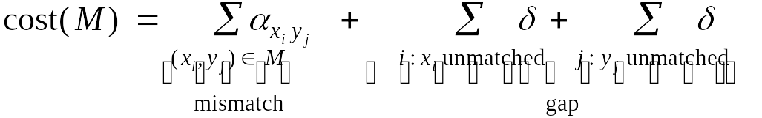
Sequence Alignment
Goal: Given two strings X = x₁ x₂ . . . x_{m} and Y = y₁ y₂ . . . y_{n} find alignment of minimum cost.
Def. An alignment M is a set of ordered pairs x_{i}-y_{j} such that each item occurs in at most one pair and no crossings.
Def. The pair x_{i}-y_{j} and x_{i'}-y_{j'} cross if i < i', but j > j'.
Ex: CTACCG vs. TACATG.
Sol: M = x₂-y₁, x₃-y₂, x₄-y₃, x₅-y₄, x₆-y₆.
x₁
x₂
x₃
x₄
x₅
x₆
C
T
A
C
C
-
G
-
T
A
C
A
T
G
y₁
y₂
y₃
y₄
y₅
y₆

Slide 71
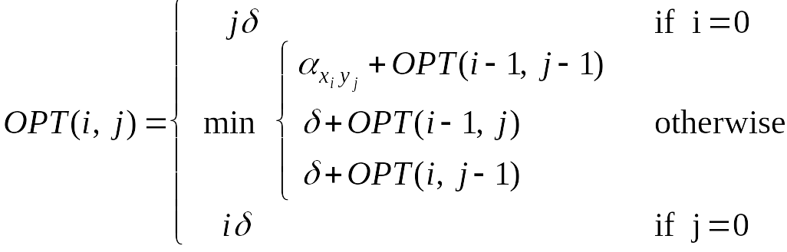
Sequence Alignment: Problem Structure
Def. OPT(i, j) = min cost of aligning strings x₁ x₂ . . . x_{i} and y₁ y₂ . . . y_{j}.
  Case 1: OPT matches x_{i}-y_{j}.
    pay mismatch for x_{i}-y_{j} + min cost of aligning two strings
    x₁ x₂ . . . x_{i-1} and y₁ y₂ . . . y_{j-1}
  Case 2a: OPT leaves x_{i} unmatched.
    pay gap for x_{i} and min cost of aligning x₁ x₂ . . . x_{i-1} and y₁ y₂ . . . y_{j}
  Case 2b: OPT leaves y_{j} unmatched.
    pay gap for y_{j} and min cost of aligning x₁ x₂ . . . x_{i} and y₁ y₂ . . . y_{j-1}

Slide 72
Sequence Alignment: Algorithm
Analysis. Θ(mn) time and space.
English words or sentences: m, n ≤ 10.
Computational biology: m = n = 100,000. 10 billions ops OK, but 10GB array?
Sequence-Alignment(m, n, x₁x₂...x_{m}, y₁y₂...y_{n}, δ, α) {
for i = 0 to m
M[0, i] = iδ
for j = 0 to n
M[j, 0] = jδ
for i = 1 to m
for j = 1 to n
M[i, j] = min(α[x_{i,} y_{j}] + M[i-1, j-1],
δ + M[i-1, j],
δ + M[i, j-1])
return M[m, n]
}

