Slide 1
Design and Analysis of Algorithms
3. Maximum Flow
Mingyu XIAO
School of Computer Science and Engineering
University of Electronic Science and Technology of China

Slide 2
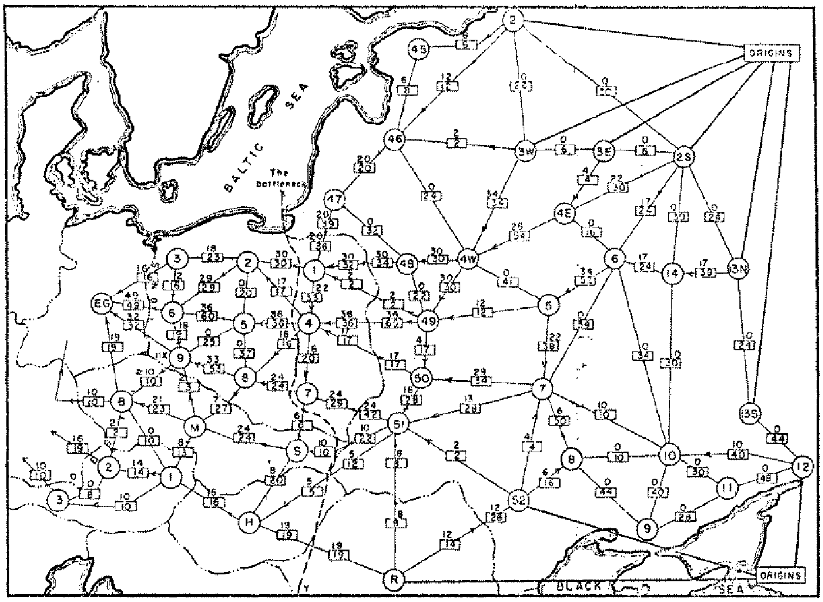
Soviet Rail Network, 1955
Reference: On the history of the transportation and maximum flow problems.
Alexander Schrijver in Math Programming, 91: 3, 2002.
Notes:
Russian scientist A. N. Tolstoi investigated soviet rail network. Wanted to optimize amount of cargo that could be shipped from origins in Soviet Union (right) to destination satellite counties (Poland, Czechoslovakia, Austria, Eastern Germany) (left). American scientists Harris and Ross were also interested in Soviet rail system but from a different perspective. In a secret report (declassified at Schrijver's request in 1999), Harris and Ross calculated a "minimum interdiction" of 163,000 tons.
after aggregation, 44 vertices, 105 edges

Slide 3
Maximum Flow and Minimum Cut
Max flow and min cut.
  Two very rich algorithmic problems.
  Cornerstone problems in combinatorial optimization.
  Beautiful mathematical duality.
Nontrivial applications / reductions.
  Data mining.
  Open-pit mining.
  Project selection.
  Airline scheduling.
  Bipartite matching.
  Baseball elimination.
  Image segmentation.
  Network connectivity.
  Network reliability.
  Distributed computing.
  Egalitarian stable matching.
  Security of statistical data.
  Network intrusion detection.
  Multi-camera scene reconstruction.
  Many many more …
Notes:
Network intrusion detection: http://www.ieee-infocom.org/2003/papers/46_02.PDF

Slide 4
Minimum Cut Problem
Flow network.
  Abstraction for material flowing through the edges.
  G = (V, E) = directed graph, no parallel edges.
  Two distinguished nodes: s = source, t = sink.
  c(e) = capacity of edge e.
2
9
5
10
4
15
15
10
source
s
5
3
8
6
10
t
sink
4
6
15
10
capacity
15
4
30
7
Notes:
source = where material originates, sink = where material goes.
We use cut to mean s-t cut.

Slide 5
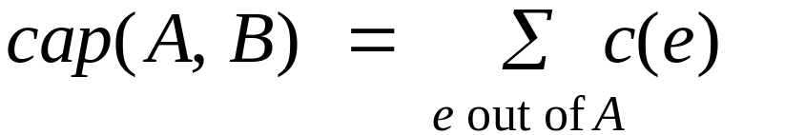
Cuts
Def. An s-t cut is a partition (A, B) of V with s ∈ A and t ∈ B.
Def. The capacity of a cut (A, B) is:
2
9
5
10
4
15
15
10
s
5
3
8
6
10
t
A
4
6
15
10
15
Capacity = 10 + 5 + 15
= 30
4
30
7

Slide 6
Cuts
Def. An s-t cut is a partition (A, B) of V with s ∈ A and t ∈ B.
Def. The capacity of a cut (A, B) is:
2
9
5
10
4
15
15
10
s
5
3
8
6
10
t
A
4
15
15
6
10
Capacity = 9 + 15 + 8 + 30
= 62
4
30
7

Slide 7
Minimum Cut Problem
Min s-t cut problem. Find an s-t cut of minimum capacity.
Capacity = 10 + 8 + 10
= 28
2
9
5
10
4
15
15
10
s
5
3
8
6
10
t
A
4
6
15
10
15
4
30
7

Slide 8

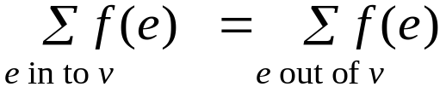
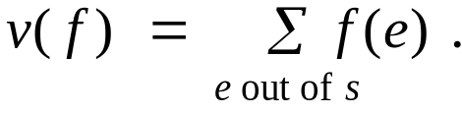
Flows
Def. An s-t flow is a function that satisfies:
  For each e ∈ E: [capacity]
  For each v ∈ V – {s, t}: [conservation]
Def. The value of a flow f is:
0
2
9
5
4
0
0
10
4
4
15
15
0
10
0
4
4
s
5
3
8
6
10
t
0
0
capacity
4
0
6
15
0
10
15
flow
0
0
Value = 4
4
30
7
Notes:
source = where material originates, sink = where material goes
flow conservation = otherwise warehouse overfills or oil pipe bursts
flow conservation is analogous to Kirchoff's law
* flow: abstract entity generated at source, transmitted across edges, absorbed at sink
* assume no arcs enter s or leave t (makes a little cleaner, no loss of generality)

Slide 9
Flows
Def. An s-t flow is a function that satisfies:
  For each e ∈ E: [capacity]
  For each v ∈ V – {s, t}: [conservation]
Def. The value of a flow f is:
6
2
9
5
10
0
6
10
4
4
15
15
0
10
3
8
8
s
5
3
8
6
10
t
1
10
capacity
4
0
6
15
0
10
15
flow
11
11
Value = 24
4
30
7
Notes:
source = where material originates, sink = where material goes
flow conservation = otherwise warehouse overfills or oil pipe bursts
flow conservation is analogous to Kirchoff's law
* flow: abstract entity generated at source, transmitted across edges, absorbed at sink
* assume no arcs enter s or leave t (makes a little cleaner, no loss of generality)

Slide 10
Maximum Flow Problem
Max flow problem. Find s-t flow of maximum value.
9
2
9
5
10
1
9
10
4
0
15
15
0
10
4
8
9
s
5
3
8
6
10
t
4
10
capacity
4
0
6
15
0
10
15
flow
14
14
Value = 28
4
30
7
Notes:
Equalize inflow and outflow at every intermediate node.
Maximize flow sent from s to t.

Slide 11
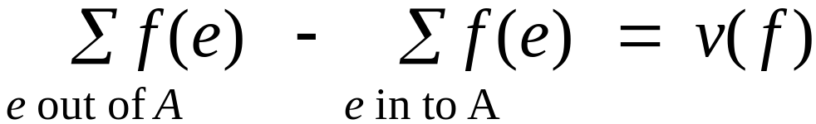
Flows and Cuts
Flow value lemma. Let f be any flow, and let (A, B) be any s-t cut. Then, the net flow sent across the cut is equal to the amount leaving s.
6
2
9
5
10
0
6
10
4
4
15
15
0
10
3
8
8
s
5
3
8
6
10
t
A
1
10
4
0
6
15
0
10
15
11
11
Value = 24
4
30
7

Slide 12
Flows and Cuts
Flow value lemma. Let f be any flow, and let (A, B) be any s-t cut. Then, the net flow sent across the cut is equal to the amount leaving s.
6
2
9
5
10
0
6
10
4
4
15
15
0
10
3
8
8
s
5
3
8
6
10
t
A
1
10
4
0
6
15
0
10
15
11
11
Value = 6 + 0 + 8 - 1 + 11
= 24
4
30
7

Slide 13
Flows and Cuts
Flow value lemma. Let f be any flow, and let (A, B) be any s-t cut. Then, the net flow sent across the cut is equal to the amount leaving s.
6
2
9
5
10
0
6
10
4
4
15
15
0
10
3
8
8
s
5
3
8
6
10
t
A
1
10
4
0
6
15
0
10
15
11
11
Value = 10 - 4 + 8 - 0 + 10
= 24
4
30
7

Slide 14
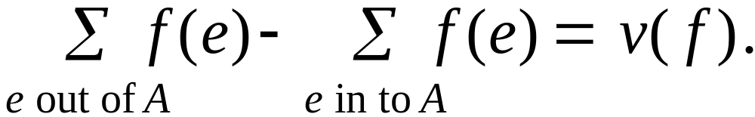
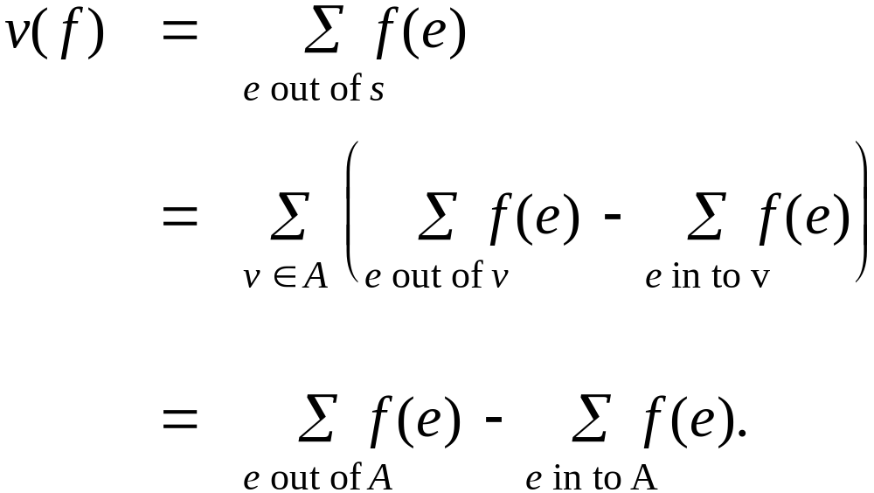
Flows and Cuts
Flow value lemma. Let f be any flow, and let (A, B) be any s-t cut. Then
Pf.
by flow conservation

Slide 15
Flows and Cuts
Weak duality. Let f be any flow, and let (A, B) be any s-t cut. Then the value of the flow is at most the capacity of the cut.
Cut capacity = 30 ⇒ Flow value ≤ 30
2
9
5
10
4
15
15
10
s
5
3
8
6
10
t
A
4
6
15
10
15
Capacity = 30
4
30
7

Slide 16
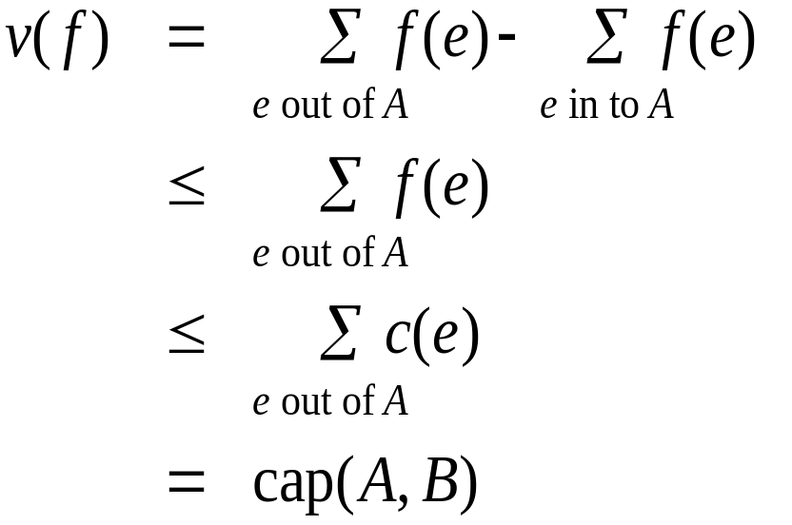
Flows and Cuts
Weak duality. Let f be any flow. Then, for any s-t cut (A, B) we have
v(f) ≤ cap(A, B).
Pf.
▪
A
B
4
8
t
s
7
6

Slide 17
Certificate of Optimality
Corollary. Let f be any flow, and let (A, B) be any cut.
If v(f) = cap(A, B), then f is a max flow and (A, B) is a min cut.
Value of flow = 28
Cut capacity = 28 ⇒ Flow value ≤ 28
9
2
9
5
10
1
9
10
4
0
15
15
0
10
4
8
9
s
5
3
8
6
10
t
4
10
A
4
0
6
15
0
10
15
14
14
4
30
7

Slide 18
Towards a Max Flow Algorithm
Greedy algorithm.
  Start with f(e) = 0 for all edge e ∈ E.
  Find an s-t path P where each edge has f(e) < c(e).
  Augment flow along path P.
  Repeat until you get stuck.
1
0
0
20
10
s
30
0
t
10
20
0
0
Flow value = 0
2

Slide 19
Towards a Max Flow Algorithm
Greedy algorithm.
  Start with f(e) = 0 for all edge e ∈ E.
  Find an s-t path P where each edge has f(e) < c(e).
  Augment flow along path P.
  Repeat until you get stuck.
1
20
0
0
X
20
10
30
0
20
t
s
X
10
20
0
0
20
Flow value = 20
X
2

Slide 20
Towards a Max Flow Algorithm
Greedy algorithm.
  Start with f(e) = 0 for all edge e ∈ E.
  Find an s-t path P where each edge has f(e) < c(e).
  Augment flow along path P.
  Repeat until you get stuck.
locally optimality ⇒ global optimality?
1
1
20
0
20
10
20
10
20
10
s
30
20
t
s
30
10
t
10
20
10
20
0
20
10
20
greedy = 20
2
opt = 30
2

Slide 21
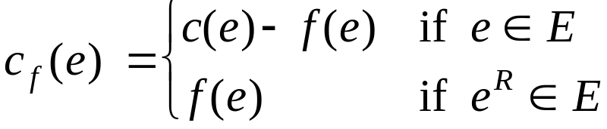
Residual Graph
Original edge: e = (u, v) ∈ E.
  Flow f(e), capacity c(e).
Residual edge.
  "Undo" flow sent.
  e = (u, v) and e^{R} = (v, u).
  Residual capacity:
Residual graph: G_{f} = (V, E_{f} ).
  Residual edges with positive residual capacity.
  E_{f} = {e : f(e) < c(e)} ∪ {e^{R} : f(e) > 0}.
capacity
u
17
v
6
flow
residual capacity
u
11
v
6
residual capacity

Slide 22
Ford-Fulkerson Algorithm
2
4
4
capacity
G:
10
2
8
6
10
s
10
3
9
5
10
t

Slide 23
Augmenting Path Algorithm
Augment(f, c, P) {
b ← bottleneck(P)
foreach e ∈ P {
if (e ∈ E) f(e) ← f(e) + b
else f(e^{R})← f(e^{R}) - b
}
return f
}
forward edge
reverse edge
Ford-Fulkerson(G, s, t, c) {
foreach e ∈ E f(e) ← 0
G_{f} ← residual graph
while (there exists augmenting path P) {
f ← Augment(f, c, P)
update G_{f}
}
return f
}

Slide 24
Max-Flow Min-Cut Theorem
Augmenting path theorem. Flow f is a max flow iff there are no augmenting paths.
Max-flow min-cut theorem. [Elias-Feinstein-Shannon 1956, Ford-Fulkerson 1956] The value of the max flow is equal to the value of the min cut.
Pf. We prove both simultaneously by showing:
  (i) There exists a cut (A, B) such that v(f) = cap(A, B).
  (ii) Flow f is a max flow.
  (iii) There is no augmenting path relative to f.
(i) ⇒ (ii) This was the corollary to weak duality lemma.
(ii) ⇒ (iii) We show contrapositive.
  Let f be a flow. If there exists an augmenting path, then we can improve f by sending flow along path.

Slide 25
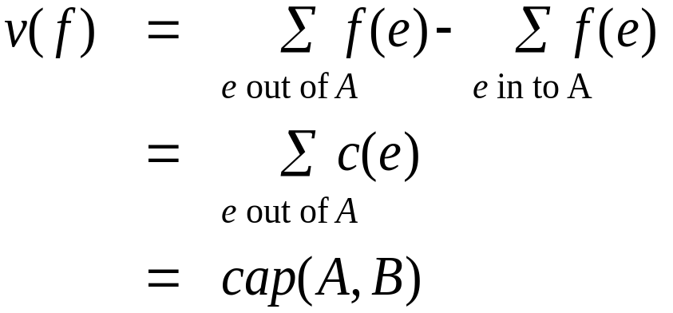
Proof of Max-Flow Min-Cut Theorem
(iii) ⇒ (i)
  Let f be a flow with no augmenting paths.
  Let A be set of vertices reachable from s in residual graph.
  By definition of A, s ∈ A.
  By definition of f, t ∉ A.
A
B
t
s
original network

Slide 26
Running Time
Assumption. All capacities are integers between 1 and C.
Invariant. Every flow value f(e) and every residual capacity c_{f} (e) remains an integer throughout the algorithm.
Theorem. The algorithm terminates in at most v(f*) ≤ mC iterations.
Pf. Each augmentation increase value by at least 1. ▪
Corollary. If C = 1, Ford-Fulkerson runs in O(m²) time.
Integrality theorem. If all capacities are integers, then there exists a max flow f for which every flow value f(e) is an integer.
Pf. Since algorithm terminates, theorem follows from invariant. ▪

Slide 27
Choosing Good Augmenting Paths

Slide 28
Ford-Fulkerson: Exponential Number of Augmentations
Q. Is generic Ford-Fulkerson algorithm polynomial in input size?
A. No. If max capacity is C, then algorithm can take C iterations.
m, n, and log C
1
1
1
0
0
1
0
0
X
X
X
1
C
C
C
C
1
0
t
1
0
1
0
t
s
X
1
s
X
X
C
C
C
C
0
0
1
0
0
1
X
1
X
X
2
2

Slide 29
Choosing Good Augmenting Paths
Use care when selecting augmenting paths.
  Some choices lead to exponential algorithms.
  Clever choices lead to polynomial algorithms.
  If capacities are irrational, algorithm not guaranteed to terminate!
Goal: choose augmenting paths so that:
  Can find augmenting paths efficiently.
  Few iterations.
Choose augmenting paths with: [Edmonds-Karp 1972, Dinitz 1970]
  Max bottleneck capacity.
  Sufficiently large bottleneck capacity.
  Fewest number of edges.

Slide 30
Capacity Scaling
Intuition. Choosing path with highest bottleneck capacity increases flow by max possible amount.
  Don't worry about finding exact highest bottleneck path.
  Maintain scaling parameter Δ.
  Let G_{f} (Δ) be the subgraph of the residual graph consisting of only arcs with capacity at least Δ.
4
4
110
102
110
102
s
1
t
s
t
122
170
122
170
2
2
G_{f}
G_{f} (100)

Slide 31
Capacity Scaling
Scaling-Max-Flow(G, s, t, c) {
foreach e ∈ E f(e) ← 0
Δ ← smallest power of 2 greater than or equal to C
G_{f} ← residual graph
while (Δ ≥ 1) {
G_{f}(Δ) ← Δ-residual graph
while (there exists augmenting path P in G_{f}(Δ)) {
f ← augment(f, c, P)
update G_{f}(Δ)
}
Δ ← Δ / 2
}
return f
}

Slide 32
Capacity Scaling: Correctness
Assumption. All edge capacities are integers between 1 and C.
Integrality invariant. All flow and residual capacity values are integral.
Correctness. If the algorithm terminates, then f is a max flow.
Pf.
  By integrality invariant, when Δ = 1 ⇒ G_{f}(Δ) = G_{f}.
  Upon termination of Δ = 1 phase, there are no augmenting paths. ▪

Slide 33
Capacity Scaling: Running Time
Lemma 1. The outer while loop repeats 1 + ⎡log₂ C⎤ times.
Pf. Initially C ≤ Δ < 2C. Δ decreases by a factor of 2 each iteration. ▪
Lemma 2. The inner while loop repeats at most 2m times.
Pf. In G_{f}(Δ) , there are at most m edge-disjoint path from s to t, the capacity of each of which is less than 2C. Then the maximum flow in G_{f}(Δ) is at most 2mC. Each iteration increase the flow by at least C.
Theorem. The scaling max-flow algorithm finds a max flow in O(m log C) augmentations. It can be implemented to run in O(m² log C) time. ▪

Slide 34
Multiflow and Multicut
Questions:
If there are more than two terminals in the graph, is value of the max flow equal to the value of the min cut?
How about the case that there are two pairs of terminals (s and t)?
How to decompose a flow?

