Slide 1

5. Approximation Algorithms
Mingyu XIAO
School of Computer Science and Engineering
University of Electronic Science and Technology of China

Slide 2
Approximation Algorithms
Q. Suppose I need to solve an NP-hard problem. What should I do?
A. Theory says you're unlikely to find a poly-time algorithm.
Must sacrifice one of three desired features.
  Solve problem to optimality.
  Solve problem in poly-time.
  Solve arbitrary instances of the problem.
ρ-approximation algorithm.
  Guaranteed to run in poly-time.
  Guaranteed to solve arbitrary instance of the problem
  Guaranteed to find solution within ratio ρ of true optimum.
Challenge. Need to prove a solution's value is close to optimum, without even knowing what optimum value is!

Slide 3


Slide 4
Load Balancing
Input. m identical machines; n jobs, job j has processing time t_{j}.
  Job j must run contiguously on one machine.
  A machine can process at most one job at a time.
Def. Let J(i) be the subset of jobs assigned to machine i. The
load of machine i is L_{i} = Σ_{j ∈ J(i)} t_{j}.
Def. The makespan is the maximum load on any machine L = max_{i} L_{i}.
Load balancing. Assign each job to a machine to minimize makespan.

Slide 5
Load Balancing: List Scheduling
List-scheduling algorithm.
  Consider n jobs in some fixed order.
  Assign job j to machine whose load is smallest so far.
Implementation. O(n log m) using a priority queue.
List-Scheduling(m, n, t₁,t₂,…,t_{n}) {
for i = 1 to m {
L_{i} ← 0
J(i) ← φ
}
for j = 1 to n {
i = argmin_{k} L_{k}
J(i) ← J(i) ∪ {j}
L_{i} ← L_{i} + t_{j}
}
return J(1), …, J(m)
}
load on machine i
jobs assigned to machine i
machine i has smallest load
assign job j to machine i
update load of machine i

Slide 6

Load Balancing: List Scheduling Analysis
Theorem. [Graham, 1966] Greedy algorithm is a 2-approximation.
  First worst-case analysis of an approximation algorithm.
  Need to compare resulting solution with optimal makespan L*.
Lemma 1. The optimal makespan L* ≥ max_{j} t_{j}.
Pf. Some machine must process the most time-consuming job. ▪
Lemma 2. The optimal makespan
Pf.
  The total processing time is Σ_{j} t_{j} .
  One of m machines must do at least a 1/m fraction of total work. ▪

Slide 7
Load Balancing: List Scheduling Analysis
Theorem. Greedy algorithm is a 2-approximation.
Pf. Consider load L_{i} of bottleneck machine i.
  Let j be last job scheduled on machine i.
  When job j assigned to machine i, i had smallest load. Its load before assignment is L_{i} - t_{j} ⇒ L_{i} - t_{j} ≤ L_{k} for all 1 ≤ k ≤ m.
blue jobs scheduled before j
machine i
j
0
L_{i} - t_{j}
L = L_{i}

Slide 8
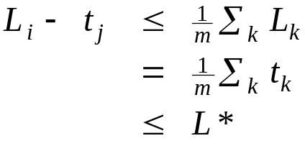
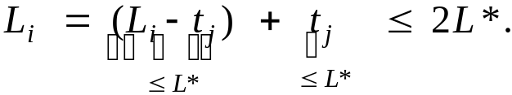
Load Balancing: List Scheduling Analysis
Theorem. Greedy algorithm is a 2-approximation.
Pf. Consider load L_{i} of bottleneck machine i.
  Let j be last job scheduled on machine i.
  When job j assigned to machine i, i had smallest load. Its load before assignment is L_{i} - t_{j} ⇒ L_{i} - t_{j} ≤ L_{k} for all 1 ≤ k ≤ m.
  Sum inequalities over all k and divide by m:
  Now ▪
Lemma 1
Lemma 2

Slide 9
Load Balancing: List Scheduling Analysis
Q. Is our analysis tight?
A. Essentially yes.
Ex: m machines, m(m-1) jobs length 1 jobs, one job of length m
machine 2 idle
machine 3 idle
machine 4 idle
m = 10
machine 5 idle
machine 6 idle
machine 7 idle
machine 8 idle
machine 9 idle
machine 10 idle
list scheduling makespan = 19

Slide 10
Load Balancing: List Scheduling Analysis
Q. Is our analysis tight?
A. Essentially yes.
Ex: m machines, m(m-1) jobs length 1 jobs, one job of length m
m = 10
optimal makespan = 10

Slide 11
Load Balancing: LPT Rule
Longest processing time (LPT). Sort n jobs in descending order of processing time, and then run list scheduling algorithm.
LPT-List-Scheduling(m, n, t₁,t₂,…,t_{n}) {
Sort jobs so that t₁ ≥ t₂ ≥ … ≥ t_{n}
for i = 1 to m {
L_{i} ← 0
J(i) ← φ
}
for j = 1 to n {
i = argmin_{k} L_{k}
J(i) ← J(i) ∪ {j}
L_{i} ← L_{i} + t_{j}
}
return J(1), …, J(m)
}
load on machine i
jobs assigned to machine i
machine i has smallest load
assign job j to machine i
update load of machine i

Slide 12
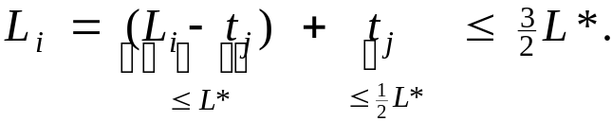
Load Balancing: LPT Rule
Observation. If at most m jobs, then list-scheduling is optimal.
Pf. Each job put on its own machine. ▪
Lemma 3. If there are more than m jobs, L* ≥ 2 t_{m+1}.
Pf.
  Consider first m+1 jobs t₁, …, t_{m+1}.
  Since the t_{i}'s are in descending order, each takes at least t_{m+1} time.
  There are m+1 jobs and m machines, so by pigeonhole principle, at least one machine gets two jobs. ▪
Theorem. LPT rule is a 3/2 approximation algorithm.
Pf. Same basic approach as for list scheduling.
▪
Lemma 3
( by observation, can assume number of jobs > m )

Slide 13
Load Balancing: LPT Rule
Q. Is our 3/2 analysis tight?
A. No.
Theorem. [Graham, 1969] LPT rule is a 4/3-approximation.
Pf. More sophisticated analysis of same algorithm.
Q. Is Graham's 4/3 analysis tight?
A. Essentially yes.
Ex: m machines, n = 2m+1 jobs, 2 jobs of length m+1, m+2, …, 2m-1 and one job of length m.

Slide 14


Slide 15
Center Selection Problem
Input. Set of n sites s₁, …, s_{n} and integer k > 0.
Center selection problem. Select k centers C so that maximum distance from a site to nearest center is minimized.
k = 4
r(C)
center
site

Slide 16
Center Selection Problem
Input. Set of n sites s₁, …, s_{n} and integer k > 0.
Center selection problem. Select k centers C so that maximum distance from a site to nearest center is minimized.
Notation.
  dist(x, y) = distance between x and y.
  dist(s_{i}, C) = min _{c ∈ C} dist(s_{i}, c) = distance from s_{i} to closest center.
  r(C) = max_{i} dist(s_{i}, C) = smallest covering radius.
Goal. Find set of centers C that minimizes r(C), subject to |C| = k.
Distance function properties.
  dist(x, x) = 0 (identity)
  dist(x, y) = dist(y, x) (symmetry)
  dist(x, y) ≤ dist(x, z) + dist(z, y) (triangle inequality)

Slide 17
Center Selection Example
Ex: each site is a point in the plane, a center can be any point in the plane, dist(x, y) = Euclidean distance.
Remark: search can be infinite!
r(C)
center
site

Slide 18
Greedy Algorithm: A False Start
Greedy algorithm. Put the first center at the best possible location for a single center, and then keep adding centers so as to reduce the covering radius each time by as much as possible.
Remark: arbitrarily bad!
greedy center 1
center
k = 2 centers
site

Slide 19
Center Selection: Greedy Algorithm
Greedy algorithm. Repeatedly choose the next center to be the site farthest from any existing center.
Observation. Upon termination all centers in C are pairwise at least r(C) apart.
Pf. By construction of algorithm.
Greedy-Center-Selection(k, n, s₁,s₂,…,s_{n}) {
C = φ
repeat k times {
Select a site s_{i} with maximum dist(s_{i}, C)
Add s_{i} to C
}
return C
}
site farthest from any center

Slide 20
Center Selection: Analysis of Greedy Algorithm
Theorem. Let C* be an optimal set of centers. Then r(C) ≤ 2r(C*).
Pf. (by contradiction) Assume r(C*) < ½ r(C).
  For each site c_{i} in C, consider ball of radius ½ r(C) around it.
  Exactly one c_{i}* in each ball; let c_{i} be the site paired with c_{i}*.
  Consider any site s and its closest center c_{i}* in C*.
  dist(s, C) ≤ dist(s, c_{i}) ≤ dist(s, c_{i}*) + dist(c_{i}*, c_{i}) ≤ 2r(C*).
  Thus r(C) ≤ 2r(C*). ▪
Δ-inequality
≤ r(C*) since c_{i}* is closest center
½ r(C)
½ r(C)
c_{i}
½ r(C)
C*
sites
c_{i}*
s

Slide 21
Center Selection
Theorem. Let C* be an optimal set of centers. Then r(C) ≤ 2r(C*).
Theorem. Greedy algorithm is a 2-approximation for center selection problem.
Remark. Greedy algorithm always places centers at sites, but is still within a factor of 2 of best solution that is allowed to place centers anywhere.
Question. Is there hope of a 3/2-approximation? 4/3?
e.g., points in the plane
Theorem. Unless P = NP, there no ρ-approximation for center-selection
problem for any ρ < 2.

Slide 22
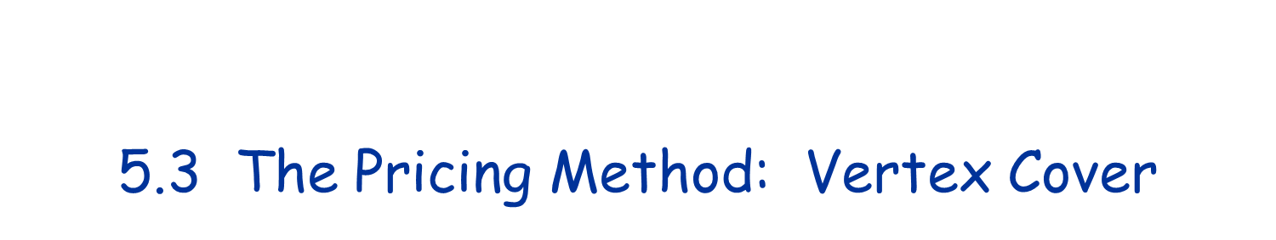

Slide 23
Weighted Vertex Cover
Weighted vertex cover. Given a graph G with vertex weights, find a vertex cover of minimum weight.
2
4
2
4
2
9
2
9
weight = 2 + 2 + 4
weight = 9

Slide 24
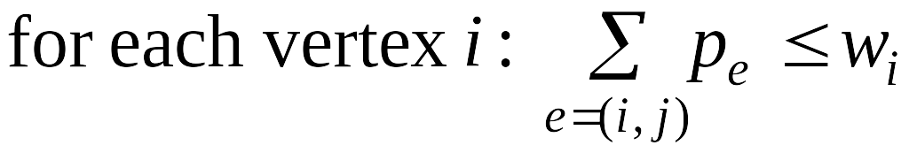
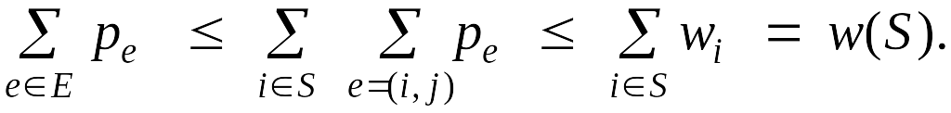
Pricing Method
Pricing method. Each edge must be covered by some vertex.
Edge e = (i, j) pays price p_{e} ≥ 0 to use vertex i and j.
Fairness. Edges incident to vertex i should pay ≤ w_{i} in total.
Lemma. For any vertex cover S and any fair prices p_{e}: ∑_{e} p_{e} ≤ w(S).
Pf. ▪
2
4
2
9
each edge e covered by
at least one node in S
sum fairness inequalities
for each node in S

Slide 25
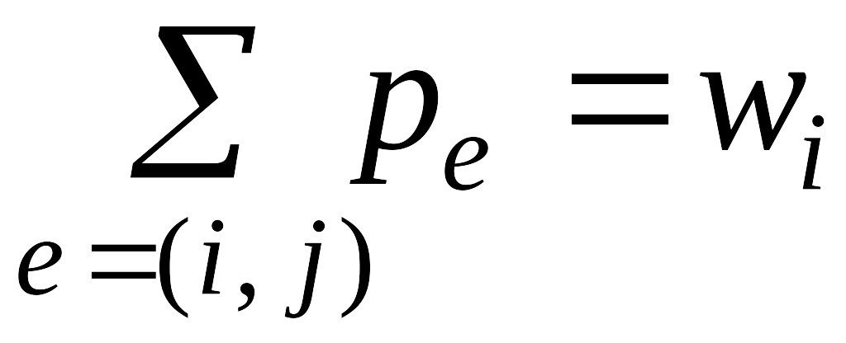
Pricing Method
Pricing method. Set prices and find vertex cover simultaneously.
Weighted-Vertex-Cover-Approx(G, w) {
foreach e in E
p_{e} = 0
while (∃ edge i-j such that neither i nor j are tight)
select such an edge e
increase p_{e} as much as possible until i or j tight
}
S ← set of all tight nodes
return S
}

Slide 26
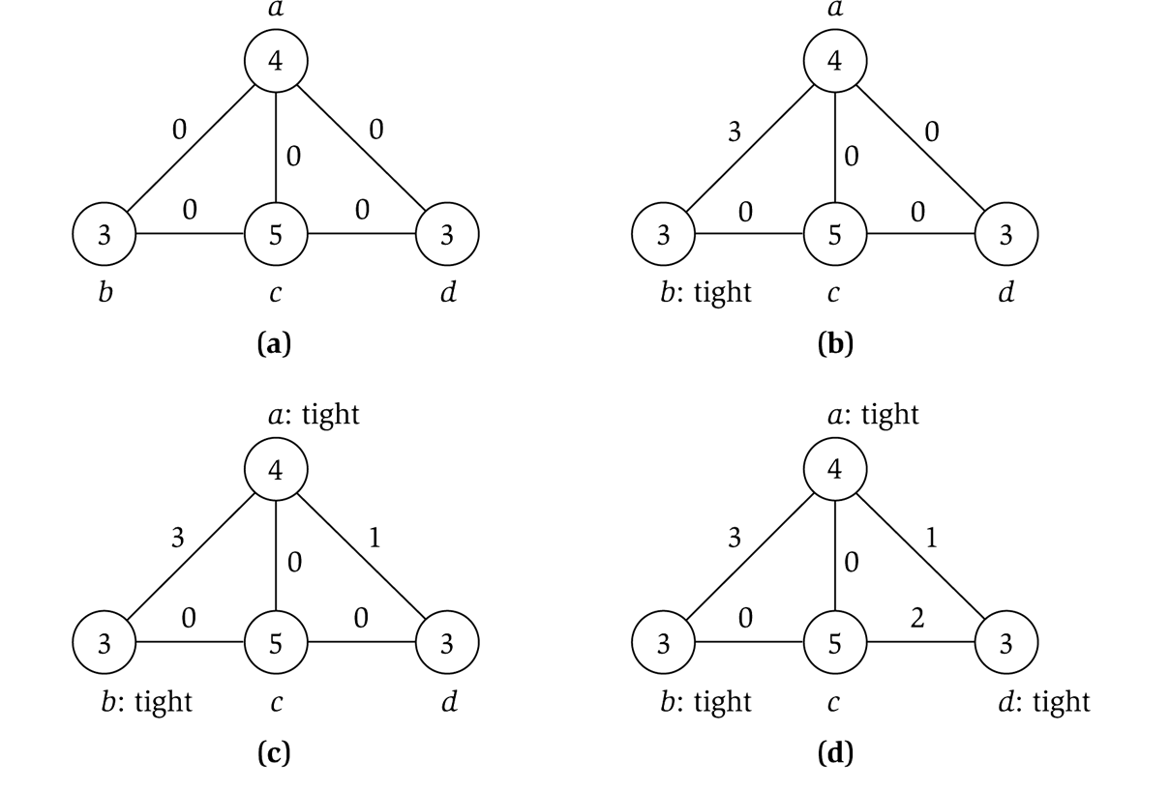
Pricing Method
price of edge a-b
vertex weight
Figure 11.8

Slide 27
Pricing Method: Analysis
Theorem. Pricing method is a 2-approximation.
Pf.
  Algorithm terminates since at least one new node becomes tight after each iteration of while loop.
  Let S = set of all tight nodes upon termination of algorithm. S is a vertex cover: if some edge i-j is uncovered, then neither i nor j is tight. But then while loop would not terminate.
  Let S* be optimal vertex cover. We show w(S) ≤ 2w(S*).
all nodes in S are tight
S ⊆ V,
prices ≥ 0
each edge counted twice
fairness lemma

Slide 28
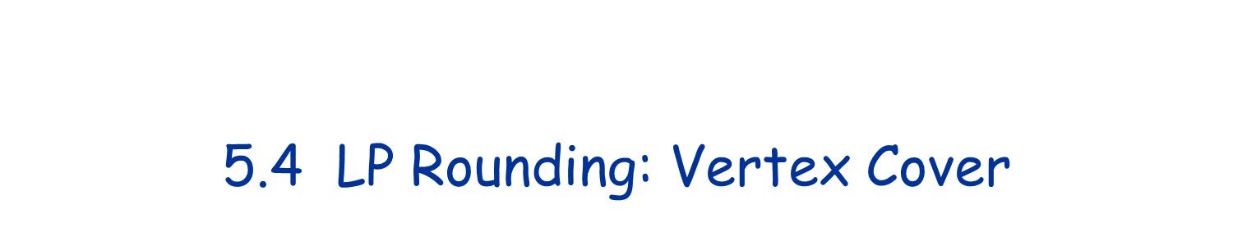

Slide 29
Weighted Vertex Cover
Weighted vertex cover. Given an undirected graph G = (V, E) with vertex weights w_{i} ≥ 0, find a minimum weight subset of nodes S such that every edge is incident to at least one vertex in S.
10
A
F
9
6
16
B
G
10
7
6
C
H
9
3
23
D
I
33
7
E
J
32
10
total weight = 55

Slide 30
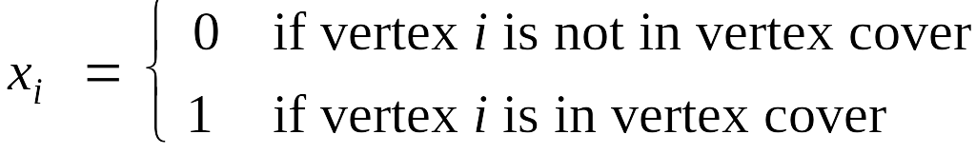
Weighted Vertex Cover: IP Formulation
Weighted vertex cover. Given an undirected graph G = (V, E) with vertex weights w_{i} ≥ 0, find a minimum weight subset of nodes S such that every edge is incident to at least one vertex in S.
Integer programming formulation.
  Model inclusion of each vertex i using a 0/1 variable x_{i}.
  Vertex covers in 1-1 correspondence with 0/1 assignments:
  S = {i ∈ V : x_{i} = 1}
  Objective function: minimize Σ_{i} w_{i} x_{i}.
  Must take either i or j: x_{i} + x_{j} ≥ 1.

Slide 31
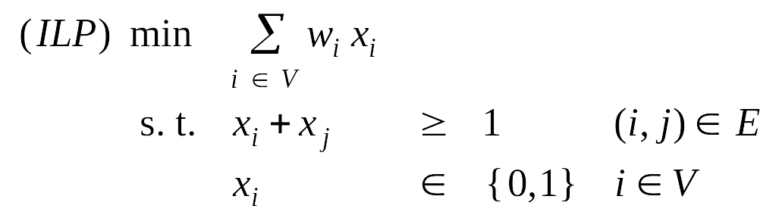
Weighted Vertex Cover: IP Formulation
Weighted vertex cover. Integer programming formulation.
Observation. If x* is optimal solution to (ILP), then S = {i ∈ V : x*_{i} = 1} is a min weight vertex cover.

Slide 32
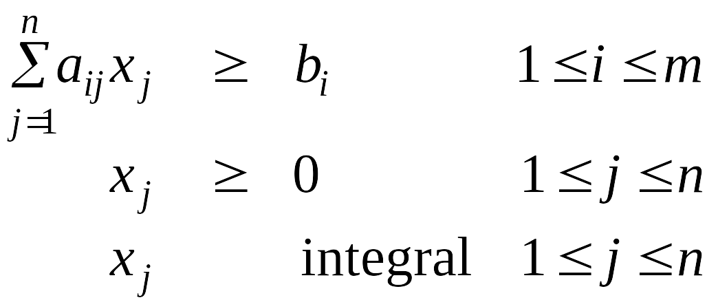
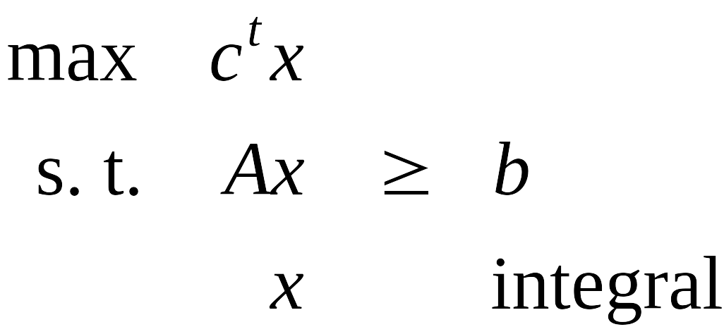
Integer Programming
INTEGER-PROGRAMMING. Given integers a_{ij} and b_{i}, find integers x_{j} that satisfy:
Observation. Vertex cover formulation proves that integer programming is an NP-hard search problem.
even if all coefficients are 0/1 and
at most two variables per inequality

Slide 33
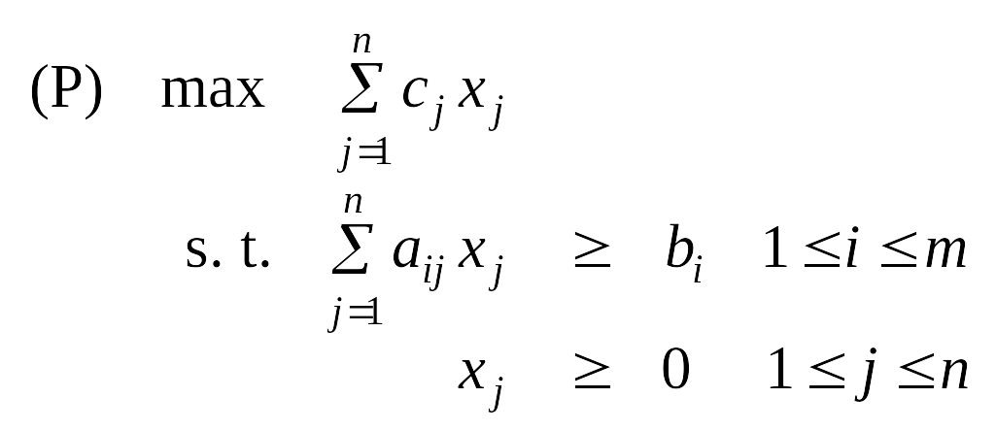
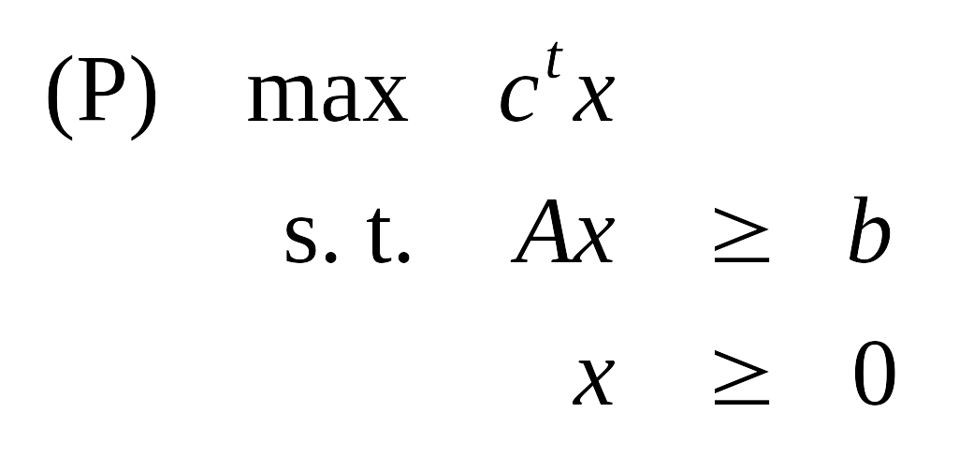
Linear Programming
Linear programming. Max/min linear objective function subject to linear inequalities.
  Input: integers c_{j}, b_{i}, a_{ij} .
  Output: real numbers x_{j}.
Linear. No x², xy, arccos(x), x(1-x), etc.
Simplex algorithm. [Dantzig 1947] Can solve LP in practice.
Ellipsoid algorithm. [Khachian 1979] Can solve LP in poly-time.

Slide 34
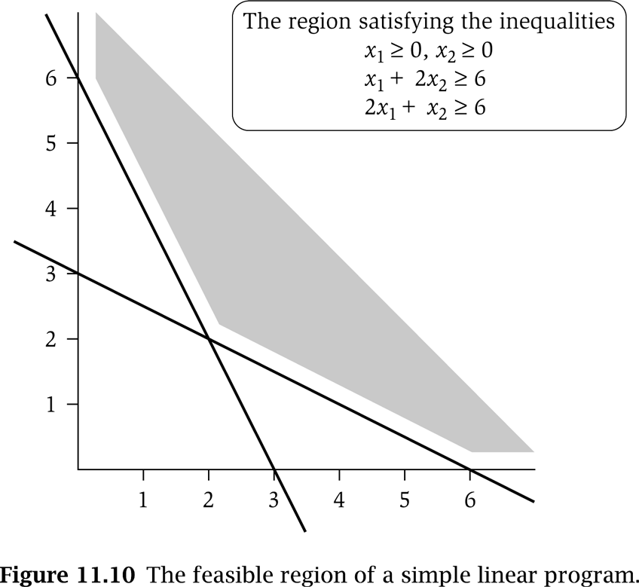
LP Feasible Region
LP geometry in 2D.
x₁ = 0
x₂ = 0
x₁ + 2x₂ = 6
2x₁ + x₂ = 6

Slide 35
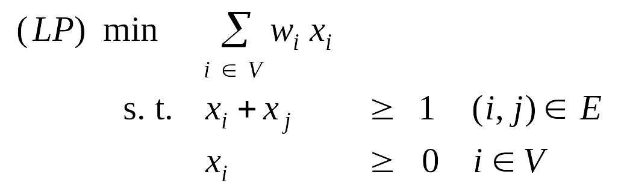
Weighted Vertex Cover: LP Relaxation
Weighted vertex cover. Linear programming formulation.
Observation. Optimal value of (LP) is ≤ optimal value of (ILP).
Pf. LP has fewer constraints.
Note. LP is not equivalent to vertex cover.
Q. How can solving LP help us find a small vertex cover?
A. Solve LP and round fractional values.
½
½
½

Slide 36
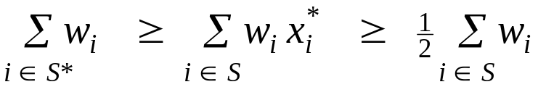
Weighted Vertex Cover
Theorem. If x* is optimal solution to (LP), then S = {i ∈ V : x*_{i} ≥ ½} is a vertex cover whose weight is at most twice the min possible weight.
Pf. [S is a vertex cover]
  Consider an edge (i, j) ∈ E.
  Since x*_{i} + x*_{j} ≥ 1, either x*_{i} ≥ ½ or x*_{j} ≥ ½ ⇒ (i, j) covered.
Pf. [S has desired cost]
  Let S* be optimal vertex cover. Then
LP is a relaxation
x*_{i} ≥ ½

Slide 37
Weighted Vertex Cover
Theorem. 2-approximation algorithm for weighted vertex cover.
Theorem. [Dinur-Safra 2001] If P ≠ NP, then no ρ-approximation
for ρ < 1.3607, even with unit weights.
Open research problem. Close the gap.
10 √5 - 21

Slide 38
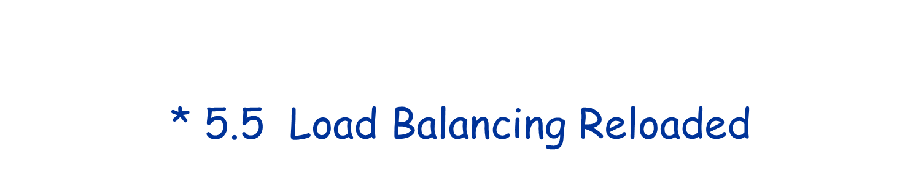

Slide 39
Generalized Load Balancing
Input. Set of m machines M; set of n jobs J.
  Job j must run contiguously on an authorized machine in M_{j} ⊆ M.
  Job j has processing time t_{j}.
  Each machine can process at most one job at a time.
Def. Let J(i) be the subset of jobs assigned to machine i. The
load of machine i is L_{i} = Σ_{j ∈ J(i)} t_{j}.
Def. The makespan is the maximum load on any machine = max_{i} L_{i}.
Generalized load balancing. Assign each job to an authorized machine to minimize makespan.

Slide 40
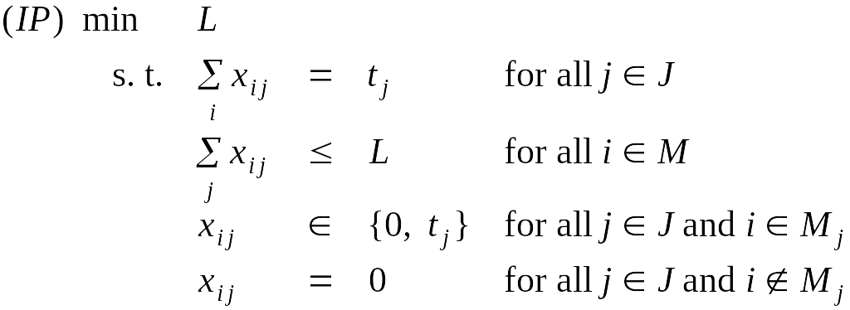
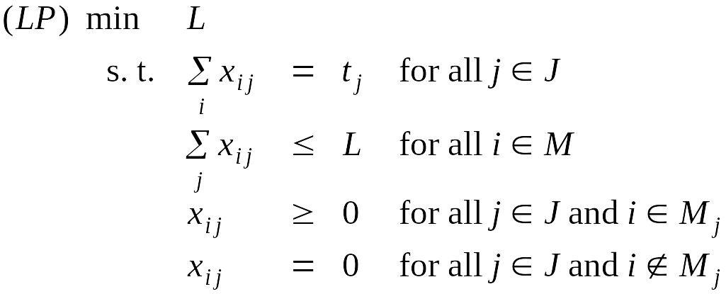
Generalized Load Balancing: Integer Linear Program and Relaxation
ILP formulation. x_{ij} = time machine i spends processing job j.
LP relaxation.

Slide 41
Generalized Load Balancing: Lower Bounds
Lemma 1. Let L be the optimal value to the LP. Then, the optimal makespan L* ≥ L.
Pf. LP has fewer constraints than IP formulation.
Lemma 2. The optimal makespan L* ≥ max_{j} t_{j}.
Pf. Some machine must process the most time-consuming job. ▪

Slide 42
Generalized Load Balancing: Structure of LP Solution
Lemma 3. Let x be solution to LP. Let G(x) be the graph with an edge from machine i to job j if x_{ij} > 0. Then G(x) is acyclic.
Pf. (deferred)
can transform x into another LP solution where
G(x) is acyclic if LP solver doesn't return such an x
x_{ij} > 0
G(x) acyclic
job
G(x) cyclic
machine

Slide 43
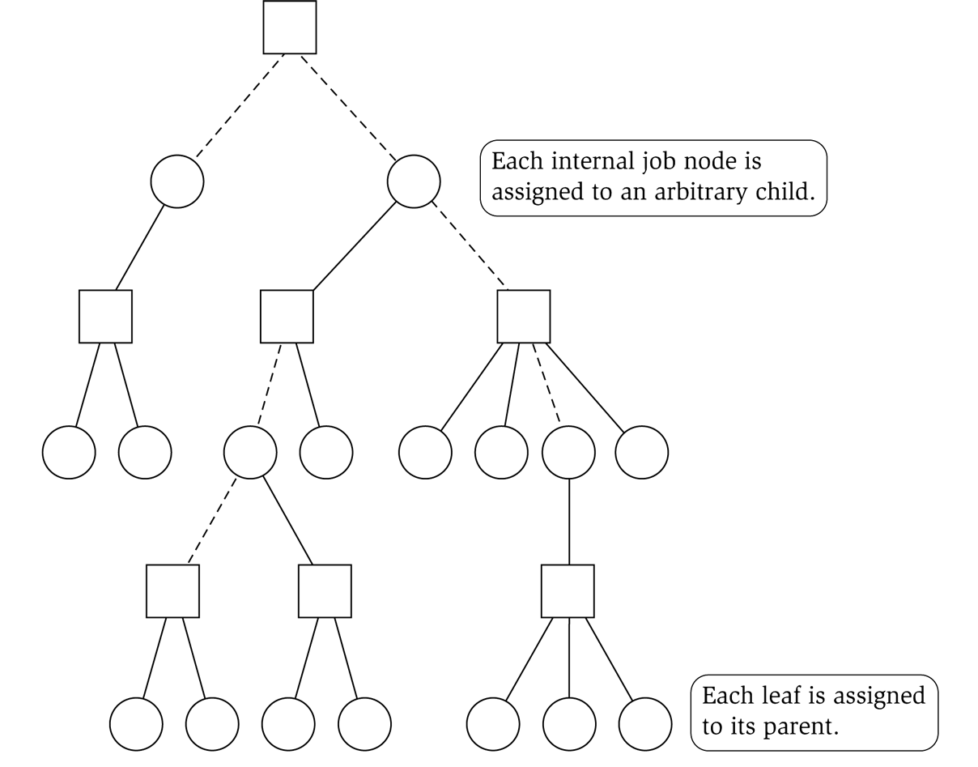
Generalized Load Balancing: Rounding
Rounded solution. Find LP solution x where G(x) is a forest. Root forest G(x) at some arbitrary machine node r.
  If job j is a leaf node, assign j to its parent machine i.
  If job j is not a leaf node, assign j to one of its children.
Lemma 4. Rounded solution only assigns jobs to authorized machines.
Pf. If job j is assigned to machine i, then x_{ij} > 0. LP solution can only assign positive value to authorized machines. ▪
job
machine

Slide 44
Generalized Load Balancing: Analysis
Lemma 5. If job j is a leaf node and machine i = parent(j), then x_{ij} = t_{j}.
Pf. Since i is a leaf, x_{ij} = 0 for all j ≠ parent(i). LP constraint guarantees Σ_{i} x_{ij} = t_{j}. ▪
Lemma 6. At most one non-leaf job is assigned to a machine.
Pf. The only possible non-leaf job assigned to machine i is parent(i). ▪
job
machine

Slide 45
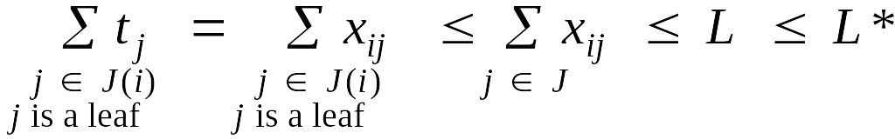
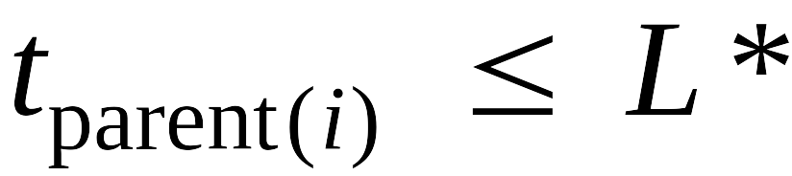
Generalized Load Balancing: Analysis
Theorem. Rounded solution is a 2-approximation.
Pf.
  Let J(i) be the jobs assigned to machine i.
  By Lemma 6, the load L_{i} on machine i has two components:
    leaf nodes
    parent(i)
  Thus, the overall load L_{i} ≤ 2L*. ▪
Lemma 5
LP
Lemma 1 (LP is a relaxation)
optimal value of LP
Lemma 2

Slide 46
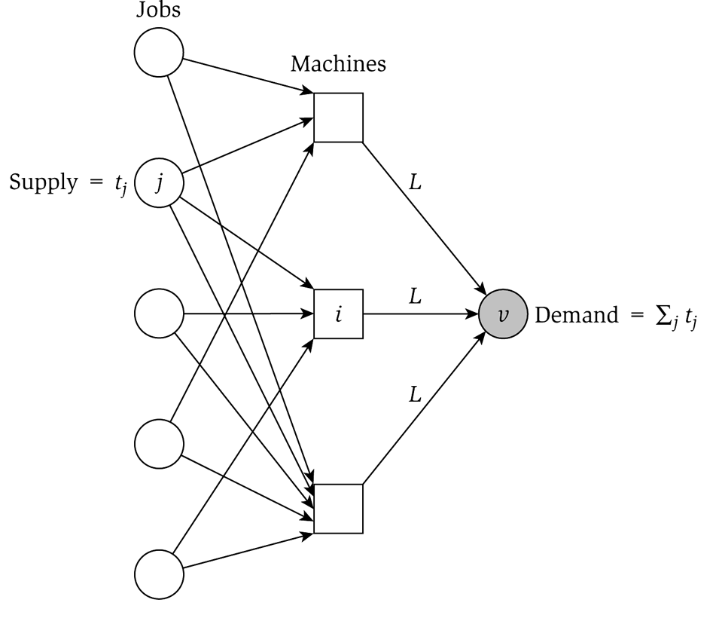
Generalized Load Balancing: Flow Formulation
Flow formulation of LP.
Observation. Solution to feasible flow problem with value L are in one-to-one correspondence with LP solutions of value L.
∞

Slide 47
Generalized Load Balancing: Structure of Solution
Lemma 3. Let (x, L) be solution to LP. Let G(x) be the graph with an edge from machine i to job j if x_{ij} > 0. We can find another solution (x', L) such that G(x') is acyclic.
Pf. Let C be a cycle in G(x).
  Augment flow along the cycle C.
  At least one edge from C is removed (and none are added).
  Repeat until G(x') is acyclic.
flow conservation maintained
3
3
3
3
6
6
2
3
4
4
2
1
1
5
5
4
3
4
4
G(x)
augment along C
G(x')

Slide 48
Conclusions
Running time. The bottleneck operation in our 2-approximation is
solving one LP with mn + 1 variables.
Remark. Can solve LP using flow techniques on a graph with m+n+1 nodes: given L, find feasible flow if it exists. Binary search to find L*.
Extensions: unrelated parallel machines. [Lenstra-Shmoys-Tardos 1990]
  Job j takes t_{ij} time if processed on machine i.
  2-approximation algorithm via LP rounding.
  No 3/2-approximation algorithm unless P = NP.

Slide 49


Slide 50
Polynomial Time Approximation Scheme
PTAS. (1 + ε)-approximation algorithm for any constant ε > 0.
  Load balancing. [Hochbaum-Shmoys 1987]
  Euclidean TSP. [Arora 1996]
Consequence. PTAS produces arbitrarily high quality solution, but trades off accuracy for time.
This section. PTAS for knapsack problem via rounding and scaling.

Slide 51
Knapsack Problem
Knapsack problem.
  Given n objects and a "knapsack."
  Item i has value v_{i} > 0 and weighs w_{i} > 0.
  Knapsack can carry weight up to W.
  Goal: fill knapsack so as to maximize total value.
Ex: { 3, 4 } has value 40.
we'll assume w_{i} ≤ W
Item
Value
Weight
1
1
1
2
6
2
W = 11
3
18
5
4
22
6
5
28
7

Slide 52
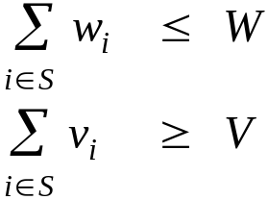
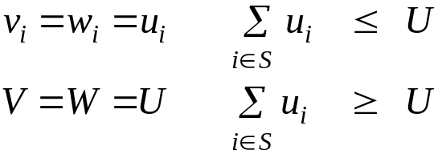
Knapsack is NP-Complete
KNAPSACK: Given a finite set X, nonnegative weights w_{i}, nonnegative values v_{i}, a weight limit W, and a target value V, is there a subset S ⊆ X such that:
SUBSET-SUM: Given a finite set X, nonnegative values u_{i}, and an integer U, is there a subset S ⊆ X whose elements sum to exactly U?
Claim. SUBSET-SUM ≤ _{P} KNAPSACK.
Pf. Given instance (u₁, …, u_{n}, U) of SUBSET-SUM, create KNAPSACK instance:

Slide 53
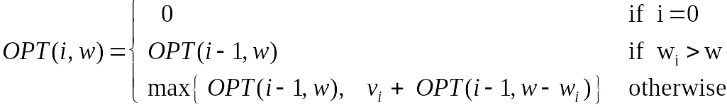
Knapsack Problem: Dynamic Programming 1
Def. OPT(i, w) = max value subset of items 1,..., i with weight limit w.
  Case 1: OPT does not select item i.
    OPT selects best of 1, …, i–1 using up to weight limit w
  Case 2: OPT selects item i.
    new weight limit = w – w_{i}
    OPT selects best of 1, …, i–1 using up to weight limit w – w_{i}
Running time. O(n W).
  W = weight limit.
  Not polynomial in input size!

Slide 54
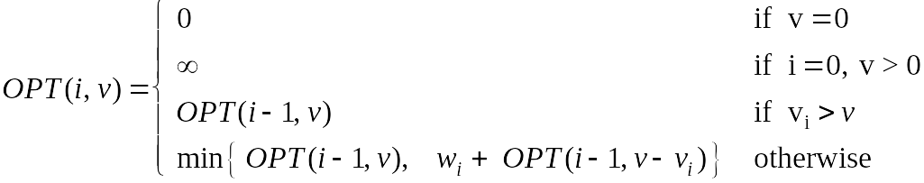
Knapsack Problem: Dynamic Programming II
Def. OPT(i, v) = min weight subset of items 1, …, i that yields value exactly v.
  Case 1: OPT does not select item i.
    OPT selects best of 1, …, i-1 that achieves exactly value v
  Case 2: OPT selects item i.
    consumes weight w_{i}, new value needed = v – v_{i}
    OPT selects best of 1, …, i-1 that achieves exactly value v
Running time. O(n V*) = O(n² v_{max}).
  V* = optimal value = maximum v such that OPT(n, v) ≤ W.
  Not polynomial in input size!
V* ≤ n v_{max}

Slide 55
Knapsack: FPTAS
Intuition for approximation algorithm.
  Round all values up to lie in smaller range.
  Run dynamic programming algorithm on rounded instance.
  Return optimal items in rounded instance.
Item
Value
Weight
Item
Value
Weight
1
934,221
1
1
1
1
2
5,956,342
2
2
6
2
3
17,810,013
5
3
18
5
4
21,217,800
6
4
22
6
5
27,343,199
7
5
28
7
W = 11
W = 11
original instance
rounded instance

Slide 56
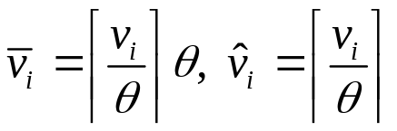


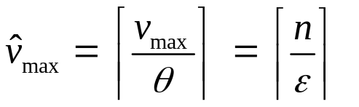
Knapsack: FPTAS
Knapsack FPTAS. Round up all values:
    v_{max} = largest value in original instance
    ε = precision parameter
    θ = scaling factor = ε v_{max} / n
For the instance
Running time. O(n³ / ε).
  Dynamic program II running time is , where

Slide 57
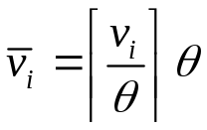

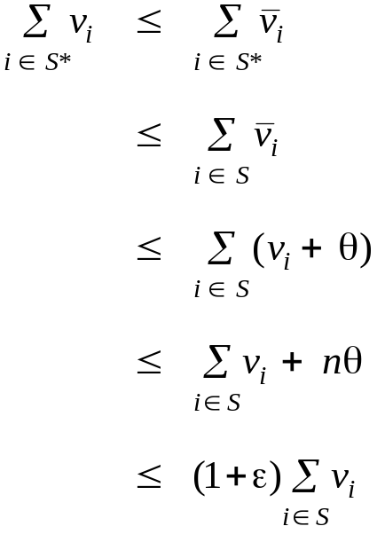
Knapsack: FPTAS
Knapsack FPTAS. Round up all values:
Theorem. If S is a solution found by our algorithm and S* is any other feasible solution then
Pf. Let S* be any feasible solution satisfying weight constraint.
always round up
solve rounded instance optimally
never round up by more than θ
|S| ≤ n
DP alg can take v_{max}
n θ = ε v_{max}, v_{max} ≤ Σ_{i∈S} v_{i}

Slide 58


Slide 59
Load Balancing on 2 Machines
Claim. Load balancing is hard even if only 2 machines.
Pf. NUMBER-PARTITIONING ≤ _{P} LOAD-BALANCE.
a
b
c
d
e
f
g
length of job f
Machine 1
machine 1
a
d
f
yes
machine 2
Machine 2
b
c
e
g
0
Time
L

Slide 60
Center Selection: Hardness of Approximation
Theorem. Unless P = NP, there is no ρ-approximation algorithm for
metric k-center problem for any ρ < 2.
Pf. We show how we could use a (2 - ε) approximation algorithm for k-center to solve DOMINATING-SET in poly-time.
  Let G = (V, E), k be an instance of DOMINATING-SET.
  Construct instance G' of k-center with sites V and distances
    d(u, v) = 1 if (u, v) ∈ E
    d(u, v) = 2 if (u, v) ∉ E
  Note that G' satisfies the triangle inequality.
  Claim: G has dominating set of size k iff there exists k centers C* with r(C*) = 1.
  Thus, if G has a dominating set of size k, a (2 - ε)-approximation algorithm on G' must find a solution C* with r(C*) = 1 since it cannot use any edge of distance 2.

Slide 61
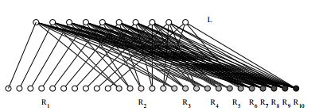
An example for Vertex Cover
A greedy algorithm: Iteratively select a vertex of maximum degree into the solution set and delete it from the graph.
Claim. The above greedy algorithm is not a 2-approximation algorithm. It can achieve approximation ratio of 1+log n.
See the example below

