Slide 1
Homework I
1. How many integers of different digits can be constructed by 1、2、3、4、5，which can not be divisible by 5 and larger than 20,000？
2. Calculate the number of the integers between 1000 and 9999, whose digits are different odds.

Slide 2
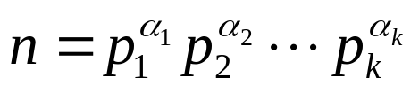


Homework I （continued）
3. Suppose , is different prime number， , Calculate the number of positive which is divisible by n.
4. There are 30 points in 3D space, in which there exist no four points in a plane and no three points in a line. How many different triangles can be constructed ? And how many tetrahedrons can be constructed ?

