Slide 1
Git Basic Training
XN/NBI Wenjing Fan

Slide 2

Git
introduction

Slide 3
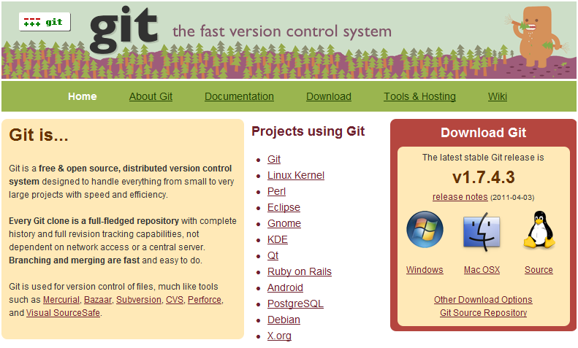
What is Git

Slide 4
Understand of Git
Fully Distributed
  (almost) everything is local
  everything is fast
  every clone is a backup
  work offline
  No Network Needed
    Performing a diff
    Viewing file history
    Committing changes
    Merging branches
    Obtaining any other revision of a file
    Switching branches
Cheap local branching and easy merging

Slide 5
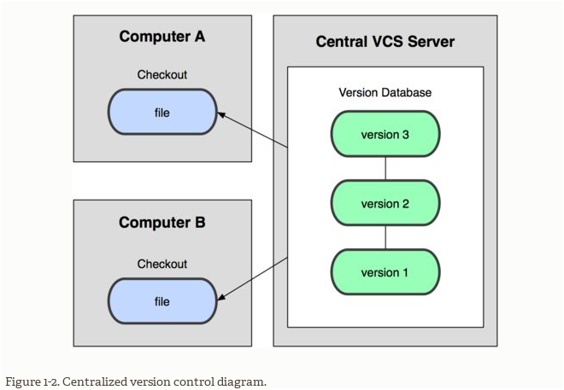
Centralized Version Control Systems

Slide 6
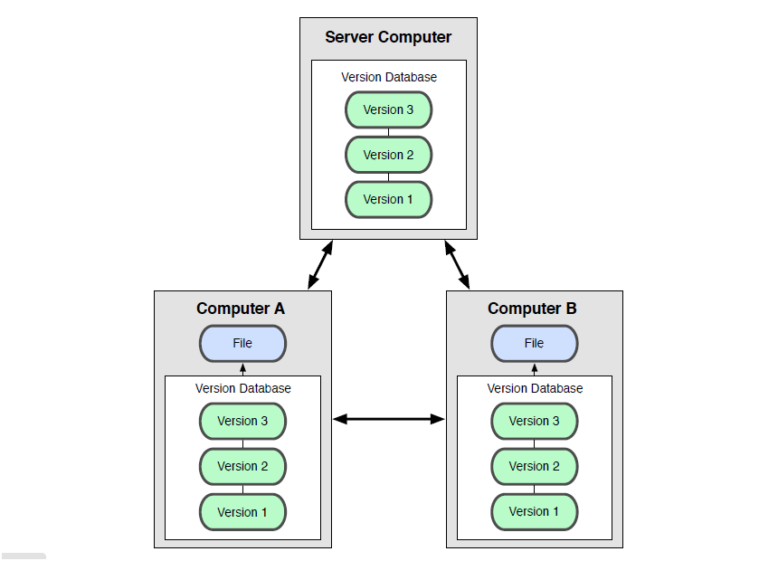
Distributed Version Control Systems

Slide 7
Clearcase vs git
ClearCase | Git
Branch (stream) | Branch
Label (baseline) | Tag
UCM Activity | Commit
mkview | git-clone, git-checkout
checkout | No equivalent
checkin | git-commit, git-push
Merge | git-merge, git-mergetool
Diff | git-diff, git-difftool
Update view | git-pull, git-fetch, git-merge
Mklabel (mkbl) | git-tag

Slide 8
IT environment differences
NAS
(The choice in
Ericsson IT HUB)
Any storage inside
Ericsson IT HUB.
ClearCase
Git
VOB server(s)
View server
Gerrit
(slave)
Gerrit
(master)
clone
fetch
pull
License server
push
Registry server
Terminal
server
Daily work are done without interaction with Gerrit servers
Terminal
server

Slide 9
Git
Install and Configure

Slide 10
Install Git on Windows
Git installation
  Install MSysGit
    http://code.google.com/p/msysgit/downloads/list
    \\eapac.ericsson.se\ecnbjdfs01\Etcgroup\X\XN\NewXN\XND\XND-M\NBI_Training_Package\SCM\GIT
      E.g. Git-1.7.11-preview20120710.exe
    Run the installer.
      Tick the check boxes for "Windows Explorer integration".
      Choose "Run Git from the Windows Command Prompt"
      If asked which SSH executable to use, choose OpenSSH.
      Choose "Checkout at is, commit Unix-style line endings".
  Install Merge tool kdiff3
    Download latest version 0.9.97 from http://sourceforge.net/projects/kdiff3/files/

Slide 11
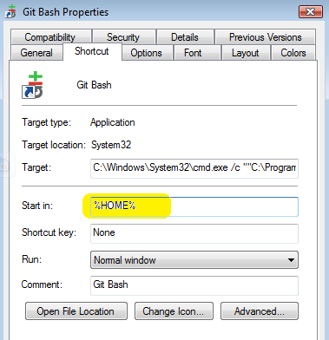
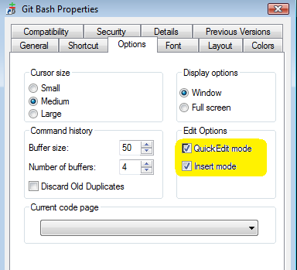
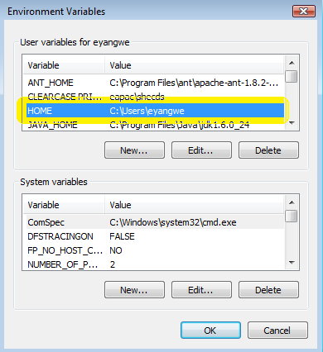
Git Bash Configuration
Edit Property by right clicking the shortcut of “Git Bash” on the desktop
    1 Start in: change to %HOME%
    2 Select Edit Options
Set the “HOME” variable in the Environment Variable of “My Computer”
  3 HOME = C:\Users\<your id>
2
1
3

Slide 12
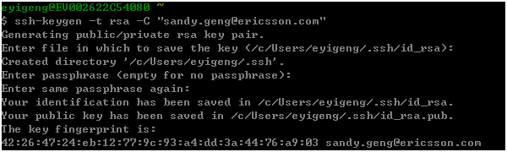
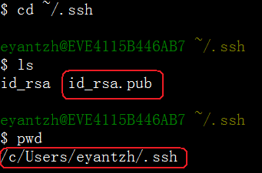
Sign in Gerrit
Generate SSH Key in Git Bash
  Run command : ssh-keygen -t rsa -C xxx.xxx@ericsson.com
    E.g. ssh-keygen -t rsa -C wenjing.fan@ericsson.com
  Input enter for all questions
  Don’t need enter any passphrase
  One pair of keys generated under ~/.ssh
    One Public Key : id_rsa.pub
    One Private Key : id_rsa
  Guide of Generate SSH key :
    http://help.github.com/win-set-up-git/

Slide 13
Configure Git on Windows
Configure :
  Run the following commands in the Git Bash
    Basic Configuration
      git config --global user.name “your eid”
      git config --global user.email xxx.xxx@ericsson.com
      git config --global core.eol lf
      git config --global core.autocrlf false
      git config --global color.ui true
    Diff tool Configuration
      git config --global diff.tool kdiff3
      git config --global difftool.kdiff3.path "C:/Program Files (x86)/KDiff3/kdiff3.exe"
      git config --global difftool.prompt false
    Merge tool Configuration
      git config --global merge.tool kdiff3
      git config --global mergetool.kdiff3.path "c:/Program Files (x86)/KDiff3/kdiff3.exe"
      git config --global mergetool.keepBackup false
  All configuration is stored in ~/.gitconfig

Slide 14
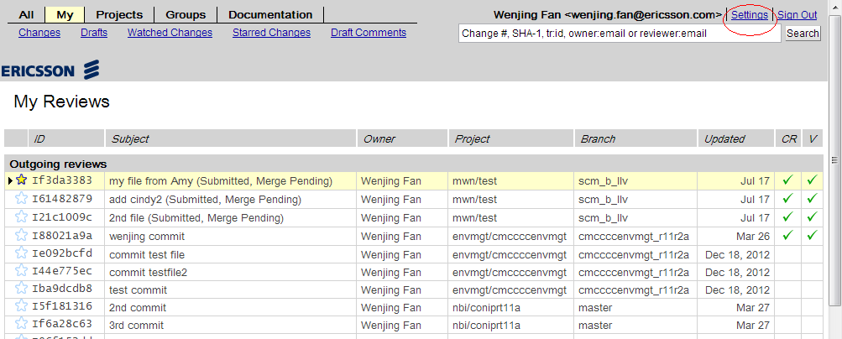
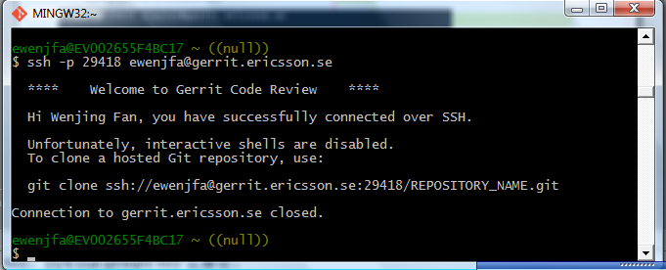
Add SSH Public Key to Gerrit for windows
Sign in Gerrit by using your ID and LAN password
  HUB Gerrit Web : https://gerrit.ericsson.se
Add SSH public key to Gerrit
Verify SSH key:
  $ ssh -p 29418 <user-id>@gerrit.ericsson.se

Slide 15
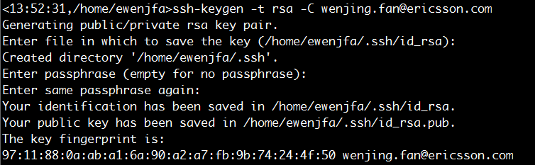

Sign in Gerrit for solaris
Login solaris server
  Eg 10.185.3.71 / 10.185.3.72
  Add /opt/git-1.7.6 to your environment variable
Generate SSH Key
  Run command : ssh-keygen -t rsa -C xxx.xxx@ericsson.com
    E.g. ssh-keygen -t rsa -C wenjing.fan@ericsson.com
  Input enter for all questions
  Don’t need enter any passphrase
  One pair of keys generated under ~/.ssh
    One Public Key : id_rsa.pub
    One Private Key : id_rsa
  Guide of Generate SSH key :
    http://help.github.com/win-set-up-git/

Slide 16
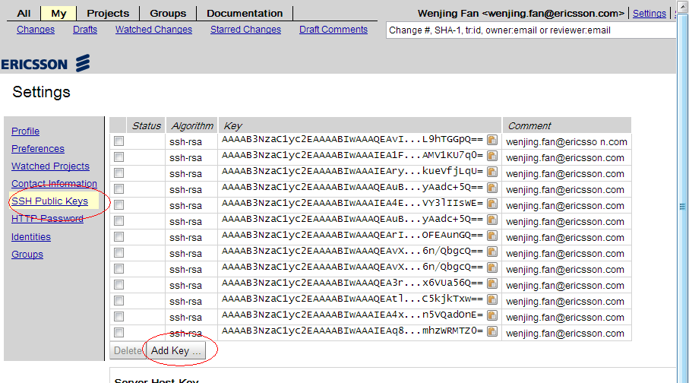
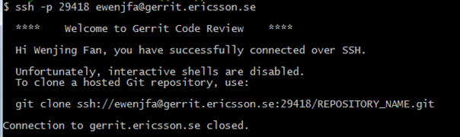
Add SSH Public Key to Gerrit for solaris
Sign in Gerrit by using your ID and LAN password
  HUB Gerrit Web : https://gerrit.ericsson.se
Add SSH public key to Gerrit
Verify SSH key:
  $ ssh -p 29418 <user-id>@gerrit.ericsson.se

Slide 17
Git
Quick start

Slide 18
Three States in Git
Three Sections of a Git project:
  Working Directory : is a single checkout of one version of the project.
  Index/Staging Area : a simple file, generally contained in the Git repository which stores the information about what will go into the next commit.
  Repository/Git Directory : store the metadata and object database for the Git project.
Three States in Git :
  Modified : change the file but not commit to the Git repository
  Staged : mark the modified file in its current version to go into the next commit snapshot
  Committed : stored in the local Git repository
index
Working directory
.git

Slide 19
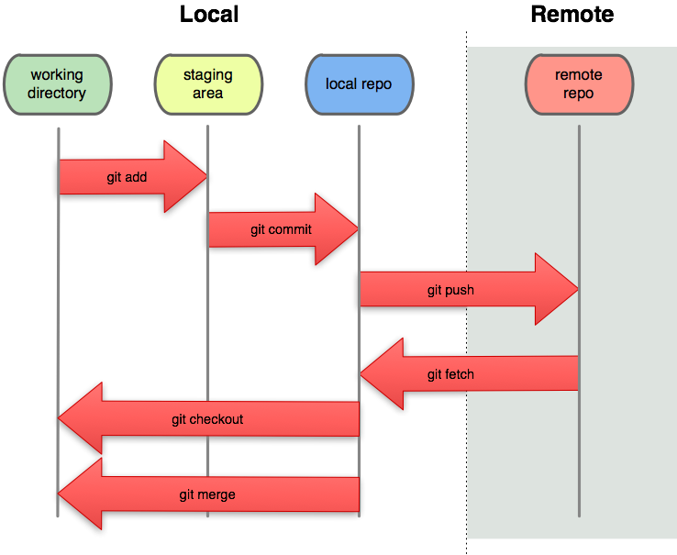

Slide 20
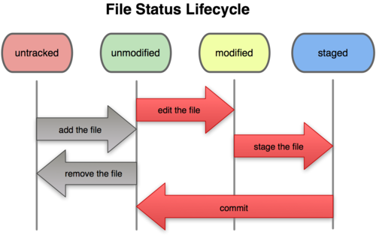
File Status Lifecycle

Slide 21
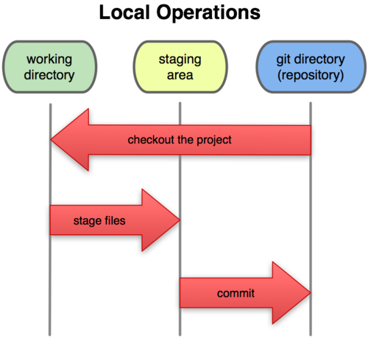
Sections of a git project
http://progit.org/book/ch1-3.html

Slide 22
A basic workflow
A working copy
of your project
working directory
git add
index
77d3001a1de6bf8f5e431972fe4d25b01e595c0b
“staging area”
git commit
object database
repository

Slide 23
What is a branch
A branch is just a simple reference
The name is local to your repository
Updated on commit
Branch names are not tracked
  There is no way to tell whether the user who created B did so when on branch int or fc63 or even r5-bugfix or any branch at all
Examples:
  D and E are in int
  F and G are in fc63 and merge-pvr
  C is in r5-bugfix and int
  B is in int, fc63, merge-pvrs
  A is in all branches
r5-bugfix
C
int
A
B
D
E
F
G
fc63
merge-pvr

Slide 24
Initial repository on server
User A
A
B
Server
int
HEAD
User B

Slide 25
User A clones from server
int
HEAD
User A
A
B
origin/int
A
B
Server
int
HEAD
User B

Slide 26
User A commits some changes
int
HEAD
User A
A
B
C
origin/int
A
B
Server
int
HEAD
User B

Slide 27
User B clones from server
int
HEAD
Jae Hee
A
B
C
origin/int
A
B
Server
int
HEAD
origin/int
Basel
A
B
int
HEAD

Slide 28
User B makes some changes
int
HEAD
User A
A
B
C
origin/int
A
B
Server
int
HEAD
origin/int
User B
A
B
D
E
int
HEAD

Slide 29
User B pushes his changes to server
int
HEAD
User A
A
B
C
origin/int
A
B
D
E
Server
int
HEAD
origin/int
User B
A
B
D
E
int
HEAD

Slide 30
A tries to push her changes to server, but they are rejected
int
HEAD
User A
A
B
C
origin/int
A
B
D
E
Server
int
HEAD
origin/int
User B
A
B
D
E
int
HEAD

Slide 31
A fetches from server
int
HEAD
User A
A
B
C
D
E
origin/int
A
B
D
E
Server
int
HEAD
origin/int
User B
A
B
D
E
int
HEAD

Slide 32
A merges her changes with B’s
int
HEAD
User A
A
B
C
F
D
E
origin/int
A
B
D
E
Server
int
HEAD
origin/int
User B
A
B
D
E
int
HEAD

Slide 33
A pushes her changes to server
int
HEAD
User A
A
B
C
F
D
E
origin/int
A
B
C
F
Server
D
E
int
HEAD
origin/int
User B
A
B
D
E
int
HEAD

Slide 34
Git
practice

Slide 35
Git Workflow – Central Repository without Code Review
If work on master branch, then <branch-name> is master;
2. Pull from Central Repository
> git pull origin <branch-name>
3. Create New Branch <task-branch> for Coding
> cd <git-repo-root>
> git checkout -b <task-branch>
> …. ( update coding on branch )
> git commit ( commit to local branch)
<task-branch> is your local created branch
1. Clone From Central Repository ( only clone at the first time)
> git clone ssh://userid@gerrit.ericsson.se:29418/nbi/onv.git
Local Repo
Central Repository
4. Merge back to <branch-name>
> git checkout <branch-name>
> git pull origin <branch-name>
> git merge <task-branch>
> git mergetool ( solve conflict if there is )
> git commit ( commit after solve conflict )
Push to server
Next loop
5. Push to Central repository
> git push origin <branch-name> ( push to central repo )
6. Check whether commit is on Gerrit Server:
Access http://gerrit.ericsson.se
7. Delete <branch>
> git branch -d <task-branch>

Slide 36
test repo of nbi
clone test repo
  git clone ssh://<your id>@gerrit.ericsson.se:29418/nbi/coniprt11a.git
modify code file
Add this change to index area
  git add .
commit your change
  git commit
    need comment
push to Gerrit Central
  git push
pull latest update

Slide 37
test repo of nbi
create local branch
  git checkout -b <branch name>
switch to other branch
  git checkout <branch name>
delete branch
  git branch -d <branch name>
Save current work on local repo as needed.
  If you are at the middle of some changes and need to switch over to another issue, but do not want to lost your work.
  1. Save and clean your workspace.
    git stash
  2. git checkout -b <temp_branch>
  3. Modify code -> add -> commit -> push
  4. Remove <temp_branch>
    git branch -d <temp_branch>
  5. Checkout and return master branch
    git checkout master
    git stash apply

Slide 38
Git Workflow – Merge/Rebase
Step for Merge
Detail of Merge:
Merge from <branch-name> to master
Detail of rebase:
Rebase master to <branch-name>
Merge branches without any conflict
> git merge <branch-name>
1. Review and commit all on branch <branch-name>
> git status
> git commit -am "commit to branch"
1. Review and commit all on <branch-name>
> git status
> git commit -am “comment”
Merge branches with conflict
> git merge <branch-name>
> git mergetool
2. Switch to master branch
> git checkout master
> git pull origin master
2. Pull latest from server
> git pull
3. Rebase from master to <branch-name>
> git rebase
3. Merge with master branch (on master branch)
> git merge <branch-name>
Merge Commit
> git cherry-pick -n <commit>
Undo merge
> git reset –hard HEAD
Fix conflict
> git mergetool
> git rebase --continue
Conflict
Merge TR: TR with commit1, commit2, …
> git cherry-pick -n <commit1>
> git cherry-pick -n <commit2>
> …
> git commit -m "merge TR with comment"
No Conflict
Fix conflict
> git mergetool
> git commit -a
Give up rebase
> git rebase --abort
Conflict
Rebase Done
No Conflict
Merge Done

Slide 39
Basic Command List
Clone
Branch
Git GUI
git clone ssh://<username>@gerrit.ericsson.se:29418/nbi/<repository-name>.git
eg: ssh://ewenjfa@gerrit.ericsson.se:29418/nbi/sca.git
Create Branch
git checkout -b <branch>
git branch <branch>
Delete Branch
git branch -d <branch>
Switch Branch
git checkout <branch>
git checkout <commit>
Show file status:
gitk --all ( all branches)
gitk <filename>
Sync Central Repo
git push origin HEAD:refs/for/master (Gerrit Code review)
git push origin <branch> (Ignore Gerrit Code review)
git pull origin <branch>
Merge
Merge from branch
git merge <branch-name>
git merge --squash <branch-name>
git merge <branch-name> --no-commit
Merge commit
git cherry-pick -n <commit-id>
git cherry-pick -n <commit-id1> [<commit-id2> …]
Solve conflict
git mergetool
git add <file1> [<file2> …]
git commit
Rollback Merge
git reset –hard HEAD
git reset –hard ORIG_HEAD
git ls-files --unmerged
Add/Remove Files
Revert Changes
git add <file1> [ <file2> …]
git add -A <directory>
git rm <file>
git commit -m “comment” <file1> [<file2> …]
git commit -a -m “comment” (commit all tracked files)
Restore <file> to <commit>
git checkout <commit> <file>
Revert the <commit> ( when commit is pushed to server )
git revert <commit>
Rollback version to <commit> ( when commit is not pushed to server )
git reset --soft <commit>
git reset -- <file>
git reset --hard <commit> ( !!! it will remove your local change without restore !!! )
Notice: if you have to add empty folder, you can create one .gitignore file under that folder.
View File Status
Show file status:
git status
git status <directory>
git status --untracked-files=no <directory>
git ls-files <directory>
git ls-files --deleted <directory>
git ls-files --unmerged
Show commit:
git show <commit>
git show --name-only <commit>
git show <commit>:<file>
Show version on <file>:
git whatchanged <file>
History
git log <tag>.. ( commits since <tag> )
git log <branch1>..<branch2> ( commit reachable from branch1 but not branch2)
git log <file> ( commit that modify <file> )
git log <folder>/ ( commit that modify files under folder )
Compare Files
git difftool/diff <commit> <commit2> <file/folder>
git difftool/diff <branch>
git difftool/diff <branch> <file/directory>
git difftool/diff <commit> HEAD <file/directory>
git difftool/diff <commit1> <commit2>
git difftool/diff <commit1>:path/file <commit2>:otherpath/otherfile
Git Help
git help
git help <command>
git <command> --help

Slide 40


