Slide 1
Comment ça va?
Transfomer
How are you?
Input
Output

Slide 2
Transfomer
Comment ça va?
Encoder
Decoder
How are you?
Input
Output

Slide 3
Transfomer
Encoder N
Decoder N
Comment ça va?
….
….
How are you?
Encoder 2
Encoder 2
Input
Output
Encoder 1
Encoder 1

Slide 4
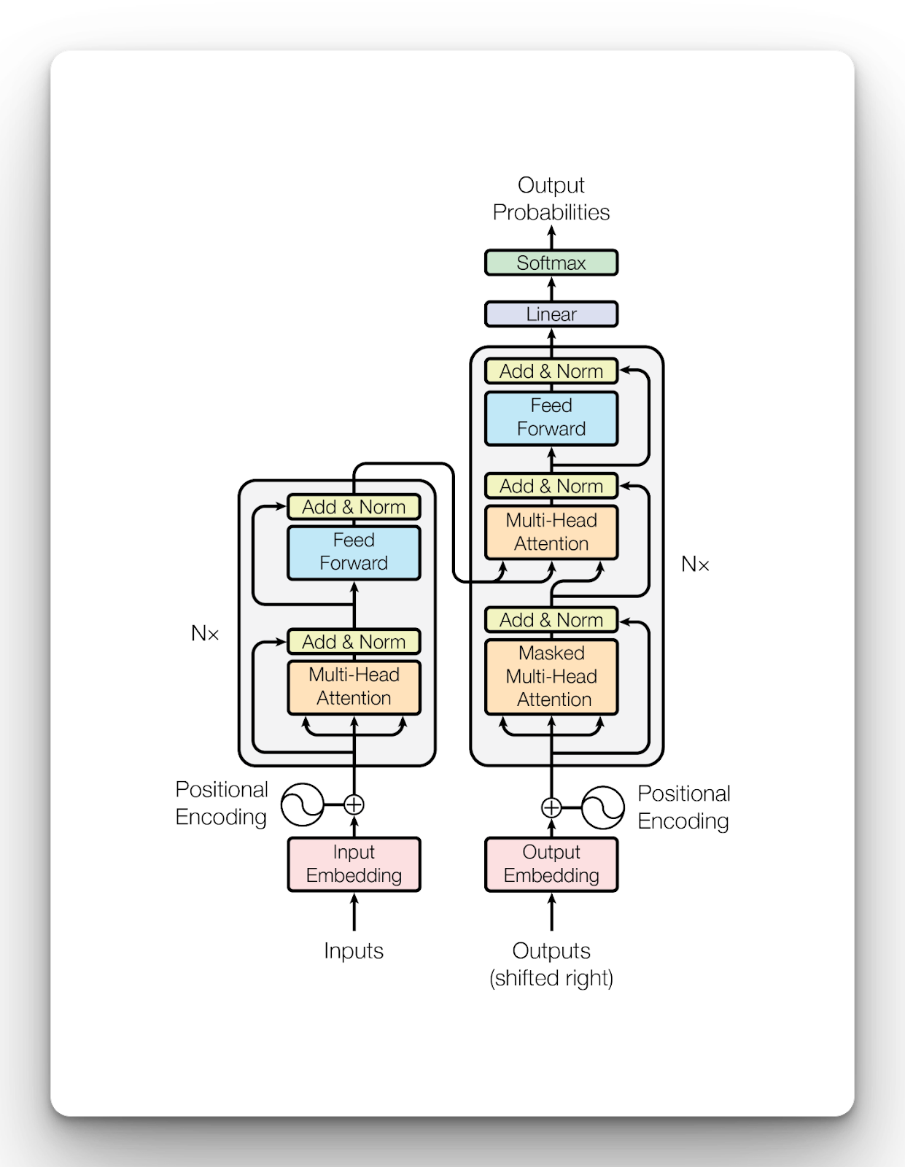
Decoder
Encoder

Slide 5
Labelling Method
Probability Model Method
Rule-Based
Manual-Based
BERT Fine-Tune
Final Model
Predict Unlabeled Articles
Fit Logistic Decay Model

Slide 6
Labelling Method
Rule-Based
Manual-Based
Fine-Tune BERT training
Final Model
Classify Unlabeled Articles

