Slide 1
Piping Task

Slide 2
Agenda
Piping Hierarchy
Route Pipes
Inserting Components
Routing a Sloped Pipe
Routing Pipes from the P&ID
Placing Instruments
Placing Piping Specialty Items
Placing Taps
Inserting Splits
© 2009. Intergraph Corporation. All Rights Reserved.

Slide 3
Agenda Conti’
Manipulating Views
Creating Spools
Sequencing Objects
Creating Isometric Drawings
© 20049. Intergraph Corporation. All Rights Reserved.

Slide 4
Piping Hierarchy
  - Piping System System and Spec Task
  - Pipeline System
  - Pipe Run
  - Features
    - Parts/Components
    - Ports
    - Connections
© 2009. Intergraph Corporation. All Rights Reserved.

Slide 5
Piping Hierarchy: Pipe System
A piping system is a way of organizing pipelines within the system hierarchy. You can base the piping system on the area where the pipelines are located or the fluid that the pipelines carry.
© 2009. Intergraph Corporation. All Rights Reserved.

Slide 6

Piping Hierarchy: Pipeline
A pipeline system is a way of organizing pipe runs within the system hierarchy and controlling the specifications that can be used within that system. If a pipeline system exists in a model, you can route the pipe runs and arrange them as children in the system hierarchy.
© 2009. Intergraph Corporation. All Rights Reserved.

Slide 7

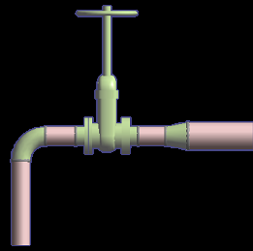
Piping Hierarchy: Pipe Run
A pipe run is a connected series of the pipe features that normally have the same nominal piping diameter (NPD) and flow direction. All the pipe runs in a model are governed by the same piping specifications. All the pipe features belong to a pipe run. One or more pipe runs together form a pipeline.
Pipe Run 2
Pipe Run 1
6” NPD
4” NPD
© 2009. Intergraph Corporation. All Rights Reserved.
.

Slide 8
PIPING HIERARCHY: PIPE FEATURES
A pipe feature is a logical collection of parts driven by the pipe specification. While routing a pipe run, you can place features on the pipe; these features define high-level design information. The software automatically selects the specific parts based on the pipe specification of the pipe run. Features are not displayed in the workspace explorer because of their ability to own several parts.
Run Change Feature
Turn Feature
Along Leg Feature
Straight Feature
End Feature
© 2009. Intergraph Corporation. All Rights Reserved.

Slide 9
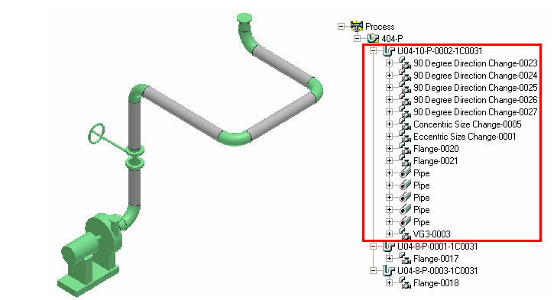
Piping Hierarchy: Pipe Parts
A piping part is a physical component that comprises a feature and is generally selected by the software. Figure 3 shows some examples of pipe parts that represent a section of a piping system. The highlighted portion in the figure shows a section of the workspace explorer containing the hierarchy of the pipe parts.
© 2009. Intergraph Corporation. All Rights Reserved.

Slide 10
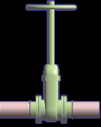
Piping Hierarchy: Pipe Port
  Is the actual connection point for the part.
Port 1
Port 2
© 2009. Intergraph Corporation. All Rights Reserved.

Slide 11
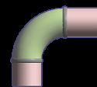
Piping Hierarchy: Pipe Connections
  Provide the connectivity model between ports of different components, nozzles and pipes (welded, bolted, etc...)
Straight Feature
Leg 1
Turn Feature
Generated parts
Pipe
Elbow
Port1
Port1
Port2
Leg 2
C
Port2
Weld
C
Port1
Straight Feature
Weld
Port2
Pipe
© 2009. Intergraph Corporation. All Rights Reserved.

Slide 12
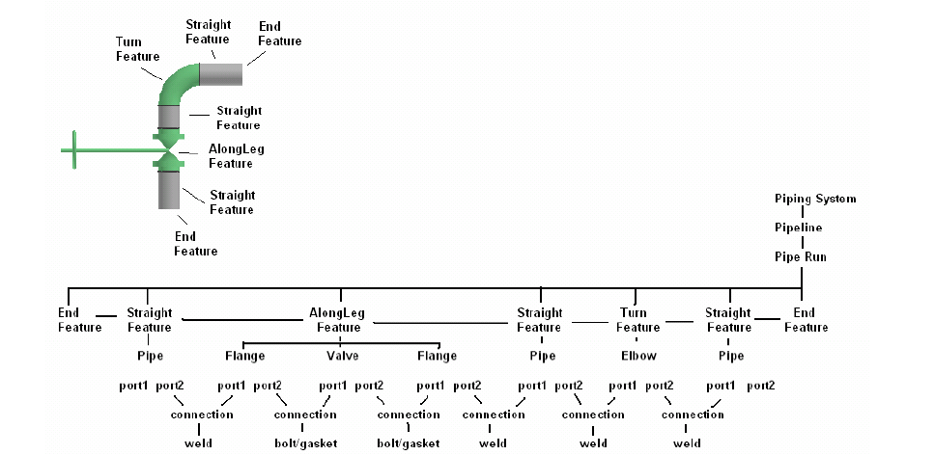
Piping Hierarchy: Overview
© 2009. Intergraph Corporation. All Rights Reserved.

Slide 13
Route Pipe: Pipe Command
        Start routing a Pipe Run from
        - a nozzle/component port
        - a point in space
        - an existing pipe run
© 2009. Intergraph Corporation. All Rights Reserved.

Slide 14
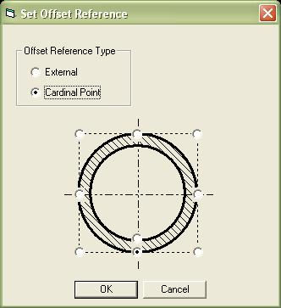

Route Pipe: Cardinal Points
Route a pipe by the top, sides, bottom, or invert elevation of the pipe instead of the pipe centerline.
Routing by invert elevation is supported for use in modeling underground piping.
© 2009. Intergraph Corporation. All Rights Reserved.

Slide 15
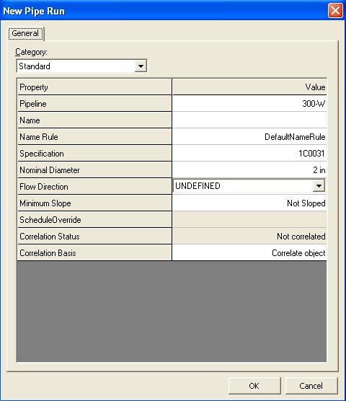
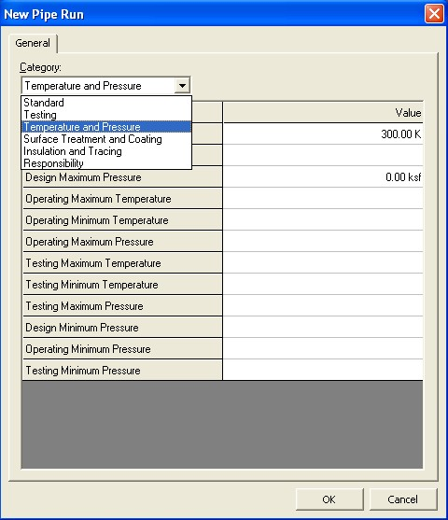
Route Pipe: Pipe Run Dialog Box
  Define the Pipe Run properties
© © 2009. Intergraph Corporation. All Rights Reserved.

Slide 16
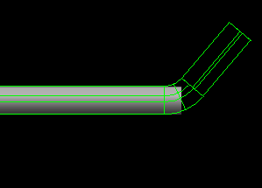
Route Pipe: Route Pipe Ribbon bar
  Designation of commodity options while routing
Commodity option for turn
Commodity option for straight
Piping offset option
Angle control
© 2009. Intergraph Corporation. All Rights Reserved.
Notes:
.

Slide 17
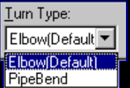
Route Pipe: Turn Type Option
  Displays the type of turn (Default, Elbow, Pipe Bend, or Miter).
  Default turn type: the system selects the type of turn as defined in the Ref Data (Default Change of Direction)
SP3D Piping can check pipe bends as they are modeled to ensure that they have adequate lengths for fabrication on an allocated bending machine.
© 2009. Intergraph Corporation. All Rights Reserved.

Slide 18
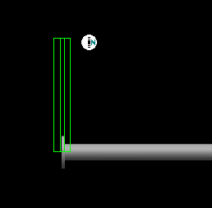
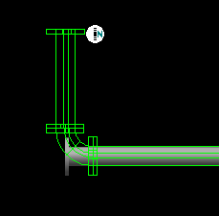
Route Pipe: Graphics Toggle
  Route command should only compute the turn part on commit or (on-going)
  Use Shift + F keys to toggle the compute modes
Do not compute the turn part
Compute the turn part
© 2009. Intergraph Corporation. All Rights Reserved.
Notes:
.

Slide 19

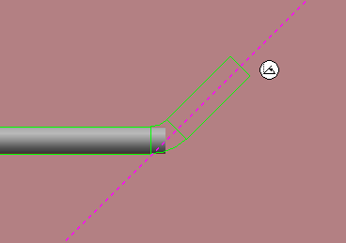

Route Pipe: Length Control Tool
  Enter or select a length for the current route path.
  - Length Lock: Lock or unlock the length field.
  - By Default: dynamically displays the current
  length of the pipe run from a turn point or a
  starting point.
  - contains the last 10 values entered by the user.
© 2009. Intergraph Corporation. All Rights Reserved.

Slide 20
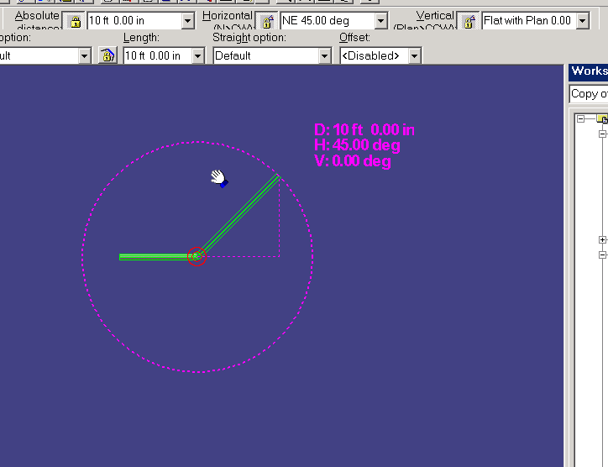
Route Pipe: Route Using Spherical Coordinates
  Relative Tracking Mode
© 2009. Intergraph Corporation. All Rights Reserved.

Slide 21
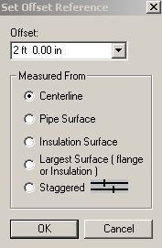
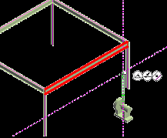
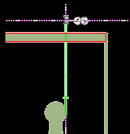
Route Pipe: Offset Value
  Offset Control Tool
  If the reference object is a planar surface or linear element, the offset distance is measured from the surface or line to the indicated reference plane on the pipe being routed. Five offset reference are available.
  An offset SmartSketch point is found on either side of the referenced plane or linear element.
North
© 2009. Intergraph Corporation. All Rights Reserved.
All Rights Reserved.

Slide 22
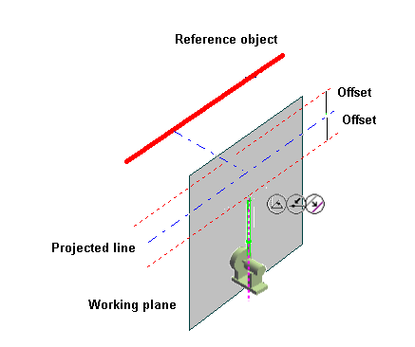
Route Pipe: Offset value
  How the Solver finds the offset:
© 2009. Intergraph Corporation. All Rights Reserved.

Slide 23
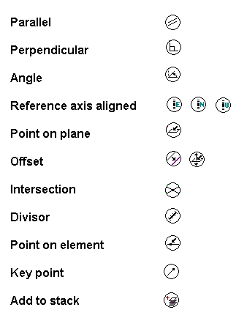
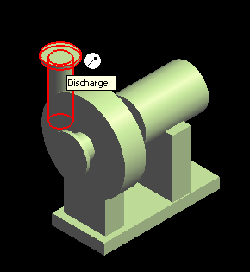
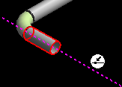
Route Pipe: SmartSketch
© 2004. Intergraph Corporation. All Rights Reserved.

Slide 24
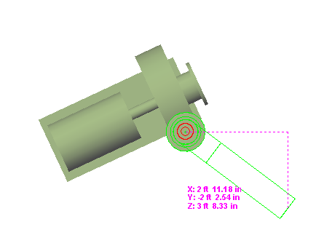
Route Pipe: PinPoint
  PinPoint provides coordinate inputs to the route command.
  x,y,z coordinates are relative to Target Point.
  Relative Tracking Mode.
© 2004. Intergraph Corporation. All Rights Reserved.

Slide 25
Route Pipe: Smart Step Ribbon Bar
  Angle lock in Route command should remain locked until manually unlocked
  Working plane should be set to plan plane when sloped run is created
  Compute offset of piping from duct and cableway routes
Working Plane Control
Angle Lock
Offset Control
© 2004. Intergraph Corporation. All Rights Reserved.
Notes:
.

Slide 26

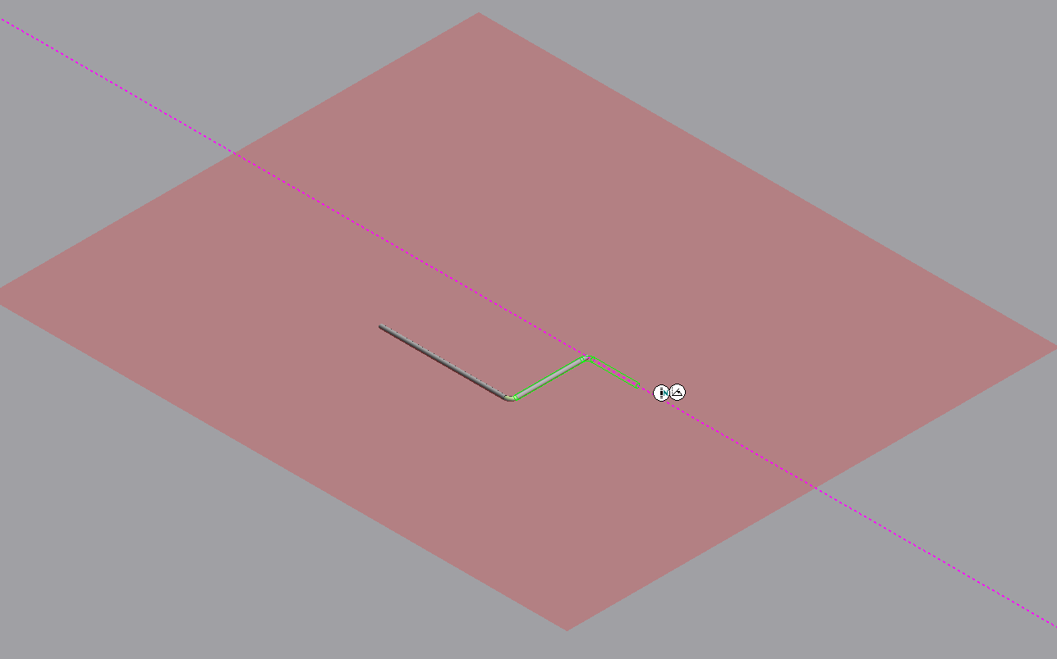
Route Pipe: Working Plane Control Tool
  Constrains the route path to a specific plane.
  Ctrl + Keyboard
  1 - Plane Plane
  2 - Elevation Plane
  3 - Section Plane
  4 - Plane by Turn/Branch
  5 - Plane by Three Points
  6 - No Plane
Route plane
© 2004. Intergraph Corporation. All Rights Reserved.

Slide 27
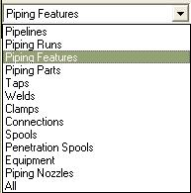
Pipe Select Command
Provides specific filters:
  Workspace Explorer (set the filter to all and key in the string in the field to find an object).
  Tools > Select by Filter
© 2004. Intergraph Corporation. All Rights Reserved.

Slide 28
Delete a Pipeline
  Deleting a pipeline deletes all pipe runs, features, and parts associated with that pipeline.
© 2004. Intergraph Corporation. All Rights Reserved.

Slide 29
Delete a Pipe Run
  Deleting the run deletes all features (and thereby all parts) belonging to the run.
  The software attempts to maintain the design integrity of the model by adjusting all previously connected features.
© 2004. Intergraph Corporation. All Rights Reserved.

Slide 30
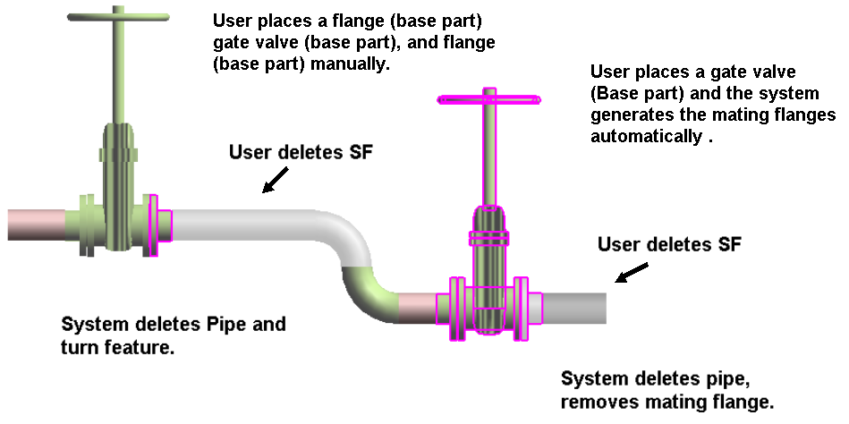
Delete Straight Features
Example:
© 2004. Intergraph Corporation. All Rights Reserved.

Slide 31
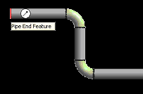
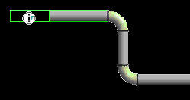
Run To or From End Features or Nozzle
  When you select an end feature during the creation of a pipe run, the Route Pipe command joins the run with the end feature and inherits the properties of the run that the end feature belongs to.
© 2004. Intergraph Corporation. All Rights Reserved.

Slide 32
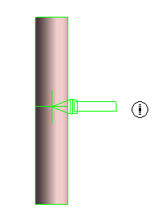
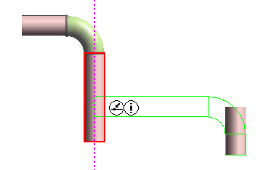
Routing To or From a Straight Feature
  Use the Route Pipe command
  Branch on Pipe Run
  Intersect to Branch
© 2004. Intergraph Corporation. All Rights Reserved.

Slide 33
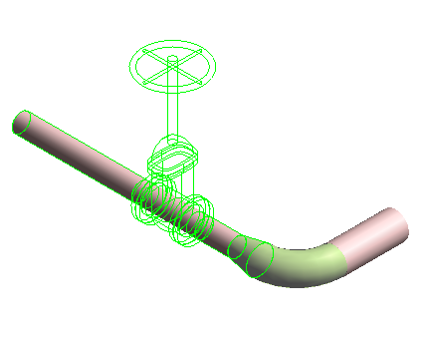
Insert Component
  Insert command inserts a component interactively.
  In-line components (Valves, Tees, Reducers); Change of direction (Elbows, Miters, Bends); End Components (caps and plugs); Strainers (Y-strainers, Basket Strainers) etc…
© 2004. Intergraph Corporation. All Rights Reserved.

Slide 34
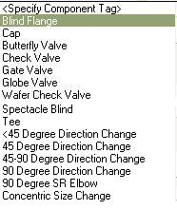
Insert Component :Insert Component Ribbon Bar
Comp Rotation
Select Feature/EF or Nozzle
Select Component Type
Display the Pipe Run
Insertion Point
Toggle Ports
End the command
Display Component Tag
Specifies a port to be the insertion point
Displays a list of available component
© 2004. Intergraph Corporation. All Rights Reserved.

Slide 35



Insert Component : Graphical Positioning
Reference Position option:
The system should slide the component along the path so that the select position (example: Origin) is located at the insertion point.
Flip option: port 1
Reference position: port 1
Reference position: origin
Reference position: port 2 or port 3
© 2004. Intergraph Corporation. All Rights Reserved.

Slide 36


Insert Component : Graphical Positioning
Flip option:
Toggles through the ports available for the component being inserted. As each port is toggled, the component is oriented so that the selected port is aligned along the axis of the leg on which it is being inserted.
Reference position: port 1
Flip option: port 1
Flip option: port 2
Flip option: port 3
© 2004. Intergraph Corporation. All Rights Reserved.

Slide 37
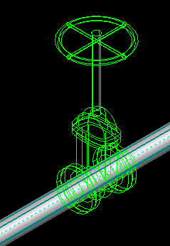
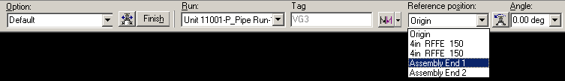
Insert Component : Mating
  Mating part ports / end terminus available in the Ref Position list.
Mating Ports
© 2004. Intergraph Corporation. All Rights Reserved.

Slide 38
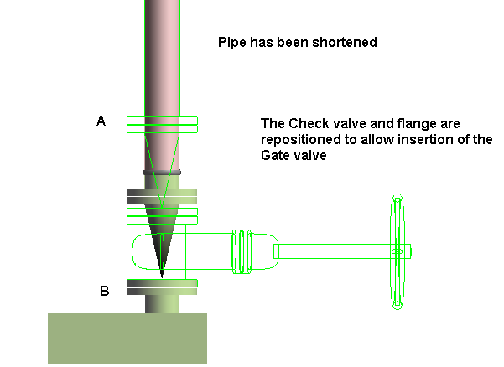
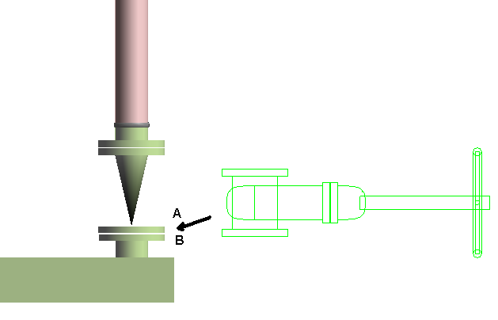
Insert Component : Positioning & Placement
  Insertion of a new component at an equipment nozzle
  Example:
  Since a suitable straight feature exists on the leg, the check valve and its connecting flange are repositioned and the gate valve is inserted.
© 2009. Intergraph Corporation. All Rights Reserved.

Slide 39
Routing Sloped Pipe
Underground piping collects drains from funnels or catch basins and transports them to a disposal point. Since there is no pressure in this piping system, the pipe must slope for flow.
© 2009. Intergraph Corporation. All Rights Reserved.

Slide 40
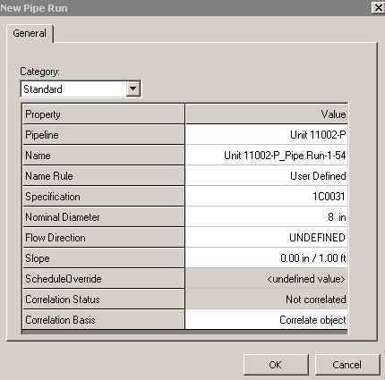
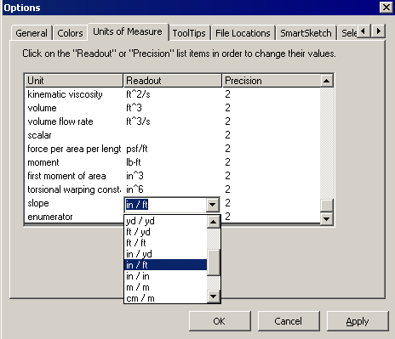
Routing Sloped Pipe
  Slope format
© 2009. Intergraph Corporation. All Rights Reserved.
Notes:
.

Slide 41
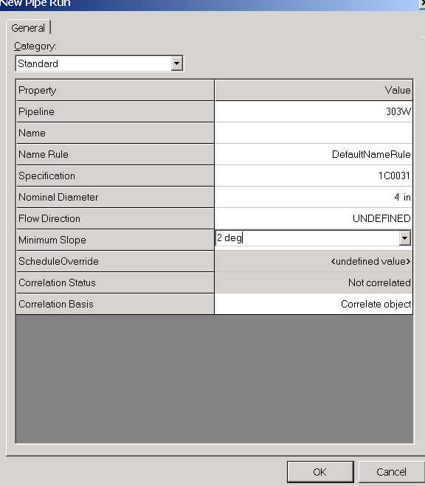
Routing Sloped Pipe
Specify Slope on New Run Properties page
© 2004. Intergraph Corporation. All Rights Reserved.

Slide 42
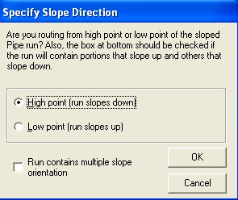

Routing Sloped Pipe: Slope Direction
Specify Slope Direction
Turn Slope Lock On/Off
© 2009. Intergraph Corporation. All Rights Reserved.

Slide 43
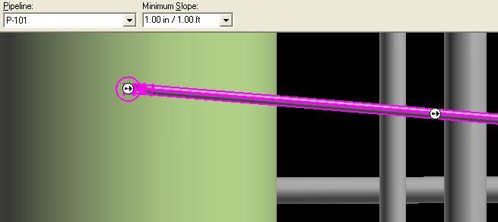
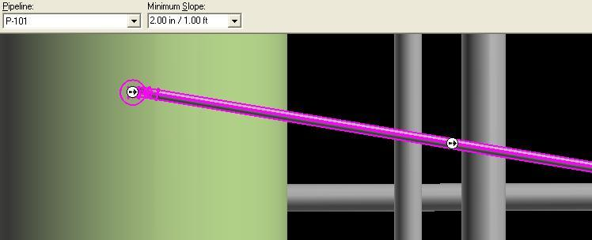
Routing Sloped Pipe: Graphical Modifications
  Modification of the “Slope” value will graphically change the slope of a run.
© 2009. Intergraph Corporation. All Rights Reserved.
Reserved.

Slide 44


Routing Sloped Pipe :Angle Control Tool
  Enter or select an angle for the current route path.
  - Angle Lock: Lock or unlock the Angle field.
  - By Default: Dynamic readout of the current
  bend angle as defined by the cursor.
  - The angle field can only be 0 or 90 deg if the working plane
  is set to NO Plane.
© 2009. Intergraph Corporation. All Rights Reserved.

Slide 45
Piping Practice Labs
Route Pipes
Inserting Components in a Pipe Run
Routing Sloped Pipe
© 2009. Intergraph Corporation. All Rights Reserved.

Slide 46
Integrated Environment
While designing or creating a plant in SP3D, you can reuse existing data from other design or authoring tools rather than creating a model from scratch. SmartPlant Foundation (SPF) supports the integration of engineering tools, such as SmartPlant® P&ID, SP3D, SmartPlant Instrumentation, and Aspen Zyqad. This integration addresses the flow of data as it moves from one engineering application to another through its lifecycle.
In an integrated environment, you publish and retrieve data from and to SP3D by using a central repository. During a publish operation, data such as drawings, reports, and 3D models transfers to a central repository. During a retrieve operation, the system retrieves P&IDs, Plant Break Down Structure, Project List, Work Breakdown Structure, Electrical Cable Schedules, and Instrumentation Dimensional Data Sheets from the central repository
© 2009. Intergraph Corporation. All Rights Reserved.

Slide 47
Retrieving Data from a P&ID
You can retrieve piping, instrumentation, and equipment data from P&ID in the integrated environment. You can use P&ID to access items, such as equipment, piping information, and SmartPlant Instrumentation dimension data, to help create the appropriate 3D design objects. For example, after you retrieve data from P&ID, you can use the P&ID File Viewer window in SP3D for guidance in routing pipes, inserting components and instruments, and placing equipment in the 3D model.
© 2004. Intergraph Corporation. All Rights Reserved.

Slide 48
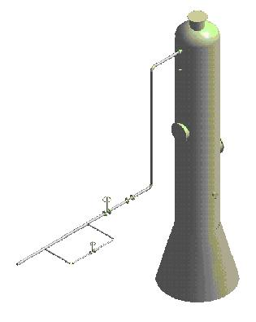
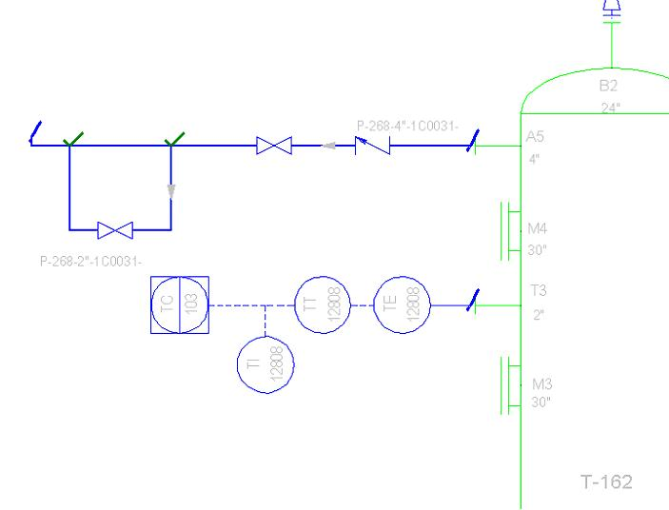
SP3D Routing From P&ID
  Users can import SmartPlant P&ID pipeline and component data into the 3D active data.
© 2004. Intergraph Corporation. All Rights Reserved.

Slide 49
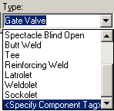
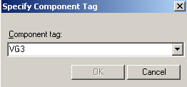
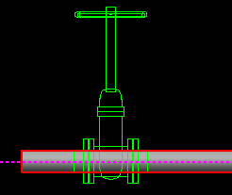
Insert Component by its Engineering Tag
The engineering tag will be available on the P&ID, and may be used to select a piping commodity from the Piping Specification.
© 2009. Intergraph Corporation. All Rights Reserved.

Slide 50
Instrument & Piping Specialty Placement
We have two types of piping specialty/instrument Parts:
1. Stock item: Stock items represent those piping items that are purchased from a manufacturer’s catalog, where no real engineering is required other than selecting the correct size, material, etc.
2. Custom-engineered item: custom engineered items are built items according to the process.
© 2009. Intergraph Corporation. All Rights Reserved.

Slide 51
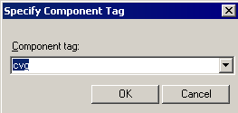
Instrument & Piping Specialty Placement
Placing piping specialty/instruments
© 2009. Intergraph Corporation. All Rights Reserved.

Slide 52
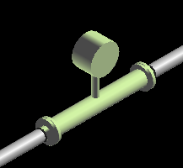
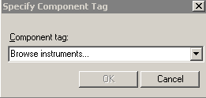
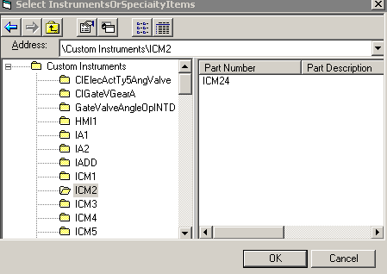
Instruments
  Placement of Instrument Items On the Fly
© 2009. Intergraph Corporation. All Rights Reserved.

Slide 53


Instruments
  Placement of Instrument Items On the Fly: User is able to provide item dims.
© 2009. Intergraph Corporation. All Rights Reserved.

Slide 54

Placing Piping Specialty Items
Specialty items are piping components that are not defined as a part of piping specification. Just like instruments, you can place specialty items in a pipeline to perform a specific task.
Isolating Gate Valve
© 2009. Intergraph Corporation. All Rights Reserved.

Slide 55
Piping Specialty Items Types
Stock specialty items: These items represents the piping items purchased from a manufacturer’s catalog, where no real engineering is required other than selecting the correct size and material.
Custom specialty items: These items are typically driven by parameters. Therefore, you can change their size and shape after placing them in the model.
© 2004. Intergraph Corporation. All Rights Reserved.

Slide 56


Placing Piping Specialty Items: Properties
  Placement of Specialty Items On the Fly
© 2009. Intergraph Corporation. All Rights Reserved.

Slide 57

Insert Tap
  Use this command when in need to tap a drain, vent, or instrument connection. Used to place taps on all piping components; elbows, tees, caps, valves, pipes, and so forth; except for mating parts.
© 2009. Intergraph Corporation. All Rights Reserved.

Slide 58

Inserting Splits : Insert Split Command Bar
  The Insert Split command cuts a straight pipe and connects the parts by a weld joint or a takedown joint.
© 2009. Intergraph Corporation. All Rights Reserved.

Slide 59

Inserting Splits : Insert Split Ribbon Bar
Feature Break
Display the type of split
Insertion Point
Takedown joint
Display the Pipe Run
Displays a list of available option items for the split
Select Feature
Welded Joint
© 2009. Intergraph Corporation. All Rights Reserved.

Slide 60

Inserting Splits : Attribute Break
  The Insert Split command can also be used to create a feature break. This makes it possible to stop heat-tracing, insulation, or a surface coating at an arbitrary location along the pipe instead of at a weld or other break in the line.
© 2009. Intergraph Corporation. All Rights Reserved.

Slide 61




Inserting Splits : Attribute Break
  Edit Pipe Run properties during modeling to create an attribute break.
  When the run properties are changed, the corresponding feature properties are automatically changed as well.
  When NPD is changed, reducers are selected from the spec to satisfy the NS change.
© 2009. Intergraph Corporation. All Rights Reserved.
.

Slide 62
Piping Practice Labs
Routing Pipes from P&ID
Placing Piping Instruments
Placing Piping Specialty Items
Placing Taps
Placing Splits
© 2009. Intergraph Corporation. All Rights Reserved.

Slide 63


Piping Manipulation : Edit Straight Features
  Moving a SF moves the entire leg to which the feature is connected.
  The move direction is always perpendicular to the axis of the SF.
  A branch feature (BF) connected to the moved leg maintains its original angle.
  Movement stops when parts on the associated leg overlap, or when they overlap with adjacent parts on connected legs.
© 2009. Intergraph Corporation. All Rights Reserved.

Slide 64

Piping Manipulation : Edit End Features
  Moving the end feature by key in the length
© 2009. Intergraph Corporation. All Rights Reserved.

Slide 65

Piping Manipulation : Edit Run Change Features
  You can move the RCF along the associated straight feature. As you move the feature, the RCF appears in dynamic mode.
© 2009. Intergraph Corporation. All Rights Reserved.

Slide 66


Piping Manipulation : Editing Features
  Shift – Select Command
Move selected legs
- Point along tool
© 2004. Intergraph Corporation. All Rights Reserved.

Slide 67

Piping Manipulation : Editing Features
  Shift – Select Command
Move along the leg the selected items
© 2009. Intergraph Corporation. All Rights Reserved.

Slide 68


Piping Manipulation : Editing Features
  Shift – Select Command
Turn off the moving along the leg
© 2009. Intergraph Corporation. All Rights Reserved.

Slide 69

Piping Manipulation : Part Modification
Mating parts can be changed to base parts using either the ribbon or the property page.
Mating Parts: Depend of a parent component for placement, i.e. if parent valve is deleted, mating flange is also removed.
Base Parts: Independent from mating component, i.e. if connecting valve is deleted, flange remains.
© 2009. Intergraph Corporation. All Rights Reserved.

Slide 70


Piping Manipulation : Item Replacement
  Operator may replace item with another of same type
  Presentation of only one short code for a particular item.
  If a component has been generated automatically by the solver, the user sees two entries in the Type list for that object: one with a "Default" suffix signifying that this part is rule generated and one without the suffix.
© 2009. Intergraph Corporation. All Rights Reserved.
Notes:
.

Slide 71

Piping Manipulation : Modification
  New Enhancement in V4
  Ability to rotate components after insertion
Dynamic
Key-In
© 2009. Intergraph Corporation. All Rights Reserved.
.

Slide 72
Piping Manipulation : Modification
  New Enhancement in V4
  Copy/Paste commands are available
  Mirror Copy command is available
  Creation of a connection (geometry permitting) when multiple objects are moved and placed on another object
© 2009. Intergraph Corporation. All Rights Reserved.

Slide 73



Piping Properties : Properties
  Right clicking on pipe run or Selecting Pipe run and selecting properties on the Route pipe ribbon bar. feature brings up menu when in Route Pipe environment
© 2009. Intergraph Corporation. All Rights Reserved.

Slide 74

Piping Properties :Edit Properties Command
  Edit Pipe Run properties.
  Features inherit the
  common properties of
  the run by default.
© 2009. Intergraph Corporation. All Rights Reserved.
.

Slide 75

Piping Properties : Flow Direction
  Flow Direction
  Downstream is the direction from the start to the end of the run
Bi-directional, Upstream, Downstream, No flow, Undefined
© 2009. Intergraph Corporation. All Rights Reserved.

Slide 76

Piping Properties : Edit Properties Dialog Box
  Insulation
© 2009. Intergraph Corporation. All Rights Reserved.

Slide 77
Piping Properties : Edit Properties Dialog Box
  Edit Pipe Run properties
  Relation Tab displays all the relationships defined for the selected pipe run.
© 2009. Intergraph Corporation. All Rights Reserved.

Slide 78

Piping Properties : Edit Properties Dialog Box
  Pipe cut lengths to reflect lining & weld gap
© 2009. Intergraph Corporation. All Rights Reserved.

Slide 79

Piping Properties : Inserting notes
  Ability to insert notes on higher level objects such as pipelines and runs
© 2009. Intergraph Corporation. All Rights Reserved.
Notes:
.

Slide 80



Creating Spools
Generation of Spools
  Generate Spools
© 2009. Intergraph Corporation. All Rights Reserved.

Slide 81



Creating Spools
Generation of Spools
  Create Penetration Spools
© 2009. Intergraph Corporation. All Rights Reserved.

Slide 82
Creating Spools
Naming of Spools
Spooling options always default to those defined in the Catalog with interactive setting changes persisting for the current session only.
© 2009. Intergraph Corporation. All Rights Reserved.

Slide 83

Creating Spools
Breaks at unions by system
Breaks at user defined control points
© 2009. Intergraph Corporation. All Rights Reserved.

Slide 84
Sequence Objects
  Renames objects in the selected pipeline, pipe run, or spool such that the names are in order. You can select to sequence the objects based on flow direction or topology.
© 2009. Intergraph Corporation. All Rights Reserved.
.

Slide 85


Materials Reports
  Users can easily extract materials lists for review from their modeled pipelines.
© 2004. Intergraph Corporation. All Rights Reserved.

Slide 86
Piping Practice Labs
  Manipulating Piping Objects
  Creating Spools
  Sequencing Objects
  Creating Isometric Drawings
© 2004. Intergraph Corporation. All Rights Reserved.

Slide 87


Interactive Clash Detection
  System can check new piping for interferences with same and other displayed disciplines as user works.
© 2009. Intergraph Corporation. All Rights Reserved.

